Slide 1
Modules Implemented
Filter Server
Repository
Registry
Sensor Data
Helper

Slide 2
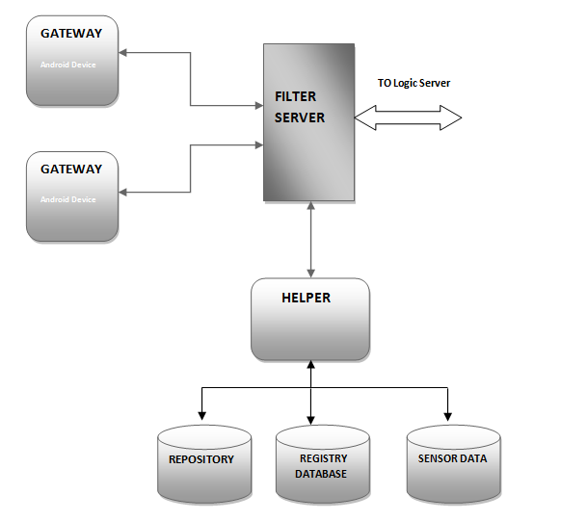
Overall View
Figure-1

Slide 3
FILTER SERVER
URL
Callback : It is used to register a callback query.For now it is hardcoded for only one join operator . Eg:
/callback/?id1=1&val1=50&op1=lt&join=or&id2=2&val2=20&op2=gt
Command : It is used to get data from a particular sensor. Eg:
/command/?id=1
New: It is used to get the data incoming from the gateway. Eg:
/new /?id=1&data=10
Inrange: It is used to give the get all the sensors within the specified range from the given latitude and longitude. Eg:
/inrange/?lat=10&lon=12&range=100

Slide 4
FILTER SERVER
In every 5seconds it will receive data from gateway.
The data consists of sensor id and the data.
If the data is valid then the filter server marks the sensor status as active(1) else inactive(0) in the registry database.
The incoming data is also stored in the sensor database.

Slide 5
DATABASE
Registry Database: It contains sensor id, type of sensor, corresponding gateway and the present state of the sensor.
Schema: Id, type, gateway, active(0 or 1)
Repository Database: It contains sensor id, type, position(lat and lon) , and the corresponding gateway.
Schema: id, type, lat, lon, gateway
Sensor Database: It gets refreshed every 5 seconds. It stores the incoming data from gateway.
Schema: id, type, lat, lon, data, timestamp

