Slide 1
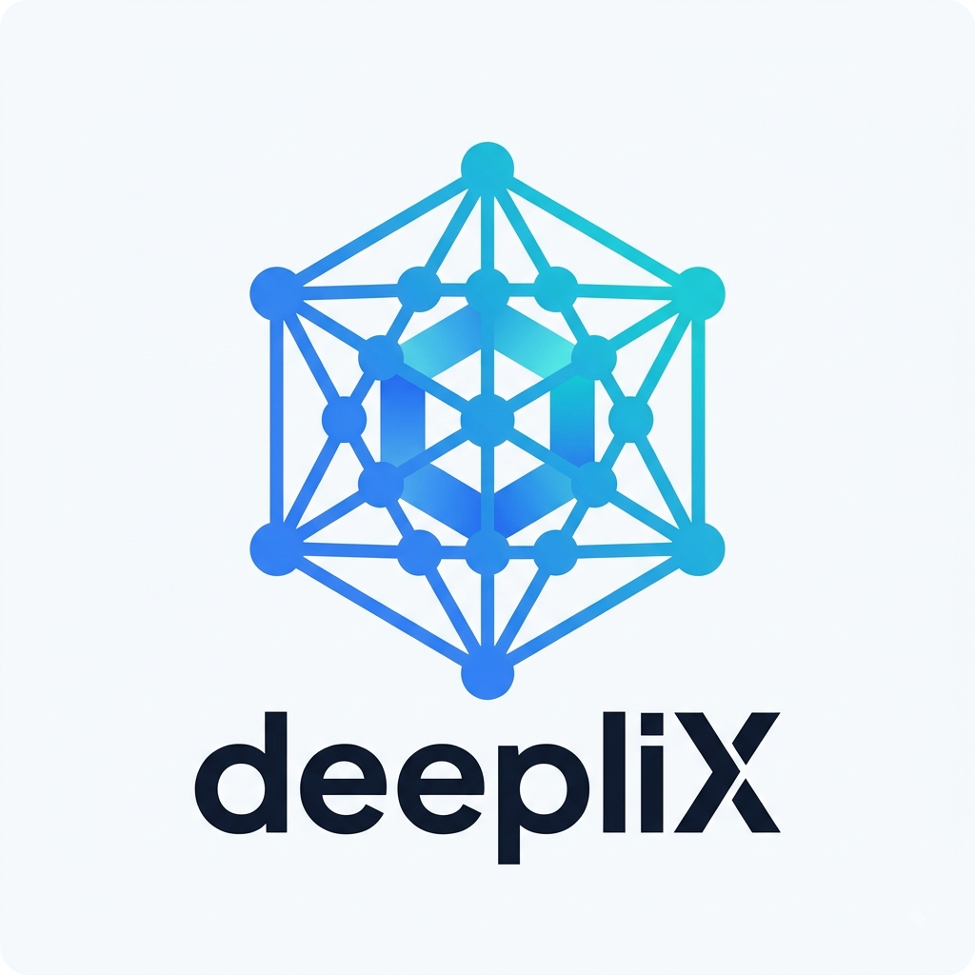
deepliX
Digital Infrastructure for Modern Businesses
COMPANY PRESENTATION · 2026

Slide 2
deepliX
THE SITUATION
Businesses run on more software
than ever — and less infrastructure
1
2
3
4
Fragmented data
Manual work
Slow reporting
Blind decisions
Information scattered across CRMs, spreadsheets, and disconnected tools.
Staff copy data between systems that were never built to talk to each other.
Numbers take days to compile — and rarely match between teams.
Leaders can't see what's really happening across their own operations.
A business can own a lot of software and still lack a coherent technology infrastructure.
deepliX | Company Presentation
2

Slide 3
deepliX
WHY IT MATTERS
The cost isn't just time —
it's speed, accuracy, and trust
→
Slower decisions
Leaders wait on manual reports instead of acting on live information.
→
Higher error rates
Manual copying between systems introduces mistakes that compound over time.
→
Wasted talent
Skilled staff spend hours on repetitive admin work instead of higher-value tasks.
→
AI stays out of reach
Without clean, connected data, AI initiatives stall before they start.
deepliX | Company Presentation
3

Slide 4
deepliX
OUR APPROACH
Connect. Automate. Understand.
Apply AI where it earns its place.
deepliX connects systems, improves data flows, automates repetitive processes, builds useful reporting and intelligence layers, and implements AI where it creates real business value — always in that order.
Connect
Systems
→
Organize
Data
→
Automate
Workflows
→
Report &
Analyze
→
Apply AI
(where it fits)
AI sits on top of good data and sound processes — never sold simply because it's popular.
deepliX | Company Presentation
4

Slide 5
deepliX
HOW IT FITS TOGETHER
Our Solution Architecture
CRM
ERP
Spreadsheets
E-commerce
Internal Apps
↓
deepliX Central Data & Integration Layer
↓
Automation
BI & Dashboards
AI Systems
Managed Services
↓
Faster decisions. Less manual work. A system that keeps improving.
deepliX | Company Presentation
5

Slide 6
deepliX
WHAT WE DELIVER
Core Capabilities
1
Data Engineering
2
System Integration
3
Business Automation
Reliable pipelines, database design, and infrastructure.
Connecting CRM, ERP, and apps to one central data layer.
Automating repetitive workflows end to end.
4
Business Intelligence
5
AI Systems
6
Managed Services
Dashboards and reporting leaders can act on.
AI applied where it creates genuine business value.
Ongoing monitoring, maintenance, and support.
deepliX | Company Presentation
6

Slide 7
deepliX
ILLUSTRATIVE EXAMPLE
What a Transformation Can Look Like
ILLUSTRATIVE EXAMPLE — NOT AN ACTUAL CLIENT
BEFORE
AFTER
Sales, inventory, and finance data live in three disconnected systems
A weekly management report takes two full days to compile by hand
Numbers regularly disagree between departments
Leadership makes decisions on data that is already a week old
Systems connected through a central data layer, updated automatically
The management report generates itself every morning
One consistent set of numbers, shared across every department
Leadership sees what's happening in near real time
→
deepliX | Company Presentation
7

Slide 8
deepliX
OUR PROCESS
How We Work
1
2
3
4
5
6
Discover
Design
Build
Deploy
Manage
Improve
→
→
→
→
→
Understand systems, data, and where friction happens.
Scope a solution to the real problem.
Implement with clear milestones.
Move to production with testing & docs.
Ongoing monitoring & support.
Identify the next opportunity.
deepliX | Company Presentation
8

Slide 9
deepliX
WORKING TOGETHER
Engagement Models
Fixed Project
Milestone-Based
Retainer / Managed
Advisory
A clearly defined, scoped implementation delivered for a fixed price.
Larger implementations billed against agreed milestones.
Ongoing monitoring, maintenance, and support after go-live.
Technology and data strategy engagements.
deepliX | Company Presentation
9

Slide 10
deepliX
TRUST BY DEFAULT
Security & Reliability
✓
Least-privilege access to client systems and data
✓
Secrets managed through proper secrets-management tools — never in plain documents
✓
Data handled per each client's own protection requirements and regulations
✓
Clear documentation of what was built and how to maintain it
✓
Defined support and response expectations under managed services
deepliX | Company Presentation
10

Slide 11
deepliX
THE DIFFERENCE
Why deepliX
★
Outcomes, not buzzwords
★
Built for the long term
We lead with the business problem — never the tool stack.
Not a one-project vendor — a partner from discovery to managed services.
★
Honest about scale
★
AI with a real case
An early-stage company that tells the truth about what it can deliver.
AI is applied only where it creates genuine value, on top of good data.
deepliX | Company Presentation
11

Slide 12

deepliX
THE TEAM
About Us
deepliX is an early-stage, serious B2B technology company — not a large agency, and not a freelance operation. The company is built around a repeatable delivery process and grows its team deliberately as real client work justifies it.
How we scale:
Deepak Raj Valmani
Establish the business and acquire real clients
Learn actual delivery requirements from real projects
Use trusted contractors and specialists where needed
Hire permanent team members as recurring workload justifies it
Founder
Leads deepliX's business direction, strategy, and technical coordination.
deepliX | Company Presentation
12

Slide 13
deepliX
GETTING STARTED
Next Steps
1
2
3
Discovery Conversation
→
Proposal & Scope
→
Kickoff
A short call to understand your systems, data, and goals.
We come back with a clear proposal, scope, and investment.
Once agreed, we begin — with a defined timeline and milestones.
No pressure, no long sales cycle — just a straightforward conversation about your business.
deepliX | Company Presentation
13

Slide 14
deepliX
Let's Talk
Connect your data. Automate your operations. Build smarter systems.
FOUNDER
EMAIL
PHONE
LOCATION
Deepak Raj Valmani
rajvalmani@gmail.com
+92 348 7932997
Karachi, Sindh, Pakistan
deepliX | Company Presentation
Linked In : https://www.linkedin.com/company/111716037
14

