Slide 1
B
BODHI MULE HUNTER AI
Real-time mule account & suspicious transaction detection
Nine layers. Three complementary model views. One calibrated score an investigator can act on — and a containment layer that refuses to act without corroboration.
0.9966
0.9707
99.99%
75×
0.054 ms
FUSED ROC-AUC
FUSED PR-AUC
FALSE POSITIVES CUT
PRECISION UPLIFT
INLINE DECISION P50
Akshay Tiwari
Palak Vishwakarma
Archi Singh Rajput
Kartik Jain
0246CS241037
0246AL241124
0246CS240174
0246AL241094
Team BODHI · CyberShield Hackathon 2026 - Problem Statement 2 · In association with Bank of India and IIT Hyderabad
github.com/archirajpoot/Bodhi_Mule_Hunter

Slide 2
THE PROBLEM
A mule account is a normal account
Real KYC. Real customer. Payments clear. Nothing about the account is anomalous — only the shape of the money moving through it, and the company it keeps.
HOW A MULE RING ACTUALLY WORKS
WHY TODAY'S RULE ENGINES FAIL
1 Victims
40 defrauded people push money into one collector, in 90 minutes
They score accounts in isolation, so they cannot express “this account's counterparties are themselves suspicious” or “these forty credits arrived in ninety minutes”. Lacking the vocabulary, they compensate with sensitivity.
2 Layering
A → B → C → D within minutes, each hop keeping 2–10%
3 Structuring
Split into transfers parked just under the reporting limit
9,647
1.33%
4 Cash-out
Drained via ATM/AePS at 03:12 — out of the banking system
ALERTS RAISED
PRECISION
99 of every 100 investigations are wasted. That is the number we set out to fix.
BODHI MULE HUNTER AI · CyberShield Hackathon 2026 · Problem Statement 2
github.com/archirajpoot/Bodhi_Mule_Hunter · 2 / 19

Slide 3
THE CORE INSIGHT
Aggregates destroy the signal that matters
The same monthly totals describe a shopkeeper and a mule. Only the ordering separates them — and no aggregate preserves order.
SHOPKEEPER
MULE
“Received ₹4 lakh from 38 payers over the month.” Spread across weeks. Money rests. Counterparties repeat.
“Received ₹4 lakh from 38 payers between 14:10 and 15:40, then withdrew ₹3.8 lakh in nineteen ATM visits beginning at 03:12.”
Identical aggregates. Completely different sequence.
So the ensemble is not three flavours of the same tabular model. It is a tabular model, a graph neural network and a temporal model — each seeing something the other two structurally cannot.
BODHI MULE HUNTER AI · CyberShield Hackathon 2026 · Problem Statement 2
github.com/archirajpoot/Bodhi_Mule_Hunter · 3 / 19

Slide 4
ARCHITECTURE
Nine layers, each owned by a named agent
Declared input/output contracts, so the provenance of every decision is recoverable from the audit trail.
INGEST & ENRICH
L1
Transaction ingestion
UPI · IMPS · NEFT · RTGS · AePS · ATM · card + NCRP tickets + RBI feeds
L2
Feature engineering
60 features: velocity, fan-in/out, dormancy, burst, structuring, device reuse
L3
Graph construction
accounts × devices × IPs × VPAs, shared-identifier cliques capped
DETECT
L4
XGBoost screening
tabular behaviour → exact TreeSHAP attributions
L5
GraphSAGE
network structure → rings, device farms, multi-hop layering
L6
Temporal graph network
event ordering → smurfing, dormant bursts, rapid routing
DECIDE & ACT
L7
Risk fusion
monotone non-negative blend, isotonic calibrated 0–100
L8
Explainability
TreeSHAP + GNNExplainer + plain-English narrative
L9
Alerting & kill-switch
proportionate, corroborated, reversible, audited
BODHI SHIELD (APK static triage) feeds extracted UPI handles and beneficiary accounts into Layer 3 — priming the graph before the first victim installs the trojan.
BODHI MULE HUNTER AI · CyberShield Hackathon 2026 · Problem Statement 2
github.com/archirajpoot/Bodhi_Mule_Hunter · 4 / 19

Slide 5
LAYERS 4–6
Three views that cannot see each other's evidence
LAYER 4
LAYER 5
LAYER 6
XGBoost
GraphSAGE
Temporal GNN
SEES
SEES
SEES
Aggregates per account
Two-hop neighbourhood
Last 64 events, in order
CATCHES
CATCHES
CATCHES
Volume, ratios, cash-out share, structuring
Rings, device farms, multi-hop layering
Smurfing, dormant bursts, rapid routing
BLIND TO
BLIND TO
BLIND TO
Who the counterparties are
When things happened
Anything outside the account
AUC 0.9946
AUC 0.9962
AUC 0.9628
Both neural layers are implemented in NumPy with hand-derived gradients — no PyTorch, no CUDA, no 2 GB of wheels. Every analytic gradient is verified against central finite differences in the test suite, so “hand-rolled” does not mean “unverified”.
BODHI MULE HUNTER AI · CyberShield Hackathon 2026 · Problem Statement 2
github.com/archirajpoot/Bodhi_Mule_Hunter · 5 / 19

Slide 6
LAYER 7
Fusion: two properties that are not negotiable
MONOTONICITY
CALIBRATION
Blend weights are constrained non-negative, so more evidence can never lower a score. An unconstrained stacker on a small fold reliably learns “higher temporal score means safer” — indefensible to an investigator, unshippable past a regulator.
The score drives an automated kill-switch at 85, so it has to mean what it says. Isotonic regression maps the blend onto observed frequencies.
0.00125
0.0047
BRIER SCORE
EXPECTED CALIB. ERROR
FOUR FOLDS, NOT THREE
train
val
fuse
test
fits the base models
early-stops them
fits the Layer-7 blend
touched exactly once
A stacker fitted on the fold that early-stopped its own inputs inherits their optimism — and came out worse than the best single layer.
BODHI MULE HUNTER AI · CyberShield Hackathon 2026 · Problem Statement 2
github.com/archirajpoot/Bodhi_Mule_Hunter · 6 / 19

Slide 7
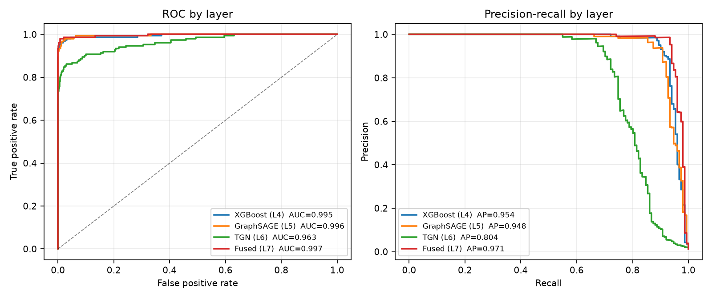
RESULTS
Every layer, on held-out data
12,000 accounts · 834,738 transactions · 151 mules (1.26%) · 21 rings
LAYER
ROC-AUC
PR-AUC
P@1%
R@1%
XGBoost (L4)
0.9946
0.9540
0.983
0.781
GraphSAGE (L5)
0.9962
0.9481
0.983
0.781
TGN (L6)
0.9628
0.8036
0.892
0.709
Intelligence
0.6883
0.3774
0.475
0.378
Fused (L7)
0.9966
0.9707
0.992
0.788
The fused model beats every individual view on both ranking metrics — which is the complementarity claim, measured.
100%
64%
0.113 ms
OUT-OF-TIME RECALL
NEVER IN ANY NCRP TICKET
INLINE DECISION P99
BODHI MULE HUNTER AI · CyberShield Hackathon 2026 · Problem Statement 2
github.com/archirajpoot/Bodhi_Mule_Hunter · 7 / 19

Slide 8
THE HEADLINE
Versus the rule engine it replaces
Compared at identical recall — because a system that alerts on everything can always claim to catch more.
RULE ENGINE · 8 SCENARIOS
BODHI · SAME RECALL
Alerts raised
9,647
Alerts raised
129
True positives
128
True positives
128
False positives
9,519
False positives
1
Precision
1.33%
Precision
99.22%
99.99% of false positives eliminated at unchanged recall — a 75× precision uplift. The analyst clears the same true positives while opening 129 cases instead of 9,647.
BODHI MULE HUNTER AI · CyberShield Hackathon 2026 · Problem Statement 2
github.com/archirajpoot/Bodhi_Mule_Hunter · 8 / 19

Slide 9
WHY THAT NUMBER IS CREDIBLE
We planted the accounts designed to break it
Any model scores ~1.0 AUC on naive synthetic fraud data. So the simulated bank is stocked with legitimate accounts that are structurally indistinguishable from mules.
LEGITIMATE POPULATION
COUNT
FALSE-POSITIVE RATE
THE HARDEST DECOY
Business Correspondent (Bank Mitra) agents
302
0.33%
A Business Correspondent legitimately operates 8–22 village accounts from one handheld and dispenses AePS cash all day. That is the exact fingerprint of a device farm doing rapid cash-out — and the system does not fall for it.
Community collectors (chit fund, tuition)
107
2.80%
Small businesses with heavy fan-in
168
0.00%
Genuine dormancy reactivation
168
3.57%
Ordinary retail
10,504
0.77%
OTHER GUARDS AGAINST FLATTERING OURSELVES
Four disjoint folds
Cross-fitted seed model
Intelligence quarantined
Point-in-time correctness
test touched exactly once
no label leaks into a neighbour's average
NCRP tickets never reach the supervised layers
tested against a manually truncated ledger
BODHI MULE HUNTER AI · CyberShield Hackathon 2026 · Problem Statement 2
github.com/archirajpoot/Bodhi_Mule_Hunter · 9 / 19

Slide 10
WHERE IT IS WEAK
Recall is not uniform, and averaging hides that
A deployment team needs to know which typologies still need human-designed scenarios alongside the model.
TYPOLOGY / ROLE
RECALL
DETECTED
WHY STRUCTURING IS THE HARDEST
SMURFING
88.9%
16/18
A single sub-threshold transfer is, by construction, indistinguishable from a genuine near-threshold property or jewellery payment. Detection depends on an aggregate pattern that only becomes visible once enough transfers have accumulated.
role: CASHOUT
92.1%
35/38
FAN IN AGGREGATION
93.3%
14/15
LAYERING CHAIN
98.3%
58/59
role: COLLECTOR
98.3%
59/60
AND CASH-OUT ACCOUNTS
APK HARVEST
100.0%
15/15
Short, thin histories — they receive once and drain. There is simply less evidence to work with.
DEVICE FARM
100.0%
31/31
DORMANT BURST
100.0%
13/13
role: RELAY
100.0%
53/53
We report these rather than averaging them away. A prototype that hides its blind spots is not useful to the team that has to deploy it.
BODHI MULE HUNTER AI · CyberShield Hackathon 2026 · Problem Statement 2
github.com/archirajpoot/Bodhi_Mule_Hunter · 10 / 19

Slide 11
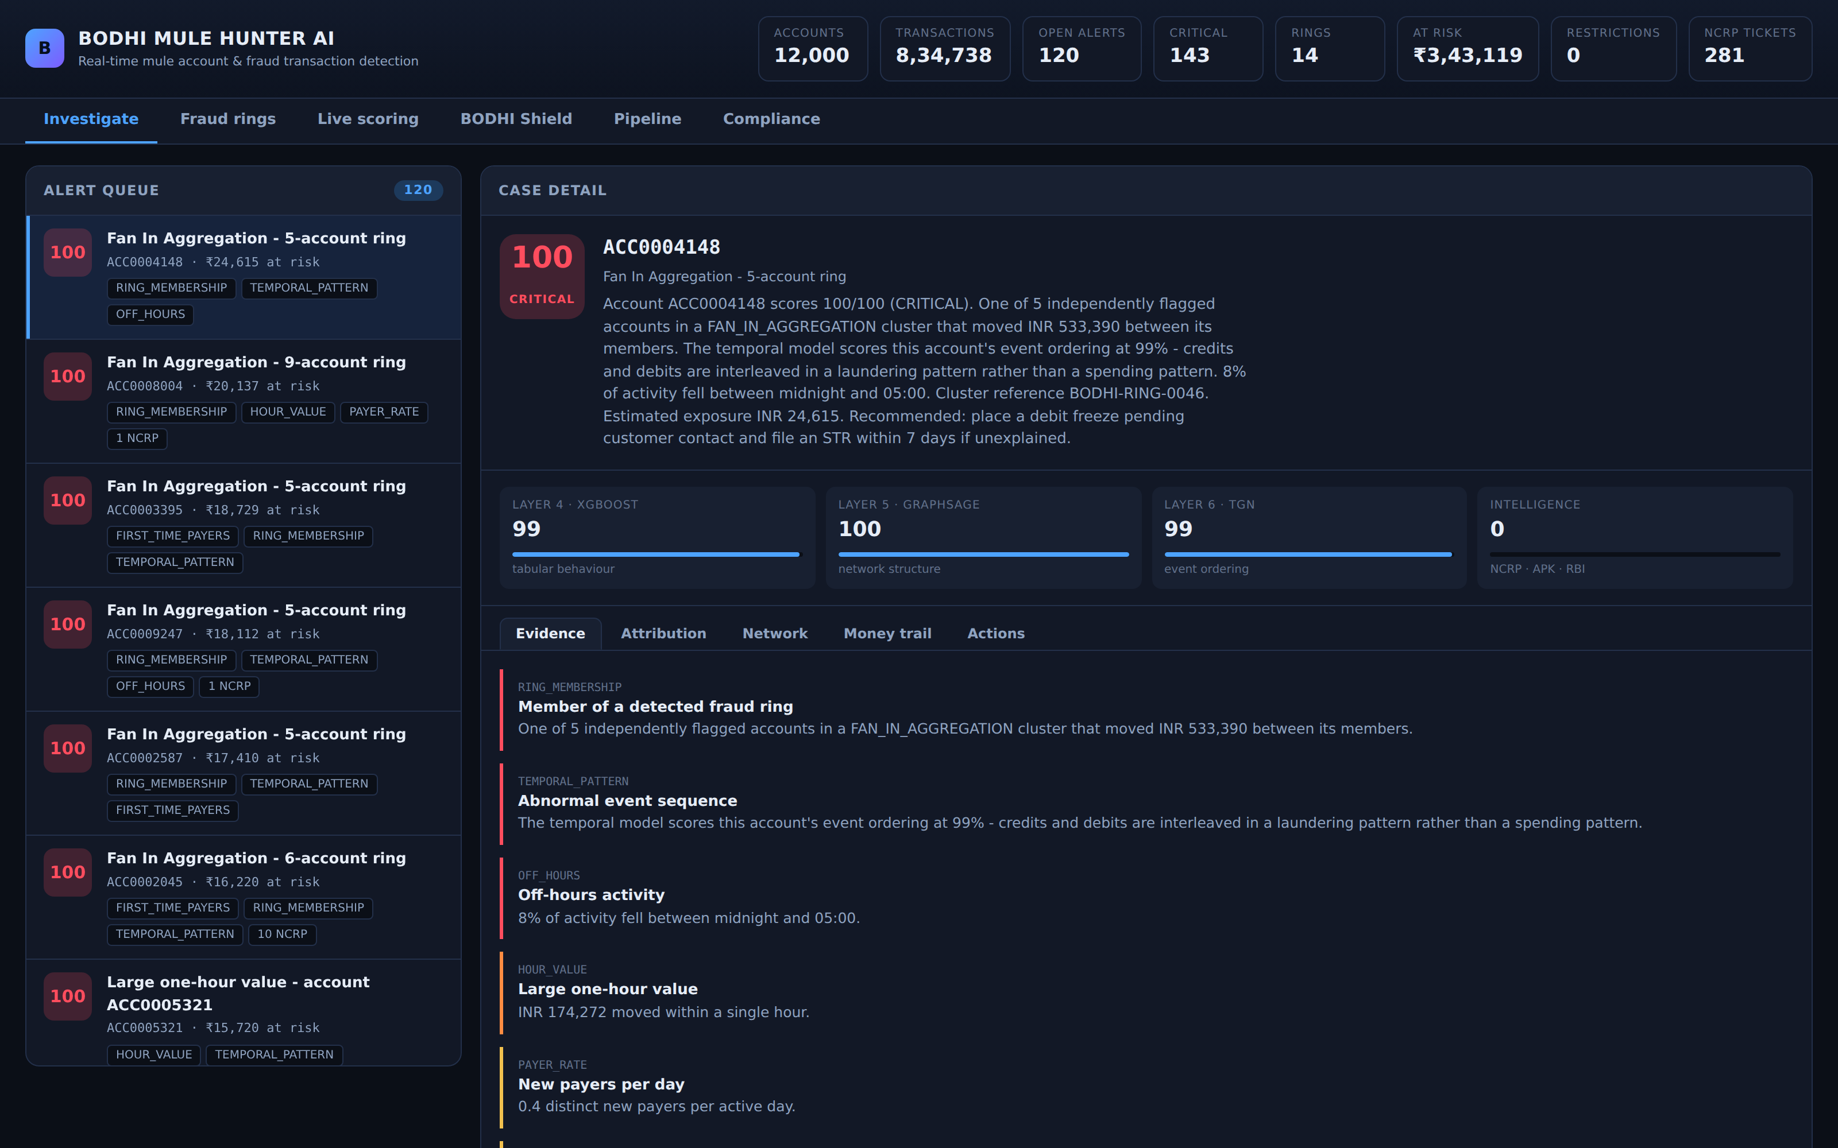
LIVE DEMO
The investigator console
Four layer scores shown separately, evidence written in the vocabulary of an AML desk, cluster and exposure on every card.
BODHI MULE HUNTER AI · CyberShield Hackathon 2026 · Problem Statement 2
github.com/archirajpoot/Bodhi_Mule_Hunter · 11 / 19

Slide 12
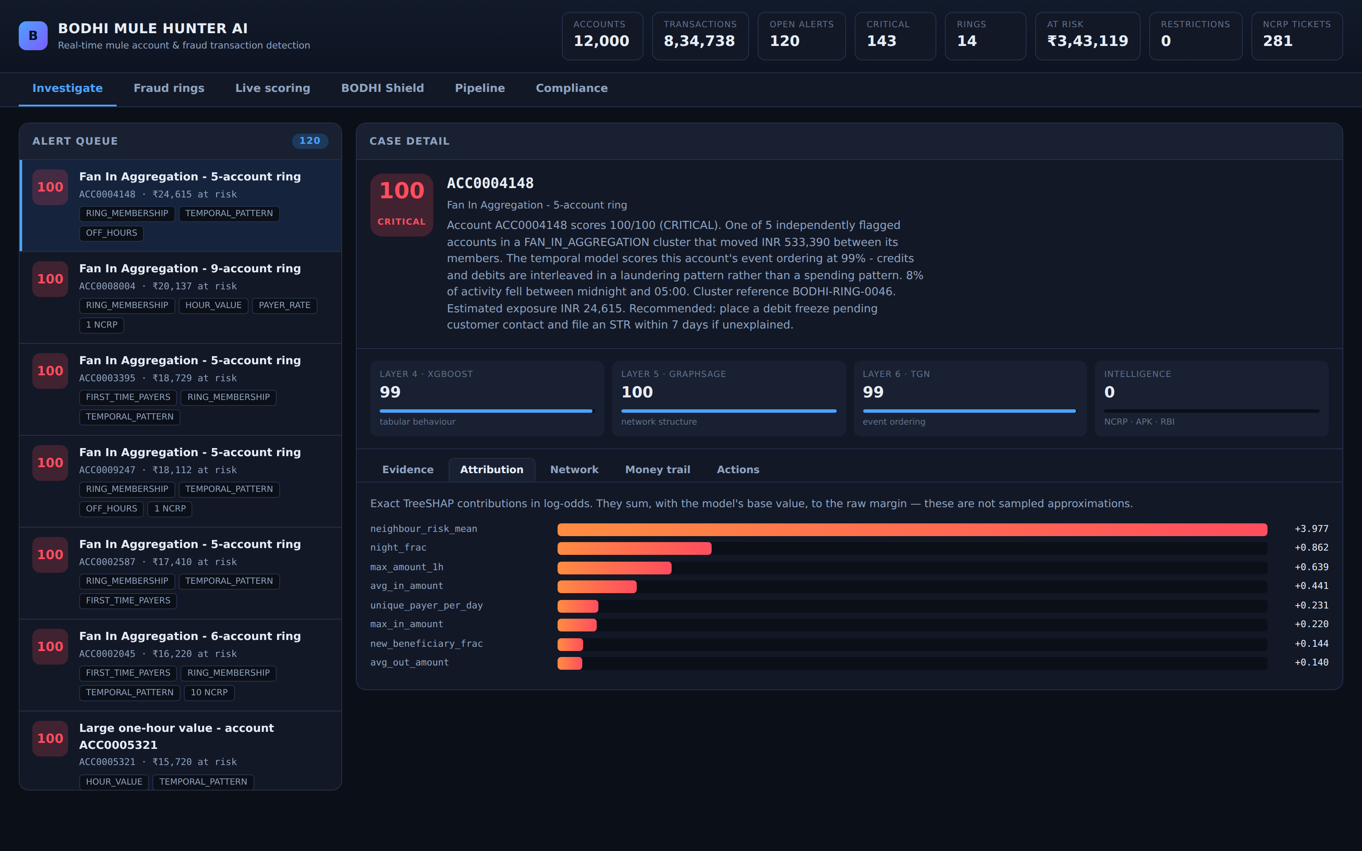
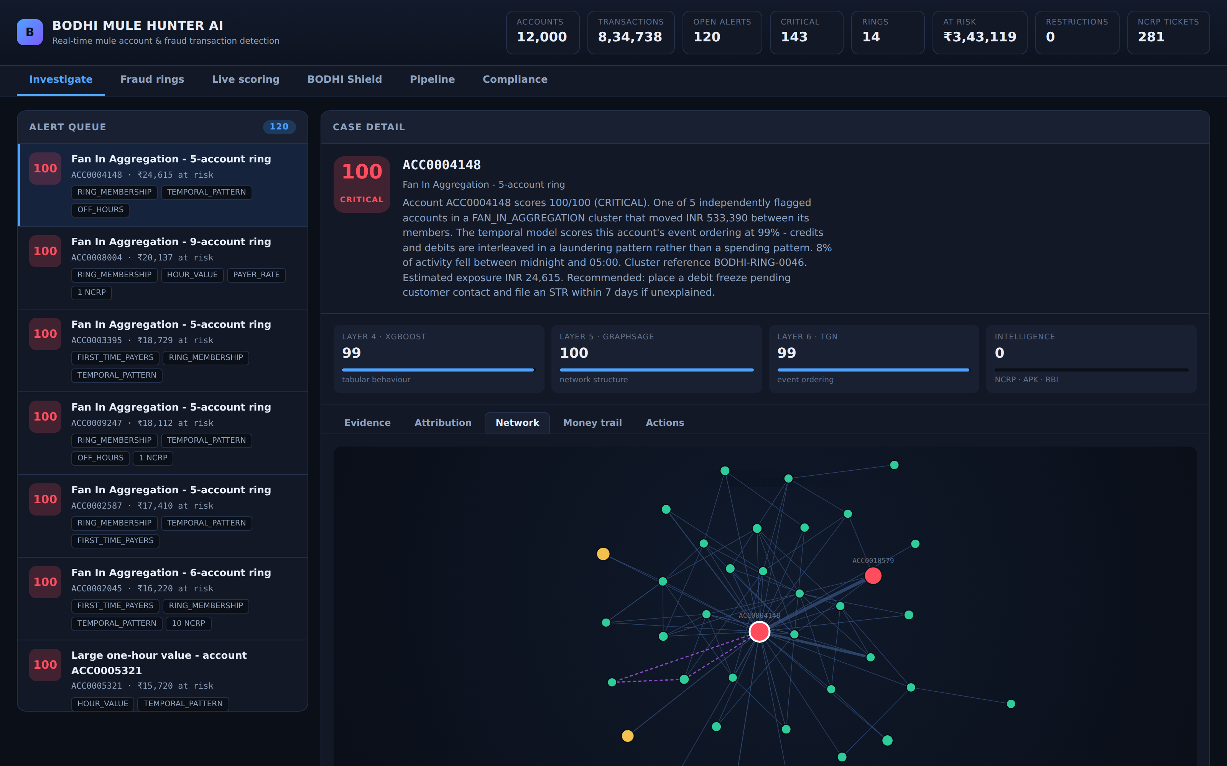
LAYER 8
Explanations specific enough to file
Exact TreeSHAP — attributions sum to the model's margin, not an approximation of it. Rendered as sentences, not feature names: “94% of every rupee credited left within 60 minutes — the account is a conduit, not a destination.”
GNNExplainer learns a mask over the two-hop neighbourhood — answering which relationships drove the score, which SHAP structurally cannot. Dashed edges are shared-device links, invisible to any tabular model.
BODHI MULE HUNTER AI · CyberShield Hackathon 2026 · Problem Statement 2
github.com/archirajpoot/Bodhi_Mule_Hunter · 12 / 19

Slide 13
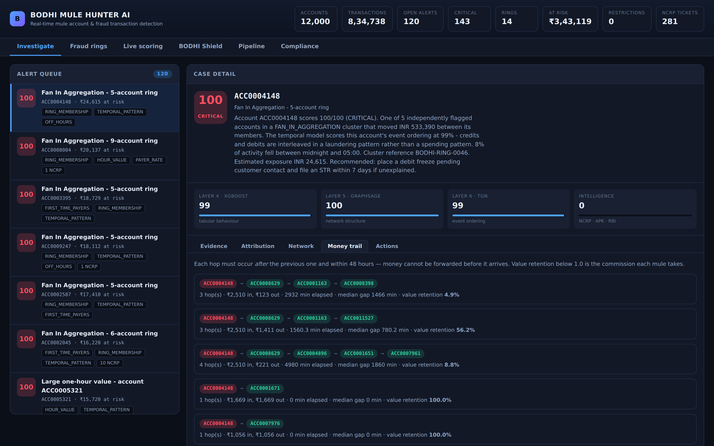
FOLLOWING THE MONEY
Time-respecting multi-hop trails
Every hop must occur after the previous one — money cannot be forwarded before it arrives. Value retention exposes each mule's commission.
THE TELL
A laundering chain leaks 2–10% at every hop as the handler's cut. Legitimate payment chains simply do not have that shape — which is why value retention is shown on every path.
BODHI MULE HUNTER AI · CyberShield Hackathon 2026 · Problem Statement 2
github.com/archirajpoot/Bodhi_Mule_Hunter · 13 / 19

Slide 14
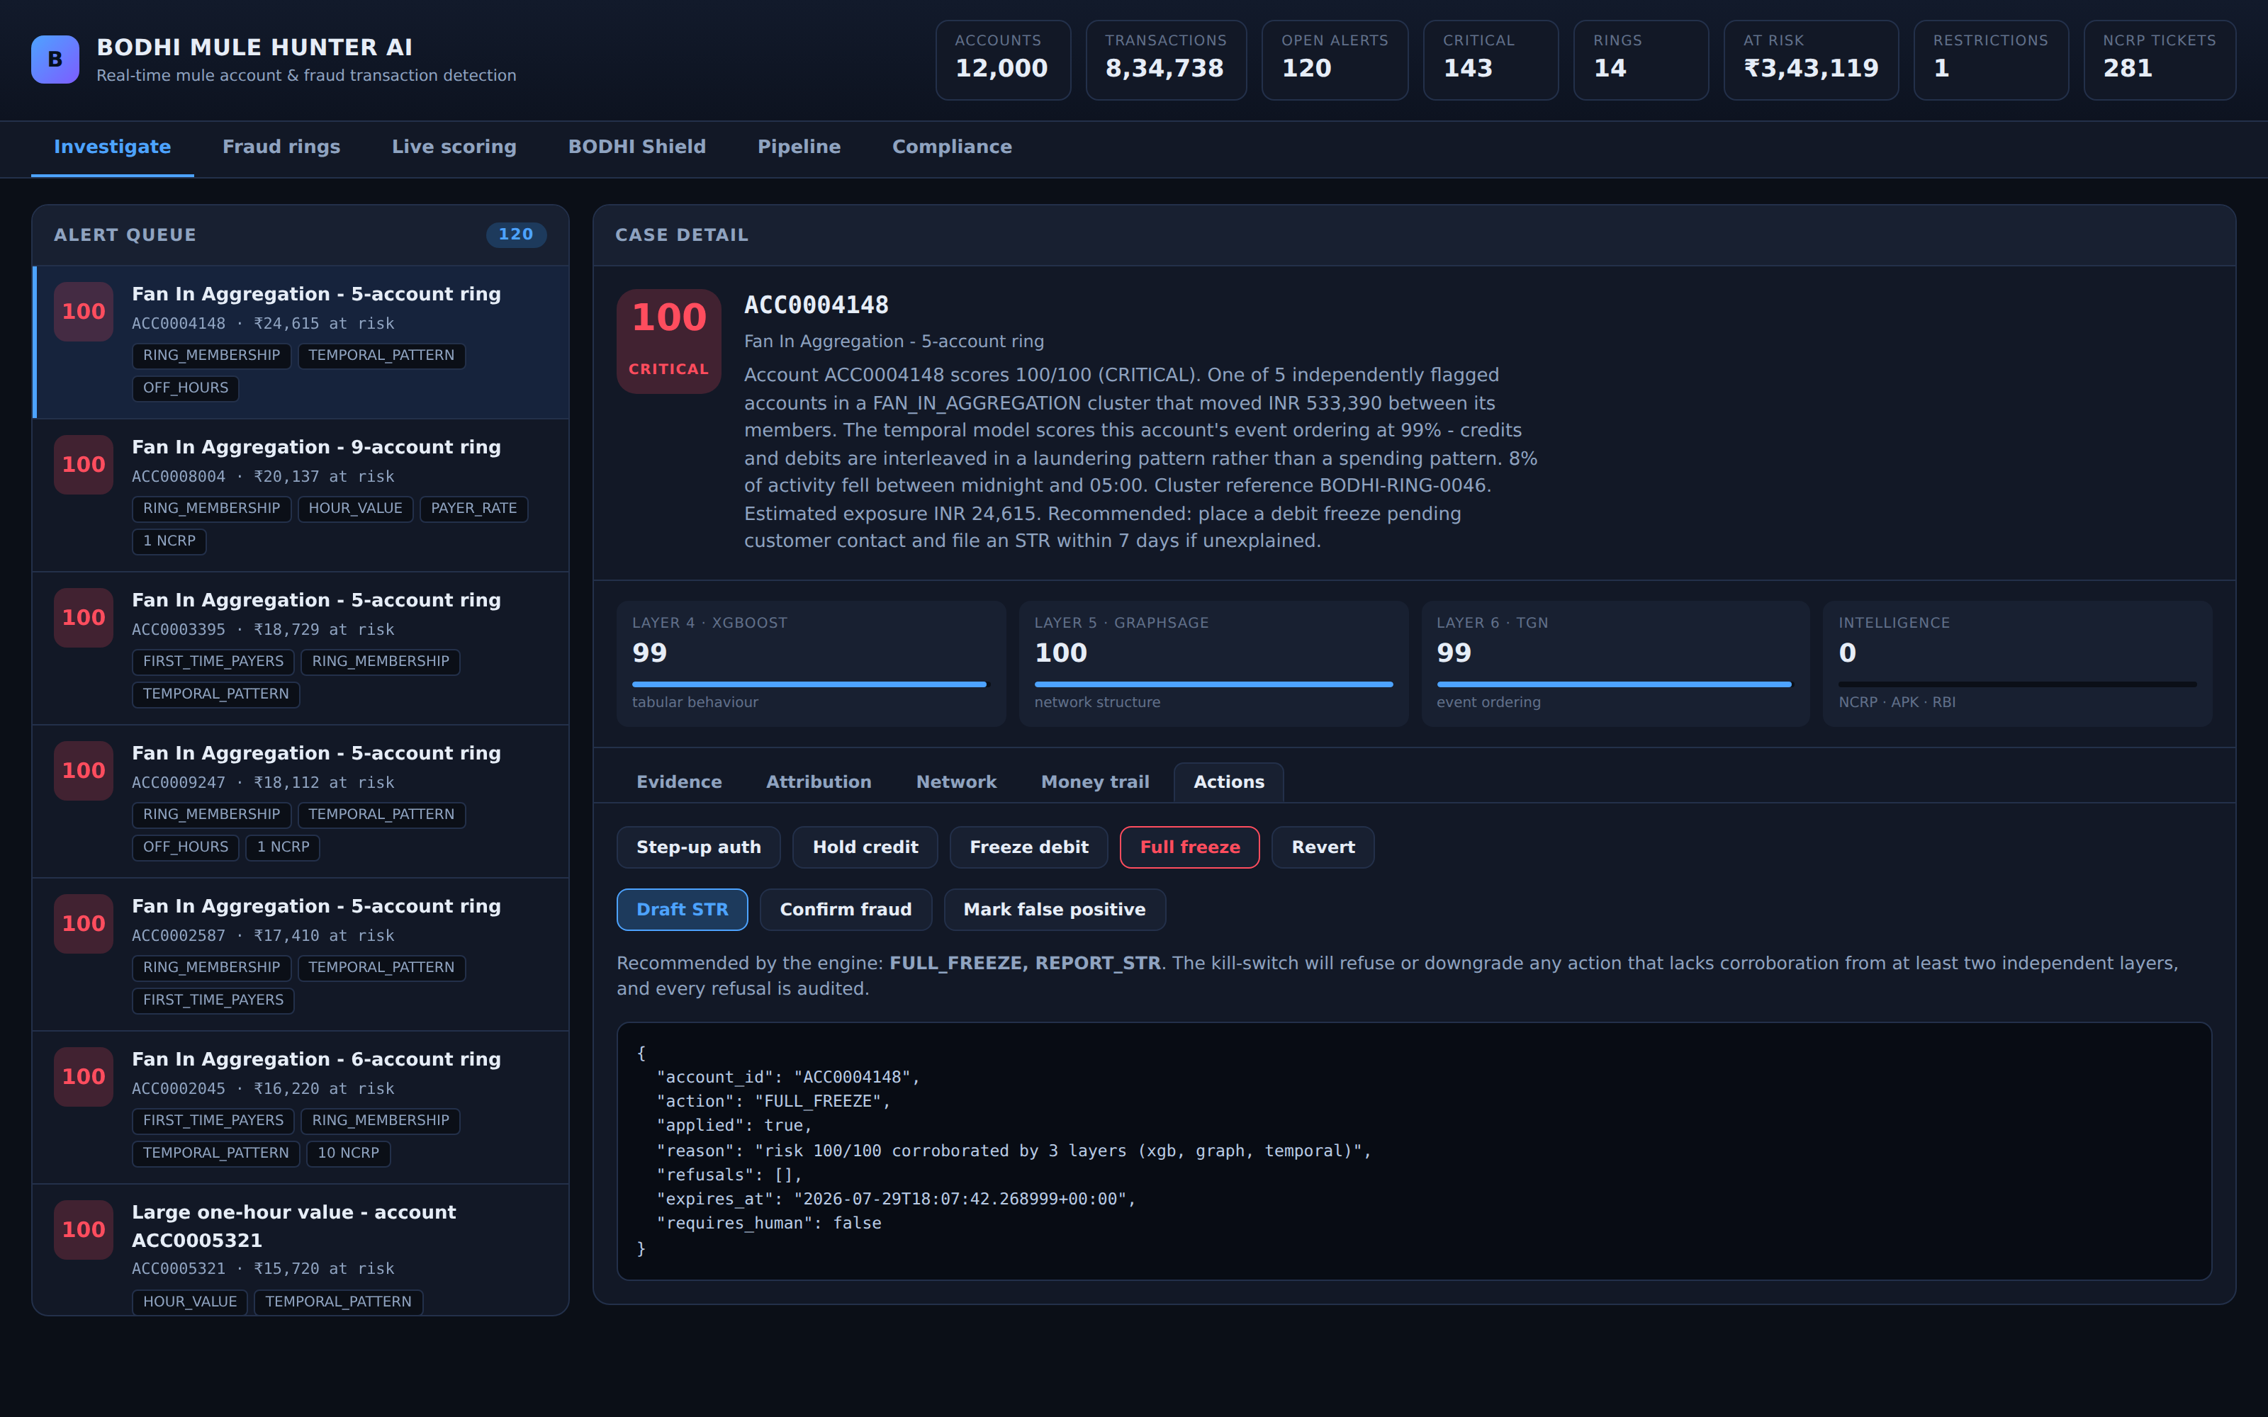
LAYER 9
Containment that can refuse
A wrongly frozen account is somebody unable to pay for medicine. No AUC improvement justifies being casual about that.
Proportionality
below 85 the automation cannot freeze at all
Corroboration
a full freeze needs ≥2 independent layers agreeing
Reversibility
every action carries a TTL and can be reverted
Rate limiting
bounded automated freezes per hour caps blast radius
Protected accounts
salary, pension and benefit accounts always go to a human
When a constraint fires, the action is downgraded — never escalated — and flagged for human review. Every decision, including every refusal, is written to a hash-chained audit log whose head hash can be externally anchored.
BODHI MULE HUNTER AI · CyberShield Hackathon 2026 · Problem Statement 2
github.com/archirajpoot/Bodhi_Mule_Hunter · 14 / 19

Slide 15
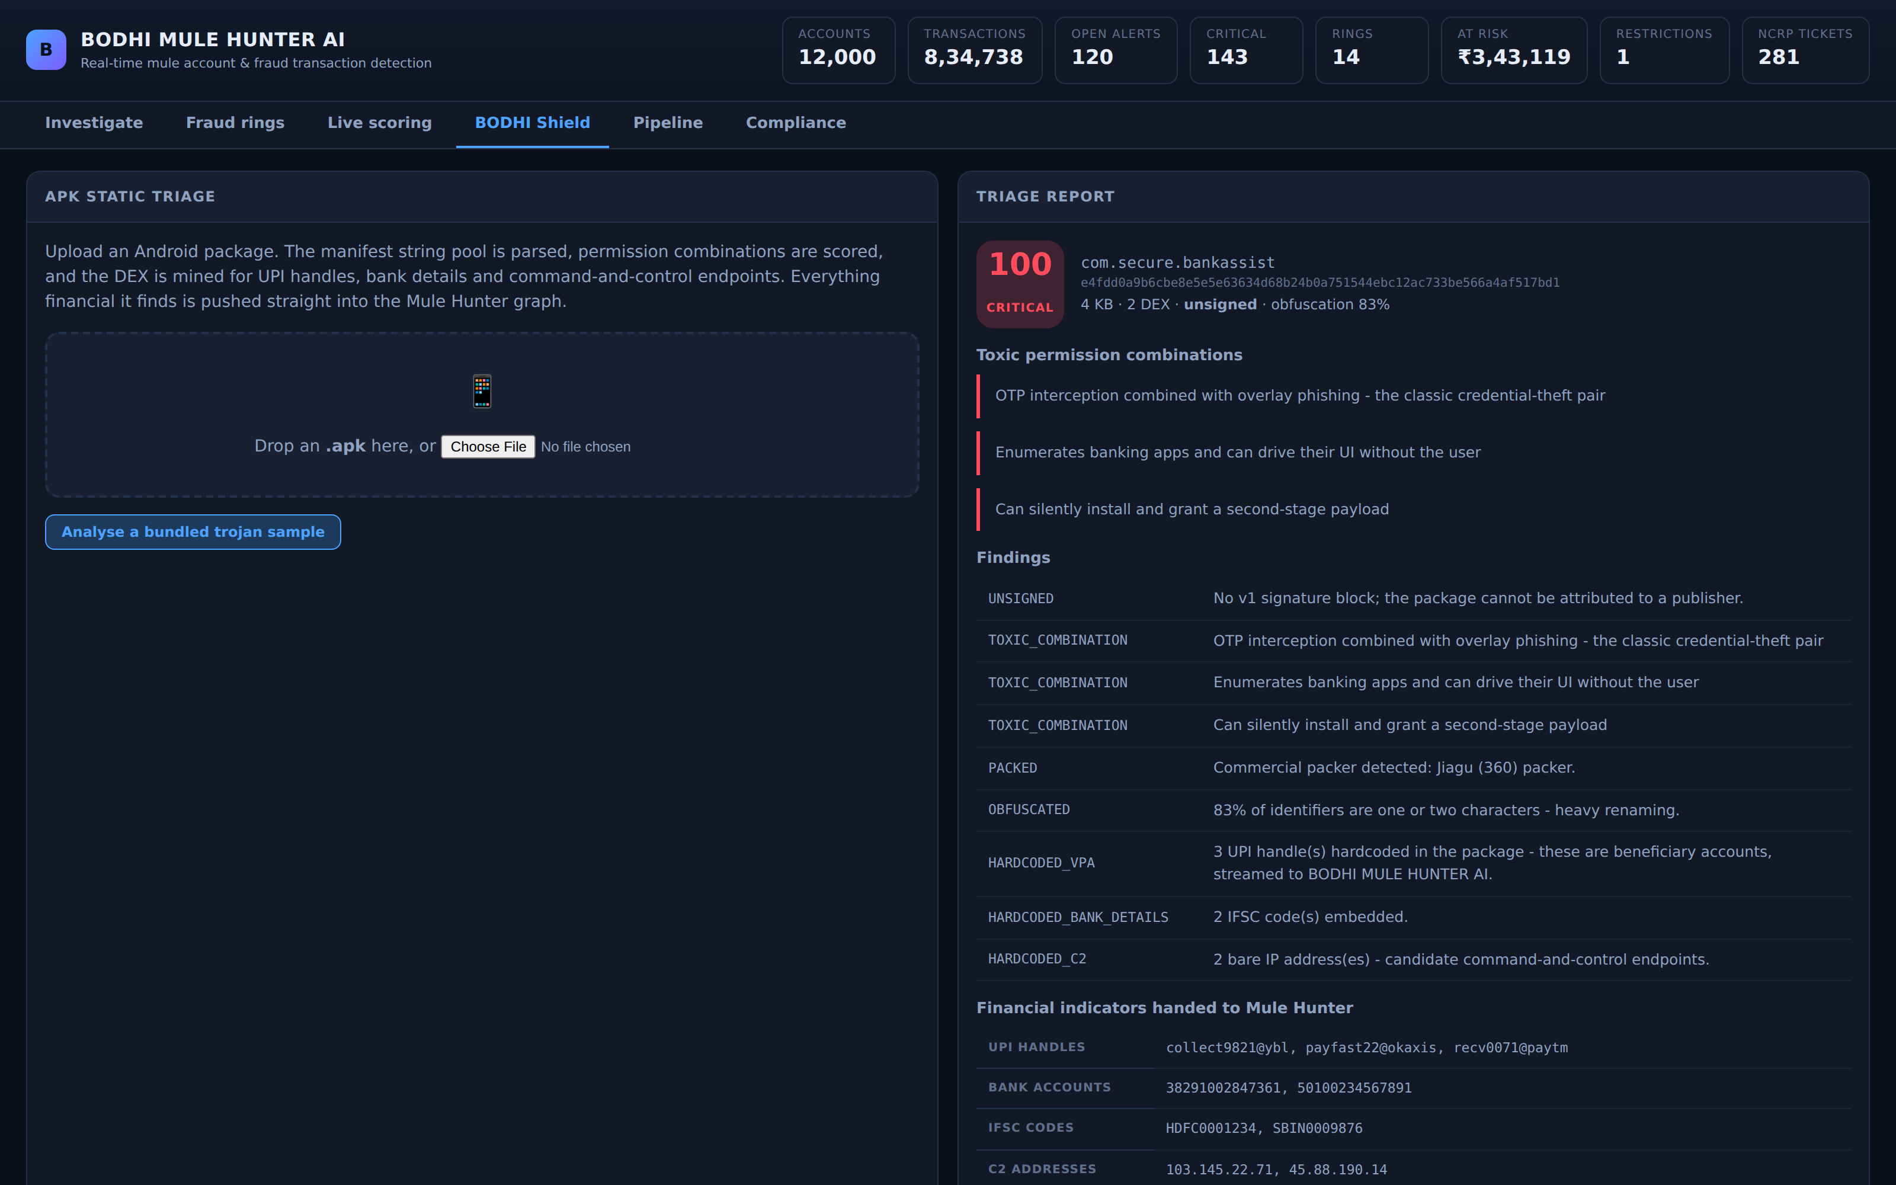
ECOSYSTEM SYNERGY
BODHI SHIELD → BODHI MULE HUNTER
Malware analysis priming fraud controls before the first victim installs the app.
1
Parse manifest
binary AndroidManifest.xml string pool, to spec
2
Score combinations
READ_SMS alone is a messaging app; + accessibility + overlay is a trojan
3
Mine the DEX
UPI handles, IFSC codes, accounts, C2 endpoints
4
Hand off
identifiers become weighted nodes in the fraud graph
BODHI MULE HUNTER AI · CyberShield Hackathon 2026 · Problem Statement 2
github.com/archirajpoot/Bodhi_Mule_Hunter · 15 / 19

Slide 16
DEPLOYMENT
How it fits a real bank
The split between scheduled graph work and the inline path is what makes a UPI-latency decision possible at all.
Core banking / switch
L1–L2 streaming features
L3/L5/L6 batch (scheduled)
Inline decision < 0.1 ms
Kafka event stream
feature store
standing risk cache
ALLOW · REVIEW · HOLD · BLOCK
MEASURED PERFORMANCE
WHY THIS SPLIT
Simulate the bank
7 s
Feature engineering
~4 s
The graph and temporal layers run on a schedule and cache a standing risk per account. The authorisation path combines those cached scores with the transaction's own attributes and never traverses the graph — which is the only way a decision is feasible at payment latencies.
Graph construction
~3 s
Full training, all layers
~123 s
Full population re-score
~38 s
Inline decision (p50)
0.054 ms
BODHI MULE HUNTER AI · CyberShield Hackathon 2026 · Problem Statement 2
github.com/archirajpoot/Bodhi_Mule_Hunter · 16 / 19

Slide 17
THEIR DATASET
Built on the schema they published
3,924 declared columns, one row per alert. The names are machine-generated from a grammar, so we parse them instead of treating them as opaque.
FOUR COLUMNS LEAK THE LABEL
FOUR STRATEGIES, SELECTION INSIDE EVERY FOLD
FRAUD_SUSPECTED · FALSE_POSITIVE · OTHER_RESOLUTION · UNATTENDED are resolution-status flags — how an analyst closed the alert. An open alert has none of them.
STRATEGY
FEATS
ROC-AUC
PR-AUC
Bank's 18 finalised
18
0.712
0.177
Bank + engineered
2,028
0.651
0.163
PR-AUC, quarantined (deployable)
0.177
Automatic top-k
131
0.622
0.137
PR-AUC, resolution columns admitted
0.972
Every column
5,926
0.618
0.112
The bank's eighteen beat all 5,926 columns. With 186 positives against thousands of predictors, that is what theory predicts.
0.7046
0.7116
5.5×
3,924
UNTOUCHED HOLDOUT ROC-AUC
CROSS-VALIDATED ESTIMATE
PR-AUC INFLATION IF LEAKED
COLUMNS PARSED BY GRAMMAR
Measured on a stand-in table with their exact schema — their data was not released when this was built. It proves the pipeline runs and does not flatter itself. It is not model performance, and we will not present it as such.
BODHI MULE HUNTER AI · CyberShield Hackathon 2026 · Problem Statement 2
github.com/archirajpoot/Bodhi_Mule_Hunter · 17 / 19

Slide 18
LIMITATIONS
Stated plainly, because hiding them helps nobody
Simulated data
Demonstrates the architecture beats a rule engine on data with realistic decoys. Not a forecast of production performance.
Static APK analysis only
The dynamic sandbox with runtime hooking needs an instrumented Android image; it cannot ship self-contained.
Graph layers are not real-time
~38 s full re-score. An account whose neighbourhood changed since the last batch is scored on slightly stale structure.
Single-institution view
Rings routing through several banks are only partly visible — a data-sharing problem, not a modelling one.
Cold start
The strongest feature is neighbourhood risk propagated from confirmed cases; with zero known mules performance drops materially.
Disparate impact unevaluated
Minimum-KYC and shared-device features are predictive but correlate with lower-income households. Alert-rate parity must be measured before go-live.
BODHI MULE HUNTER AI · CyberShield Hackathon 2026 · Problem Statement 2
github.com/archirajpoot/Bodhi_Mule_Hunter · 18 / 19

Slide 19
Mule detection fails today not because the signal is absent
— but because single-account rule engines cannot express it.
Three complementary views, fused under a monotonicity constraint into a calibrated score, cut false positives by 99.99% at unchanged recall — with explanations specific enough to file and containment cautious enough to automate.
113
~17.4k
9
0
TESTS PASSING
LINES OF CODE
LAYERS, ALL RUNNING
EXTERNAL ML FRAMEWORKS
Akshay Tiwari
Palak Vishwakarma
Archi Singh Rajput
Kartik Jain
0246CS241037
0246AL241124
0246CS240174
0246AL241094
make setup && make all && make serve · github.com/archirajpoot/Bodhi_Mule_Hunter

