Slide 1
CS6301 MACHINE LEARNING
MINI PROJECT
MUSIC GENERATION USING DEEP LEARNING
BATCH - 11
DATE : 31/10/2020
PRESENTED BY
SUBRAMANIAN V SRIKANTH GR DEEPAK VM
2018103606 2018203603 2018103522

Slide 2
Music generation using deep learning
INTRODUCTION
The traditional approach to music generation would be to describe a stochastic grammar (probabilistic). It is purely based on Mathematics of the music.
On the other hand, the machine learning approach is not concerned about the concrete mathematical structure of music.
The model will be trained to understand musical sequences, and thereby generate a full-fledged melody based on the training data set.

Slide 3
OBJECTIVE
For a neural network to generate music, it needs to be able to capture motifs and musical ideas besides comprehending music theory.
This means that the neural network must be capable of capturing long term characteristics of the musical dataset.
Our objective is to design a long short-term memory (LSTM) model, to predict the next note to be played, based on the previous notes.

Slide 4
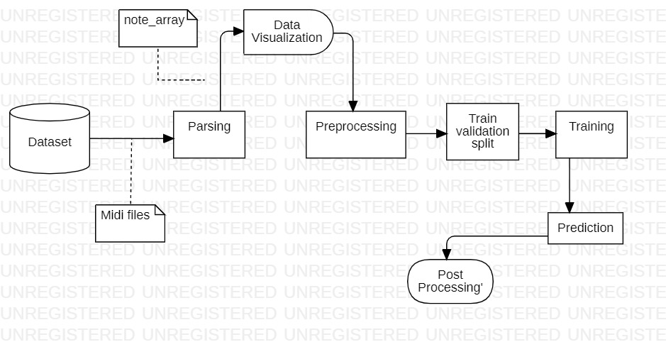
System architecture

Slide 5
The Main imported library
Music 21 is a Python library developed by MIT for understanding music data. MIDI is a standard format for storing music files. MIDI stands for Musical Instrument Digital Interface. MIDI files contain the instructions rather than the actual audio. Hence, it occupies very little memory. That’s why it is usually preferred while transferring files.
#library for understanding music
from music21 import *

Slide 6
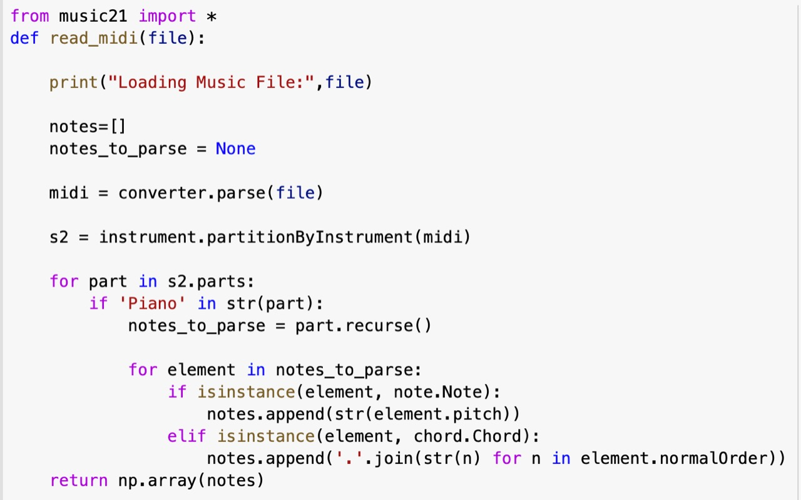
MODULE 1 – PARSING
INPUT : DATASET CONTAINING MIDI FILES
OUTPUT : NOTES_ARRAY REPRESENTING NOTES FOR EACH MIDI FILES
READ_MIDI function is defined straight away for reading the MIDI files. It returns the stream of notes and chords present in the musical file.

Slide 7
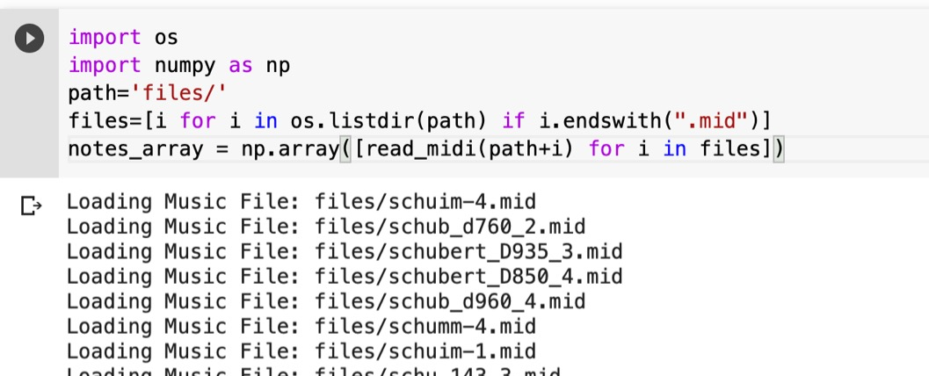
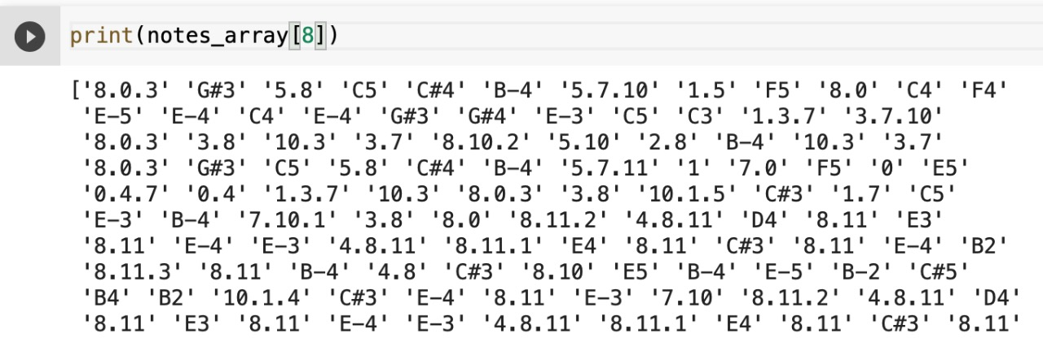
IMPORTING MIDI FILES FROM THE SYSTEM AND STORING IT AN ARRAY
Output:

Slide 8
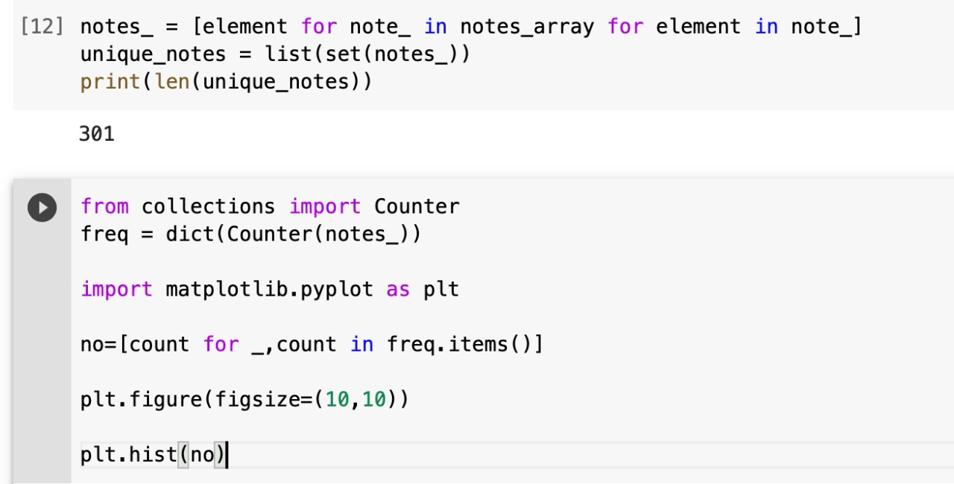
MODULE 2 – DATA VISUALIZATION
OUTPUT : GRAPH PLOTTED BETWEEN NOTE VS ITS FREQUENCY

Slide 9
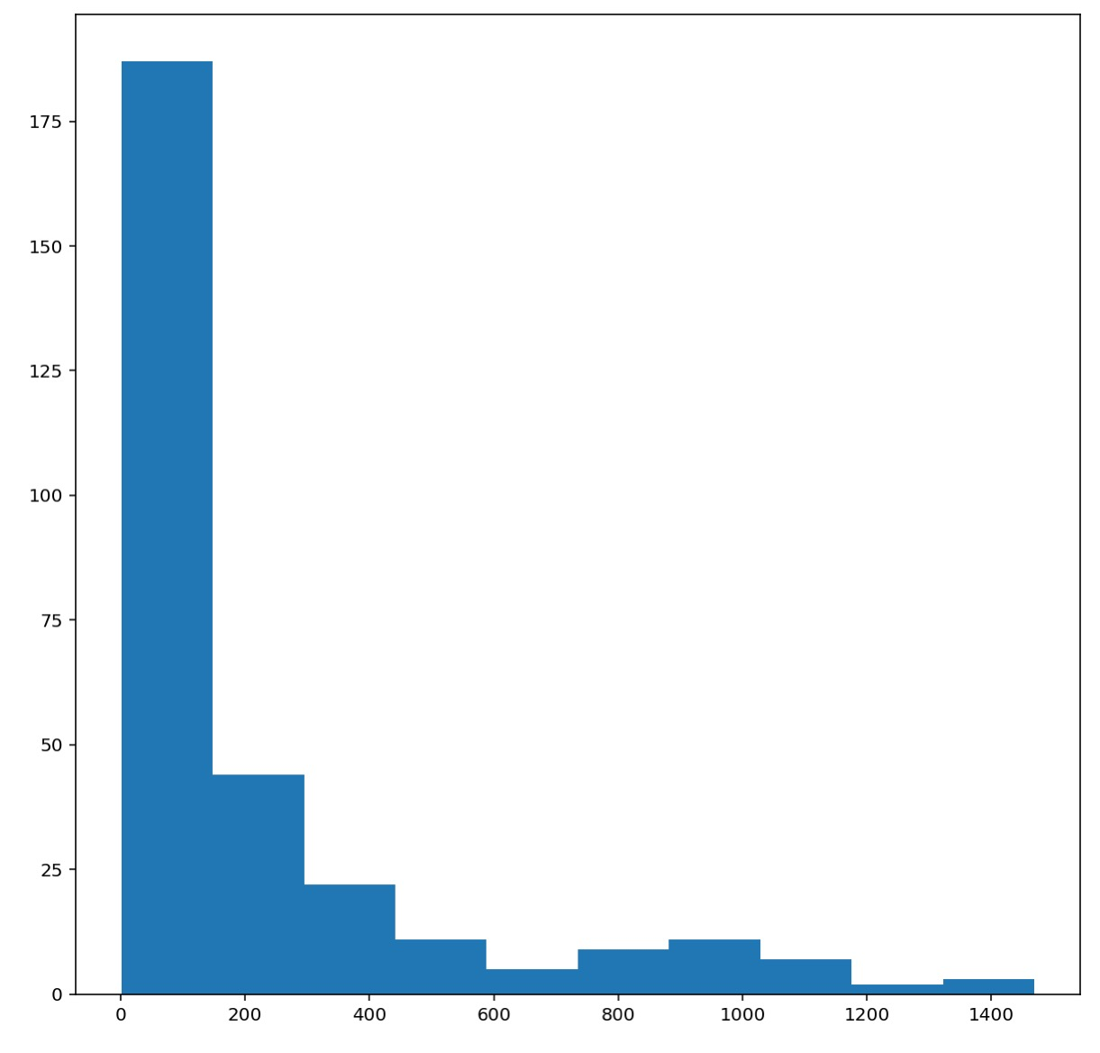
OUTPUT:
From the above plot, we can infer that most of the notes have a very low frequency. So, we keep the top frequent notes and ignore the low-frequency ones. Here, we are defining the threshold as 50.

Slide 10
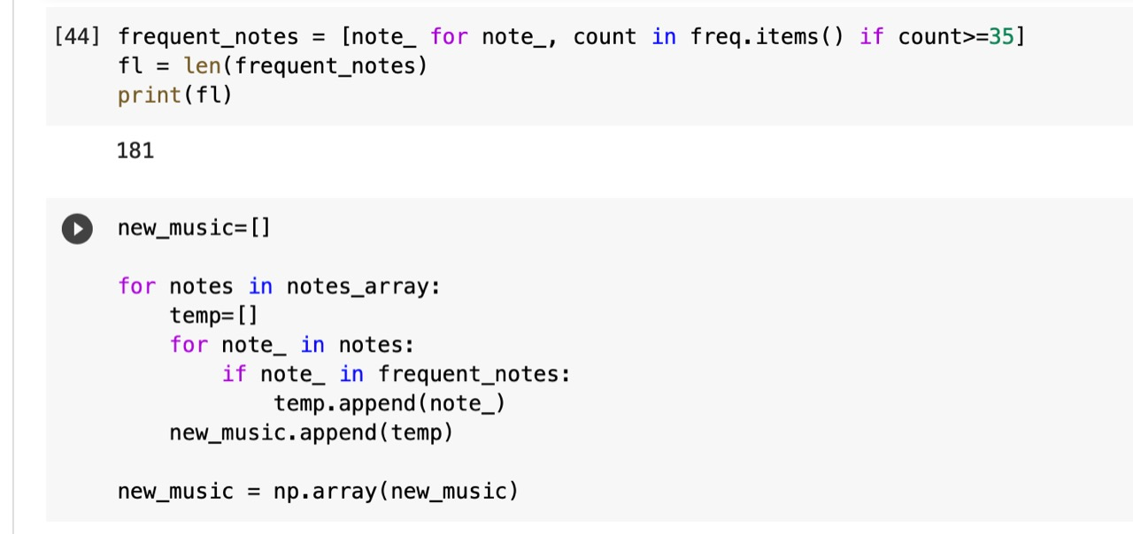
MODULE 3 - PREPROCESSING
INPUT : NOTES_ARRAY REPRESENTING NOTES FOR EACH MIDI FILES
OUTPUT : CLEAN NOTES_ARRAY

Slide 11
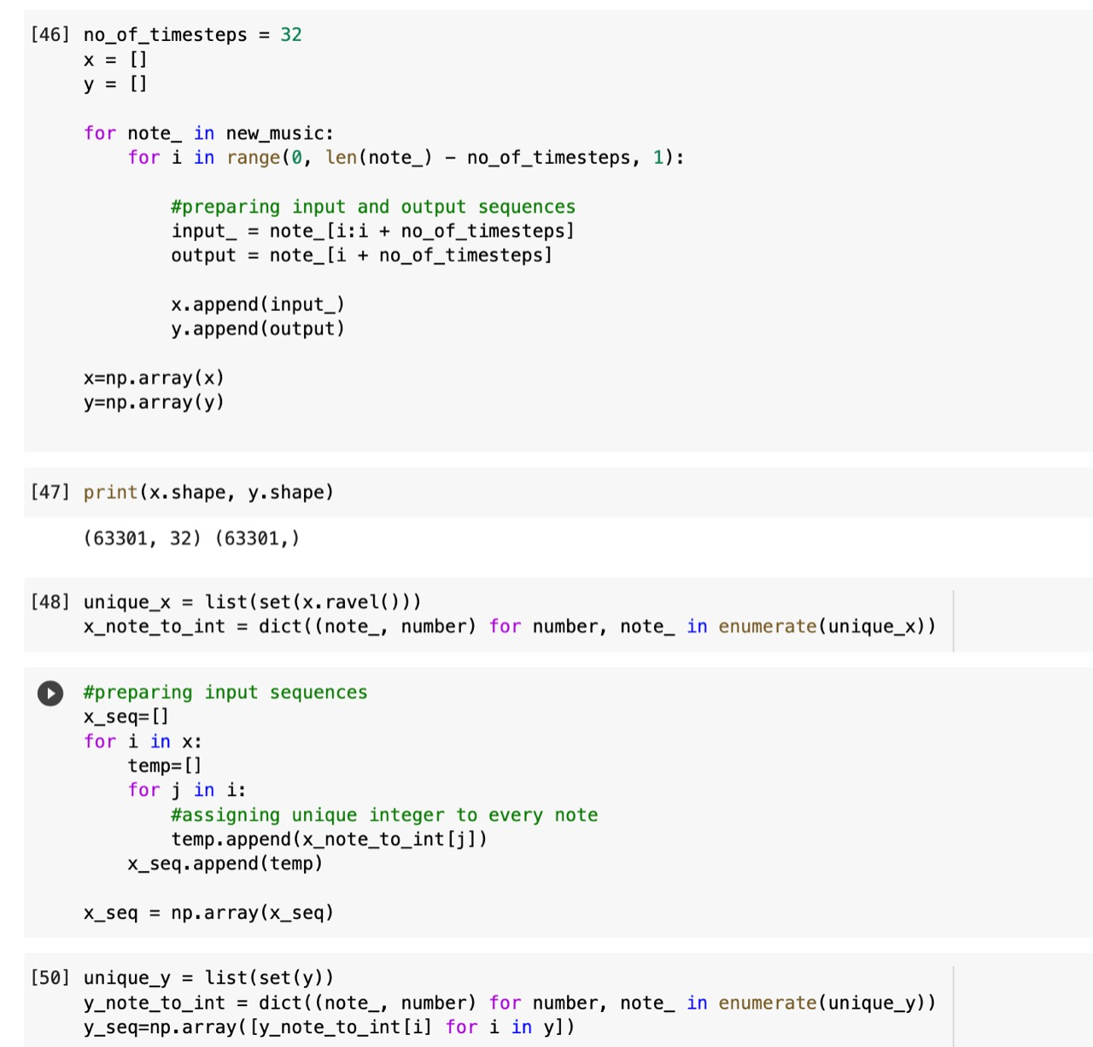
Preparing the input and output sequences
And we will assign a unique integer to every note:

Slide 12
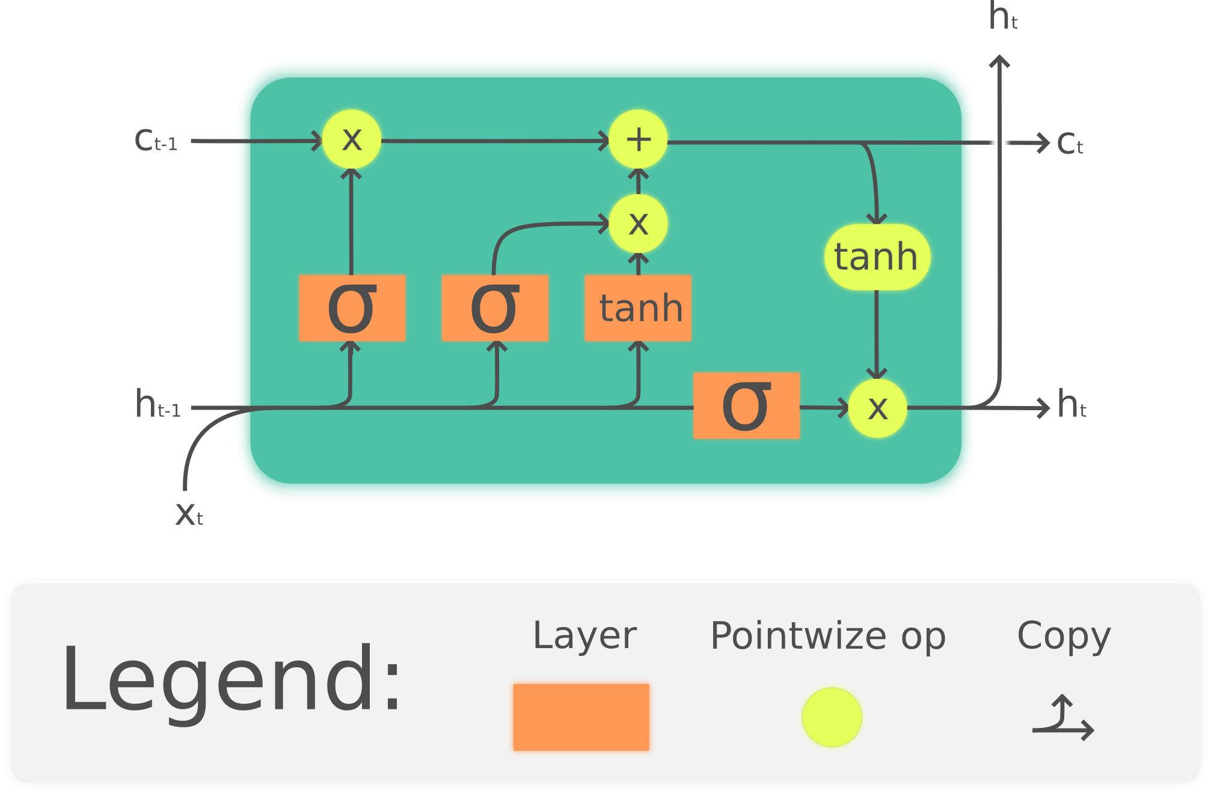
Module 4 – model building

Slide 13
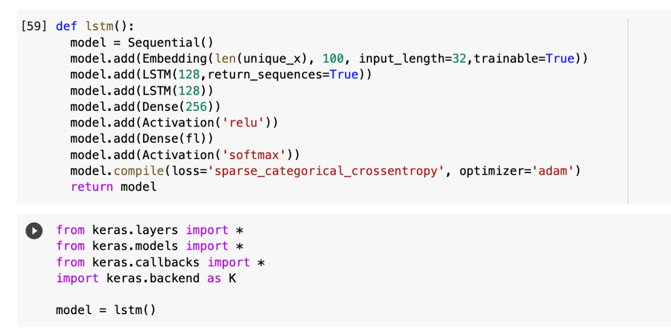

Slide 14
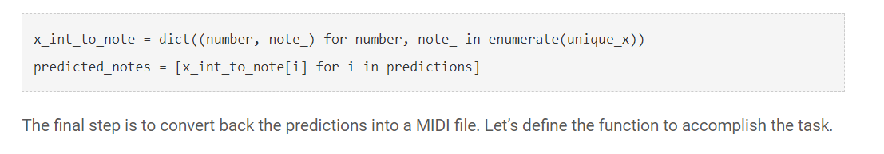
Module 5 – prediction and post processing
Converting the integers back into the notes.

Slide 15
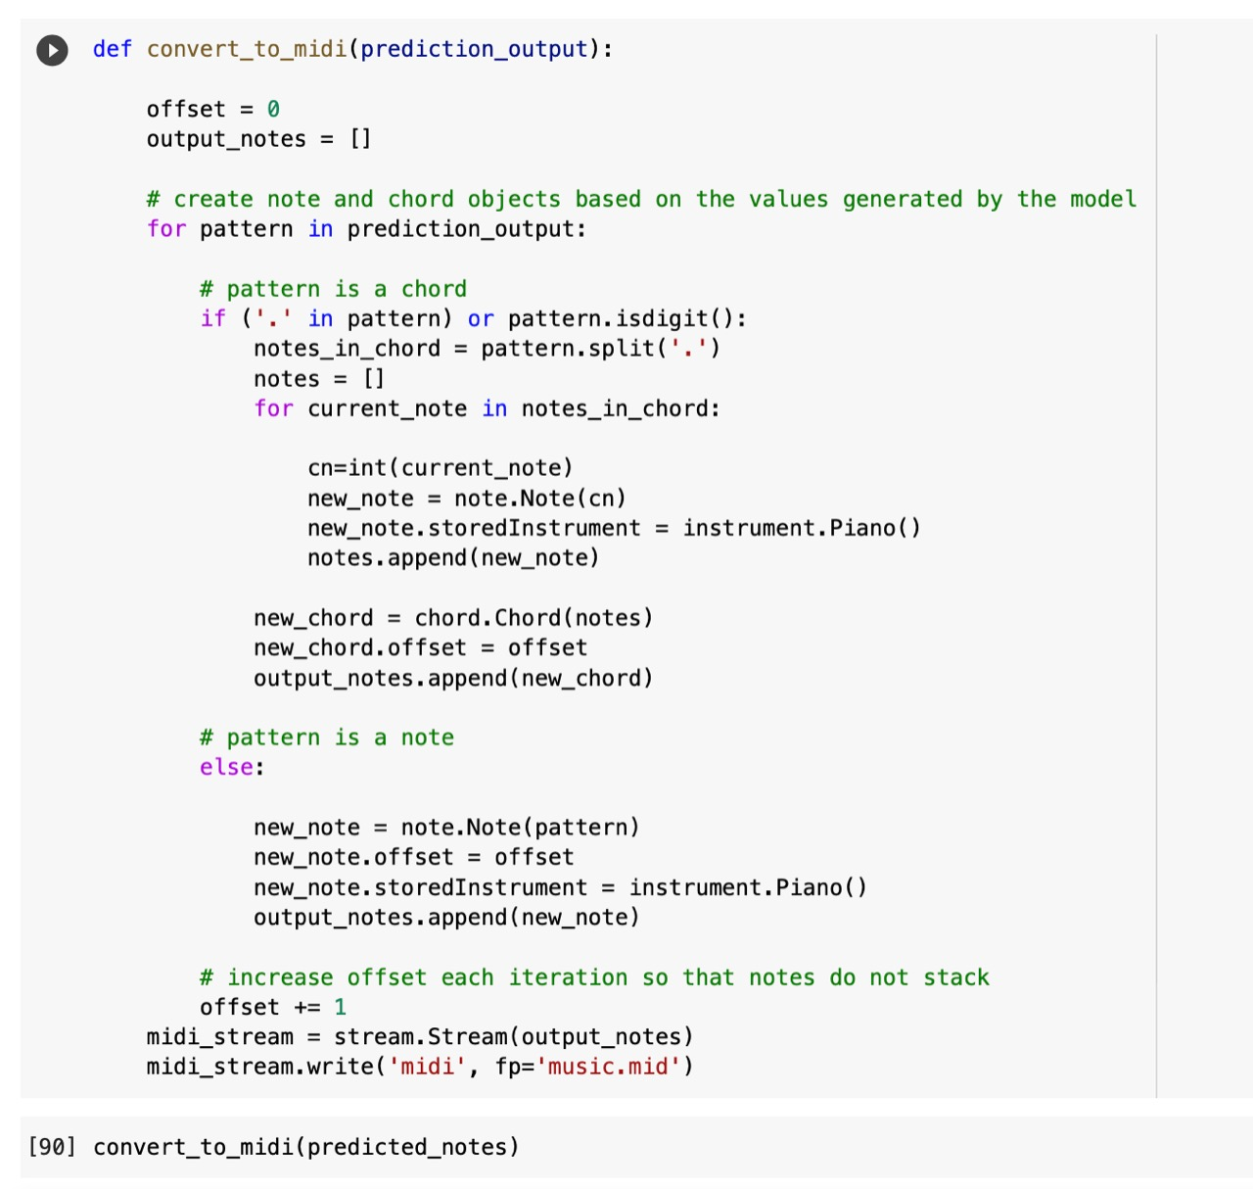
The final step is to convert back the predictions into a MIDI file
Converting the predictions into a musical file:

Slide 16
The dataset
A description of the dataset:
The dataset is a collection of multiple classical music files, made from a digital piano. The music was originally composed by Franz Schubert.
Link to the dataset: https://drive.google.com/file/d/1qnQVK17DNVkU19MgVA4Vg88zRDvwCRXw/view
It consists of 29 short music files composed by Schubert and rendered using a digital piano. These music files are combined inside the notebook and converted into arrays of numbers to be easily interpreted by the machine.
All the music files in the dataset are in the MIDI (Musical Instrument Digital Interface) format, which is playable by a media player. The output generated from the model is of the same format.

Slide 17
EXPerimental results
The core aim of training a machine is to ensure that we do not keep getting the same output again and again. It must be different.
Here, the model tries to get different notes every time. You can see the results:

Slide 18
POST PRECESSING
SAMPLE OUTPUT:
https://drive.google.com/file/d/1q5yo6pVks1q3ve7_EjJ0ZjY0h809-zie/view?usp=sharing

Slide 19
Ablation ANALYSIS
RECCURRENT ACTIVATION | ACTIVATION | VALIDATION LOSS
SIGMOID | TAN H | 2.3895
SOFT MAX | TAN H | 3.6213
SIGMOID | RELU | 3.1372

Slide 20
Ablation ANALYSIS
WHEN SET THE NUMBER EPOCHS GREATER THAN 20 IT STARTS OVERFITTING
WHEN RELU LAYER IS REMOVED THE OUTPUT IS VERY SIMPLE AND PREDICTABLE

Slide 21
Conclusion
We have now successfully trained a LSTM, a recurring neural network, to understand and parse classical music, as well as reproduce it with sharp accuracy.
This model is just a baseline model. It can be tweaked and improved, in order to improve the performance.
Using a pre-trained model and fine-tuning it would give much better results. But for this project, we have chosen to train our model from scratch.
A huge dataset with thousands of music files can be used, but the training time would increase exponentially as well. It generally takes about 20 seconds to parse a short music file.
Now, onward to the references....

Slide 22
REFERENCES
The following papers were taken as references:
1. Deep Learning for Music - Allen Huang, Raymond Wu (2016) Link: https://cs224d.stanford.edu/reports/allenh.pdf
2. MuseGAN: Multi-track Sequential Generative Adversarial Networks for Symbolic Music Generation and Accompaniment – Hao-Wen Dong, Wen-Yi Hsiao, Li-Chia Yiang, Yi-Hsuan Yang (2017) Link: https://arxiv.org/pdf/1709.06298v2.pdf
3. MusPy: A Toolkit for Symbolic Music Generation – Julian McAuley, Ke Chen, Hao-Wen Dong, Taylor Berg-Kirkpatrick (2020) Link: https://arxiv.org/pdf/2008.01951v1.pdf

Slide 23
THANK YOU

