Slide 1
TEXT RECOGNITION IN IMAGES
TEAM MEMBERS:
YOGITA (19MCA0009)
DEEPALI PODDAR (19MCA0019)
MANSI LOHIYA (19MCA0154)
GUIDE:
Prof. P G SHYNU
PANEL INCHARGE:
Prof. G Uma Maheswari

Slide 2
TABLE OF CONTENT
Objective
Related Work
Proposed Architecture
Experiment
A. Dataset
B. Libraries
Output
Conclusion
Future Work

Slide 3
OBJECTIVE:
Images need to be saved to the computer so that it can be used in the future. As these images might contain some important information related to the person such as some official document, which can be in the form of scanned documents or in the form of normal images may be colored or black and white, which have some content written over them.
Since we cannot copy and paste the content directly from these images for reusing it further and typing the whole image content manually for querying, is definitely a tedious task and it is clearly a waste of one’s time and efforts.
In order to perform this and for better utilization of the content written over images, OCR (Optical Character Recognition)is one of the advanced technology which will be used to overcome this problem.

Slide 4
RELATED WORK
In [1], techniques are used to analyze documents by reading its content, car number plate recognition, consumer products recognition, natural scene, text reading etc., which was done on the basis of CNN and LSTM architecture. Hence, various tasks were automated that have been linked with each other because it has better identification reliability.
Nowadays the main creator of information is social media, as it contains a large amount of data that should be preprocessed before getting valuable information from it. In [2], Tesseract OCR technique is used to generate highly accurate documents by extracting text from images. The preprocessing techniques include- document localization, resolution improvement, text localization.
In [3], the K-means algorithm is used to reduce the process complication. In this, two different algorithms are evaluated and then compared to opt out the better accuracy between classification and efficiency. In [5], MKL framework is used to transform text detection into pattern classification. The Kernel method is finer than the traditional SVM method.

Slide 5
RELATED WORK CONTD..
Digital image processing is increased very quickly and plays a major role in the fields like AI, robotics and many more. This paper also helps in providing direct links between humans and computers which establish easy understanding between them.
According to the survey, text recognition in images haven’t been explored much. As there is still some researches are on-going. Major challenges of OCR are talked about and then their further important role is discussed. OCR technique also provides accurate information as its comprehensive algorithm focuses on a dataset, which is the main source of text extraction.
To reduce the workload of humans in rectifying text and transform it into useful information, machine learning algorithms came into existence. These algorithms help in providing more reliable and relevant information [9].
Techniques such as- face detection and OCR are used to better update the text information which is collected from image sources [11]. By this, generated text gives relevant and useful information. Similarly, video OCR is used to identify the grey level character images [12], this helps in reducing the level of noise or any kind of distortion among the video

Slide 6
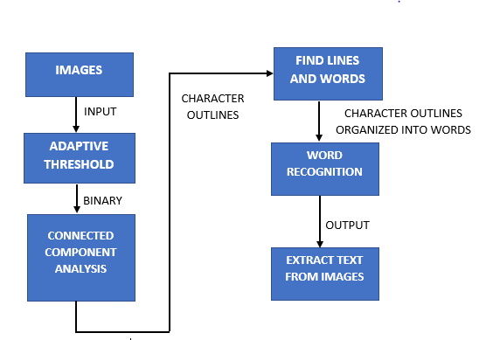
PROPOSED ARCHITECTURE

Slide 7
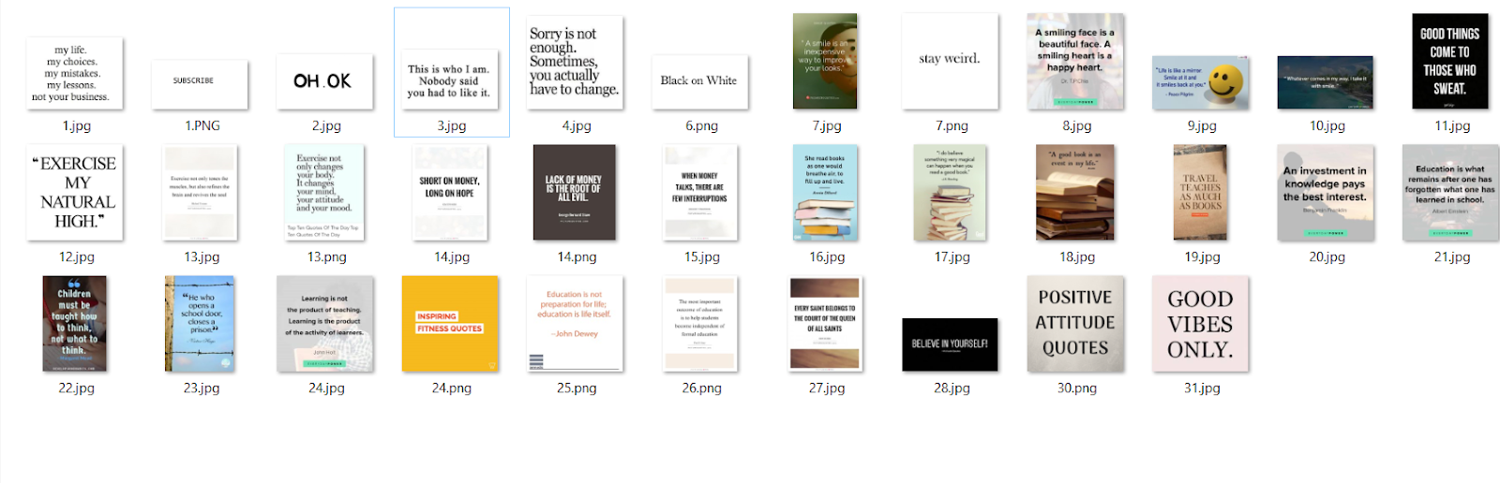
EXPERIMENT A. DATASET

Slide 8
B. LIBRARIES
from PIL import Image :
extraction of text from images is done using Python inbuilt packages and functions. Used image from PIL(Python Imaging Library) which supports opening, manipulating and saving images in different image file formats such as jpeg, png, etc.
import pytesseract :
Pytesseract which is an open source OCR software is used. It is free and needs to be installed on the machine as Pytesseract depends on it. It is the OCR tool for python which used to read text from images.
import os:
Next used library is OS which provides modules to interact with the operating system. It comes under Python’s standard utility modules. It grants permission to interface with the underlying operating system.

Slide 9
LIBRARIES CONTD..
import pandas as pd:
Imported Pandas to create data frames. It will store file name and corresponding extracted text in tabular format.
We need to give a full path of the directory where tesseract is installed so that it can open it and can use it’s functionality. All the images which need to be processed should be stored in a file so that tesseract can take images as an input and process it further
Pytesseract converts images in binary form and extracts text from it using the built in function pytesseract.image_to_string(). It saves the extracted text in specified file format. The stored file can be accessed and we can see the extracted text.

Slide 10
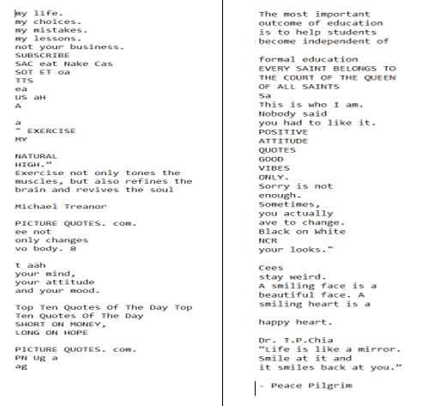
OUTPUT
Text gets extracted from the set of images and stored in a file in specified format. The directory of the stored file will be the same as the input directory.

Slide 11
CONCLUSION
This paper concludes that nowadays, images contain more textual information or we can say that more information comes in the format of documents or images.
To read that information from images, various researches have been done and various techniques were introduced to extract that textual data from an image document or from a normal image which contains some kind of text. Also this technique can work on both black and white and colored images.
In this paper, we use tesseract OCR technique to extract text information from various images. In this, multiple images at once can be taken as an input dataset and then after processing by in-built functionalities of OCR the output text will be generated.
This output is in the actual form of text rather than images which is easy to understand and is more simplified than images.

Slide 12
FUTURE WORK
In this paper, multiple colored, black and white images are taken as the input to be processed with the OCR software and as the output we are obtaining the text content that is written on the images into our desired format such as a notepad file, word document, data frame etc.
For future work, this extracted text from these images can be used as another text data set for further classification.
For example, we can classify the content or quote written on images whether it is a motivational quote, travel quote, lifestyle or fitness quote etc.
The classification will be totally dependent on the type of images that you are including in the dataset.

Slide 13
THANK YOU!!

