Slide 1

DoorDash ETA Prediction
Group Members:
PXA240008 - Pratik Alkutkar
VKC240000 - Vaishnavi Chaudhari
DSA230007 - Deepali Attavar
RXM230023 - Ramesh Mohan
FXS230031 - Firasuddin Syed

Slide 2
Introduction and Motivation
Late Deliveries = Lost Customers.
Root cause can be less on shift dashers or complex orders.
We can predict accurate delivery time using ML.
Save Customers and Profits.
“43% of customers abandon platforms after 2 late deliveries”
--Voxware Study
Notes:
Imagine waiting 90 mins for cold tacos—our project prevents this!

Slide 3
From Data to Delivery: Smarter ETAs for Happier Customers.
01
02
03
04
Improve Accuracy
Boost Satisfaction
Optimize Operations
Goal
Benchmark Success
Enhance DoorDash ETA predictions using machine learning to reduce delivery time errors.
Increase customer trust and retention with reliable delivery estimates.
Help DoorDash cut costs and improve driver efficiency through data-driven insights.
Compare model performance before/after preprocessing to show measurable impact.

Slide 4
Why ETA prediction matters?
Late Pizzas = Angry Customers
On-time Burritos = Repeat Business

Slide 5
01
02
04
03
Linear Regression
Ridge Regression
Random Forest
Models Used
XGBoost
Notes:
We used both Linear and Ridge Regression to compare the impact of regularization. While Linear Regression provides a baseline, Ridge helps prevent overfitting by penalizing large coefficients.This comparison ensures we select the most stable model for generalization, especially when dealing with multicollinearity or noisy features. Ridge helps stabilize predictions by reducing the impact of noisy or less relevant features, offering more robust results.

Slide 6
Data Description and Challenges
Data Source – Kaggle
Size: 197,428 rows × 16 columns

Slide 7
Data Description and Challenges
market_id: Numeric ID for the city/region.
created_at: UTC timestamp when the order was placed.
actual_delivery_time: UTC timestamp when the order arrived.
store_id: Numeric ID for the restaurant.
store_primary_category: Cuisine type (e.g. Italian, Asian).
order_protocol: ID for the channel used (app/API/etc.).
total_items: Total count of items ordered.
subtotal: Order value in cents.
num_distinct_items: Count of unique items.
min_item_price: Lowest single‑item price in cents.
max_item_price: Highest single‑item price in cents.
total_onshift_dashers: Dashers online within 10 mi at order time.
total_busy_dashers: Of those, dashers currently on a delivery.
total_outstanding_orders: Active orders within 10 mi.
estimated_order_place_duration: Estimated time for the restaurant to receive the order from DoorDash (s).
estimated_store_to_consumer_driving_duration: Model’s predicted drive time (s).

Slide 8

Target Variable
The target variable delivery_duration_minutes represents the total time (in minutes) taken for an order to be delivered from the moment it is placed.
Calculation:
delivery_duration_minutes = (actual_delivery_time - created_at).total_seconds() / 60

Slide 9
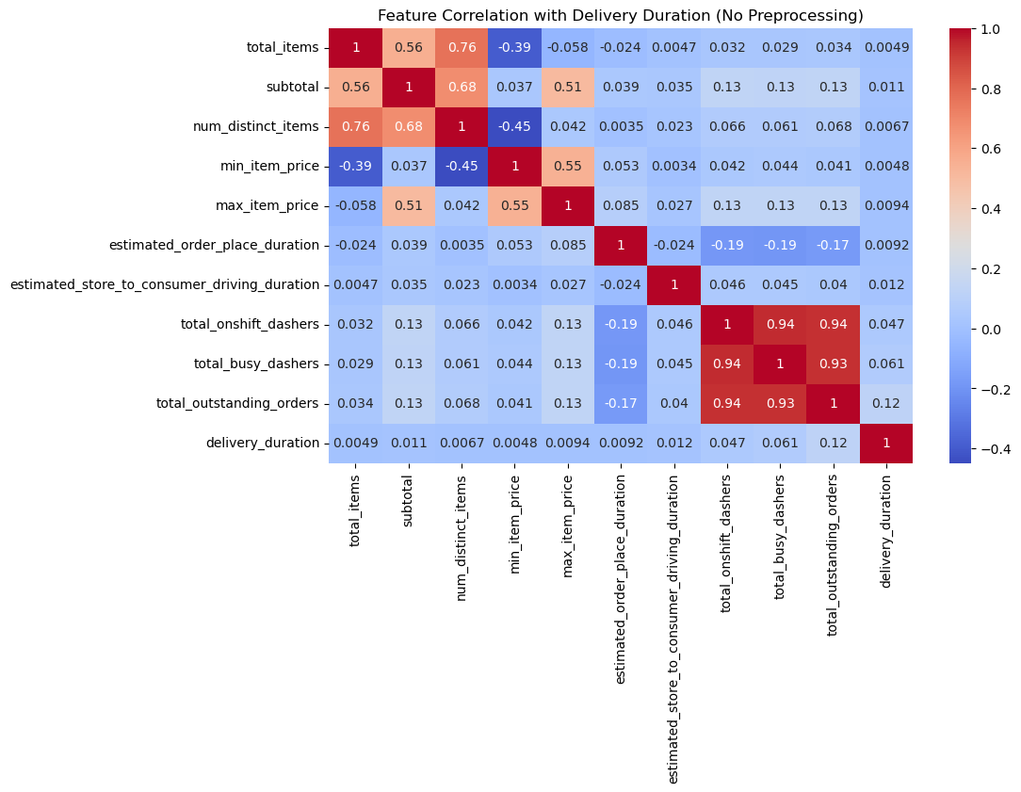
Before Data Pre-processing
1. Most features show weak correlation with delivery duration. 2. total_outstanding_orders, total_busy_dashers, and total_onshift_dashers shows moderate correlation, indicating a more direct impact on delivery efficiency.
0
Notes:
Feature Correlation with Delivery Duration (No Preprocessing)

Slide 10
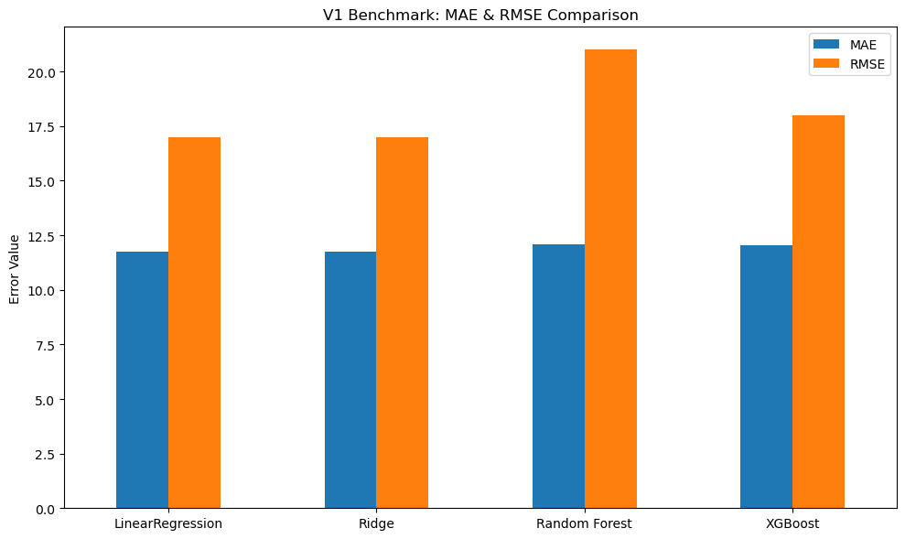
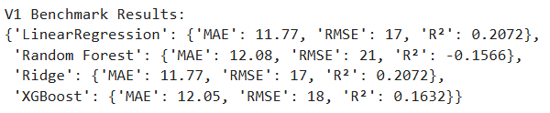
Before Data Pre-processing
0
Linear and Ridge deliver the lowest errors, Random Forest performs worst, and XGBoost sits in the middle.

Slide 11
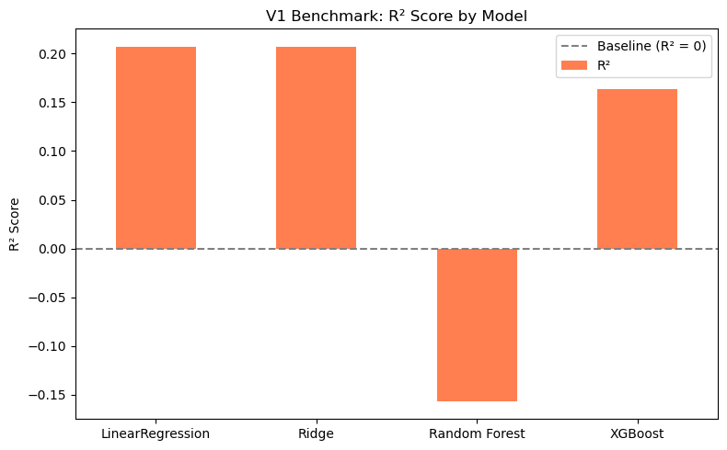
Before Data Pre-processing
0
Linear and Ridge explain about 20% of the variance, XGBoost about 16%, and Random Forest actually scores below zero.

Slide 12
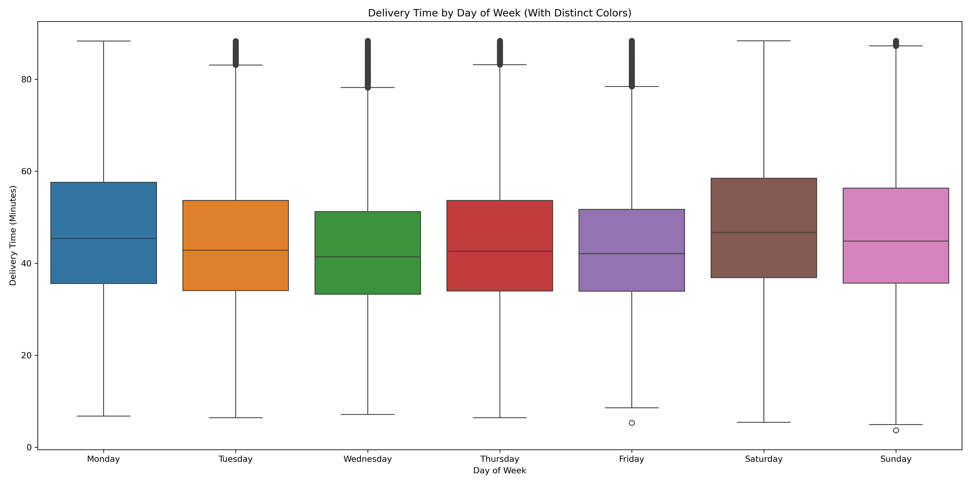
Data Processing – Version 1
Saturday and Monday have the slowest deliveries, while Wednesday and Friday are the fastest and most consistent.

Slide 13
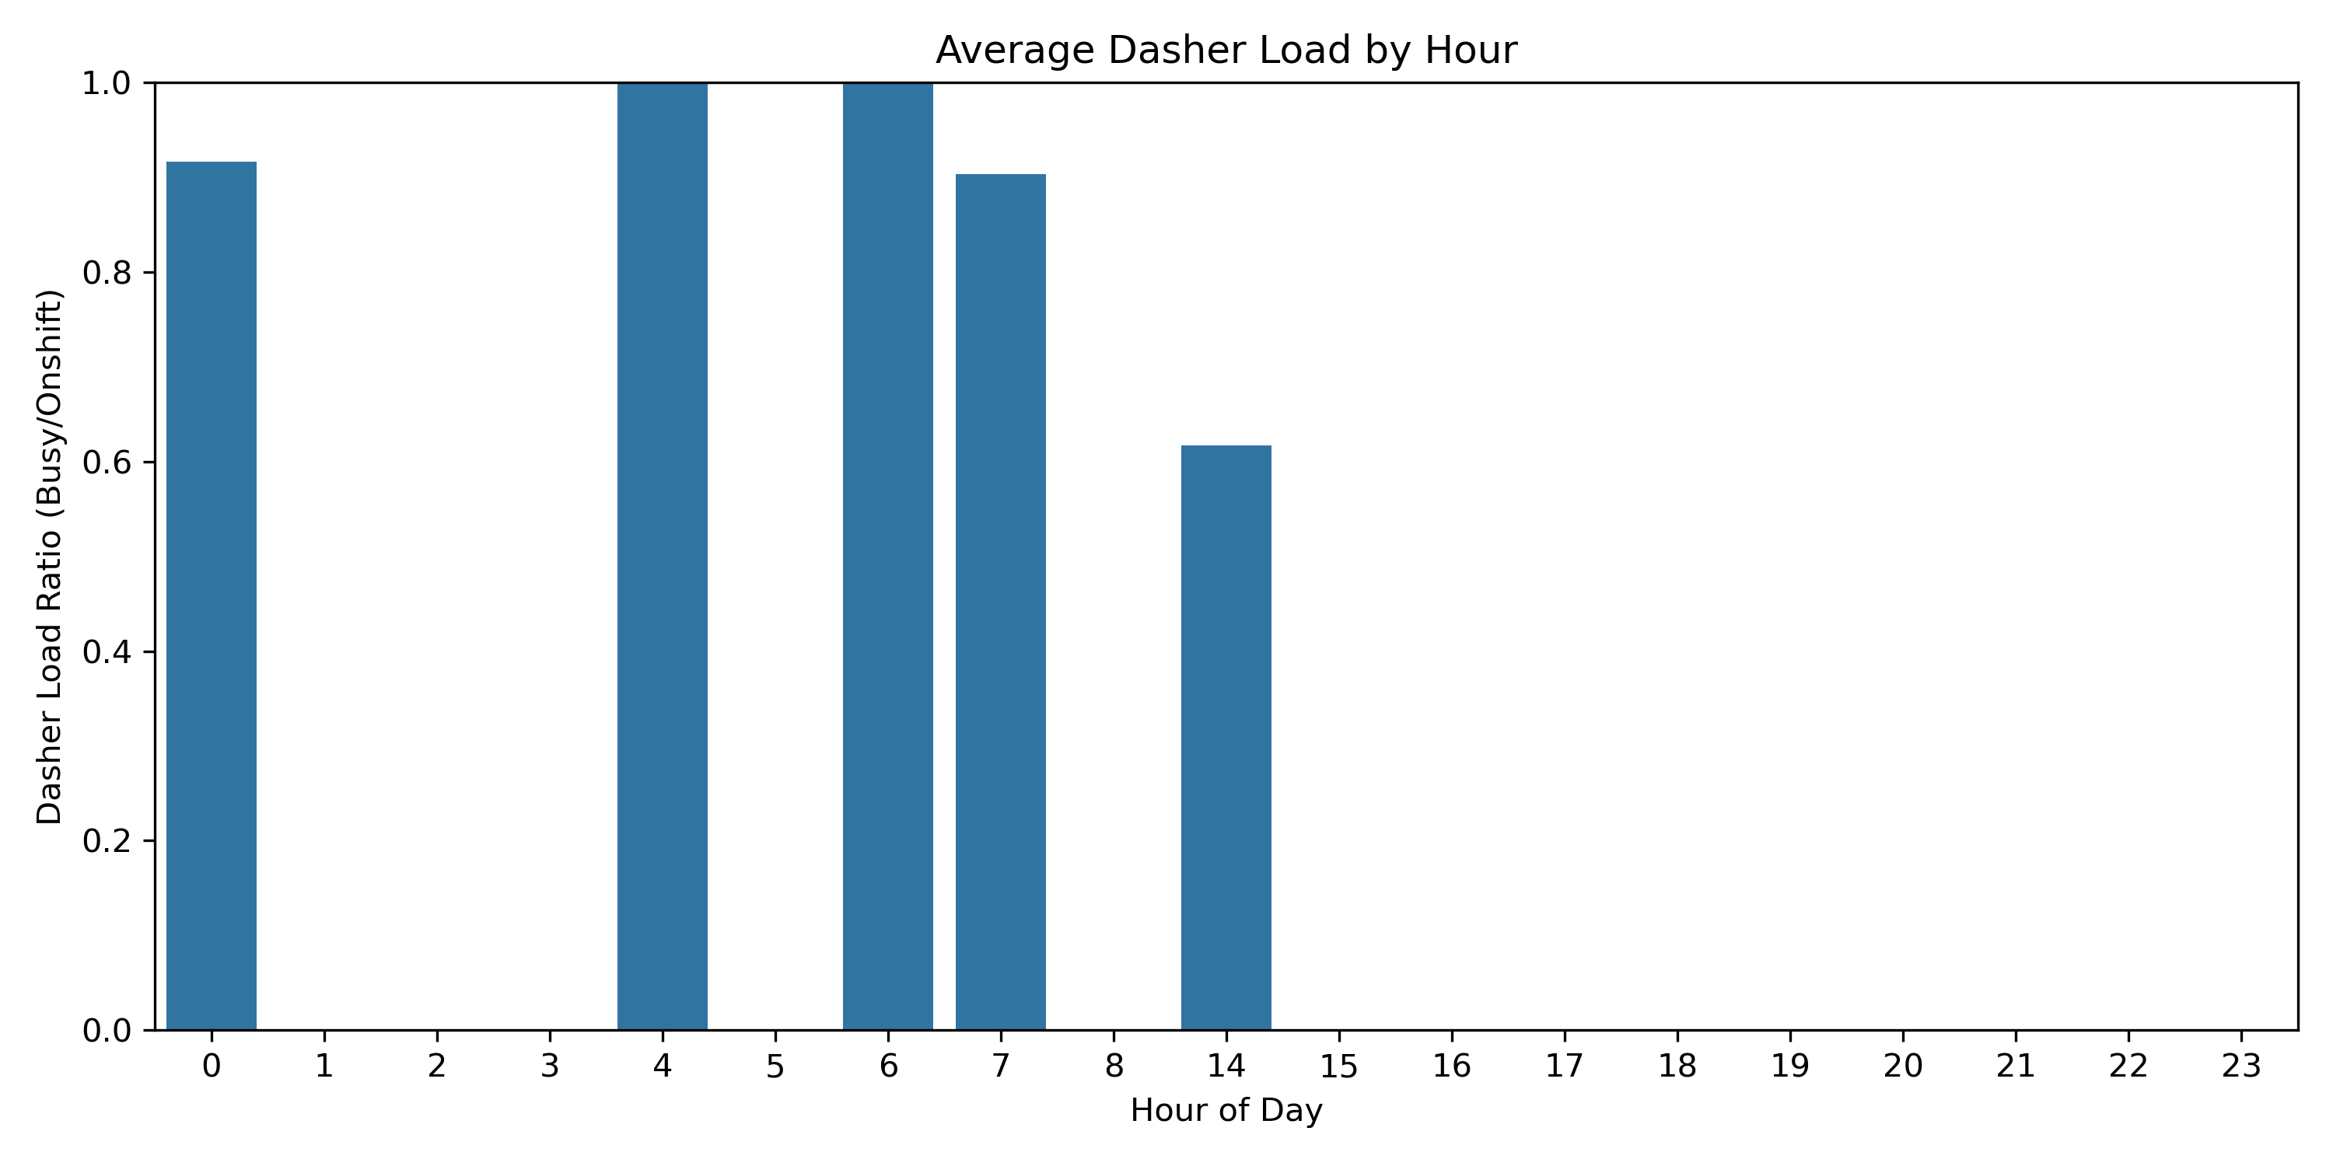
Data Processing – Version 1
Dasher load peaks at specific hours, highlighting the day’s highest-demand periods.

Slide 14
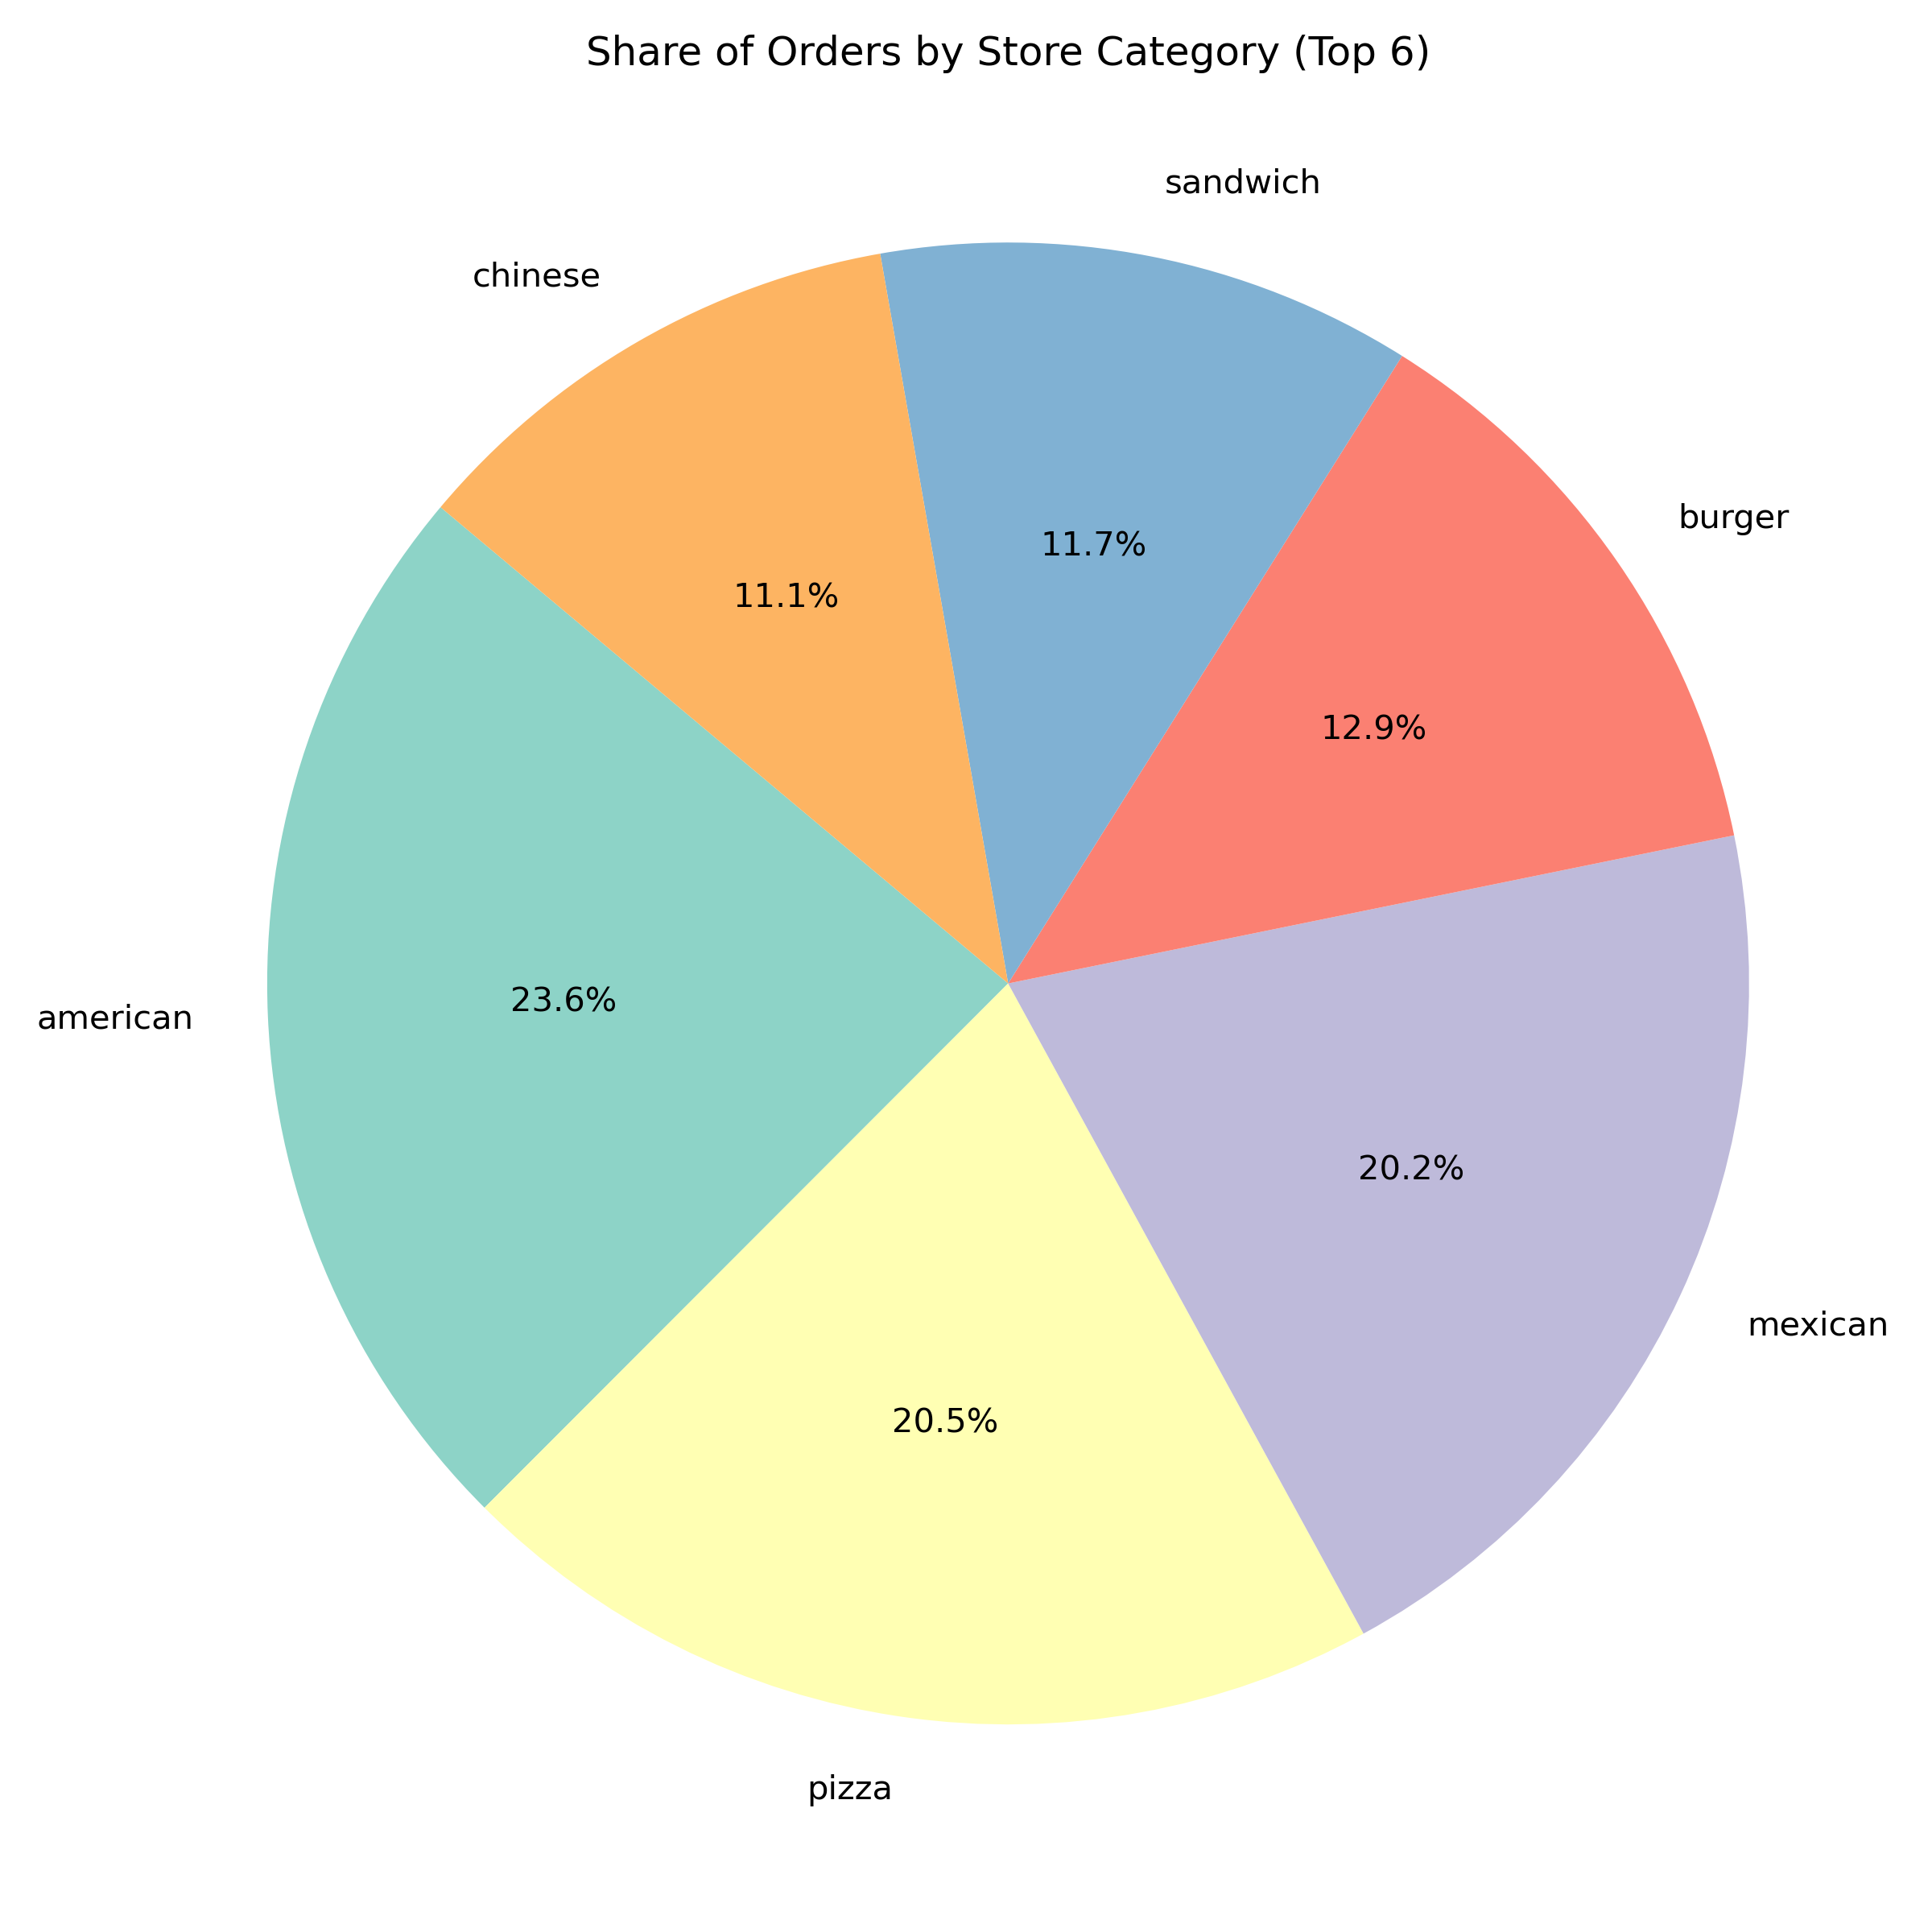
Data Processing – Version 1
American, Pizza, and Mexican together account for over 60% of orders among the top six categories.

Slide 15
Version 1 – Null Value Removal + Encoding
Preprocessing Steps:
Encoding Strategy
Null Value Removal
Target encoding
→ Weakened interpretability and generalization
One Hot encoding
→ Made models (esp. Linear, Ridge) more prone to noise and overfitting
Dropped rows
with missing values
→ Reduced data size
→ Less diversity
→ Potential bias
V1 used:
→ Null Value Removal
→ Encoding
Notes:
Summary of Preprocessing Pitfalls
❌ Dropping data ➝ less training info ➝ weaker model learning
⚠️ Target encoding ➝ overfit & under-generalized categories
➕ More features ≠ better model ➝ added noise instead of signal
You have low-cardinality categorical variables (few unique values) - one hot
You have high-cardinality categorical column - target
Label Encoding introduces false ordinal relationships that hurt model performance

Slide 16
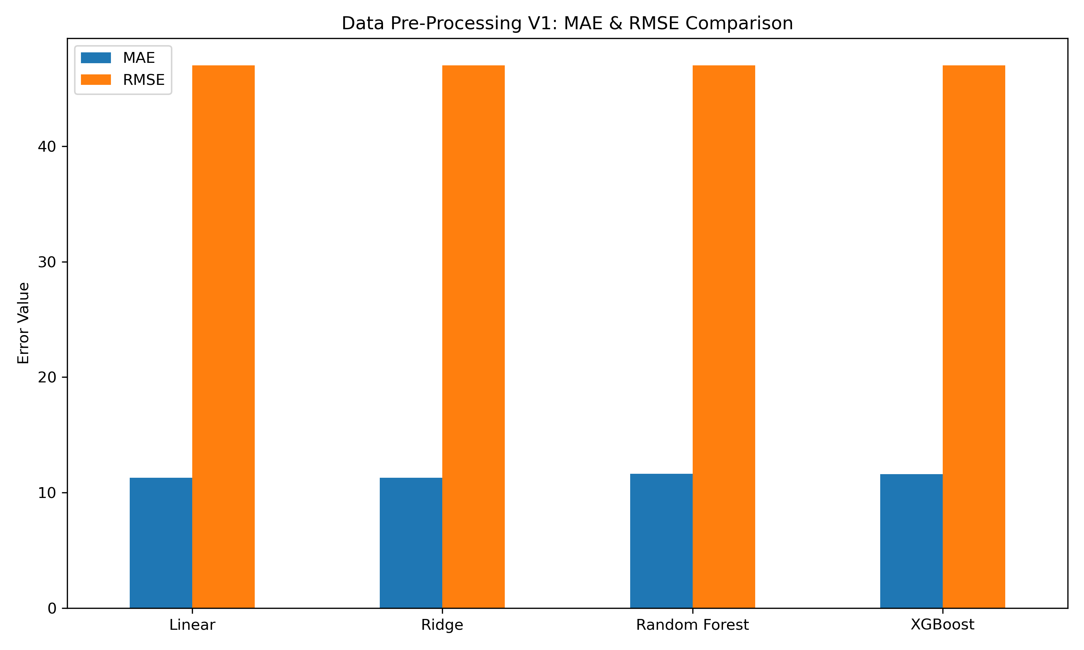
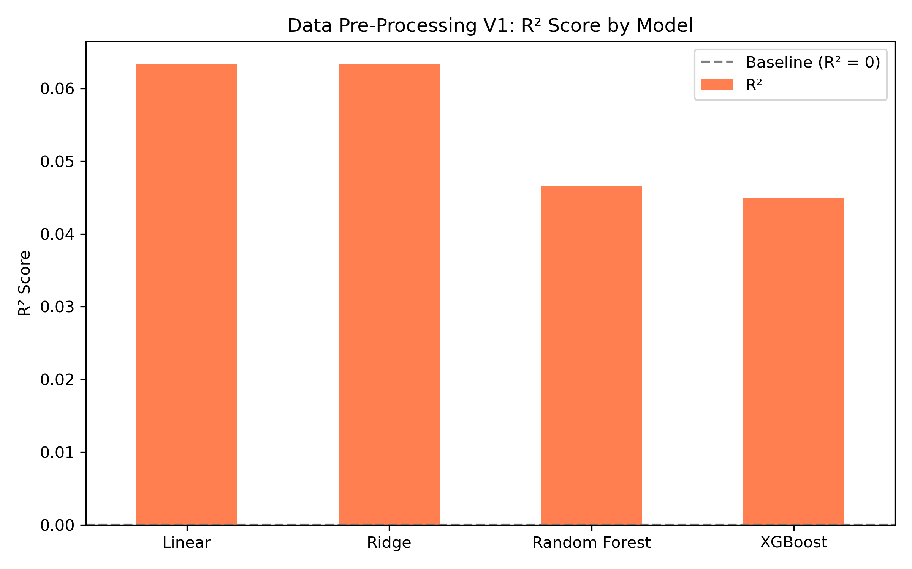
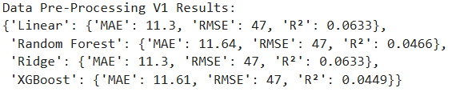
Data Processing – Version 1
Model performance is poor across all approaches, with low R² scores (≤ 0.06) and consistently high RMSE (~47), indicating limited predictive accuracy.

Slide 17
Version 2 – Null Value Removal + Encoding + Outlier Removal
Preprocessing Steps:
Outlier Removal
PCA
Outliers were identified using the Interquartile Range (IQR) method across key numeric features and removed to improve data quality
PCA reduced dimensionality by combining correlated features into fewer components. It retained ~95% of data variance using just 6 components, improving model efficiency and reducing noise while preserving key patterns for delivery time prediction.
V2 used:
→ Null Value Removal
→ Encoding
→ Outlier Removal
→ PCA

Slide 18
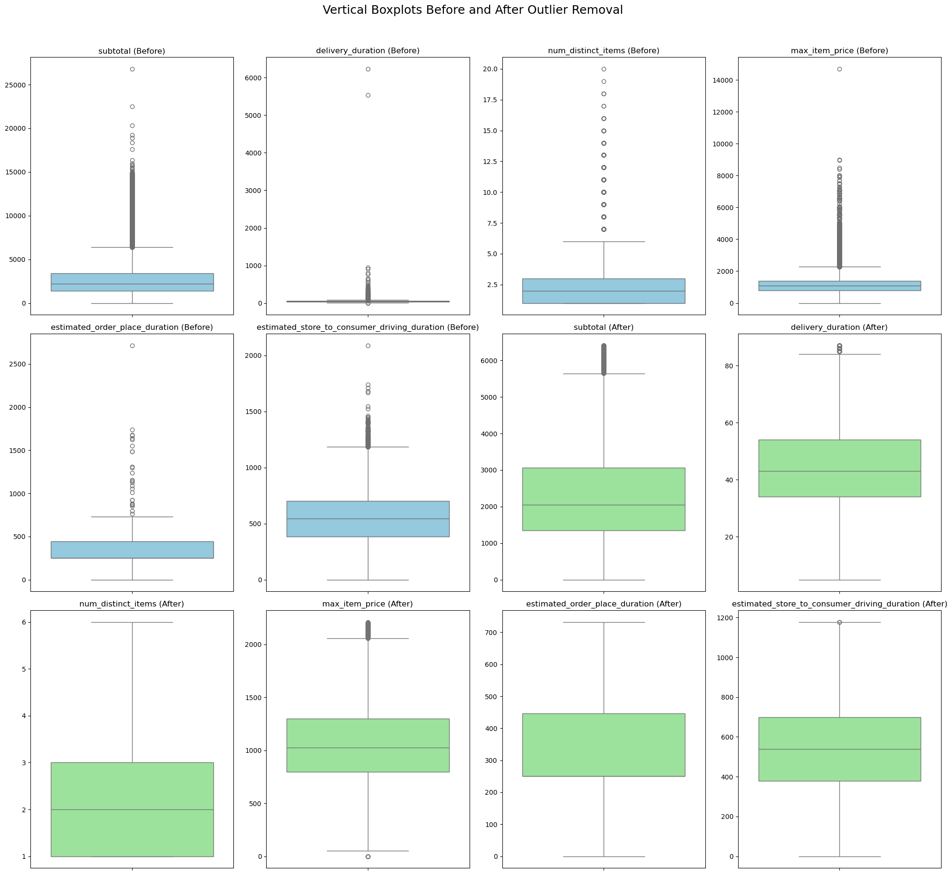
Data Processing – Version 2
Box plots before outlier removal and after outlier removal.

Slide 19
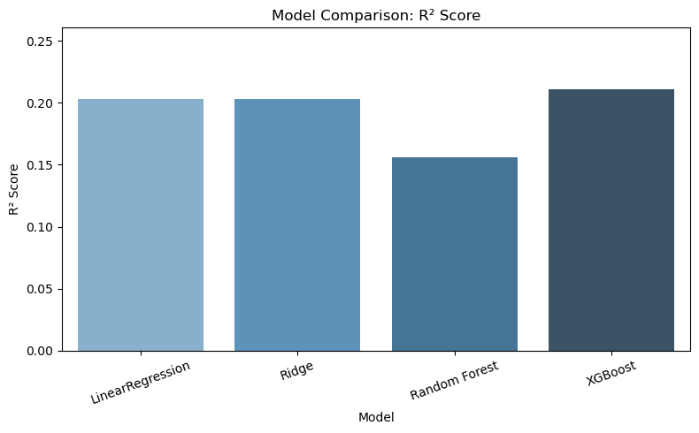
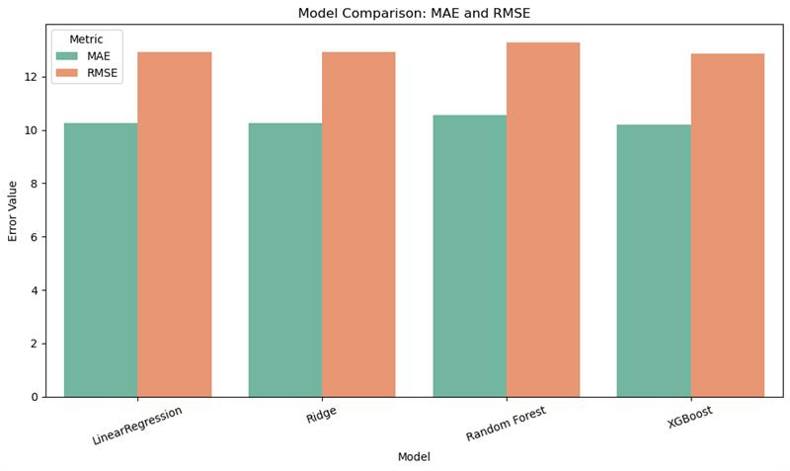

Data Processing – Version 2
Outlier removal significantly improved model performance, for eg. XGBoost showed the most improvement, with R² increasing from 0.0446 to 0.2105, MAE reducing from 11.65 to 10.21, and RMSE dropping from 47 to 12.85.

Slide 20
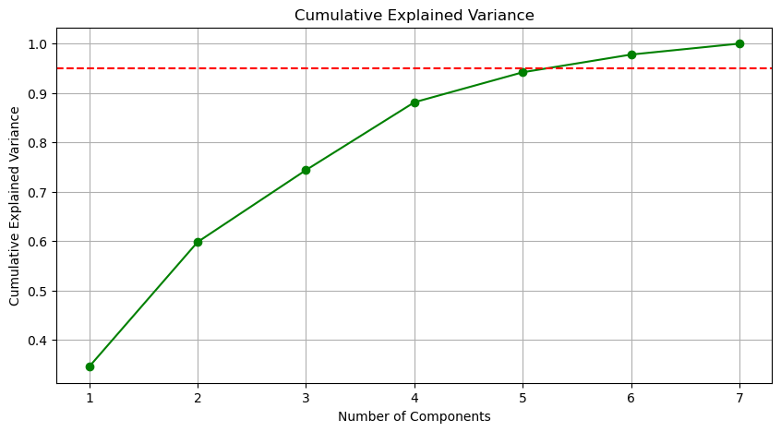
Data Processing – Version 2
About five components capture over 95% of the total variance.
Notes:
The first PC alone captures about 35% of the variance, the first two together about 60%, the first three about 74%, and the first four about 88%—by the fifth component you’ve exceeded 95% cumulative variance, so a 5-dimensional projection retains virtually all the information.

Slide 21
Why PCA and what have we found?
PCA helped us to: 1. Evaluate how much of our data's structure could be captured in fewer dimensions. 2. Test if reducing feature dimensions would impact model performance. What we found: PCA was able to capture 95% of the model's variance in about 5 components but it did not improve the model performance because in our case, the features showed low linear correlation with the target variable and hence could not improve the prediction accuracy.
Notes:
The PCA plot tells us that the directions of greatest variance in the input features don’t align with delivery time—fast and slow orders all overlap in PC1/PC2 space—so just projecting onto those two axes won’t separate deliveries by speed. We’d need other feature transformations or a supervised model to pull out the delivery-time signal.

Slide 22
PCA & Dimensionality Reduction
5 components capture ~95% variance—huge compression!
Helps models train faster and avoid overfitting.
Think of PCA like a treasure map—it shows you the X’s but not always the gold
Notes:
Think of PCA like a treasure map—it shows you the X’s but not always the gold.

Slide 23
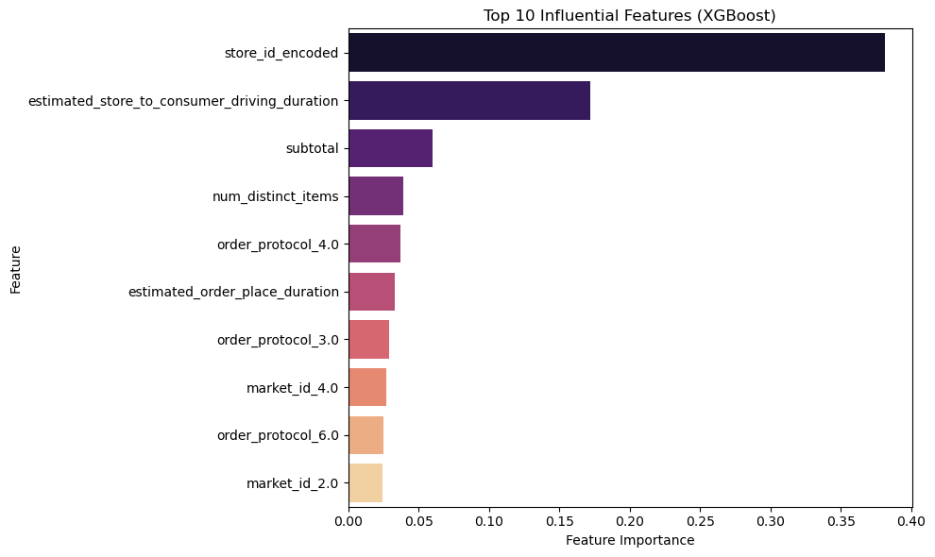
Data Processing – Version 2
XGBoost identified store_id_encoded and estimated_store_to_consumer_driving_duration as the most influential features in predicting delivery time.

Slide 24
Data Processing – Version 3
Filled missing store_primary_category with "Uncategorized" and order_protocol with its mode value.
Imputed missing estimated_store_to_consumer_driving_duration using the median to handle numeric nulls.
Filled missing values in total_onshift_dashers, total_busy_dashers, and total_outstanding_orders using their respective column means to retain data consistency without reducing dataset size.
Engineered new features like price_range, Avg_delivery_time, Delivery_Speed, dashers_per_order, orderPlaced_to_home_location_time and Avg_price to capture order complexity, store-hour efficiency, and pricing patterns that may influence delivery duration.
Notes:
Think of PCA like a treasure map—it shows you the X’s but not always the gold.

Slide 25
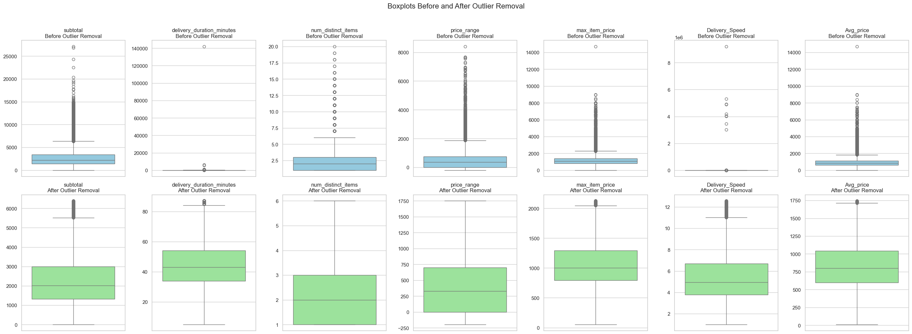
Data Processing – Version 3
Box plots before outlier removal and after outlier removal.

Slide 26
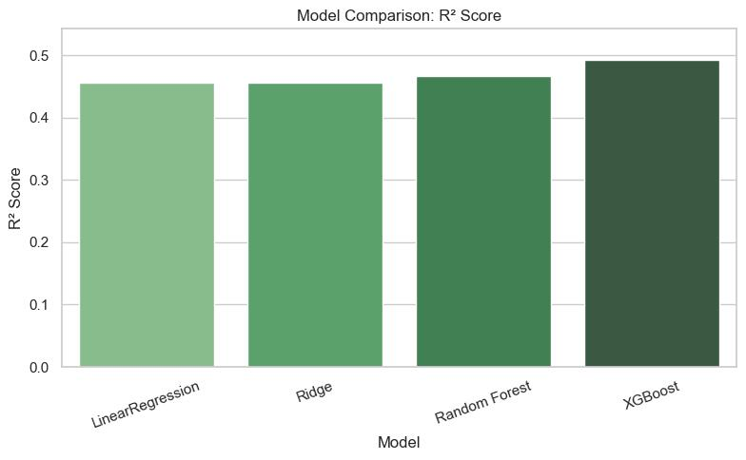
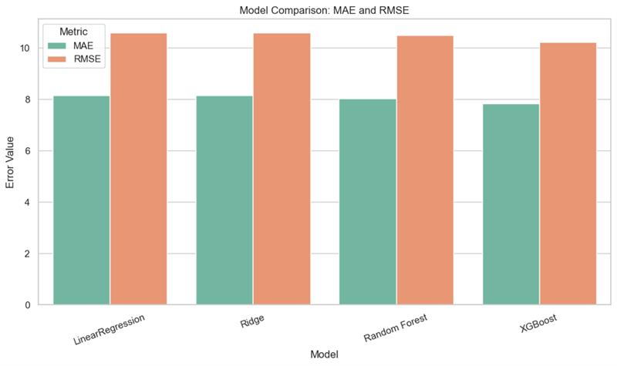

Data Processing – Version 3
Enhanced the data through feature engineering and smarter missing value handling led to substantial model performance gains.
For eg, XGBoost’s R² improved from 0.21 to 0.49, MAE dropped from 10.21 to 7.84, and RMSE decreased from 12.85 to 10.23.

Slide 27
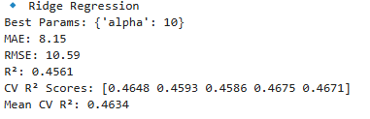
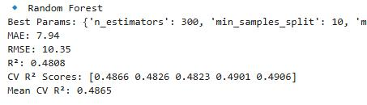
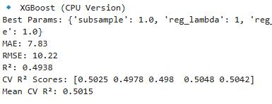
Hyper-parameter tuning
Notes:
The PCA plot tells us that the directions of greatest variance in the input features don’t align with delivery time—fast and slow orders all overlap in PC1/PC2 space—so just projecting onto those two axes won’t separate deliveries by speed. We’d need other feature transformations or a supervised model to pull out the delivery-time signal.

Slide 28
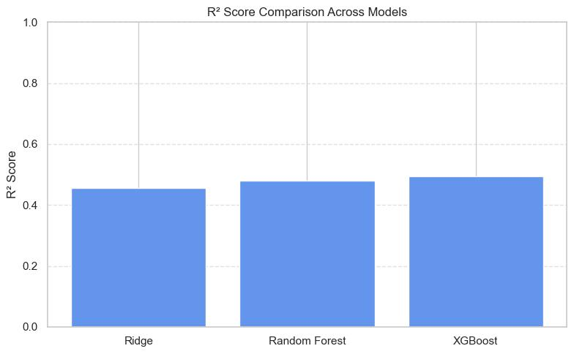
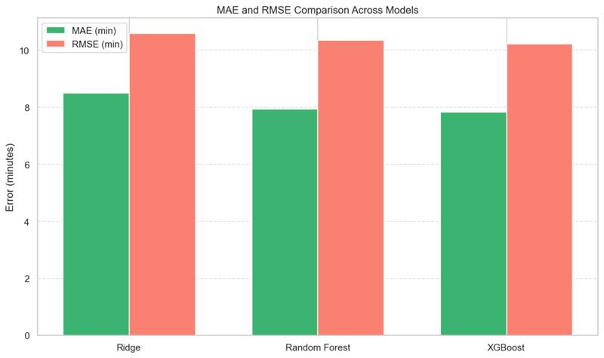
Model Comparison after Hyper-parameter tuning
Hyperparameter tuning led to slight performance gains, particularly improving model stability as seen in cross-validation scores.
For eg, XGBoost’s R² increased marginally from 0.4926 to 0.4938, but its mean CV R² reached 0.5015 — indicating more consistent predictions.
After hyperparameter tuning, XGBoost delivered the best overall performance with the highest test R² (0.4938) and CV R² (0.5015), along with the lowest MAE and RMSE. This indicates XGBoost’s strong generalization ability and superior accuracy in predicting delivery duration.

Slide 29
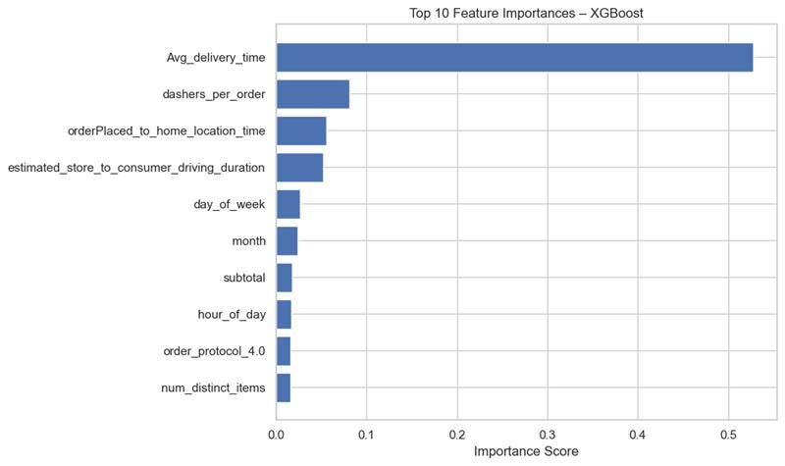
Most Influential Features
Avg_delivery_time emerged as the most correlated feature after hyperparameter tuning in XGBoost. Other features like dashers per order, (However, since this feature is derived from actual time taken, this is to be expected). estimated_store_to_consumer_driving_duration, and orderPlaced_to_home_location_time also played an important role, showing how delivery and distance-related factors affect the timing.

Slide 30
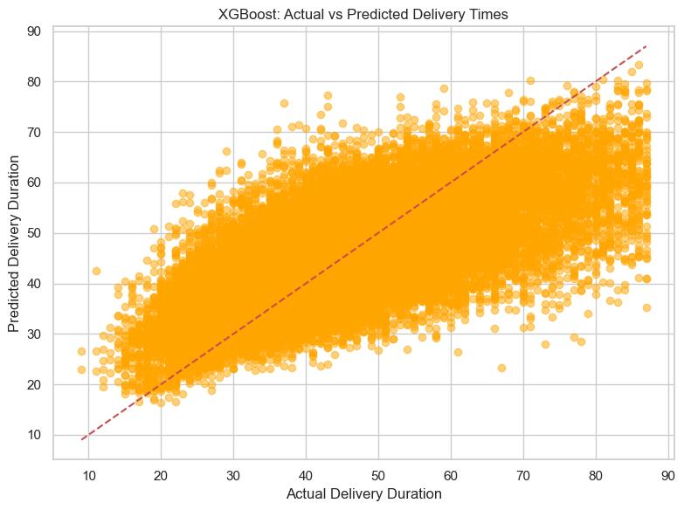
Scatter plot on Actual vs Predicted Delivery Time
This scatterplot shows that XGBoost’s predictions closely match actual delivery times, especially in the mid-range. While there’s more variation for longer deliveries, the model generally performs well with few outliers.

Slide 31
Conclusion
Started with basic models and minimal preprocessing, achieving limited accuracy due to noise, missing data, and uninformative features.
Gradual enhancements — including null value handling, outlier removal, and feature engineering — significantly improved model performance.
XGBoost showed the best results overall, improving from R²: 0.21 to 0.49 and RMSE: 12.85 to 10.23 through smarter data handling and tuning.
The most impactful features identified were Avg_delivery_time, dashers_per_order and orderPlaced_to_home_location_time

Slide 32
Thanks!
Do you have any questions?

