Slide 1
Transitioning to Reactive
Time-Synchronized Systems
An Empirical Review of the Reactor Model vs. Traditional Embedded C
Lingua Franca Community Meeting
28th October 2026
Deepali Banka • School of Electronics Engineering (SENSE), VIT Chennai, India
Prof. Anupam Chattopadhyay • College of Computing and Data Science, NTU, Singapore

Slide 2
LINGUA FRANCA VS. EMBEDDED C REVIEW
Why Transition to Reactive Time-Synchronized Systems?
Distributed Cyber-Physical Systems (CPS) such as autonomous vehicles and smart grids rely entirely on precise coordination between computational logic and real-world time
Distributed software events must synchronize with accurate physical clocks to trigger safe operations
Dual-axis “correctness”
  Numerical accuracy: Logical computations must yield correct, mathematically sound results
  Temporal Precision: Physical output signals must actuate at precise real-world timestamps
What Defines CPS Correctness?
CORRECTNESS = MATH + TIME
Reactive vs. Imperative Paradigms – An NTP Case Study | Slide 2

Slide 3
LINGUA FRANCA VS. EMBEDDED C REVIEW
Traditional Embedded C Lacks Native Constructs for Time and Concurrency
The Imperative Heritage: Embedded C is highly execution-efficient, but its basic execution model is fundamentally sequential and lacks any native concept of time or scheduling
Manual Coordination: Developers are forced to construct low-level synchronization boilerplate to approximate temporal behavior
Cognitive Burden: Programmers must reason about thread safety, deadlock prevention, and clock adjustments concurrently with core business logic
Manual Threading
Concurrency requires spawning raw POSIX threads and manual state tracking, yielding high risk of race conditions
Implicit Temporal Semantics
Timing depends entirely on CPU execution speed, OS delay and manual sleep routines, offering no language-level temporal guarantees
Non-deterministic Jitter
Uncoordinated hardware access and OS-level scheduler decisions inject unpredictable runtime execution delay
Reactive vs. Imperative Paradigms – An NTP Case Study | Slide 3

Slide 4
LINGUA FRANCA VS. EMBEDDED C REVIEW
The Lingua Franca Reactor Model Elevates Time to a First-Class Language Construct
Modular Reactors
Encapsulated State Components
Reactors are independent architectural components containing isolated state, configuration parameters, and ordered reactions
They can easily scale and represent modular execution units
Atomic Reactions
Discrete Event Handlers
Atomic procedures triggered by discrete occurrences (actions, timers, or ports)
Multiple reactions within a reactor are executed in a deterministic order managed entirely by the coordination runtime
Logical Actions
Explicit Timing Guarantees
Event triggers scheduled at precise logical time interval
Ensure strict causality, allowing predictable timing and repeatability that is entirely absent in standard imperative languages
Reactive vs. Imperative Paradigms – An NTP Case Study | Slide 4

Slide 5
LINGUA FRANCA VS. EMBEDDED C REVIEW
The Network Time Protocol Case Study
NTP is the standard protocol for synchronizing clocks across distributed networks to a single reference source by exchanging packets to measure network transit delays and clock skew
NTP Canonical Testbed: NTP evaluates clock synchronization accuracy via timestamp exchange
  Requires exchanging packets to measure transit delays and clock skew between the client and the server
Four Time-Critical Points: Transitions are captured sequentially
  T₁: Request departure from the Client
  T₂: Request arrival at the Server
  T₃: Response departure from the Server
  T₄: Response received at the Client
Mathematical Offset Calculation
Offset = [ (T₂ - T₁) + (T₃ - T₄) ] / 2
Mathematical offset represents Client Skew assuming path symmetry
Reactive vs. Imperative Paradigms – An NTP Case Study | Slide 5

Slide 6
LINGUA FRANCA VS. EMBEDDED C REVIEW
A Taxonomy of Network Time Synchronization
Simple NTP (SNTP)
Protocol: Stateless Client Polling
Precision: 10 to 100+ milliseconds
Omits NTP's complex clock discipline and drift-filtering loops; operates via stateless unicast request-response transactions
Best for low-resource IoT nodes, edge microcontrollers, and systems with relaxed timing requirements
Standard NTPv4
Protocol: Stateful Clock Filtering
Precision: 1 to 10 milliseconds
Implements full stateful skew estimation, active jitter filtering, offset math, and clock-discipline loops to steer local time
Standard for enterprise database servers, cloud infrastructure, and network-wide general timing synchronization
Precision Time Protocol
Protocol: Hardware Timestamping
Precision: Sub-microsecond range
Captures timestamps directly at the physical network interface layer, bypassing OS scheduling layers and CPU-induced jitter
Critical for safety-critical distributed CPS, smart grid protection, autonomous vehicle clusters, and real-time robotics
Reactive vs. Imperative Paradigms – An NTP Case Study | Slide 6

Slide 7
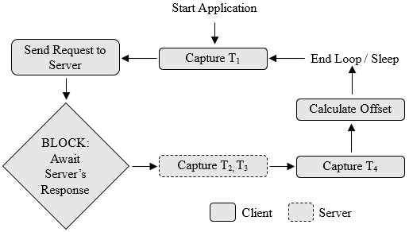
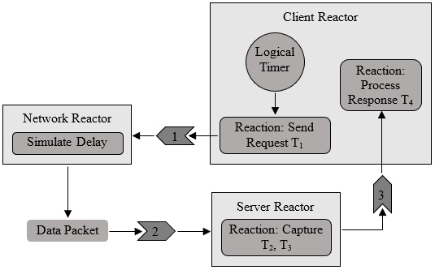
LINGUA FRANCA VS. EMBEDDED C REVIEW
LF Replaces C's Sequential Blocking Threads with Event-Driven Reactive Flow
Embedded C: Blocking Sequence
Linear Thread Execution: The program executes a strictly linear, blocking timeline
In-Line Waiting: After capturing T₁ and sending the socket packet, the main execution idles (blocks) for the network response
Thread Hanging Risks: If an issue occurs, the execution stalls indefinitely unless manual socket timeouts are implemented
Lingua Franca: Reactive Event Graph
Event-Driven Paradigm: System functions execute in a non-blocking reactive environment
Immediate Control Yielding: The Client reactor records T₁, fires the output port, and immediately yields execution control to the scheduler
On-Demand Reactivation: The client reactivates if and only if a response lands on its input port, keeping CPU resources highly optimized and safe
Reactive vs. Imperative Paradigms – An NTP Case Study | Slide 7

Slide 8
LINGUA FRANCA VS. EMBEDDED C REVIEW
Tight Monolithic Coupling in C Gives Way to Loose Modular Port Coupling in LF
C Execution Logic: Built on synchronous, sequential procedures where timing is implicit
Monolithic Structure: Application algorithms, network socket handlers, and physical clock readings are tightly intertwined in a single monolithic code segment
Manual Concurrency: C is single-threaded by default; executing parallel activities requires integrating threading libraries manually, exposing the code to race hazards
LF Coordination Logic: Event-driven reactive coordination based on logical time segments
Modular Port Isolation: Independent reactors communicate strictly through typed, time-stamped ports isolating internal behavior from timing logic
Automated Concurrency: LF runtime automatically analyses dependency graphs to safely execute independent reactions in parallel, freeing up the programmer to focus on logic
Reactive vs. Imperative Paradigms – An NTP Case Study | Slide 8

Slide 9
LINGUA FRANCA VS. EMBEDDED C REVIEW
LF Shifts Robustness From a Programming Skill to a Structural Guarantee
Scenario | Embedded C (Imperative Model) | Lingua Franca (Reactive Model)
Network Timeout | System Block – Thread hangs indefinitely, manual timeouts should be implemented | Deterministic Timeout – A timeout reaction is registered and triggered natively by the runtime
Component Crash | System Failure – Monolithic flow instantly freezes the entire application | Fault Containment – Errors are strictly isolated within reactor boundaries, allowing rest of the system to function
Timing Violation | Silent Error – Delays and jitters are silently incorporated into the clock offset calculation | Logical Consistency – Scheduler manages the lags deterministically using logical runtime semantics
Error Recovery | Manual and Fragile – Requires complex, manual state resetting and thread-safety variables | Structured and Clean – Reinvocation follows native event ordering and execution semantics consistently
Debugging | Non-Deterministic – Hard to trace race conditions | Deterministic – Allows repeatable execution traces
Reactive vs. Imperative Paradigms – An NTP Case Study | Slide 9

Slide 10
LINGUA FRANCA VS. EMBEDDED C REVIEW
Event Execution Ordered by Logical Timestamps Avoids OS-Induced Jitter in LF
C Timing Semantics: Governed strictly by physical real-time execution speeds
Vulnerability to OS Jitter: The execution is entirely dependent on the operating system scheduler, any scheduling interruptions are silently baked into the NTP timestamps
Unverifiable Clock Calculations: Cumulative physical timing variations propagate into the offset calculations, leaving the system without formal mathematical guarantee
LF Timing Semantics: Governed strictly by explicit, coordinated logical timestamps
Causality Enforcement: Reactions are processed in a repeatable, coordinated event queue, which guarantees that effects never precede causes in logical time
Verifiable Execution Traces: Coordinated logical timestamps guarantee perfectly repeatable scheduling, enabling formal verification of synchronization logic
Reactive vs. Imperative Paradigms – An NTP Case Study | Slide 10

Slide 11
LINGUA FRANCA VS. EMBEDDED C REVIEW
LF Offloads Massive Coordination Infrastructure to the Compiler
Metric | Embedded C | Lingua Franca
Programmer Written Logic | ~180 LoC | ~156 LoC
Coordination Infrastructure | ~8,000 LoC (Manual) | Native / Automated
Total System Footprint | ~180 LoC | ~20,000 LoC
Cyclomatic Complexity | High (Nested Logic) | Low (Flat Reactions)
Manual Effort | High (Infrastructure + Logic) | Low (Logic only)
Human vs. Machine Burden: C leaves complex synchronization, event ordering, and safety checks to the manual programming skill of the developer
The Infrastructure Gap: Replicating LF's deterministic safety in Embedded C requires writing ~8,000 lines of manual scheduling and event management code
Automated Guarantees: LF compiler automatically generates ~20,000 lines of robust coordination runtime to support multi-reactor concurrency and causality guards natively
Reactive vs. Imperative Paradigms – An NTP Case Study | Slide 11

Slide 12
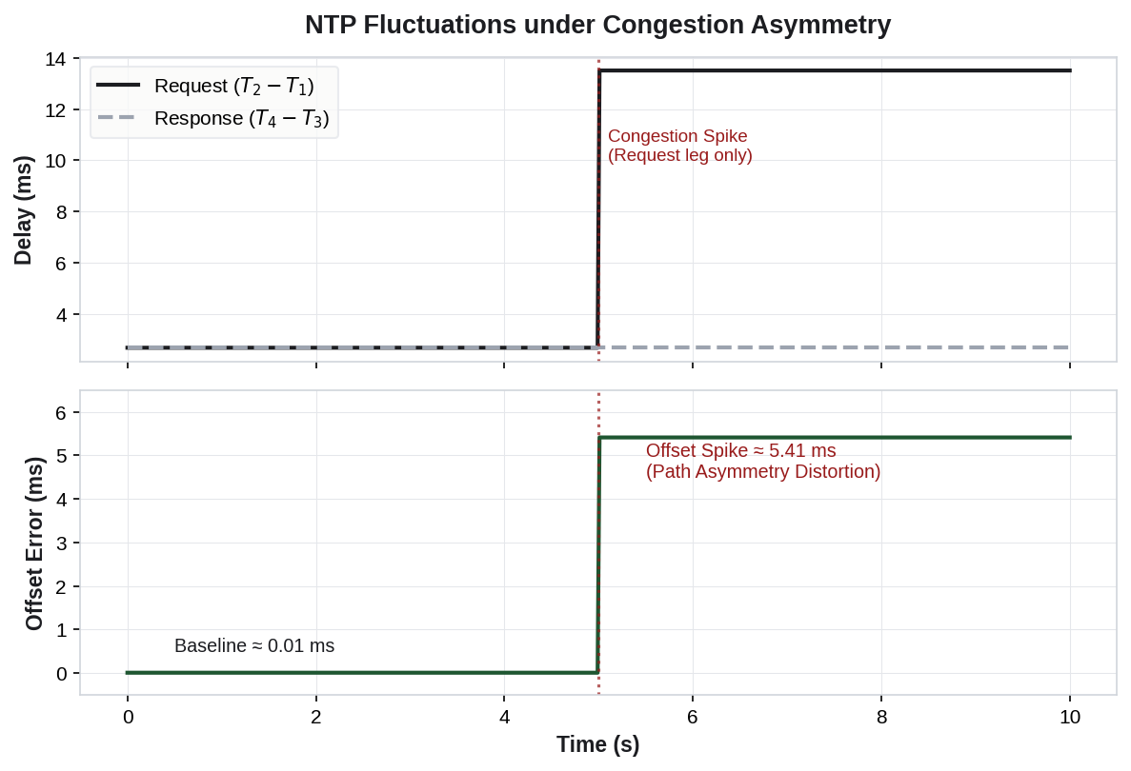
LINGUA FRANCA VS. EMBEDDED C REVIEW
Network Variability due to Path Asymmetry Distorts NTP Math
LF Preserves System Stability
Introducing dynamic congestion spike
  Delays jump on the forward leg from 2.7 ms to 13.5 ms, resulting in a 10.8 ms asymmetry
  Degrades calculated clock offset by 5.41 ms
  A mathematical artifact of path asymmetry, not the real physical clock drift
Contrasting Resilience
  Embedded C requires manual low-level socket timeouts and non-blocking I/O routines to prevent execution freeze
  LF scheduler absorbs the spike natively in its logical event queue automatically preserving application stability
Reactive vs. Imperative Paradigms – An NTP Case Study | Slide 12

Slide 13
LINGUA FRANCA VS. EMBEDDED C REVIEW
Network Variability due to Network and Topology Variations
LF Handles Out-of-Order Packets Safely
Multi-hop routing configurations and server topology variations lead to fluctuating arrival windows and out-of-order packet delivery
Metric | Imperative Embedded C | Reactive LF
Out-of-Order Transparency | Prone to "data races" and variable overwrites | Maintained natively via logical timestamps
Concurrency Infrastructure | Requires explicit low-level primitives (pthread_mutex) | Automated on-demand stream mapping to ports
Race Condition Guard | Demands manual, complex non-blocking buffers | Encapsulated isolated state inside reactors
Thread Synchronization | High risk of thread jams and race conditions | Zero manual structural adjustments needed
Reactive vs. Imperative Paradigms – An NTP Case Study | Slide 13

Slide 14
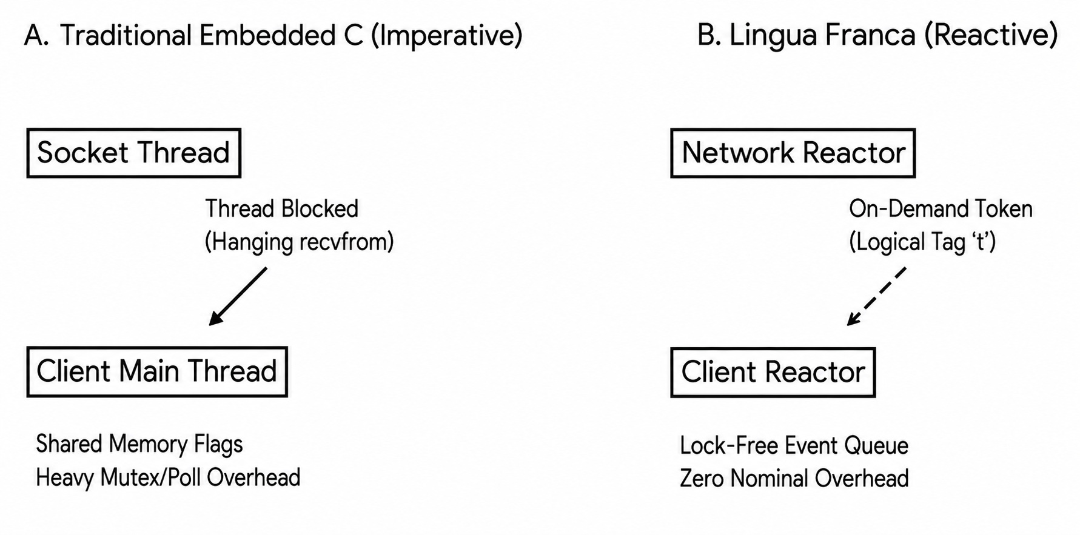
LINGUA FRANCA VS. EMBEDDED C REVIEW
Network Variability due to Partial Network Failure
LF Allows Executing Error Recovery Routines On-Demand
Simulating a stochastic 15% packet drop challenged both client recovery and temporal stability
Execution vulnerability in C
  Silent packet drops trap C threads indefinitely within blocking socket reads (recvfrom)
  Preventing freezes and signalling errors across threads requires low-level non-blocking polling loops and heavy mutexes, which injects severe scheduling jitter
Dynamic lock-free recovery in LF
  Network reactor emits a timestamped failure token only when a drop occurs triggering client’s error recovery reaction
  On-demand execution of lock-free recovery routine ensures zero runtime overhead during nominal operation
Reactive vs. Imperative Paradigms – An NTP Case Study | Slide 14

Slide 15
LINGUA FRANCA VS. EMBEDDED C REVIEW
Embedded C Minimizes Resource Footprint, LF Ensures Temporal Determinism
Dimension | Embedded C – Imperative Paradigm | Lingua Franca – Reactive Paradigm
Core Strengths | Guarantees minimal resource utilization, low memory footprint and direct hardware control, making it ideal for bare-metal IoT microcontrollers | Guarantees strict temporal determinism via formal time semantics, native non-blocking concurrency, ensuring safe abstraction
Core Weaknesses | Extremely difficult to formally verify concurrency or timing safety; highly prone to date races and non-deterministic OS delays | Requires a higher runtime execution abstraction layer; currently less suited for deeply resource-constrained microcontrollers
Scalability | Adding complex features forces manual synchronization updates, drastically escalating development and verification costs | Scales seamlessly by adding modular reactors and ports; the coordination runtime automatically manages the scheduling graph
Reactive vs. Imperative Paradigms – An NTP Case Study | Slide 15

Slide 16
LINGUA FRANCA VS. EMBEDDED C REVIEW
Future Work – Validate Across Distributed Clusters and Hardware-Level PTP Synchronization
Core Achievement
Translating Abstraction to Resilience
Lingua Franca effectively reduces software engineering overhead by pushing coordination responsibilities down to the architecture
Developer primarily reasons about ”what reacts to what”
Our empirical tests validate that the LF abstraction directly translates to operational resilience
Future Research
Moving to Multi-Node Hardware
While current experiments validate timing precision in simulated network environments, the executions ran on a single physical host
Future work will deploy the system across physical hardware clusters (e.g., Raspberry Pi single-board computers connected over Ethernet)
Hardware-Level Sync
Integrating IEEE 1588 PTP
Decentralized nodes introduce physical hardware clock drift over time
Resolving such clock drifts will require integrating hardware-level precision clock synchronization (IEEE 1588 PTP) to supplement LF's software-level scheduling loop
Reactive vs. Imperative Paradigms – An NTP Case Study | Slide 16

Slide 17
Q&A

Slide 18
LINGUA FRANCA VS. EMBEDDED C REVIEW
Appendix – My Lingua Franca GitHub
https://github.com/deepalib1710/Lingua-Franca
Challenges faced in setting up the Lingua Franca environment
Reported bug(s)
  Special thanks to the Lingua Franca team for their diligent fixes and patches
Code
Reactive vs. Imperative Paradigms – An NTP Case Study | Slide 18

Slide 19
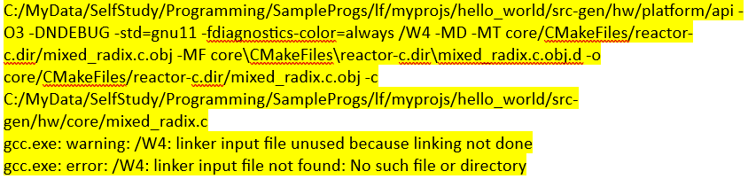
LINGUA FRANCA VS. EMBEDDED C REVIEW
Appendix – Failed First Build
Started with LF extension in Visual Studio Code on Windows
First build failed for all the 3 targets – C, C++, Python
  Issue due to gcc setup which used 32-bit MinGW, resulting in mismatch between 64-bit and 32-bit dependencies
  64-bit MinGW fixed the C++ target, still had issues with C and Python targets
gcc interpreted /W4 as a input file rather than a compiler warning level flag
  /W4 is used with Microsoft’s Visual C++ compiler (cl.exe) to set the warning level to 4
  gcc uses -Wall, -Wextra, or similar flags to control warning levels
Reactive vs. Imperative Paradigms – An NTP Case Study | Slide 19

Slide 20
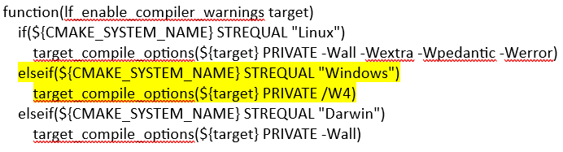
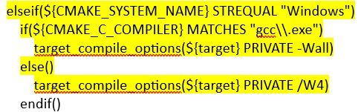
LINGUA FRANCA VS. EMBEDDED C REVIEW
Appendix – Debugging the Root-Cause
“lf_utils.cmake” defines lf_enable_compiler_warnings
Manually replaced "/W4" with "-Wall" in "build.ninja“, and reran only the failing cmake command from the failure log
  cmake --build . --target install --parallel 8 --config Debug
Recommended patch in “lf_utils.cmake”
Python target still had issues on Windows; eventually switched to LF on Linux
Reactive vs. Imperative Paradigms – An NTP Case Study | Slide 20

