Slide 1
CFI
Style Guide

Slide 2

Target Device: Width: 750px ; Height: 1334px
Bg-color: #ffffff
Bg-color: #d95d31
Bg-color: #232f3e
Font-family: Roboto Bold;
Font-size: 32px;
Color: #ffffff
Font-family: Roboto Regular;
Font-size: 22px;
Color: #ffffff
Font-family: Roboto Regular;
Font-size: 28px;
Color: #e3a81c
Font-family: Roboto Bold;
Font-size: 30px;
Color: #000000;
Bg-color: #FFFFFF;
Font-family: Roboto Regular;
Font-size: 24px;
Color: #767676
Bg-color: #dcdcdc
Font-family: Roboto Regular;
Font-size: 30px;
Color: #e3a81c
Font-family: Roboto Regular;
Font-size: 30px;
Color: #767676;
Font-family: Roboto Bold;
Font-size: 30px;
Color: #767676
Font-family: Roboto Medium;
Font-size: 72px;
Color: #e3a81c;
Font-family: Roboto Regular;
Font-size: 30px;
Color: #000000;
Font-family: Roboto Regular;
Font-size: 30px;
Color: #767676;
Bg-color: #e3a81c; Font-family: Roboto Medium; Font-size: 30px; color: #FFFFFF;

Slide 3
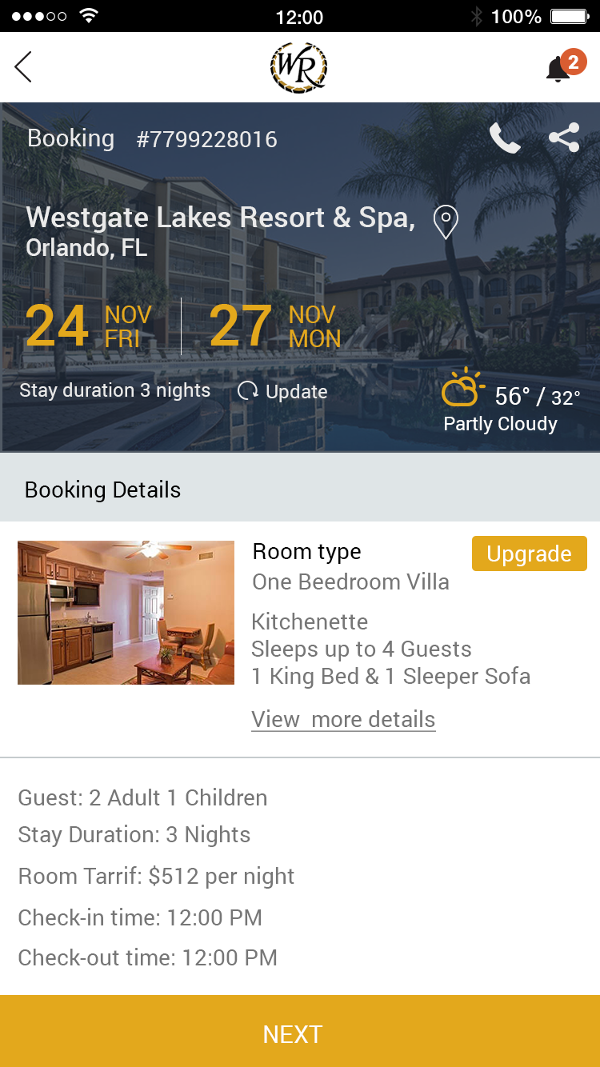
Target Device: Width: 750px ; Height: 1334px
Bg-color: #ffffff
Font-family: Roboto Regular;
Font-size: 30px;
Color: #eaeaea
Bg-color: #d95d31
Font-family: Roboto Regular;
Font-size: 30px;
Color: # eaeaea
Font-family: Roboto Medium;
Font-size: 36px;
Color: #eaeaea
Font-family: Roboto Regular;
Font-size: 30px;
Color: #e3a81c;
Font-family: Roboto Medium;
Font-size: 72px;
Color: # e3a81c
Font-family: Roboto Regular;
Font-size: 30px; Font-size: 24px;
Color: # eaeaea;
Font-family: Roboto Regular;
Font-size: 28px;
Color: #000000;
Bg-color: #dfe5e7;
Font-family: Roboto Regular;
Font-size: 24px;
Color: # eaeaea;
Bg-color: #e3a81c;
Font-family: Roboto Regular
Color: #FFFFFF;
Font-size: 28px
Font-family: Roboto Regular
Color: #000000;
Font-size:28px;
Bg-color: # dcdcdc;
Font-family: Roboto Medium;
Font-size: 28px;
Color: #e3a81c;
Font-family: Roboto Regular;
Font-size: 28px;
Color: #767676
Bg-color: #e3a81c;
Font-family: Roboto Medium;
Font-size: 30px; color: #FFFFFF;

