Slide 1
Data Scientist Job Scene In India
Capstone Project by Deepali Bhatt
12th November 2016

Slide 2
Overview & Road Map
The Data Science Pipeline:
The Problem/Question
Data Wrangling
Exploratory Analysis
Text Analysis
Data Visualisation

Slide 3
The Problem- Introduction
From hundreds of job sites in India posting thousands of job posting for data scientist roles:
“Where does a friend relocate to in India to increase its chances of getting “Data Scientist” job and not get confused by so many choices?”
In particular interested in knowing :
Which states in India have the highest density of “Data Scientist” jobs?
Which cities in India have the highest density of “Data Scientist” jobs?
Which companies/consultants in India are hiring the most for the “Data Scientist” jobs?
What non-technical skills are required mostly for the “Data Scientist” jobs?
What technical skills are required mostly for the “Data Scientist” jobs?

Slide 4
Data Overview
The data set has 10 variables and has over 1200 search results. The data description is as follows:
Serial Number | Variable Name | Variable Description | Value Stored | Variable Type
1 | Row Number | Unique Row Number | Unique value identifying the row | Identifier
2 | Job Title | Name of the job role | 1-1104 | Categorical (qualitative variable)
3 | Company | Company offering the job role | 1-1104 | Categorical (qualitative variable)
4 | State | State in which company is located | 1-1104 | Categorical (qualitative variable)
5 | City | City in which company is located | 1-1104 | Categorical (qualitative variable)
6 | Country | India in which company is located | 1-1104 | Categorical (qualitative variable)
7 | Formatted Location | Containing city and respective state in one cell | 1-1104 | Categorical (qualitative variable)
8 | Source | Source through which, job role is extracted on the web | 1-1104 | Categorical (qualitative variable)
9 | Date | Date the job role was posted | 1-1104 | Categorical (qualitative variable)
10 | Snippet | Brief truncated description of the job role | 1-1104 | Categorical (qualitative variable)
11 | Expired | Date when the job posting expires | True, False | Categorical (binary)
12 | Python | Unique character identified as a technical skill extracted from snippet column | True, False | Categorical (binary)
13 | Machine | Unique character identified as a technical skill extracted from snippet column | True, False | Categorical (binary)
14 | Sql | Unique character identified as a technical skill extracted from snippet column | True, False | Categorical (binary)

Slide 5
Data Preparation
Open API research
Data extraction using following techniques:
- Customizing various parameters of the XML URL string to match Indeed India’s website
- Experiment by using "xmlTreeParse" which gave “Null” results and then using “xmlToDataframe“ to convert XML file into data frame.
- Fixing the above problem by using “getNodetSet" and renaming them as a column.
Creating a ‘While’ loop which would stop at 48 to extract all 1197 results as one page could accommodate only 25 results.
Dividing updated XML string into various string for “While” loop to extract all job results and combining the strings.

Slide 6
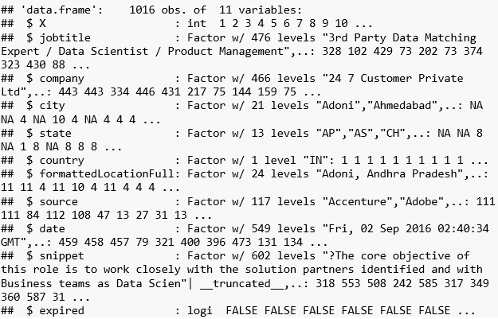
Methodology
First Step: Data Import
The XMl file is parsed and a csv file “indeedfile” is created. The structure of the indeedfile csv is below:

Slide 7
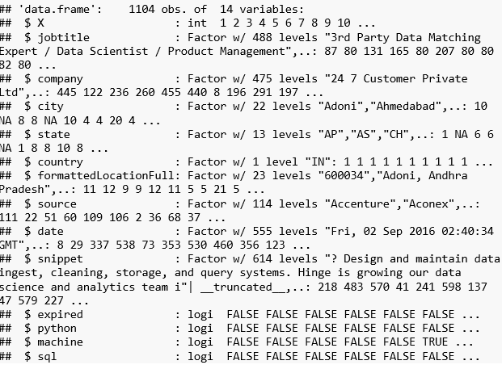
Methodology
Second Step: Data Preparation
Look for companies that have the three top skills "Python", "machine learning", "SQL". Used “If else” function and the logic of TRUE if the respective skills were found otherwise put FALSE and create separate columns with respective logical answer. Then these three columns were merged with the existing data file. The new structure is as follows:

Slide 8
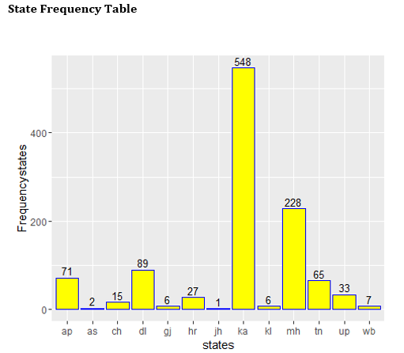
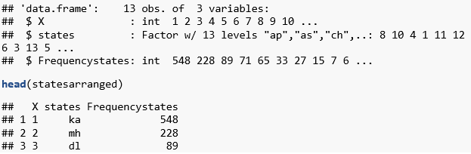

Data Wrangling
Which states in India are hiring for data scientist roles?
Extracted “states” column from the indeed data frame.
Identified unique values.
Found the frequency of unique value. Structure as follows:
Using ggplot2 made a bar plot using geom_bar, geom_text, theme.

Slide 9
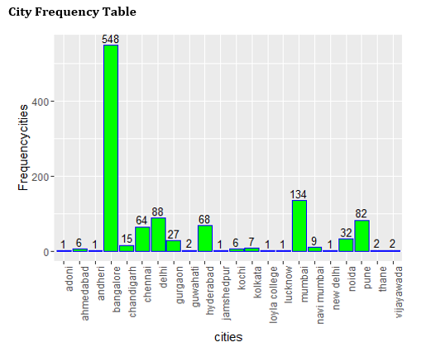
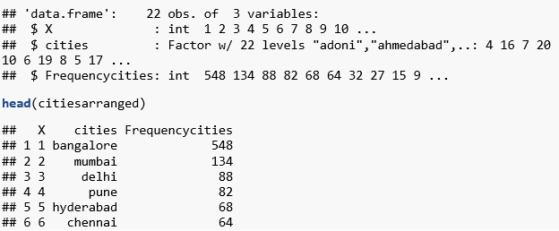
Data Wrangling
Which cities in India are hiring for data scientist roles?
Extracted “cities” column from the indeed data frame.
Identified unique values.
Found the frequency of unique value. Structure as follows:
Using ggplot2 made a bar plot using geom_bar, geom_text, theme.

Slide 10
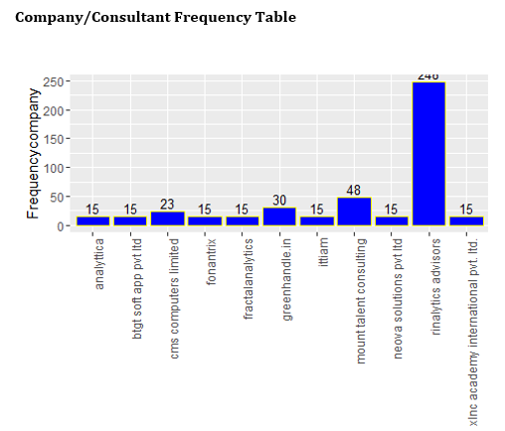
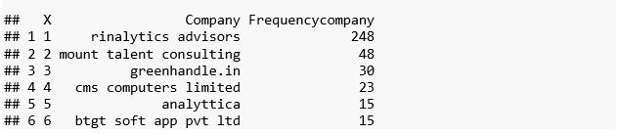
Data Wrangling
Which companies/consultants are hiring for data scientist roles?
Extracted “cities” column from the indeed data frame.
Identified unique values.
Found the frequency of unique value. Structure as follows:
Using ggplot2 made a bar plot using geom_bar, geom_text, theme.

Slide 11
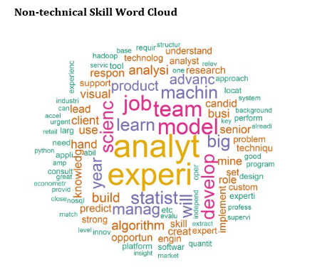
Data Exploration- Text Analysis
What non-technical skills are required for data scientist job?
Extracted “snippet” column from the indeed data frame.
Data processing involved removing punctuation; using stop words and adding general use terms in ‘snippet’ column e.g. "scienti","work", "are", "looking“.
Used ‘bag of words’ approach to turn text into numeric.
Generated word cloud.

Slide 12
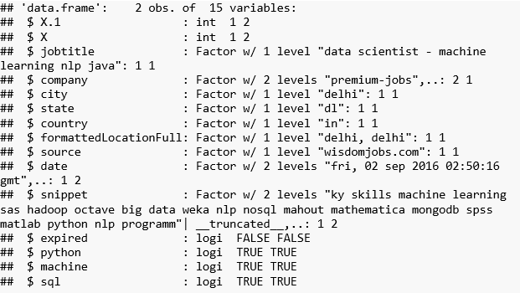
Data Exploration- Logic Building
What non-technical skills are required for data scientist job?
Created the code using "if else" , "logical condition" and used dplyr "regex“.
Identified Python, Sql and Machine learning as the three main technical skills.
Created the condition- if in the snippet column we see "python", "sql", "machine" make a respective column name python, sql and machine and print the logic "true" or "false".
Used the pipe function to filter the columns that have "true" in all the columns python, sql and machine.The following is the structure of the technical skills file.
Companies/consultants Table
Title | Company | City | State | Expired | Python | Machine | SQL
data scientist - machine learning nlp java | staffio | Delhi | Delhi | False | True | True | True
data scientist - machine learning nlp java | premium-jobs | Delhi | Delhi | False | True | True | True

Slide 13
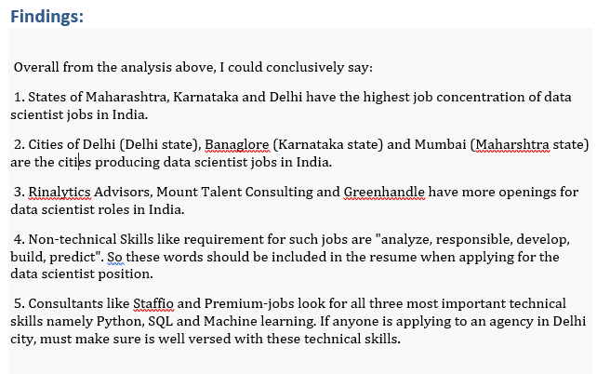
Wrap- Up

Slide 14
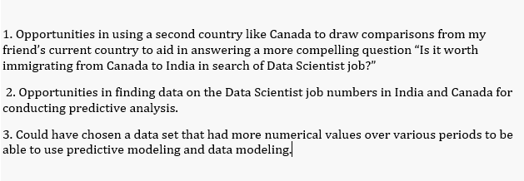
Lessons Learnt

Slide 15
Thank You !!

