Slide 1
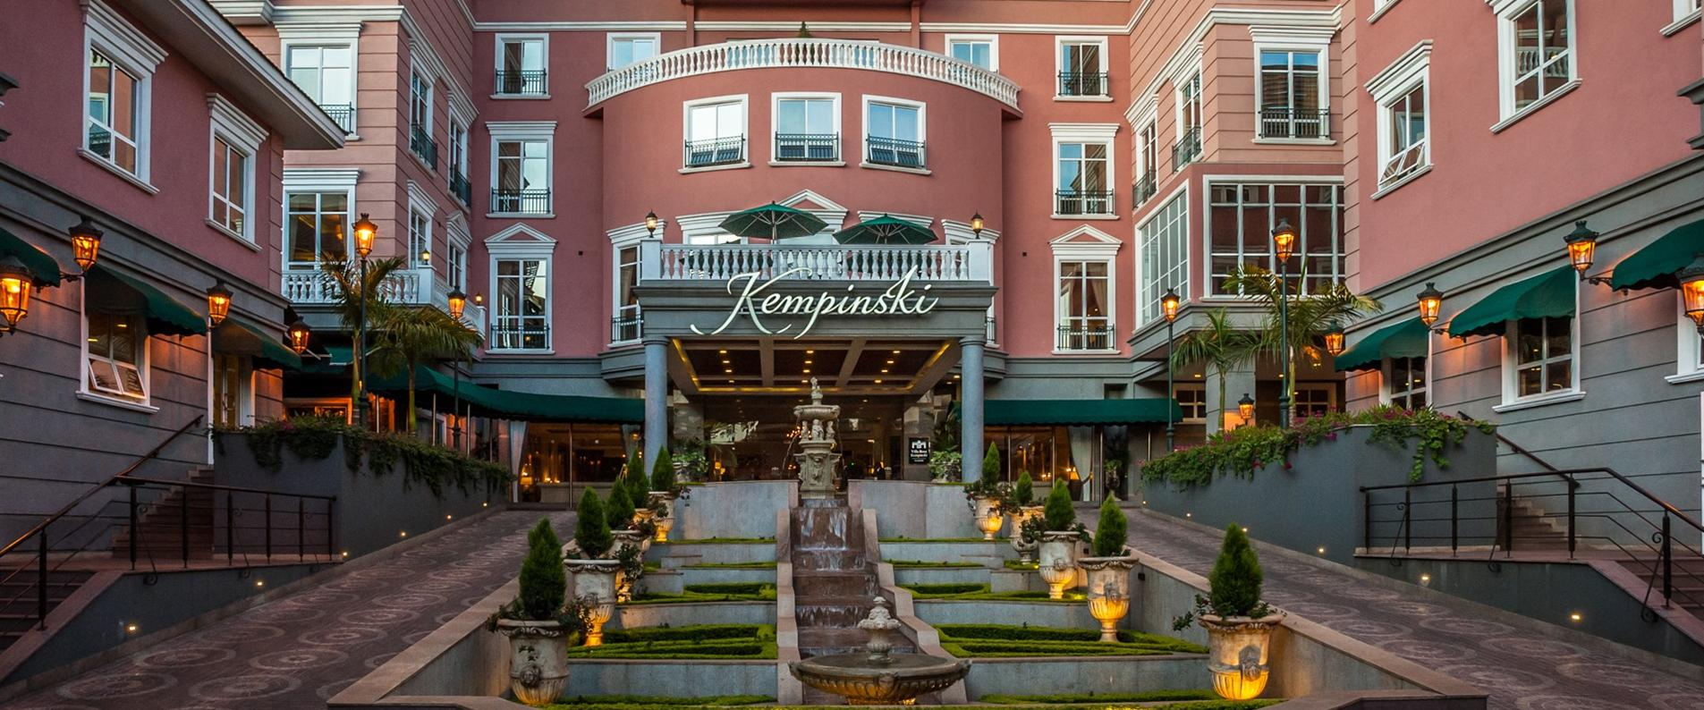
LOG IN PORTAL
Username
Password
Log In

Slide 2
Gift Shop
Rooms
Guests
LINKS
Restaurant
Reports
Bar

Slide 3

Front desk
Bar
Gift Shop
Restaurant
Reports
LOGO
NAME OF HOTEL
LOG OUT
ROOM TYPE NAME
BASE PRICE
EXTRA PERSON CHANGE
(PER PERSON)
EXTRA BED CHANGE
(PER PERSON)
NO. OF ROOMS
(PER BED)
NO. OF ROOMS
LEFT
Standard
Ex. Bed:
Ksh
0
Ksh
0
Ksh
0
0
0
Base:
1
Max:
1
0
Deluxe
Base:
Max:
Ex. Bed:
Ksh
0
Ksh
0
Ksh
0
0
0
1
1
0
Luxury
Base:
Max:
Ex. Bed:
Ksh
0
Ksh
0
Ksh
0
0
0
1
1
0
+ Add Room Type
BOOK
Back

Slide 4
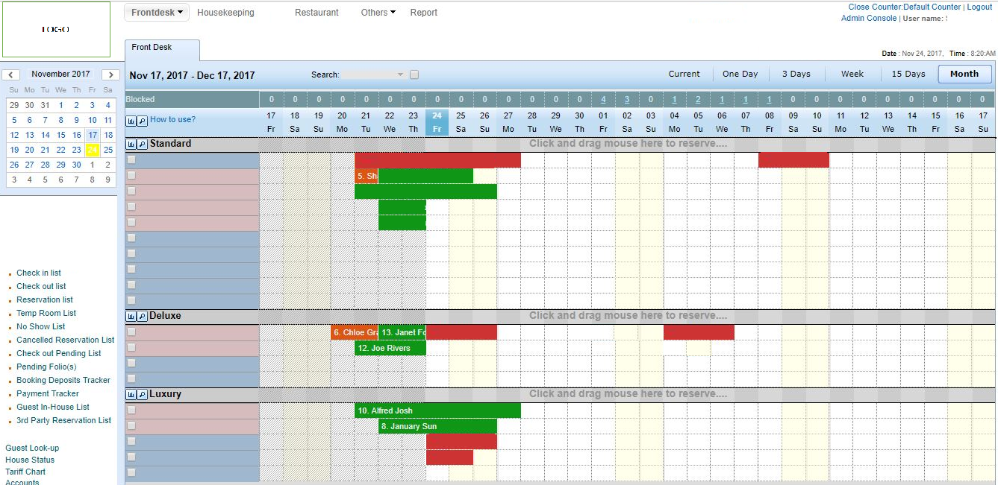
LOGO
Front desk
Bar
Gift Shop
Restaurant
Reports
LOG OUT
1 | 2 | 3 | 4 | 5 | 6 | 7 | 8 | 9 | 10 | 11 | 12 | 13 | 14 | 15 | 16 | 17 | 18
Mon | Tues | Wed | Thur | Fri | Sat | Sun | Mon | Tue | Wed | Thur | Fri | Sat | Sun | Mon | Tue | Wed | Thur
Back
Check Out
Check In
Reserved

Slide 5
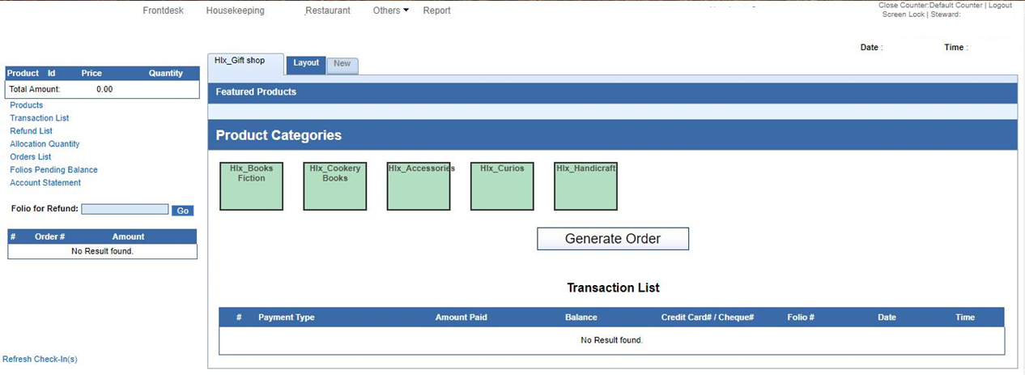
Front desk
Bar
Gift Shop
Restaurant
Reports
LOG OUT
Gift Shop/Bar/Restaurant
Item
Item
Item
Item
Item
Item
Item
Item
Item
Item
# Payment Type Amount Paid Balance Credit Card/ Cash Room No. Date Time
Back

Slide 6
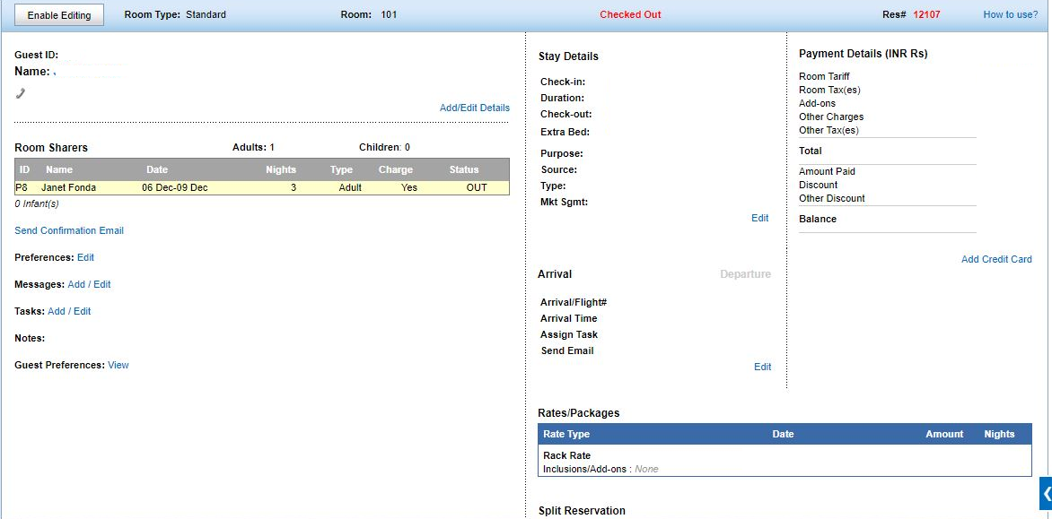
Front desk
Bar
Gift Shop
Restaurant
Reports
LOG OUT
GUEST DETAILS
Room Type: Room: Status: GuestID:
Enable Editing
Back
Print

Slide 7
Front desk
Bar
Gift Shop
Restaurant
Reports
LOG OUT
REPORTS
PDF | EXCEL
2018 | 2018
JANUARY TO APRIL 2018 | JANUARY TO APRIL 2018
MAY TO AUGUST 2018 | MAY TO AUGUST 2018
SEPTEMBER TO DECEMBER 2018 | SEPTEMBER TO DECEMBER 2018
2017 | 2017
2016 | 2016
2015 | 2015
2014 | 2014
Back

