Slide 1
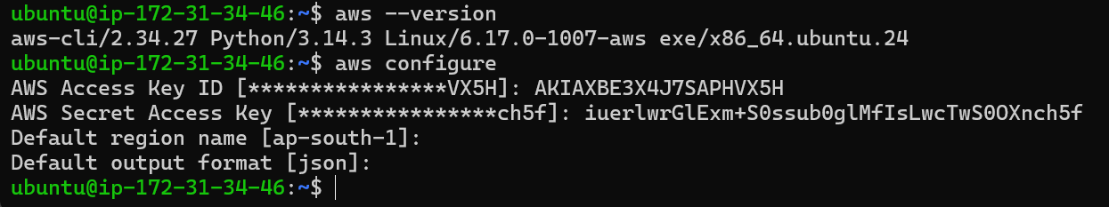
How to Install AWS CLI
sudo apt install awscli
sudo apt update
sudo apt install unzip -y
curl "https://awscli.amazonaws.com/awscli-exe-linux-x86_64.zip" -o "awscliv2.zip“
unzip awscliv2.zip
sudo ./aws/install
aws --version
aws configure

Slide 2
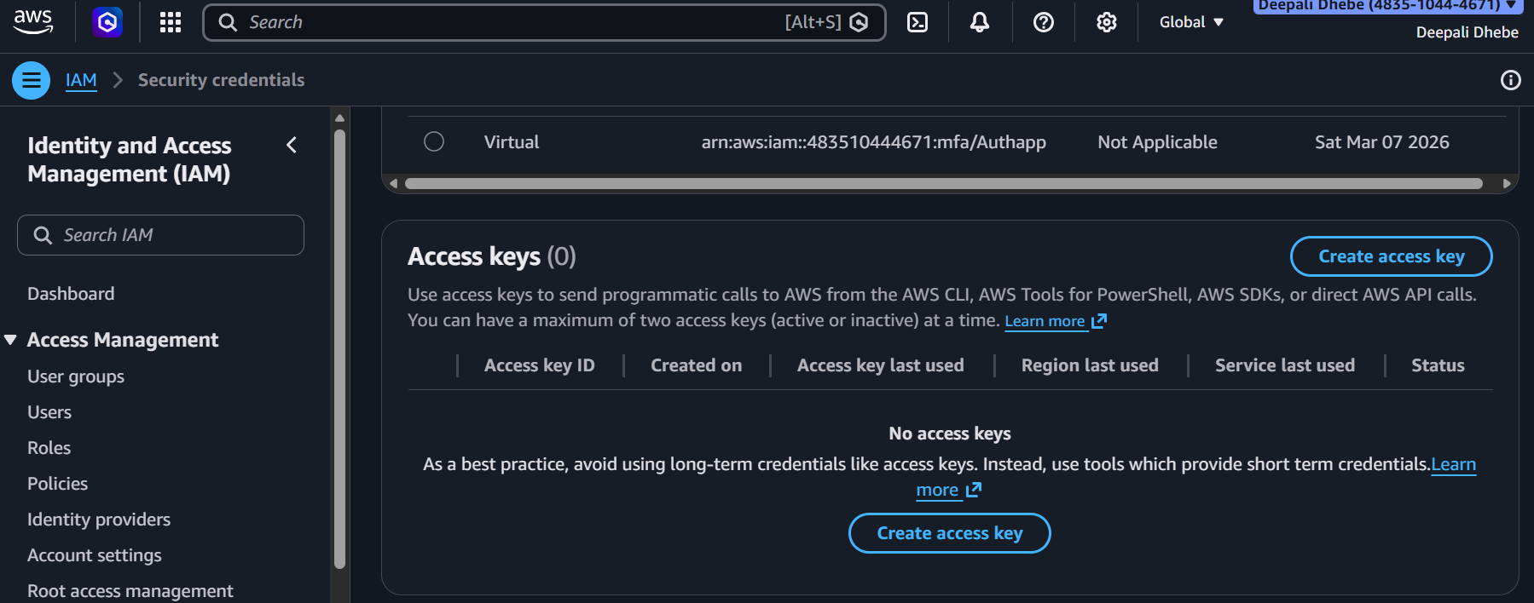
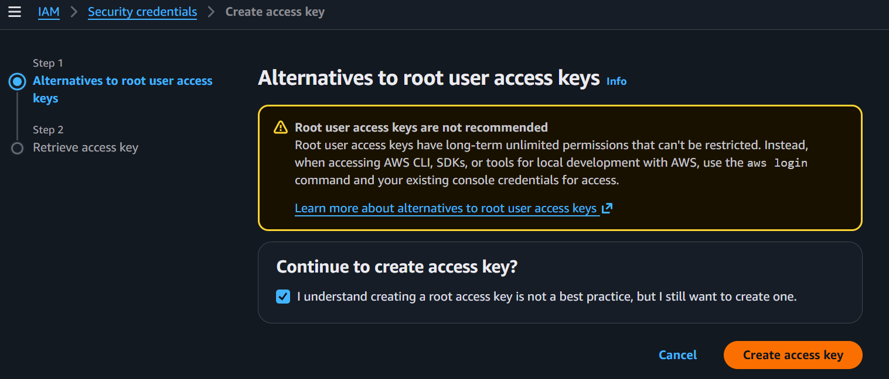
How to Create Access Keys on AWS
Go to IAM > Security Credentials > Access Keys > Create Access Key
Acknowledge the message and select – Create Access Key
Copy the Access key and Secret Access Key to somewhere – can be used while configuring AWS.

Slide 3
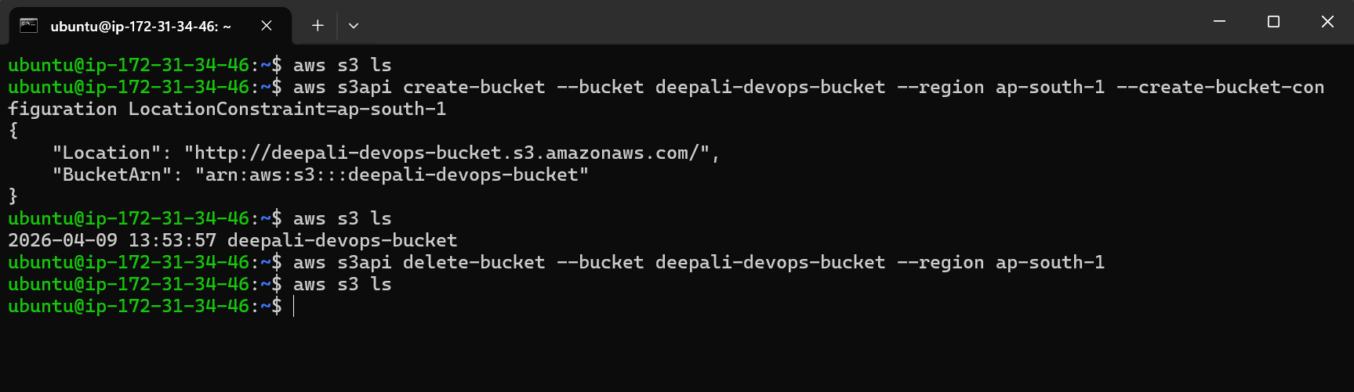
How to Create/Delete S3 Buckets

