Slide 1
To-Do List in Blockchain
Vidyavardhini’s College of Engineering & Technology
K.T. Marg, Vartak College Campus, Vasai Rd, Vasai-Virar, Maharashtra 401202
Department of Artificial Intelligence and Data Science
Group No: 02
Arya Bhosle 02
Deepali Kothari 09
Om Tiwari 29
Prof. Sumeet Shingi
Date: 16-10-2023

Slide 2
Contents
Introduction
Problem Statement
Literature Survey
Proposed System
Process Design
Details of Hardware/Software used
Output
Result analysis
Conclusion
References
Thank you

Slide 3

Introduction
To-Do Lists in blockchain offer a novel way to organize, track, and verify tasks, promising a more secure and tamper-proof approach to managing daily activities and responsibilities.
This introduction delves into the intriguing world of To-Do Lists in blockchain, exploring their potential to redefine the way we prioritize and accomplish tasks while ensuring trust and reliability in our digital interactions.

Slide 4
Problem Statement
The problem of maintaining a secure and tamper-proof to-do list is a significant challenge in the digital age, where data integrity and privacy are paramount.
Traditional to-do list applications are susceptible to data manipulation and unauthorized access, as they rely on centralized servers and databases that can be vulnerable to hacking and data breaches.
Developing a to-do list application on a blockchain can ensure that tasks and their associated data remain secure, transparent, and resistant to unauthorized alterations, thus addressing the inherent issues of trust and data integrity that plague conventional to-do list platforms.

Slide 5
Literature Survey
Sr. No | Paper Title | Advantages | Disadvantages
1 | A Decentralised Approach to Task Allocation Using Blockchain | Blockchain's transparent ledger system allows all participants in a network to view and verify task allocations and rewards. This transparency reduces the potential for disputes and fosters trust among participants. | Blockchain networks face challenges related to scalability. As more tasks and users are added to the network, it can become slower and more resource-intensive.
2 | Task manager using blockchain | Blockchain uses cryptographic techniques to secure data and transactions | Energy Consumption: Proof-of-Work (PoW) blockchains, which are used by some networks like Bitcoin, consume significant amounts of energy, which can be environmentally problematic.
3 | A Review of Task Manager Applications in Various Industries | Decentralized task allocation on a blockchain can reduce the need for intermediaries or trusted third parties, which can streamline the process and reduce costs. | Once information is added to the blockchain, it becomes extremely difficult to alter or delete it.
4 | Smart Contract-Based To-Do list Using Ethereum Blockchain | Automated smart contracts can be used for task allocation, which can execute automatically when predefined conditions are met | Decentralized networks may face challenges in reaching consensus on governance decisions, which can hinder their ability to adapt and evolve.
5 | A Decentralized To-Do list Based on Smart Contracts | Blockchain-based systems can incorporate token incentives or cryptocurrency rewards for participants, which can motivate individuals to perform tasks efficiently and accurately. | The legal and regulatory environment surrounding blockchain and cryptocurrencies is still evolving, which can create uncertainties and challenges for organizations and individuals.

Slide 6
Proposed system
A proposed system for a To-Do List application on the blockchain aims to leverage the decentralized and secure nature of blockchain technology to enhance task management and data integrity.
In this system, each task or item on the to-do list would be represented as a unique and immutable blockchain transaction or smart contract.
Users can create, update, delete, count and mark tasks as complete, with all actions being recorded on the blockchain, ensuring transparency and trust in the system. The decentralized nature of the blockchain eliminates the need for a central authority, reducing the risk of data manipulation or loss.

Slide 7
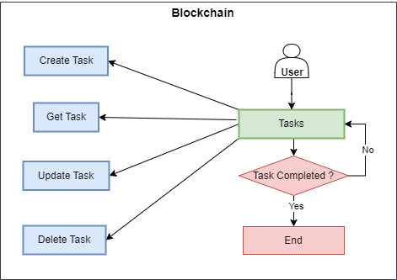
Process Design

Slide 8

Details of Hardware/Software used
Hardware details:
Processor: A multi-core processor, such as an Intel Core i5 or AMD Ryzen, is recommended for smoother development and testing.
Memory (RAM): At least 8GB of RAM is recommended, especially for larger projects and testing.
Storage: You'll need storage for your development environment, IDE, and project files. An SSD (Solid State Drive) is preferred for faster load times.

Slide 9
Details of Hardware/Software used
Software details:
Remix Ethereum IDE: For initial contract development and testing.
Programming Languages:
Solidity programming language: For writing the smart contract.

Slide 10
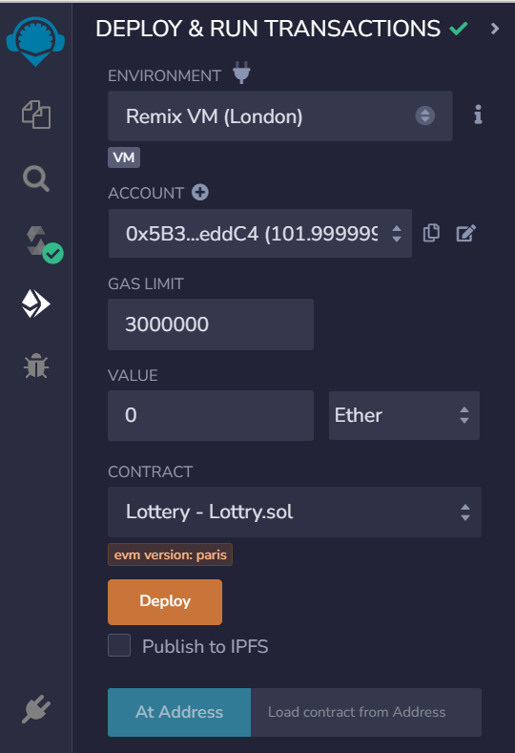
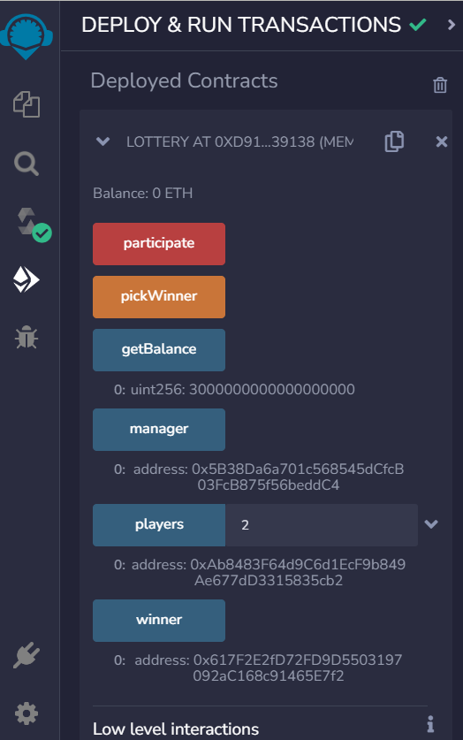
Output
Fig 1. Participation process
Fig 2. Managing Process

Slide 11
Result Analysis
The smart contract has been audited by a reputable firm and is free from known vulnerabilities.
The project maintains high levels of transparency by publishing contract code and lottery results on a public blockchain.
Users can easily verify transactions and lottery outcomes.
Total funds raised remain stable, indicating a healthy user base.
The project's roadmap outlines future development and expansion plans, ensuring long-term viability.
The project adheres to the rules and terms outlined, maintaining user confidence.

Slide 12
Conclusion
On the positive side, blockchain technology ensures data immutability, transparency, and decentralization, making it highly secure and resistant to unauthorized alterations.
Each to-do item can be securely recorded as a transaction on the blockchain, providing a reliable and tamper-proof history of tasks. Additionally, smart contracts can automate task management, enabling automatic notifications and updates.
However, it's important to consider the scalability and cost issues associated with blockchain, as transactions can be relatively slow and expensive compared to traditional databases.
Furthermore, user-friendly interfaces and adoption hurdles may need to be addressed for widespread use. In conclusion, while a blockchain-based To-Do List offers robust security and trustworthiness, its practicality and efficiency for everyday task management may depend on further advancements in blockchain technology and user adoption.

Slide 13
References
[1] Aarju Dixit, Aditya Trivedi, and W. Wilfred Godfrey. “Blockchain Based Task Manager by Using Smart Contract.” In: 2022 IEEE 6th Conference on Information and Communication Technology (CICT). Gwalior, India, Nov. 18-20, 2022. DOI: 10.1109/CICT56698.2022.9997830.
[2] Arihant Duggar, Divyanshu Gupta, Royal, and Mohan C.G. “Task Allocation System Using Smart Contract and Blockchain Technology.” In: International Journal for Research in Applied Science & Engineering Technology (IJRASET) 10.IV (Apr. 2022). ISSN: 2321-9653; IC Value: 45.98; SJ DOI: 10.22214/ijraset.2022.41695.
[3] Christian Fuchs et al. “Blockchain To-Do lists: Applications, challenges, and opportunities.” In: Journal of Ambient Intelligence and Humanized Computing (2021). DOI: 10.1007/s12083-021-01127-0.
[4] Jianhua Zhang et al. “A Secure To-Do on Smart Contracts.” In: IEEE Access 8 (2020), pp. 21496–21506. DOI: 10.1109/ACCESS.2020.2965025.
[5] Kaiwen Sun et al. “Design of a Blockchain-Based Task Allocater for Smart Applications.” In: IEEE Access 5 (2017), pp. 18671–18679. DOI: 10.1109/ACCESS.2017.2756844.

Slide 14
References
[6] Taherdoost, Hamed. (2023). To-Do List in Blockchain Technology: A Critical Review. Information. 14. 117. 10.3390/info14020117.
[7] Vieira, G.; Zhang, J. Peer-to-peer energy trading in a microgrid leveraged by smart contracts. Renew. Sustain. Energy Rev. 2021,143, 110900.
[8] Taherdoost, H.A. Critical Review of Blockchain Acceptance Models—Blockchain Technology Adoption Frameworks and Applications. Computers 2022,11, 24.
[9] Macrinici, D.; Cartofeanu, C.; Gao, S. Smart contract applications within blockchain technology: A systematic mapping study. Telemat. Inform. 2018,35, 2337–2354
[10] Madanchian, M.; Taherdoost, H. The Impact of Digital Transformation Development on Organizational Change. In Driving Transformative Change in E-Business through Applied Intelligence and Emerging Technologies; IGI Global: Hershey, PA, USA, 2022; pp. 1–24.

Slide 15
Thank you

