Slide 1
VENDING MACHINE

Slide 2
CONTENT
FSM
ABOUT FSM
FSM WORKING
VENDING MACHINE
CODE
CONCLUSION

Slide 3
FSM
Finite state machine is used to recognize patterns.
Finite automata machine takes the string of symbol as input and changes its state accordingly. In the input, when a desired symbol is found then the transition occurs.
While transition, the automata can either move to the next state or stay in the same state.
FA has two states: accept state or reject state. When the input string is successfully processed and the automata reached its final state then it will accept.

Slide 4
FSM Definition
Definition: A finite-state machine is a 6-tuple M=(S, I, O, f, g, S₀) where
  S is a finite set of states
  I is a finite input alphabet
  O is a finite output alphabet
  f:S×I→S is a transition function from each state-input pair to a state
  g:S×I→O is a output function from each state-input pair to an output
  S₀ is the initial state

Slide 5
How FSM work ?
The working of an FSM can be summarized in four steps:
Initialization: FSM is initialized with an initial state, and any necessary i/ps & o/ps are initialized as well.
Input Processing: FSM receives an i/p signal, which causes it to transition to a new state. The i/p can be any kind of signal, such as a button press or a sensor reading.
State Transition: FSM transitions from its current state to a new state based on the i/p it has received. The transition is determined by a set of rules, which are defined by the designer of the FSM.
Output Generation: FSM produces an o/p based on its current state & i/p. The o/p can be any kind of action, such as turning on a motor or displaying a message on a screen.
This process is repeated continuously as the FSM receives new i/ps and generates new o/ps.

Slide 6
Applications
Finite-State Machines are used in a variety of applications.
  Spell checking programs
  Grammar checking
  Indexing and searching large text files
  Speech/Language recognition
  Network Protocols

Slide 7
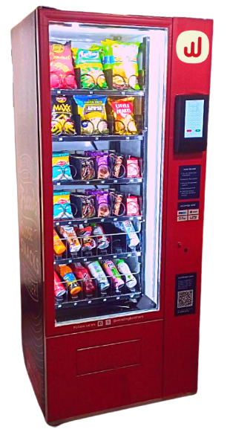
Vending Machine
A vending machine is an automated machine that provides items such as snacks, beverages, and lottery tickets to consumers after cash, a credit card, or other forms of payment are inserted into the machine or otherwise made.

Slide 8
Vending Machine FSM
A vending machine can be modeled as a finite state machine (FSM) with inputs, outputs, states & transitions.
Inputs:
Coin: A customer inserts a coin into the machine.
Product Selection: A customer selects a product to purchase.
Outputs:
Product: The selected product is dispensed.
Change: Any remaining change is dispensed.
States:
Idle: The machine is waiting for a customer to insert a coin.
Product Selected: A customer has selected a product, and the machine is waiting for payment.
Dispense Product: The product is dispensed to the customer.
Dispense Change: Any remaining change is dispensed to the customer.

Slide 9
.
Transitions:
Idle -> Product Selected: When the customer selects a product, the machine moves to the Product Selected state.
Product Selected -> Idle: If the customer cancels the purchase or doesn't provide enough money, the machine returns to the Idle state.
Product Selected -> Dispense Product: If the customer provides enough money, the machine moves to the Dispense Product state.
Dispense Product -> Dispense Change: After dispensing the product, the machine calculates and dispenses any remaining change.
Dispense Change -> Idle: The machine returns to the Idle state, ready for the next customer.

Slide 10
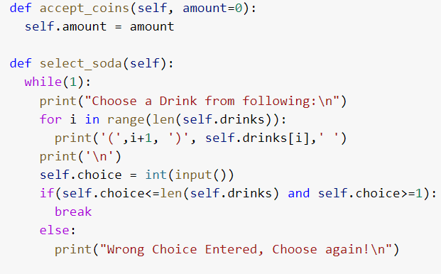
Input code
The input code consists of two functions, accept_coins() and select_soda().
accept_coins() accepts the amount of coins inserted into the vending machine and sets the value of self.amount to that amount.
select_soda() provides a menu of drink choices and allows the user to select a drink by entering a number. It ensures that the choice is valid and within the range of available options

Slide 11
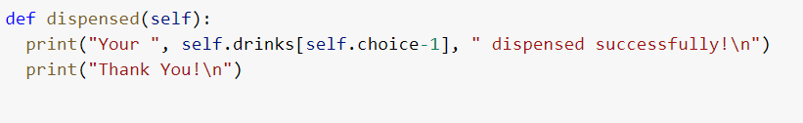
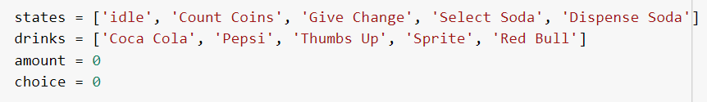
Output & State code
dispensed() method is the output code of the Dispense Soda state.
It prints the message "Your [selected drink] dispensed successfully!" and "Thank You!" to the console.
State code:
states variable is the list of all possible states in the vending machine.
drinks variable is the list of available drinks in the vending machine.
amount variable stores the amount of money inserted by the user.
choice variable stores the user's choice of drink.

Slide 12
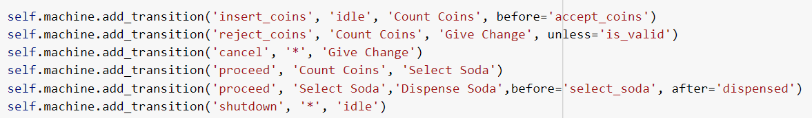
Transition State
The code defines the state transitions that can occur in the vending machine.
It specifies which function will be called before and/or after each transition and under what conditions each transition can take place.
The transitions include accepting coins, rejecting coins if they are not enough, canceling the purchase, proceeding to select a soda, proceeding to dispense the selected soda, and shutting down the machine.

Slide 13
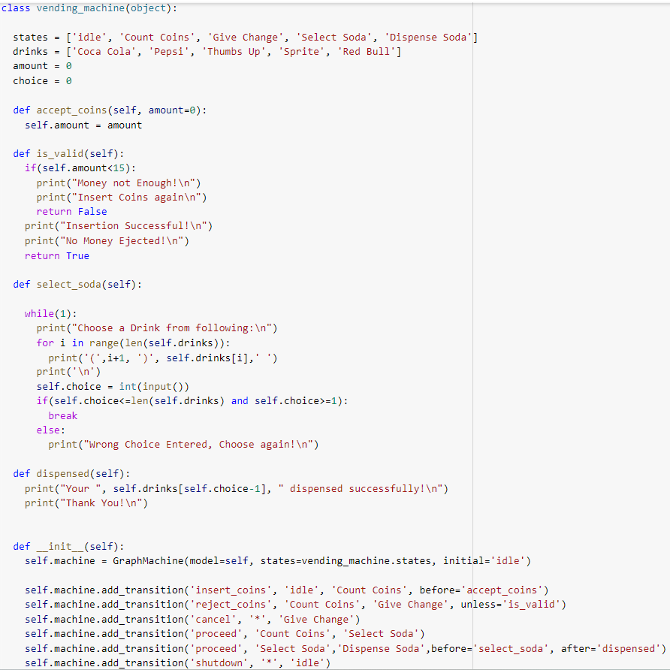
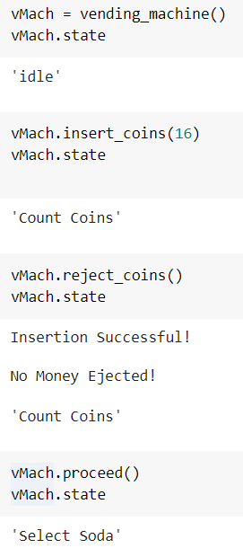

Slide 14
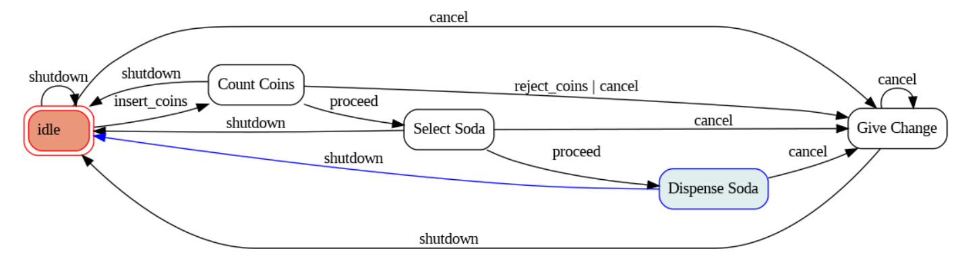
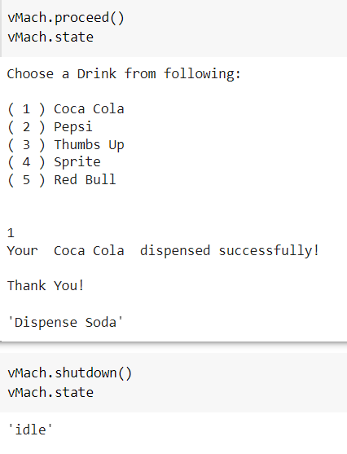
STATE DIAGRAM

Slide 15
CONCLUSION
In conclusion, the Finite State Machine (FSM) model is a useful tool for designing and implementing a vending machine.
The code provided demonstrates how the different states and transitions of a vending machine can be defined using the add_transition method.
The FSM approach helps to simplify the logic and design of the vending machine, making it more efficient and easier to maintain. By breaking down the vending machine into smaller, simpler states, it becomes easier to manage and ensure that it functions correctly.

