Slide 1
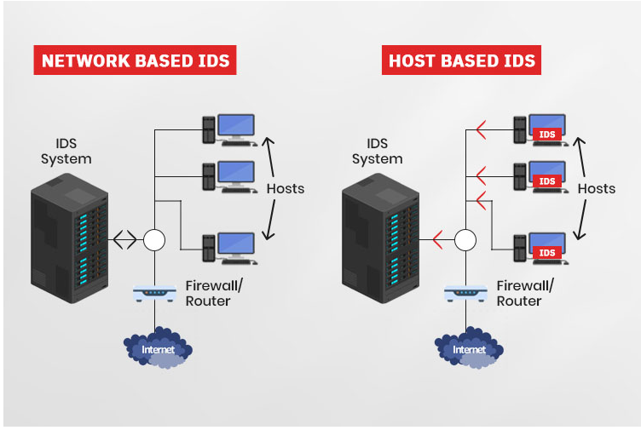

Intrusion detection systems using long short‑term memory (LSTM)
DEEPALI KUMARI
ap22122040007

Slide 2
Content:
Introduction
Model architecture
RNN vs LSTM
Feature Selection method
About dataset
Parameter used
Result
Conclusion

Slide 3
INTRODUCTION
Network attacks are constantly changing, posing serious threats to government, military, and commercial bodies.
Intrusion Detection Systems (IDSs) are crucial for improving security in computer systems.
Traditional IDSs use shallow learning algorithms, which rely on manual feature engineering and are not effective for real-time environmental problems.
Deep learning models, such as LSTM, have gained popularity for intrusion detection.
In this paper, author implemented deep learning solutions for detecting attacks based on Long Short-Term Memory (LSTM). PCA (principal component analysis) and Mutual information (MI) are used as dimensionality reduction and feature selection techniques.

Slide 4
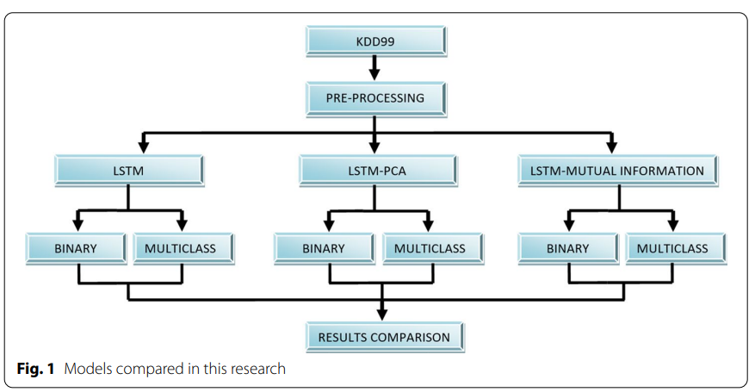
.

Slide 5
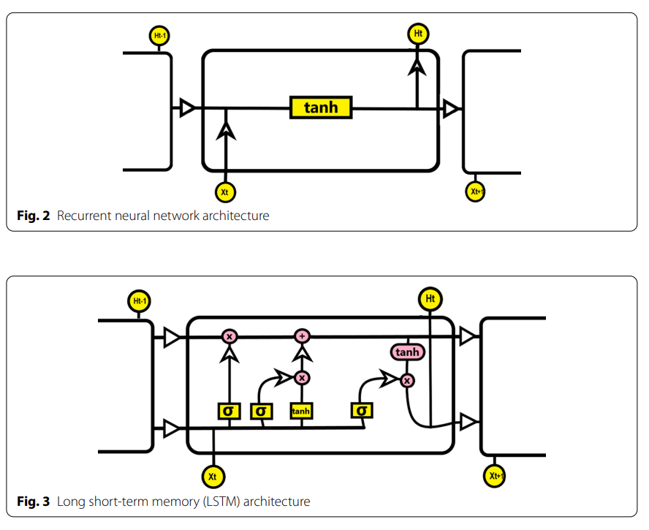

Slide 6
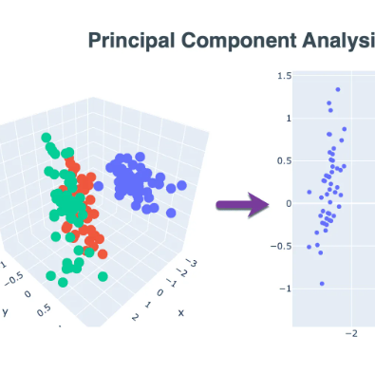
Feature selection
Principal component analysis (PCA) :
PCA is a technique for reducing the dimensionality of datasets, by creating new uncorrelated variables that successively maximize variance. Using PCA, we can reduce the computational costs and the error of parameter estimation by reducing the number of dimensions of the feature space by extracting a subspace that describes the data best.
Mutual information (MI):
Unlike PCA, Mutual information calculates the statistical dependence between two variables. It measures how much information is communicated, on average, in one random variable about another and assigns a score for each feature. High MI score between two variables indicates a large reduction in uncertainty’

Slide 7
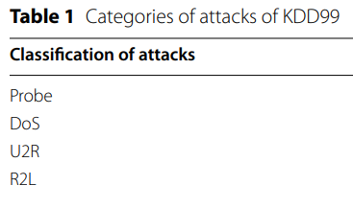
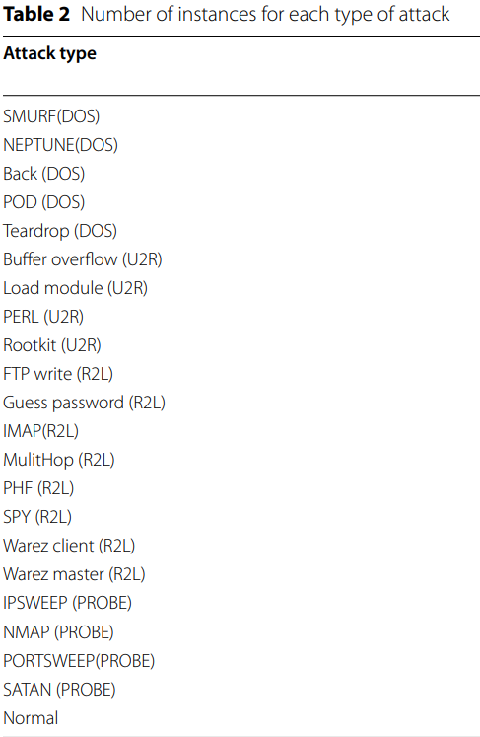
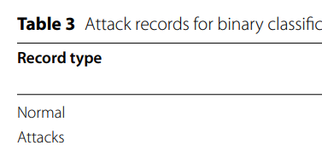
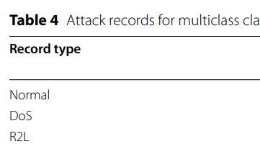
The KDD99 dataset
KDD99 dataset is more than 19 years old, it is still widely used in academic research.
The raw training data were processed into about five million connection records. A connection is a sequence of TCP packets starting and ending at some well-defined times.
The dataset contains 53 features, and falls into 4 attacks categories (DoS, Probe, U2R, and R2L) divided into 22 different attacks

Slide 8
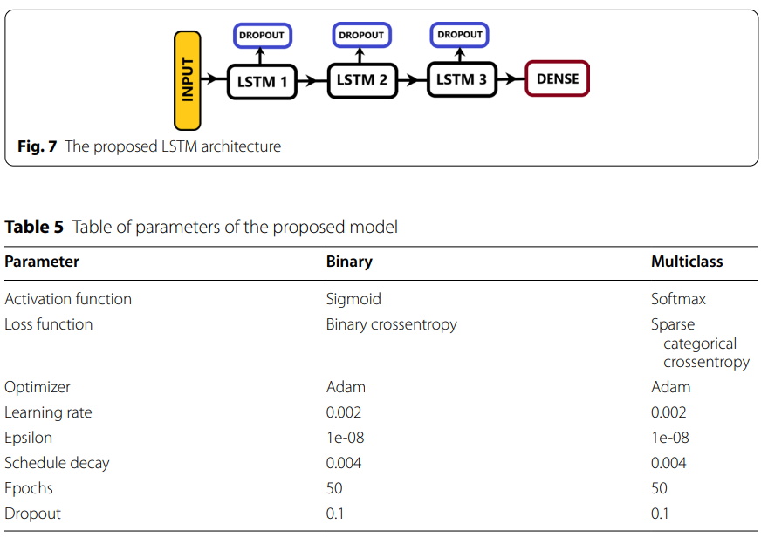
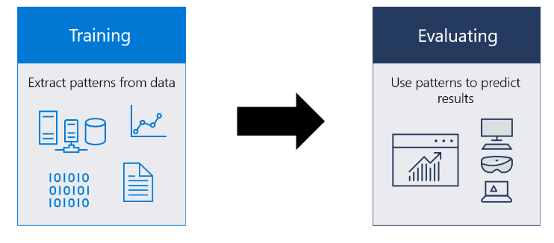

Slide 9
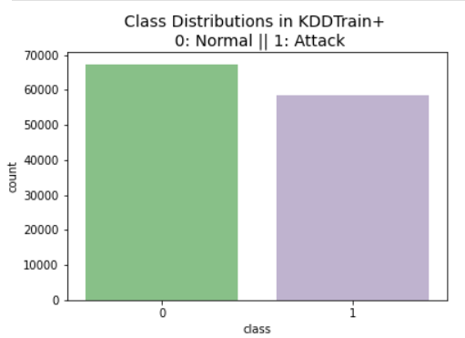
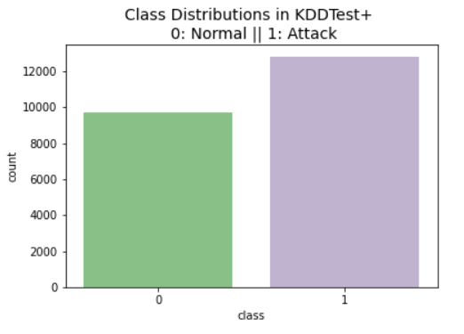
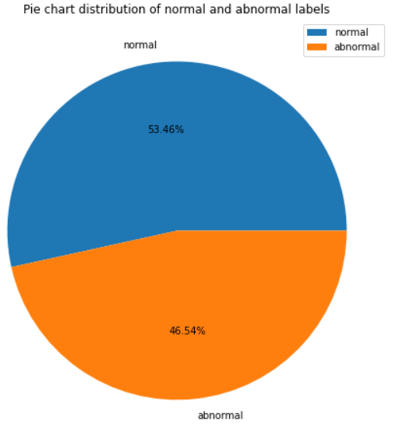
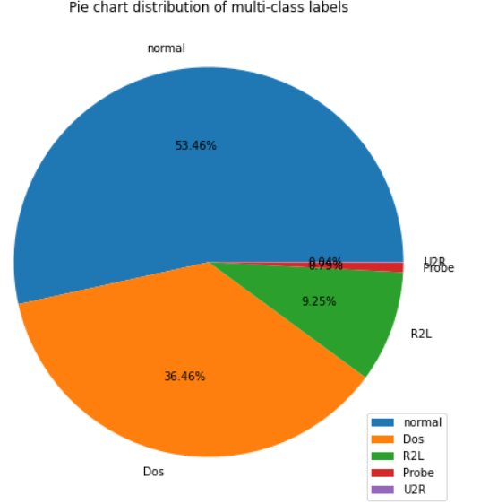
LSTM Binary classification & Multi classification RESULT

Slide 10
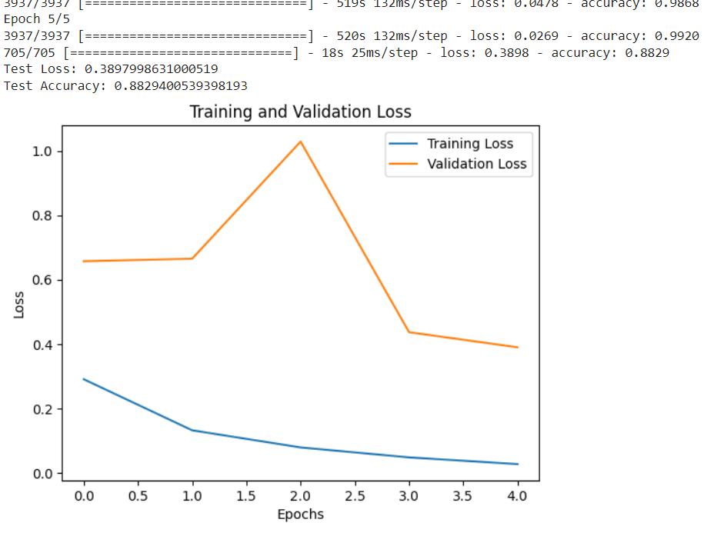
Result obtained by LSTM binary classification

Slide 11
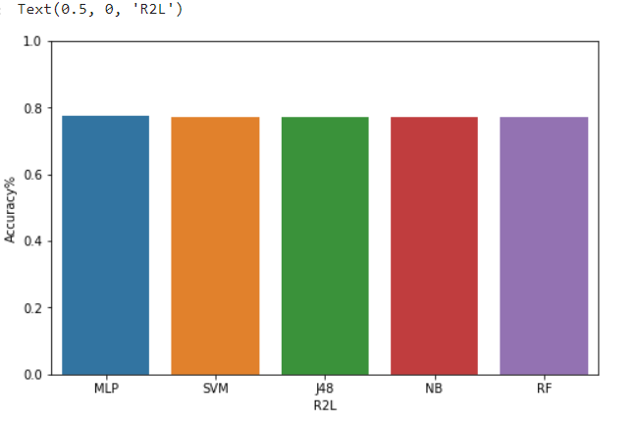
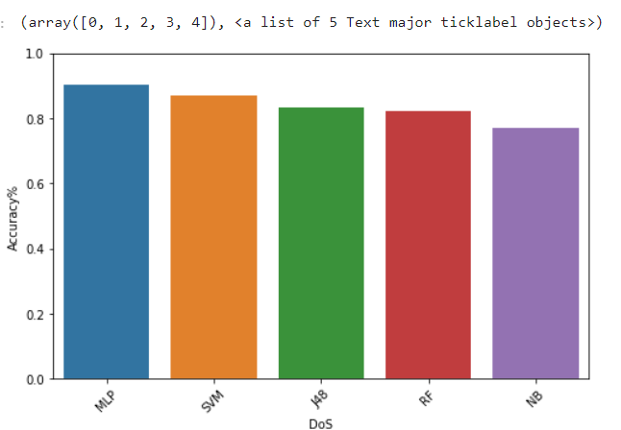
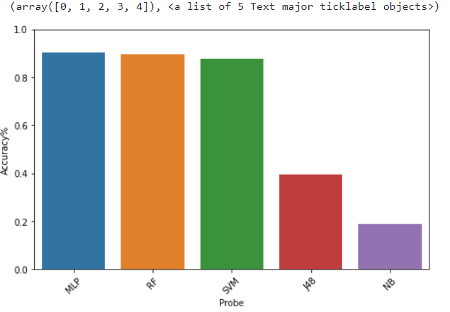
Result obtained by LSTM multiclassification (3 attacks) on different ML model

Slide 12
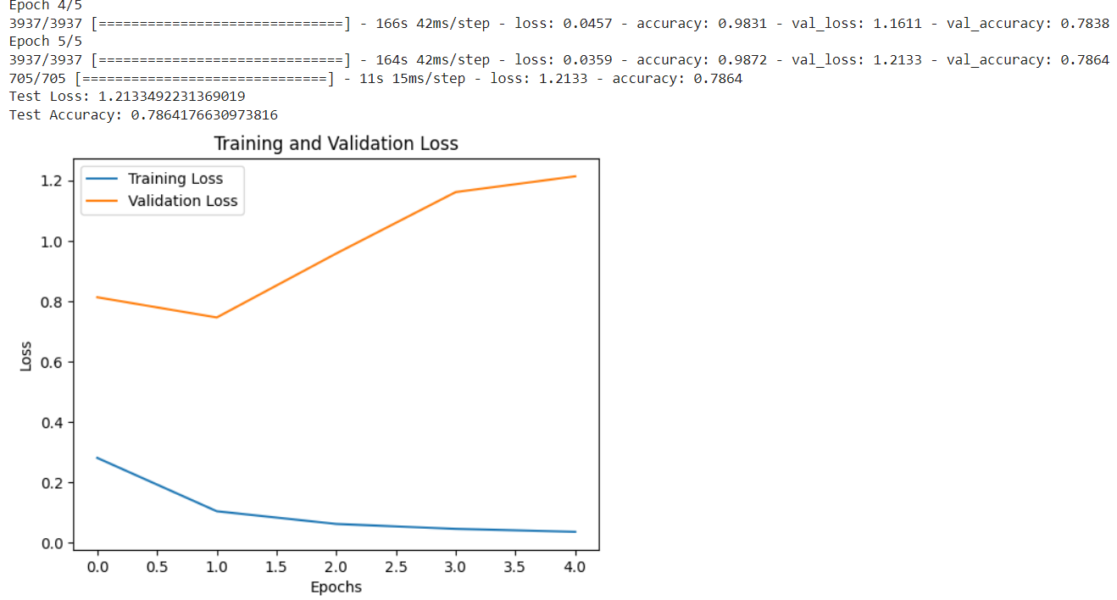
LSTM Multi-classification with PCA FEATURE SCALLING

Slide 13
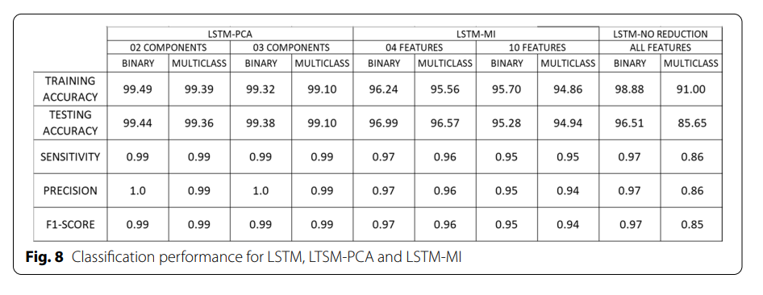
Result
.

Slide 14
Conclusion
Experimental results on the KDD99 benchmark dataset demonstrate the effectiveness of PCA-based models for both binary and multiclass classification.

