Slide 1
Kruskal Wallis test DEEPALI KUMARI

Slide 2
OUTLINE
ABOUT
ASSUMPTIONS
PROCEDURE
TEST STATISTIC
EXAMPLE
CODE
CONCLUSION

Slide 3

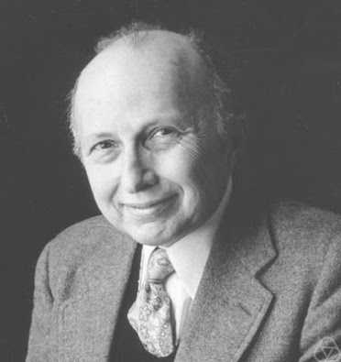
Kruskal Wallis test
Kruskal-Wallis test was proposed by Kruskal and Wallis in 1952.

Slide 4
Kruskal Wallis test
The Kruskal-Wallis test is a nonparametric (distribution free) test, and is used when the assumptions of ANOVA are not met.
In the ANOVA
we assume that distribution of each group is normally distributed
there is approximately equal variance on the scores for each group.
The Kruskal–Wallis test by ranks, Kruskal–Wallis H test or one-way ANOVA on ranks is a non-parametric method for testing whether samples originate from the same distribution.
It is used for comparing two or more independent samples of equal or different sample sizes. The parametric equivalent of the Kruskal–Wallis test is the one-way analysis of variance (ANOVA).

Slide 5

Assumptions
Random Sampling:
The samples are chosen randomly from the population.
Independence:
The groups are unrelated, and each observation is independent.
Measurement Scale:
The variable is ordered or ranked.
Continuous Variable:
The variable can have any value within a range.
Similar Populations:
The populations are mostly the same, except for a possible difference in at least one of them.

Slide 6

Hypothesis:
Null hypothesis: Null hypothesis assumes that the samples are from identical populations.
Alternative hypothesis: Alternative hypothesis assumes at least one population distribution differs

Slide 7

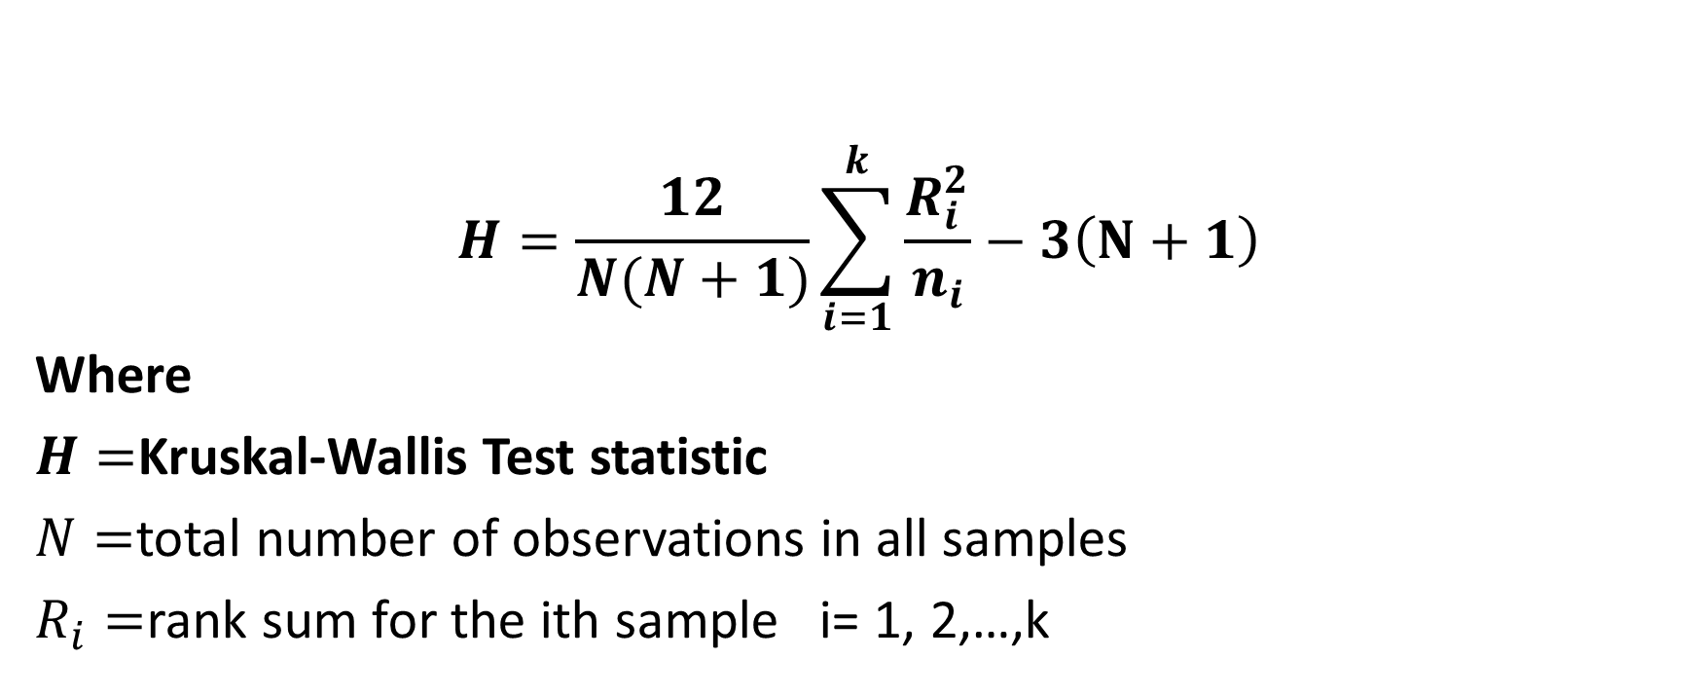

Slide 8


Test Procedure
Rank all the data from lowest to highest, considering all groups together.
Calculate the sum of ranks for each group.
Calculate the test statistic (H statistic) using the formula.
Calculate the degrees of freedom (df) using the formula: df = k - 1 where k is the number of groups.
Compare the obtained H statistic with the critical value from the chi-square distribution table with df degrees of freedom.
If the obtained H statistic is greater than the critical value, reject the null hypothesis.

Slide 9
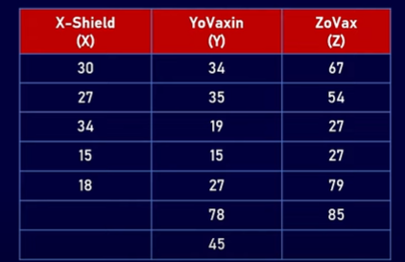
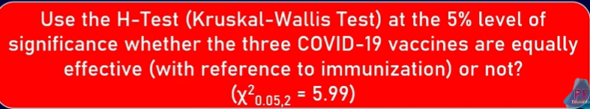
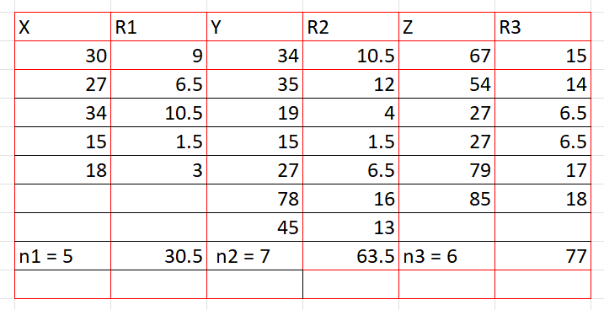
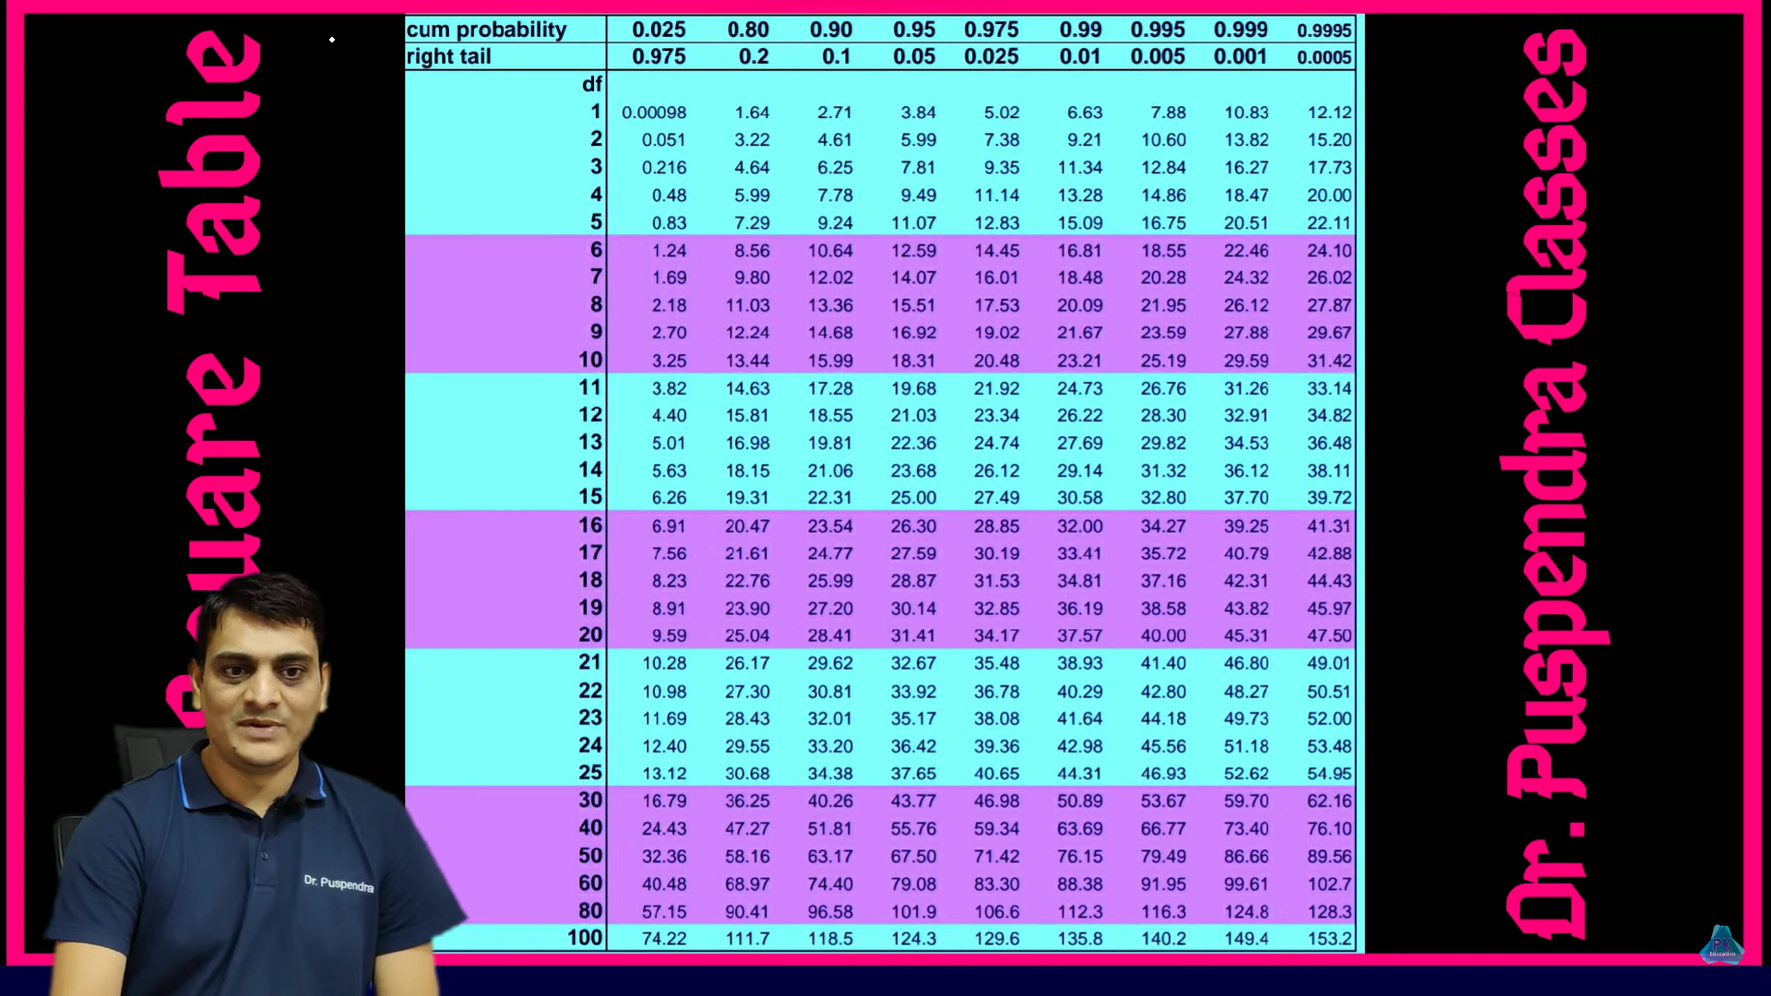

Slide 10
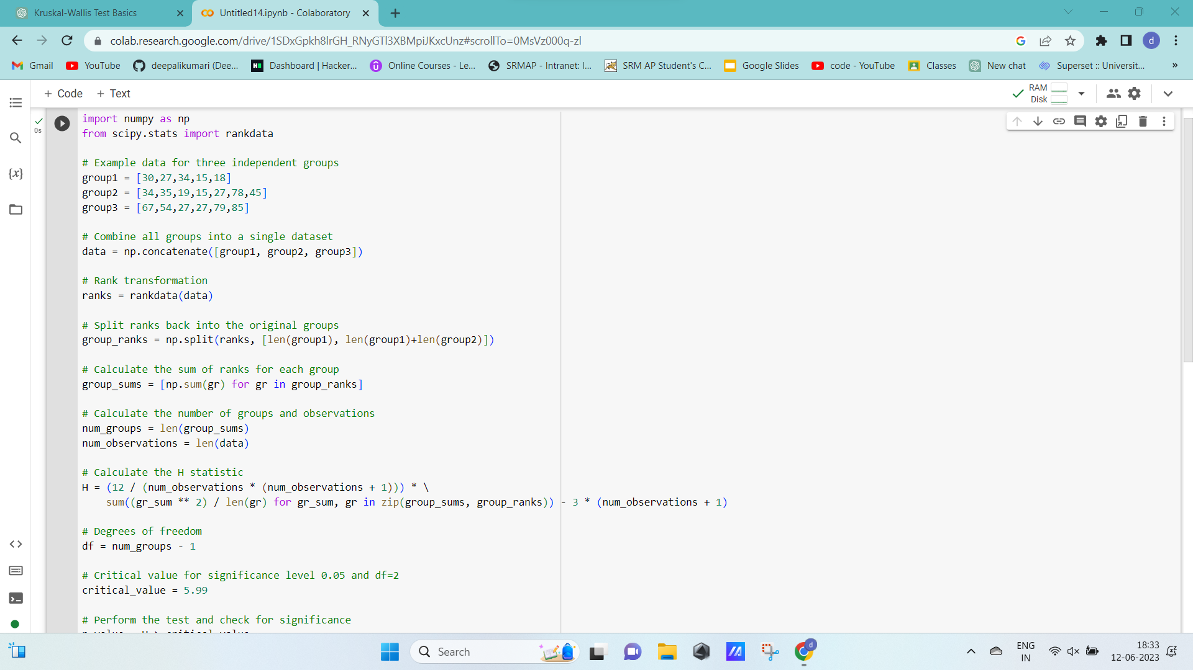
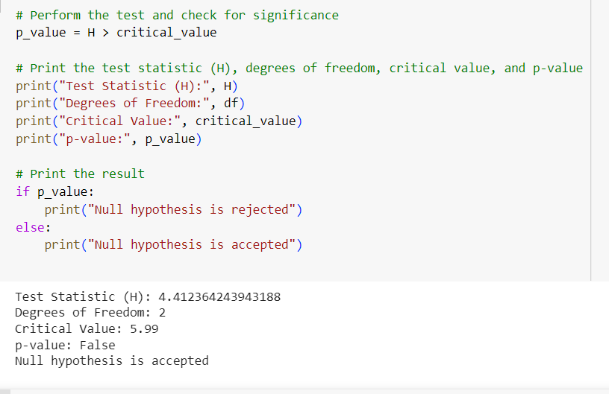

Slide 11

Advantages and Limitations
Advantages:
Suitable for non-normally distributed data.
Can handle unequal variances.
Provides a non-parametric alternative to one-way ANOVA.
Limitations:
Does not provide information about which specific groups differ.
Assumes independence between groups and observations within each group.
Less powerful than parametric tests when assumptions are met.

Slide 12
Conclusion
The Kruskal-Wallis test is a valuable tool for comparing three or more independent groups when the data violate the assumptions of normality and equal variances.
It allows us to determine if there are significant differences in population medians among the groups.
However, follow-up tests may be required to identify which specific groups differ from each other.

Slide 13

Thank you

