Slide 1
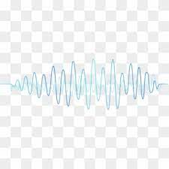
Voice Assistant
Deepali Kumari
(AP22122040007)
Shrishti Shiva
(AP22122040009)
Under the guidance of
Dr. Jatindra Kumar Dash

Slide 2

AGENDA
Introduction
​About
Task it’s doing
Working
Library used
Advantages and disadvantages
Result
Summary
​

Slide 3
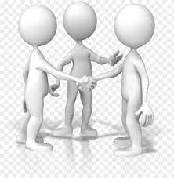

Introduction
Voice Assistant is a virtual assistant that uses speech recognition , neural network , machine learning ,artificial intelligence , python libraries and natural language processing to take actions on user command to help its users.
We propose a BOSS (voice assistant ) that performs task according to the voice input.
Automatic Speech Recognition, identifies spoken words and phrases and translates them to a readable computer format also known as speech-to-text conversion.
BOSS takes the input of the user in the form of a voice and processes it and returns the feedback in different ways. Some examples of voice assistant are Google assistant , Alexa , Shri , Cortana.
BOSS uses single commands as input for the application they usually consist of single phrases. When commands become ambiguous, the resulting actions can be misunderstood by the application.
BOSS able to do some Machine learning task on the voice command on IRIS dataset .

Slide 4
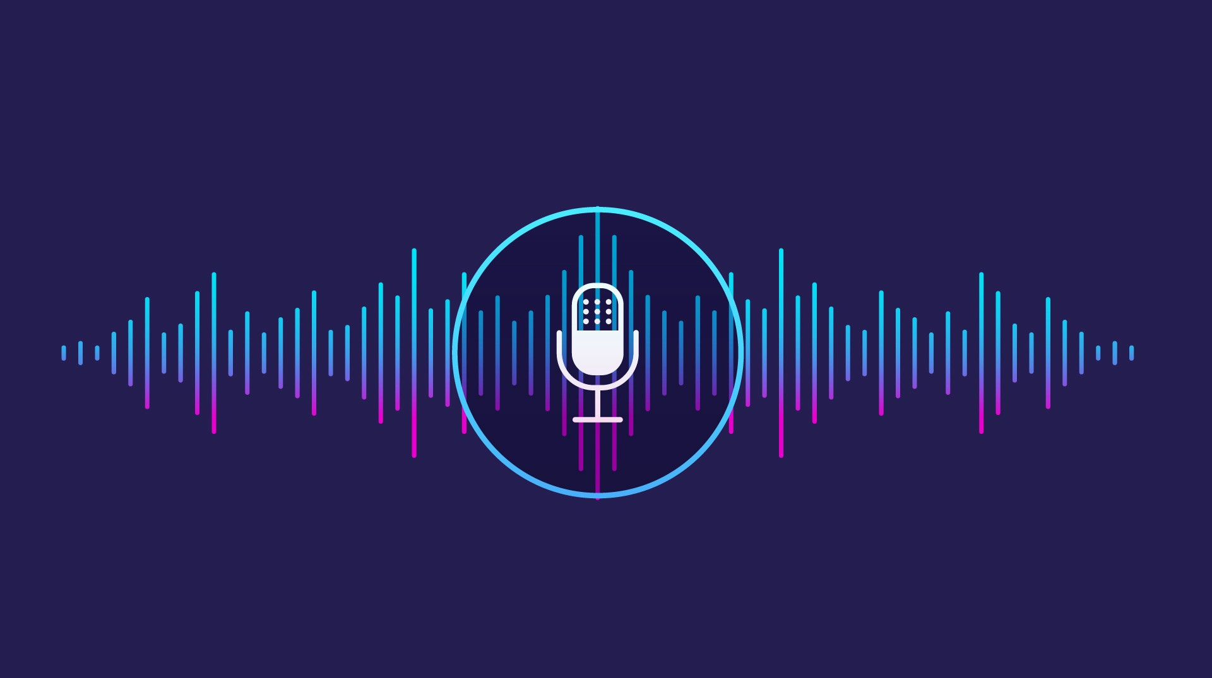
About
It's software that carries out everyday tasks via voice command. It's brings AI and Machine Learning together to recognize our voice and do what we ask it. Voice assistant is a conversational AI tool that uses voice commands to receive and interpret directives. With this technology, devices can interact and respond to human questions in natural language.
Today voice assistants are not limited to smart speakers but are also available in cars, household devices, smartphones, and several apps.

Slide 5

Task
Date , time and day
If we ask for date and time it give the date and time as an output . It greets you as per real time.
Google Search
Find information online ,from hotel booking ,directions ,weather ,etc.
Wikipedia
It search for Wikipedia as per need.
Chatbot
It responses on your questions , greeting , etc . for example if you ask for his health is will response .
Machine learning
It train the model using machine learning . It check the accuracy of a model using voice command .We train the model using Dataset in machine learning model . Calculating accuracy splitting the data.
Basically it perform two type of function non-input function and input function.
The Principal Component Analysis is a popular unsupervised learning technique for reducing the dimensionality of data. It increases interpretability yet, at the same time, it minimizes information loss.
It helps to find the most significant features in a dataset and makes the data easy for plotting in 2D and 3D. PCA helps in finding a sequence of linear combinations of variables.
Decision tree is supervised learning technique that can be used for both classification and regression, but mostly preferred for solving classification problem.

Slide 6
Task continued…
We apply machine learning algorithm to calculate Euclidean distance .
We applied K-nearest neighbor algorithm , K-Nearest Neighbor is one of the simplest Machine Learning algorithms based on Supervised Learning technique.
We applied simple linear regression , Simple Linear Regression is a type of Regression algorithms that models the relationship between a dependent variable and a single independent variable.
The relationship shown by a Simple Linear Regression model is linear or a sloped straight line, hence it is called Simple Linear Regression.

Slide 7

working
User ask the assistant to perform task.
The natural language (English) audio signal is converted into digital data or signal that can be analyzed by our software.
It must need internet connection while we are using this software .
We use database for performing training our voice assistant model.
We are creating different script like speak ,listening ,brain , neural network , we are giving training to our model also and we are also tried to give some of the emotion to our model .

Slide 8
Speak
We made this script to make our BOSS to speak .
We use pyttsx3 library,pyttsx3 is a text -to-speech conversion library in python were pyttsx3 supports two voices first is female and the second is male here then we the speak function in it then we call sapi5 which is Microsoft speaking API .
After that get the voice then set the voice for male or female voice then we set the speed of voice.
Now our voice assistant is able to speak.

Slide 9
listen
We made this script to listen means taking input from outside we define listen function in it .
With the help of speech recognition our voice assistant listen .
Speech recognition is a library which is used to automatic speech recognition it translate spoken words into text using closed captions to enable a person with hearing loss to understand what others are saying .
It allows computers to understand human language.

Slide 10
Brain
Brain is the central part of the system .So here we created brain of BOSS with the help of neural network using Pytorch .
Pytorch is python library ,it is an open source machine learning framework it is used for creating deep neural network .
In it first we create class of neural network which takes 3 input which are named as input size ,hidden size and num classes and relucate them to give the output.

Slide 11
Neural network
Now we are creating neural network .Using natural language processing we built it’s consciousness.
A neural network is a method in artificial intelligence that teaches computers to process data in a way that is inspired by the human brain. It is a type of machine learning process, called deep learning, that uses interconnected nodes or neurons in a layered structure that resembles the human brain.
whatever we says goes inside it as sentence and with the help of NLTK it is tokenize similar thing happen for word and create a bag of words of token and this bag goes to neural network .We use numpy library here .
Numpy is used for working with arrays.

Slide 12
Intent
Intent script we created in which we put the emotions of the voice assistant.
We created basics of emotions and their replies such that greeting , health , identity , time ,date , Wikipedia ,etc.
In it we created a tag first then the pattern of input and then the responses means reply for it.
We are just creating a dictionary of emotions . for example if we greet to our BOSS “Hello ,How are you?” then it reply “I m fine ,and you?”

Slide 13
Train
Now the actual work start now we start training our voice assistant .
we use numpy and torch library and then importing some part of other file like we are importing neural network from brain ,bags of words ,tokenize from neural network.
After that we call the intent json file. Now we start training of data .
After that we make a new class of chat-dataset then calculate loss function and created a file which is work faster.
We made Chat dataset in it we train X and Y data.

Slide 14
BOSS
We created a BOSS script in this script we use json, torch and random library files then we call neural network from brain .
After that we call the intent json file then we are defining input size ,hidden size, output size ,all words , model state and tag .
Then we start making Boss .first we import listen ,speak and task .After that defining main function in which we are calling google for execution , time ,date and day also.

Slide 15
Task
Now we created task script then we import date and time library. Then we start defining non-input executable functions and input executable functions.
Non-input executable function mean it doesn’t need any input for execution but input executable function needs.
In task script we are defining task which take input and non-input executable function .

Slide 16
Machine Learning
Machine Learning algorithms are the programs that can learn the hidden patterns from the data, predict the output, and improve the performance from experiences on their own.
Different algorithms can be used in machine learning for different tasks, such as simple linear regression that can be used for prediction problems like stock market prediction ,and many more.
We created a new script in which we are defining the Regression ,Principal component analysis, Decision tree ,K neighbors classifier and solving them using different formula . We use IRIS dataset for implementing all the above mentioned machine learning algorithms .
Our Boss is able to find Euclidian distance ,confusion matrix ,train and test and split the dataset ,correlation matrix , m-dimensional feature vector.

Slide 17
Task performed by the model
We are using BOSS to perform Machine learning basic tasks like PCA, Decision Tree, regression, Knn and many more.
BOSS supports uploading a CSV dataset. Supports data description, data cleaning and data visualization. And it is mainly used to perform and get output of classification models of machine learning that is, Logistic regression, K Neighbors Classifier, Decision Tree Classifier.
It also support finding Euclidean distance, confusion matrix, train-test splits, k fold cross validation, feature engineering methods like calculating mean and variance, covariance, correlation matrix, m- dimensional feature vector.

Slide 18
Library requirement
We use so many library but we want to mention some of the important library .
Numpy:NumPy is a Python library used for working with arrays. It also has functions for working in domain of linear algebra, Fourier transform, and matrices. NumPy provide an array object that is up to 50x faster than traditional Python lists.
Pandas: Pandas is an open-source library that is made mainly for working with relational or labeled data both easily and intuitively. It provides various data structures and operations for manipulating numerical data and time series.

Slide 19
Library requirement continued…
Matplotlib : Matplotlib is a python library used to create 2D graphs and plots by using python scripts .It supports a very wide variety of graphs and plots namely - histogram, bar charts, power spectra, error charts etc.
Pytorch : PyTorch is an open-source deep learning (DL) framework that accelerates the process from ML research to model deployment.
Speech recognition: Speech recognition, also known as automatic speech recognition (ASR), computer speech recognition, or speech-to-text, is a capability which enables a program to process human speech into a written format.

Slide 20
Library requirement continued…
Sklearn:Scikit-learn is probably the most useful library for machine learning in Python. The sklearn library contains a lot of efficient tools for machine learning and statistical modeling including classification, regression, clustering and dimensionality reduction.
Random: Python Random module is an in-built module of Python which is used to generate random numbers. These are pseudo-random numbers means these are not truly random. This module can be used to perform random actions such as generating random numbers, print random a value for a list or string, etc.

Slide 21
Library requirement continued…
Random: Python is a standard python library that provides a set of diverse algorithms for NLP. It is one of the most used libraries for NLP and Computational Linguistics.
Pyttsx3:pyttsx3 is a text-to-speech conversion library in Python. Unlike alternative libraries, it works offline and is compatible with both Python 2 and 3. An application invokes the pyttsx3.init() factory function to get a reference to a pyttsx3.
Datetime: Date and time are not a data type of their own, but a module named datetime can be imported to work with the date as well as time.

Slide 22
Library requirement continued…
Wikipedia: Wikipedia library, which wraps the official Wikipedia API. This can be done by entering the command below in your command prompt or terminal:
Pip install wikipedia

Slide 23
Advantages:
Easily configured to perform many of regular tasks by simply giving voice commands.
Voice based search that is a boon for many, like senior citizens who are not comfortable using keypad/keyword.
Able to write the text through both keyboard and voice input.
Different notepad commands such as open , save, clear etc. & Require less consumption of time in writing text.
Lower operational Costs & Open different windows software , based on voice input.

Slide 24
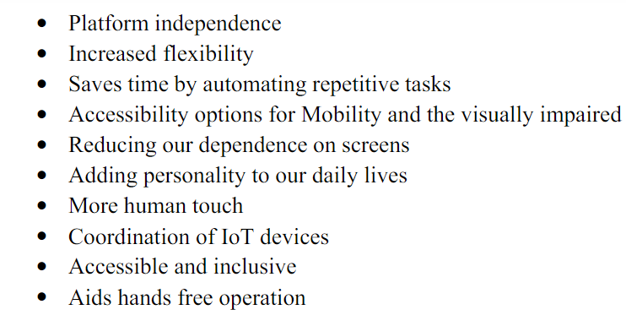
SOME OTHER ADVANTAGES …

Slide 25
DISADVANATAGEs :
Not good in noisy places.
A user had to speak much louder and slower than their normal speed and volume.
Low accuracy.

Slide 27
Result
BOSS is a less time consuming. BOSS is a software that understands verbal or written commands and complete task assigned by client.
BOSS use natural language processing (NLP) to match user voice or text input with executable commands.
With the help of virtual assistant, you able to run your machine-like laptop or PC’s on your own command. It is the fast process; therefore, it saves time. Virtual assistant is working for you at set times, so always available to you and able to adapt to changing needs quickly.
Virtual assistant will be available to you and, should their workload enable, help others too, such as family and colleagues.

Slide 28
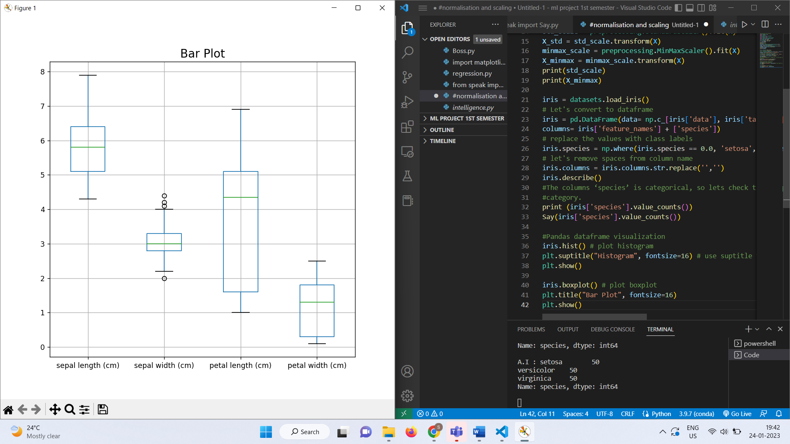

Slide 29
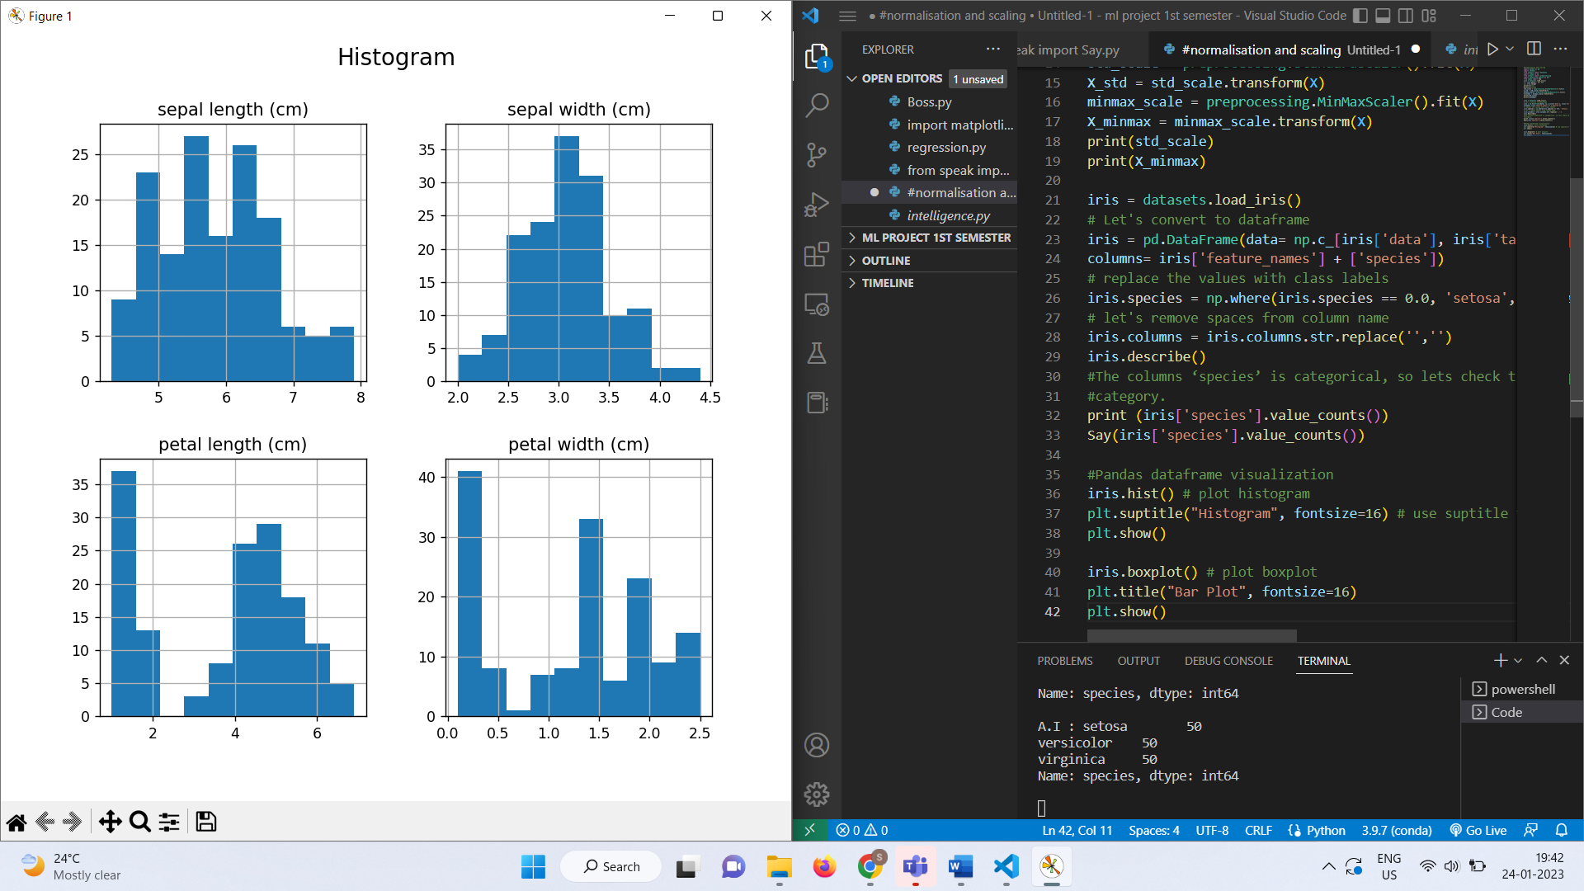

Slide 30
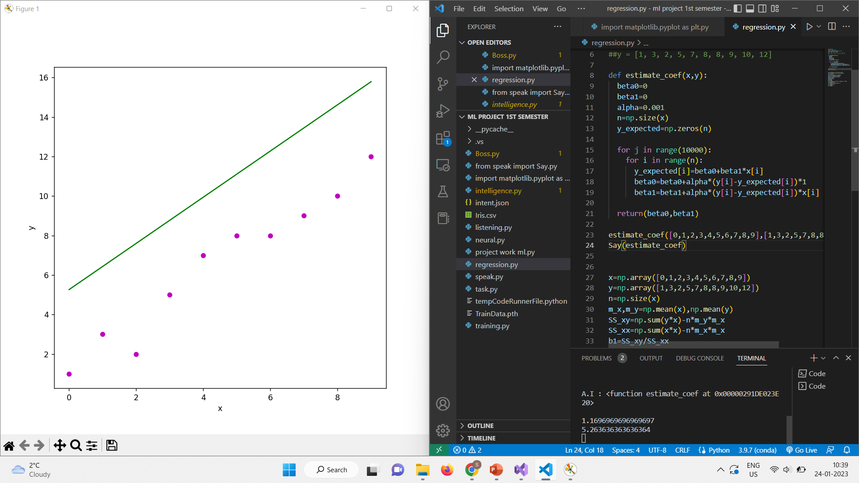

Slide 31
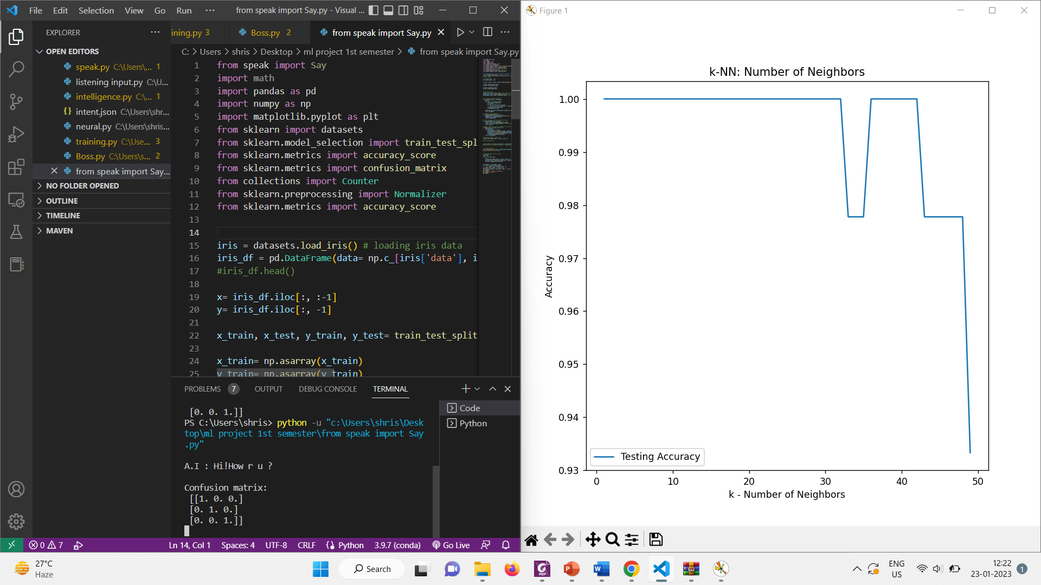

Slide 32
SUMMARY
This project presents a comprehensive overview of the design and development of a voice enabled personal assistant for pc “BOSS” using Python programming language.
The Assistant works properly to perform some tasks given by user. It’s effective to organize our schedule.
“BOSS” is more portable and can be use anytime as it is connected by internet it contains a lot of data.
Furthermore, there are many things that this assistant can do like Chat-Bot, Showing Time/Date, Google Search, Wikipedia, etc. with just one voice command.
This Voice enabled personal assistant, in today’s era will be more effective & useful w.r.t less cost and less disadvantages. This system can have a good future.

Slide 33
THANK YOU

