Slide 1

INTERNAL HACKATHON @ IET DAVV INDORE
Ministry/ Organization name : Govt. of Goa Problem Statement Number/ID : DR111 Domain Bucket : Software – Web App Development Team Name : KEYCODERS 2.0 Team Leader Name : Sumit Kr Singh
PS and Team Details

Slide 2
Problem Statement Description
The Directorate of Higher Education has 7 Government Colleges and 26 aided colleges under it. Altogether, more than 10000 students that pass out from them every year either choose to opt for further studies, work or have their own startups. Currently, there is no mechanism for the colleges and the Directorate to keep a track of the students passing out. Hence, the problem is to develop a web based application for colleges and the Directorate to keep a track of the Alumni. The said application should have the following features:-
(a)Allow the Alumni members to register themselves
(b)Allow colleges to verify and authenticate their registered alumni
(c)Provision for alumni members to update their details
(d)Allow the colleges to search details based on criteria such as year, subject, etc.
(e) Allow the Directorate to search details based on criteria such as colleges, year, subject, etc.
(f)Send messages and emails to alumni members
(g)Group chats, create events, publish notices on the portal
(h)Security features with login for every user.

Slide 3
Idea / Approach details
A social network platform dedicated to alumni of the colleges under The Directorate of Higher Education, Government of Goa.
Our web-app will have 3-level hierarchy i.e. (i)Directorate, (ii)College admins and (iii)Alumni.
Directorate will have authority to control admins and search details based on different factors.
Each college Admin will have the responsibility of verifying all the newly registered alumni of their respective colleges. He can also post events and publish notices along with sending mails and messages to alumni in network.
Each alumni will register themselves to portal. They can also edit their profile, see events and notices and connect with people on their network through facilities provided such as group chats.
A web-based app which will use the extensible database to keep track of the alumni, their current positions and providing an interactive user-experience with all the required functionalities :
3-Tier Application => Directorate, College Admins, Alumni.
1st => Alumni registration.
2nd => Verification(of Alumni) Portal for each college admin.
3rd => Colleges and Directorate can search details based on criteria such as year, subject, etc.
4th Build on MVC Architecture.
5th Scalability of adding new colleges and admins by Directorate Admin.

Slide 4
Technology Selection
Front End
HTML
Back End
PHP
CSS, Bootstrap(Framework)
JavaScript, JQuery
MySQL
Database
CodeIgniter(Framework)
AJAX(Technology)

Slide 5
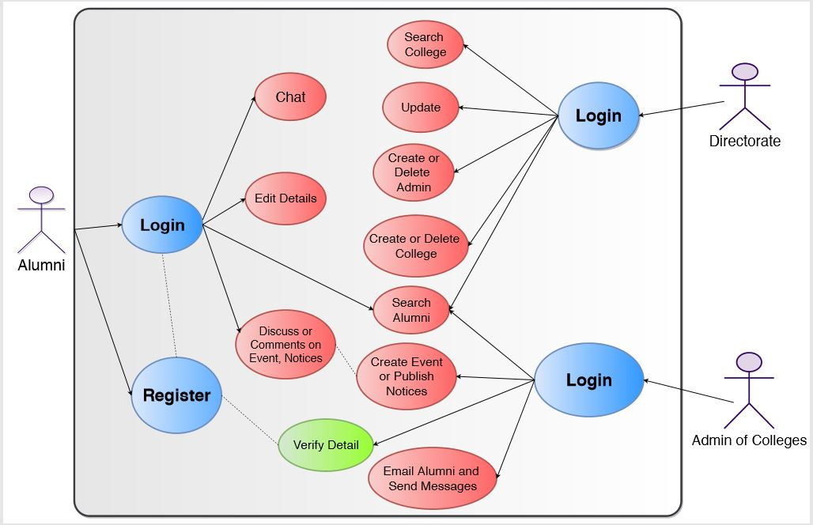
Preliminary Analysis and Design (Use-cases)

Slide 6
Preliminary Analysis and Design (Dependencies)
External APIs of LinkedIn, Google and Facebook for Sign In.
Student Data of College Alumni(passed out students).
Messaging API/Server
Email Server
Web Hosting

