Slide 1

Movie Rental Analysis
DEEPA KUMARI

Slide 2

INTRODUCTION
The objective of this project is to analyze the Sakila Movie Rental Dataset to gain insights into customer behavior, rental patterns, film preferences, and store performance. By exploring the dataset, we aim to extract valuable information that can be used to optimize business operations, improve customer satisfaction, and enhance decision-making processes.

Slide 3
EDA Analysis

Slide 4
Q1. What are the purchasing patterns of new customers versus repeat customers?
As per my analyzation repeat customers are 599, so Sakila DVD store has more customer retention as compared to new customers.
It means that the rental service has successfully retained a significant portion of its customer base. This is a positive indicator of customer satisfaction and loyalty.

Slide 5
Q2. Which films have the highest rental rates and are most in demand?
Tequila Past, Bowfinger Gables, Creepers Kane, Twisted Pirates, Train Bunch, Punk Divorce, Stranger Strangers, Range Moonwalker, President Bang, Birds Perdition are top 10 films which has higher rental rates and are in most in demand as per Sakila DVD rental dataset.

Slide 6
Are there correlations between staff performance and customer satisfaction?
Analyzing the average ratings received by
staff members provides insights into their performance
and its potential impact on customer satisfaction.
These insights can inform decision-making processes related
to staff training, customer service initiatives, and overall
business strategies aimed at improving customer experience and
loyalty.

Slide 7
Are there seasonal trends in customer behavior across different locations?
As per the result, I have analyzed that Customers in summer season in different locations are highest in rental values as compared to spring and winter.
So, we should more focus in summer season for increasing our sales.

Slide 8
Are certain language films more popular among specific customer segments?
As per Sakila dataset and my analyzation, English is the only language which is most popular in each customer segment whether it is active or inactive.

Slide 9
How does customer loyalty impact sales revenue over time?
As per the result, my analyzation is that customer loyalty decreases the sales revenue as compared to new one. But customer loyalty helps to attract new customers via word-of-mouth which eventually increases the sales revenue. Hence, it’s important to retain the customer loyalty.

Slide 10
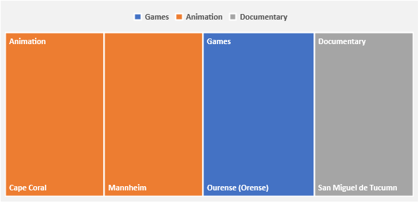
Are certain film categories more popular in specific locations?
Games, Animation, Documentary are the most popular film categories which are popular in Orense, Cape Coral & Mannheim, San Miguel de Tucumn respectively as per my result.

Slide 11
How does the availability and knowledge of staff affect customer ratings?
When staff has more availability and knowledge
than customers get more service and knowledge
and they are satisfied, so eventually it increases
the customer ratings. As Mike has more ratings
than Jon.

Slide 12
How does the proximity of stores to customers impact rental frequency?
 | In the Sakila DVD rental dataset, the proximity of a store to customers can impact rental frequency in different ways:
 | 1, Convenience: Customers are more likely to rent from a store that is closer to their location.
 | 2. Competition : If there are multiple stores in close proximity, competition between them may influence rental frequency.
 | 3. Foot Traffic: Stores in closer proximity to customers may experience higher foot traffic, resulting in more rental frequency.

Slide 13
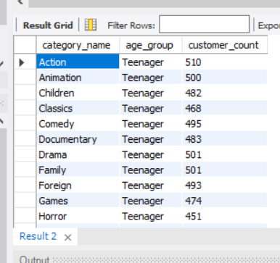
Do specific film categories attract different age groups of customers?
As per my analyzation, Teenagers are only there who are attracted towards every film categories.

Slide 14
What are the demographics and preferences of the highest-spending customers?
Ana, Clara, Eleanor, Karl, Marcia, Marion, Rhonda, Tim, Tommy, Wesley are the highest spending customers. And they prefer all the film categories.

Slide 15
How does the availability of inventory impact customer satisfaction and repeat business?
After analyzing my result, it is cleared that the inventory has significant effect on customer satisfaction and repeat business in different ways:
Variety and selection of movies
Availability of popular titles
Customer loyalty
Inventory management
Order fulfillment
avg_customer_rating | Total film_id | Total inventory_count
1 | 75984 | 791
2 | 98388 | 924
3 | 113796 | 1018
4 | 97040 | 904
5 | 96281 | 944

Slide 16
What are the busiest hours or days for each store location, and how does it impact staffing requirements?
For each store location, The busiest hour is 23 and the total rental count for Lethbridge and Woodridge are 5317 and 8121 respectively.
Store_location | Busiest hour | Total rental count
Lethbridge | 23 | 5317
Woodridge | 23 | 8121

Slide 17
What are the cultural or demographic factors that influence customer preferences in different locations?
 | Customer preferences in different locations are influenced by a variety of cultural, demographic, socioeconomic factors. Here are some key factors:
 | Language
 | Customer Country
 | Age
 | Gender
 | Economic Factors

Slide 18
How does the availability of films in different languages impact customer satisfaction and rental frequency?
As per Sakila DVD dataset, there is only one language i.e. English which is available. So, As per my analyzation, here language has no impact on customer satisfaction and rental frequency.

Slide 19
Power BI Analysis

Slide 20
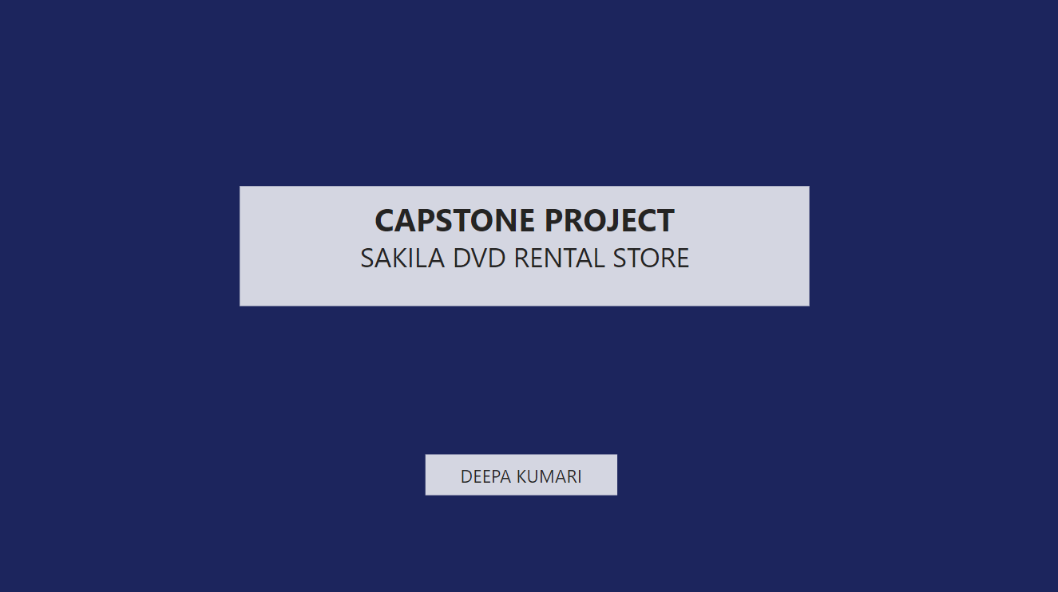

Slide 21
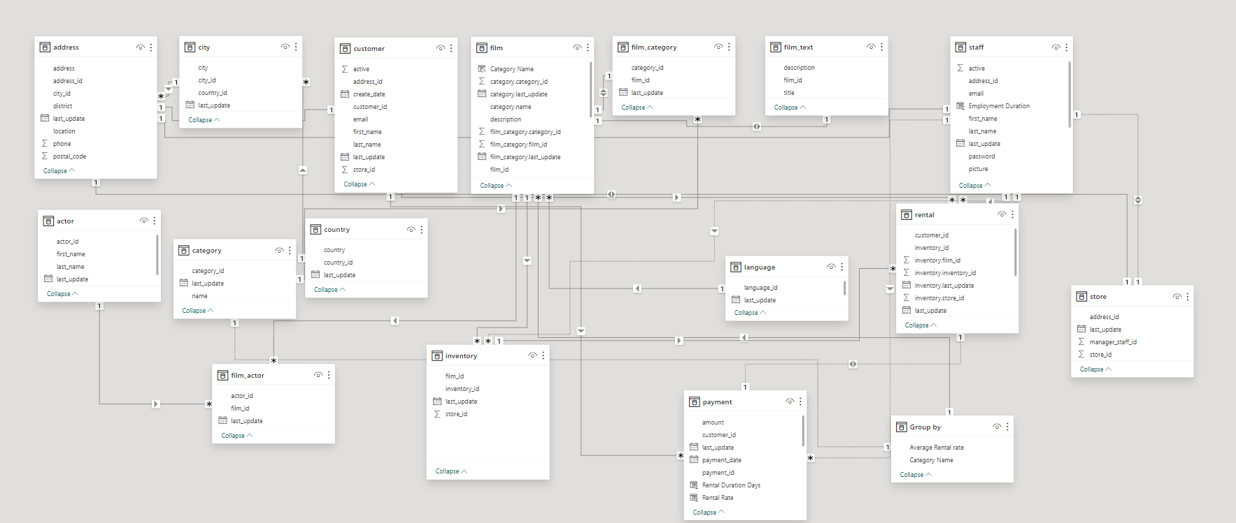
ER Diagram

Slide 22
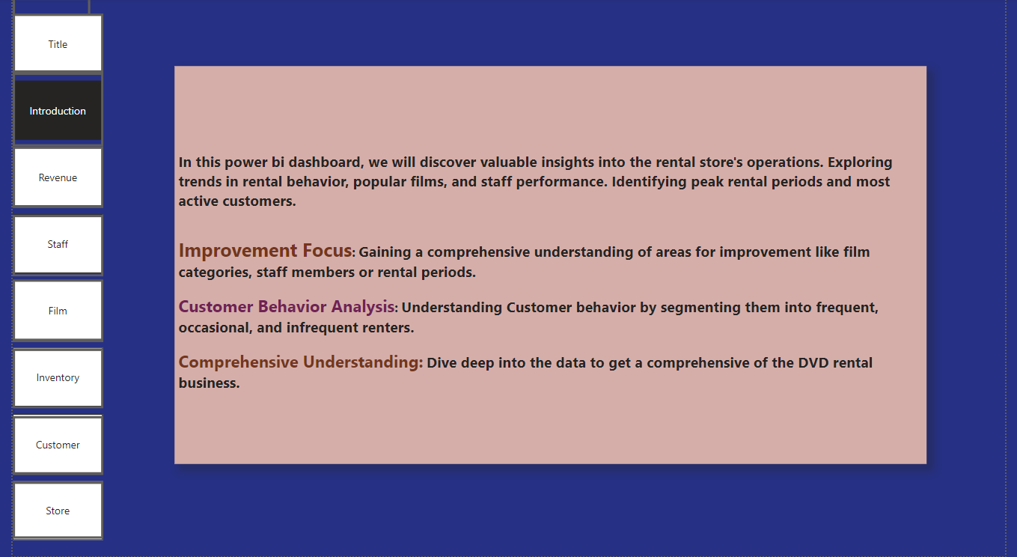

Slide 23
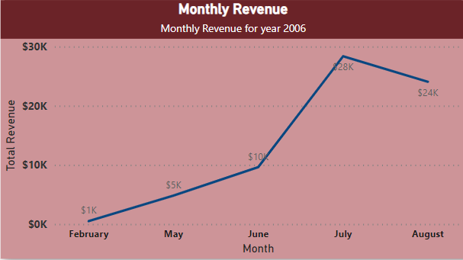
How does the sales revenue vary by month?
As per my analyzation, the revenue increases as per month.
From February to July, the revenue increases but in august month it decreases by 4k.

Slide 24
What is the distribution of sales by payment method?
There is no payment method related column is given. So, it’s difficult to get the analyzation.

Slide 25
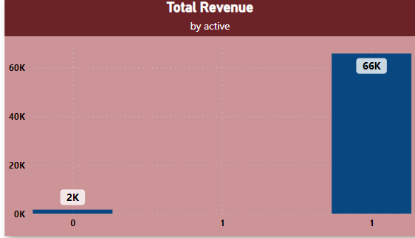
Which customer segments generate the highest sales?
Active customer segment has maximum
revenue as compared to inactive customer segment.

Slide 26
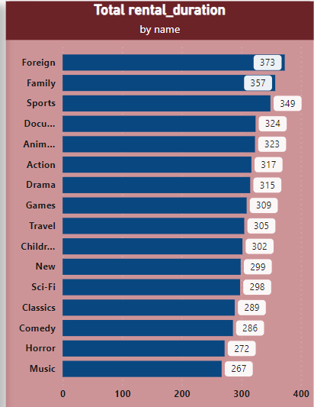
What is the distribution of films by rental duration?
As per my analyzation, Foreign Films has more rental duration i.e. 373, family films has 357, Sports film has 349 etc.

Slide 27
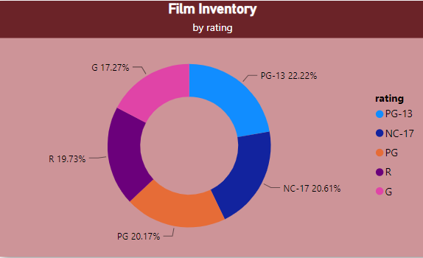
How does the inventory vary by film rating?
PG-13 rated films has highest film inventory contribution as compared as other ratings.

Slide 28
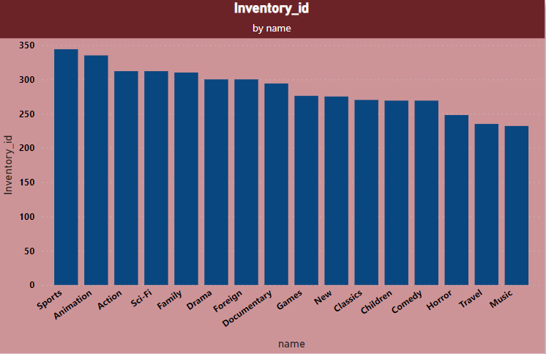
What is the breakdown of film categories in the inventory?
Understanding the breakdown of film categories
in the Sakila DVD dataset enhances the user
experience by organizing the content systematically,
providing insights into content distribution, and facilitating
exploration based on specific interests or preferences.

Slide 29
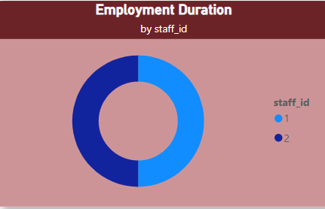
What is the distribution of staff by employment duration?
The distribution of staff by employment duration
provides insights into the stability and longevity
of the workforce, which can be valuable for HR
management and strategic decision-making within
the organization.

Slide 30
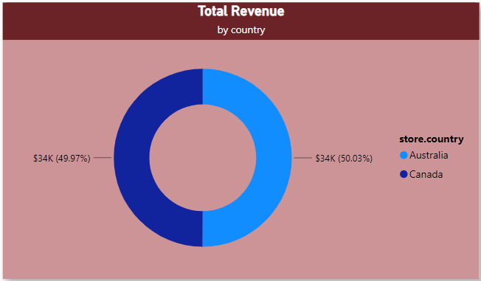
How does the store performance vary by location?
Store performance can vary significantly by location due to various factors such as demographic difference, competition in the area, economic conditions, local preferences, and even cultural influences. As per the adjacent chart, in context to total revenue including above factors Australian store has slightly higher revenue than Canada.

Slide 31
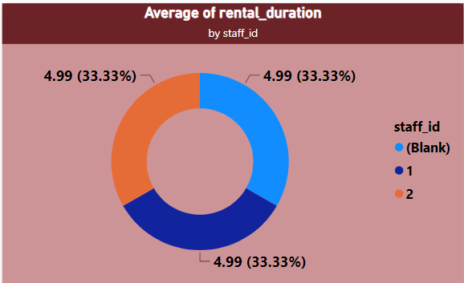
What is the average rental duration by staff member?
The average rental duration per staff member is approx. 5 hours over the one-month period.

Slide 32
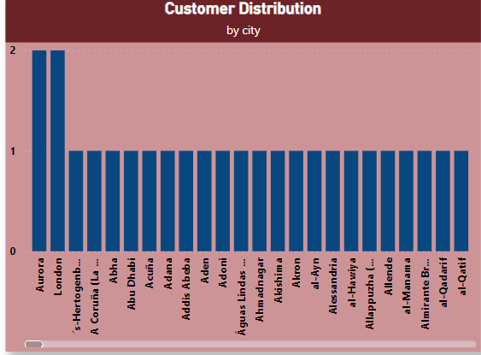
What is the distribution of customers across different cities?
Aurora & London are the two cities which have highest number of customers. So, these cities are likely to be the primary markets for DVD rental store.

Slide 33
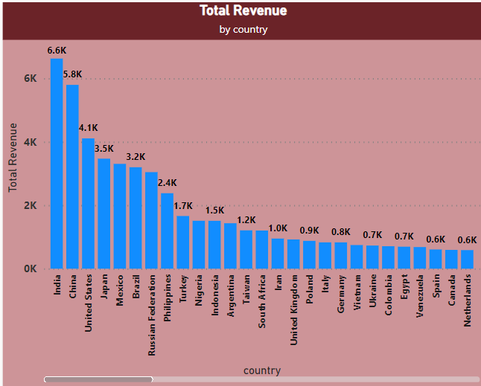
How does the rental revenue vary by country?
India is the largest market among all countries, then China, afterwards United States which has generated the highest rental revenue. So these countries are likely to be our target markets where we can expand more.

Slide 34
Which locations have the highest and lowest customer ratings?
In the Sakila DVD Rental Store Database, customer ratings are typically associated with film rentals rather than specific locations. However, we can infer the locations with the highest and lowest customer ratings by analyzing the average ratings of the films rented in each city.

Slide 35
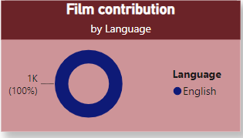
What is the distribution of films by language?
English is the only language which is preferred by every corner of the country. So, all the films available in Sakila DVD store is in English language.

Slide 36
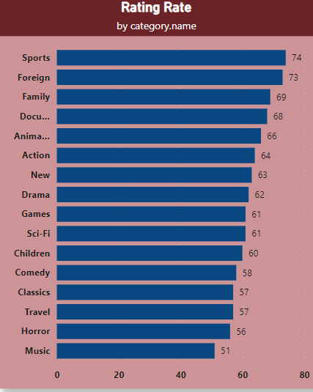
Which film categories have the highest rental rates?
Among all the film categories, Sports, Foreign, Family, Documentaries, & Animation are the top 5 film categories which have highest rental rates. So, we should focus more on these top 5 categories for increasing our revenue.

Slide 37
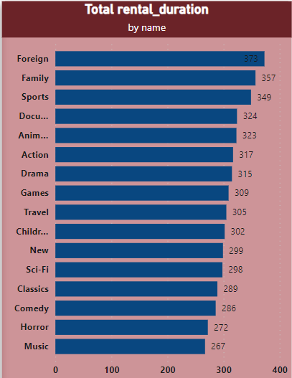
How does the average rental duration vary by film category?
Among all the film categories, Foreign, Family, Sports, Documentaries, & Animation are the top 5 film categories which have highest rental duration. As per these analyzation, we can optimize our DVD rental business, including inventory management, market strategies, and customer engagement, ultimately driving revenue and customer satisfaction.

