Slide 1
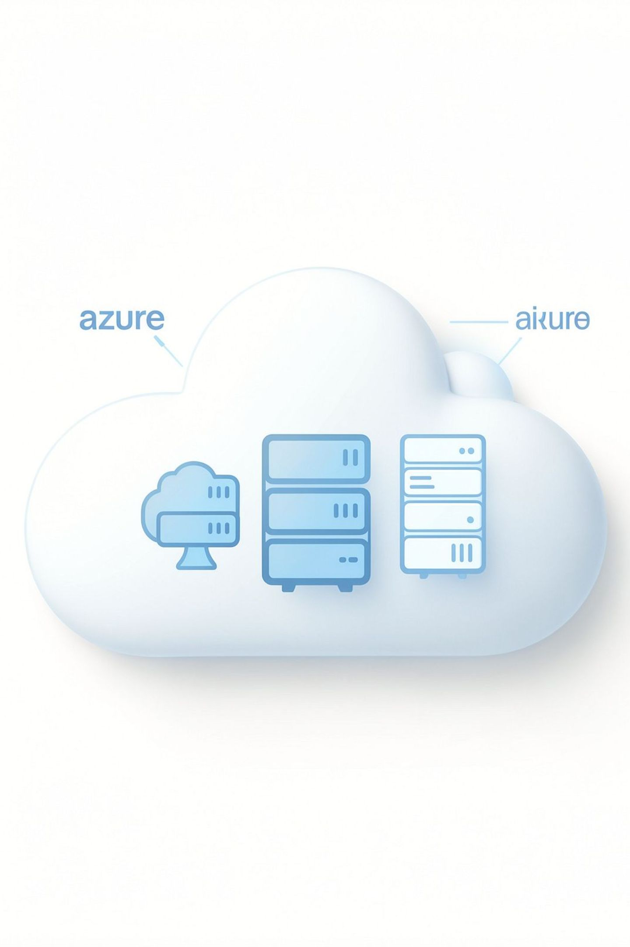
Azure Confidential or Isolated Compute Design Study
Secure and Cost-Aware Azure Compute for Sensitive Workloads
Project No.: 24CC3046-P074 Team No.: T176 Section: 52-MA Mentor: Raju Anitha
Team Members: Deepamrutha Thota • Vallela Sasidhar Reddy • Devaragatla Siddartha • Jetty Kundhan Yaswanth Sai

Slide 2
Introduction & Problem Statement
Organizations process highly sensitive data (financial, healthcare, government, customer records). Choosing the right Azure compute environment affects confidentiality, compliance and operational cost.
Problem: How can an organization select an Azure compute environment that provides appropriate protection and isolation while balancing security, compliance, performance, availability and cost?
Security
Protection of data at rest and in memory
Isolation
Workload separation and tenant isolation
Compliance
Regulatory and audit requirements
Performance
Latency and throughput needs
Availability
Uptime and fault domains
Cost
CapEx/Opex implications and SKU premiums

Slide 3



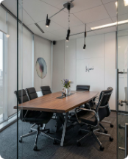
Objectives and Use Cases
Primary Use Cases
Banking & Finance
Healthcare
Objectives
Patient data processing and analytics
Transaction processing, sensitive ledgers
Study Azure Confidential and Isolated compute options
Compare alternatives for security, privacy and compliance
Evaluate performance, availability and cost trade-offs
Provide compliance justification for each option
Identify regional availability and cost challenges
Government
Enterprise Confidential Apps
Citizen records and regulated services
Proprietary workloads and IP protection

Slide 4
Azure Compute Options Under Study
Comparison of core compute choices considered in this project. Table lists purpose, isolation characteristics, and intended project usage.
Option | Purpose | Isolation | Project Usage
Standard Azure VM | Baseline environment for general-purpose workloads | Shared host kernel, logical isolation | Practical implementation / baseline
Azure Confidential VM | Confidential computing with TEEs (trusted execution) | Hardware-based memory protection, stronger isolation | Evaluate for sensitive workloads
Azure Dedicated Host | Dedicated physical server for tenant isolation | Infrastructure-level isolation (single-tenant host) | Alternative architecture to compare isolation

Slide 5
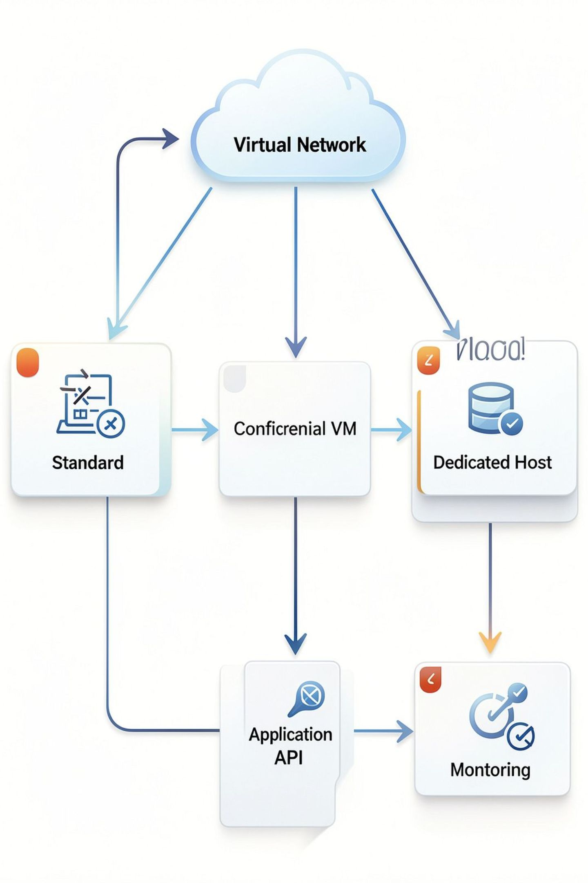
Proposed Azure Architecture
Explanation:
Standard VM used as the baseline deployment for the sample workload.
Confidential VM and Dedicated Host are evaluated as specialized options for stronger isolation.
Same workload is deployed across environments to compare security, isolation, performance, availability and cost.
Key Vault stores secrets; Azure Monitor collects metrics and logs for comparison.

Slide 6

Project Workflow
Problem Definition
Requirements
List security, performance, cost, and availability needs.
Clarify workload goals and evaluation factors.
Availability Check
Azure Options
Identify compute choices and deployment models.
Verify region and SKU availability constraints.
Compare the same sample workload using security, isolation, performance, availability and cost as evaluation factors.

Slide 7
Azure Resource, Identity and Resource Management
Task 1 — Managed Disk
Task 2 — Azure AD / Identity
Task 3 — Resource Management
Use Azure Cloud Shell PowerShell to create Resource Group and Managed Disk; configure disk via Azure PowerShell.
Create/configure Azure AD users, assigned & dynamic groups, tenant setup and guest user management.
Deploy resources, move between Resource Groups and implement Resource Locks for protection.

Slide 8
Networking, Virtual Machines and Storage
Task 4 — Azure Networking
Task 5 — Azure Storage
Key activities:
Key activities:
Create & configure Virtual Network and subnets
Deploy VMs into VNet, assign private/public IPs
Configure Network Security Groups (NSGs)
Use Azure DNS for internal/external resolution
Deploy VM and create Storage Account
Manage Blob Storage and Azure File Share
Configure authentication & access control
Visual: Storage Account → Blob Storage + File Share
Visual: VNet → Subnet → VM → NSG → IP → DNS

Slide 9
Azure Services and Key Considerations
Azure Services
Security & Compliance
Cost & Challenges
Virtual Network, NSG, Azure DNS
Standard VM, Confidential VM, Dedicated Host
Key Vault, Azure Monitor, Managed Disks, Storage
Protect data at rest, in transit and in memory
Stronger workload separation when required
Use Key Vault for secrets; document justification
NSGs and secure networking for segmentation
Specialized compute SKUs can incur higher costs
Limited regional availability for confidential SKUs
Leverage low-cost services where appropriate
Practical deployments may require paid credits or procurement

Slide 10
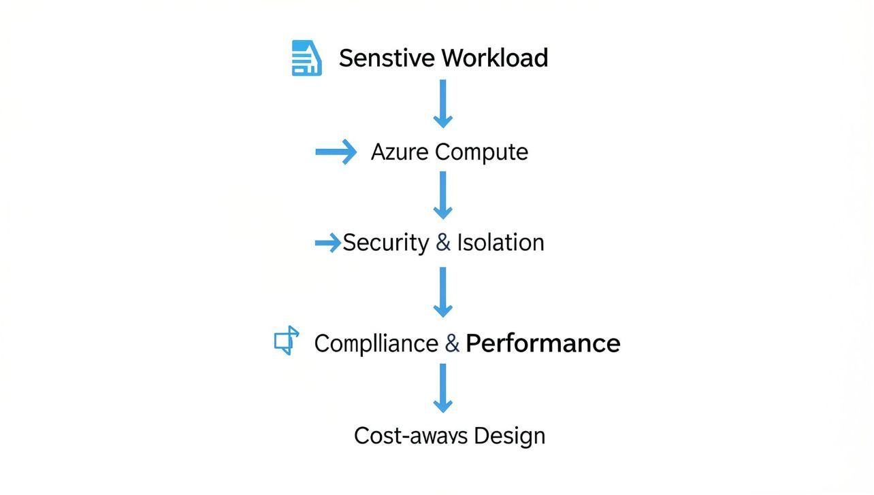
Conclusion
This study evaluates Azure compute options for sensitive workloads while distinguishing practical implementation from conceptual evaluation.
Standard VM serves as a practical baseline; Confidential VM and Dedicated Host are specialized alternatives for stronger isolation.
Evaluation covers security, isolation, compliance, performance, availability and cost—without inventing deployment results.
Regional SKU availability and specialized-compute cost are key practical challenges to document.
Approach supports further studies for banking, healthcare, government and enterprise workloads.
THANK YOU

