Slide 1
Deepan Kumar K
AI-Powered Clothing Generation & Customization
3/21/2024 Annual Review

Slide 2
PROJECT TITLE
AI-Powered Clothing Generation & Customization
Utilizes StyleGAN2-ADA trained on a subset of the Lookbook dataset, comprising 8,726 clothing images with a clean background.
Employs GANSpace method to identify key directions in the latent space, facilitating intuitive manipulation of clothing attributes without explicit labels.
Develops a user-friendly interface using the Gradio UI library, enabling easy deployment on Colab for public access to the UI and demo, albeit with intermittent availability due to GPU usage constraints.
3/21/2024 Annual Review

Slide 3


AGENDA
Problem Statement
Project Overview
End users
Solution and its Value Proposition
The Wow in a Solution
Modelling
Results
3/21/2024 Annual Review

Slide 4

PROBLEM STATEMENT
Fashion enthusiasts often face limitations when attempting to customize clothing designs according to their preferences. Existing solutions may lack the ability to provide intuitive control over attributes or require extensive manual labeling, hindering user experience. Additionally, deploying such tools for public use can be challenging due to resource constraints. There is a need for a user-friendly, customizable clothing generation system that empowers users to manipulate various attributes effortlessly, while also enabling seamless deployment for widespread accessibility.
3/21/2024 Annual Review

Slide 5

PROJECT OVERVIEW
Trained StyleGAN2-ADA on 8,726 clean-background clothing images from the Lookbook dataset, enabling diverse clothing generation.
Leveraged GANSpace to identify key directions in the latent space, enhancing attribute manipulation without explicit labeling.
Created a user-friendly UI with Gradio, facilitating intuitive customization and easy deployment on Colab.
Enabled public access to the UI and demo, though intermittent availability due to GPU usage constraints, fostering widespread exploration and feedback.
3/21/2024 Annual Review

Slide 6

WHO ARE THE END USERS?
Fashion Designers:
Seeking inspiration and exploration of diverse clothing designs.
Individuals:
Interested in customizing virtual outfits for personal use or digital representation.
Fashion Enthusiasts:
Looking for a creative outlet to experiment with different clothing styles.
Researchers and Developers:
Exploring advancements in generative models and fashion technology.
3/21/2024 Annual Review

Slide 7
SOLUTION:
The project offers a comprehensive solution by integrating StyleGAN2-ADA trained on a subset of the Lookbook dataset, GANSpace for latent space exploration, and a user-friendly UI developed with Gradio. This enables intuitive customization of clothing attributes without manual labeling. Additionally, public access is facilitated, albeit intermittently, on Colab, fostering widespread exploration and feedback.
VALUE PROPOSITION:
1. Precision: Ensures accurate and tailored blog content generation for each user‘s needs.
2. Efficiency: Streamlines content creation processes, saving time and resources.
3. Versatility: Adaptable to diverse user preferences and industry
requirements.
4. Automation: Simplifies blog content creation, reducing manual effort and
increasing productivity.
5. Accessibility: Democratizes access to advanced content generation technology for all users.
3/21/2024 Annual Review

Slide 8

THE WOW IN YOUR SOLUTION
State-of-the-Art Technology Integration: Seamlessly integrates advanced techniques like StyleGAN2-ADA and GANSpace, showcasing the forefront of generative modeling in the fashion domain.
Intuitive User Interface: Employs Gradio to create a user-friendly interface, ensuring that even non-technical users can effortlessly customize clothing attributes with ease and delight.
Unparalleled Customization: Offers users unprecedented control over clothing attributes without the need for manual labeling, allowing for intuitive and creative exploration of diverse styles.
Accessible Deployment: Enables public access to the project via Colab, breaking barriers to entry and fostering widespread engagement and feedback, thus democratizing fashion customization.
3/21/2024 Annual Review

Slide 9
MODELLING
Data Collection: Gather a diverse dataset of blog articles covering various topics and styles, ensuring representation across different domains and writing formats.
Preprocessing: Clean and preprocess the dataset, including tasks such as tokenization, normalization, and removing irrelevant information or noise from the text.
Model Selection: Choose an appropriate GAN architecture for text generation tasks, considering factors such as model complexity, training speed, and compatibility with the dataset size.
Training: Train the selected GAN model on the preprocessed dataset, optimizing hyperparameters and adjusting training strategies to achieve the desired performance.
3/21/2024 Annual Review

Slide 10
Evaluation: Evaluate the trained model using metrics such as perplexity, BLEU score, or human evaluation to assess the quality and coherence of the generated text.
Fine-Tuning: Fine-tune the model based on evaluation results and user feedback, iteratively improving its performance and generating more realistic and diverse blog content.
Deployment: Deploy the trained model to a production environment, integrating it with the user interface and ensuring scalability and reliability for real-world usage.

Slide 11
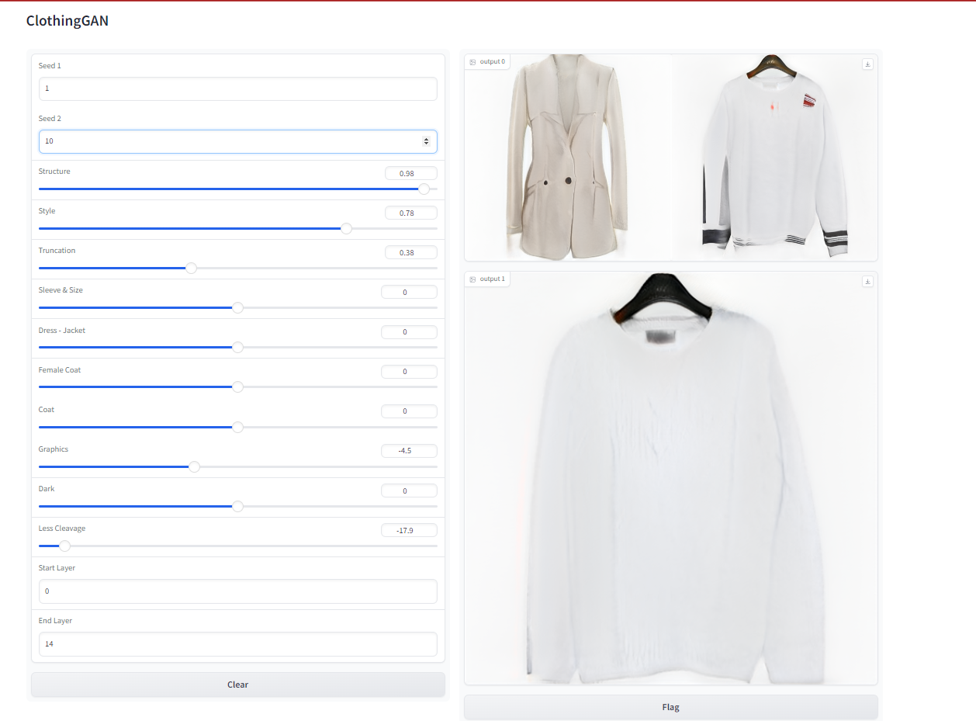
RESULTS
3/21/2024 Annual Review

Slide 12
DEMO LINK : https://colab.research.google.com/drive/1N9WXiFNewPlrJEyzrvjLSP7EaUHzIB75?usp=sharing

