Slide 1
Cyclistic Bike-Share Analysis
Strategic Analysis of User Behavior
for
Membership Conversion
Notes:
Introduce the project and highlight the business objective.

Slide 2
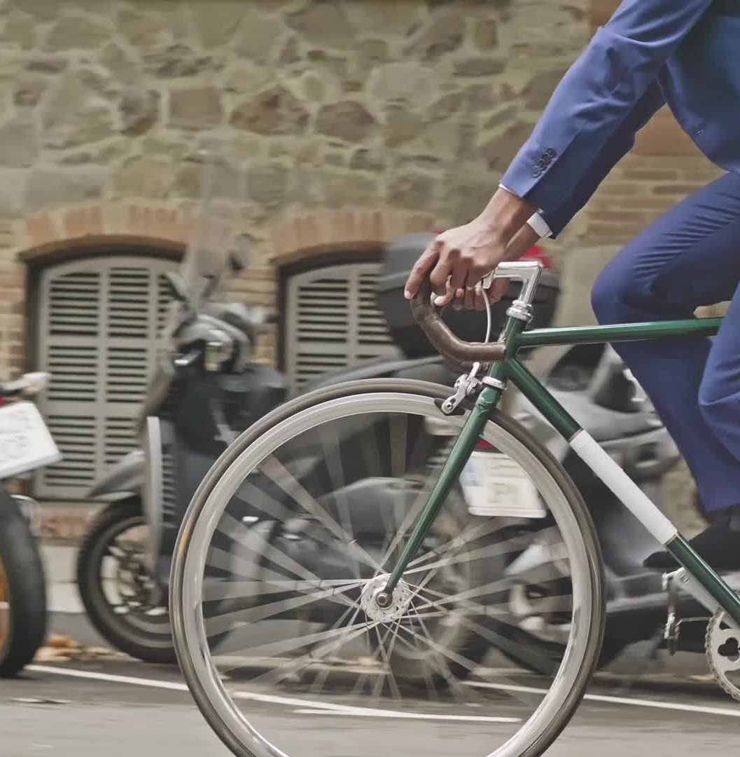
Business Context
Cyclistic is a bike-share company focused on increasing long-term profitability by converting casual riders into annual members.
Members generate predictable and recurring revenue, whereas casual users represent an opportunity for growth.
This analysis aims to identify behavioural differences between user types to support strategic decision-making.
Notes:
Explain why recurring revenue is critical.

Slide 3
Objective
Analyze behavioural differences between members and casual users
Identify usage patterns across time and duration
Develop actionable business recommendations
Key Question: How can casual riders be converted into long-term members?
Notes:
State analytical goal.

Slide 4

Data Sources https://divvy-tripdata.s3.amazonaws.com/index.html
Divvy Trips 2019 Q1
Divvy Trips 2020 Q1
Total Records: 791,000+
Data Includes:
Ride timestamps
Station information
Ride duration
User type
Notes:
Mention dataset size.

Slide 5

ETL Process - Python
A structured ETL pipeline was implemented using Python:
Merged datasets from different years
Standardized schema and column names
Converted data types (timestamps, numeric fields)
Removed inconsistencies and null values
Notes:
Highlight technical work.

Slide 6
Data Cleaning
Converted timestamps to datetime format
Calculated ride_length (in minutes)
Removed invalid records (negative or zero duration)
Removed outliers (> 90 minutes)
Result: Clean and analysis-ready dataset
Notes:
Importance of clean data.

Slide 7
Feature Engineering
New variables created:
day_of_week
hour
time_period (Morning, Afternoon, Evening, Night)
ride_category (Short, Medium, Long)
These features enabled deeper behavioural analysis.
Notes:
Explain usefulness.

Slide 8
User Type Standardization
Original categories included:
Subscriber
Customer
Member
Casual
Standardized into:
Member
Casual
Ensures consistency and clarity in analysis.
Notes:
Explain consistency.

Slide 9
Dataset Summary
Total Clean Records: 778,000
Members: 92%
Casual: 8%
Average Ride Length:
Members: 11 minutes
Casual: 26 minutes
Notes:
Highlight imbalance.

Slide 10
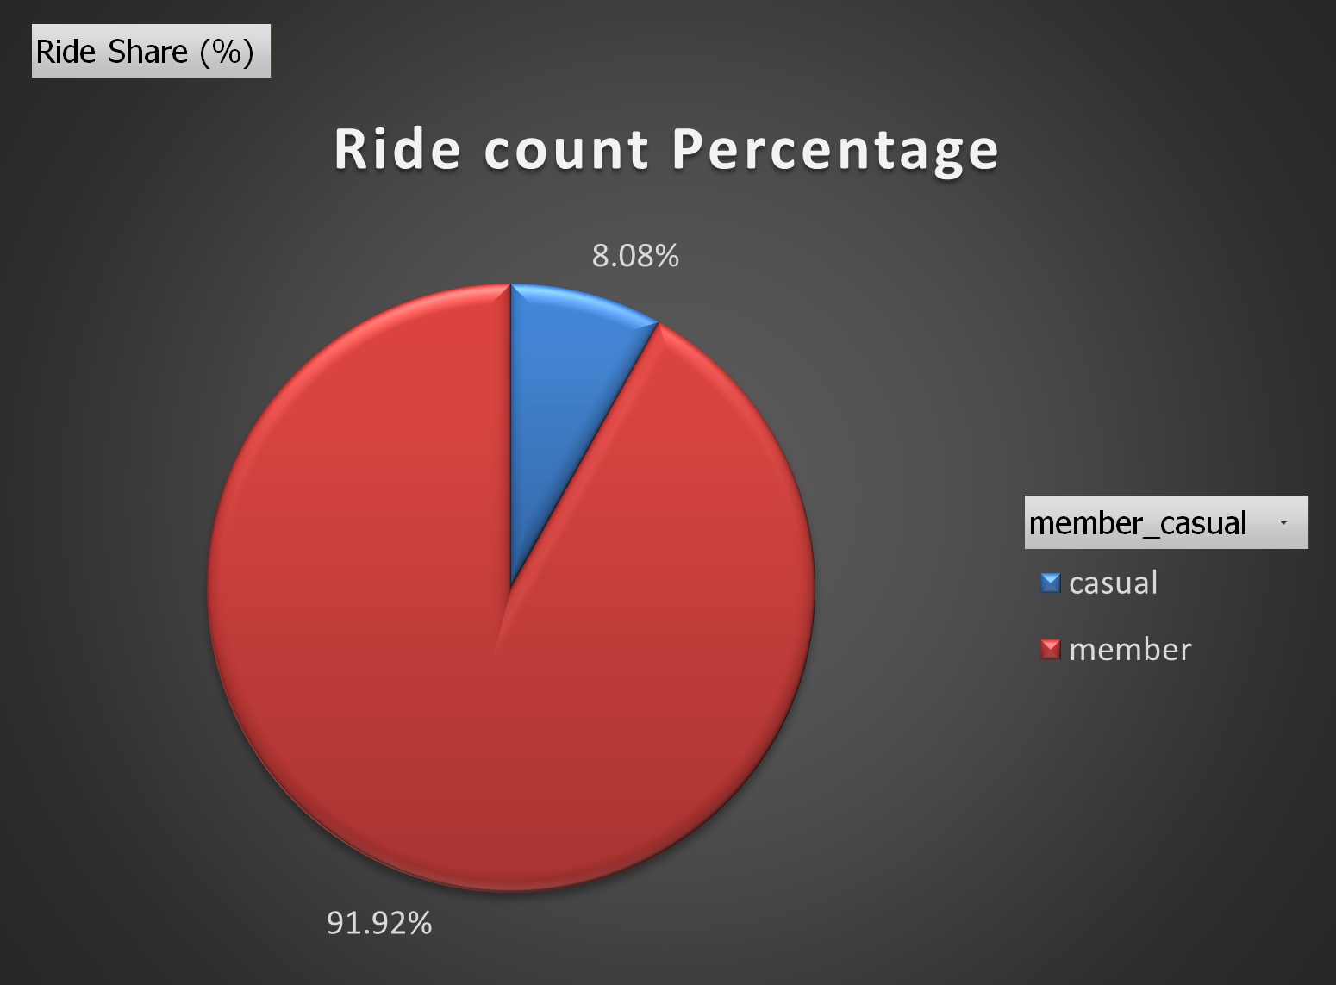
Ride Count by User Type
Members dominate total ride volume, accounting for over 90% of all rides.
Casual users represent a smaller but strategically important segment for growth.
Notes:
Explain dominance.

Slide 11
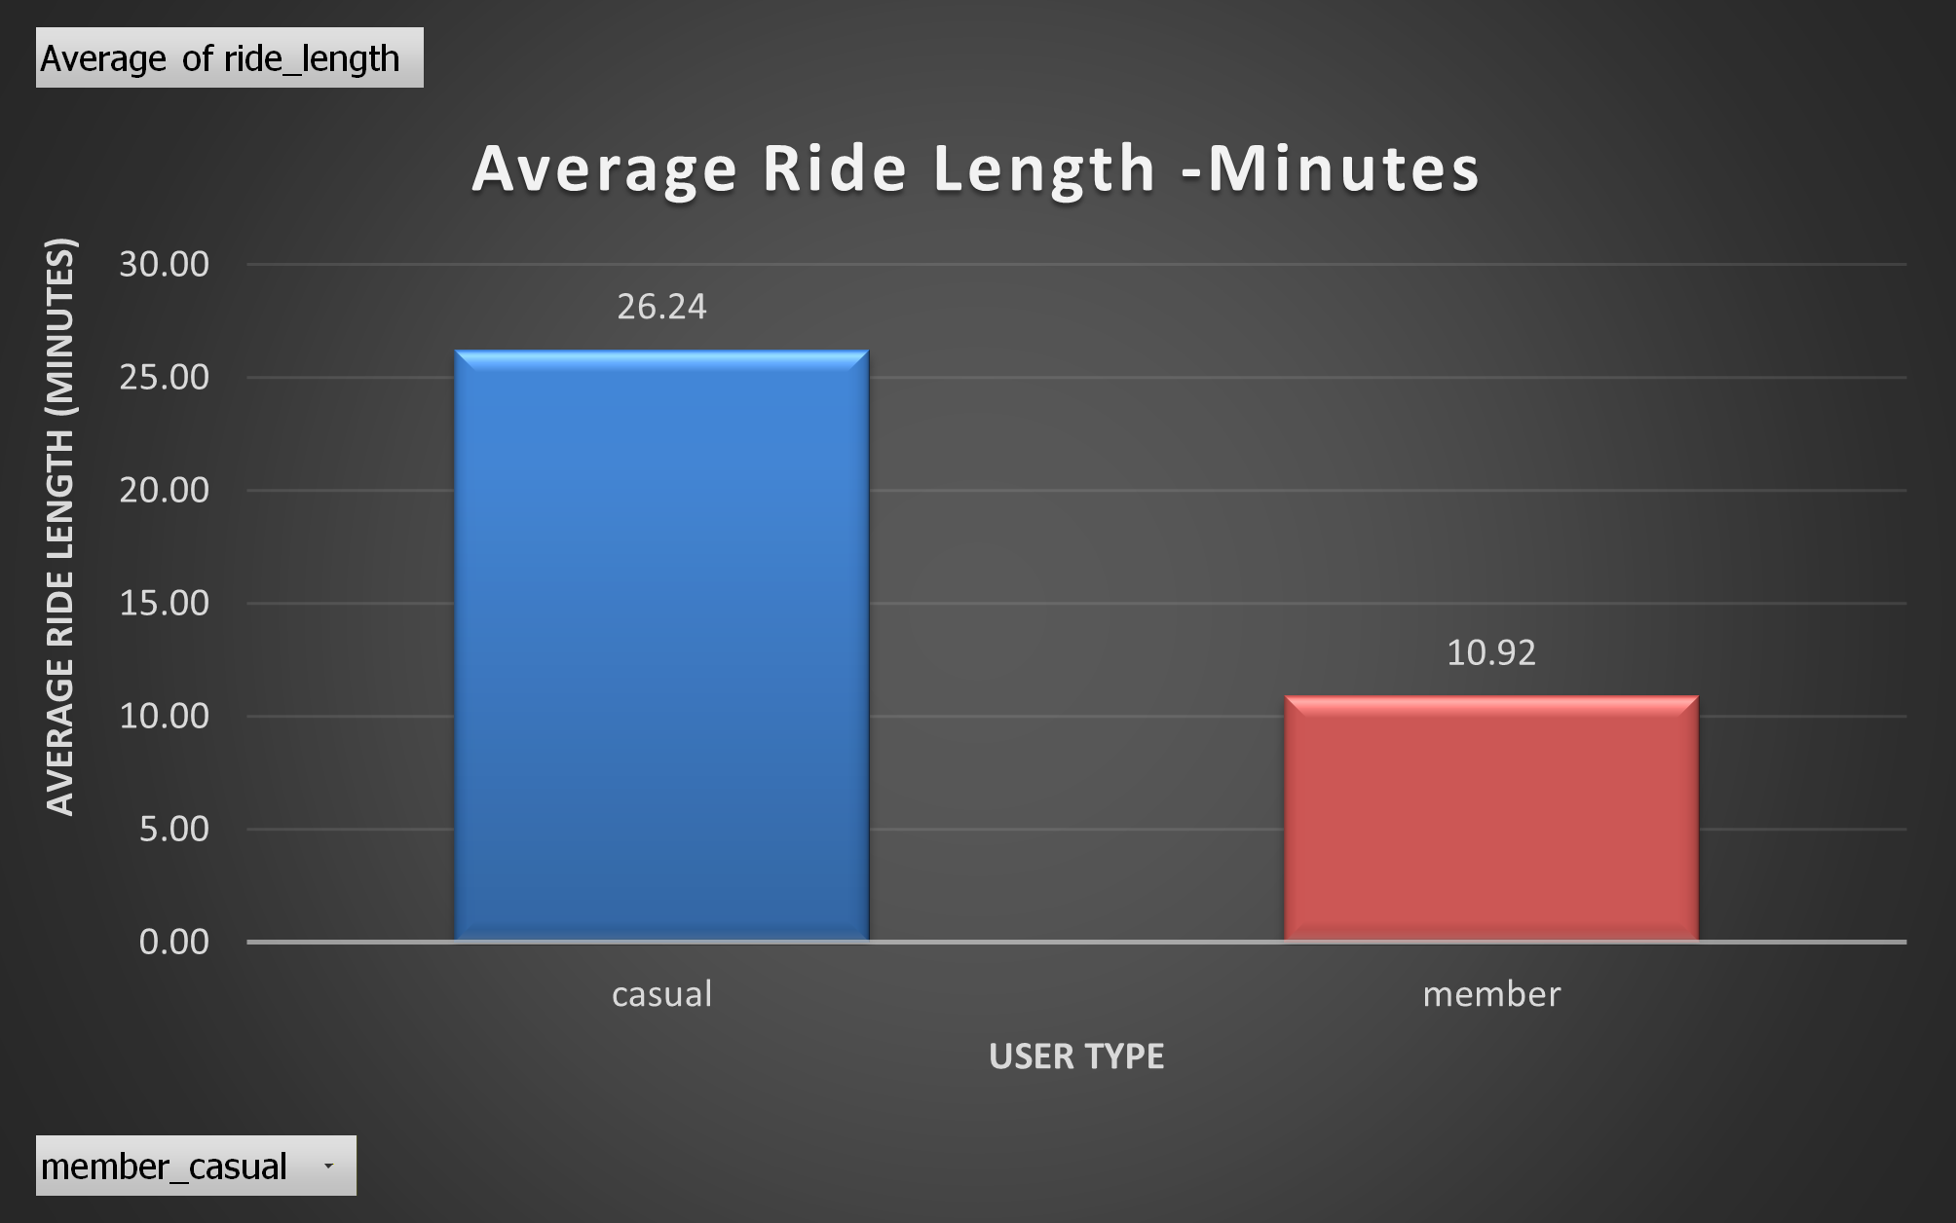
Average Ride Length by User Type
Casual users have significantly longer rides, indicating leisure usage.
Members exhibit shorter, frequent trips consistent with commuting behavior.
Notes:
Leisure vs commute.

Slide 12
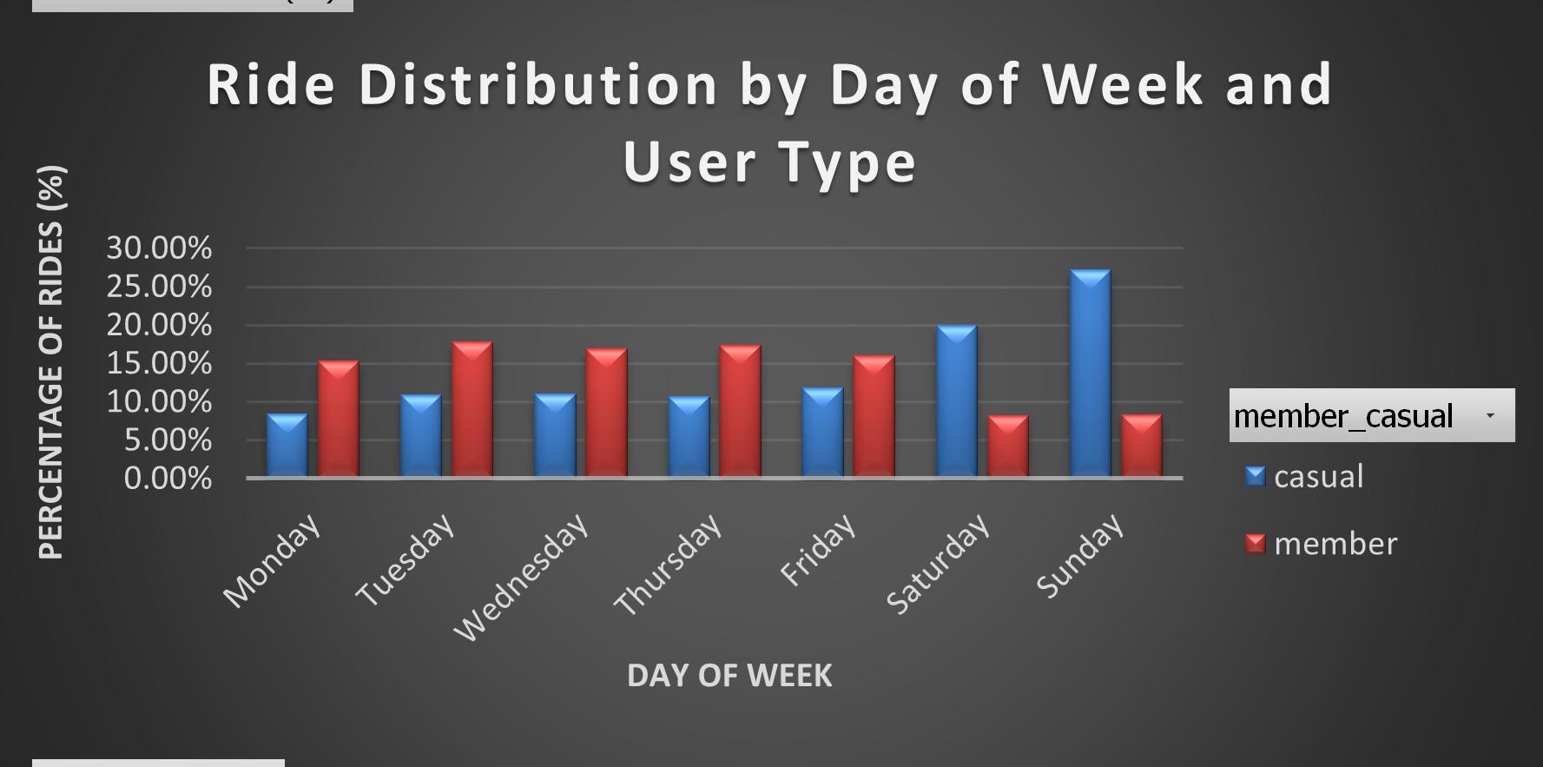
Ride Distribution by Day of Week
Members show consistent weekday usage.
casual users peak on weekends, indicating recreational usage patterns.
Notes:
Routine vs leisure.

Slide 13
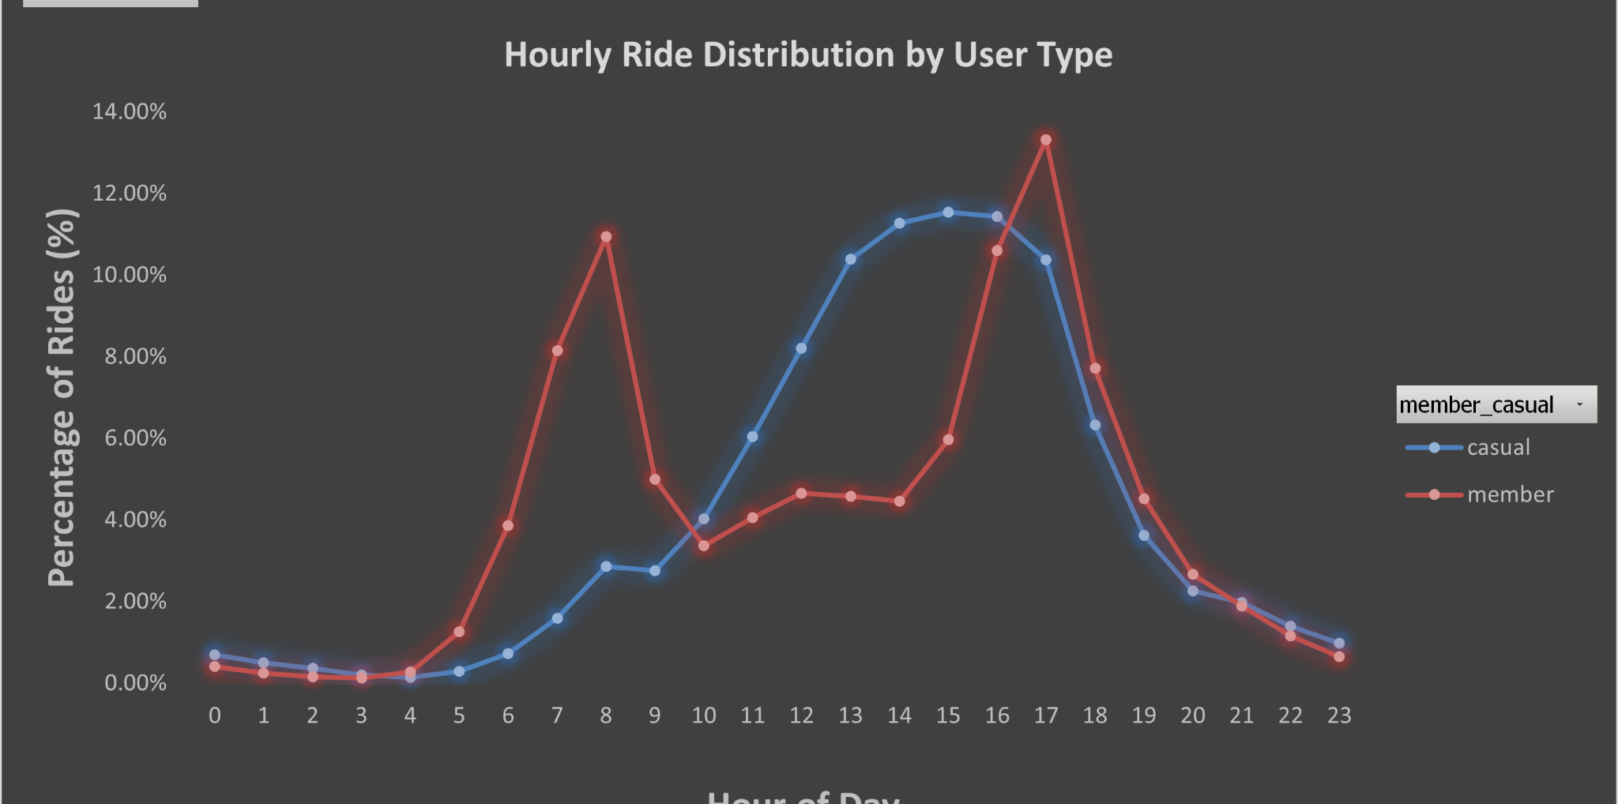
Hourly Ride Distribution
Members peak during commuting hours (morning and evening).
Casual users show higher usage during midday periods.
Notes:
Time behavior.

Slide 14
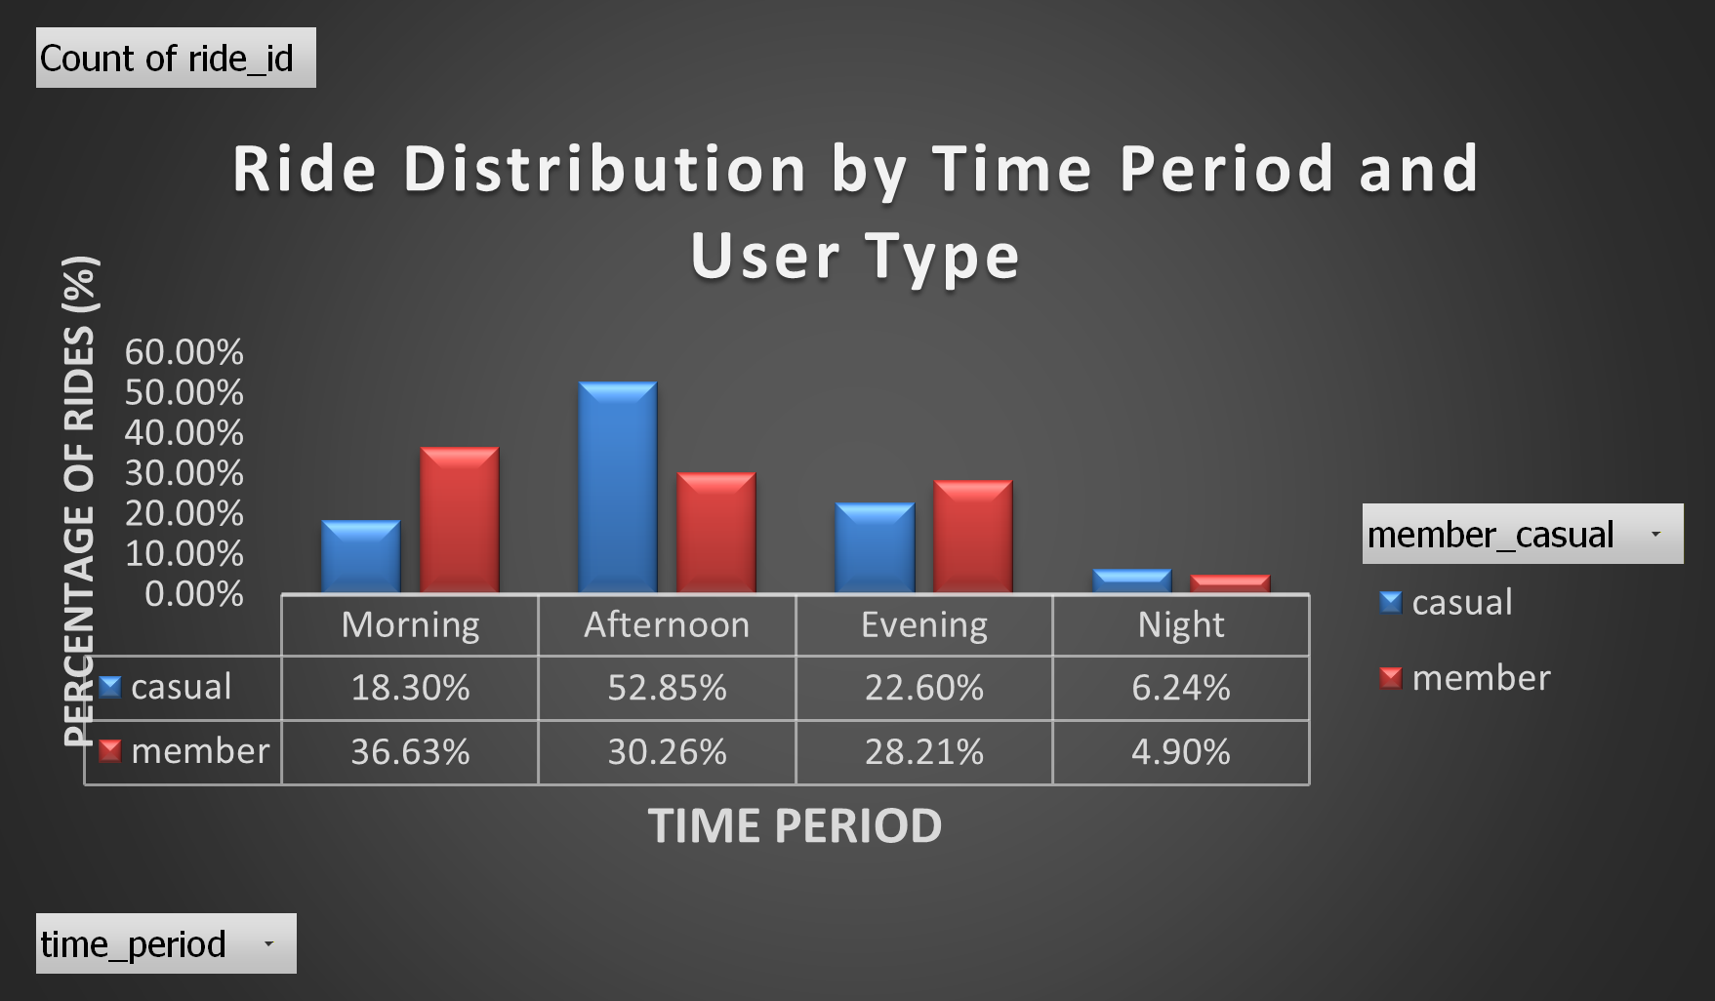
Ride Distribution by Time Period
Casual users concentrate rides in the afternoon.
Members show structured usage across morning and evening periods.
Notes:
Time segmentation.

Slide 15
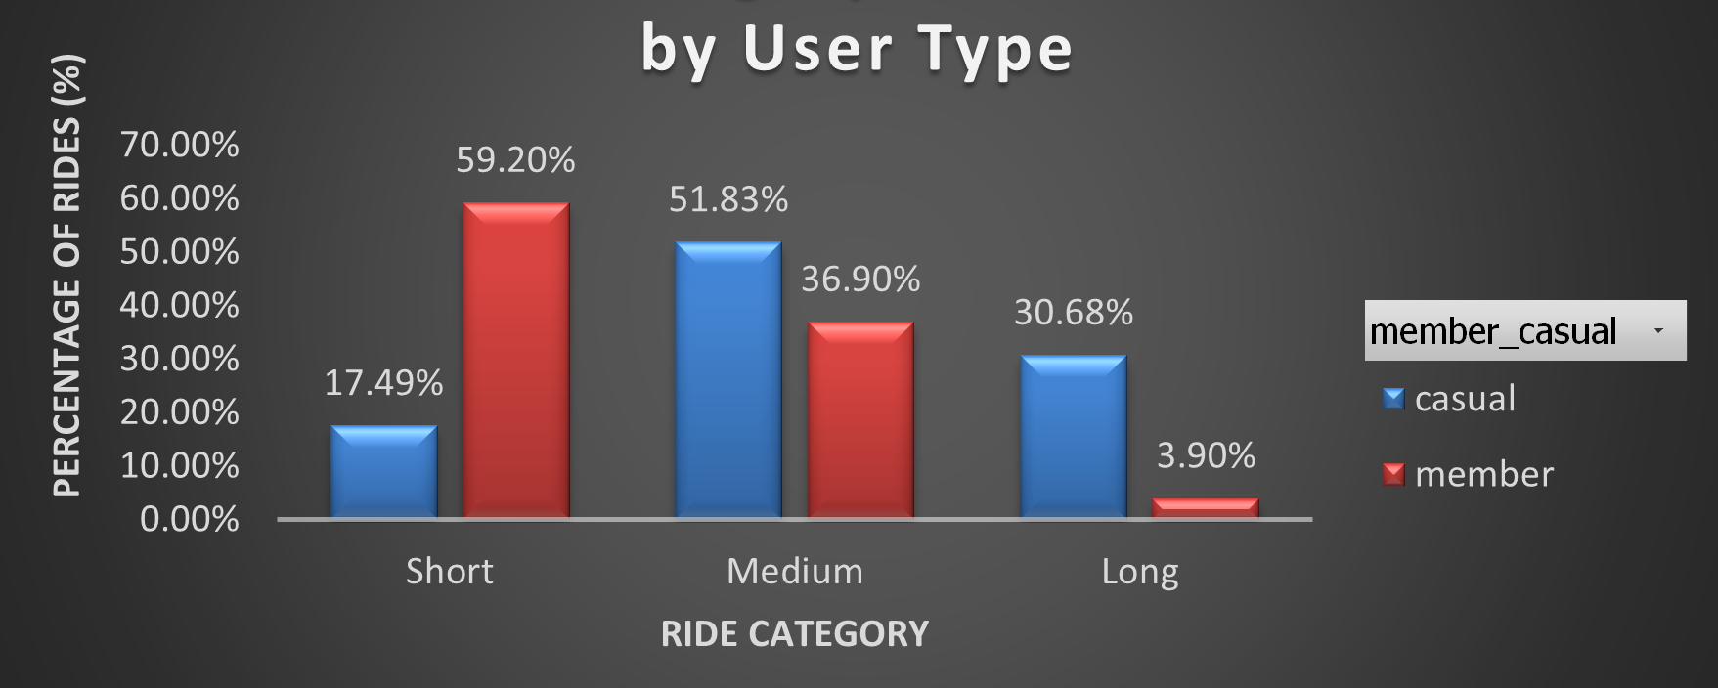
Ride Category Distribution
Members predominantly take short rides.
Casual users are more likely to engage in medium and long-duration trips.
Notes:
Duration insight.

Slide 16
Key Insights
Members
routine, short, frequent rides
Casual
longer, leisure-based rides
Clear behavioral segmentation exists
Notes:
Summarize findings.

Slide 17
Recommendations
Offer
Offer weekend-to-membership promotions
Introduce
Introduce ride bundles for casual users
Target
Target afternoon usage campaigns
Incentivize
Incentivize long-ride users to convert
Notes:
Business strategy.

Slide 18

Conclusion
Behavioral differences provide a strong foundation for targeted marketing strategies and membership growth.
Notes:
Reinforce value.

Slide 19
Tools Used
Python
(ETL & EDA)
Excel
(Analysis & Visualization)
Tableau
(Dashboarding)
Notes:
Tech stack.

Slide 20

Thank You
Questions?
Contact me at the e-mail id given on the profile.
Notes:
Close confidently.

