Slide 1








Security Alert
Client Environment and
Data protection
6th November 2025
www.relanto.ai

Slide 2
Usage of the client and Relanto Hardware
Accessing Relanto Systems via client Devices or Networks
Using client-provided laptops or client networks to log into Relanto platforms (Outlook, Teams, SharePoint, OneDrive) poses serious security and compliance risks
Transferring client Data from Relanto System
Uploading client data to personal drives or accounts (e.g., Gmail, Google Drive, Dropbox)
Sharing client information via internal Relanto emails or Teams chats
Locally storing client files on Relanto-issued devices
Do Keep Software Updated
Do Be Cautious with Emails
Consequences of Non-Compliance
Immediate removal from ongoing projects
Project termination by the client due to policy breach
Potential legal action or contractual penalties for both the employee and the organization

Slide 3


Data Protection Mandates
and Zero-tolerance security rules
Copyright © 2025 Relanto Inc. All rights reserved.

Slide 4

Security First
Do not upload, store or transfer source codes or proprietary information/ client data on personal devices, personal cloud accounts (e.g. Google Drive, Dropbox, iCloud), or any unauthorized platforms.

Slide 5
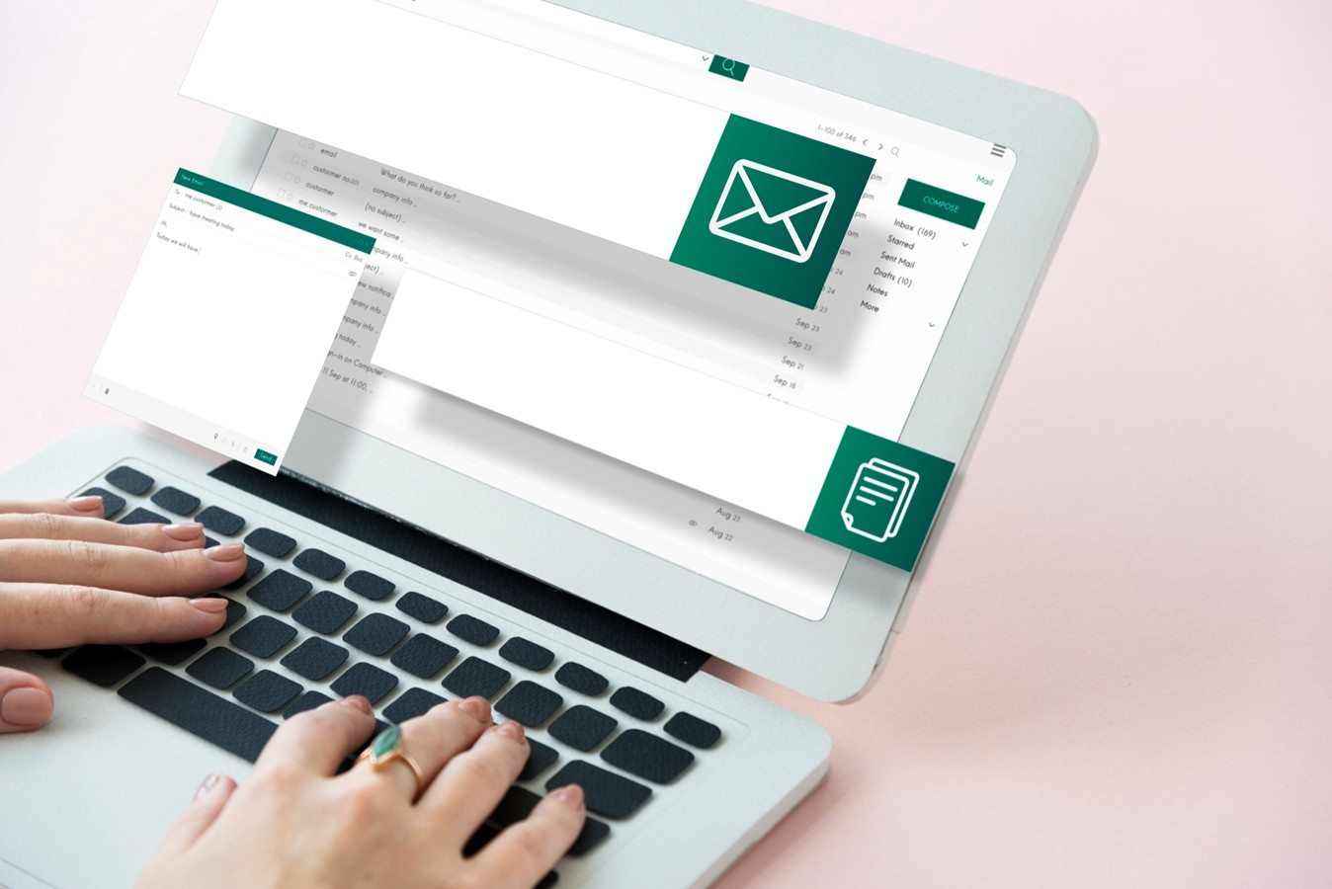
Security First
Do not use Relanto laptops to access, store, or share client data. Additionally, use of client data for internal POC’s is prohibited. (e.g., personal email, online shopping, gaming)

Slide 6

Security First
Do not upload any files or screenshots from client laptops into Relanto Cloud (e.g. SharePoint, OneDrive), Relanto Microsoft Teams or any other Relanto-managed collaboration tools.

Slide 7

Security First
Do not send client data from client laptops using Relanto email IDs, Personal email accounts (e.g. Gmail, Yahoo), Messaging apps (e.g., WhatsApp, Slack, Signal)

Slide 8

Security First
Do not configure Microsoft Teams or other Relanto apps on client laptops using Relanto credentials or use a non-client network for sensitive work. (e.g., public Wi-Fi without approved VPN)

Slide 9

Security First
Do not install unauthorized third-party software on client laptops.( e.g., personal tools, non-approved utilities)

Slide 10
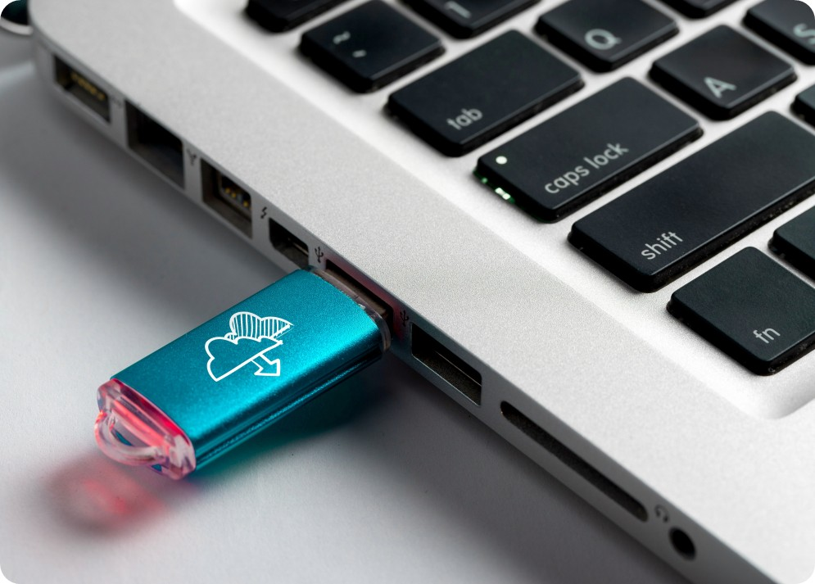
Security First
Do not connect unauthorized external hardware for file transfers (eg, USB drives, personal phones, non-approved peripherals) to client laptops without procuring client authorization in writing.

Slide 11
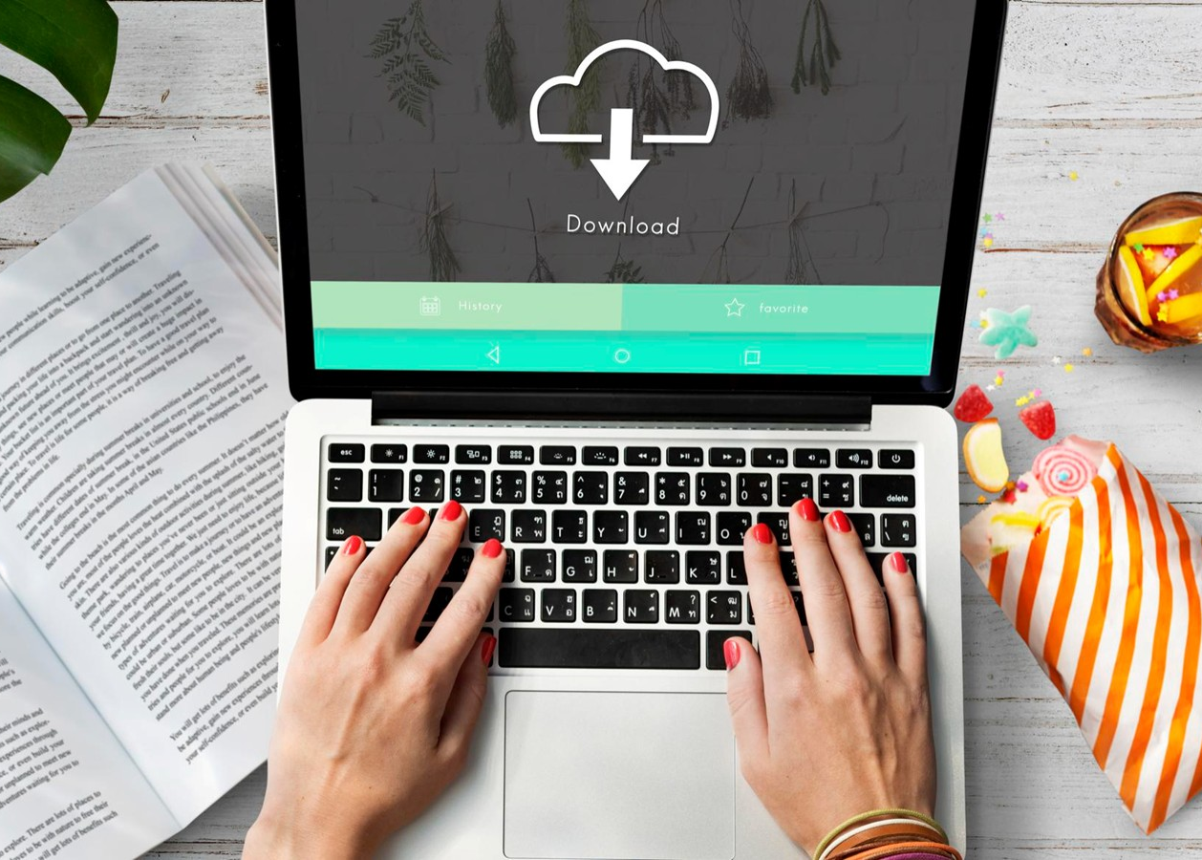
Security First
Do not download WhatsApp or similar messaging apps on client laptops nor use the client laptops for personal use (e.g., personal email, online shopping, gaming)

Slide 12

Security First
Do not use unauthorized Al tools (eg, ChatGPT, Copilot, Bard, or browser extensions) on client laptops unless explicitly approved by the client.

Slide 13

Security First
Employees are strictly prohibited from uploading, transmitting, or exposing client-owned code or proprietary data to any external Large Language Model (LLM) platforms—including but not limited to ChatGPT, Gemini, Sonet, and LLaMA- without prior WRITTEN authorization from the client.

Slide 14
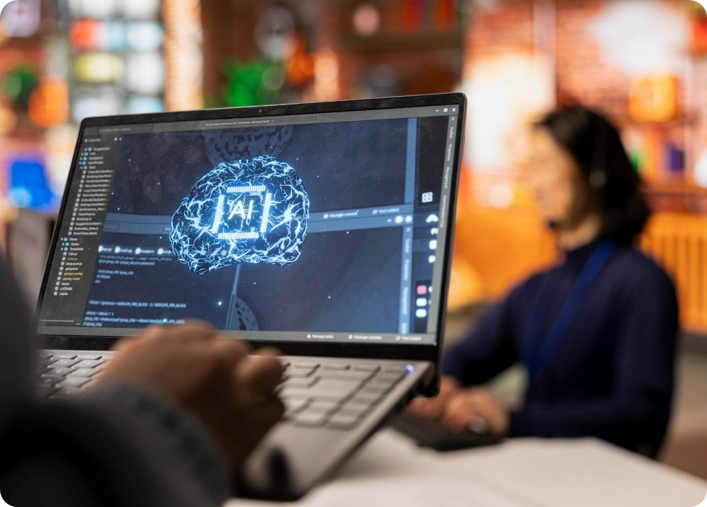
Security First
Do not directly incorporate code generated by AI tools (including but not limited to ChatGPT, Gemini, Sonet, LLaMA, or similar platforms) into any customer application or code repository without thorough validation and explicit WRITTEN approval from the client.

Slide 15

Security First
Do not connect AI tools, either directly or via plugins, APIs, or integrations, to customer code repositories, GitHub, or environments under any circumstances unless expressly authorized in writing by the client and approved by internal compliance.

Slide 16
Security First
Examples of Unauthorized Platforms:
The following platforms are considered unauthorized unless explicitly approved by the client:
Cloud storage: Google Drive, Dropbox, Box, iCloud Messaging apps: WhatsApp, Telegram, Signal, Slack (non-client instances)
Email services: Gmail Yahoo Mail, Outlook.com
File-sharing tools: WeTransfer, Mega, AirDrop
Social media: Facebook, Instagram, Linkedin, Twitter
Al tools:
ChatGPT, Copilot, Bard, Claude, browser-based Al extensions
Examples of Non-Approved Utilities:
System & Maintenance Tools -CCleaner, Driver Booster
Examples of 3rd Party software: Slack, Google meet, Zoom,

Slide 17


Thank You!
www.relanto.ai

