Slide 1


Slide 2
Objective
Goodness of products
Likings and disliking about specific products
Reduce user queries
Improving the recommendation for specific event

Slide 3
Data Description
Company: Amazon
Category: Baby products
Data Files: Reviews, Product Metadata and User Queries
Data Size: 1 million reviews, 70,000 products and 100,000 queries
Source: http://jmcauley.ucsd.edu/data/amazon/

Slide 4
Attributes
Review:
Product ID
Review text
Summary: summary of the review
Rating of product
Product Metadata:
Product ID
Product description
Product price
User Queries:
User Id
Product Id
Question type: “Yes/No” or “Open-Ended”
Question
Answer

Slide 5
Pre-Processing
Removed redundant columns
Stop Words (NLTK)
Stemming (NLTK)
String to Word Vectorizer - WEKA
CFS

Slide 6
Guiding Question 1:
What are the qualities that makes user dissatisfied with the baby product?
Decision tree (J48) – Weka
N-Gram – 1
K-Folds = 10
Independent Variable: summary of review column
Target: Positive or Negative

Slide 7
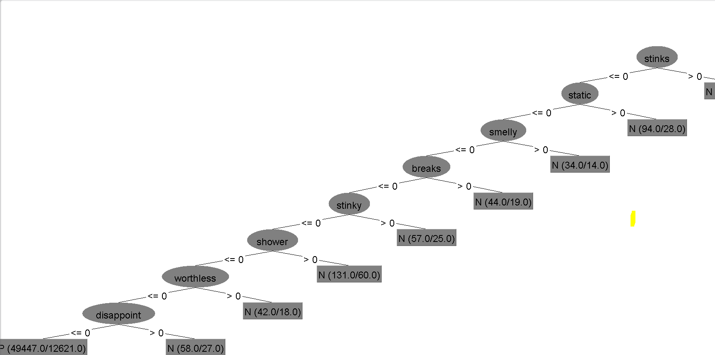

Slide 8
Guiding Question 2
Is there any specific category of products about which user usually appreciate or complains?
Decision tree (J48) – Weka
N-Gram – 1
K-Folds = 10
Independent Variable: Review Text
Target: Positive or Negative
Association Rules
Car= True

Slide 9
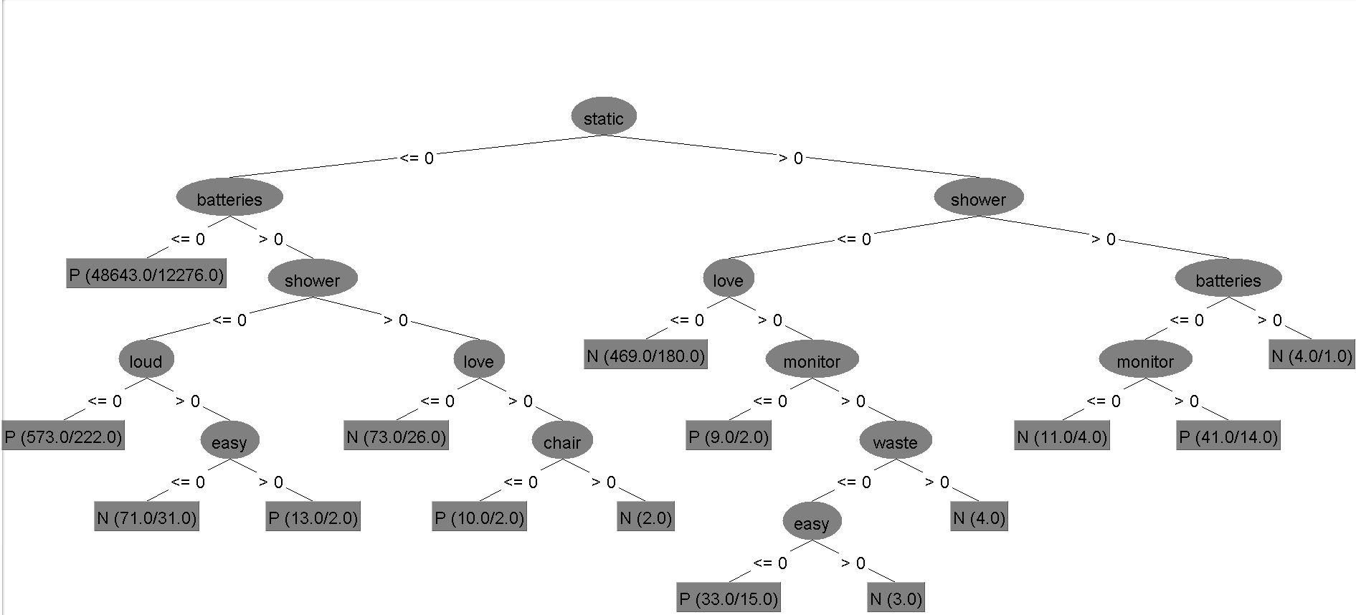
The First Years - Crib CD Player – Static
Graco ultra baby monitor – Monitor
The First Years Night and Day Bottle Warmer System – Warmer and Leak

Slide 10
Guiding Question 3
What should be included in the product description that reduces user queries?
Decision Trees (Python)
Independent Variable: Questions
Target: Question Type
N-Gram= 2
K-splits= 10
Max depth=4

Slide 11
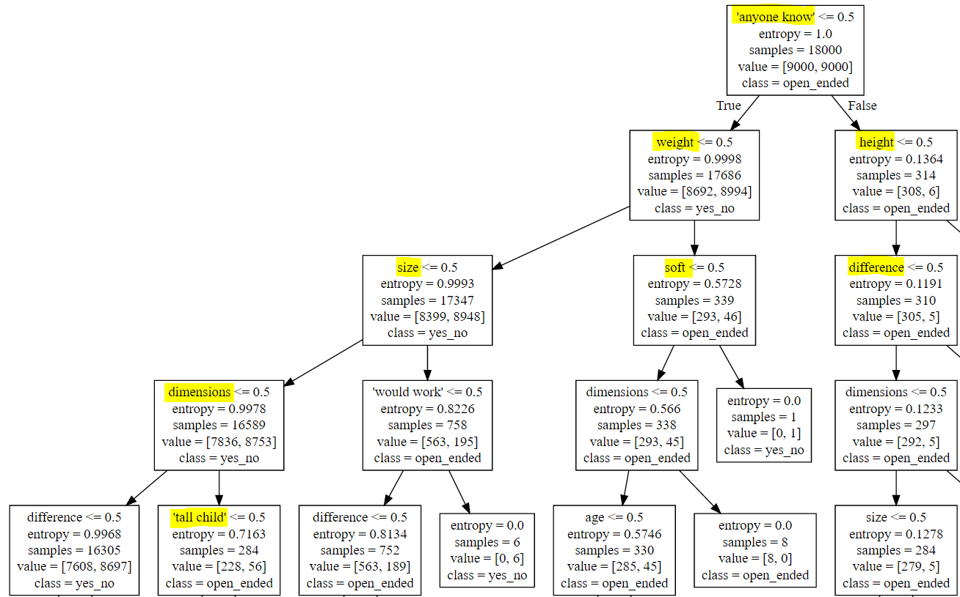

Slide 12
Guiding Question 4
Which are the product that people prefer to gift for baby shower?
Decision tree
Filtered reviews with “Shower” keyword
Independent Variable: Review Text
Target: Cheap or Expensive
N-Gram= 2
K-splits= 10
Association Rules
Car= True

Slide 13
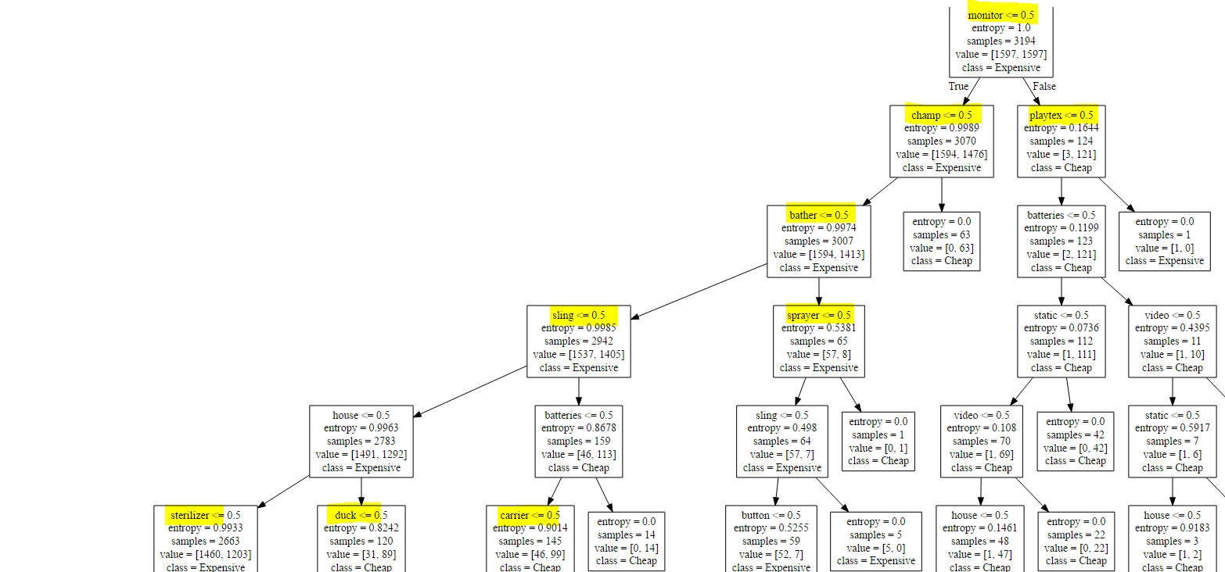
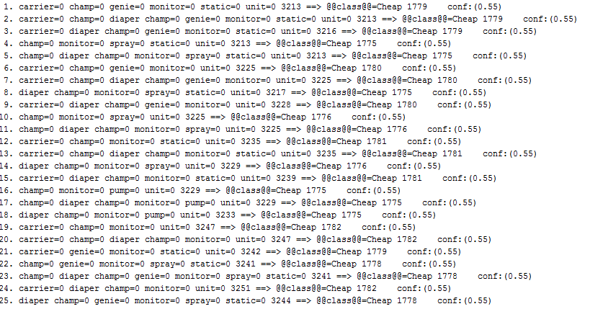
Champ, genie – Diaper brand
Carrier - BABYBJORN Original Carrier - City Black
Playtex - Playtex Drop-Ins Original BPA Free Nurser Newborn Starter Set

Slide 14


