Slide 1


DESIGN AND IMPLEMENTATION OF APPROXIMATE ADDER FOR ERROR TOLERANT APPLICATIONS

Slide 2
Contents
Objective
Applications
Abstract introduction
Literature review
01
Existing method
Drawbacks
Proposed method
advantages
02
Tools
Results
Conclusion
references
03

Slide 3
Objective

Slide 4
Applications
Image Processing:
Video Processing and Multimedia Systems:
Machine Learning and Artificial Intelligence:
Digital Signal Processing (DSP):
Internet of Things (IoT) Devices:
Edge Computing:

Slide 5
Abstract
Modern VLSI design demands high speed and low power, particularly in arithmetic circuits. Conventional adders like RCA and CLA provide accurate results but suffer from higher delay and power consumption. This work proposes an approximate adder for error-tolerant applications and compares its performance with RCA and CLA based on MOS count, power, delay, and PDP. The proposed adder achieves significantly lower delay (0.1 ns) and power consumption (480 nW), with a much smaller PDP (48 aJ), indicating improved energy efficiency. Although its MOS count is slightly higher than RCA, it remains lower than CLA while delivering better overall performance. Thus, the approximate adder offers an effective trade-off between accuracy and efficiency, making it suitable for applications such as image processing, multimedia, and machine learning.
Keywords:
Approximate Adder, Error-Tolerant Applications, Low Power Design, High-Speed Arithmetic, Ripple Carry Adder (RCA), Carry Look Ahead Adder (CLA), Power-Delay Product (PDP), Area Optimization, Digital VLSI Design, Energy Efficiency

Slide 6
Introduction
The advancement of VLSI technology has increased the demand for high-speed, low-power, and area-efficient arithmetic circuits, with adders being essential components in digital systems. Conventional adders such as RCA and CLA provide accurate results but suffer from limitations in delay, power consumption, and complexity. RCA is simple and area-efficient but slow due to carry propagation, while CLA improves speed at the cost of higher power and hardware complexity.
Approximate computing has emerged as an effective solution for error-tolerant applications like image processing, machine learning, and multimedia, where perfect accuracy is not always required. Approximate adders exploit this by introducing controlled inaccuracies, typically in less significant bits, to reduce delay, power consumption, and circuit complexity. This results in faster operation, lower energy usage, and compact design.

Slide 7
Introduction
These adders offer a better trade-off between accuracy and efficiency compared to traditional designs, making them suitable for modern low-power systems. Error metrics such as ER, MRED, and MNED are used to ensure acceptable accuracy levels. Despite challenges in maintaining output quality, well-designed approximate adders achieve significant performance improvements.
Overall, approximate adders provide an efficient alternative to exact adders and are highly promising for next-generation energy-efficient VLSI applications.

Slide 8
Literature review
Joshi Viraj Vilas and Pravin Mane (2024)
Title: Study on Approximate Arithmetic Circuits for Error-Tolerant Applications
Summary:
The authors presented a detailed analysis of approximate adder architectures and compared them with conventional adders like RCA and CLA. Their work showed that approximate adders significantly reduce power consumption and delay due to simplified logic design. The study also highlighted that for applications such as image and video processing, minor inaccuracies do not affect output quality, making approximate adders more efficient and suitable for energy-efficient systems.

Slide 9
Literature review
Akram Mohammadi et al. (2022)
Title: CNFET-Based Approximate Full Adder Design
Summary:
This work proposed an approximate full adder using CNFET technology combined with transmission gate and pass transistor logic. The design achieved lower switching activity and improved energy efficiency. Results indicated a significant reduction in power-delay product (PDP) and faster operation compared to CMOS-based RCA and CLA, making it ideal for low-power and high-speed applications.

Slide 10
Literature review
Bhaskar Gaur, Himanshu Thapliyal, and Travis S. Humble (2024)
Title: Noise-Resilient Approximate Quantum Adders
Summary:
The authors extended approximate computing concepts to quantum systems by designing noise-resilient approximate quantum adders. Their approach reduced circuit depth and enhanced fault tolerance. The study demonstrated that approximation improves computational efficiency and robustness against quantum noise, indicating its importance in future quantum computing technologies.

Slide 11
Literature review
Melanie Qiu et al. (2024)
Title: IMPLY Logic-Based Approximate Adders for In-Memory Computing
Summary:
This research introduced approximate adders using IMPLY logic for in-memory computing architectures. The design minimized computational steps, resulting in improved speed and reduced energy consumption. The proposed adder outperformed RCA in delay and showed lower complexity and power usage than CLA, making it suitable for machine learning and data-intensive applications.

Slide 12
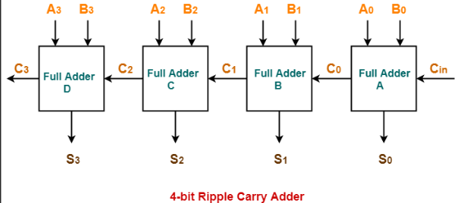
Existing method
Ripple Carry Adder (RCA):
RCA is a simple adder formed by cascading full adders, where the carry propagates sequentially from LSB to MSB. It is easy to design and area-efficient, but suffers from high delay due to linear carry propagation. As bit size increases, delay and power consumption rise, making RCA unsuitable for high-speed applications.

Slide 13
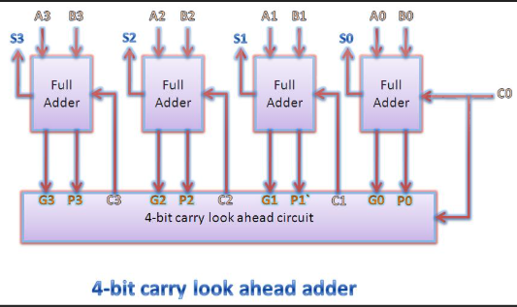
Existing method
Carry Look Ahead Adder (CLA):
CLA improves speed by computing carry signals in advance using generate (G = A·B) and propagate (P = A ⊕ B) logic, enabling parallel carry calculation. This significantly reduces delay compared to RCA and is suitable for high-speed operations. However, CLA has higher complexity, increased area, and greater power consumption, especially for larger bit-width designs.

Slide 14
Drawbacks
High propagation delay in RCA due to linear carry chain
Poor performance of RCA for large bit-width operations
Sequential carry dependency prevents parallel computation in RCA
Increased power consumption in RCA at higher frequencies
High hardware complexity and larger area in CLA
Higher power consumption and scalability issues in CLA

Slide 15
Proposed method
With the growth of VLSI systems, conventional adders like RCA and CLA are becoming inefficient due to high power, delay, and area, especially when perfect accuracy is not always required. Applications such as multimedia and machine learning can tolerate small errors, leading to the use of approximate adders.
The proposed approximate adder divides the circuit into two parts: an accurate MSB section using full adders to maintain result quality, and an approximate LSB section using simplified logic to reduce complexity. By minimizing or eliminating carry propagation in the LSBs, the design achieves lower delay and power consumption.
The adder operates by computing approximate sums in parallel while maintaining accuracy in higher bits, forming a hybrid structure. Error metrics like ER, MRED, and MNED are used to ensure acceptable accuracy, with partial approximation (typically 25–50% LSBs) providing an effective balance between performance and precision.

Slide 16
Advantages
Reduced power consumption due to simplified logic and lower switching activity
High-speed operation by minimizing carry propagation delay
Lower hardware complexity with fewer logic gates
Improved area efficiency with reduced transistor count
Better power-delay product (PDP) for enhanced energy efficiency

Slide 17
Tools
Tool: Cadence Virtuoso
Technology: 45nm

Slide 18
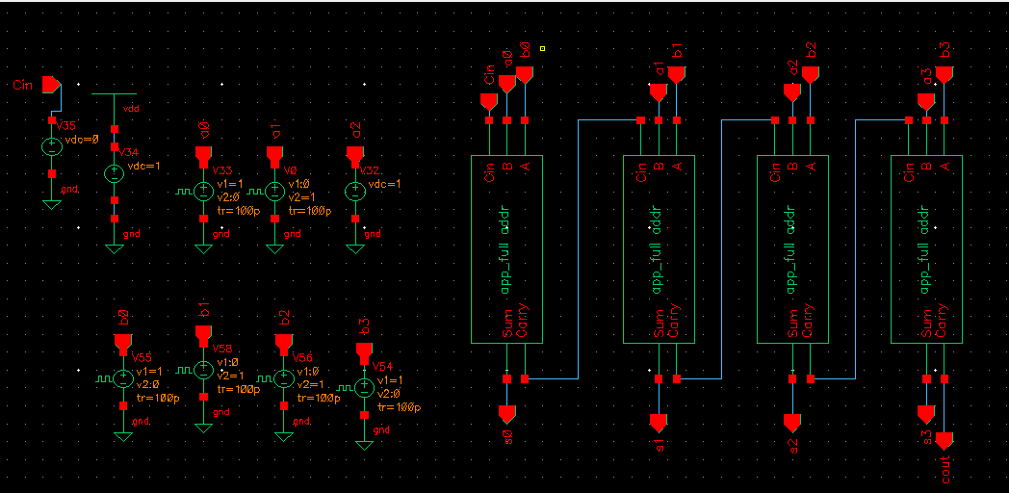
Results
Approximate 4 bit adder

Slide 19
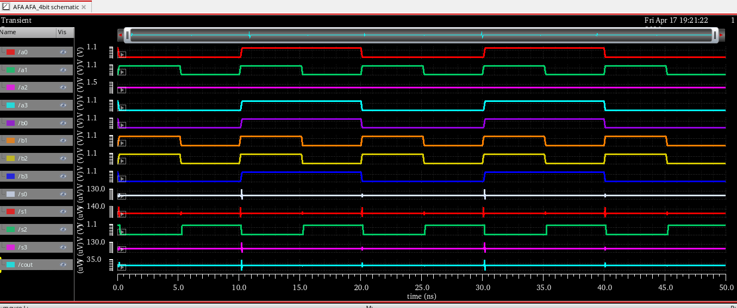
Results
Waveform of Approximate full adder 4 bit

Slide 20
Comparison Table
 | Mos count | Power consumption (nW) | Delay (ns) | PDP (aj)
Appr_adder | 136 | 480 | 0.1 | 48
RCA | 112 | 867 | 25 | 21675
CLA | 184 | 1191 | 9 | 10719

Slide 21
Conclusion
The comparative analysis shows that the approximate adder outperforms RCA and CLA in speed and energy efficiency. It achieves very low delay (0.1 ns) and reduced power consumption (480 nW), making it suitable for high-speed, low-power applications. Although its MOS count is slightly higher than RCA, it remains lower than CLA, ensuring balanced complexity. The PDP (48 aJ) is significantly lower than both RCA and CLA, confirming superior performance. Hence, the approximate adder offers an effective trade-off between accuracy, speed, and power, making it ideal for error-tolerant applications like AI, multimedia, and image processing.

Slide 22
References
V. V. Joshi and P. Mane, “Design and Analysis of Approximate Arithmetic Circuits for Error-Resilient Applications,” International Journal of Intelligent Systems and Applications in Engineering, vol. 12, no. 4, pp. 1–10, 2024.
A. Mohammadi, et al., “Design of High-Speed and Low-Energy Approximate Full Adder Using CNFET Technology,” Microelectronics Journal, vol. 123, pp. 105–112, 2022.
B. Gaur, H. Thapliyal, and T. S. Humble, “Noise-Resilient Approximate Quantum Adders,” arXiv preprint arXiv:2408.00927, 2024.
M. Qiu, et al., “IMPLY-Based Approximate Adders for In-Memory Computing,” arXiv preprint arXiv:2412.15888, 2024.

