Slide 1
Topic Name: Hospital Management System
Presented By: 2605 Bhumika Bet
2627 Vaishnavi Fulpati
2628 Prerna Gaikwad
2636 Pooja Nama
2650 Akhila Vaggu
Guided By: Ms Jadhav K.D

Slide 2
Introduction
Hospital management system is a computer system that helps manage the information related to health care and aids in the job completion of health care providers effectively. They manage the data related to all departments of healthcare .
HMS came into the picture of hospital management as early as 1960 and have ever since been evolving and synchronizing with the technologies while modernizing healthcare facilities. In today’s world, the management of healthcare starts from the hands of the patients through their mobile phones and facilitates the needs of the patient.

Slide 3
Why is HMS important for a hospital?
HMS was introduced to solve the complications coming from managing all the paper works of every patient associated with the various departments of hospitalization with confidentiality. HMS provides the ability to manage all the paperwork in one place, reducing the work of staff in arranging and analyzing the paperwork of the patients. HMS does many works like:
Maintain the medical records of the patient
Maintain the contact details of the patient
Keep track of the appointment dates
Save the insurance information for later reference
Tracking the bill payments.

Slide 4
Advantages of Hospital Management System:
The implementation of hospital management system project provides the institution with different advantages that improve the service quality and efficiency. As mentioned above it is created for three groups of users: patients, hospital staff and management, and third-parties like drug suppliers and insurance companies. The interaction between them conveys the general performance. The benefits received by a certain group of users also positively influence the work of the others. Cooperation and communication are the fundamental requirements here.
In order to create the hospital management system feature list, you need to identify your priorities by choosing the benefits that are prior for your case.

Slide 5
Improved Processes
Automation is one of the main benefits here. It helps to optimize the user experience. Medical specialists, patients, and hospital authorities can interact online, make the appointments and exchange information.
Digital medical records
The hospital database includes all the necessary patient data. The disease history, test results, prescribed treatment can be accessed by doctors without much delay in order to make an accurate diagnosis and monitor the patient’s health. It enables lower risks of mistakes.
Staff interaction
It is vital to engage all of your employees for improved coordination and teamwork. They do not need to make special requests and wait for a long time for an answer. Each specialist will be in charge of certain process stage and can share outcomes with colleagues just in one click.

Slide 6
Financial control and tax planning
The management has the ability to monitor different financial operations including expenses, profits, and losses, paying bills and taxes, in and outpatient billing. The financial awareness helps to analyse business prospects quite clear and move in the right direction.
Market strategy
Due to the high market competitive nature, the medical industry is also open to all the different innovations that enable communication between patients, doctors, suppliers, and marketing services providers.
Insurance claims processing
Integration with health insurance services improves the experience of the patients and brings benefits to the institution. It allows you to be innovative and helps both the patient and hospital to handle many aspects of the insurance process successfully.

Slide 7
Less time consuming
As the services and interactions are improved in all possible ways, everything is being planned with greater precision. It saves the time of all the system users and provides them with up-to-date information.
Patient self-service
Patients have their own system accounts where the list of various actions can be performed. They are able to make online requests or reservation, receive the test results, receive the consultation of the medical specialists and many more.
Better customer experience
Since the clinic management system is patient-oriented, the treatment process can be less stressful. Doctors have more time for the examination and interaction with patients. In addition, all the requested information can be received online.

Slide 8
Features of Hospital Management System
Appointment Management:
For hospitals having their own site, appointment widgets will be integrated onto the site. Patients visiting the hospital’s website can book online appointments with ease.
Billing Management:
Integrated Billing with treatments, Lab and Radiology. Alerts will be sent on Discount Authorisation. Automatic due capture, Option to bill before and after consultation.
Prescription Management:
Manage commonly and recently used medicines. Option to show medicines available in the pharmacy. SMS prescriptions to Patients.
Discharge Summary:
Template based Discharge Summary. ICD10 integration. Option to prevent discharge summary till IP bill is closed.

Slide 9
Operation Theatre Management:
Automatic notification can be sent to customers on test results. Lab notifications like email, SMS of the test reports sent from the Automated Lab notification module.
Pharmacy Management:
Comprehensive Pharmacy Management handles stock, Prescription Integration, Ward Request, Stock Management, Stock Moment and intelligent reports.
Lab Management:
Comprehensive Lab Management handles complete order management, Custom Reports, Smart Notifications, Credit Settlement, detailed MIS Reports, Analytics and App for Phlebotomist.
Master Information Systems:
Lets you access entire MIS data from your palm.

Slide 10
Importance of Hospital Management System
The health system is one of essential socio-economic activities; therefore, it requires rational and effective management. For this, it is necessary to have a tool that allows adequate control of the information generated in health institutions.
Hospitals, as the main actors of the health system, generate an essential volume of information, but in most cases, it is dispersed or not available in the necessary time and manner.
In recent years, health information systems have helped improve the quality of life of people in all sectors of our society, so it is inevitable to adhere to this dizzying technological career. Currently, clinical and administrative management of hospitals and health centers is possible through a single platform, with the support of cutting-edge technology, developed to optimize the processes that allow the operation of organizations dedicated to treating patients in any branch of the medicine.

Slide 11
Hospital management systems allows us the ability to optimize and digitize all the processes within the institution, which will help to improve customer service, reduce process costs, streamline the search of medical records, bills, patients, doctors, etc.; thus, having a database of each module implemented.
A hospital management system is a web system developed for companies that wish to manage their processes, implementing modules for each of the required areas. It is essential to mention that the information is controlled by trained personnel. Computer technology is only a tool that allows us to perfect the inveterate use of paper records (notebooks, index cards, diaries, bibliographies, record books), or more recently, cassettes or video cassettes. A PC only collects and processes data; it is the individual that acquires information. allows us the ability to optimize and digitize all the processes within the institution, which will help to improve customer service, reduce process costs, streamline the search of medical records, bills, patients, doctors, etc.; thus, having a database of each module implemented.

Slide 12
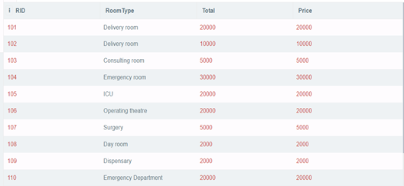
Output of Project:
RoomMst-Table

Slide 13
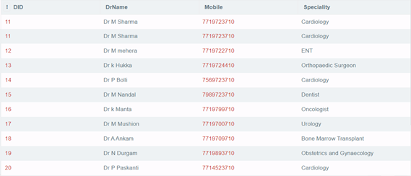
DoctorMst-Table

Slide 14
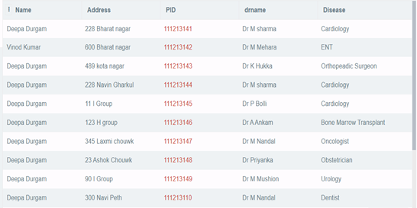
PatientMst-Table

Slide 15
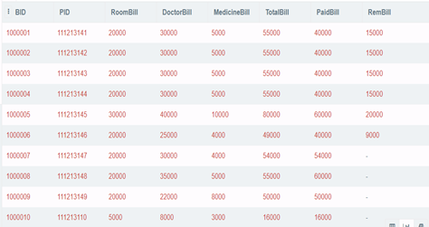
BillMst-Table

Slide 16
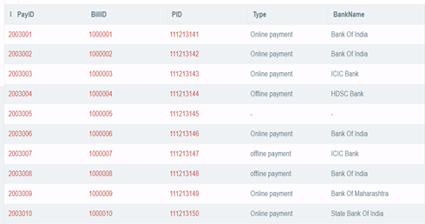
PaymentMst-Table

Slide 17
Conclusion
Taking into account all the mentioned details, we can make the conclusion that the hospital management system is the inevitable part of the lifecycle of the modern medical institution. It automates numerous daily operations and enables smooth interactions of the users. Developing the hospital system software is a great opportunity to create the distinct, efficient and fast delivering healthcare model. Implementation of hospital management system project helps to store all the kinds of records, provide coordination and user communication, implement policies, improve day-to-day operations, arrange the supply chain, manage financial and human resources, and market hospital services. This beneficial decision covers the needs of the patients, staff and hospital authorities and simplifies their interactions. It has become the usual approach to manage the hospital. Many clinics have already experienced its advantages and continue developing new hospital management system project modules.

