Slide 1
Project Presentation of Industry Oriented Hands on Experience (22CS422)
On
Grape Segmentation
Laxmi Narayan Pandey | Kumud
2211981212 | 2211981207
Supervised By
Miss. Swati
Department of Computer Science and Engineering,
Chitkara University, Punjab

Slide 2
Introduction
Precision agriculture is transforming modern farming by improving productivity and resource efficiency
Accurate grape segmentation plays a crucial role in yield estimation, disease detection, and automated harvesting.
However, real-world vineyard conditions such as occlusion, complex backgrounds, and varying lighting make segmentation challenging.
Deep learning models, especially YOLO-based architectures, provide efficient and real-time solutions for segmentation tasks.
This study focuses on comparing YOLOv11, YOLOv12, and YOLOv26 to identify the best model for practical agricultural use.
2

Slide 3
Problem Statement
Grape segmentation in real-world vineyards is highly challenging
Presence of complex backgrounds, occlusion (leaves, overlap), and varying lighting affects accuracy
Traditional methods (thresholding, edge detection, color-based) fail in dynamic environments
Existing models are not fairly compared under the same conditions
Need for a solution that balances accuracy and real-time performance
3

Slide 4
Objective
To compare the performance of YOLOv11, YOLOv12, and YOLOv26 for grape segmentation
To evaluate models using metrics like precision, recall, F1-score, and mAP
To analyze both accuracy and inference speed for real-world usability
To identify the most suitable model for practical agricultural applications
4

Slide 5
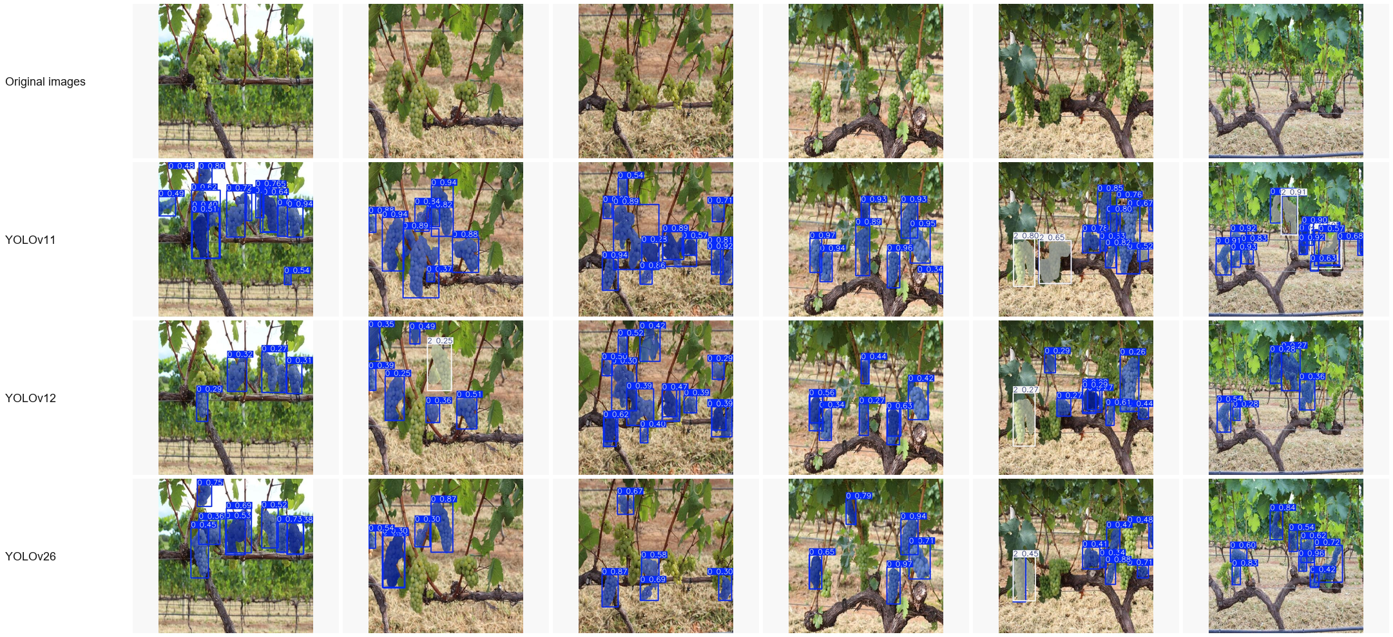
Methodology
5

Slide 6
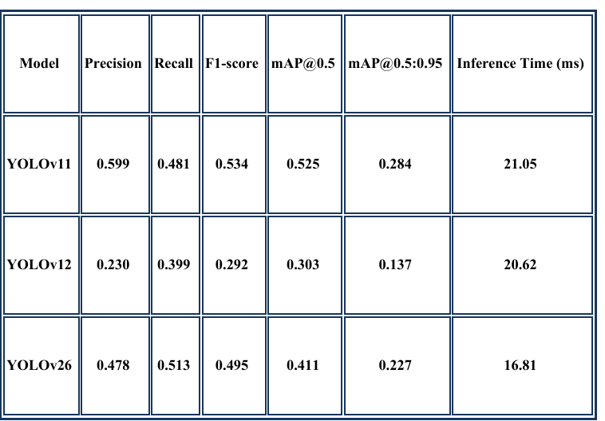
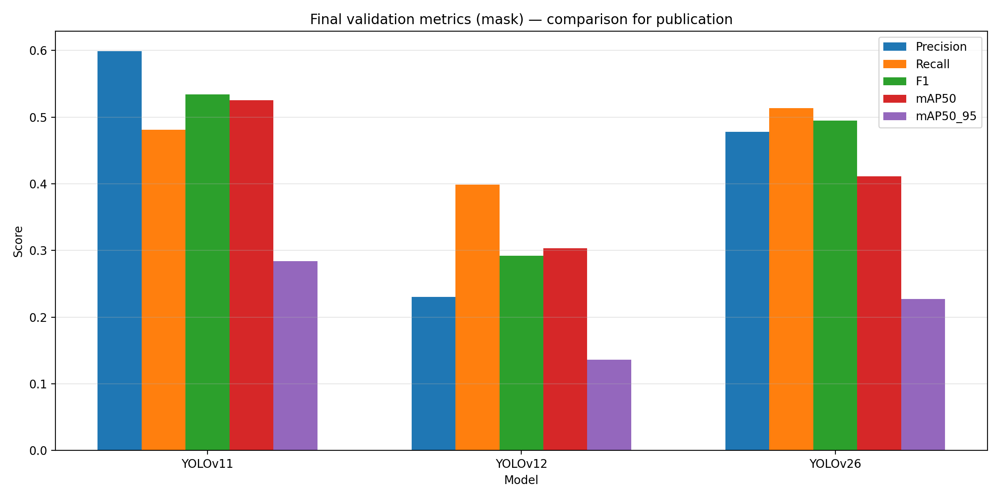
Results & Analysis
Quantitative Results
Performance Analysis
6

Slide 7
Thank You
7

