Slide 1
Advanced Encryption Standard
(AES)

Slide 2

AES
AES is a non-Feistel cipher that encrypts and decrypts a data block of 128 bits. It uses 10, 12, or 14 rounds. The key size, which can be 128, 192, or 256 bits, depends on the number of rounds.
Note
AES has defined three versions, with 10, 12, and 14 rounds.
Each version uses a different cipher key size (128, 192, or 256), but the round keys are always 128 bits.

Slide 3
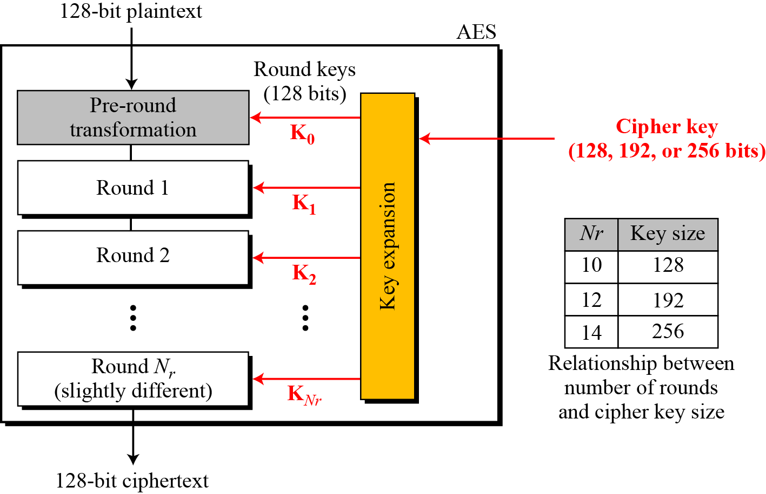
Continue
Fig General design of AES encryption cipher

Slide 4
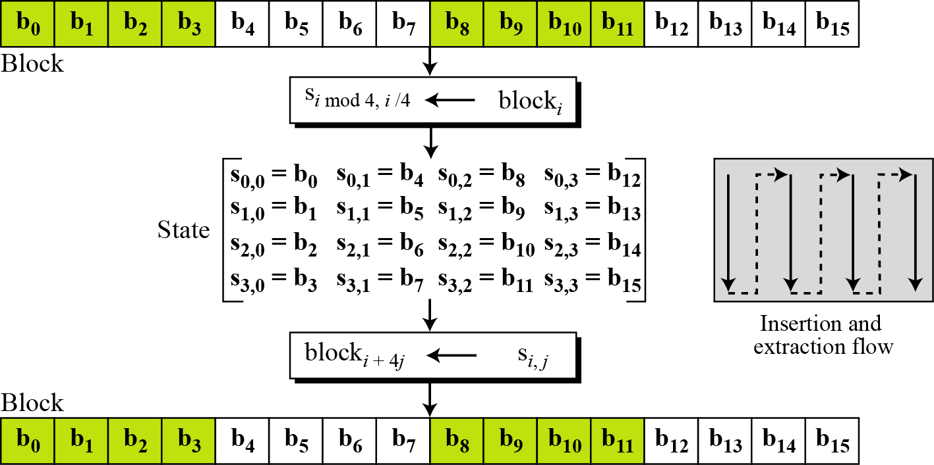
Data Units.
Fig Block-to-state and state-to-block transformation

Slide 5
Convert to State Array
Input block:
0 | 4 | 8 | 12
1 | 5 | 9 | 13
2 | 6 | 10 | 14
3 | 7 | 11 | 15
=
S_{0,0} | S_{0,1} | S_{0,2} | S_{0,3}
S_{1,0} | S_{1,1} | S_{1,2} | S_{1,3}
S_{2,0} | S_{2,1} | S_{2,2} | S_{2,3}
S_{3,0} | S_{3,1} | S_{3,2} | S_{3,3}
0
1
2
3
4
5
6
7
8
9
10
11
12
13
14
15

Slide 6
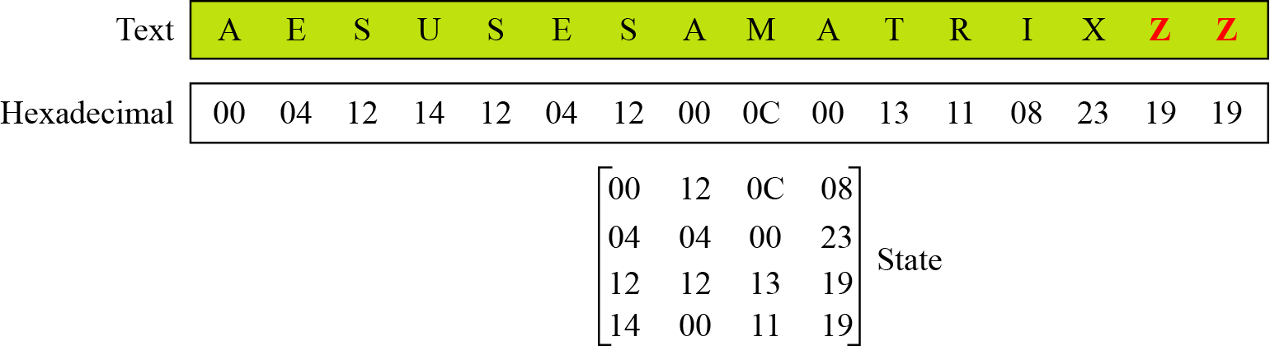
Continue
Example
Fig Changing plaintext to state

Slide 7
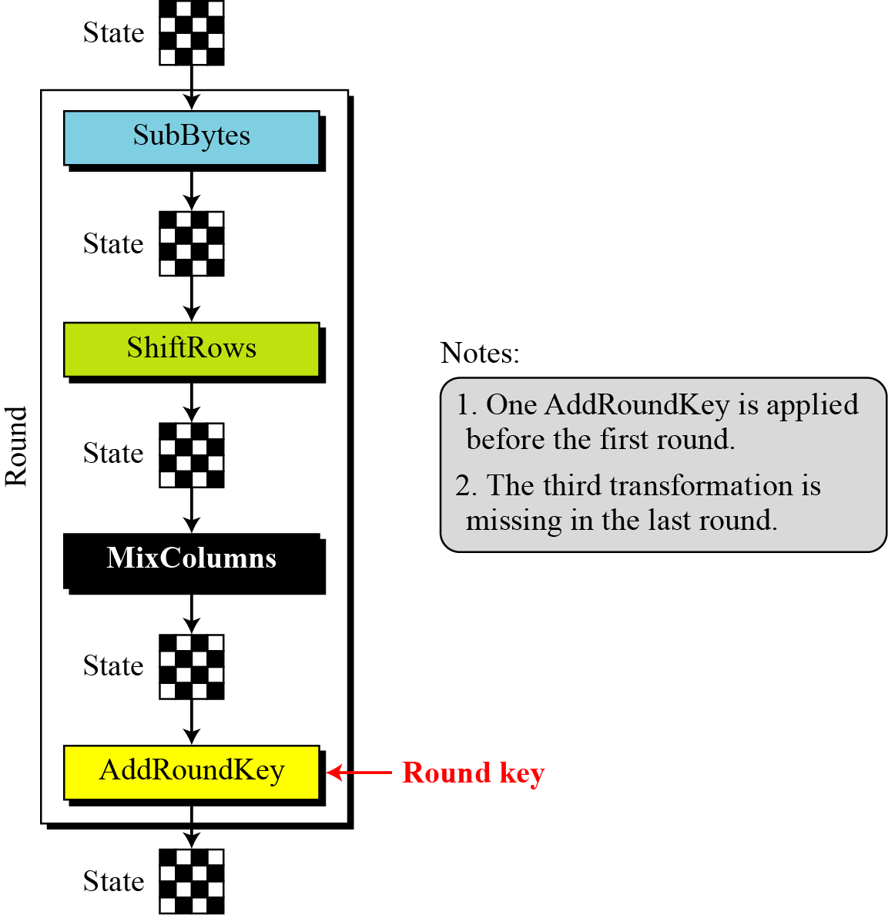
Structure of Each Round
Fig Structure of each round at the encryption site

Slide 8
TRANSFORMATIONS
To provide security, AES uses four types of transformations: substitution, permutation, mixing, and key-adding.
Topics discussed in this section:
Substitution
Permutation
Mixing
Key Adding

Slide 9
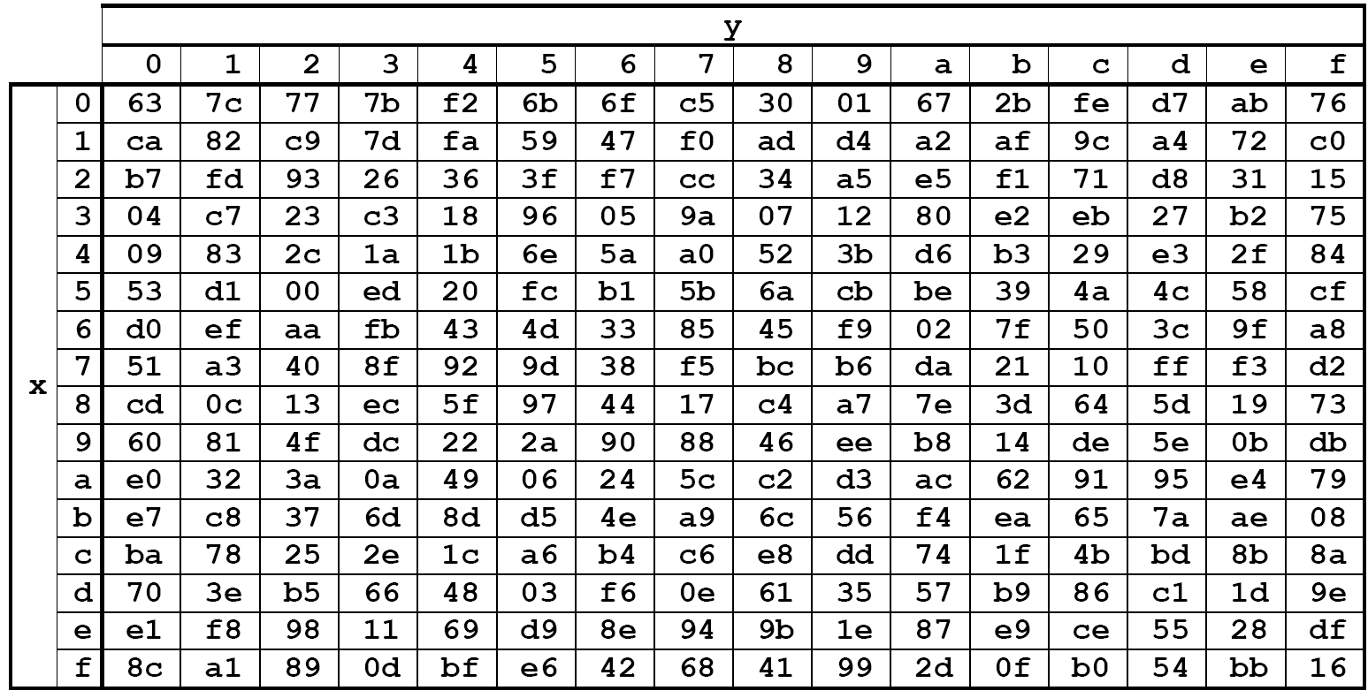
SubBytes
Replace each byte in the state array with its corresponding value from the S-Box
00 | 44 | 88 | CC
11 | 55 | 99 | DD
22 | 66 | AA | EE
33 | 77 | BB | FF
55

Slide 10
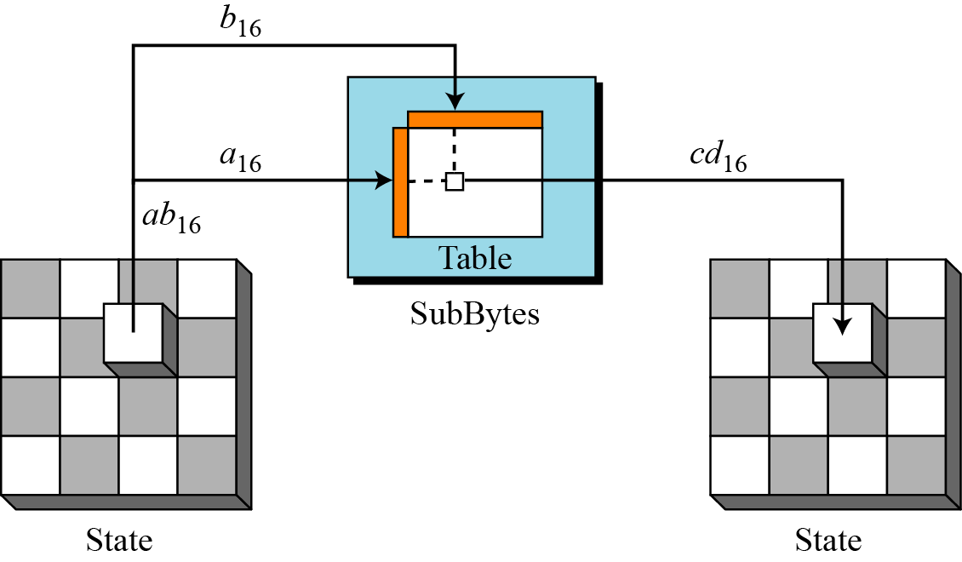
Continue
Fig SubBytes transformation

Slide 12
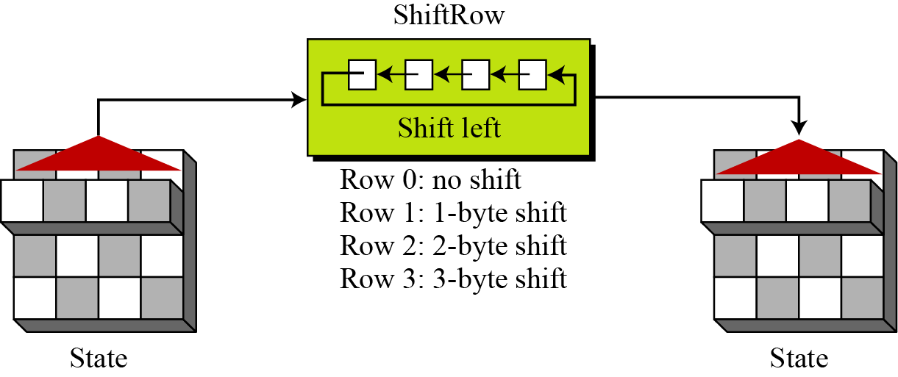
Permutation
Another transformation found in a round is shifting, which permutes the bytes.
ShiftRows
In the encryption, the transformation is called ShiftRows.
Fig ShiftRows transformation

Slide 13
ShiftRows
Last three rows are cyclically shifted
S_{0,0}
S_{0,1}
S_{0,2}
S_{0,3}
S_{1,0}
S_{1,0}
S_{1,1}
S_{1,2}
S_{1,3}
S_{2,0}
S_{2,1}
S_{2,0}
S_{2,1}
S_{2,2}
S_{2,3}
S_{3,0}
S_{3,1}
S_{3,2}
S_{3,0}
S_{3,1}
S_{3,2}
S_{3,3}

Slide 14
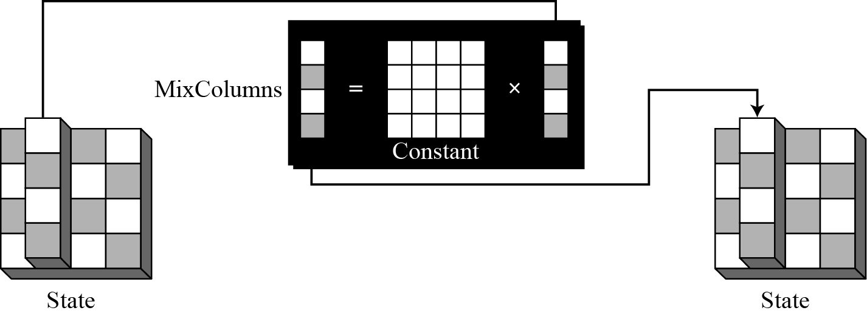
MixColumns
The MixColumns transformation operates at the column level; it transforms each column of the state to a new column.
Figure 7.13 MixColumns transformation

Slide 15
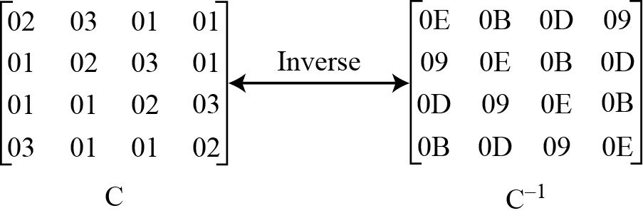
Continue
Fig Constant matrices used by MixColumns and InvMixColumns

Slide 16
Mixing
Apply MixColumn transformation to each column
S’_{0,c} = ({02} • S_{0,c}) ⊕ ({03} • S_{1,c}) ⊕ S_{2,c} ⊕ S_{3,c}
S’_{1,c} = S_{0,c} ⊕ ({02} • S_{1,c}) ⊕ ({03} • S_{2,c}) ⊕ S_{3,c}
S’_{2,c} = S_{0,c} ⊕ S_{1,c} ⊕ ({02} • S_{2,c} ) ⊕ ({03} • S_{3,c})
S’_{3,c} = ({03} • S_{0,c}) ⊕ S_{1,c} ⊕ S_{2,c} ⊕ ({02} • S_{3,c}
MixColumns()
S_{0,1}
S’_{0,1}
S_{0,0} | S_{0,1} | S_{0,2} | S_{0,3}
S_{1,0} | S_{1,1} | S_{1,2} | S_{1,3}
S_{2,0} | S_{2,1} | S_{2,2} | S_{2,3}
S_{3,0} | S_{3,1} | S_{3,2} | S_{3,3}
S’_{0,0} | S’_{0,1} | S’_{0,2} | S’_{0,3}
S’_{1,0} | S’_{1,1} | S’_{1,2} | S’_{1,3}
S’_{2,0} | S’_{2,1} | S’_{2,2} | S’_{2,3}
S’_{3,0} | S’_{3,1} | S’_{3,2} | S’_{3,3}
S_{1,1}
S’_{1,1}
S_{2,1}
S’_{2,1}
S_{3,1}
S’_{3,1}

Slide 17
AddRoundKey
XOR each byte of the round key with its corresponding byte in the state array
XOR
S_{0,1}
S_{0,0} | S_{0,1} | S_{0,2} | S_{0,3}
S_{1,0} | S_{1,1} | S_{1,2} | S_{1,3}
S_{2,0} | S_{2,1} | S_{2,2} | S_{2,3}
S_{3,0} | S_{3,1} | S_{3,2} | S_{3,3}
S_{1,1}
S’_{0,1}
R_{0,1}
S_{2,1}
S’_{0,0} | S’_{0,1} | S’_{0,2} | S’_{0,3}
S’_{1,0} | S’_{1,1} | S’_{1,2} | S’_{1,3}
S’_{2,0} | S’_{2,1} | S’_{2,2} | S’_{2,3}
S’_{3,0} | S’_{3,1} | S’_{3,2} | S’_{3,3}
R_{0,0} | R_{0,1} | R_{0,2} | R_{0,3}
R_{1,0} | R_{1,1} | R_{1,2} | R_{1,3}
R_{2,0} | R_{2,1} | R_{2,2} | R_{2,3}
R_{3,0} | R_{3,1} | R_{3,2} | R_{3,3}
S’_{1,1}
R_{1,1}
S_{3,1}
S’_{2,1}
R_{2,1}
S’_{3,1}
R_{3,1}

Slide 18
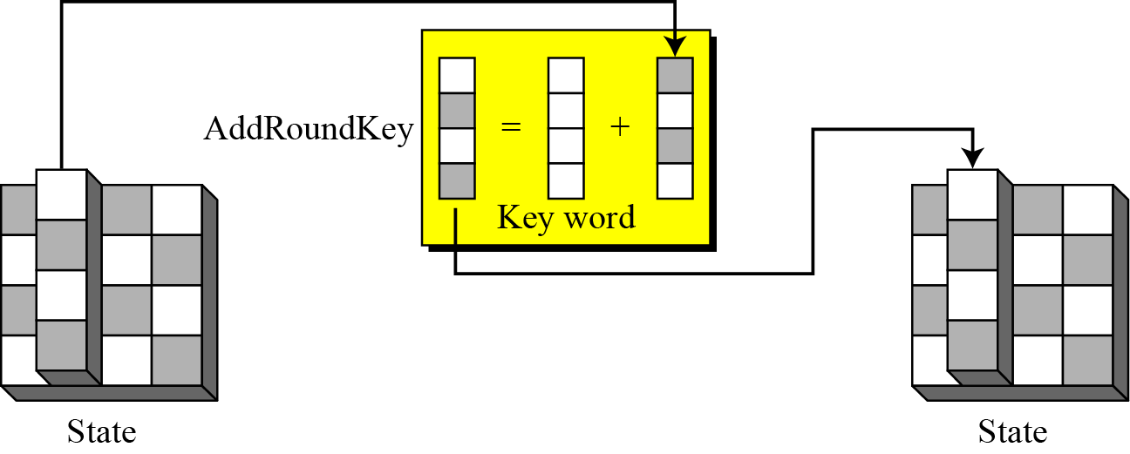
Continue
Figure AddRoundKey transformation

Slide 19
KEY EXPANSION
To create round keys for each round, AES uses a key-expansion process. If the number of rounds is N_{r} , the key-expansion routine creates N_{r} + 1 128-bit round keys from one single 128-bit cipher key.

Slide 20
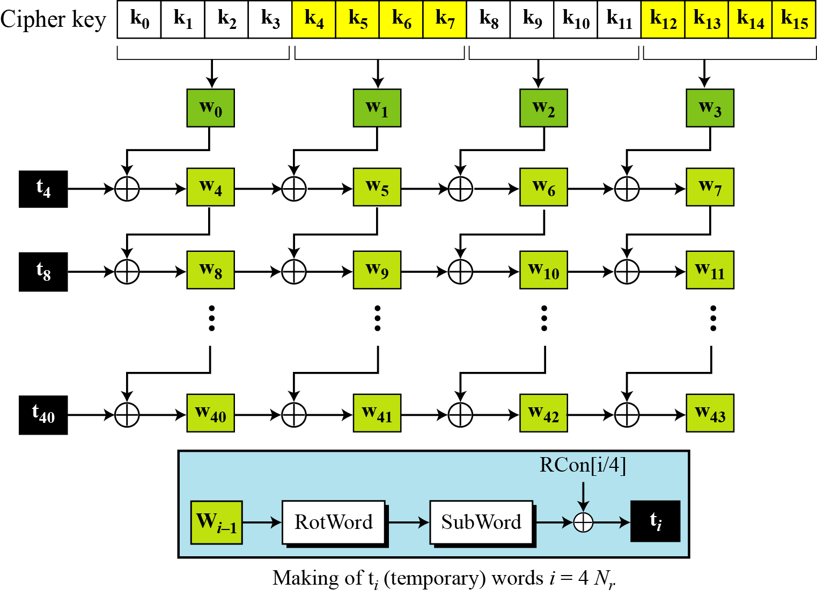
Key Expansion in AES-128
Fig Key expansion in AES

Slide 21
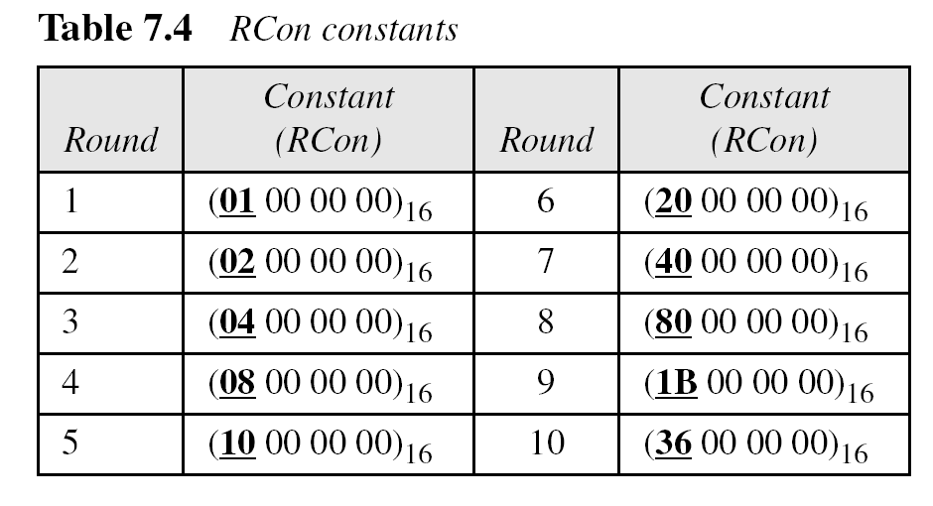
Continue

Slide 22
Continue
The key-expansion routine can either use the above table when calculating the words or use the GF(2⁸) field to calculate the leftmost byte dynamically, as shown below (prime is the irreducible polynomial):

Slide 23
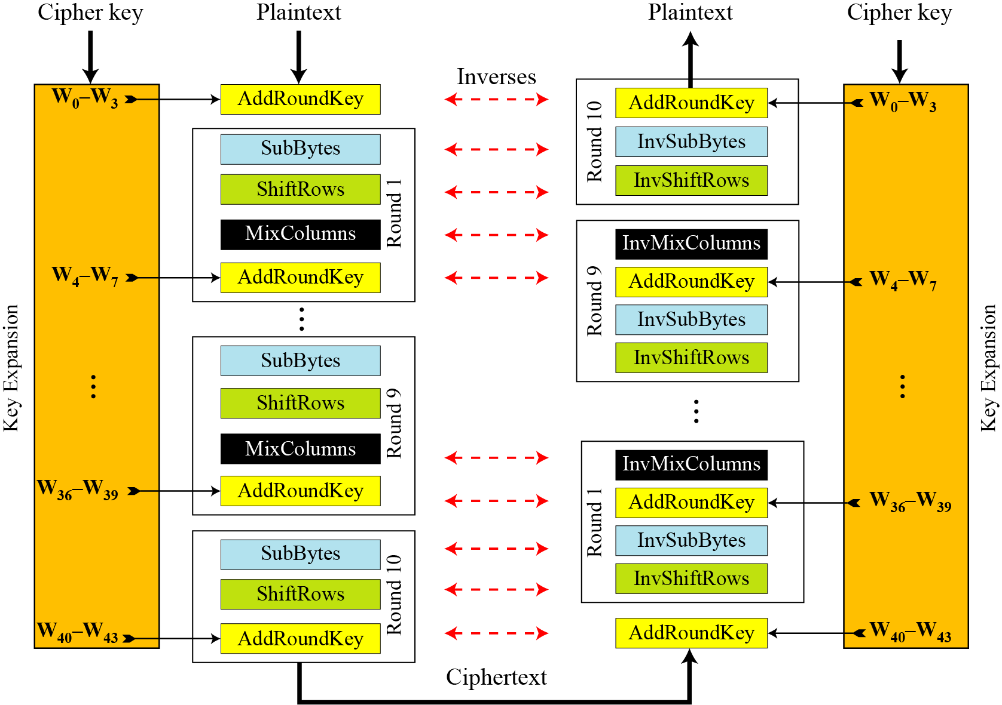
Original Design
Ciphers and inverse ciphers of the original design

