Slide 1
Fake News Detection using Machine Learning and Natural Language Processing
Group Number : 5
Palak Tiwari (MT20103)
Deepankar Kansal (MT20007)
Vineet Maheshwari (MT20020)

Slide 2


Slide 3
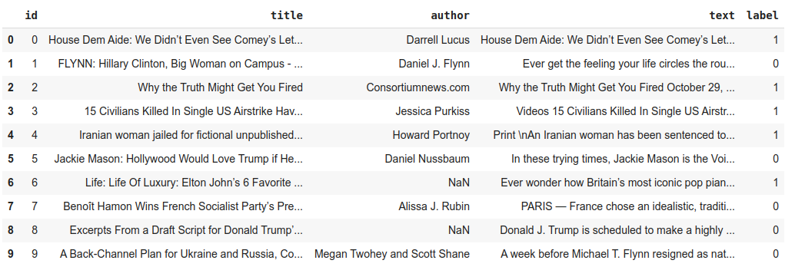
Dataset Description

Slide 4
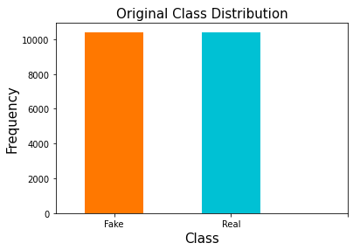
Unbiased Dataset
As we can see here, the dataset used is Unbiased and therefore it will generate satisfactory results

Slide 5
Main Libraries Used Are:
For text preprocessing and feature extraction:
nltk (Natural Language Toolkit):- Like Corpus, PorterStemmer
re (Regular Expression)
CountVectorizer class from SciKit-learn
Classification Models Applied: From SciKit-learn
Logistic Regression (LR), Decision Tree (DT), Support Vector Machines (SVM)

Slide 6
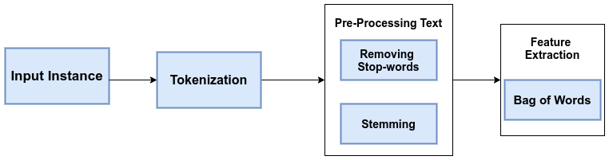
Text Preprocessing
Using libraries nltk, re, and CountVectorizer (class)

Slide 7
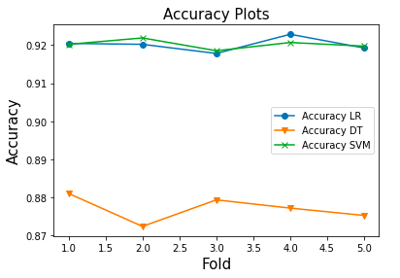
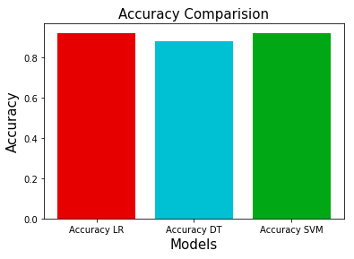
Evaluating Models
Accuracies plot at different folds
Accuracies comparison of three classification models

Slide 8
Future Work
Implementing TF-IDF on bi-grams and n-grams as one of the feature extraction method
Training data on various Machine learning models/algorithms like Naive Bayes, kNN etc.
Applying various ensembling machine learning techniques like Bagging and Boosting
Thinking of implementing some deep learning techniques for improving the models performance using word embedding.
Evaluating model using the headline, body and author of the article and flagging it as fake or real.

