Slide 1

Beyond Development: Explaining Climate Resilience Across Indian Districts
Review 2
Faculty name - Dr Bhanu Priya
Team Members info-
Sehjodh Grewal (RA2411031010081)
Devanshu Kumar (RA2411031010102)
Deepankar (RA2411031010103)
Tanmay Singh (RA2411031010118)
Notes:
Good morning. Our project asks why some developed Indian districts remain highly climate-vulnerable while some less-developed districts are resilient. We built a Big Data pipeline over 30 years of IMD climate data and a novel deep-learning model, A-CPN, to explain each district.

Slide 2
Contents
1
Dataset
7
Results of Classification using proposed model
2
Proposed Model (A-CPN)
8
Comparison with the existing classifier models
3
Overall System Architecture Diagram
9
Plan of Action / Member Tasks
4
Preprocessing (Big Data analysis and its steps)
10
References
5
Results of Preprocessing
11
Geotagged photo taken during Review 2 presentation
6
Classification (proposed model)
12
Google Colab Implementation link
Presenter: Sehjodh Grewal
Notes:
This is the order we follow, as required for Review 2: dataset, model, architecture, preprocessing and its results, classification, comparison, team plan, references, photo and the Colab link.

Slide 3
Problem Statement & Objectives
Why do some developed Indian districts remain highly climate-vulnerable, while some less-developed districts are resilient?
Objectives
469 districts, median splits
▪ Big Data pipeline over 30 years (1991–2020) of IMD daily climate data: HDFS, MapReduce, Hive, Spark
▪ Novel deep-learning model A-CPN (Attentive Climate Push Network)
▪ Compare with 5 existing ML models on identical folds
▪ Explain each district as climate-driven or development-driven
Low vulnerability
High vulnerability
High development
143
Expected
92
Anomaly A
Low development
89
Anomaly B
145
Expected
181 districts (38.6%) break the expected pattern
Presenter: Sehjodh Grewal
Notes:
Development alone should predict resilience, but it does not always. Splitting districts at the median of development and of vulnerability gives four groups; 181 of 469 districts break the expected pattern. Our objectives are the pipeline, the novel model, a fair comparison, and a per-district explanation.

Slide 4
Dataset
▪ 5 development variables: literacy, female literacy, agri-worker share (Census 2011); MGNREGA days, yield variability (NDAP 2021)
▪ 8 hazard variables: annual rain, rain variability, max 5-day rain, heavy-rain days, longest dry spell, mean Tmax, hot days, tropical nights
▪ Scale: ~212 million gridded climate values; 1.08 GB in HDFS (Colab run 2026-10-11)
Dataset | Source | Year | Format | Size | Role
Climate Vulnerability Index + indicators | NITI Aayog NDAP 7160 | 2021 | CSV | 699 × 79 | Outcome + 2 dev vars
Primary Census Abstract | Census of India | 2011 | CSV | 640 districts | 3 dev vars
Daily gridded rainfall 0.25° | IMD Pune | 1991–2020 | binary .grd | 135 × 129 grid | Hazard
Daily gridded Tmax / Tmin 1° | IMD Pune | 1991–2020 | binary .grd | 31 × 31 grid | Hazard
District boundaries | DataMeet | 2011 | Shapefile | 641 polygons | Grid → district
Presenter: Sehjodh Grewal
Notes:
We combine five public sources. NDAP gives the outcome and two development variables, Census 2011 gives three more, and IMD gives 30 years of daily gridded rainfall and temperature, which is what makes this a Big Data problem. The vulnerability index is only ever the target, never an input.

Slide 5
Proposed Model: A-CPN
▪ Attentive Climate Push Network: a novel deep-learning model combining recent techniques
▪ Development baseline: linear layer on the 5 development features (interpretable)
▪ Climate push: feature attention → KAN layer → residual MLP on the 8 IMD hazard features
▪ Output: p = σ(baseline + climate push); push > 0 means climate adds risk beyond development
▪ Uncertainty: MC Dropout + conformal prediction; index never used as input (no circularity)
Development
5 features
Linear baseline
interpretable
Baseline
b
σ(b + c)
High / Low
+
Climate (IMD)
8 features
Attention → KAN → Residual MLP
Climate push
c (+/−)
Uncertainty
MC Dropout + conformal
Novelty: recent techniques (attention, KAN, residual blocks, conformal prediction) combined into a development-anchored network for district climate vulnerability
Presenter: Devanshu Kumar
Notes:
A-CPN splits each district's risk into two parts. A linear development baseline says how vulnerable the district should be from development alone. A deep climate network learns a climate push that raises or lowers that risk. Attention shows which climate factor drives the push, and MC Dropout with conformal prediction says how certain we are.

Slide 6
Overall System Architecture Diagram
Sources
NDAP · Census · IMD · DataMeet
HDFS raw zone
/project/raw
Grid → district
Python (NumPy, shapely)
HDFS staging
7.0 M district-day rows
Spark
k-means + MLlib
Hive
30-yr baseline + join
MapReduce on YARN
→ 19,200 district-years
A-CPN
PyTorch
Comparison tables
Tables 1–6
Report / slides
results/ · figures/
Legend:
Storage (HDFS)
Big Data processing
Python / outputs
Novel model
Single-node pseudo-distributed Hadoop 3.3.6, HDFS replication 1, 2 vCPU, 12.7 GB RAM (Colab run 2026-10-11); no multi-machine speed-up is claimed
Presenter: Deepankar
Notes:
Data flows top-left to bottom-right. Raw sources land in the HDFS raw zone; Python converts the IMD grids to district-day rows in staging; MapReduce on YARN aggregates 7 million daily rows to yearly indices; Hive builds the 30-year baseline and joins development data; Spark finds climate regimes and trains the MLlib baselines; A-CPN is trained in PyTorch and compared.

Slide 7
Big Data Platform & HDFS Storage
HDFS zone | Contents | Size
/project/raw/imd/rain | 30 yearly rainfall files (0.25° grid) | 763.3 MB
/project/raw/imd/tmax, tmin | 60 temperature files (1° grid) | 84.2 MB
/project/raw/sources | NDAP, Census, boundaries | 11.5 MB
/project/staging/district_day | 7,013,120 district-day rows | 222.8 MB
/project/processed | MapReduce, Hive, Spark outputs | 1.2 MB
Total | measured with hdfs dfs -du (Colab run 2026-10-11) | 1.08 GB
Tool | What it does / purpose | Why chosen
HDFS | Central store for raw, staging and processed zones | 128 MB blocks for parallel jobs; read directly by MapReduce, Hive, Spark
YARN | Allocates CPU / memory and runs MapReduce tasks | Hadoop's standard scheduler for MapReduce
▪ Hadoop 3.3.6 + YARN, Hive 3.1.3, Spark (pyspark), Java 8 (Hive 3.1.3 fails on Java 11)
▪ Daemons started directly (Colab has no SSH); replication 1, block size 128 MB
Presenter: Deepankar
Notes:
We installed Java 8, Hadoop with HDFS and YARN, Hive and Spark inside Colab. HDFS has three zones so the raw data is never modified. In total 1.08 GB is stored, mostly the 30 years of rainfall grids. These sizes were measured with hdfs dfs -du in the Colab run 2026-10-11.

Slide 8
Big Data Processing: MapReduce, Hive, Spark
Job | Input | Output | Result | Why this tool
MapReduce (Hadoop Streaming) | 7,013,120 district-day rows | 19,200 district-year rows, 7 indices | 306 s (30 years) | Work splits by (district, year)
MapReduce scalability | 1 / 10 / 30 years | 640 / 6,400 / 19,200 rows | 53 s / 132 s / 306 s | Measures throughput, 2 repeats
Hive baseline + join | 19,200 rows + dev table | 469-district table, 8 hazard vars | identical to pandas (max diff 0.0) | Averages + joins are SQL
Spark k-means | 8 hazard vars | climate regimes (k by silhouette) | k = 2, silhouette 0.651 | In-memory iterative algorithm
Spark MLlib | 469 districts × 13 features | 4 baseline models | see Table 5 | Distributed standard models
MapReduce and Hive values: Colab run 2026-10-11 (2 vCPU, 12.7 GB RAM). Single node: throughput rises with input size, but no multi-machine speed-up is claimed.
Presenter: Tanmay Singh
Notes:
MapReduce does the heaviest step, 7 million daily rows to 19,200 district-years, because the work splits by district and year. Hive does the averaging and the join in SQL, and its output matched pandas exactly. Spark is used for k-means climate regimes and the MLlib baselines because it works in memory.

Slide 9
Preprocessing: Big Data Analysis Steps
Step | Operation | Tool | Result
1 Census rates | literacy, female literacy, agri share | pandas | 640 districts; totals validated
2 District matching | NDAP ↔ Census by state + name | Python | 602/699 matched; 2 wrong fuzzy matches blocked
3 Variable selection | NDAP sparsity analysis | pandas | 64/79 columns >50% empty → 5 dev vars, no imputation
4 Grid weights | cell overlap × cos(lat), normalised | shapely, imdlib | 10,291 rain + 2,074 temp pairs, 640/640
5 Grid → district-day | weighted mean over non-NaN cells | NumPy sparse | 7,013,120 rows
6 Orientation check | Chennai rain must peak Oct–Dec | Python | passed
7 Standardisation | z-scores on training folds only | scikit-learn | no leakage
Presenter: Sehjodh Grewal
Notes:
Seven preprocessing steps take the raw sources to a model-ready table. Matching is done inside states and two wrong fuzzy matches are blocked. We never impute: only 5 development variables are complete enough. Standardisation uses training-fold statistics only, so there is no leakage.

Slide 10
Results of Preprocessing
Table 1: retention and validation
Feature signal (single-feature ROC-AUC)
Stage / check | Value
Census 2011 districts | 640
Matched to NDAP | 602
With vulnerability index | 589
Complete (all 13 features) | 469 (21 states)
Census population | 1,210,854,977
National literacy | 72.98%
Class balance High / Low | 237 / 232
NDAP columns >50% empty | 64 of 79
Sample skew | UP 70, MP 49, Bihar 38, Rajasthan 33
Feature | AUC
agri worker share | 0.674
female literacy rate | 0.661
literacy rate | 0.660
tropical nights | 0.631
rx5day mm | 0.591
annual rain mm | 0.583
heavy rain days | 0.575
yield variability | 0.549
mgnrega days | 0.540
rain variability | 0.539
hot days | 0.524
mean tmax | 0.522
max dry spell | 0.512
Presenter: Sehjodh Grewal
Notes:
Districts are kept only when every variable is real, which takes us from 640 Census districts to 469 complete ones in 21 states. Census totals match the official figures. On the right, each feature's single-variable ROC-AUC shows how much signal it carries before any model is trained.

Slide 11
Preprocessing Error Metrics: Before vs After
Check | Before / reference | After / measured | Error
Census population | official 1,210,854,977 | 1,210,854,977 | 0 (0.000%)
National literacy | official 72.98% | 72.9819% | 0.0019 pp
NDAP missing cells | 75.0% of all cells | 0 missing in 13 features | no imputation
District matching | 699 names; 97 post-2011; 2 wrong fuzzy | 602 matched, 0 duplicate codes | 2 errors blocked
Grid weights Σw = 1 | 10,291 rain / 2,074 temp pairs | max |Σw−1| 7e-08 / 2e-08 | RMSE 1.2e-08
District-day missing cells | rain 0.62%, Tmax 0.37% | kept as NaN, weights renormalised | 0 zero-filled
Final table quality | — | 0 duplicates, 0 out of range | 66 outlier cells flagged, kept
Hive vs pandas | 469 rows | 469 rows | max diff 0.0
MapReduce vs pandas | same district-days | PENDING | RMSE / MAE: PENDING
Area-weighted vs nearest-cell | naive method | PENDING | RMSE: PENDING
Computed 2026-10-21 from project data; district-day and Hive values from the Colab run 2026-10-11. PENDING rows need the raw IMD grids (Colab).
Presenter: Sehjodh Grewal
Notes:
Each preprocessing step is checked against a reference. Census totals reproduce the official figures, grid weights sum to one within rounding, missing climate cells stay missing instead of becoming zero, and the final table has no missing, duplicate or out-of-range values. Two checks need the raw IMD grids and will be filled by the Colab run.

Slide 12
Preprocessing Improvement: Before vs After
Model | AUC before | AUC after | AUC gain | F1 before | F1 after | F1 gain
A-CPN (proposed) | 0.740 | 0.761 | +0.021 | 0.679 | 0.693 | +0.014
Logistic Regression | 0.747 | 0.747 | +0.000 | 0.701 | 0.701 | +0.000
Random Forest | 0.805 | 0.804 | +0.000 | 0.708 | 0.708 | +0.000
Gradient-Boosted Trees | 0.811 | 0.811 | +0.000 | 0.724 | 0.724 | +0.000
Linear SVM | 0.755 | 0.755 | +0.000 | 0.708 | 0.708 | +0.000
Standard MLP | 0.758 | 0.784 | +0.026 | 0.677 | 0.696 | +0.018
▪ Before: raw features (rain in mm, days, %, °C on very different scales); After: preprocessed, same 25 folds
▪ Result: largest gain MLP +0.026 ROC-AUC, A-CPN +0.021. RF and GBT ignore feature scale, and Spark's LR and Linear SVM standardise internally, so their before/after runs are equal.
Presenter: Sehjodh Grewal
Notes:
To measure what preprocessing buys, every model is trained twice on the same districts and folds: once on the raw features exactly as they come, and once on the preprocessed features. The gain column is the improvement. The neural models gain the most. Random Forest and GBT do not depend on scale, and Spark's Logistic Regression and Linear SVM standardise features internally, so those four do not change.

Slide 13
Classification: A-CPN Model Card
Component | Specification
Development baseline | Linear(5 → 1) on the 5 development features
Feature attention | 8 climate features → softmax attention weights (which factor matters)
KAN layer | Kolmogorov–Arnold layer (8 → 16), learnable cubic B-spline per edge
Residual MLP | Linear(16→16) → BatchNorm → ReLU → Dropout 0.3, skip connection → Linear(16→1)
Output | p = σ(development baseline + climate push)
Uncertainty | MC Dropout (50 passes) + split conformal: 91.2% coverage (target 90%), avg set size 1.58
Loss / optimiser | Class-weighted BCE; AdamW lr 3e-3, weight decay 1e-3, batch 64, early stopping (patience 30)
Parameters / train time | 1,775 trainable / 1.3 s per fold (CPU)
Validation | Repeated stratified 5-fold × 5 (25 folds) + leave-one-state-out
Target | High vs Low vulnerability (median of 2021 index); index never an input
Presenter: Devanshu Kumar
Notes:
Table 4 lists the full A-CPN specification. The development part is deliberately linear so the baseline is readable; the climate part is a small deep network sized for 469 districts. Every model, including A-CPN, uses the same 25 folds plus leave-one-state-out.

Slide 14
Comparison with Existing Classifier Models
Model | Type / Tool | ROC-AUC | Bal. acc. | Accuracy | F1 | LOSO AUC
A-CPN (proposed) | Novel DL · PyTorch | 0.761 | 0.702 | 0.701 | 0.693 | 0.693
Logistic Regression | Spark MLlib | 0.747 | 0.691 | 0.692 | 0.701 | 0.661
Random Forest | Spark MLlib | 0.804 | 0.715 | 0.715 | 0.708 | 0.706
Gradient-Boosted Trees | Spark MLlib | 0.811 | 0.726 | 0.725 | 0.724 | 0.698
Linear SVM | Spark MLlib | 0.755 | 0.696 | 0.696 | 0.708 | 0.691
Standard MLP | PyTorch | 0.784 | 0.701 | 0.701 | 0.696 | 0.711
▪ Result: Gradient-Boosted Trees is best (ROC-AUC 0.811); A-CPN ranks 4 of 6 (0.761, gap 0.050 > 1 SD = 0.045)
▪ A-CPN is higher than: LR, Linear SVM
▪ A-CPN's added value: a per-district climate push, attention and uncertainty, which the baselines do not give
Presenter: Devanshu Kumar
Notes:
Table 5 compares A-CPN with five existing models on exactly the same 25 folds and the same leave-one-state-out split. Values are means over folds. We call a model best only if its lead is larger than one standard deviation, and we report a baseline that beats A-CPN as it is.

Slide 15
Detailed Classifier Metrics
Model | Prec. | Recall | Spec. | MCC | Kappa | PR-AUC | Log loss | Brier | ECE
A-CPN (proposed) | 0.720 | 0.673 | 0.730 | 0.406 | 0.403 | 0.786 | 0.613 | 0.203 | 0.119
Logistic Regression | 0.688 | 0.718 | 0.665 | 0.386 | 0.383 | 0.746 | 0.611 | 0.206 | 0.101
Random Forest | 0.735 | 0.689 | 0.742 | 0.434 | 0.430 | 0.830 | 0.539 | 0.182 | 0.095
Gradient-Boosted Trees | 0.736 | 0.718 | 0.733 | 0.454 | 0.451 | 0.826 | 0.570 | 0.188 | 0.131
Linear SVM | 0.689 | 0.733 | 0.659 | 0.396 | 0.392 | 0.751 | n/a | n/a | n/a
Standard MLP | 0.720 | 0.680 | 0.723 | 0.407 | 0.403 | 0.810 | 0.579 | 0.194 | 0.118
▪ Higher is better: precision, recall, specificity, MCC, Cohen's kappa, PR-AUC
▪ Lower is better: log loss, Brier, ECE (Linear SVM: n/a, no probabilities)
Presenter: Devanshu Kumar
Notes:
Beyond accuracy we report precision, recall and specificity, two chance-corrected scores (MCC and kappa), PR-AUC, and three probability-quality scores: log loss, Brier score and expected calibration error, where lower is better. Linear SVM gives no probabilities, so those cells are n/a.

Slide 16
Confusion Matrix, CIs and Significance
Model | TP | TN | FP | FN | ROC-AUC 95% CI | p vs A-CPN
A-CPN (proposed) | 798 | 846 | 314 | 387 | 0.711 – 0.811 | —
Logistic Regression | 851 | 771 | 389 | 334 | 0.700 – 0.793 | 0.594
Random Forest | 816 | 860 | 300 | 369 | 0.764 – 0.845 | 0.049
Gradient-Boosted Trees | 851 | 850 | 310 | 334 | 0.773 – 0.849 | 0.073
Linear SVM | 869 | 764 | 396 | 316 | 0.711 – 0.798 | 0.826
Standard MLP | 806 | 838 | 322 | 379 | 0.741 – 0.827 | 0.330
▪ TP/TN/FP/FN: summed over the 25 test folds (High = positive class)
▪ Significance: corrected resampled t-test (Nadeau–Bengio) on paired fold ROC-AUC; p < 0.05 = real difference
Presenter: Devanshu Kumar
Notes:
Confusion counts are summed over all 25 test folds. The 95% confidence interval shows how certain each ROC-AUC is, and the corrected paired test tells us whether a difference from A-CPN is real or could be noise from the folds; p below 0.05 means a real difference.

Slide 17
Ablation Study
Variant | ROC-AUC | Change vs full | p vs full
Full A-CPN | 0.761 | — | —
Without feature attention | 0.774 | +0.013 | 0.709
Without KAN layer (plain MLP) | 0.784 | +0.023 | 0.532
Without residual block | 0.756 | -0.005 | 0.895
Climate only (no development baseline) | 0.757 | -0.004 | 0.903
Development only (no climate push) | 0.670 | -0.091 | 0.068
Linear climate part (no deep layers) | 0.733 | -0.028 | 0.491
▪ Removal hurts by more than 1 SD: Development only (no climate push)
▪ Within 1 SD (no clear accuracy gain): Without feature attention, Without KAN layer (plain MLP), Without residual block, Climate only (no development baseline), Linear climate part (no deep layers)
Presenter: Devanshu Kumar
Notes:
Each row removes one part of A-CPN and re-runs it on the same folds. If accuracy drops by more than one standard deviation, that part helps prediction; if not, the part is kept only for what it explains, and we say so.

Slide 18
Climate-Push Analysis: What It Explains
Group | Districts | Mean climate push | Push > 0 | Top climate factor
High dev / Low vul (expected) | 143 | -0.53 | 27% | max dry spell
Low dev / High vul (expected) | 145 | +0.81 | 73% | hot days
Anomaly A: developed yet vulnerable | 92 | +0.31 | 54% | max dry spell
Anomaly B: less developed yet resilient | 89 | -0.98 | 19% | annual rain mm
Spark k-means climate regime 0 | 95 | -1.00 | — | max dry spell
Spark k-means climate regime 1 | 374 | +0.21 | — | mean tmax
Anomaly A vs expected developed: p = 9.21e-07; Anomaly B vs expected less-developed: p = 3.06e-18; mean MC Dropout SD of push = 0.53
Top 5 climate-driven districts (push)
Top 5 development-driven (climate share)
▪ Khagaria (Bihar) +3.34
▪ Madhepura (Bihar) +3.31
▪ Maldah (West Bengal) +3.18
▪ Sahebganj (Jharkhand) +3.12
▪ Saharsa (Bihar) +3.07
▪ Darjeeling (West Bengal) 1%
▪ Mahoba (Uttar Pradesh) 1%
▪ Kannur (Kerala) 2%
▪ Kanpur Dehat (Uttar Pradesh) 4%
▪ Deogarh (Odisha) 5%
Presenter: Devanshu Kumar
Notes:
The climate push answers our research question. A positive push means climate makes a district more vulnerable than its development predicts. We compare Anomaly A with the expected developed districts, and Anomaly B with the expected less-developed districts.

Slide 19
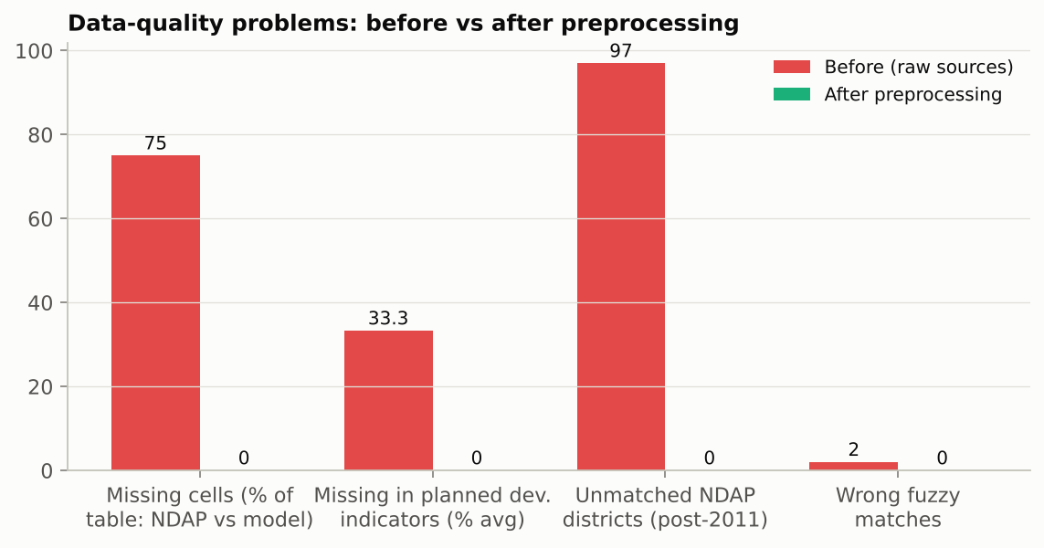
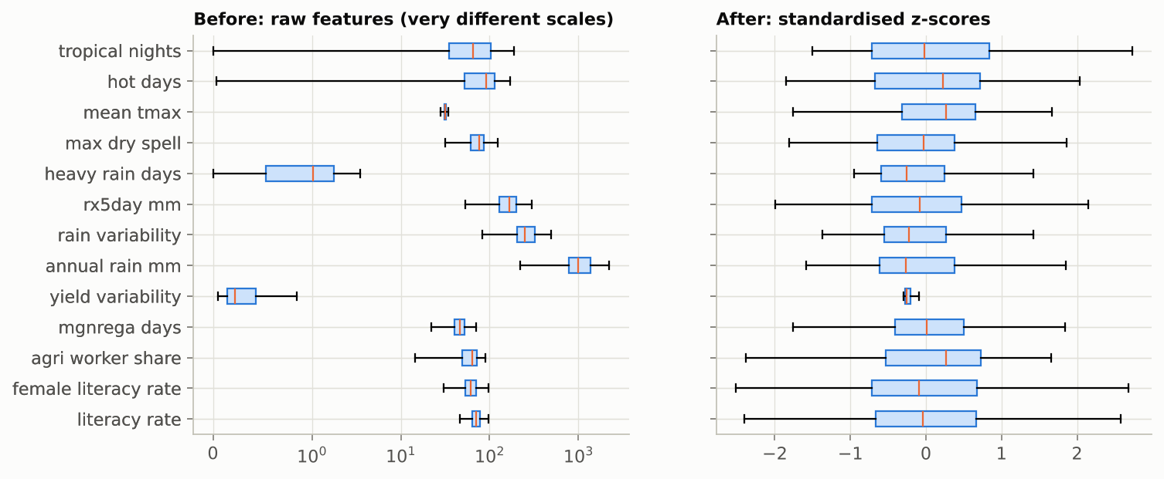
Preprocessing: Before vs After (Figures)
Top: Data-quality problems before vs after. Bottom: Feature scales before (raw) vs after (standardised).
Presenter: Sehjodh Grewal
Notes:
Top: the data-quality problems in the raw sources and after preprocessing; missing values, unmatched and wrongly matched districts all go to zero without imputation. Bottom: the raw features live on very different scales, and after standardisation they are comparable.

Slide 20
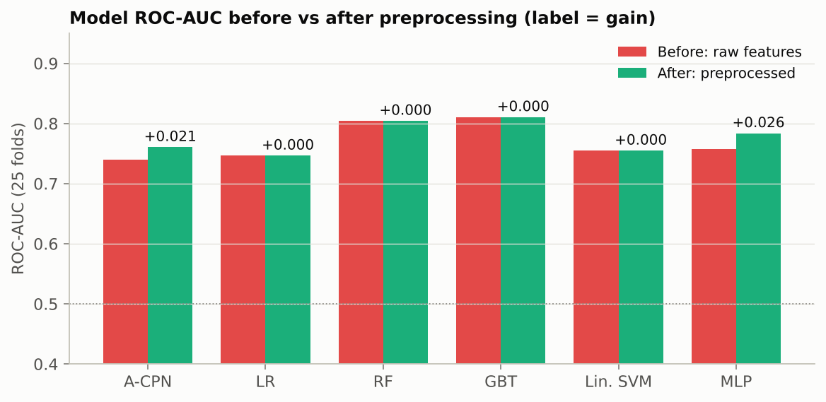
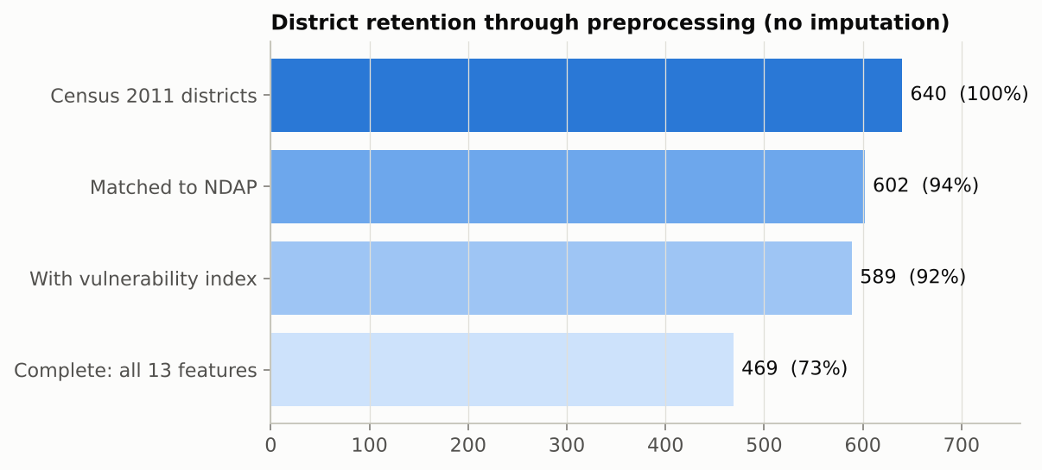
Preprocessing Improvement (Figures)
Top: Model ROC-AUC before vs after preprocessing. Bottom: District retention 640 → 469.
Presenter: Sehjodh Grewal
Notes:
Top: ROC-AUC of every model on raw versus preprocessed features, with the gain written above each pair. Bottom: how many districts survive each preprocessing stage when nothing is imputed.

Slide 21
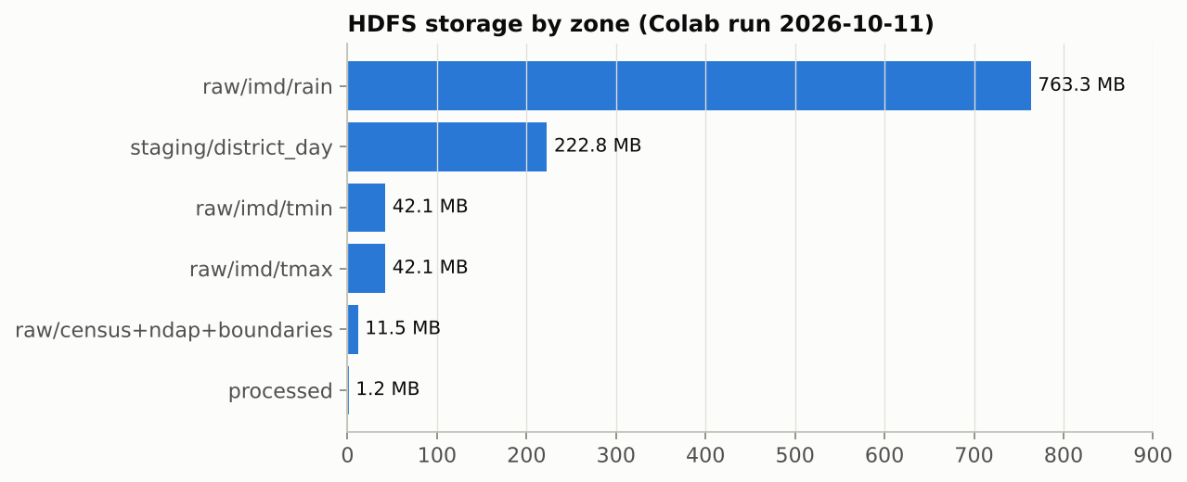
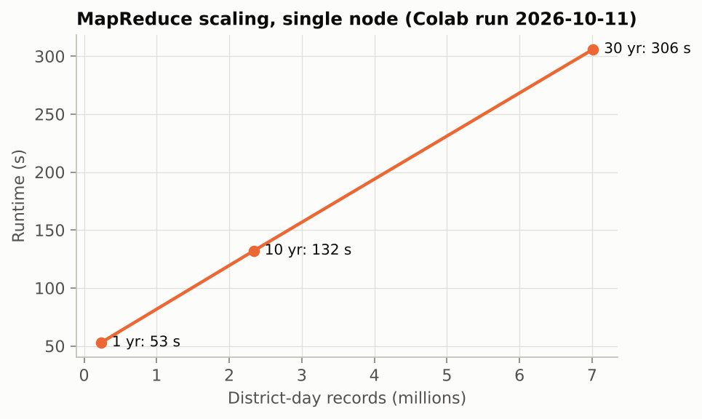
Big Data Results (Figures)
Top: HDFS storage by zone (Colab run 2026-10-11). Bottom: MapReduce scaling, single node (Colab run 2026-10-11).
Presenter: Tanmay Singh
Notes:
Top: HDFS storage by zone, dominated by the 30 years of rainfall grids. Bottom: MapReduce runtime against input size for 1, 10 and 30 years on a single node; both measured in the earlier Colab run.

Slide 22
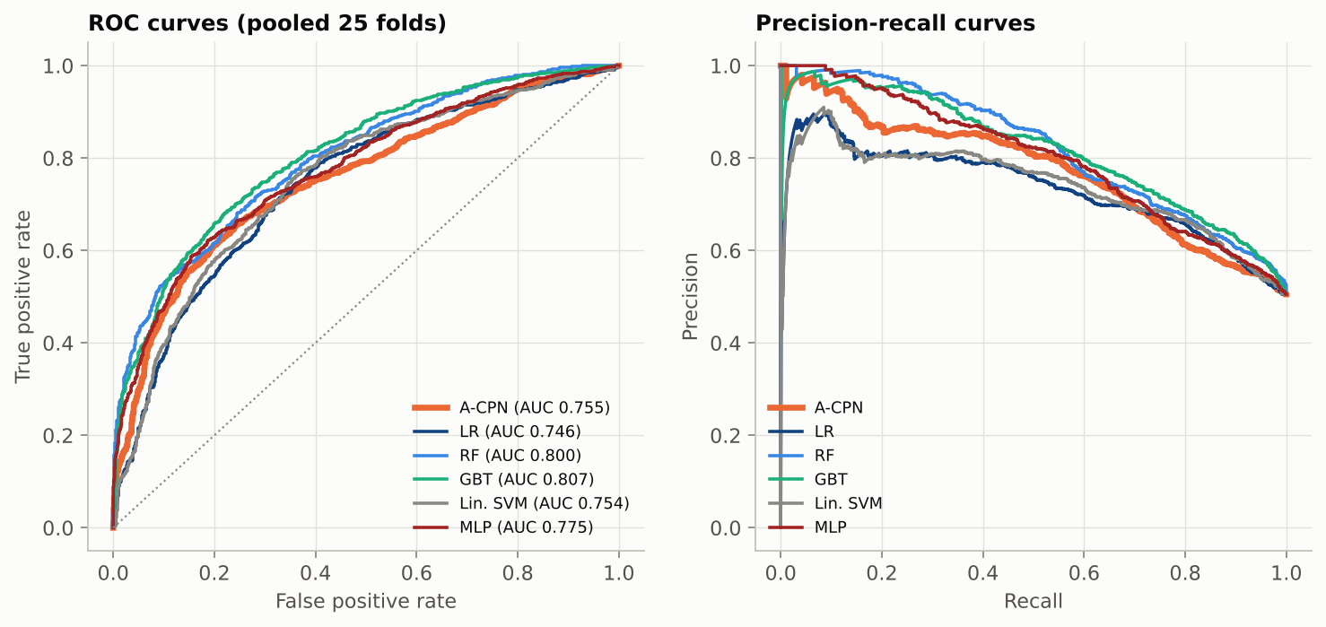
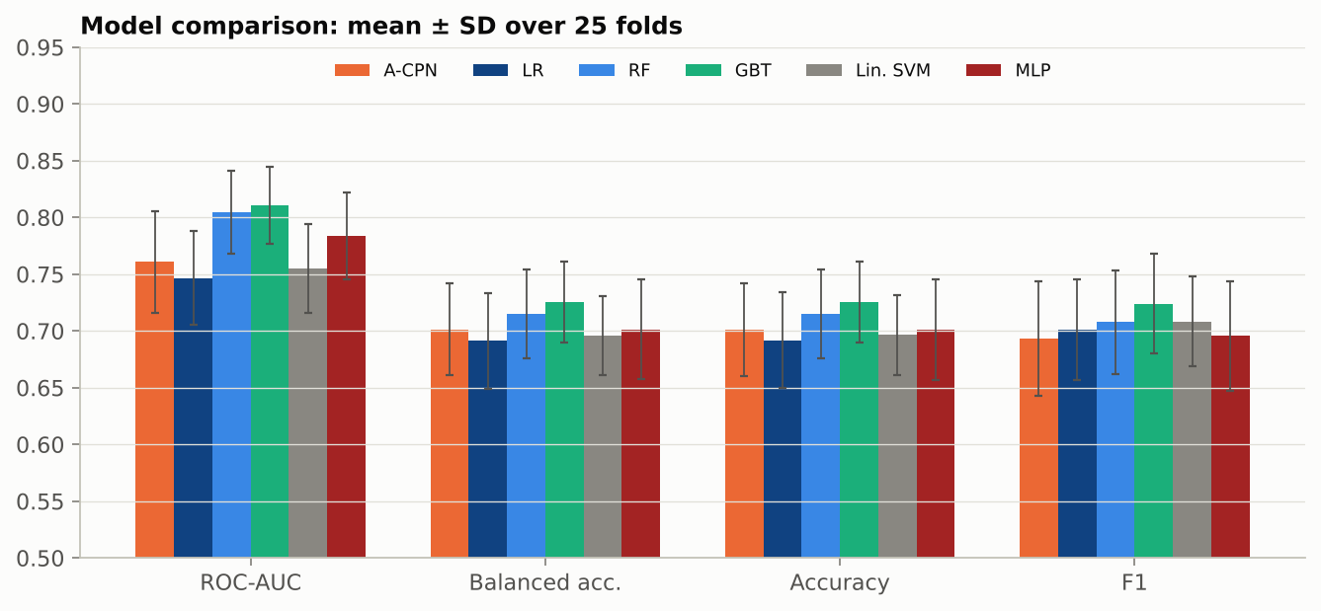
Results of Classification (Figures)
Top: ROC and precision-recall curves (25 folds). Bottom: Comparison: mean ± SD over 25 folds.
Presenter: Devanshu Kumar
Notes:
Top: ROC and precision-recall curves for A-CPN and the five baselines, pooled over the 25 folds. Bottom: mean and standard deviation of four metrics for every model.

Slide 23
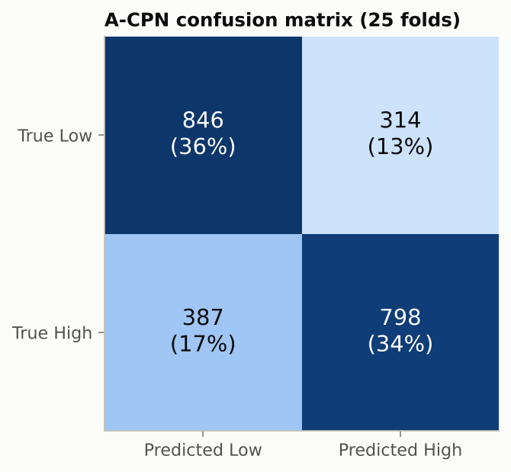
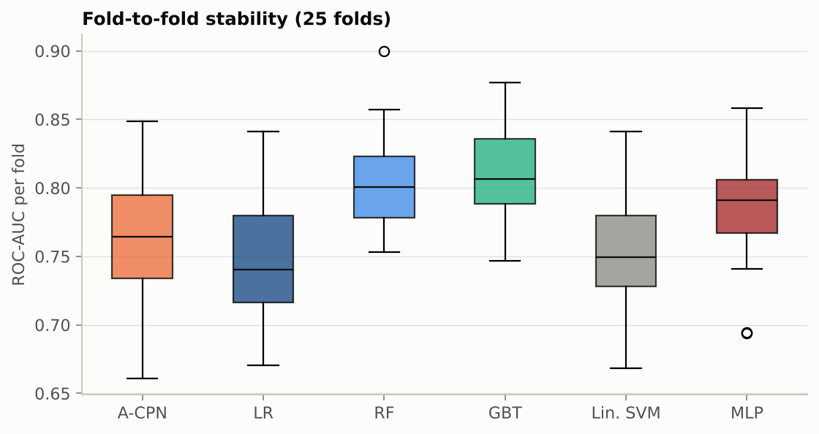
Confusion Matrix & Stability (Figures)
A-CPN confusion matrix (25 folds)
ROC-AUC per fold, all models
Presenter: Devanshu Kumar
Notes:
Left: the A-CPN confusion matrix summed over all test folds. Right: the spread of ROC-AUC across the 25 folds for every model, which shows how stable each model is.

Slide 24
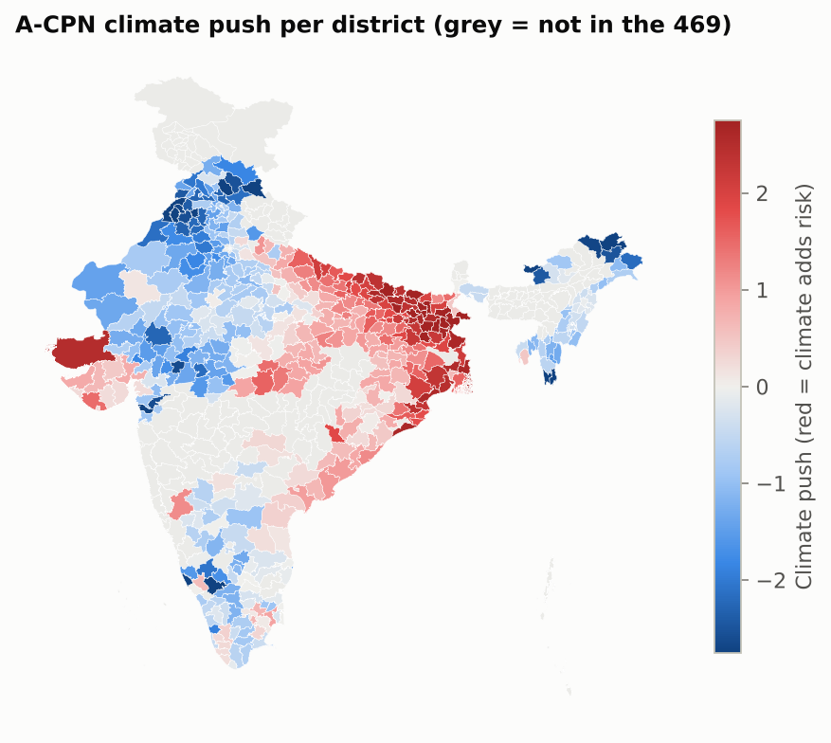
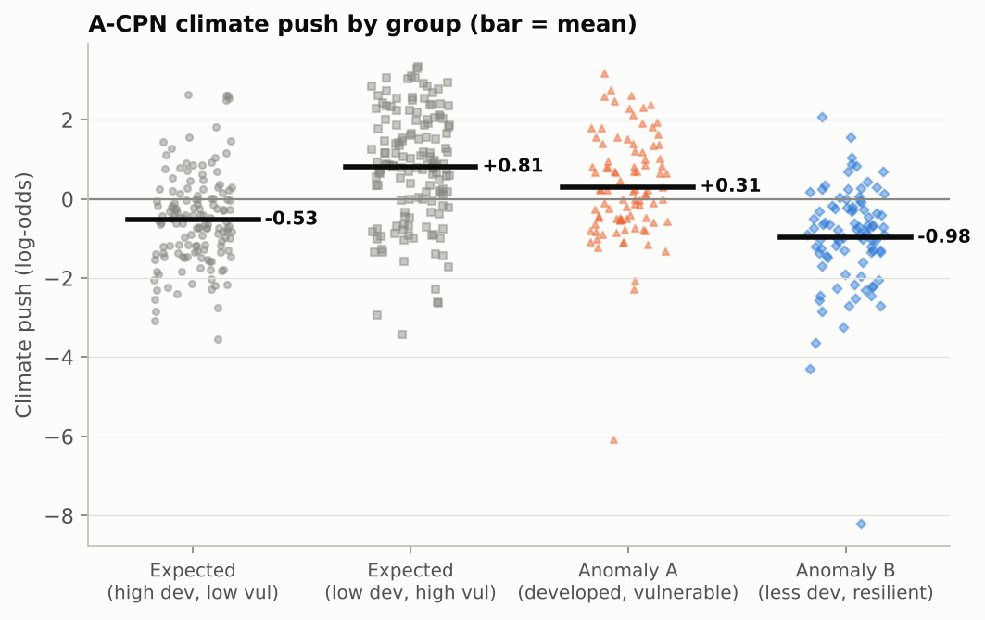
Climate-Push Visualisation
Climate push by group (bar = mean)
Climate push per district (469)
Presenter: Devanshu Kumar
Notes:
Left: the climate push of every district by group, with the group mean. Right: an India map of the climate push, so the panel can see where climate drives vulnerability beyond development.

Slide 25
Key Findings
▪ Development is not enough: R² 0.127; Pearson -0.356
▪ Climate adds signal: R² rises to 0.334 with the 8 hazard variables
▪ Anomalies are common: 181/469 districts (38.6%)
▪ Anomaly A: ≈2× tropical nights (91 vs 45 per year)
▪ Anomaly B: drier (863 vs 1078 mm annual rain)
▪ A-CPN result: ROC-AUC 0.761 vs best GBT 0.811; climate push Anomaly A +0.31 vs expected -0.53
▪ Limitations: 2011 Census vs 2021 index; 1° temperature grid; single-node Hadoop; 469 districts
Source: Colab run 2026-10-11
Presenter: Tanmay Singh
Notes:
Development explains only 13% of the variation in vulnerability; adding climate raises that to 33%, and state alone explains 48%. Anomaly A districts have about twice as many tropical nights, and Anomaly B districts are drier. Limitations are listed honestly.

Slide 26
Plan of Action / Member Tasks
Team member | Assigned work | Key responsibilities | Completion (Review 2)
Sehjodh Grewal | Data acquisition & preprocessing | Data download, Census rates, district matching, grid weights, grid-to-district conversion, Table 1, preprocessing error metrics | 100% (estimate)
Deepankar | Big Data platform & storage | Hadoop/YARN/Hive/Spark setup in Colab, HDFS zones, data loading, storage report (Table 2), repo and notebook integration | 90% (estimate: fresh Colab run pending)
Tanmay Singh | Big Data processing jobs | MapReduce, Hive queries, Spark k-means climate regimes, processing results (Table 3), slide assembly | 90% (estimate: fresh MapReduce/Hive run pending)
Devanshu Kumar | Models & comparison | A-CPN design and training, 5 comparison models, metrics, ablation, climate-push analysis (Tables 4-6) | 95% (estimate: all models run; tuning next)
Next (Review 3): full 1901–2024 rainfall in HDFS and re-timing; A-CPN tuning; comparison with CEEW / DST district rankings; final report.
Presenter: Tanmay Singh
Notes:
Each member owns one stage of the pipeline with no overlap: Sehjodh the data and preprocessing, Deepankar the Big Data platform, Tanmay the processing jobs, and Devanshu the models. Completion percentages are estimates at Review 2.

Slide 27
References
[1] A. Mohanty and S. Wadhawan, Mapping India's Climate Vulnerability, CEEW, 2021.
[2] NITI Aayog, District-Level Climate Vulnerability Indicators, NDAP dataset 7160.
[3] Census of India 2011, Primary Census Abstract.
[4] D. S. Pai et al., MAUSAM 65(1), 2014 (IMD gridded rainfall).
[5] A. K. Srivastava et al., Atmospheric Science Letters 10, 2009 (IMD gridded temperature).
[6] H.-T. Cheng et al., Wide & Deep Learning for Recommender Systems, DLRS 2016.
[7] S. Ö. Arık and T. Pfister, TabNet: Attentive Interpretable Tabular Learning, AAAI 2021.
[8] Z. Liu et al., KAN: Kolmogorov–Arnold Networks, arXiv:2404.19756, 2024.
[9] K. He et al., Deep Residual Learning for Image Recognition, CVPR 2016.
[10] Y. Gal and Z. Ghahramani, Dropout as a Bayesian Approximation, ICML 2016.
[11] A. N. Angelopoulos and S. Bates, A Gentle Introduction to Conformal Prediction, arXiv:2107.07511, 2021.
[12] K. Shvachko et al., The Hadoop Distributed File System, MSST 2010.
[13] J. Dean and S. Ghemawat, MapReduce, Communications of the ACM, 2008.
[14] A. Thusoo et al., Hive, VLDB 2009.
[15] M. Zaharia et al., Apache Spark: A Unified Engine for Big Data Processing, CACM 59(11), 2016.
[16] X. Meng et al., MLlib: Machine Learning in Apache Spark, JMLR 17, 2016.
[17] DataMeet, Community Created Maps of India.
Presenter: Tanmay Singh
Notes:
These are the data sources, the papers behind each A-CPN component, and the Big Data tools we used.

Slide 28
Geotagged Photo: Review 2
Insert geotagged photo
Presenter: Tanmay Singh
Notes:
The team adds the geotagged photo taken during the Review 2 presentation here.

Slide 29
Google Colab Implementation Link
Colab (with outputs):
https://colab.research.google.com/github/deepankarkumar1310/hadoop-ml-algorithm-/blob/main/notebooks/Review2_Colab.ipynb
GitHub: https://github.com/deepankarkumar1310/hadoop-ml-algorithm-
Notebook section | What it shows | Owner
0–2 Setup, data, preprocessing | Install, IMD download to Drive, Table 1 + error metrics | Sehjodh
3–4 Hadoop + HDFS | Cluster start, health report, HDFS load, Table 2 | Deepankar
5–7 MapReduce, Hive, Spark | YARN job + timings, Hive check, k-means regimes, Table 3 | Tanmay
8–10 A-CPN + comparison | Model card, 5 baselines, Tables 4–6, ablation | Devanshu
11 Visualisations | All figures, only after every table | Each owner
12 Slides | Builds this deck from results/ | Tanmay
Presenter: Tanmay Singh
Notes:
The Colab notebook runs the whole project in the Review 2 order, with every table printed before any figure. The model sections can also run on their own from the committed analysis table.

