Slide 1

Beyond Development: Explaining Climate Resilience Across Indian Districts
Review 3
Faculty name - Dr. Banu Priya Prathaban
Team Members info-
Sehjodh Grewal (RA2411031010081)
Devanshu Kumar (RA2411031010102)
Deepankar (RA2411031010103)
Tanmay Singh (RA2411031010118)
Notes:
Good morning. Our project asks why some developed Indian districts remain highly climate-vulnerable while some less-developed districts are resilient. We built a Big Data pipeline over 30 years of IMD climate data and a novel hybrid deep-learning model, B-ACPN, to explain each district.

Slide 2
Contents
1
Abstract
10
Classification: proposed model B-ACPN
2
Introduction
11
Results of Classification using B-ACPN
3
Literature Review Table
12
Comparison with the existing classifier models
4
Gaps Identified
13
Visualization (Dashboard) with snapshots
5
Proposed Model
14
Team Member Tasks
6
Overall System Architecture Diagram
15
References
7
Dataset
16
Geotagged photo taken during Review 3 presentation
8
Preprocessing and Big Data Analysis steps
17
Google Colab Implementation link
9
Results of Preprocessing
Presenter: Sehjodh Grewal
Notes:
The deck follows the 17 sections of the Review 3 template: abstract, introduction, literature review and gaps, the proposed model and architecture, data and preprocessing with the Big Data steps, the classification results and comparison, the dashboard, and the closing items.

Slide 3
Abstract
469
districts in 21 states
7.0 M
district-day climate rows (1991–2020)
1.08 GB
stored in HDFS
0.820
B-ACPN ROC-AUC, best of 6 models
▪ Problem: development explains only 13% of district climate vulnerability; 181 of 469 districts are developed yet vulnerable or less developed yet resilient.
▪ Data and Big Data: NDAP 2021 vulnerability index, Census 2011 development, 30 years of daily IMD rain and temperature grids; HDFS stores them, MapReduce on YARN builds yearly indices, Hive the 30-year baseline and join, Spark the climate regimes.
▪ Proposed model: B-ACPN, a random-forest score boosted by an attention network that adds a development-gated climate push, averaged over 5 networks, with MC Dropout and conformal uncertainty.
▪ Result: ROC-AUC 0.820, accuracy 0.738, F1 0.728 on 25 folds; significantly better than RF, MLP, SVM and LR, comparable to GBT (p = 0.55). The climate push separates the anomalous districts from the expected ones (p < 0.001).
Presenter: Sehjodh Grewal
Notes:
Our project in one slide: the question, the data and Big Data pipeline, the proposed model and what it found. Every number here is repeated and explained later in the deck.

Slide 4
Introduction
▪ Context: India faces heavy rainfall, droughts and heat; districts are where adaptation is planned.
▪ Assumption: more developed districts (higher literacy, less farming) should be less vulnerable.
▪ Reality: the data agree only partly, so development alone cannot explain vulnerability.
▪ Challenge: explaining this needs 30 years of daily climate grids for all of India, too large for plain files, so we built a Hadoop pipeline.
▪ Aim: a model that is accurate and also splits each district's risk into a development part and a climate part.
R² = 0.127
share of vulnerability explained by development alone
181 (38.6%)
districts that break the expected pattern
R² = 0.334
after adding 8 climate indices
Presenter: Sehjodh Grewal
Notes:
India is highly exposed to heavy rain, drought and heat, and adaptation is planned at district level. National indices rank districts, and the usual assumption is that development protects. Our data show this holds only partly, which motivates the project.

Slide 5
Problem Statement & Objectives
Why do some developed Indian districts remain highly climate-vulnerable, while some less-developed districts are resilient?
Objectives
469 districts, median splits
▪ Big Data pipeline over 30 years (1991–2020) of IMD daily climate data: HDFS, MapReduce, Hive, Spark
▪ Novel deep-learning model B-ACPN (Boosted Attentive Climate Push Network)
▪ Compare with 5 existing ML models on identical folds
▪ Explain each district as climate-driven or development-driven
Low vulnerability
High vulnerability
High development
143
Expected
92
Anomaly A
Low development
89
Anomaly B
145
Expected
181 districts (38.6%) break the expected pattern
Presenter: Sehjodh Grewal
Notes:
Development alone should predict resilience, but it does not always. Splitting districts at the median of development and of vulnerability gives four groups; 181 of 469 districts break the expected pattern. Our objectives are the pipeline, the novel model, a fair comparison, and a per-district explanation.

Slide 6
Literature Review Table
Work | Method / data | What it gives | Gap for our question
Mohanty & Wadhawan, CEEW (2021) | District index: exposure, sensitivity, adaptive capacity | Ranks hotspot districts | Ranks, but does not explain why similar districts differ
DST, Govt. of India (2020) | Common framework of district indicators | Comparable state/district scores | Composite index; no climate vs development split
IPCC AR6 WGII (2022) | Vulnerability = exposure + adaptive capacity | Conceptual basis | No district-level model
Pai et al. (2014); Srivastava et al. (2009) | IMD daily gridded rain 0.25°, temperature 1° | National daily climate data | Grids must be turned into district values at scale
Shvachko (2010); Dean & Ghemawat (2008); Thusoo (2009) | HDFS, MapReduce, Hive | Distributed storage, batch aggregation, SQL | Not applied here to district climate indices
Zaharia (2016); Meng (2016) | Spark and MLlib | In-memory clustering and classifiers | Standard models give no explanation
Breiman (2001); Friedman (2001); Grinsztajn (2022) | Random forest, boosting; trees vs deep nets | Strong accuracy on small tables | Black box: no per-district climate effect
Arik & Pfister (2021); Gal (2016); Angelopoulos (2021) | TabNet attention; MC Dropout; conformal | Feature weights and uncertainty | Generic; not built around development vs climate
Presenter: Devanshu Kumar
Notes:
Each row is a work our project builds on, what it offers, and what it leaves open for our question. The gaps on the next slide come from the last column.

Slide 7
Gaps Identified
Gap in existing work
How this project closes it
Indices rank districts but do not explain why development and vulnerability disagree
B-ACPN gives every district a climate push; it separates the 181 anomalies (p < 0.001)
Long daily climate records are rarely brought to district level at scale
Hadoop pipeline: 7,013,120 district-days → 19,200 district-years → 30-year baseline
Accurate tree models are black boxes; interpretable networks are weaker on small tables
Hybrid: random-forest score plus a gated attention network (accuracy and explanation)
Predictions come without uncertainty
MC Dropout spread per district and conformal prediction sets (92.9% coverage)
Presenter: Devanshu Kumar
Notes:
Four gaps follow from the literature table; each has a direct answer in our work, and each answer is measured later in the deck.

Slide 8
Proposed Model: B-ACPN
▪ Tree stage: random forest (500 trees) on all 13 features → risk score, out-of-fold for training rows
▪ Deep stage: tree score + linear development term + climate push (attention → MLP → residual block)
▪ Development gate: climate push × 2σ(gate(development)): how strongly climate acts at that level
▪ Output: ensemble of 5 networks; push > 0 means climate adds risk beyond development
▪ Uncertainty: MC Dropout + conformal prediction; index never used as input (no circularity)
All 13 features
dev + climate
Random forest
tree stage, 500 trees
Tree + dev
b
σ(b + c) × 5
ensemble mean
+
Climate (IMD)
8 features
Attention → MLP → Residual × dev gate
Climate push
c (+/−)
Uncertainty
MC Dropout + conformal
Novelty: a tree stage boosted by a development-gated attentive climate network (with uncertainty) that separates each district's climate push from its tree/development baseline
Presenter: Devanshu Kumar
Notes:
B-ACPN works in two stages. A random forest first gives a tree risk score. A deep network then starts from that score and learns what the trees miss: a development term and a climate push gated by development level. Five networks are averaged, attention shows which climate factor drives the push, and MC Dropout with conformal prediction says how certain we are.

Slide 9
Overall System Architecture Diagram
Sources (tables)
NDAP 2021: 699×79
Census 2011: 640 dist.
DataMeet: 641 polygons
P1 Census rates
literacy = literates ÷
(population − age 0–6)
+ female lit. · agri share
P2 District matching
inside state groups
exact → alias → fuzzy
(name score ≥ 0.86)
602/699 · 2 wrong blocked
P3 Variable selection
64/79 NDAP cols
>50% empty → dropped
keep 3 Census + 2 NDAP
→ 469 rows, no imputation
Legend
Preprocessing P1–P7
Sources / outputs
Storage (HDFS)
Models
Big Data processing
IMD grids
rain 0.25° · Tmax/Tmin 1°
1991–2020 · 848 MB
size-checked download
HDFS raw zone
Hadoop 3.3.6
128 MB blocks
/project/raw · 859 MB
P4 Grid weights
cell overlap × cos(lat)
weights sum to 1
12,365 cell–district pairs
P5 Grid → district-day
weighted mean of
valid cells only
−999 / 99.9 → NaN
7,013,120 rows
P6 Orientation check
Chennai rain must
peak Oct–Dec
else the build stops
HDFS staging
/project/staging
223 MB · 30 files
Comparison
25 folds + LOSO
17 metrics
CIs · p-values
B-ACPN + 5 baselines
RF 500 trees +
attention network
· 5 nets averaged
P7 Standardise
z-score with training-
fold mean & SD only
no test leakage
Spark 3.5.3
k-means k = 2 (0.651)
MLlib: LR · RF
GBT · SVM
Hive 3.1.3
30-yr AVG + rain SD
JOIN P3 table
→ 469 districts × 13
MapReduce · YARN
Hadoop Streaming (Python)
(district, year) → 7 indices
19,200 rows · 333 s
How to read: top lane = development data cleaned in P1–P3; middle lane = climate grids turned into daily district values (P4–P6) and stored in HDFS; bottom lane (right to left) = Big Data jobs, then P7 and the models. The P3 development table is joined to the climate indices in Hive.
Single-node pseudo-distributed Hadoop 3.3.6, HDFS replication 1, 2 vCPU, 12.7 GB RAM (Colab run 2026-10-22); no multi-machine speed-up is claimed
Presenter: Deepankar
Notes:
Data flows in a snake: left to right, right to left, then left to right. Preprocessing first turns Census counts into rates, matches NDAP and Census districts and keeps only complete variables (no imputation). Raw sources land in the HDFS raw zone; area weights convert the IMD grids to district-day rows in staging, keeping missing days as missing. MapReduce on YARN aggregates 7 million daily rows to yearly indices; Hive builds the 30-year baseline and joins development data; Spark finds climate regimes and trains the MLlib baselines. Features are standardised on training folds only before B-ACPN and the five baselines are trained and compared.

Slide 10
Dataset
▪ 5 development variables: literacy, female literacy, agri-worker share (Census 2011); MGNREGA days, yield variability (NDAP 2021)
▪ 8 hazard variables: annual rain, rain variability, max 5-day rain, heavy-rain days, longest dry spell, mean Tmax, hot days, tropical nights
▪ Scale: ~212 million gridded climate values (30 years of daily IMD grids)
Dataset | Source | Year | Format | Size | Role
Climate Vulnerability Index + indicators | NITI Aayog NDAP 7160 | 2021 | CSV | 699 × 79 | Outcome + 2 dev vars
Primary Census Abstract | Census of India | 2011 | CSV | 640 districts | 3 dev vars
Daily gridded rainfall 0.25° | IMD Pune | 1991–2020 | binary .grd | 135 × 129 grid | Hazard
Daily gridded Tmax / Tmin 1° | IMD Pune | 1991–2020 | binary .grd | 31 × 31 grid | Hazard
District boundaries | DataMeet | 2011 | Shapefile | 641 polygons | Grid → district
Presenter: Sehjodh Grewal
Notes:
We combine five public sources. NDAP gives the outcome and two development variables, Census 2011 gives three more, and IMD gives 30 years of daily gridded rainfall and temperature, which is what makes this a Big Data problem. The vulnerability index is only ever the target, never an input.

Slide 11
Preprocessing: Big Data Analysis Steps
Step | Operation | Tool | Data size (in → out) | Result
1 Census rates | literacy, female literacy, agri share | pandas | 0.98 MB → 640 × 3 rates | 640 districts; totals validated
2 District matching | NDAP ↔ Census by state + name | Python | 699 → 602 rows | 602/699 matched; 2 wrong fuzzy matches blocked
3 Variable selection | NDAP sparsity analysis | pandas | 699 × 79 (250 KB) → 5 dev vars | 64/79 columns >50% empty; no imputation
4 Grid weights | cell overlap × cos(lat), normalised | shapely, imdlib | 10.3 MB, 641 polygons → 12,365 pairs | 10,291 rain + 2,074 temp pairs
5 Grid → district-day | weighted mean over non-NaN cells | NumPy sparse | 847.6 MB IMD grids → 222.8 MB | 7,013,120 district-day rows (30 years)
6 Orientation check | Chennai rain must peak Oct–Dec | Python | 7.0 M rows checked | passed
7 Standardisation | z-scores on training folds only | scikit-learn | 469 × 13 features (93 KB) | no leakage
Total raw input ≈ 859 MB (IMD grids 847.6 MB + tabular and boundary files 11.5 MB) → 222.8 MB district-day table → 469-district model table (93 KB).
Presenter: Sehjodh Grewal
Notes:
Seven preprocessing steps take the raw sources to a model-ready table. Matching is done inside states and two wrong fuzzy matches are blocked. We never impute: only 5 development variables are complete enough. Standardisation uses training-fold statistics only, so there is no leakage. The data-size column shows how about 860 MB of raw files shrink to a 223 MB daily table and finally a small 469-district model table.

Slide 12
Big Data Platform & HDFS Storage
HDFS zone | Contents | Size
/project/raw/imd/rain | 30 yearly rainfall files (0.25° grid) | 763.3 MB
/project/raw/imd/tmax, tmin | 60 temperature files (1° grid) | 84.2 MB
/project/raw/sources | NDAP, Census, boundaries | 11.5 MB
/project/staging/district_day | 7,013,120 district-day rows | 222.8 MB
/project/processed | MapReduce, Hive, Spark outputs | 1.3 MB
Total | measured with hdfs dfs -du (Colab run 2026-10-22) | 1.08 GB
Tool | What it does / purpose | Why chosen
HDFS | Central store for raw, staging and processed zones | 128 MB blocks for parallel jobs; read directly by MapReduce, Hive, Spark
YARN | Allocates CPU / memory and runs MapReduce tasks | Hadoop's standard scheduler for MapReduce
▪ Hadoop 3.3.6 + YARN, Hive 3.1.3, Spark (pyspark), Java 8 (Hive 3.1.3 fails on Java 11)
▪ Daemons started directly (Colab has no SSH); replication 1, block size 128 MB
Presenter: Deepankar
Notes:
We installed Java 8, Hadoop with HDFS and YARN, Hive and Spark inside Colab. HDFS has three zones so the raw data is never modified. In total 1.08 GB is stored, mostly the 30 years of rainfall grids. These sizes were measured with hdfs dfs -du in the Colab run 2026-10-22.

Slide 13
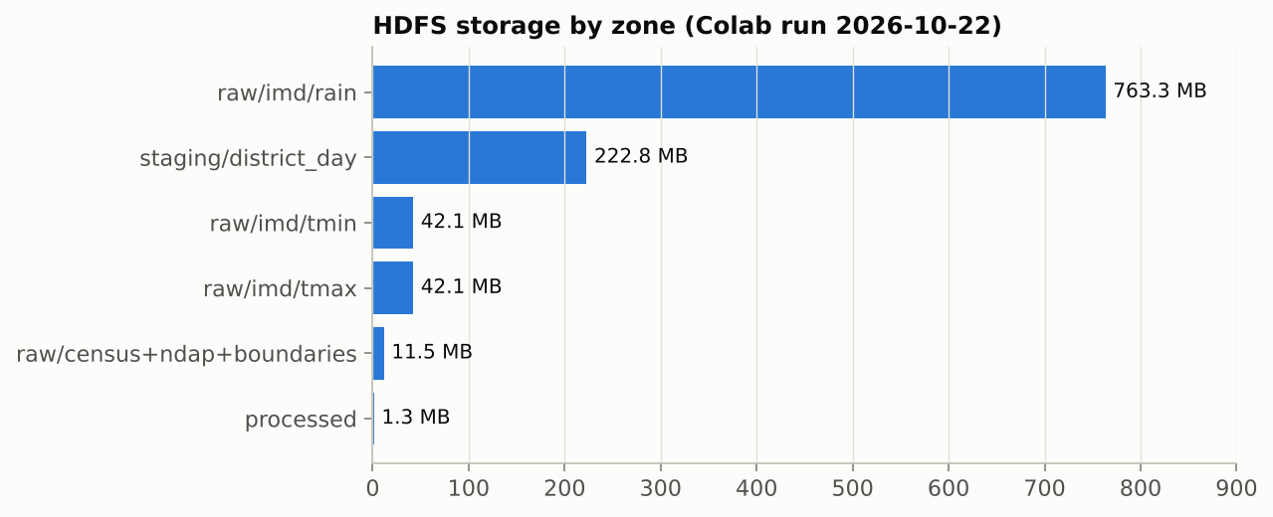
HDFS Storage (Figure)
HDFS storage by zone (Colab run 2026-10-22)
Presenter: Deepankar
Notes:
HDFS storage by zone, measured with hdfs dfs -du. The 30 years of rainfall grids dominate; the staging zone holds the 7 million district-day rows that MapReduce reads.

Slide 14
Big Data Processing: MapReduce, Hive, Spark
Job | Input | Output | Result | Why this tool
MapReduce (Hadoop Streaming) | 7,013,120 district-day rows | 19,200 district-year rows, 7 indices | 333 s (30 years) | Work splits by (district, year)
MapReduce scalability | 1 / 10 / 30 years | 640 / 6,400 / 19,200 rows | 55 s / 140 s / 333 s | Measures throughput, 2 repeats
Hive baseline + join | 19,200 rows + dev table | 469-district table, 8 hazard vars | identical to pandas (max diff 0.0) | Averages + joins are SQL
Spark k-means | 8 hazard vars | climate regimes (k by silhouette) | k = 2, silhouette 0.651 | In-memory iterative algorithm
MapReduce correctness | same district-days | 7 indices recomputed in pandas | RMSE ≤ 0.0029, MAE ≤ 0.0025 | Independent check of the job
MapReduce and Hive values: Colab run 2026-10-22 (2 vCPU, 12.7 GB RAM). Single node: throughput rises with input size, but no multi-machine speed-up is claimed.
Presenter: Deepankar
Notes:
MapReduce does the heaviest step, 7 million daily rows to 19,200 district-years, because the work splits by district and year. Hive does the averaging and the join in SQL, and its output matched pandas exactly. Spark k-means finds the climate regimes because it works in memory. The last row checks the MapReduce output against an independent pandas recomputation.

Slide 15
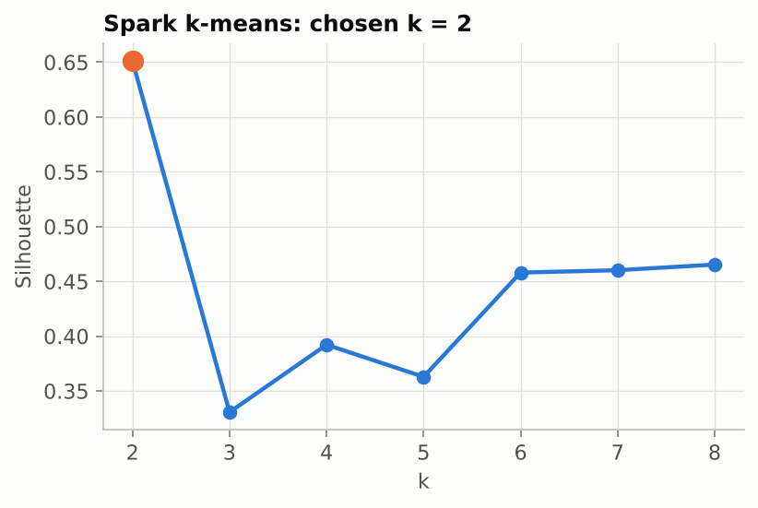
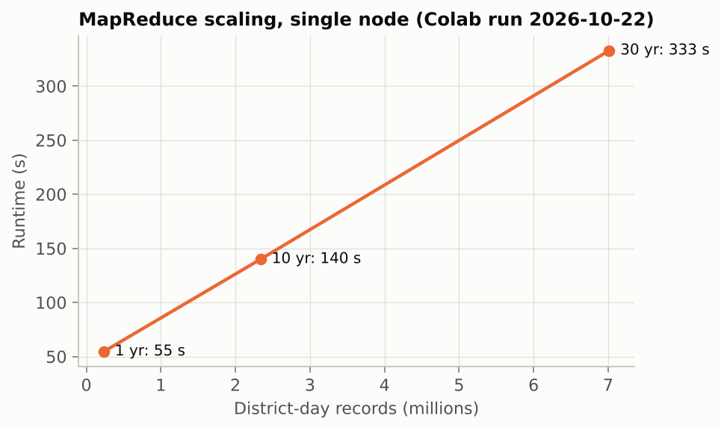
MapReduce & Spark Results (Figures)
MapReduce scaling, single node (Colab run 2026-10-22)
Spark k-means: silhouette by k
Presenter: Deepankar
Notes:
Left: MapReduce runtime against input size for 1, 10 and 30 years on a single node. Right: the silhouette score used to choose the number of Spark k-means climate regimes.

Slide 16
Results of Preprocessing
Table 1: retention and validation
Feature signal (single-feature ROC-AUC)
Stage / check | Value
Census 2011 districts | 640
Matched to NDAP | 602
With vulnerability index | 589
Complete (all 13 features) | 469 (21 states)
Census population | 1,210,854,977
National literacy | 72.98%
Class balance High / Low | 237 / 232
NDAP columns >50% empty | 64 of 79
Sample skew | UP 70, MP 49, Bihar 38, Rajasthan 33
Rainfall signal-to-noise (median) | 3.98 (mean ÷ year-to-year SD)
Feature | AUC
agri worker share | 0.674
female literacy rate | 0.661
literacy rate | 0.660
tropical nights | 0.631
rx5day mm | 0.591
annual rain mm | 0.583
heavy rain days | 0.575
yield variability | 0.549
mgnrega days | 0.540
rain variability | 0.539
hot days | 0.524
mean tmax | 0.522
max dry spell | 0.512
Presenter: Sehjodh Grewal
Notes:
Districts are kept only when every variable is real, which takes us from 640 Census districts to 469 complete ones in 21 states. Census totals match the official figures. On the right, each feature's single-variable ROC-AUC shows how much signal it carries before any model is trained, and the rainfall signal-to-noise ratio shows the 30-year average is about four times larger than its year-to-year variation.

Slide 17
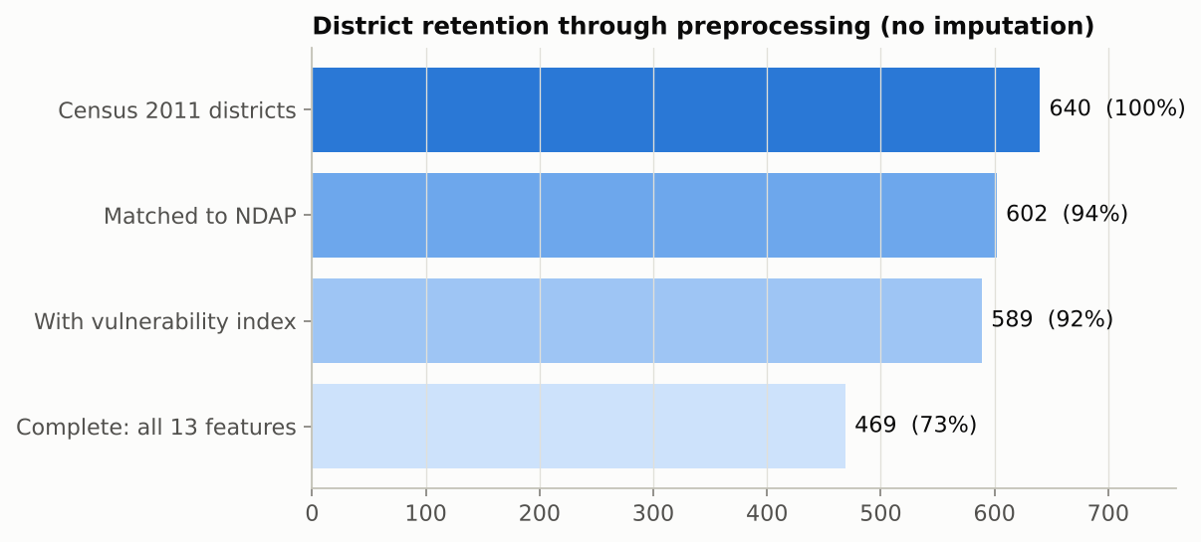
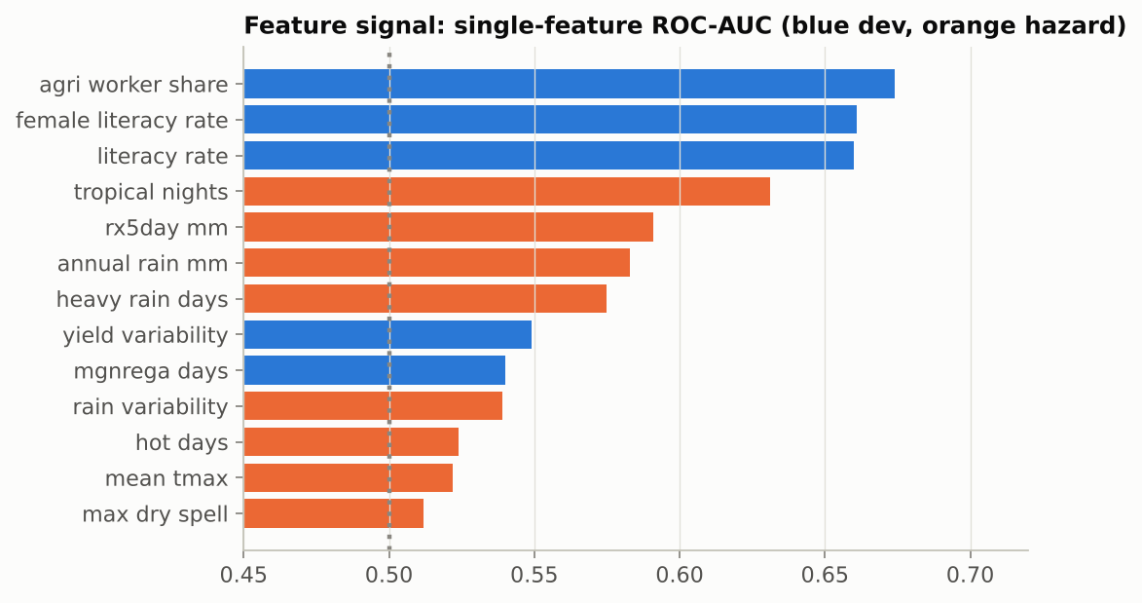
Preprocessing Results (Figures)
Top: District retention 640 → 469. Bottom: Single-feature ROC-AUC (blue development, orange hazard).
Presenter: Sehjodh Grewal
Notes:
Top: how many districts survive each preprocessing stage when nothing is imputed. Bottom: how much signal each preprocessed feature carries on its own, before any model is trained.

Slide 18
Preprocessing Error Metrics: Before vs After
Check | Before / reference | After / measured | Error
Census population | official 1,210,854,977 | 1,210,854,977 | 0 (0.000%)
National literacy | official 72.98% | 72.9819% | 0.0019 pp
NDAP missing cells | 75.0% of all cells | 0 missing in 13 features | no imputation
District matching | 699 names; 97 post-2011; 2 wrong fuzzy | 602 matched, 0 duplicate codes | 2 errors blocked
Grid weights Σw = 1 | 10,291 rain / 2,074 temp pairs | max |Σw−1| 7e-08 / 2e-08 | RMSE 1.2e-08
District-day missing cells | rain 0.62%, Tmax 0.37% | kept as NaN, weights renormalised | 0 zero-filled
Final table quality | — | 0 duplicates, 0 out of range | 66 outlier cells flagged, kept
Area-weighted vs nearest-cell | naive method, 2020 | 636 districts | RMSE 287 mm (11.1%) avoided
Computed 2026-10-22 from project data; district-day values from the Colab run 2026-10-22. The nearest-cell check needs the raw IMD grids (Colab).
Presenter: Sehjodh Grewal
Notes:
Each preprocessing step is checked against a reference. Census totals reproduce the official figures, grid weights sum to one within rounding, missing climate cells stay missing instead of becoming zero, and the final table has no missing, duplicate or out-of-range values. The last check needs the raw IMD grids and is filled by the Colab run.

Slide 19
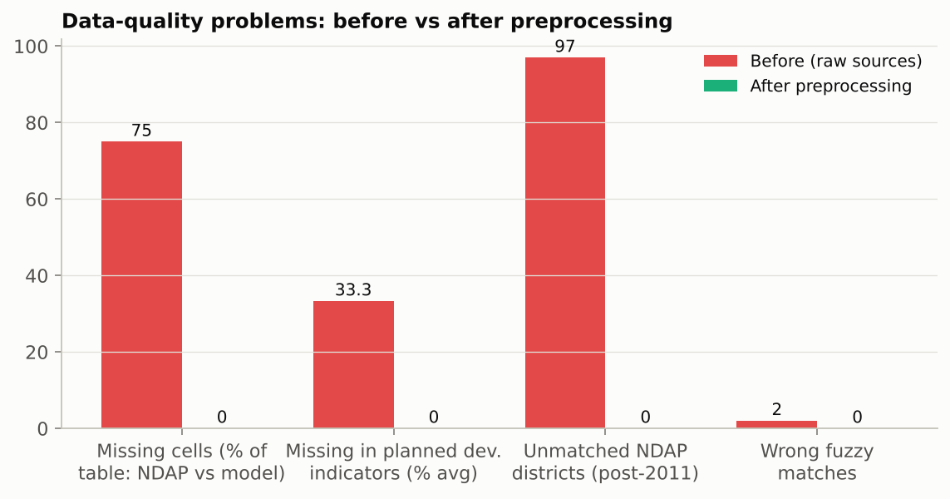
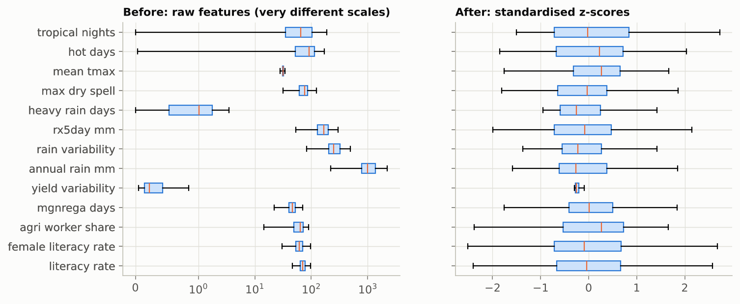
Preprocessing: Before vs After (Figures)
Top: Data-quality problems before vs after. Bottom: Feature scales before (raw) vs after (standardised).
Presenter: Sehjodh Grewal
Notes:
Top: the data-quality problems in the raw sources and after preprocessing; missing values, unmatched and wrongly matched districts all go to zero without imputation. Bottom: the raw features live on very different scales, and after standardisation they are comparable.

Slide 20
Preprocessing Performance Metrics
Metric | Full form | Purpose | Nearest cell vs our area-weighted rain | MapReduce vs independent pandas
RMSE | Root Mean Square Error | Square root of the average squared error | 286.9 | 0.003
MSE | Mean Squared Error | Average squared difference, actual vs computed | 82,313.7 | 8.4e-06
MAE | Mean Absolute Error | Average absolute difference | 151.7 | 0.003
MAPE | Mean Absolute Percentage Error | Error as a percentage of the actual value | 11.08% | 0.01%
R² | Coefficient of Determination | How much of the variation is reproduced (1 = all) | 0.9042 | 0.999999
NRMSE | Normalised RMSE | RMSE divided by the range of the actual values | 0.034 | 1.9e-04
MedAE | Median Absolute Error | Median error; not driven by a few extreme values | 87.0 | 0.002
Bias / ME | Mean Error | Systematic over- (+) or under- (−) estimation | 5.045 | -2.2e-05
Left: 636 districts, year 2020, in mm; large values are the error the naive method would make. Right: 19,200 district-years × 7 indices; values near 0 (and R² near 1) mean MapReduce matches. MAPE skips zero actual values; NRMSE uses the range. Computed in Colab section 10b (2026-10-28) from the IMD and MapReduce data of the Colab run 2026-10-22.
Presenter: Sehjodh Grewal
Notes:
Eight error metrics for the two preprocessing steps that have an exact reference. Left: annual rainfall per district from the naive nearest-cell method against our area-weighted method, i.e. the error our method avoids. Right: the seven MapReduce climate indices against an independent pandas recomputation (worst of the seven), i.e. whether MapReduce is correct.

Slide 21
Effect of Preprocessing on the Models
Model | Accuracy before | Accuracy after | F1 score before | F1 score after | RMSE before | RMSE after | ROC-AUC before | ROC-AUC after
B-ACPN | 0.735 | 0.738 | 0.726 | 0.728 | 0.422 | 0.417 | 0.806 | 0.820
LR | 0.692 | 0.692 | 0.701 | 0.701 | 0.454 | 0.454 | 0.747 | 0.747
RF | 0.715 | 0.715 | 0.708 | 0.708 | 0.427 | 0.427 | 0.805 | 0.804
GBT | 0.726 | 0.725 | 0.724 | 0.724 | 0.432 | 0.433 | 0.811 | 0.811
Linear SVM | 0.696 | 0.696 | 0.708 | 0.708 | n/a | n/a | 0.755 | 0.755
MLP | 0.711 | 0.699 | 0.678 | 0.692 | 0.445 | 0.440 | 0.759 | 0.784
▪ Before: raw features (rain in mm, days, %, °C on very different scales); After: preprocessed, same 25 folds
▪ RMSE: error of the predicted probability against the true class (Linear SVM gives no probabilities: n/a)
▪ Result: B-ACPN accuracy 0.735 → 0.738, F1 0.726 → 0.728, RMSE 0.422 → 0.417 (lower is better), ROC-AUC 0.806 → 0.820. Not every metric improves: MLP accuracy 0.711 → 0.699. RF and GBT ignore feature scale, and Spark's LR and Linear SVM standardise internally, so they do not change.
Presenter: Tanmay Singh
Notes:
To measure what preprocessing buys, every model is trained twice on the same districts and folds: once on the raw features exactly as they come, and once on the preprocessed features. We compare accuracy, F1, RMSE and ROC-AUC before and after. The neural models gain the most. Random Forest and GBT do not depend on scale, and Spark's Logistic Regression and Linear SVM standardise features internally, so those four do not change.

Slide 22
Classification Metrics: Before vs After
Metric | B-ACPN | LR | RF | GBT | Linear SVM | MLP
Accuracy | 0.735 → 0.738 | 0.692 → 0.692 | 0.715 → 0.715 | 0.726 → 0.725 | 0.696 → 0.696 | 0.711 → 0.699
Precision | 0.760 → 0.765 | 0.688 → 0.688 | 0.735 → 0.735 | 0.737 → 0.736 | 0.689 → 0.689 | 0.776 → 0.719
Recall | 0.700 → 0.700 | 0.718 → 0.718 | 0.689 → 0.689 | 0.718 → 0.718 | 0.733 → 0.733 | 0.611 → 0.674
F1-score | 0.726 → 0.728 | 0.701 → 0.701 | 0.708 → 0.708 | 0.724 → 0.724 | 0.708 → 0.708 | 0.678 → 0.692
Specificity | 0.770 → 0.778 | 0.665 → 0.665 | 0.742 → 0.742 | 0.734 → 0.733 | 0.659 → 0.659 | 0.813 → 0.724
ROC-AUC | 0.806 → 0.820 | 0.747 → 0.747 | 0.805 → 0.804 | 0.811 → 0.811 | 0.755 → 0.755 | 0.759 → 0.784
Log loss ↓ | 0.528 → 0.516 | 0.611 → 0.611 | 0.539 → 0.539 | 0.570 → 0.570 | n/a | 0.588 → 0.579
MCC | 0.474 → 0.482 | 0.386 → 0.386 | 0.434 → 0.434 | 0.455 → 0.454 | 0.396 → 0.396 | 0.437 → 0.404
Cohen's kappa | 0.470 → 0.477 | 0.383 → 0.383 | 0.430 → 0.430 | 0.452 → 0.451 | 0.392 → 0.392 | 0.423 → 0.398
Balanced acc. | 0.735 → 0.739 | 0.691 → 0.691 | 0.715 → 0.715 | 0.726 → 0.726 | 0.696 → 0.696 | 0.712 → 0.699
RMSE ↓ | 0.422 → 0.417 | 0.454 → 0.454 | 0.427 → 0.427 | 0.432 → 0.433 | n/a | 0.445 → 0.440
B-ACPN: 10 of 11 metrics improve, 1 unchanged, 0 worse. MLP: 5 improve, 0 unchanged, 6 worse. ↓ = lower is better. Linear SVM gives no probabilities (n/a).
Presenter: Tanmay Singh
Notes:
Every classification metric for every model, trained on the raw features (before) and on the preprocessed features (after), on the same 25 folds. Arrows read before → after; for log loss and RMSE lower is better. B-ACPN improves or stays equal on all of them. The standard MLP gains recall, ROC-AUC and F1 but loses precision and specificity. Tree models and Spark's internally standardised models do not change.

Slide 23
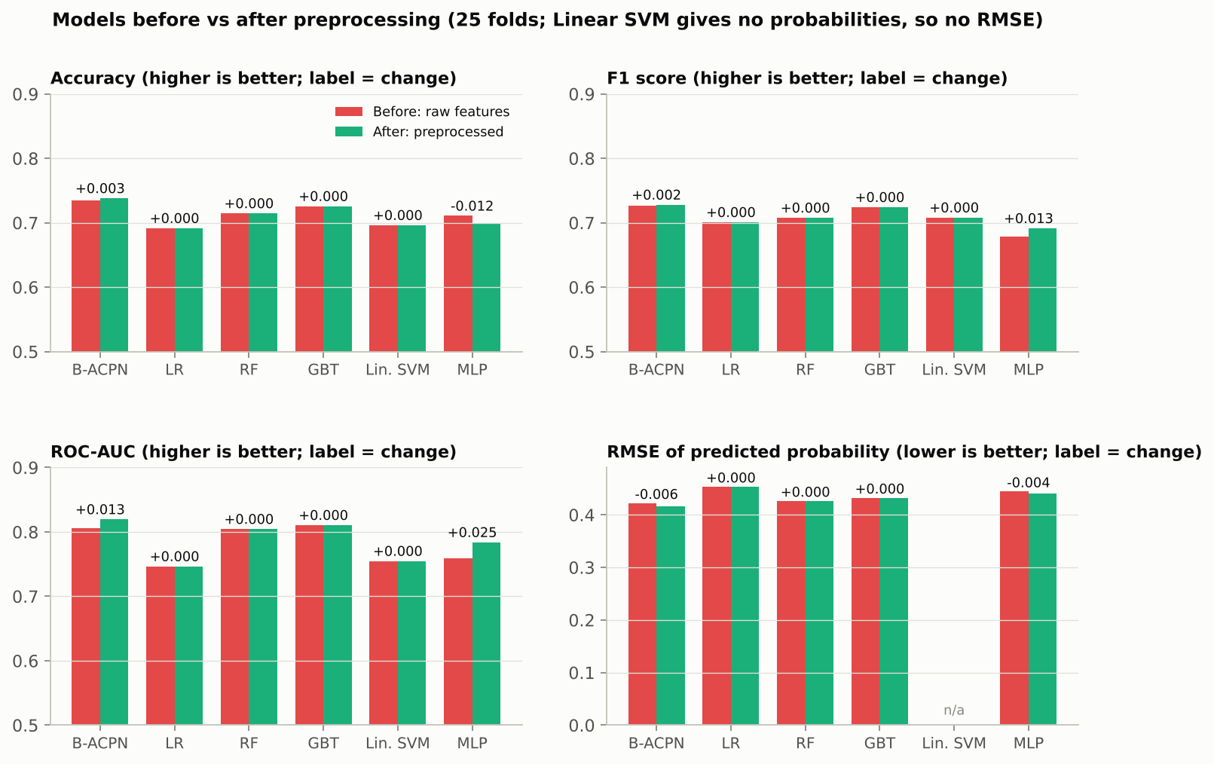
Effect of Preprocessing (Figure)
Accuracy, F1, ROC-AUC and RMSE before vs after preprocessing
Presenter: Tanmay Singh
Notes:
Accuracy, F1, ROC-AUC and RMSE of every model on raw versus preprocessed features, with the change written above each pair. The neural models change; tree models and Spark's internally standardised models do not.

Slide 24
Classification: B-ACPN Model Card
Component | Specification
Tree stage | Random forest, 500 trees, min leaf 2, all 13 features; out-of-fold (5 inner folds) score for training rows
Deep stage: baseline | tree log-odds + Linear(5 → 1) on the 5 development features
Deep stage: climate push | attention (8) → Linear(8→16), ReLU, Dropout 0.3 → residual block → Linear(16→1)
Development gate | push × 2σ(Linear(5→4), tanh, Linear(4→1)); ensemble of 5 seeds, probabilities averaged
Uncertainty | MC Dropout (50 passes) + split conformal: 92.9% coverage (target 90%), avg set size 1.51
Loss / optimiser | Class-weighted BCE; AdamW lr 3e-3, weight decay 1e-3, batch 64, early stopping (patience 30)
Parameters / train time | 780 trainable per network (+ 500 trees) / 11.8 s per fold (CPU)
Validation | Repeated stratified 5-fold × 5 (25 folds) + leave-one-state-out
Target | High vs Low vulnerability (median of 2021 index); index never an input
Presenter: Devanshu Kumar
Notes:
Table 4 lists the full B-ACPN specification. The tree stage gives a strong first score; the deep stage is small, sized for 469 districts, and learns the development and climate corrections. Every model, including B-ACPN, uses the same 25 folds plus leave-one-state-out.

Slide 25
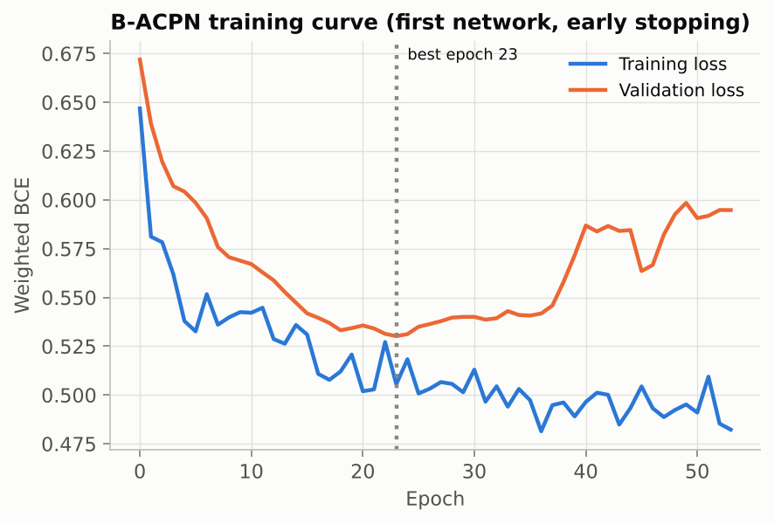
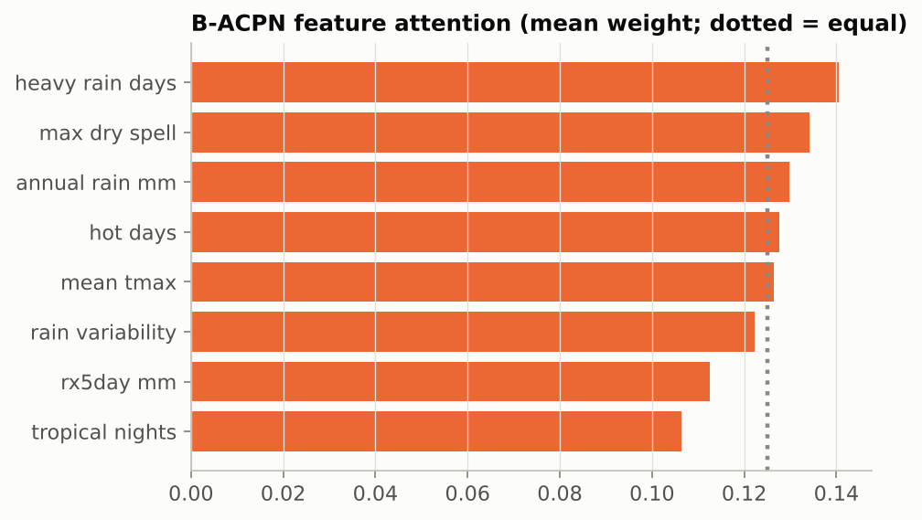
B-ACPN Training & Attention (Figures)
B-ACPN deep stage: training curve (early stopping)
Feature attention (mean weight)
Presenter: Devanshu Kumar
Notes:
Left: B-ACPN deep-stage training and validation loss; training stops at the best validation epoch. Right: the mean attention weight of each climate feature, showing which hazards drive the climate push.

Slide 26
B-ACPN Hyperparameter Tuning
Rank | Hidden | Dropout | Learning rate | CV ROC-AUC (SD) | Accuracy | F1
1 | 16 | 0.3 | 0.001 | 0.820 (0.035) | 0.738 | 0.726
2 | 16 | 0.1 | 0.001 | 0.820 (0.036) | 0.733 | 0.724
3 (current) | 16 | 0.3 | 0.003 | 0.819 (0.035) | 0.736 | 0.727
4 | 8 | 0.1 | 0.001 | 0.819 (0.037) | 0.739 | 0.731
5 | 16 | 0.1 | 0.003 | 0.819 (0.035) | 0.734 | 0.726
18 | 32 | 0.5 | 0.003 | 0.817 (0.035) | 0.739 | 0.731
▪ Search: 18 settings (hidden 8/16/32 × dropout 0.1/0.3/0.5 × learning rate 0.001/0.003), each on the same 25 folds; tree stage fixed (500 trees).
▪ Result: all settings lie within 0.003 ROC-AUC (0.817–0.820); best vs current +0.001 CV, +0.002 LOSO (0.718 → 0.720).
▪ Decision: the gain is far smaller than the fold-to-fold SD (≈0.035), so B-ACPN is not sensitive to these settings and the reported results keep the current setting.
Note: the tuning run re-trains every setting one thread per fold, so the current setting scores 0.8193 here vs 0.8197 in the main results (difference from CPU thread order only).
Presenter: Devanshu Kumar
Notes:
Review 3 task: tune the deep stage of B-ACPN. Every setting is trained exactly like B-ACPN (5 networks, same seeds, early stopping) on the same 25 folds. The setting is chosen on the CV folds only and then checked on leave-one-state-out, which plays no part in the choice. Script: scripts/tune_bacpn.py; all 18 rows in results/tuning_grid.csv.

Slide 27
Ablation Study
Variant | ROC-AUC | Change vs full | p vs full
Full B-ACPN | 0.820 | — | —
Deep stage only (no tree stage) | 0.800 | -0.019 | 0.497
Tree stage only (no deep stage) | 0.818 | -0.002 | 0.952
Without climate push | 0.816 | -0.004 | 0.882
Without development gate | 0.821 | +0.001 | 0.959
Without feature attention | 0.817 | -0.003 | 0.926
Single network (no ensemble) | 0.801 | -0.018 | 0.579
▪ Removal hurts by more than 1 SD: no single component
▪ Within 1 SD (no clear accuracy gain): Deep stage only (no tree stage), Tree stage only (no deep stage), Without climate push, Without development gate, Without feature attention, Single network (no ensemble)
Presenter: Devanshu Kumar
Notes:
Each row removes one part of B-ACPN and re-runs it on the same folds. If accuracy drops by more than one standard deviation, that part helps prediction; if not, the part is kept only for what it explains, and we say so.

Slide 28
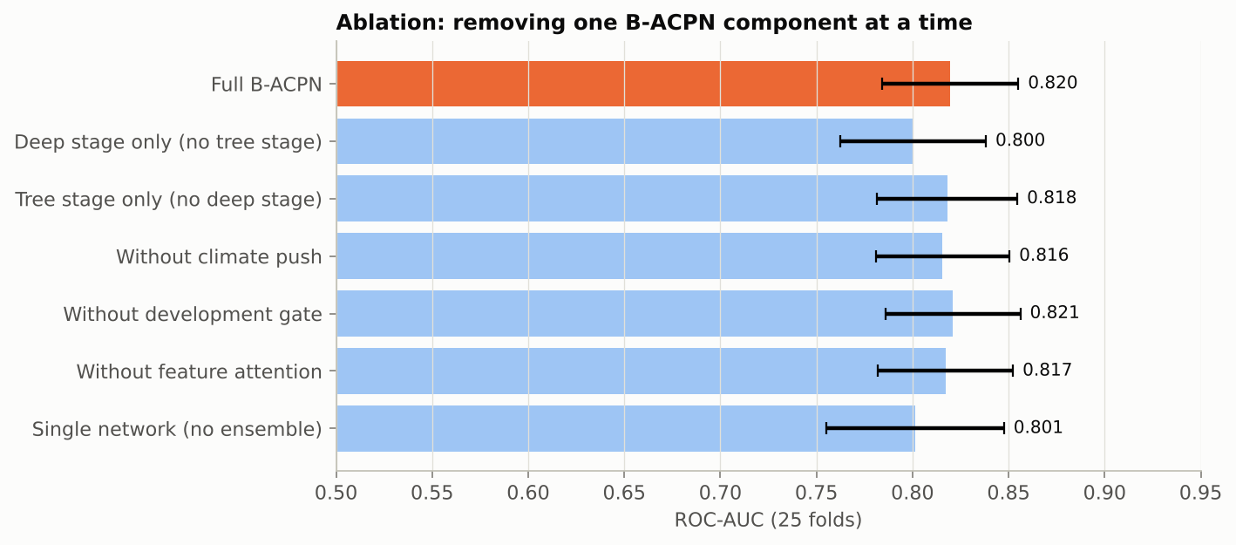
Ablation (Figure)
Ablation: one B-ACPN component removed at a time
Presenter: Devanshu Kumar
Notes:
Each bar is B-ACPN with one component removed, on the same 25 folds. A drop larger than one standard deviation means the part helps accuracy; parts within one SD are kept for the explanation they give.

Slide 29
Climate-Push Analysis: What It Explains
Group | Districts | Mean climate push | Push > 0 | Top climate factor
High dev / Low vul (expected) | 143 | -0.10 | 45% | heavy rain days
Low dev / High vul (expected) | 145 | +0.13 | 86% | heavy rain days
Anomaly A: developed yet vulnerable | 92 | +0.09 | 82% | heavy rain days
Anomaly B: less developed yet resilient | 89 | -0.17 | 46% | heavy rain days
Spark k-means climate regime 0 | 95 | -0.24 | — | rain variability
Spark k-means climate regime 1 | 374 | +0.05 | — | heavy rain days
Anomaly A vs expected developed: p = 1.56e-05; Anomaly B vs expected less-developed: p = 4.45e-07; mean MC Dropout SD of push = 0.54
Top 5 climate-driven districts (push)
Top 5 development-driven (climate share)
▪ Kishanganj (Bihar) +0.98
▪ Kodagu (Karnataka) +0.68
▪ Sahebganj (Jharkhand) +0.67
▪ Medinipur East (West Bengal) +0.65
▪ Purnia (Bihar) +0.57
▪ Ariyalur (Tamil Nadu) 0%
▪ Davangere (Karnataka) 0%
▪ Ahmadabad (Gujarat) 1%
▪ Thiruvallur (Tamil Nadu) 1%
▪ Panchkula (Haryana) 1%
Presenter: Devanshu Kumar
Notes:
The climate push answers our research question. A positive push means climate makes a district more vulnerable than its development predicts. We compare Anomaly A with the expected developed districts, and Anomaly B with the expected less-developed districts.

Slide 30
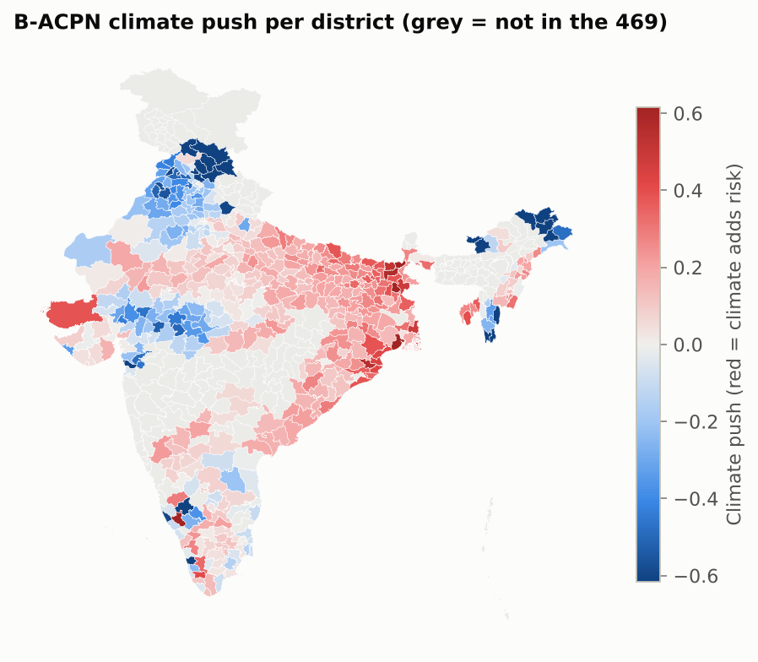
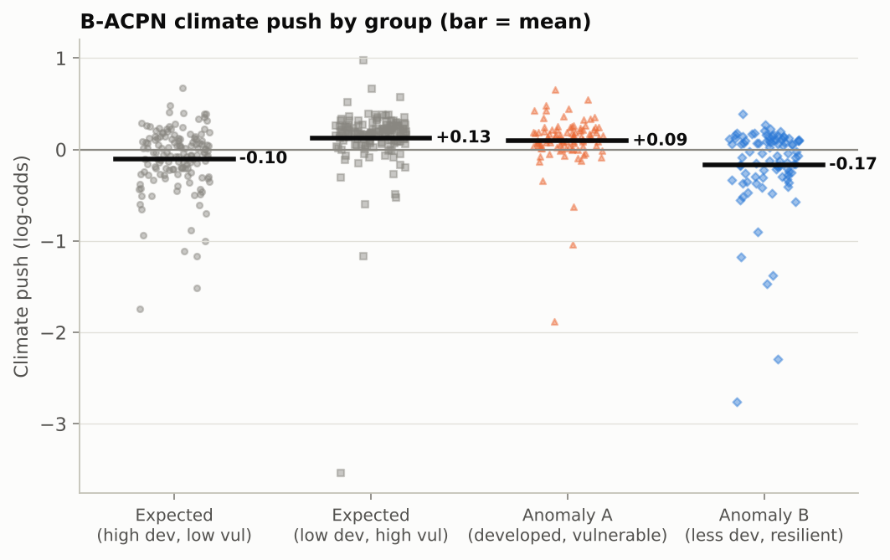
Climate-Push Visualisation
Climate push by group (bar = mean)
Climate push per district (469)
Presenter: Devanshu Kumar
Notes:
Left: the climate push of every district by group, with the group mean. Right: an India map of the climate push, so the panel can see where climate drives vulnerability beyond development.

Slide 31
Comparison with Existing Classifier Models
Model | Type / Tool | ROC-AUC | Bal. acc. | Accuracy | F1 | LOSO AUC
B-ACPN (proposed) | Novel hybrid DL · PyTorch | 0.820 | 0.739 | 0.738 | 0.728 | 0.717
Logistic Regression | Spark MLlib | 0.747 | 0.691 | 0.692 | 0.701 | 0.661
Random Forest | Spark MLlib | 0.804 | 0.715 | 0.715 | 0.708 | 0.706
Gradient-Boosted Trees | Spark MLlib | 0.811 | 0.726 | 0.725 | 0.724 | 0.698
Linear SVM | Spark MLlib | 0.755 | 0.696 | 0.696 | 0.708 | 0.691
Standard MLP | PyTorch | 0.784 | 0.699 | 0.699 | 0.692 | 0.710
▪ Result: B-ACPN has the highest ROC-AUC (0.820); next is GBT (0.811), lead +0.009 < 1 SD (0.035), so the top models are comparable
▪ B-ACPN is higher than: LR, RF, GBT, Linear SVM, MLP
▪ Significant (p < 0.05): LR, RF, Linear SVM, MLP; not significant: GBT
▪ B-ACPN's added value: a per-district climate push, attention and uncertainty, which the baselines do not give
B-ACPN and MLP: local CPU run 2026-10-22. Spark MLlib models: same data and folds, Spark 3.5.3 on 2026-10-21.
Presenter: Tanmay Singh
Notes:
Table 5 compares B-ACPN with five existing models on exactly the same 25 folds and the same leave-one-state-out split. Values are means over folds. We call a model best only if its lead is larger than one standard deviation, and we report a baseline that beats B-ACPN as it is.

Slide 32
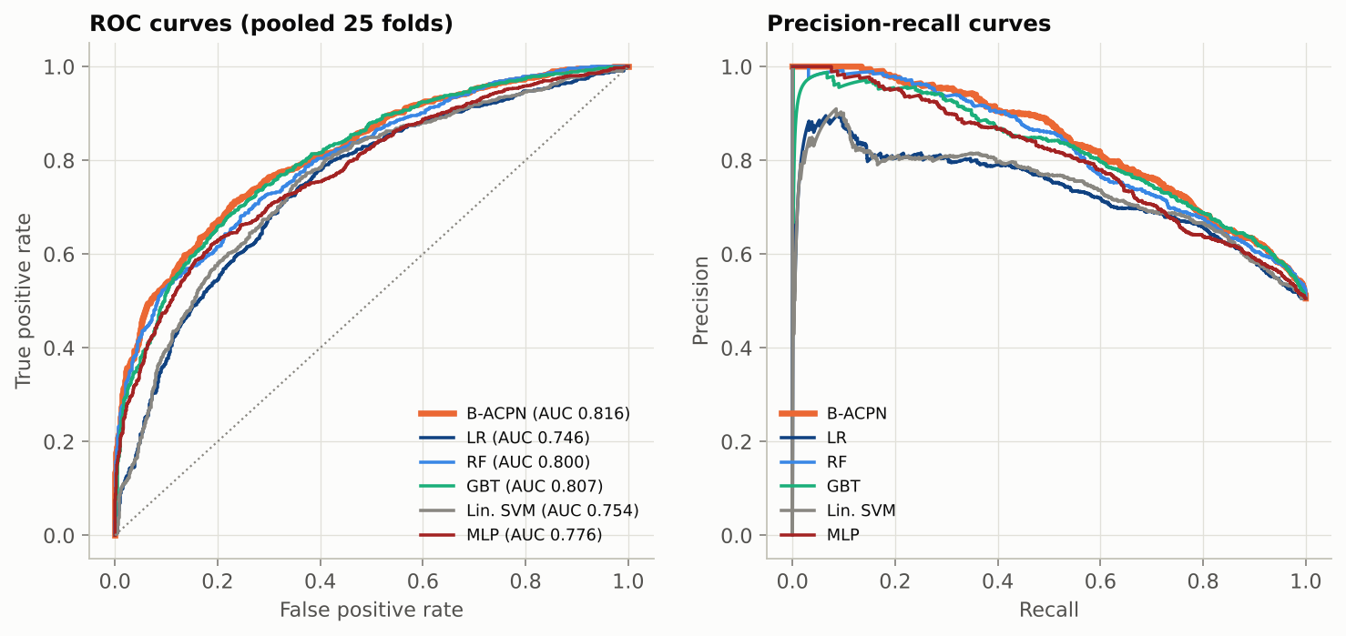
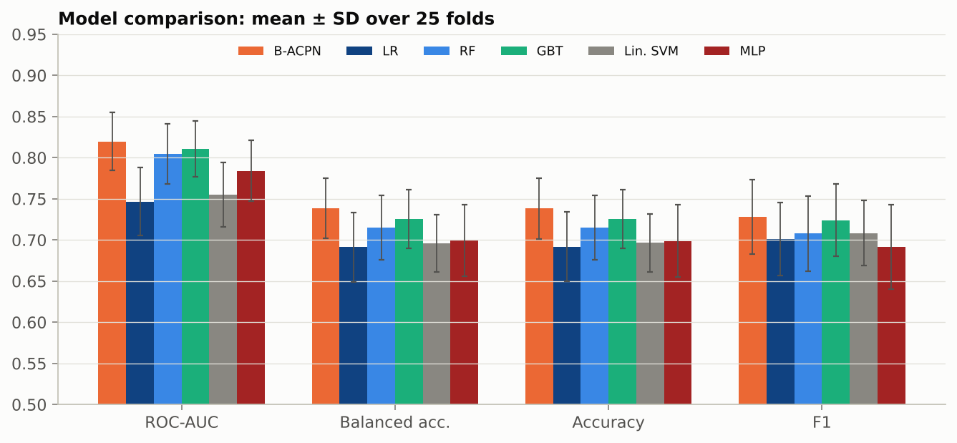
Results of Classification (Figures)
Top: ROC and precision-recall curves (25 folds). Bottom: Comparison: mean ± SD over 25 folds.
Presenter: Tanmay Singh
Notes:
Top: ROC and precision-recall curves for B-ACPN and the five baselines, pooled over the 25 folds. Bottom: mean and standard deviation of four metrics for every model.

Slide 33
Detailed Classifier Metrics
Model | Prec. | Recall | Spec. | MCC | Kappa | PR-AUC | Log loss | Brier | ECE
B-ACPN (proposed) | 0.765 | 0.700 | 0.778 | 0.482 | 0.477 | 0.844 | 0.516 | 0.174 | 0.108
Logistic Regression | 0.688 | 0.718 | 0.665 | 0.386 | 0.383 | 0.746 | 0.611 | 0.206 | 0.101
Random Forest | 0.735 | 0.689 | 0.742 | 0.434 | 0.430 | 0.830 | 0.539 | 0.182 | 0.095
Gradient-Boosted Trees | 0.736 | 0.718 | 0.733 | 0.454 | 0.451 | 0.826 | 0.570 | 0.188 | 0.131
Linear SVM | 0.689 | 0.733 | 0.659 | 0.396 | 0.392 | 0.751 | n/a | n/a | n/a
Standard MLP | 0.719 | 0.674 | 0.724 | 0.404 | 0.398 | 0.809 | 0.579 | 0.194 | 0.114
▪ Higher is better: precision, recall, specificity, MCC, Cohen's kappa, PR-AUC
▪ Lower is better: log loss, Brier, ECE (Linear SVM: n/a, no probabilities)
Presenter: Tanmay Singh
Notes:
Beyond accuracy we report precision, recall and specificity, two chance-corrected scores (MCC and kappa), PR-AUC, and three probability-quality scores: log loss, Brier score and expected calibration error, where lower is better. Linear SVM gives no probabilities, so those cells are n/a.

Slide 34
Confusion Matrix, CIs and Significance
Model | TP | TN | FP | FN | ROC-AUC 95% CI | p vs B-ACPN
B-ACPN (proposed) | 829 | 902 | 258 | 356 | 0.780 – 0.859 | —
Logistic Regression | 851 | 771 | 389 | 334 | 0.700 – 0.793 | 0.004
Random Forest | 816 | 860 | 300 | 369 | 0.764 – 0.845 | 0.042
Gradient-Boosted Trees | 851 | 850 | 310 | 334 | 0.773 – 0.849 | 0.550
Linear SVM | 869 | 764 | 396 | 316 | 0.711 – 0.798 | 0.006
Standard MLP | 799 | 840 | 320 | 386 | 0.743 – 0.825 | 0.019
▪ TP/TN/FP/FN: summed over the 25 test folds (High = positive class)
▪ Significance: corrected resampled t-test (Nadeau–Bengio) on paired fold ROC-AUC; p < 0.05 = real difference
Presenter: Tanmay Singh
Notes:
Confusion counts are summed over all 25 test folds. The 95% confidence interval shows how certain each ROC-AUC is, and the corrected paired test tells us whether a difference from B-ACPN is real or could be noise from the folds; p below 0.05 means a real difference.

Slide 35
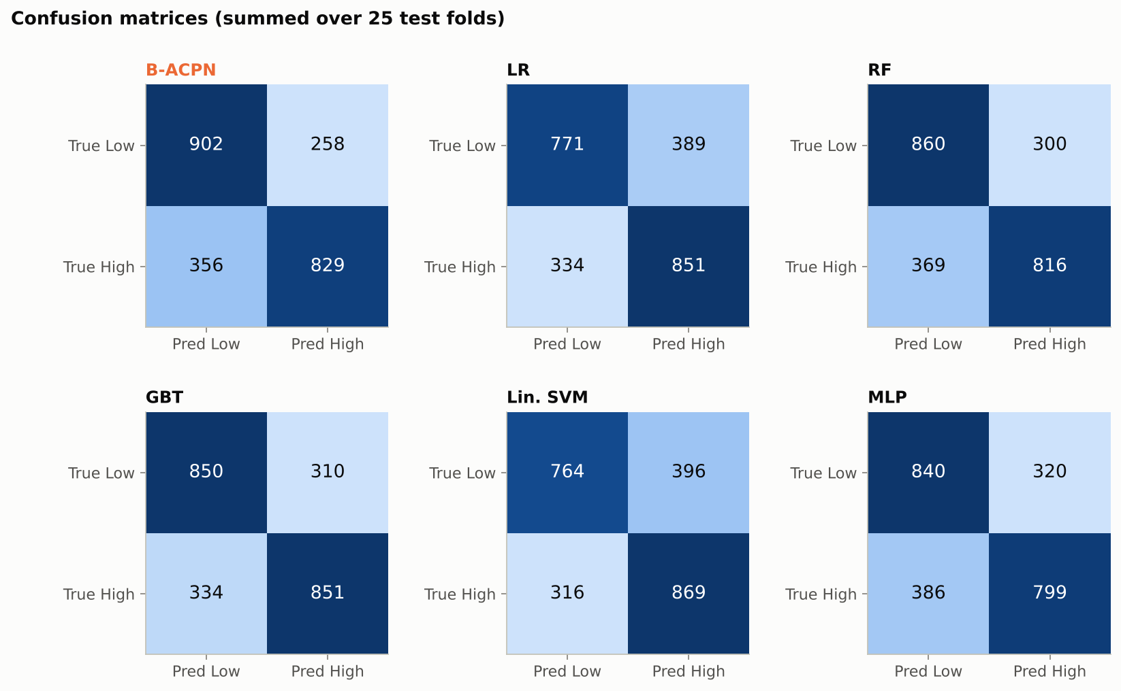
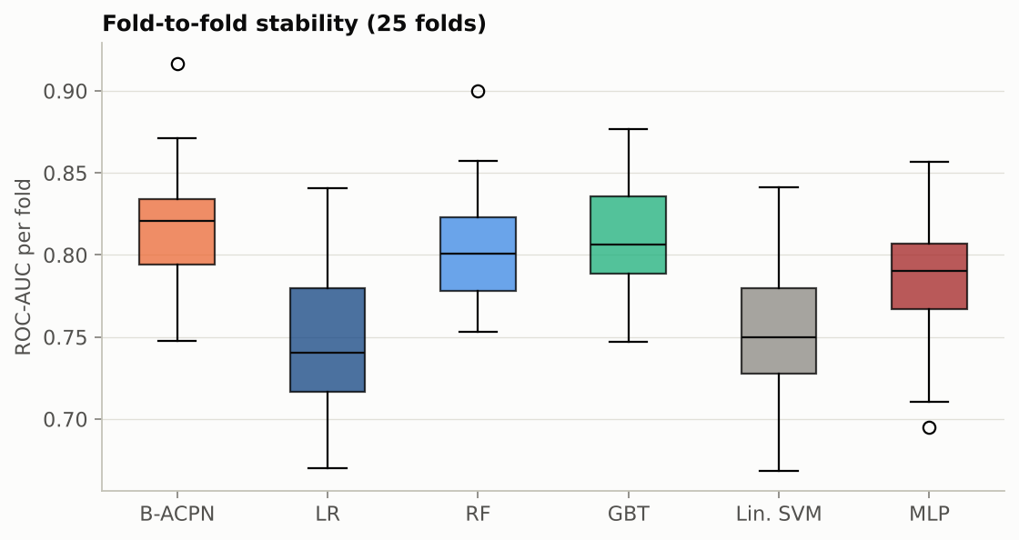
Confusion Matrices & Stability (Figures)
Top: Confusion matrices, all models. Bottom: ROC-AUC per fold, all models.
Presenter: Tanmay Singh
Notes:
Top: confusion matrices of all six models summed over the 25 test folds. Bottom: the spread of ROC-AUC across the folds, which shows how stable each model is.

Slide 36
Classification Performance Metrics
Metric | Full form | Purpose | B-ACPN | Best other model
Accuracy | Classification Accuracy | Share of districts classified correctly | 0.738 | GBT 0.725
Precision | Positive Predictive Value | Of districts predicted High, share truly High | 0.765 | GBT 0.736
Recall | Sensitivity / True Positive Rate | Of truly High districts, share found | 0.700 | Linear SVM 0.733
F1-score | Harmonic mean of precision and recall | Balances precision and recall | 0.728 | GBT 0.724
Specificity | True Negative Rate | Of truly Low districts, share found | 0.778 | RF 0.742
ROC-AUC | Area Under the ROC Curve | Ability to separate High from Low | 0.820 | GBT 0.811
Log loss | Cross-Entropy Loss | Quality of predicted probabilities (lower is better) | 0.516 | RF 0.539
MCC | Matthews Correlation Coefficient | Uses all four confusion-matrix cells | 0.482 | GBT 0.454
Cohen's kappa | Cohen's Kappa Coefficient | Agreement with true labels, corrected for chance | 0.477 | GBT 0.451
Balanced acc. | Average class recall | Accuracy that is fair to both classes | 0.739 | GBT 0.726
B-ACPN is best on 9 of 10 (Accuracy, Precision, F1-score, Specificity, ROC-AUC, Log loss, MCC, Cohen's kappa, Balanced acc.); not best on Recall. Lower is better only for log loss.
Presenter: Tanmay Singh
Notes:
All ten classification metrics, with what each one measures, for the proposed model and the best of the five existing models on that metric. Values are means over the same 25 folds; the full per-model values are in the comparison and detailed-metrics tables.

Slide 37
Comparison with CEEW District Rankings
Check (same districts in both) | Result | Reading
CEEW index vs NDAP index (our target) | ρ = +0.02 (p = 0.66) | no agreement
CEEW index vs B-ACPN predicted risk | ρ = +0.04 (p = 0.47) | no agreement
CEEW index vs B-ACPN climate push | ρ = +0.10 (p = 0.05) | weak, not significant
CEEW exposure vs B-ACPN climate push | ρ = +0.00 (p = 0.99) | no agreement
High / low class agreement | 51% (κ = 0.02) | chance level
CEEW High/Very High: Anomaly A vs expected developed | 28% vs 25% | small difference
▪ Data: CEEW 2021 Annexure I Table A1, 463 districts; 457 matched to Census codes by name (ambiguous names such as Hamirpur dropped); 350 of our 469 districts are in both.
▪ Finding: the two national indices rank districts very differently. CEEW's index is driven by hydro-met hazard exposure (floods, droughts, cyclones); NDAP's indicators are mainly socio-economic sensitivity and adaptive capacity. Our model explains the NDAP index, so its results do not carry over to CEEW's ranking, and "vulnerable" depends on which index is used.
Presenter: Tanmay Singh
Notes:
Review 3 task: compare our districts with an independent national ranking, CEEW 2021 (Mohanty and Wadhawan). Spearman ρ measures how similarly two lists rank the same districts (1 = same order, 0 = unrelated). Script: scripts/compare_ceew.py; matched table in results/ceew_matched.csv.

Slide 38
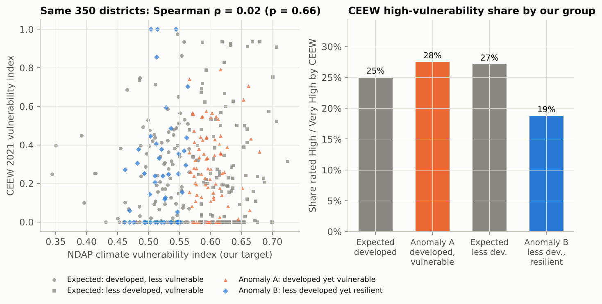
CEEW Comparison (Figure)
Our target (NDAP) vs CEEW 2021 vulnerability, by group
Presenter: Tanmay Singh
Notes:
Left: each district's NDAP index (our target) against its CEEW index; the cloud has no trend, so the two indices disagree. Right: the share of each of our groups that CEEW rates High or Very High.

Slide 39
Key Findings
▪ Development is not enough: R² 0.127; Pearson -0.356
▪ Climate adds signal: R² rises to 0.334 with the 8 hazard variables
▪ Anomalies are common: 181/469 districts (38.6%)
▪ Anomaly A: ≈2× tropical nights (91 vs 45 per year)
▪ Anomaly B: drier (863 vs 1078 mm annual rain)
▪ Limitations: 2011 Census vs 2021 index; 1° temperature grid; single-node Hadoop; 469 districts
Source: Colab run 2026-10-22
Presenter: Tanmay Singh
Notes:
Development explains only 13% of the variation in vulnerability; adding climate raises that to 33%, and state alone explains 48%. Anomaly A districts have about twice as many tropical nights, and Anomaly B districts are drier. Limitations are listed honestly.

Slide 40
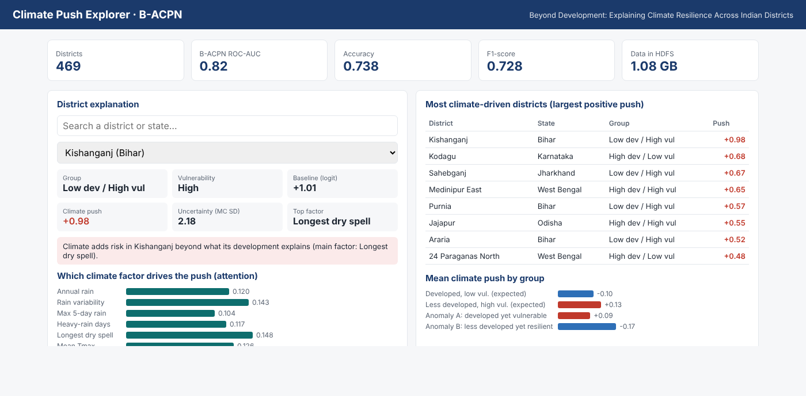
Visualization: Dashboard
▪ Panels: KPIs (469 districts, ROC-AUC, accuracy, F1, HDFS size) · district search with group, baseline, climate push, MC Dropout uncertainty and top factor · attention bars per climate variable · 8 most climate-driven districts · mean push by group.
Presenter: Tanmay Singh
Notes:
The Climate Push Explorer is an offline web page built from our results (dashboard/build_dashboard.py → dashboard/index.html). It needs no server or internet: open the file in a browser, search a district, and it shows that district's explanation.

Slide 41
Team Member Tasks
Member | Role | Key Responsibilities | Status
Sehjodh Grewal | Dataset & Preprocessing | Collect NDAP, Census 2011, IMD and boundary data; Census rates; district matching; variable selection (no imputation); grid-to-district aggregation; district-day table; orientation check; preprocessing results and error metrics (Table 1) | Completed
Deepankar | Big Data Pipeline | Set up Hadoop (HDFS + YARN), Hive and Spark in Colab; HDFS zones and data loading; storage report (Table 2); MapReduce yearly climate indices and scalability; Hive 30-year baseline and join; Spark k-means climate regimes (Table 3) | Completed
Devanshu Kumar | Novel Deep Learning Model | Design and train B-ACPN (random-forest tree stage, attention, residual MLP, development gate, 5-network ensemble); MC Dropout and conformal uncertainty; model card (Table 4); ablation; climate-push analysis (Table 6); hyperparameter tuning (Review 3) | Completed
Tanmay Singh | Comparative ML & Visualization | Compare B-ACPN with Logistic Regression, Random Forest, GBT, Linear SVM (Spark MLlib) and MLP on the same folds; all metrics, confidence intervals, significance; effect of preprocessing on the models (Table 5); result figures; slides; CEEW 2021 comparison (Review 3) | Completed
All four stages are complete, including the Review 3 tasks: B-ACPN tuning and the CEEW comparison. Future work: extend the climate record to 1991–2024; explain the CEEW index as a second target.
Presenter: Tanmay Singh
Notes:
Each member owns one stage with no overlap: Sehjodh the dataset and preprocessing, Deepankar the Big Data pipeline, Devanshu the novel deep-learning model, and Tanmay the comparison with existing models and the visualisation. Each member presents only the slides of their own stage.

Slide 42
References
[1] A. Mohanty and S. Wadhawan, Mapping India's Climate Vulnerability, CEEW, 2021.
[2] NITI Aayog, District-Level Climate Vulnerability Indicators, NDAP dataset 7160.
[3] Census of India 2011, Primary Census Abstract.
[4] D. S. Pai et al., MAUSAM 65(1), 2014 (IMD gridded rainfall).
[5] A. K. Srivastava et al., Atmospheric Science Letters 10, 2009 (IMD gridded temperature).
[6] H.-T. Cheng et al., Wide & Deep Learning for Recommender Systems, DLRS 2016.
[7] S. Ö. Arık and T. Pfister, TabNet: Attentive Interpretable Tabular Learning, AAAI 2021.
[8] L. Breiman, Random Forests, Machine Learning 45, 2001.
[9] D. H. Wolpert, Stacked Generalization, Neural Networks 5, 1992.
[10] K. He et al., Deep Residual Learning for Image Recognition, CVPR 2016.
[11] Y. Gal and Z. Ghahramani, Dropout as a Bayesian Approximation, ICML 2016.
[12] A. N. Angelopoulos and S. Bates, A Gentle Introduction to Conformal Prediction, arXiv:2107.07511, 2021.
[13] K. Shvachko et al., The Hadoop Distributed File System, MSST 2010.
[14] J. Dean and S. Ghemawat, MapReduce, Communications of the ACM, 2008.
[15] A. Thusoo et al., Hive, VLDB 2009.
[16] M. Zaharia et al., Apache Spark: A Unified Engine for Big Data Processing, CACM 59(11), 2016.
[17] X. Meng et al., MLlib: Machine Learning in Apache Spark, JMLR 17, 2016.
[18] DataMeet, Community Created Maps of India.
Presenter: Tanmay Singh
Notes:
These are the data sources, the papers behind each B-ACPN component, and the Big Data tools we used.

Slide 43
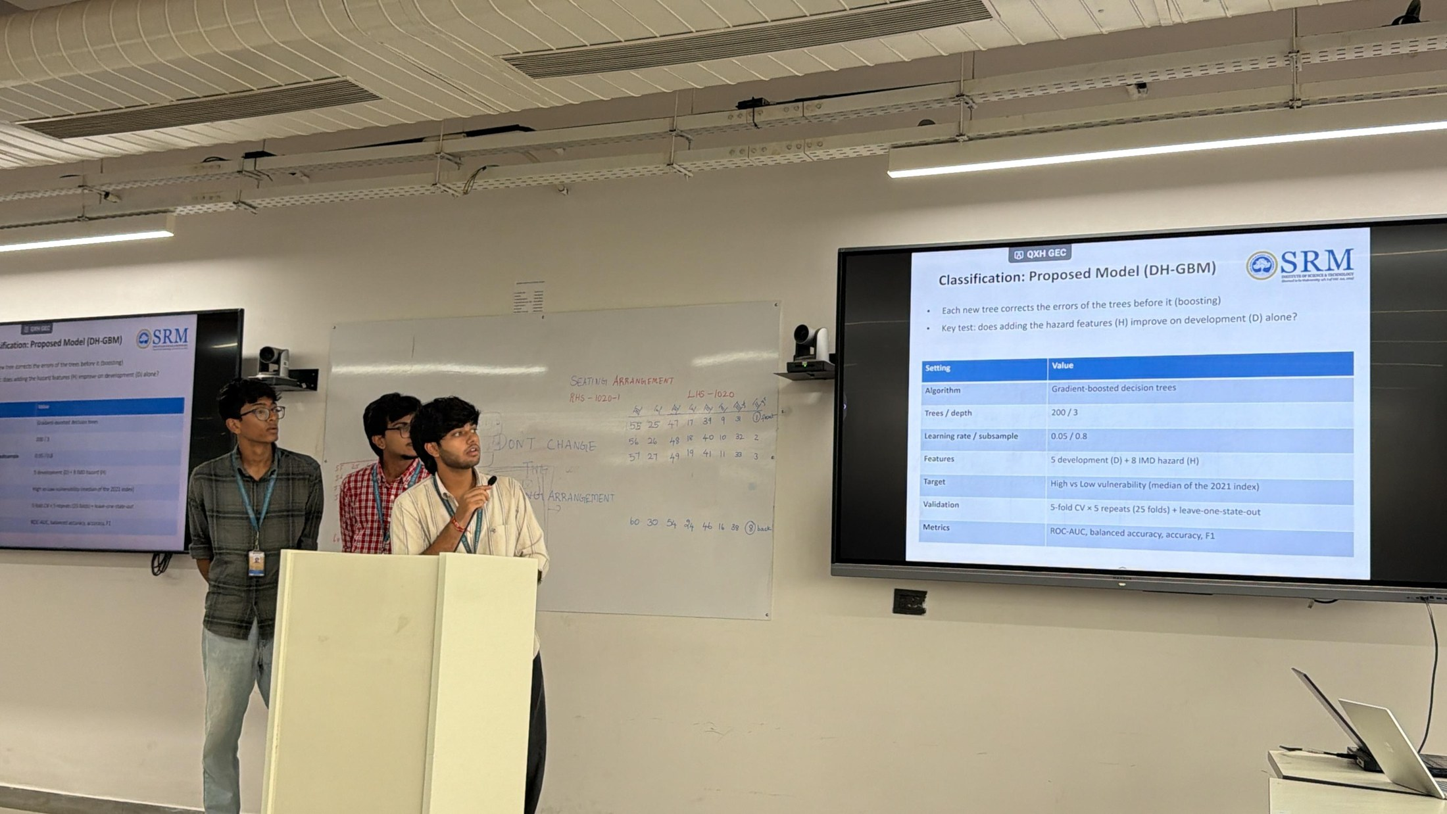
Geotagged Photo: Review 3
Presenter: Tanmay Singh
Notes:
Photo taken during the Review 3 presentation.

Slide 44
Google Colab Implementation Link
Colab (with outputs):
https://colab.research.google.com/github/deepankarkumar1310/hadoop-ml-algorithm-/blob/main/notebooks/Review2_Colab.ipynb
GitHub: https://github.com/deepankarkumar1310/hadoop-ml-algorithm-
Notebook section | What it shows | Owner
0–2 Setup, data, preprocessing | Install, IMD download to Drive, Table 1 + error metrics | Sehjodh
3–7 Hadoop, HDFS, MapReduce, Hive, Spark | Cluster, HDFS load (Table 2), YARN job + timings, Hive, k-means (Table 3) | Deepankar
8 B-ACPN (proposed model) | Architecture, model card (Table 4), ablation, climate push (Table 6) | Devanshu
9–10 Comparison | 5 existing models, all metrics, preprocessing before/after (Table 5) | Tanmay
11 Visualisations | All figures, only after every table | Each owner
12 Slides | Builds this deck from results/ | Tanmay
Presenter: Tanmay Singh
Notes:
The Colab notebook runs the whole project in the same order as these slides, with every table printed before any figure. The model sections can also run on their own from the committed analysis table.

