Slide 1
CS 315: Database Systems
IIT Kanpur Jan-May 2022
Relational Queries
References:
1. Database Systems the Complete Book. Garcia-Molina et. al.

Slide 2

Schema
We will consider several queries and write relational algebra expressions.
To keep notations short, the database schema is abbreviated as:
$Mov\left(t,y,l,g\right)$to represent that a movie identified by its title t and year of release y is of duration l (in mins), of genre g.
$Star(t,y,n)$ says that the actor with name n starred in the movie with title t and year y.

Slide 3
1. Simple Join Queries Join queries with no diff op

Slide 4
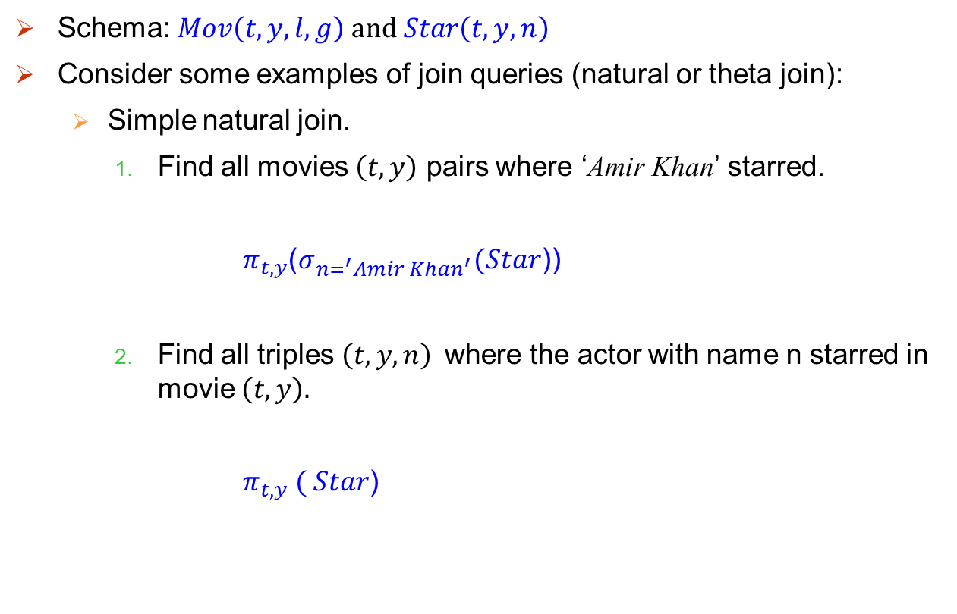
Simple Queries
Schema: $Mov\left(t,y,l,g\right) and Star\left(t,y,n\right)$
Consider some examples of join queries (natural or theta join):
Simple natural join.
Find all movies $\left(t,y\right)$ pairs where ‘Amir Khan’ starred.
$π_{t,y}$($σ_{n=^{′}Amir Khan^{′}}(Star$))
Find all triples $\left(t,y,n\right)$where the actor with name n starred in movie $\left(t,y\right).$
$π_{t,y} ( Star$)

Slide 5
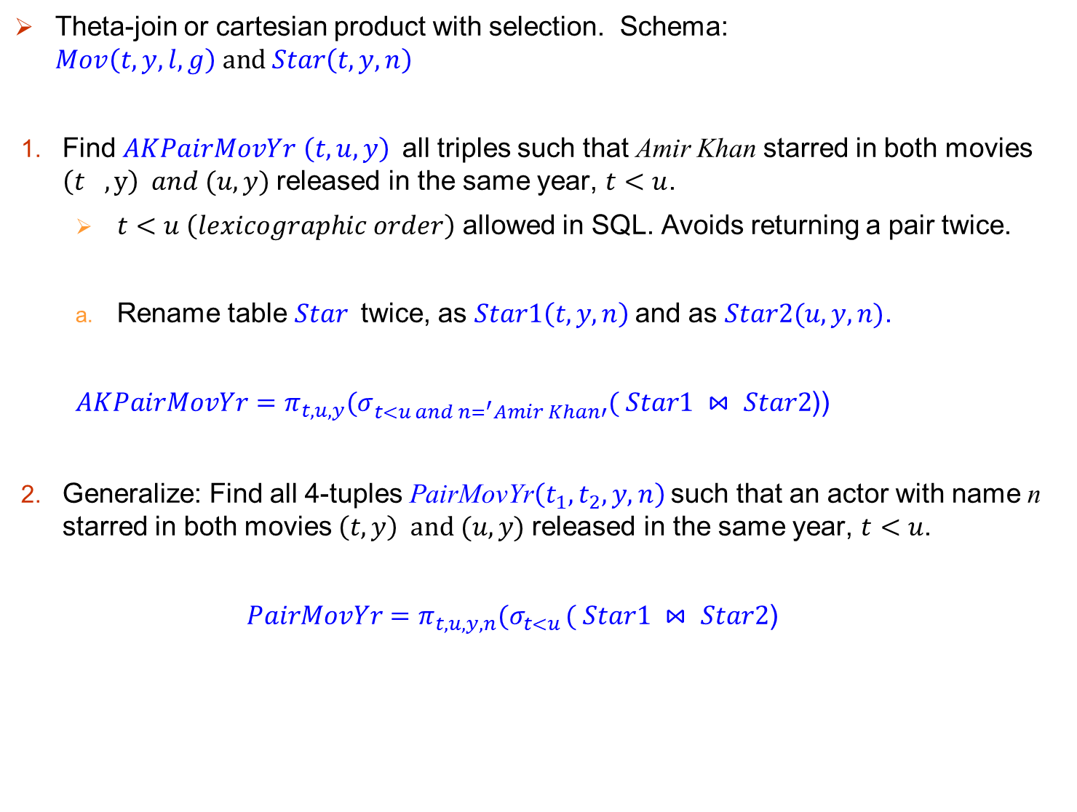
Simple Join Queries
Theta-join or cartesian product with selection. Schema: $Mov\left(t,y,l,g\right) and Star\left(t,y,n\right)$
Find $AKPairMovYr$ $\left(t,u,y\right)$all triples such that Amir Khan starred in both movies $\left(t_{},y\right) and (u,y)$released in the same year, $t<u$.
$t<u \left(lexicographic order\right)$ allowed in SQL. Avoids returning a pair twice.
Rename table $Star$twice, as $Star1\left(t,y,n\right)$and as $Star2(u,y,n)$.
$AKPairMovYr=π_{t,u,y}{(σ}_{t<u and n=^{′}Amir Khan′}( Star1 ⋈ Star2$))
Generalize: Find all 4-tuples PairMovYr$\left(t_{1},t_{2},y,n\right)$ such that an actor with name n starred in both movies $\left(t,y\right) and (u,y)$released in the same year, $t<u$.
$PairMovYr=π_{t,u,y,n}{(σ}_{t<u }( Star1 ⋈ Star2$)

Slide 6
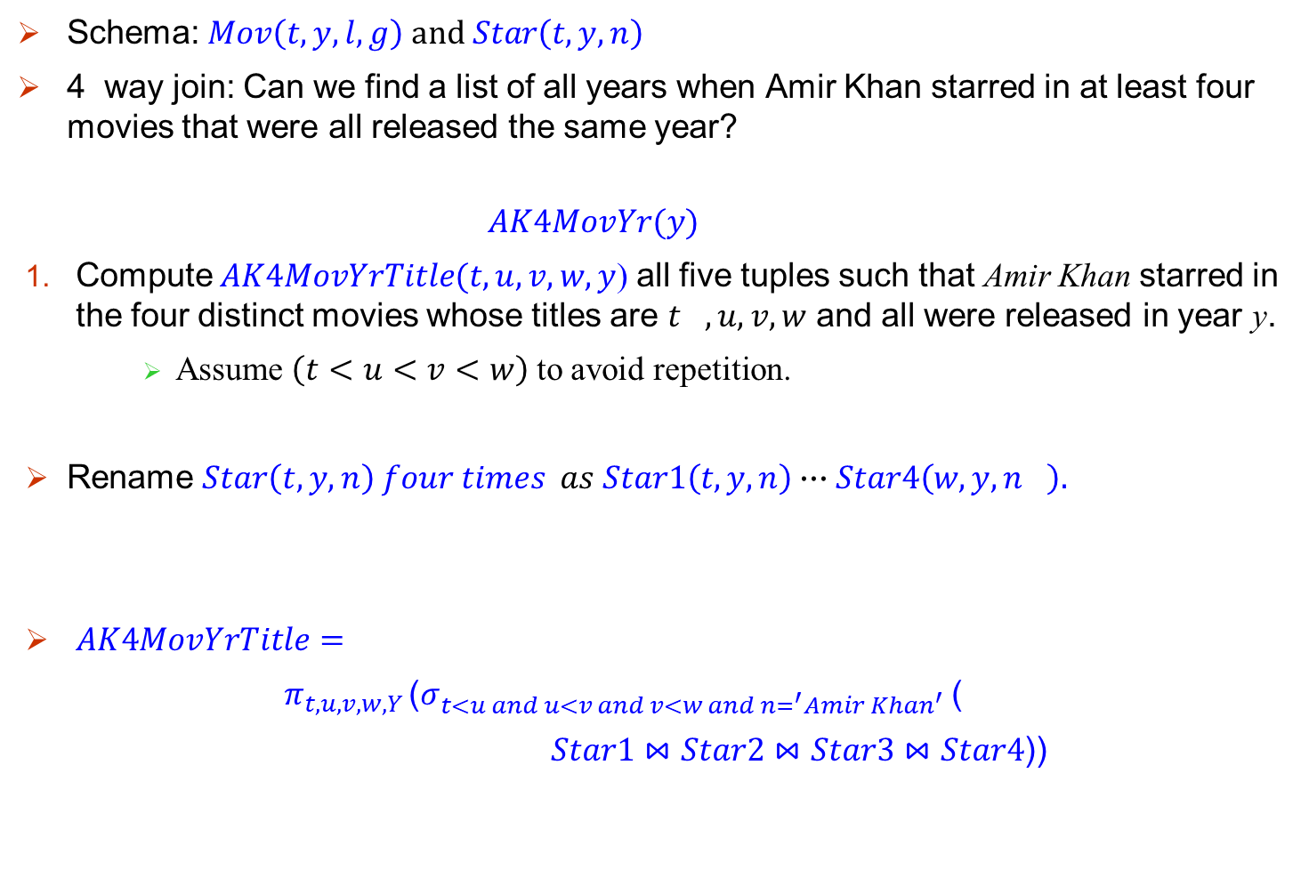
Simple Join Queries
Schema: $Mov\left(t,y,l,g\right) and Star\left(t,y,n\right)$
4 way join: Can we find a list of all years when Amir Khan starred in at least four movies that were all released the same year?
$$AK4MovYr(y)$$
Compute $AK4MovYrTitle(t,u,v,w,y$) all five tuples such that Amir Khan starred in the four distinct movies whose titles are $t_{},u,v,w$ and all were released in year y.
Assume $\left(t<u<v<w\right)$ to avoid repetition.
Rename $Star\left(t,y,n\right) four times as Star1\left(t,y,n\right)∙∙∙Star4\left(w,y,n_{}\right).$
$AK4MovYrTitle=$
$π_{t,u,v,w,Y }$($σ_{t<u and u<v and v<w and n=^{′}Amir Khan^{′} }$(
$Star1⋈Star2⋈Star3⋈Star4$))

Slide 7
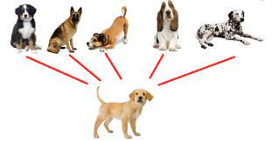
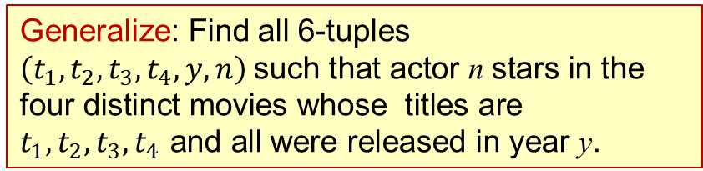
Simple Join Queries
Generalize: Find all 6-tuples $\left(t_{1},t_{2},t_{3},t_{4},y,n\right) \text{such} \text{tha}\text{t} \text{actor} \text{n} \text{star}\text{s} \text{in} \text{the} \text{four} \text{distinct} \text{movies} \text{whose} \text{titles} \text{are} t_{1},t_{2},t_{3},t_{4} \text{and} \text{all} \text{were} \text{released} \text{in} \text{year} \text{y}\text{.}$

Slide 8
Queries with one diff op

Slide 9

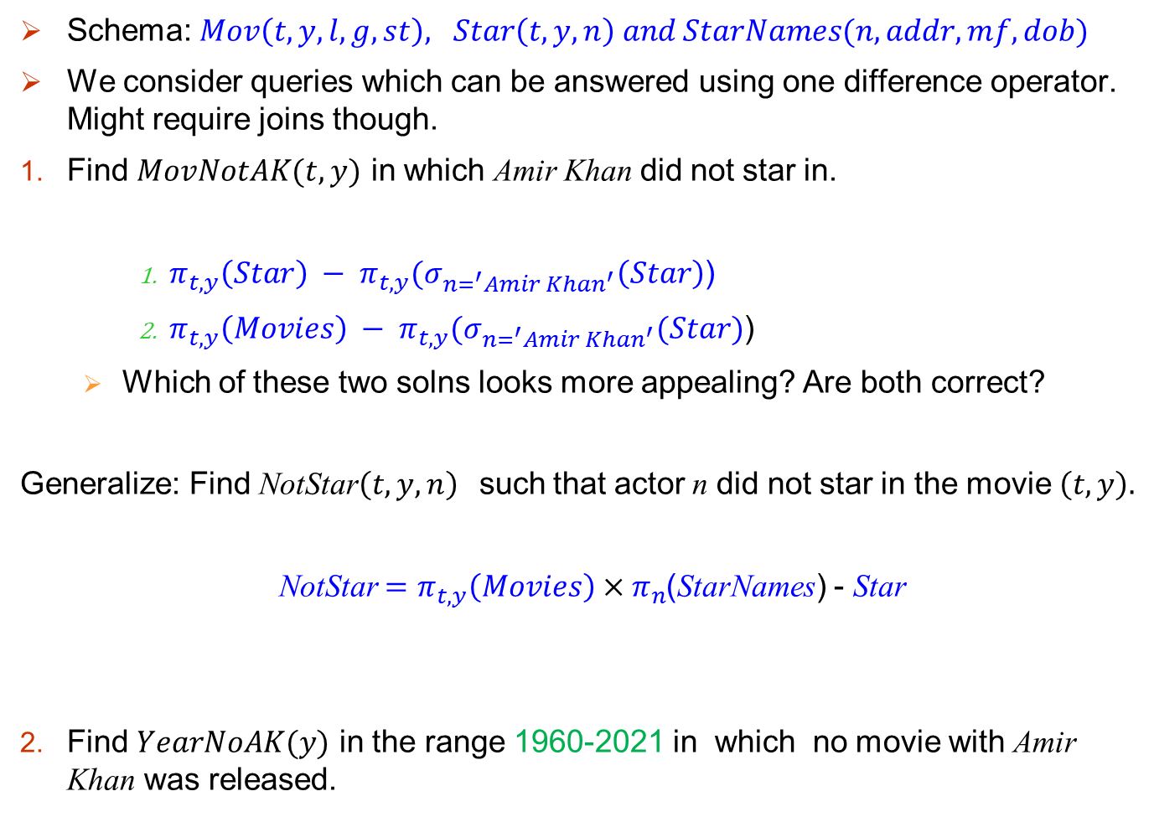
One diff op
Schema: $Mov\left(t,y,l,g,st\right), Star\left(t,y,n\right) and StarNames(n,addr,mf,dob)$
We consider queries which can be answered using one difference operator. Might require joins though.
Find $MovNotAK(t,y)$ in which Amir Khan did not star in.
$π_{t,y}\left(Star\right) − π_{t,y}{(σ}_{n=^{′}Amir Khan^{′}}\left(Star\right)$)
$π_{t,y}\left(Movies\right) − π_{t,y}{(σ}_{n=^{′}Amir Khan^{′}}(Star)$)
Which of these two solns looks more appealing? Are both correct?
Generalize: Find NotStar$\left(t,y,n\right)$such that actor n did not star in the movie $\left(t,y\right).$
NotStar $=π_{t,y}\left(Movies\right)×π_{n}$(StarNames) - Star
Find $YearNoAK(y)$ in the range 1960-2021 in which no movie with Amir Khan was released.

Slide 10
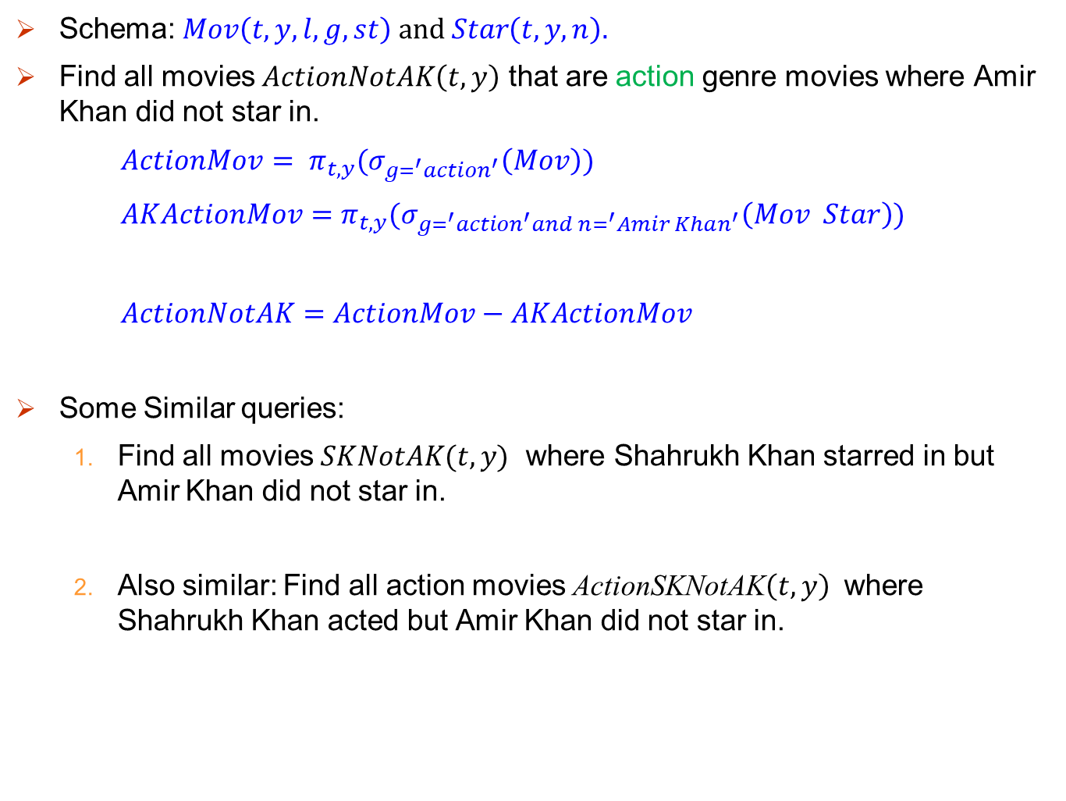
One diff op
Schema: $Mov\left(t,y,l,g,st\right) and Star\left(t,y,n\right).$
Find all movies $ActionNotAK\left(t,y\right)$ that are action genre movies where Amir Khan did not star in.
$ActionMov= π_{t,y}{(σ}_{g=^{′}action^{′}}\left(Mov\right))$
$AKActionMov=$ $π_{t,y}{(σ}_{g=^{′}action^{′}and n=^{′}Amir Khan^{′}}\left(Mov Star\right))$
$ActionNotAK=ActionMov−AKActionMov$
Some Similar queries:
Find all movies $SKNotAK(t,y)$ where Shahrukh Khan starred in but Amir Khan did not star in.
Also similar: Find all action movies ActionSKNotAK$\left(t,y\right)$ where Shahrukh Khan acted but Amir Khan did not star in.

Slide 11
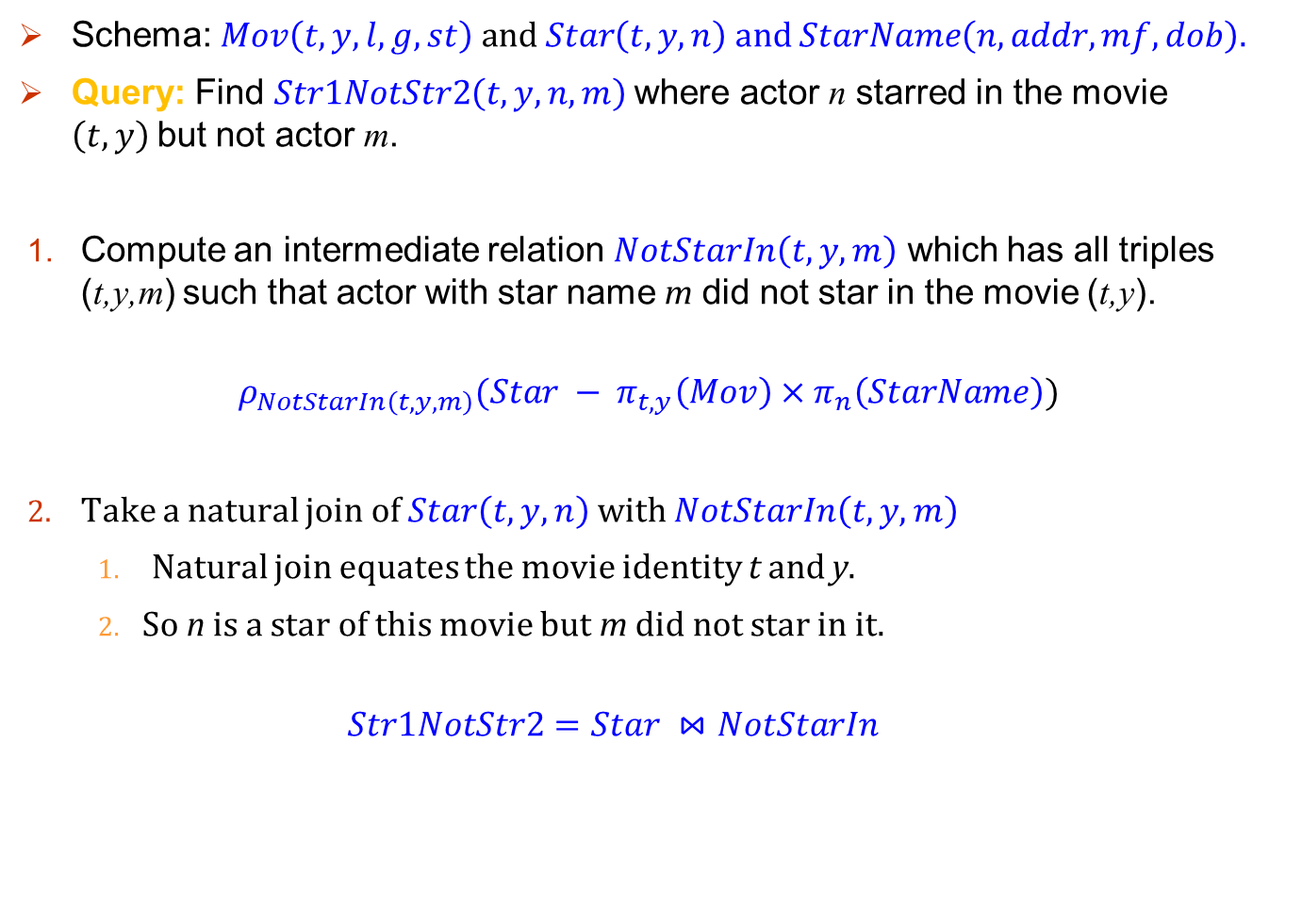
Schema: $Mov\left(t,y,l,g,st\right) and Star\left(t,y,n\right) and StarName\left(n, addr, mf, dob\right).$
Query: Find $Str1NotStr2\left(t,y,n,m\right)$where actor n starred in the movie $\left(t,y\right)$but not actor m.
Compute an intermediate relation $NotStarIn\left(t,y,m\right)$ which has all triples (t,y,m) such that actor with star name m did not star in the movie (t,y).
$$ρ_{NotStarIn\left(t,y,m\right)}(Star − π_{t,y}\left(Mov\right)×π_{n}\left(StarName\right))$$
Take a natural join of $Star\left(t,y,n\right)$with $NotStarIn\left(t,y,m\right)$
Natural join equates the movie identity t and y.
So n is a star of this movie but m did not star in it.
$$Str1NotStr2=Star ⋈NotStarIn$$

Slide 12
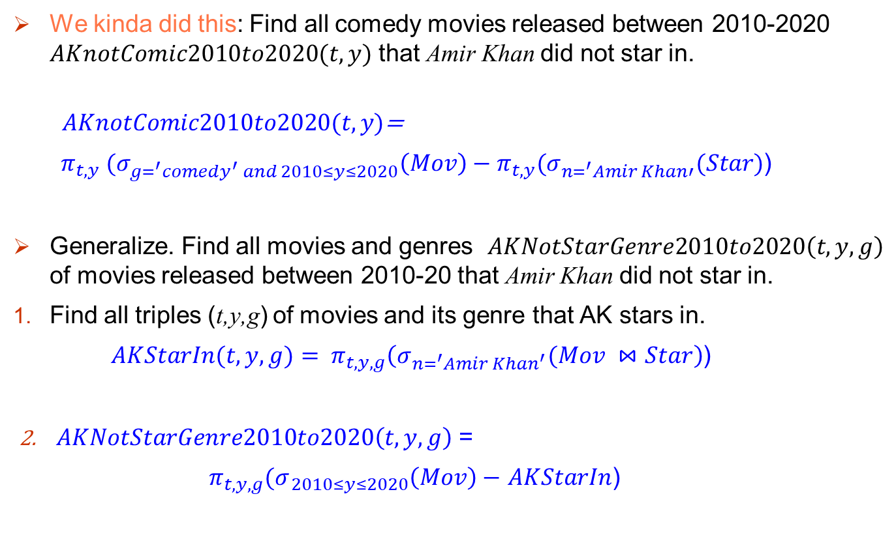
One diff op
We kinda did this: Find all comedy movies released between 2010-2020 $AKnotComic2010to2020(t,y)$ that Amir Khan did not star in.
$AKnotComic2010to2020(t,y)$=
$π_{t,y} (σ_{g=^{′}comedy^{′} and 2010≤y≤2020}\left(Mov\right)−π_{t,y}(σ_{n=^{′}Amir Khan′}(Star)$)
Generalize. Find all movies and genres $AKNotStarGenre2010to2020\left(t,y,g\right)$ of movies released between 2010-20 that Amir Khan did not star in.
Find all triples (t,y,g) of movies and its genre that AK stars in.
$AKStarIn(t,y,g)= π_{t,y,g}\left(σ_{n=^{′}Amir Khan^{′}}(Mov ⋈Star\right)$)
$AKNotStarGenre2010to2020\left(t,y,g\right)$ =
$π_{t,y,g}{(σ}_{ 2010≤y≤2020}\left(Mov\right)−$ $AKStarIn$)

Slide 13
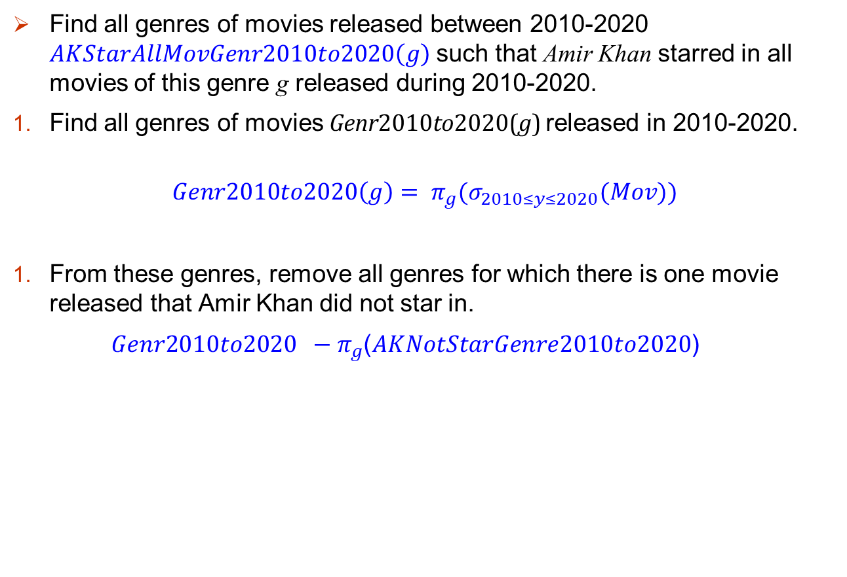
Two diff ops
Find all genres of movies released between 2010-2020 $AKStarAllMovGenr2010to2020\left(g\right)$ such that Amir Khan starred in all movies of this genre g released during 2010-2020.
Find all genres of movies Genr2010to2020(g) released in 2010-2020.
$$Genr2010to2020\left(g\right)= π_{g}{(σ}_{2010≤y≤2020}(Mov))$$
From these genres, remove all genres for which there is one movie released that Amir Khan did not star in.
${Genr2010to2020 −π}_{g}$($AKNotStarGenre2010to2020$)

Slide 14
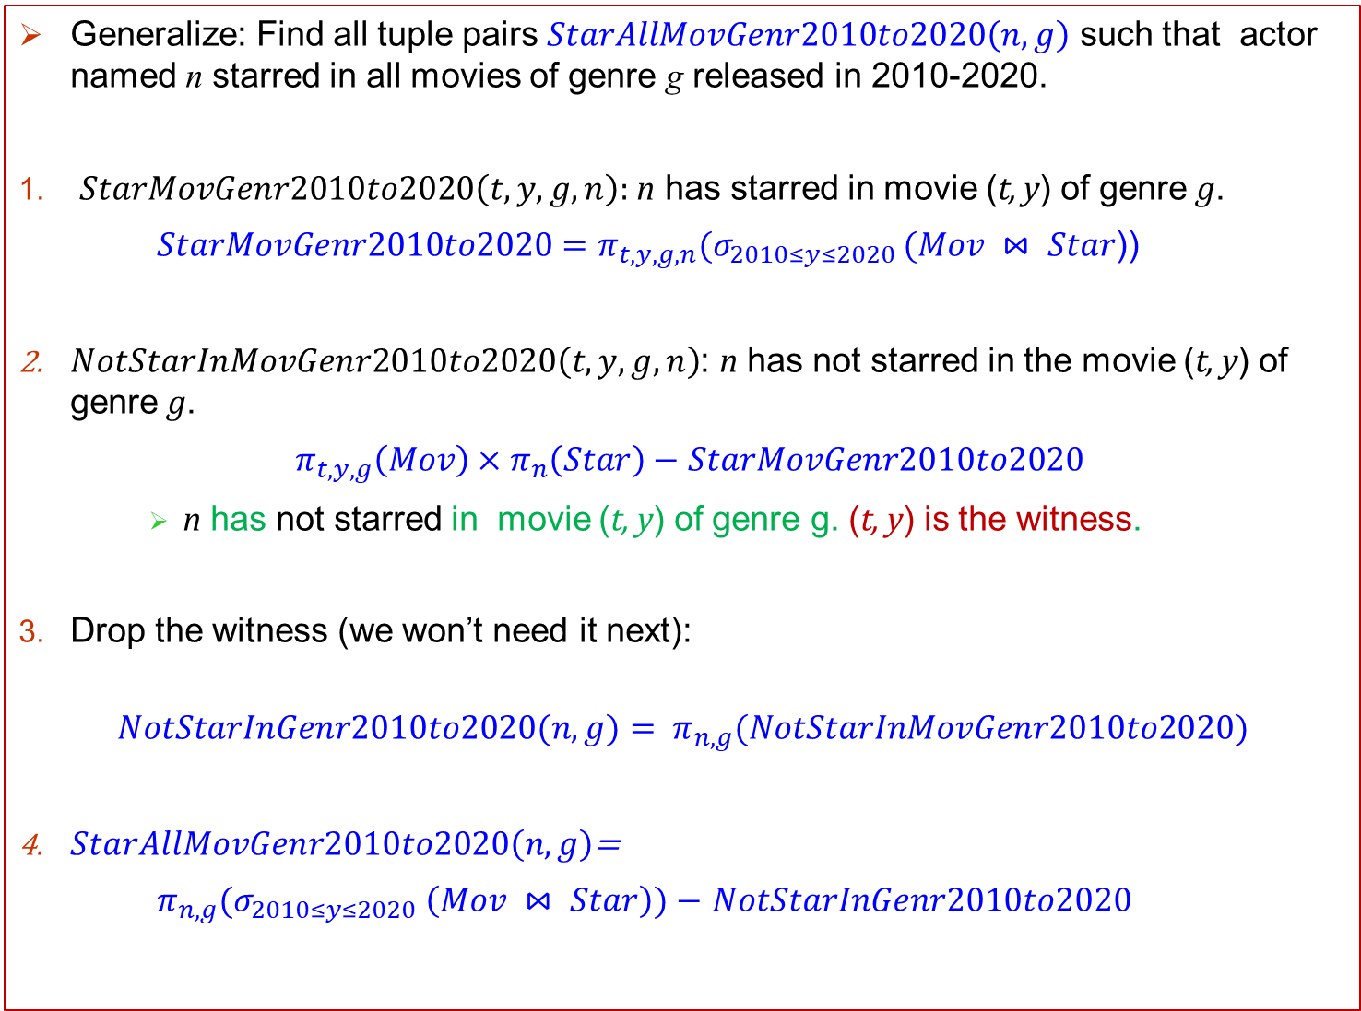
2 diff ops
Generalize: Find all tuple pairs $StarAllMovGenr2010to2020\left(n,g\right)$ such that actor named n starred in all movies of genre g released in 2010-2020.
$StarMovGenr2010to2020\left(t,y,g,n\right):$n has starred in movie (t, y) of genre g.
${StarMovGenr2010to2020=π}_{t,y,g,n}(σ_{2010≤y≤2020 }(Mov ⋈ Star$))
$NotStarInMovGenr2010to2020\left(t,y,g,n\right)$: n has not starred in the movie (t, y) of genre g.
$π_{t,y,g}\left(Mov\right)×π_{n}\left(Star\right)−$ ${StarMovGenr2010to2020}_{}$
n has not starred in movie (t, y) of genre g. (t, y) is the witness.
Drop the witness (we won’t need it next):
$$NotStarInGenr2010to2020(n,g)= π_{n,g}(NotStarInMovGenr2010to2020)$$
$StarAllMovGenr2010to2020\left(n,g\right)$=
$π_{n,g}(σ_{2010≤y≤2020} \left(Mov ⋈ Star\right))$ $−$ $NotStarInGenr2010to2020$

Slide 15
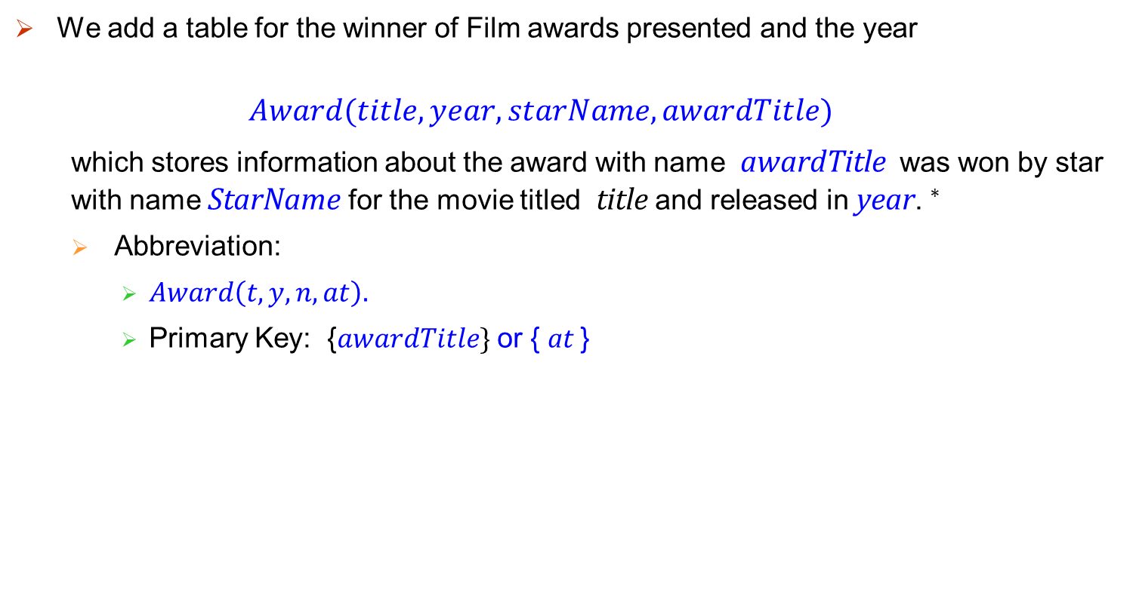
Extending Example: Table of Awards
We add a table for the winner of Film awards presented and the year
$$Award(title, year,starName, awardTitle)$$
which stores information about the award with name awardTitle was won by star with name StarName for the movie titled title and released in year.$^{∗}$
Abbreviation:
$Award\left(t,y,n,at\right).$
Primary Key: {$awardTitle\}$ or { at }
$^{∗}$For simplicity, we assume that the Award table keeps track of annual awards given for films released in that year, awards such are lifetime achievements awards are not considered.

Slide 16
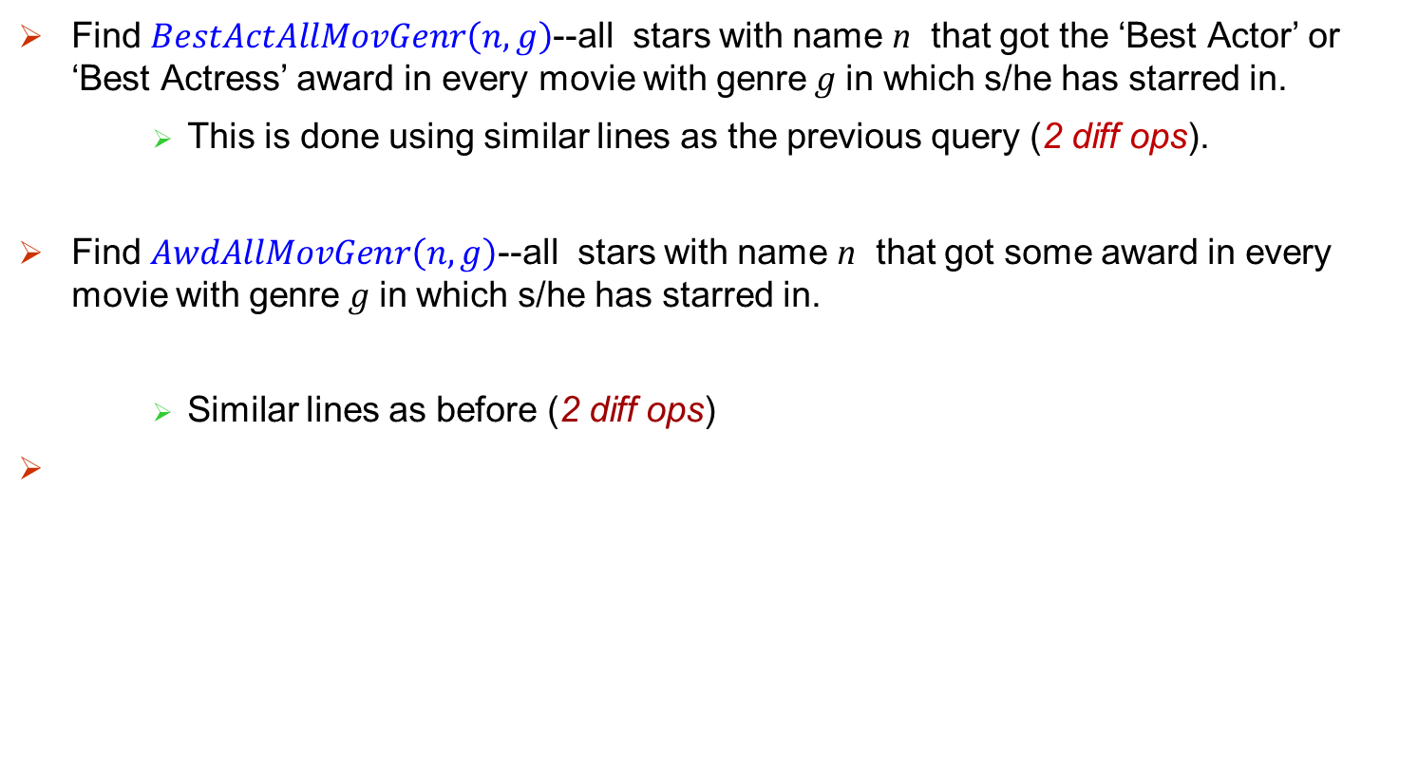
Find $BestActAllMovGenr\left(n,g\right)$--all stars with name n that got the ‘Best Actor’ or ‘Best Actress’ award in every movie with genre g in which s/he has starred in.
This is done using similar lines as the previous query (2 diff ops).
Find $AwdAllMovGenr\left(n,g\right)$--all stars with name n that got some award in every movie with genre g in which s/he has starred in.
Similar lines as before (2 diff ops)

Slide 17
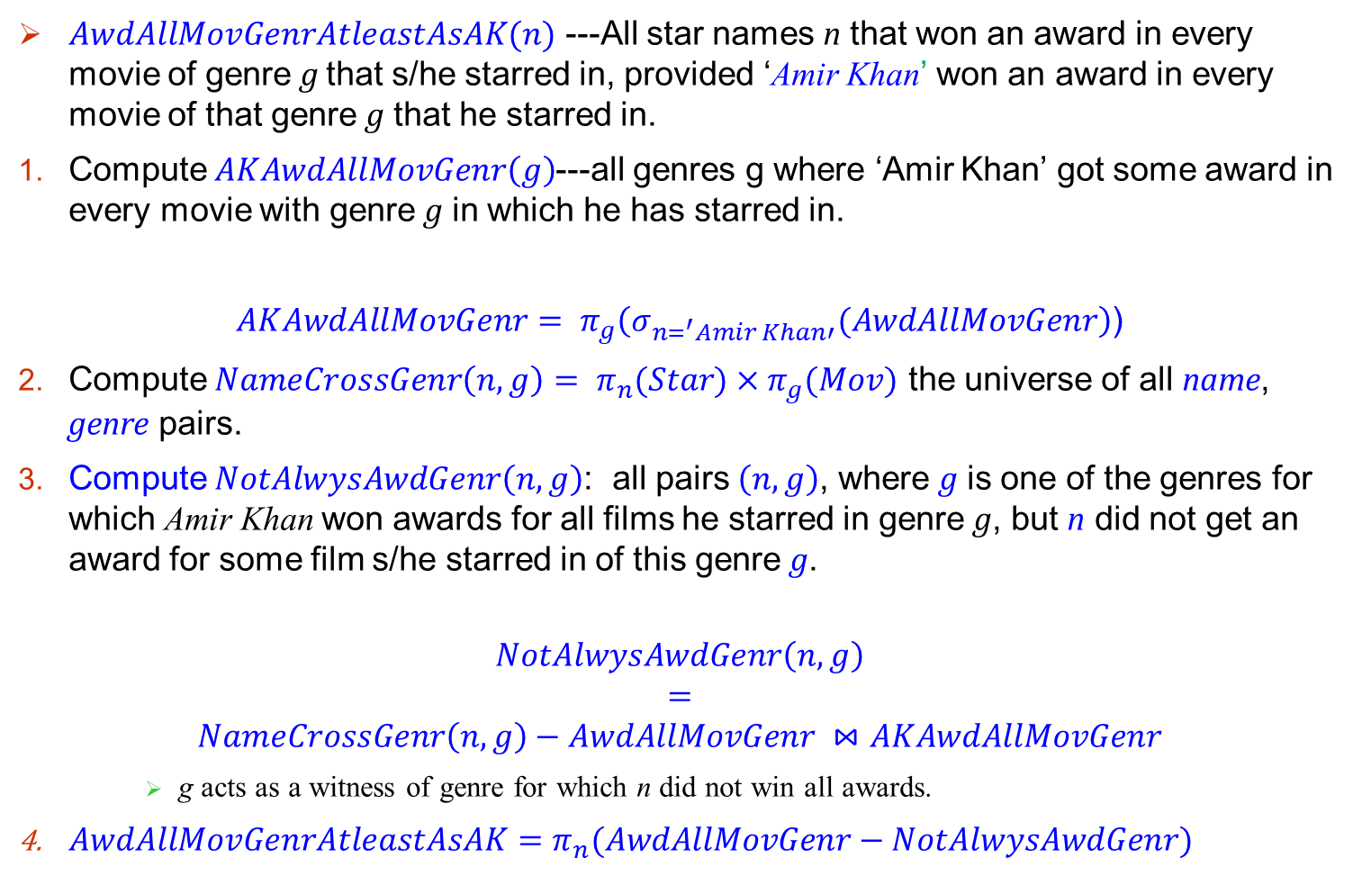
2 successive 2 diff ops
$AwdAllMovGenrAtleastAsAK(n)$ ---All star names n that won an award in every movie of genre g that s/he starred in, provided ‘Amir Khan’ won an award in every movie of that genre g that he starred in.
Compute $AKAwdAllMovGenr\left(g\right)$---all genres g where ‘Amir Khan’ got some award in every movie with genre g in which he has starred in.
$AKAwdAllMovGenr= π_{g}\left(σ_{n=^{′}Amir Khan′}(AwdAllMovGenr\right)$)
Compute $NameCrossGenr\left(n,g\right)= π_{n}(Star)×π_{g}(Mov)$ the universe of all name, genre pairs.
Compute $NotAlwysAwdGenr\left(n,g\right)$: all pairs $\left(n,g\right)$, where g is one of the genres for which Amir Khan won awards for all films he starred in genre g, but n did not get an award for some film s/he starred in of this genre g.
$$NotAlwysAwdGenr\left(n,g\right)$$
$$=$$
$$NameCrossGenr\left(n,g\right)−AwdAllMovGenr ⋈AKAwdAllMovGenr$$
g acts as a witness of genre for which n did not win all awards.
$AwdAllMovGenrAtleastAsAK=π_{n}(AwdAllMovGenr−NotAlwysAwdGenr)$

Slide 18
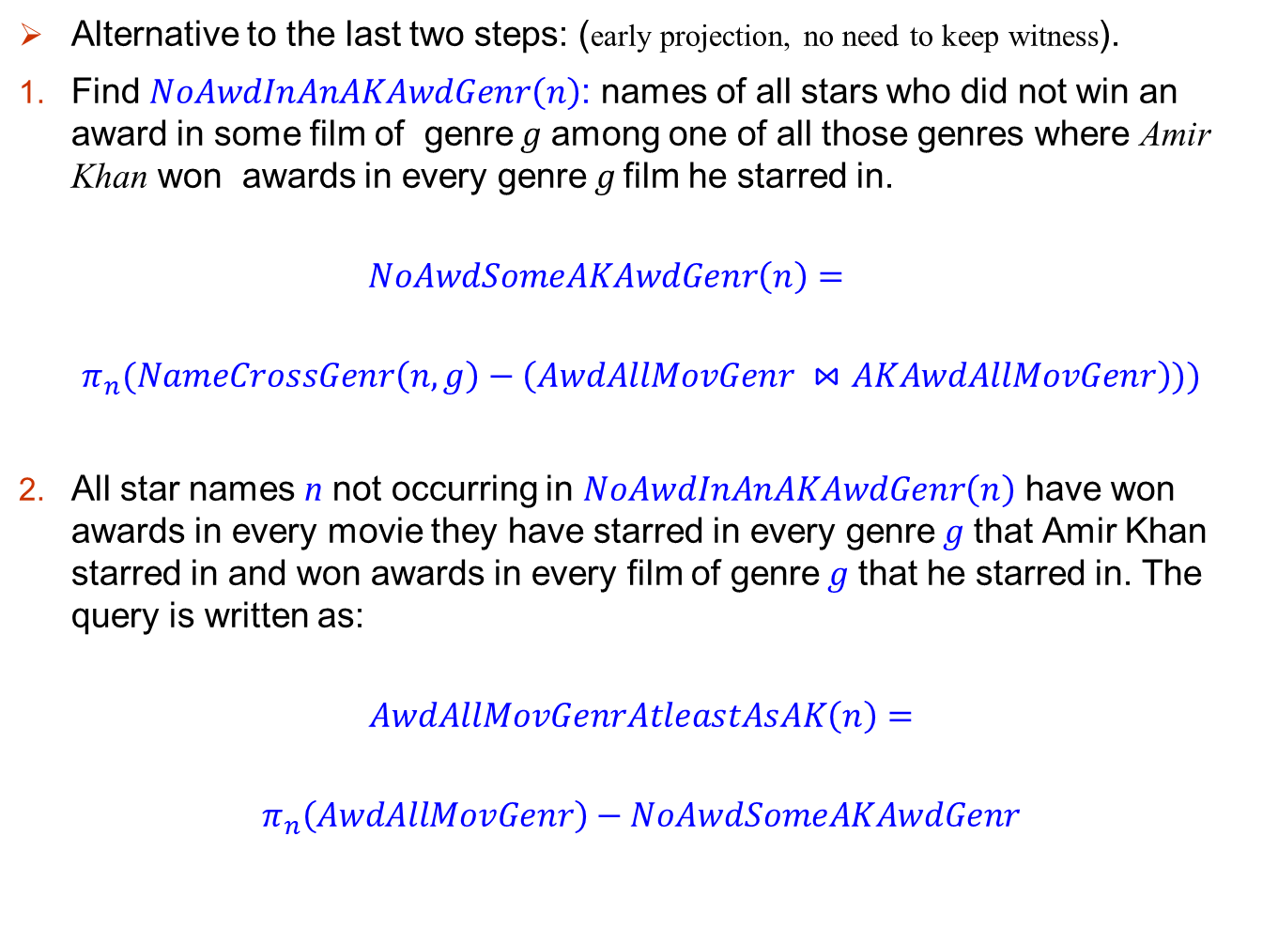
Alternative to the last two steps: (early projection, no need to keep witness).
Find $NoAwdInAnAKAwdGenr\left(n\right)$: names of all stars who did not win an award in some film of genre g among one of all those genres where Amir Khan won awards in every genre g film he starred in.
$$NoAwdSomeAKAwdGenr\left(n\right)=$$
$$π_{n}(NameCrossGenr\left(n,g\right)−\left(AwdAllMovGenr ⋈AKAwdAllMovGenr\right)))$$
All star names n not occurring in $NoAwdInAnAKAwdGenr\left(n\right)$ have won awards in every movie they have starred in every genre g that Amir Khan starred in and won awards in every film of genre g that he starred in. The query is written as:
$$AwdAllMovGenrAtleastAsAK\left(n\right)=$$
$$π_{n}\left(AwdAllMovGenr\right)−NoAwdSomeAKAwdGenr$$

Slide 19
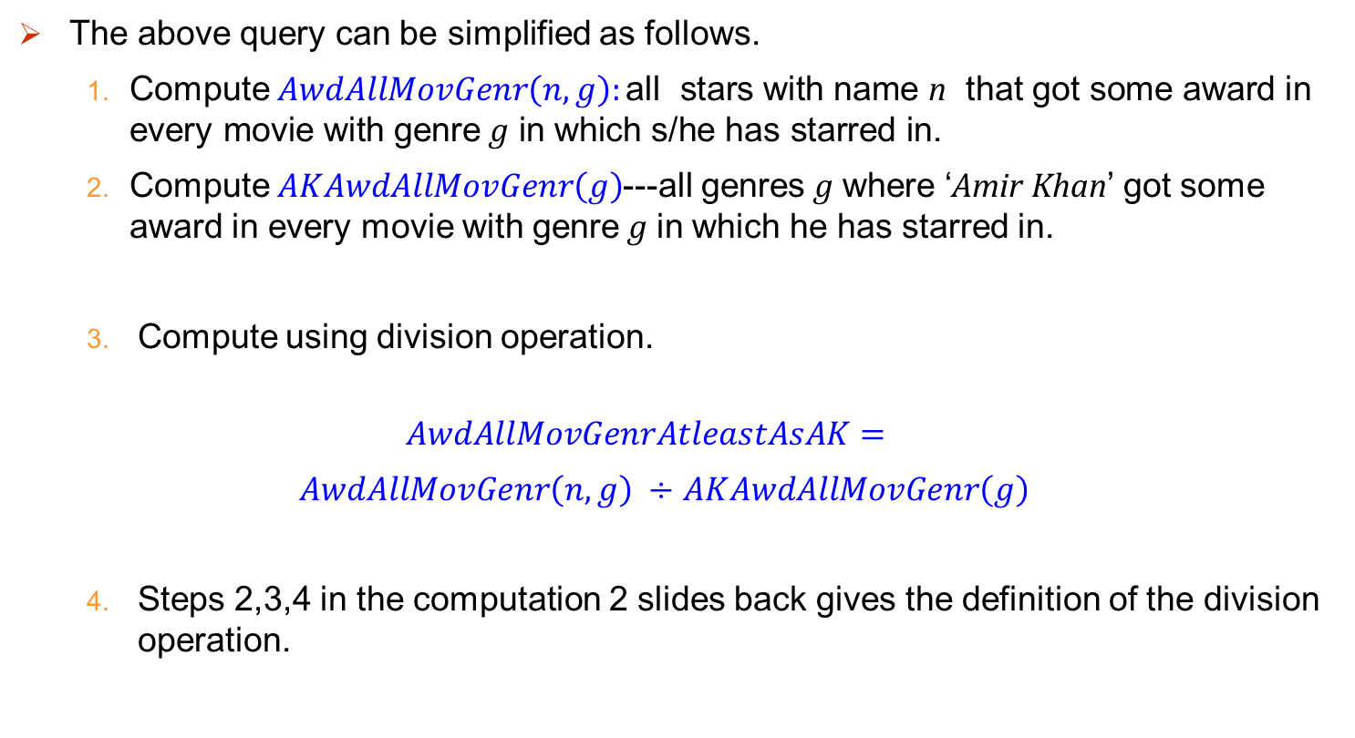

Relational division $÷op$
The above query can be simplified as follows.
Compute $AwdAllMovGenr\left(n,g\right):\text{all} \text{stars} \text{with} \text{name} \text{n} \text{that} \text{got} \text{some} \text{award} \text{in} \text{every} \text{movie} \text{with} \text{genre} \text{g} \text{in} \text{which} \text{s}\text{/}\text{he} \text{has} \text{starred} \text{in}\text{.}$
Compute $AKAwdAllMovGenr\left(g\right)$---all genres g where ‘Amir Khan’ got some award in every movie with genre g in which he has starred in.
Compute using division operation.
$$AwdAllMovGenrAtleastAsAK=$$
$AwdAllMovGenr\left(n,g\right) ÷$ $AKAwdAllMovGenr\left(g\right)$
Steps 2,3,4 in the computation 2 slides back gives the definition of the division operation.

Slide 20
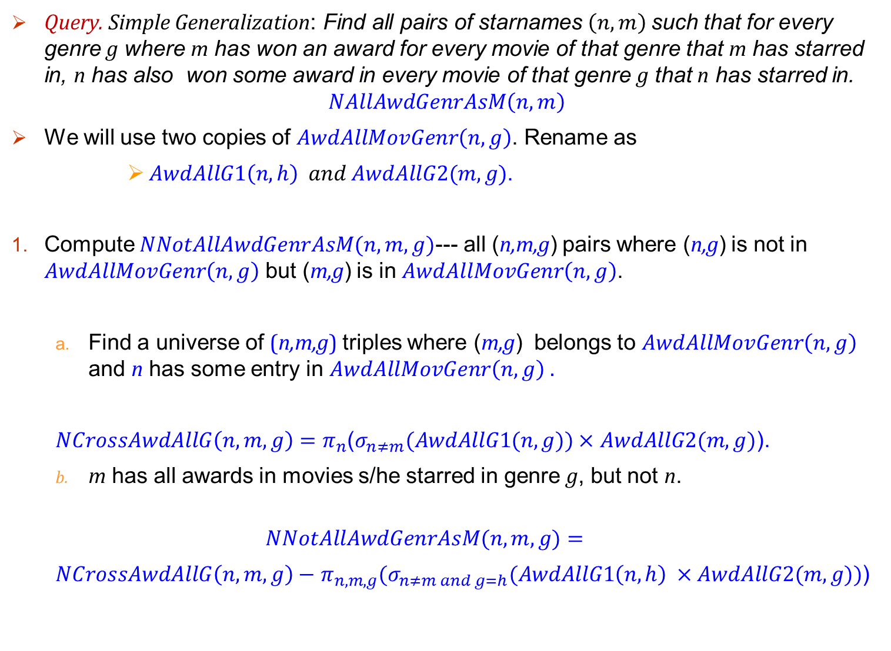
Query. Simple Generalization: Find all pairs of starnames $\left(n,m\right)$such that for every genre g where m has won an award for every movie of that genre that m has starred in, n has also won some award in every movie of that genre g that n has starred in.
$$NAllAwdGenrAsM\left(n,m\right)$$
We will use two copies of $AwdAllMovGenr\left(n,g\right)$. Rename as
$AwdAllG1\left(n,h\right) and AwdAllG2(m,g)$.
Compute $NNotAllAwdGenrAsM(n,m,g)$--- all (n,m,g) pairs where (n,g) is not in $AwdAllMovGenr\left(n,g\right)$ but (m,g) is in $AwdAllMovGenr\left(n,g\right)$.
Find a universe of (n,m,g) triples where (m,g) belongs to $AwdAllMovGenr\left(n,g\right)$ and n has some entry in $AwdAllMovGenr\left(n,g\right) .$
$NCrossAwdAllG\left(n,m,g\right)=π_{n}$($σ_{n≠m}(AwdAllG1(n,g))×$ $AwdAllG2(m,g)$).
m has all awards in movies s/he starred in genre g, but not n.
$$NNotAllAwdGenrAsM(n,m,g)=$$
$NCrossAwdAllG\left(n,m,g\right)−$ $π_{n,m,g}(σ_{n≠m and g=h}(AwdAllG1\left(n,h\right) ×AwdAllG2(m,g)\text{)}$)

Slide 21

Completing the solution
Solution:
$$NAllAwdGenrAsM\left(n,m\right)=$$
$π_{n,m}(AwdAllG1(n,h)×$ $AwdAllG2(m,g)) − π_{n,m}$($NNotAllAwdGenrAsM$)

Slide 22
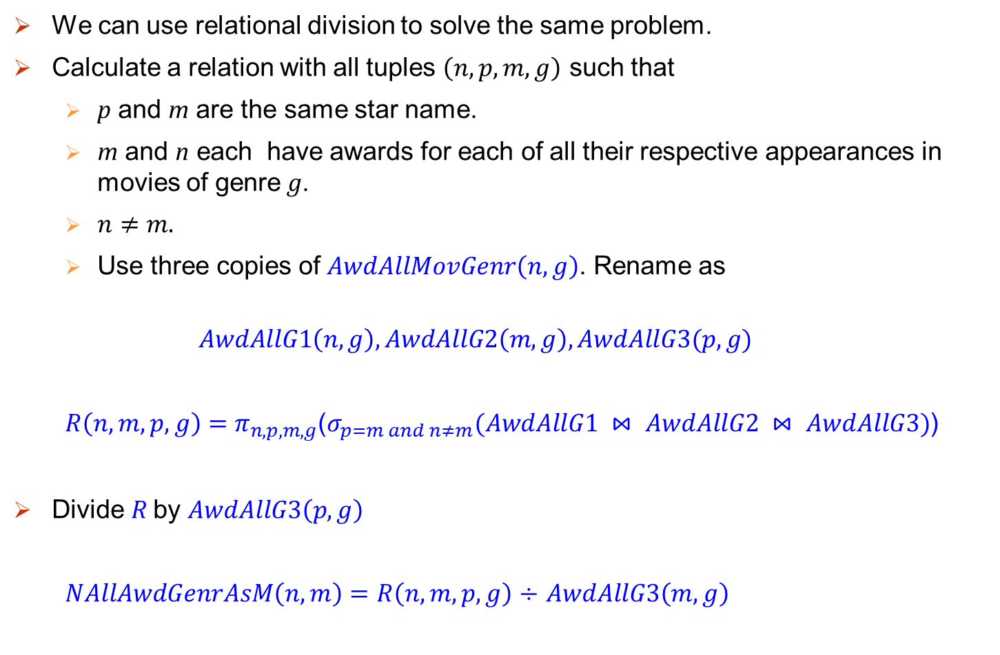
Writing the query Using $÷$
We can use relational division to solve the same problem.
Calculate a relation with all tuples $\left(n,p,m,g\right)$ such that
p and m are the same star name.
m and n each have awards for each of all their respective appearances in movies of genre g.
$n≠m.$
Use three copies of $AwdAllMovGenr\left(n,g\right)$. Rename as
$$AwdAllG1\left(n,g\right), AwdAllG2\left(m,g\right), AwdAllG3(p,g)$$
$R\left(n,m,p,g\right)=$ $π_{n,p,m,g}$($σ_{p=m and n≠m}(AwdAllG1 ⋈ AwdAllG2 ⋈ AwdAllG3)$)
Divide R by $AwdAllG3\left(p,g\right)$
$NAllAwdGenrAsM\left(n,m\right)=R\left(n,m,p,g\right)$ $÷$ $AwdAllG3\left(m,g\right)$

Slide 23
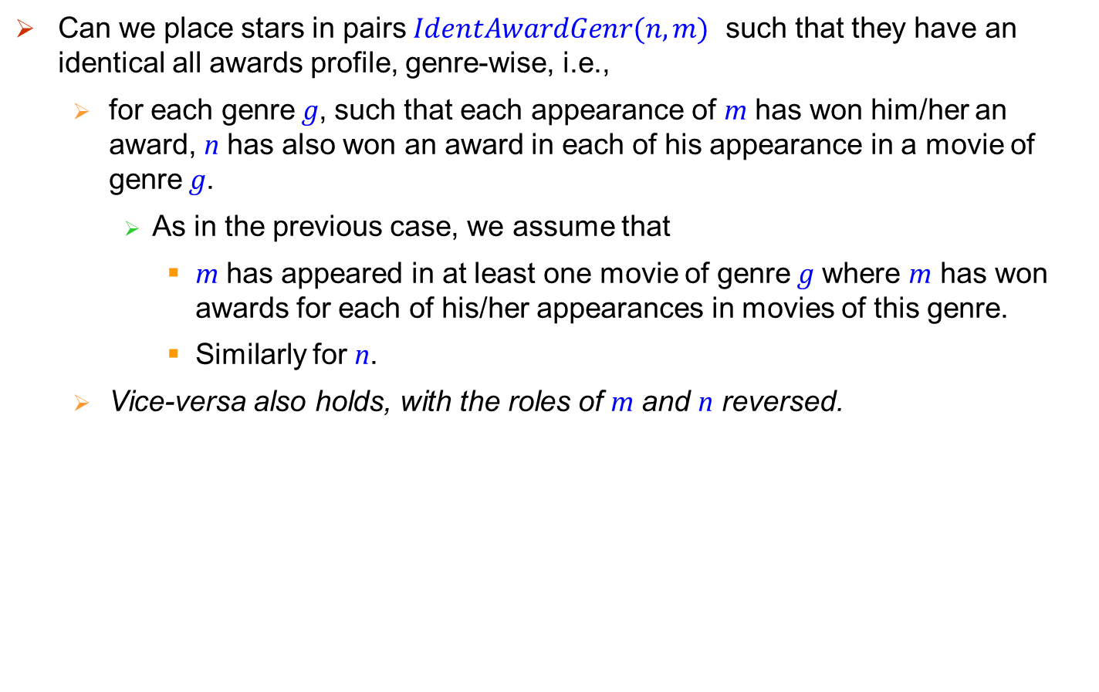
Last example
Can we place stars in pairs $IdentAwardGenr(n,m)$ such that they have an identical all awards profile, genre-wise, i.e.,
for each genre g, such that each appearance of m has won him/her an award, n has also won an award in each of his appearance in a movie of genre g.
As in the previous case, we assume that
m has appeared in at least one movie of genre g where m has won awards for each of his/her appearances in movies of this genre.
Similarly for n.
Vice-versa also holds, with the roles of m and n reversed.

Slide 24
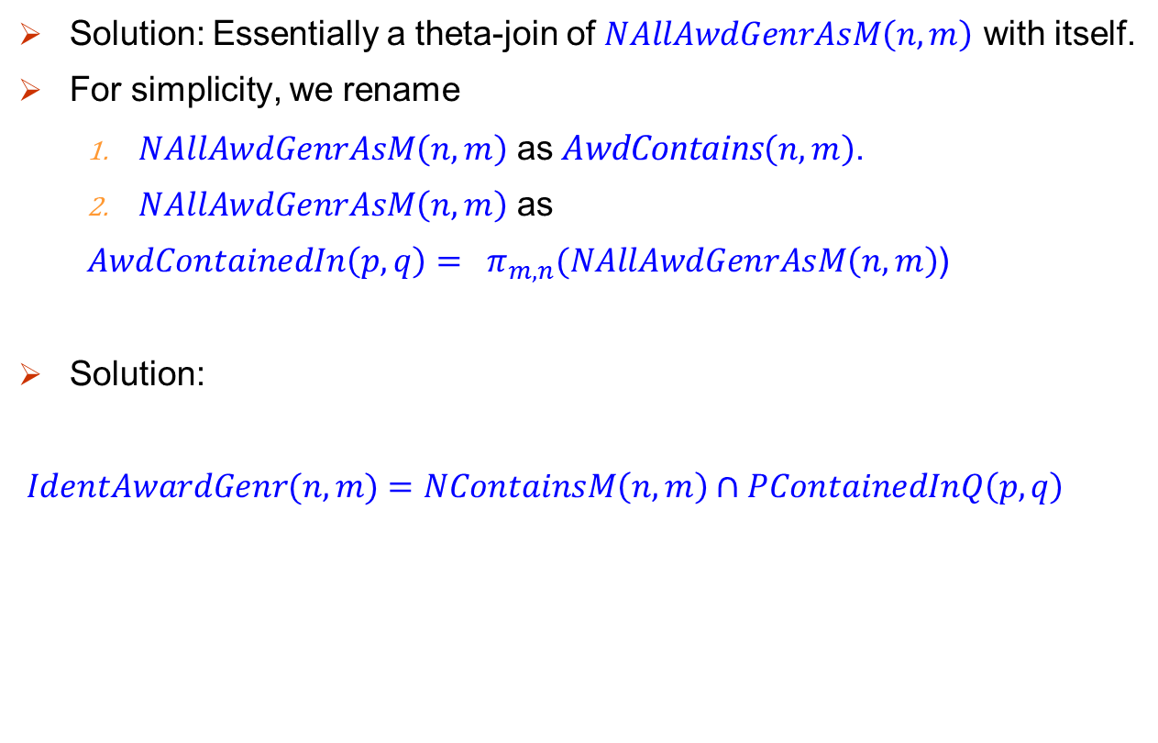
Solution: Essentially a theta-join of $NAllAwdGenrAsM\left(n,m\right)$ with itself.
For simplicity, we rename
$NAllAwdGenrAsM\left(n,m\right)$ as AwdContains$\left(n,m\right)$.
$NAllAwdGenrAsM\left(n,m\right)$ as
$AwdContainedIn\left(p,q\right)= π_{m,n}(NAllAwdGenrAsM\left(n,m\right)$)
Solution:
$IdentAwardGenr(n,m)$ $=NContainsM\left(n,m\right)∩PContainedInQ\left(p,q\right)$

Slide 25
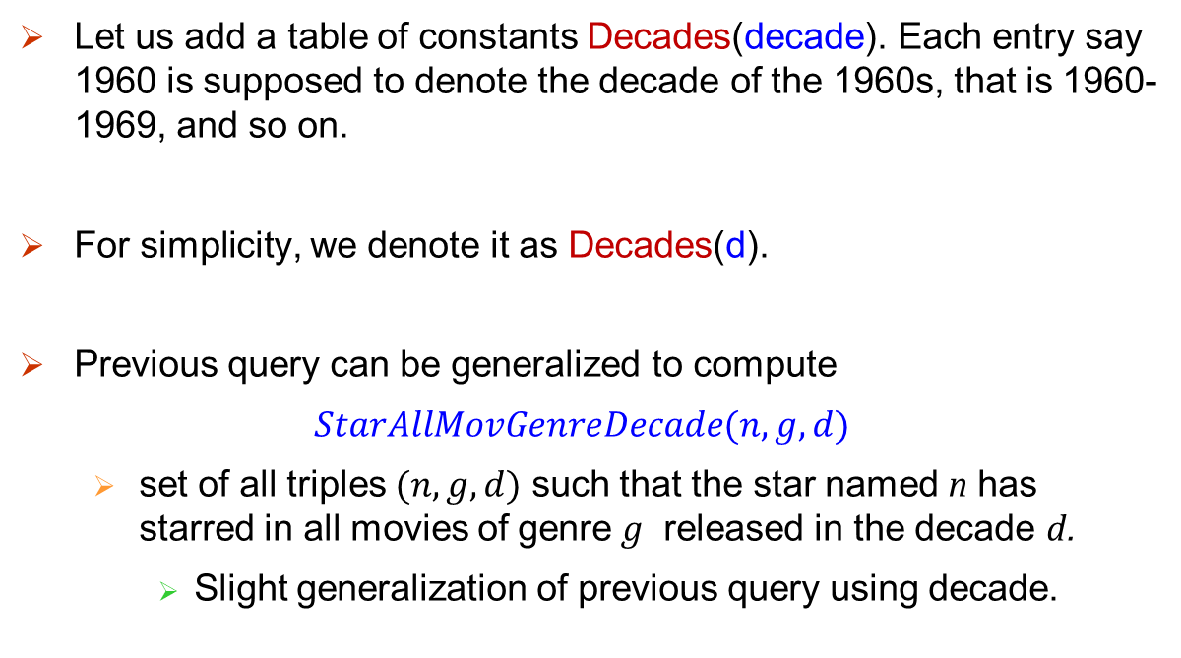
Extending example: Table of Decade
Decade
1950
1960
1970
1980
1990
2000
2010
Let us add a table of constants Decades(decade). Each entry say 1960 is supposed to denote the decade of the 1960s, that is 1960-1969, and so on.
For simplicity, we denote it as Decades(d).
Previous query can be generalized to compute
$StarAllMovGenreDecade(n,g,d)$
set of all triples $(n,g,d)$ such that the star named n has starred in all movies of genre g released in the decade d.
Slight generalization of previous query using decade.

