Slide 1

Advanced Concepts of OOPs CS 19.102 Java Project SUBMITTED TO: SUBMITTED BY: Mr. Raman Puneet Singh 190097 Aayushi Bhargava 190098 Aditi Singh 190110 Deepansha Singh 190123 Samyukta Singh

Slide 2
Oneirology - An INTERACTIVE FICTION

Slide 3
CONTENTS
ABOUT THE PROJECT
PROGRAMMING LANGUAGE USED
FEATURES OF OUR PROJECT
IMPORTANT METHODS
SNIPPETS OF CODE
OUTPUT SCREENSHOTS

Slide 4
ABOUT THE PROJECT..
What do you understand by Interactive Fiction?
Interactive Fiction or (IF) is a classic genre where interaction with player decides the fate of the game.
We have designed a text based interactive fiction where all the interaction takes place through on-screen words

Slide 5
ONEIROLOGY
We have named our game Oneirology.
It is a term which means study of dreams.
In this game we provide the player with three different narratives thus providing the player with the experience of three completely different genre. Player can choose any of these stories according to the convenience.

Slide 6
l. DAILY BLUES
Daily Blues provides the user an opportunity to explore and experience what a day in the life of any socially-pressured person feels like. Right from the beginning of the day of a stressed high-school student, till the time he/she go back to bed.
This Interactive Fiction gives you a brief outlook into what might seem as basic normalcies in one's life, may actually be the toughest jobs for the others.

Slide 7
ll. TREASURE HUNT
This narrative gives user an opportunity to put oneself in the shoes of a captain who is in search of his ancestral treasure.
At every point player is provided with a clue in the form of a riddle, each correct answer leads to the treasure ,however one wrong answer leads to loosing.

Slide 8
lll. MURDER MYSTERY
Murder Mystery brings the challenges of solving one. The player gets to play the role of a detective, player is provided with detailed information about the case.
Player gets an opportunity to design their own path of investigation .At the end the game turns about finding the real culprit.

Slide 9
PROGRAMMING LANGUAGE USED <JAVA>
About Java
Java is a general-purpose programming language that is class-based, object-oriented, and designed to have as few implementation dependencies as possible .Java was developed b Sun Microsystems Inc in 1991.
Focuses on the concepts of :
Abstraction
Encapsulation
Inheritance
Polymorphism

Slide 10
Features of Java:
Platform Independent
Simple
Secure
Architecture-neutral
Portable
Robust
Multithreaded

Slide 11
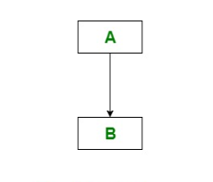
Use of Single Inheritance in our code:
Single Inheritance?
Single inheritance enables a derived class to inherit properties and behaviour from a single parent class. It allows a derived class to inherit the properties and behaviour of a base class, thus enabling code reusability as well as adding new features to the existing code.

Slide 12
We have combined all the functions that were part of all the three narratives into a class (Sundarta), then we extended all the three classes(of respective narratives) to sundarta class.
Thus reusing our code. Using Single inheritance in our code made it easy to understand and efficient.

Slide 13
FEATURES OF PROJECT
This game provides the user with three different narratives of varied genres.
User can quit the game at any point which makes it user friendly
Instructions are very clear and elaborate ,it gives user an opportunity to pause the game at any point thus making it easy to understand and convenient.

Slide 14
IMPORTANT methods
any_key()
to provide a short break for the user to catch up on the story where he can almost pause the story and continue on his own whim.
Beautify()
we use this function to enhance the visual ability of the project providing clarity of thoughts and a smooth sail.

Slide 15
input()
it is one of the major methods ,it used to take input from the user at every turn of the narrative
zaruri()
motive of this method is to inform the user, at the time of any invalid entry made during the game .
typewriter()
to provide typewrite effect on the screen where every few seconds a letter appears after the previous one.

Slide 16
CODE SNIPPETS
public static void typewriter(String message) {
for(int i = 0; i<message.length(); i++) {
System.out.print(message.charAt(i));
try {
Thread.sleep(30);
}
catch(InterruptedException e) {}
}
}
public void beautify() {
System.out.println();
for(int i = 0; i<168; i++) {
System.out.print("-");
}
System.out.println();
}

Slide 17
public int input() {
System.out.println("\n\nEnter your choice : ");
Scanner obj = new Scanner(System.in);
int option = obj.nextInt();
return option;
}
public void any_key() {
typewriter("\n\n\nPress ENTER to continue...");
System.console().readPassword();
}
public void zaroori() {
typewriter("\n\nInvalid Entry!");
any_key();
beautify();
}

Slide 18
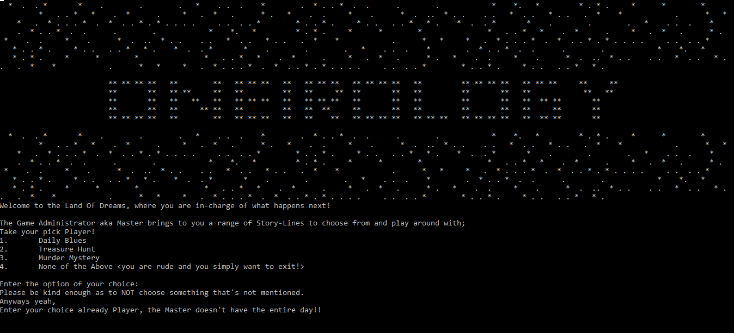
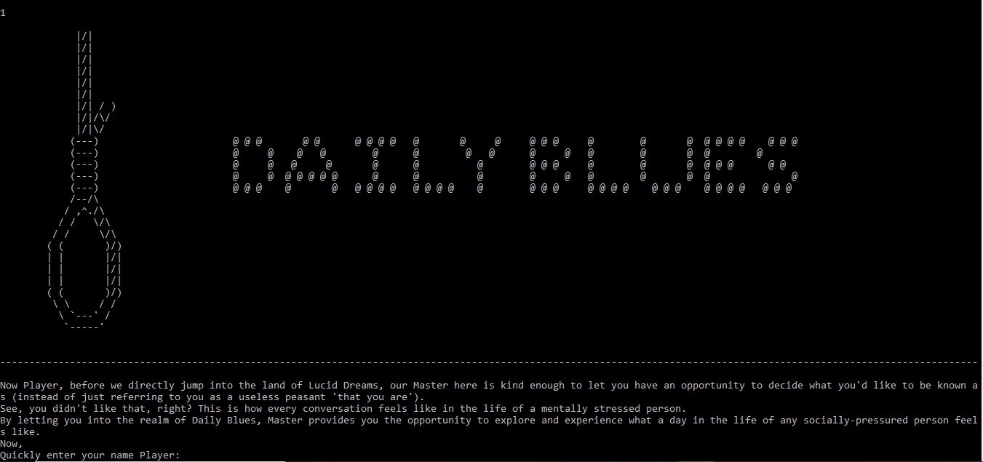
OUTPUT SCREENSHOTS

Slide 19
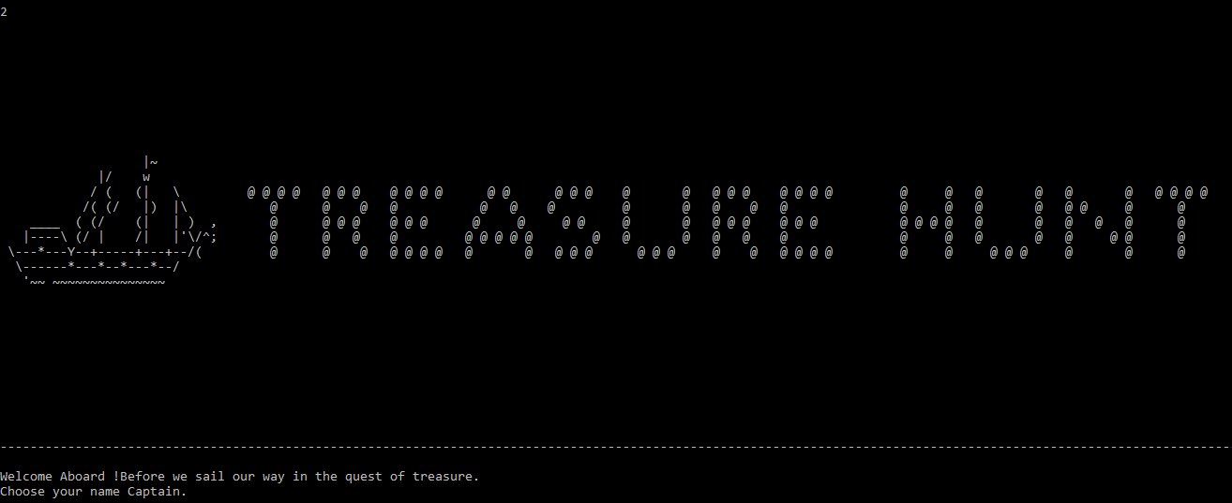
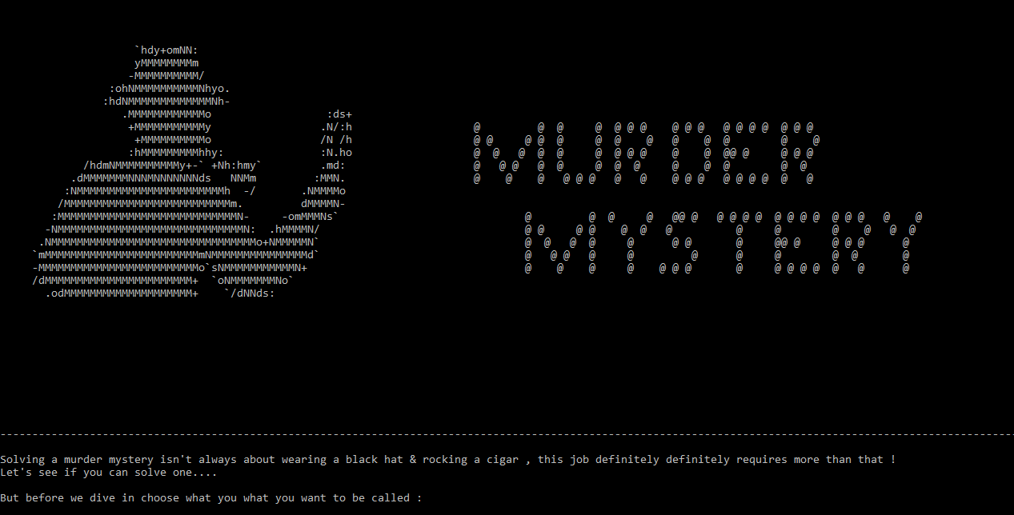

Slide 20
THANK YOU !

