Slide 1
PDM-Teams MINOR PROJECT
PROJECT GUIDE :- Dr. Jasvinder (HOD ,CSE Dept)
BY:- Deepansh Singh (A40319001/20)

Slide 2
TABLE OF CONTENT
Abstract
Introduction
Scope & Objective of the Project
Tools and Technology used
Technical Details
Methodology
References

Slide 3
ABSTRACT
This Project is based on sever to server communication between sender side to receiver side.
We are making a real time chat application that helps people to communicate even through huge distance.
It will featuring a private room feature that help to chat in an organised way.
The user should enter the username to chat.

Slide 4
Introduction
This project is an example of server to server communication which is basically based on public chatting (message is broadcasted to all connected users in a room).
The app allows multiple users to chat together. The messages will be updated without refreshing the page. For simplicity we will be avoiding the authentication part.
The user should enter user name to chat / video call.

Slide 5
OBJECTIVE & SCOPE
This Project Entitled as PDM-Teams is used basically for chatting purpose with the remote clients or users on Internet or local networks. Our university website doesn’t have a real time video conferencing app.
We also face the network problem in the period of covid-19 which tends to cancelling the required class.
As we are providing the chatting feature to the project so it is very easy to the teachers to answer the query of students by the text. Text sharing is very important to communicate to other students so that everyone should connect to the portal very easily.

Slide 6
Tools and Technology used
FRONTEND
We are using HTML , CSS , JAVASCRIPT for the frontend part
BACKEND
We are using NODE.JS for the backend logics.
We are using WEB SOCKETS for the real time communication.
And we are using EXPRESS.JS for the server of the site.

Slide 7
HTML
HTML (HyperText Markup Language) is the most basic building block of the Web. It defines the meaning and structure of web content.
CSS
Cascading Style Sheets (CSS) is style sheet language used to describe the presentation of a document written in HTML or XML .CSS describes how elements should be rendered on screen, on paper, in speech, or on other media.
JavaScript
JavaScript is a programming language that allows you to implement complex things on web pages. Every time a web page does more than just sit there and display static information for you to look at—displaying timely content updates, interactive maps , scrolling video jukeboxes, or more.

Slide 8
Node.js
Node.js is an open-source, cross-platform JavaScript run-time environment that executes JavaScript code outside the browser. The most important advantage of using Node is that we can use JavaScript as both a front-end and back-end language.
As we know, JavaScript was used primarily for client-side scripting, in which scripts were embedded in a webpage’s HTML and run client-side by a JavaScript engine in the user’s web browser.

Slide 9
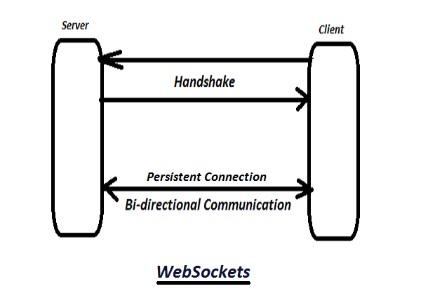
Web Sockets
Web Sockets are very beautiful tools that allow us to establish a real-time communication in modern web applications. In fact this mechanism is so powerful and it’s used to build different kind of apps like real-time chat or notification system etc..

Slide 10
Express.js
Express.js, or simply Express, is a web application framework for Node.js. Express provides a robust set of features for web and mobile applications. Express provides a thin layer of fundamental web application features, without obscuring Node.js features.
There are many frameworks that can be added as modules to our Node application

Slide 11
WebRTC
WebRTC (Web Real Time Communication) is an open source project that enables peer- to-peer communication between browsers. In other words, WebRTC allows you to exchange any kind of media through the web (such as video, audio and data) without any required plugin or framework.
Direct communication between browsers improves performance and reduces latency times since clients don’t need to keep sending and receiving messages through a server. For instance, we could use WebSockets to connect two clients but a server would have to route their messages

Slide 12
TECHNICAL DETAILS
SOFTWARE REQUIREMENTS:
HTML(Hyper Text Markup Language) , CSS (Cascading Style Sheet) (Front End)
JAVASCRIPT , NODE JS , EXPRESS , WEB SOCKETS.IO (Back End)
Microsoft Windows , Linux , Mac (All OF THEM)
Internet Explorer (5.0 and above) or Mozilla Firefox (6.0 and above)
VSCODE text editor , A Bash terminal / command prompt.
HARDWARE REQUIREMENTS:
Intel core 2 (minimum spec)
Ram :- 2 GB
Computer Memory :- 128 GB
Intel HD graphics (minimum version 15.40.46.5144)

Slide 13
METHODOLOGY
Agile is a set of techniques to manage software development projects. It consists in: • Being able to respond to changes and new requirements quickly. • Teamwork, even with the client. • Building operating software over extensive documentation. • Individuals and their interaction over tools. I believe it is a perfect fit for this project since I did not know most requirements beforehand. By using the Agile, will be able to focus only on the features which had the most priority at the time.
Agile project management is an iterative approach to project management which allows you to break large projects down into more manageable tasks tackled in short iterations or sprints. This enables your team to adapt to change quickly and deliver work fast.
The diagram of the agile project management shown below:-

Slide 14
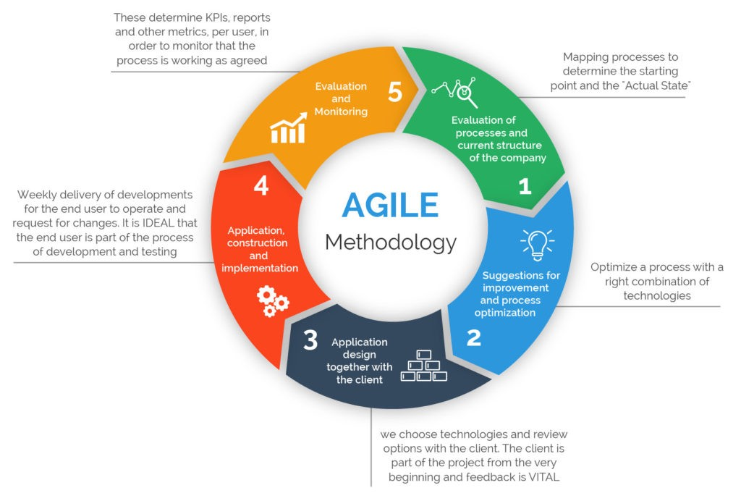
Agile project management

Slide 15
ROLES OF Team Members
DEEPANSH SINGH (FULL BACKEND , SERVER DEVELOPMENT AND FRONT END DEVELOPMENT)

Slide 16
REFERENCES
https://css-tricks.com/
https://nodejs.org/en/
https://developer.mozilla.org/en-US/
https://www.npmjs.com/package/websocket
https://expressjs.com/

