Slide 1
ECE 6255 Final Project Pitch Shifting
Team member: Deepanshi Deepanshi, Siddharth Sudhakaran, Shuangyang Li

Slide 2
Problem Statement

Slide 3
Pitch Shifting

Slide 4
Algorithm
Short-Term Analysis Framework for Pitch Shifting
Phase vocoder
Resampling

Slide 5
Short-Term Analysis

Slide 6
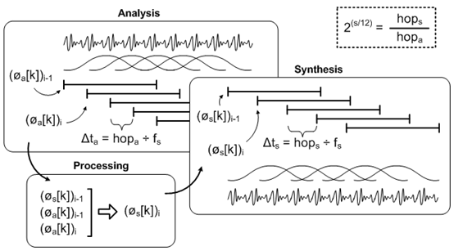
Phase Vocoder
Framework

Slide 7
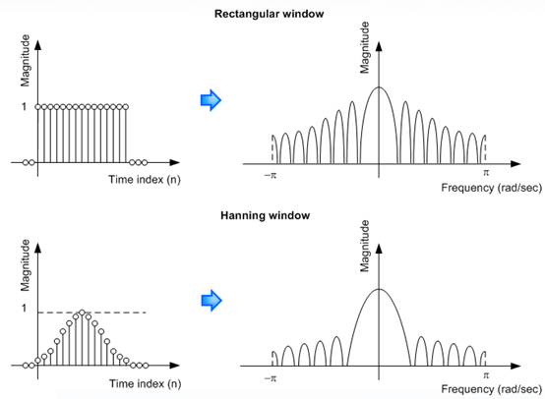

Phase Vocoder
Windowing

Slide 8
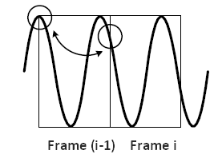
Phase Vocoder
Processing
For each frame of length N, the FFT result consists of two sets of values: the magnitudes and the phases of N frequency bands, or in other way to say, N bins.
For a sequence of shifted frames, the later frame will have a phase difference from the previous frame. Specifically, for each bin k in frame i, it has a phase shift compared to the bin k in frame i-1.

Slide 9

Phase Vocoder
The phase shift, time interval, and the true frequency are related.
Before adjusted:
After adjusted:

Slide 10

Phase Vocoder
However, the phase information provided by FFT is wrapped such that its value is within the range of [-pi, pi]. So that the frequency difference between two frames should also be wrapped to obtain the true frequency.

Slide 11

Phase Vocoder
Synthesis
Apply IDFT for each frame with the Hanning window
Overlap each frame

