Slide 1

E-COMMERCE SALES DASHBOARD:
Analyzing and Maximizing Online Business

Slide 2
Objective
To analyze e-commerce sales data and extract actionable business insights
To identify trends, top-performing states, product sizes, and sales channels
To provide a real-time, interactive dashboard for business stakeholders

Slide 3
📈 Key Metrics (KPIs)
Top KPIs Displayed on Dashboard:
Total Quantity Sold: 1,16,649 units
Total Sales Amount: ₹78,592,678
Total Categories: 9
Total Products: 7,190
Total Sizes: 11

Slide 4
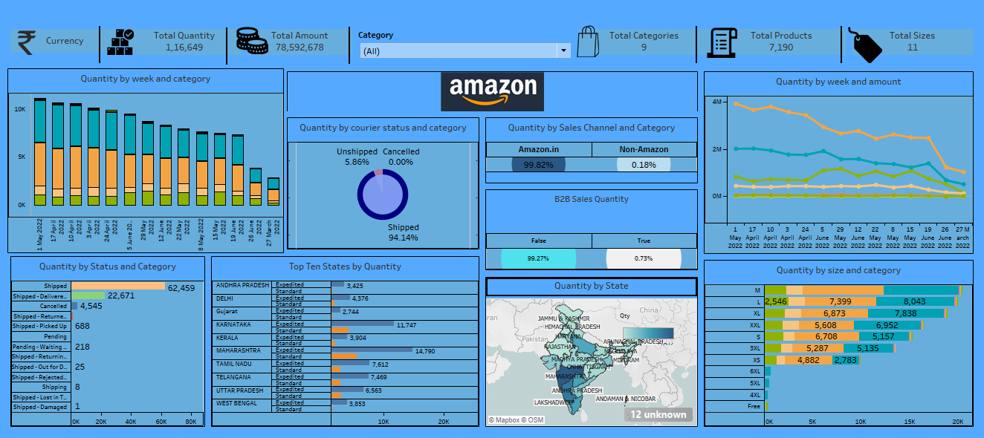
AMAZON SALES DASHBOARD

Slide 5

Sales Trends
Time-Series Analysis shows weekly trends in both:
Quantity sold (stacked bar)
Amount generated (line graph)
Noticeable decline in quantity toward end of June
Key insight :
Early May had highest volume

Slide 6

Courier & Channel Analysis
01
Shipped Orders: 94.14%
Sales Channel:
Amazon.in: 99.82%
02
Unshipped: 5.86%
Non-Amazon: 0.18%
03
B2B Sales:
Only 0.73%
Cancelled: 0% (excellent performance)

Slide 7
Status & Category Distribution 📦
Most orders fall under Shipped - Delivered
Other status types include returns, damaged, picked up, etc.
Balanced contribution across multiple categories

Slide 8
State-Wise & Size-Based Insights
Top States by Quantity:
Maharashtra, Karnataka, and Uttar Pradesh lead
Size-Based Trends:
Highest sales in L, XL, XXL
Category-size insights reveal customer preferences

Slide 9
Slide 8: Dashboard Design Highlights
Filters : Category-level dropdown for interactive filtering
Visual Elements: Map, pie chart, stacked bars, line charts, and KPI cards
Color Scheme: Consistent blue theme for readability and branding
Branding: Amazon logo for a professional touch

Slide 10
Business Insights
Peak sales observed in early weeks of May
L and XL sizes dominate sales volume
Maharashtra is the leading state by order quantity
94% of orders are successfully shipped — strong logistics performance
Very low cancellation and non-Amazon sales share

Slide 11
Recommendations
Stock Up on L, XL, XXL Sizes – High demand sizes
Focus on Top States – Maharashtra, Karnataka, UP
Maintain Shipping Quality – 94% shipped successfully
Boost B2B Sales – Explore business buyers
Counter Sales Drop – Launch mid-month offers
Expand Sales Channels – Add Flipkart, own website

