Slide 1





Acropolis Institute of Technology and Research, Indore
Department of Information Technology
AI Manthan 2.0 | Problem Statement 11
FloodSense AI
Predict Before It Pools
Team Cosmos
Achal Goyal, Deepanshi Mane, Vanshvi Jain

Slide 2



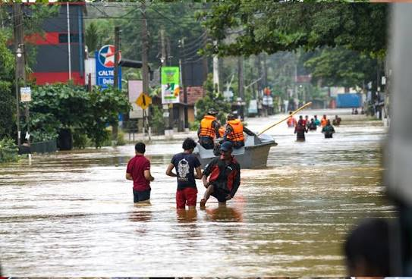
Cosmos
PROBLEM STATEMENT 11 | FLOODSENSE AI
Problem & Proposed Solution
Mumbai's Dadar-Hindmata-Parel corridor floods every monsoon.
Hindmata junction sits in a saucer depression — when Arabian Sea
tides exceed 3.51 m CD, drains reverse and pumps are the only relief.
Current response is REACTIVE. Pumps dispatched only after flooding.
FloodSense AI brings proactive, data-driven flood management:
Our Solution
• ST-GNN model predicts flood depth at 110 junctions (1–3 hrs ahead)
• 70.5% flood onset recall vs 0.0% for the persistence baseline
• Pump optimizer dispatches proactively, reducing flood exposure 9.4%
9.4%
flood exposure cut
vs current practice
70.5%
flood onset recall
vs 0.0% baseline
AI – मंथन 2.0
2

Slide 3
Cosmos
TECHNICAL APPROACH
Technologies Used
ST-GNN Model
PyTorch Geometric · Spatio-Temporal GNN
Recall 91.5% | MAE 1.18 cm | 110 nodes
FastAPI Backend
REST API serving predictions, pump commands
and bilingual flood alerts in real time
Streamlit Dashboard
Interactive flood map, timeline slider,
pump status panel and color-coded alerts
System Pipeline
Rain + Tide
real-time sensor inputs
ST-GNN
depth forecast 1-3 hrs
Pump Optimizer
rule-based dispatch
Alert Engine
bilingual notification
Dashboard
citizen-facing UI
Trained on real OpenStreetMap drain topology + Copernicus GLO-30 DEM elevation data
Validated on 46 unseen test storms across Light (40mm), Heavy (120mm) and Extreme (250mm) scenarios
AI – मंथन 2.0
3

Slide 4
Cosmos
FEASIBILITY, CHALLENGES & SOLUTIONS
Feasibility
Challenges
How We Overcome
Real OSM drain graph + Copernicus DEM elevation
Runs in browser via Streamlit — no GPU required
Validated on 46 unseen storms with dual baseline
Open-source stack: PyTorch, FastAPI, Streamlit
Sparse labeled monsoon sensor data
Tide-flood interaction nonlinearity
Class imbalance (flood events are rare)
Multi-junction spatial dependency
12x loss penalty for missed flood events
Synthetic storm scenarios (40 / 120 / 250 mm)
Dual baseline: Persistence + Passive drainage
Graph convolution captures spatial drain topology
AI – मंथन 2.0
4

Slide 5
Cosmos
IMPACT AND BENEFITS
Impact on Mumbai & Beyond
FloodSense AI reduces flood exposure 9.4% vs current municipal practice
ST-GNN detects flood onset at Hindmata 1+ hr ahead with 70.5% recall
Bilingual alerts (English + Hindi) reach citizens before inundation
Scalable: tested on Mumbai Dadar-Hindmata (N=110) & Kurla-Mithi (N=91)
Benefits
Social
Early warning enables timely evacuation and saves lives
Economic
Proactive pump dispatch cuts infrastructure damage cost
91.5%
Flood Detection
Recall (ST-GNN)
70.5%
Onset Recall at +1h
vs 0.0% baseline
Environmental
Reduces urban waterlogging and associated health risks
AI – मंथन 2.0
5

Slide 6
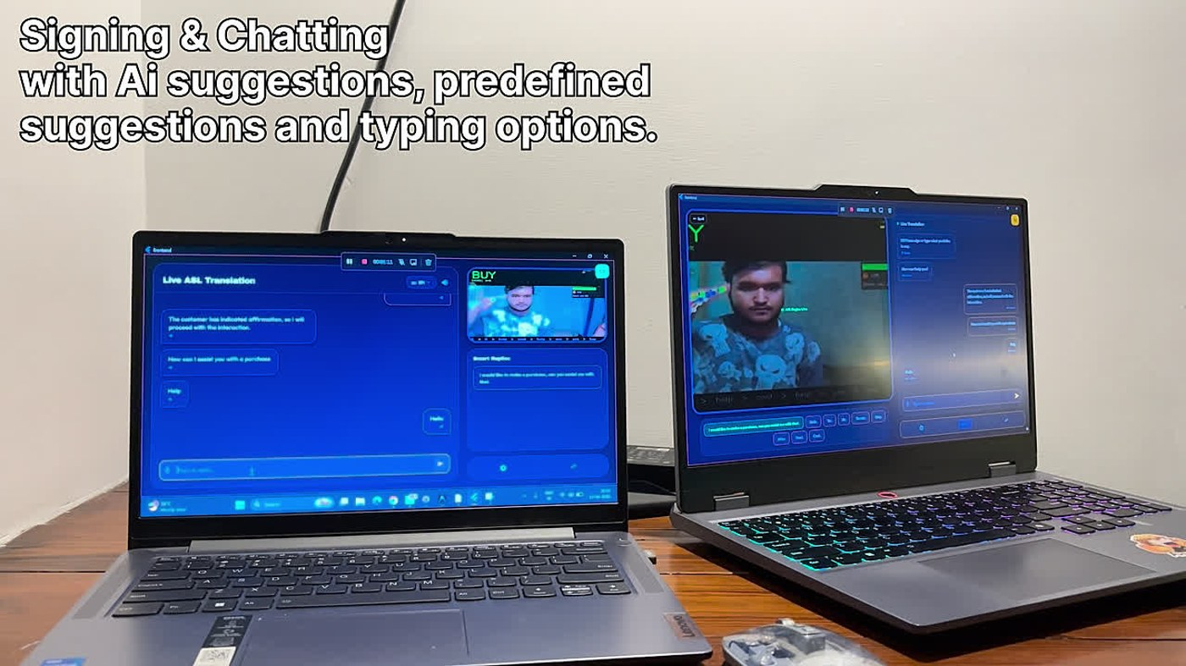
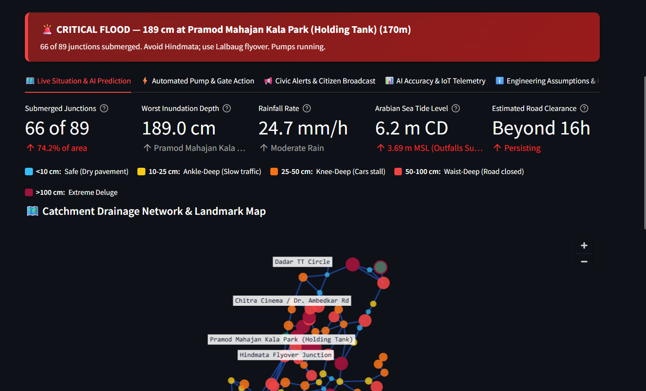
Cosmos
DATA SOURCES & REFERENCES
Real Data Sources
OpenStreetMap (osmnx) — Mumbai drain network topology
Copernicus GLO-30 DEM — 30 m elevation data
BRIMSTOWAD — pump capacities (3–6 m3/s per station)
IMD rainfall records — monsoon intensity data
PyTorch Geometric — ST-GNN framework
Streamlit + FastAPI + Folium — dashboard & API stack
Key References
Yao et al. (2018) DCRNN | Shi et al. (2015) ConvLSTM
AI Manthan 2.0 PS-11 — Urban Flood Management
GitHub: Team Cosmos · FloodSense AI
Live Streamlit dashboard — flood map, timeline, pump status & bilingual alerts
AI – मंथन 2.0
6

Slide 7
Cosmos
Thank You
Predict. Prevent. Protect.
Turning Mumbai's monsoon crisis into a manageable forecast
— one junction at a time.
AI – मंथन 2.0
7

