Slide 1
MCA PROJECT
E-Commerce Sales Analytics
& Interactive Business Intelligence Dashboard
Deepansh Jain
Power BI | SQL | Business Intelligence | Data Analytics
438K
37K
500
121K
Total Revenue
Profit Margin
Orders
Avg Order Value

Slide 2
Project Overview
Transforming raw e-commerce data into an interactive BI dashboard that drives faster, data-driven decisions.
Purpose
Objectives
BI Benefits
Analyze sales, profit, customer, product & payment patterns across the e-commerce business for end-to-end visibility.
Track KPIs, identify high-performing segments, and provide real-time executive monitoring via interactive filters.
Centralized reporting, faster insight generation, improved strategic visibility and self-service decision support.

Slide 3
Problem Statement
Without a unified analytics layer, e-commerce stakeholders struggle to track performance and act on business risks.
Sales, profit, and order trends scattered across raw files and disconnected reports — no single source of truth.
Business teams lack clear visibility into state-wise revenue analysis and customer purchase behavior.
Payment mode preferences are not consistently monitored, limiting operational and marketing decisions.
Product-level profitability patterns may be missed, reducing category optimization opportunities.
Monthly profit fluctuations are harder to diagnose without an interactive dashboard view.

Slide 4
Technologies Used
📊
🗄️
📋
Power BI
SQL
Excel / CSV
Dashboard creation, interactive filters, visual storytelling & KPI monitoring
Database integration, querying, aggregations, joins & structured data extraction
Source files for orders and related business data; data import & validation
🔧
⚙️
Data Cleaning
DAX & Modeling
Handling missing values, standardizing formats & preparing usable datasets
Calculated measures, KPI logic, table relationships & analytical performance

Slide 5
Data Analysis Process
01
02
03
Data Collection
Data Cleaning
SQL Querying
Orders, customers, products, categories, payment modes, state-wise sales
Remove inconsistencies, standardize fields, validate records
Extract trends, aggregate metrics, prepare business-ready tables
04
05
06
Data Modeling
Dashboard Dev
KPI Analysis
Create relationships, define DAX measures, calculate KPIs
Build Power BI views, interactive filters, visual storytelling
Interpret performance indicators and surface actionable insights

Slide 6
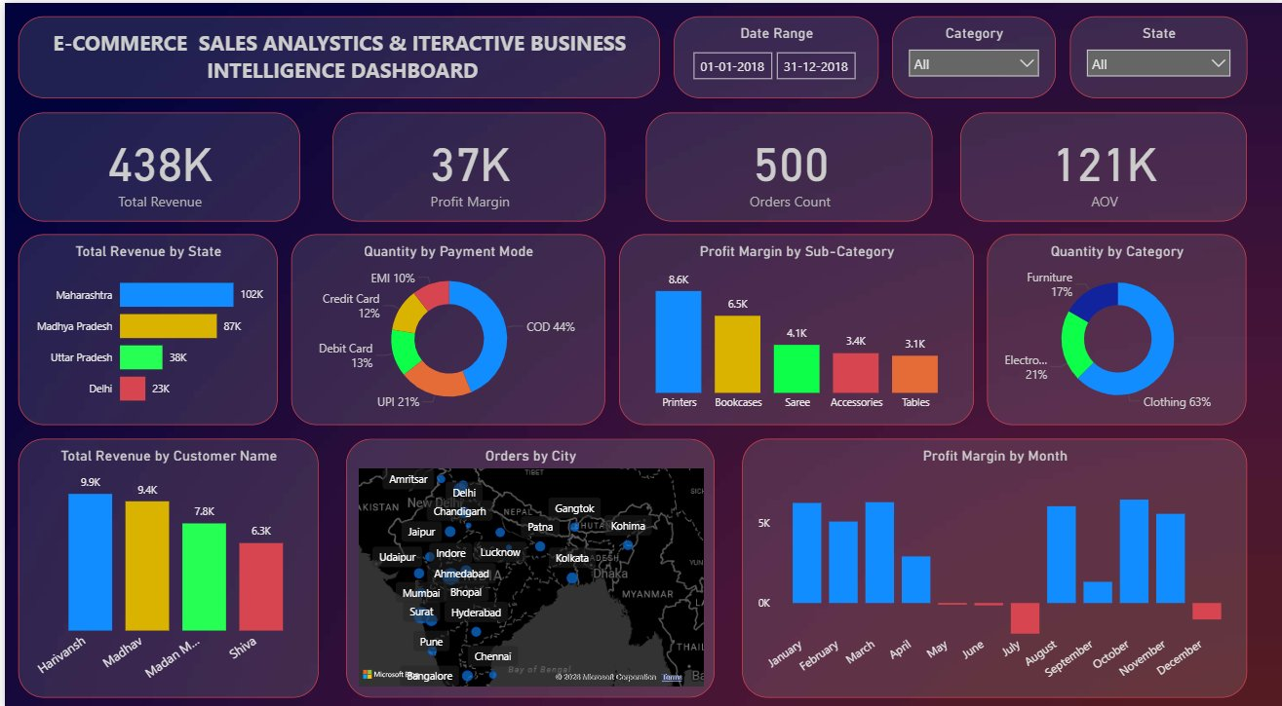
Dashboard Overview
438K
37K
Total Revenue
Profit Margin
500
121K
Orders Count
Avg Order Value
Interactive Filters:
State
Category
Payment Mode
Date Range

Slide 7
Key Insights & Findings

Slide 8
Business Impact
📈 Single Source of Truth
💳 Operational Intelligence
Management can monitor revenue, orders, and profitability from one centralized dashboard — eliminating scattered reports.
Payment mode analytics and customer purchase trends improve operational understanding and marketing targeting.
🗺️ Regional Decision Making
⚡ Reduced Manual Effort
State-wise revenue analysis enables faster, targeted business decisions for high and low performing regions.
Automated reporting reduces manual workload, freeing analysts for higher-value strategic work and building a data culture.
🏷️ Category Optimization
Product quantity and profit-margin insights enable strategic inventory and category management decisions.

Slide 9
Future Enhancements
Phase 1 — Short Term
Phase 2 — Medium Term
Phase 3 — Long Term
1
Add forecasting models for future sales & profit trends
1
Expand SQL integration to automated pipelines
1
Drill-down views for products, customers & return analysis
2
Introduce customer segmentation analytics
2
Near real-time data refresh for live monitoring
2
Advanced alerts, executive scorecards & mobile layouts
.

Slide 10
Thank You
Deepansh Jain
MCA STUDENT
This project demonstrates practical Data Analytics, BI Dashboarding, and Business Storytelling
capability — combining SQL, Power BI, DAX, Data Modeling & Data Cleaning into one business solution.
📧 Email
🔗 LinkedIn
💼 Portfolio
deepanshjain06@email.com
linkedin.com/in/deepanshjain06
github.com/deepanshjain06
438K Revenue
37K Profit
500 Orders
5615 Total Qty

