Slide 1
PROJECT REPORT
By-
Deepansh Nagaria
Abhishek Kumar
Hemant Singh

Slide 2
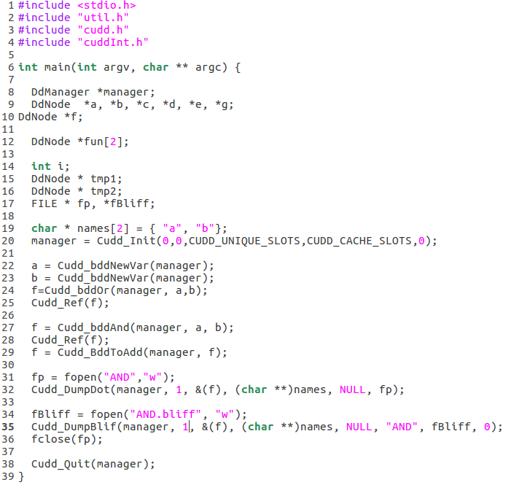
BDD of AND Gate

Slide 3
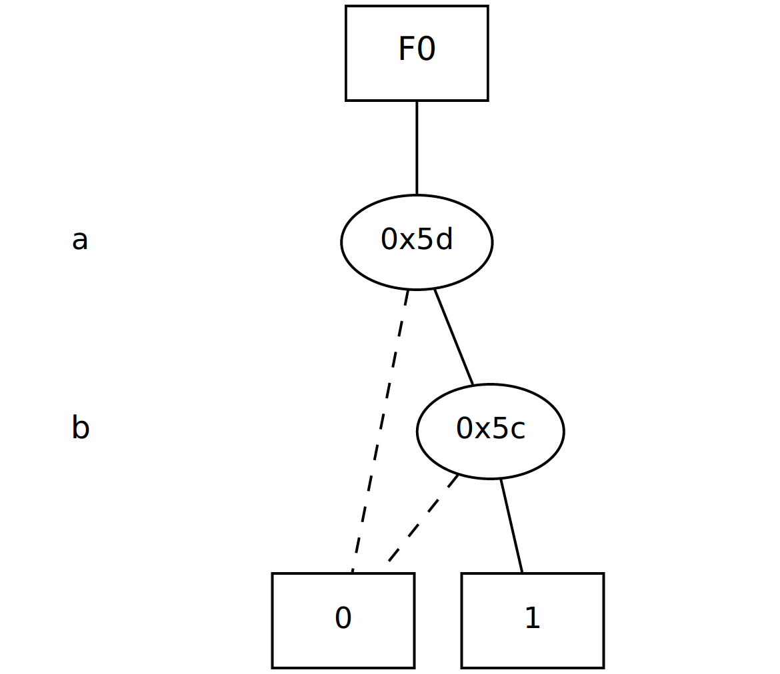
F0=a*b

Slide 4
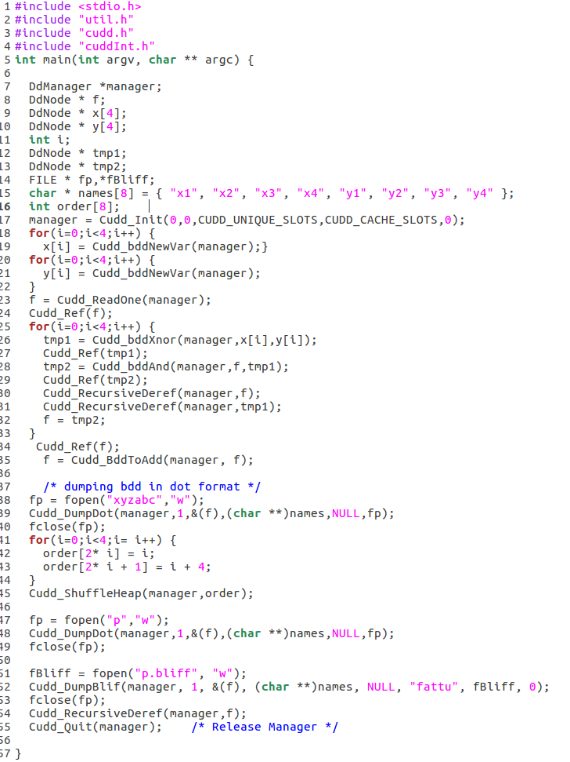
BDD of 8 inputs XOR Gate

Slide 5
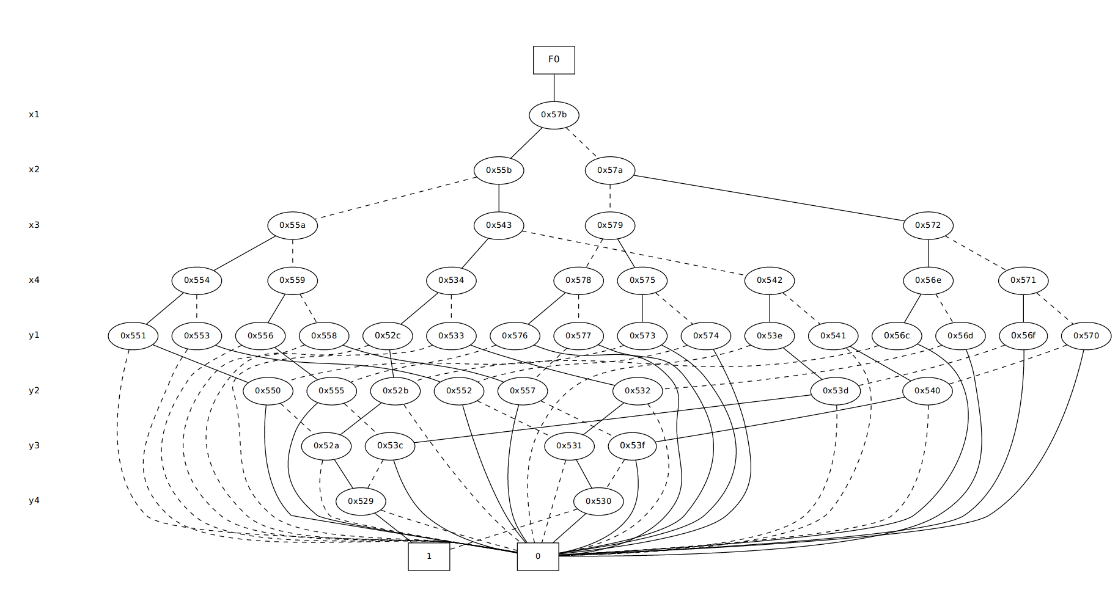

Slide 6
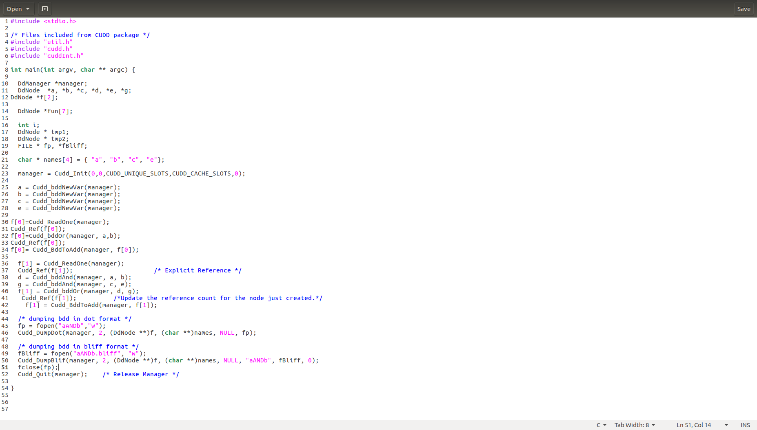
BDD of Multiple Output Functions

Slide 7
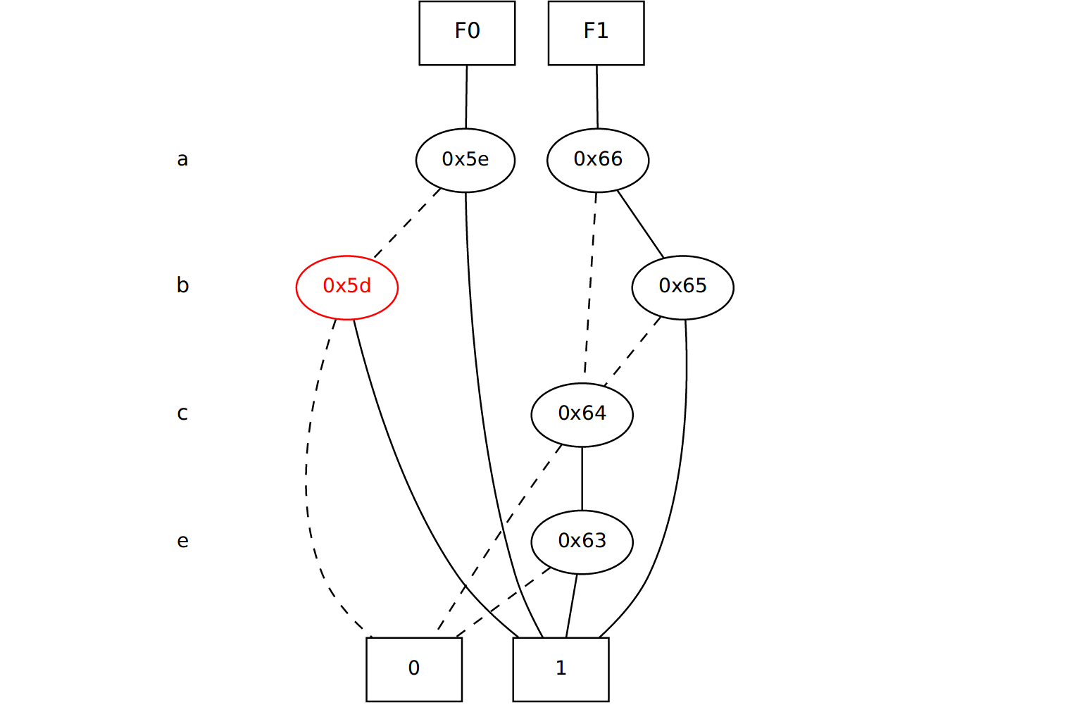
F0=a+b F1=a*b+c*e

Slide 8
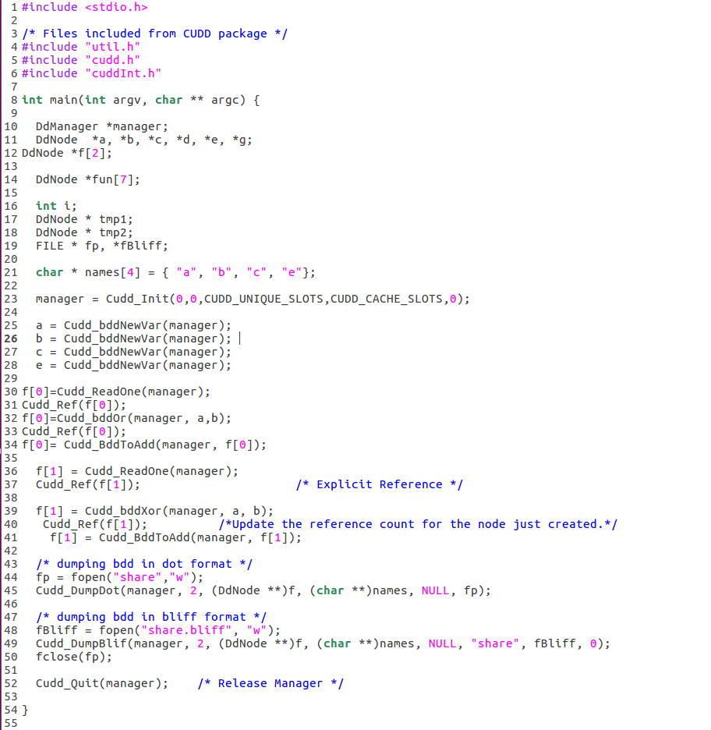
BDD of Node Sharing

Slide 9
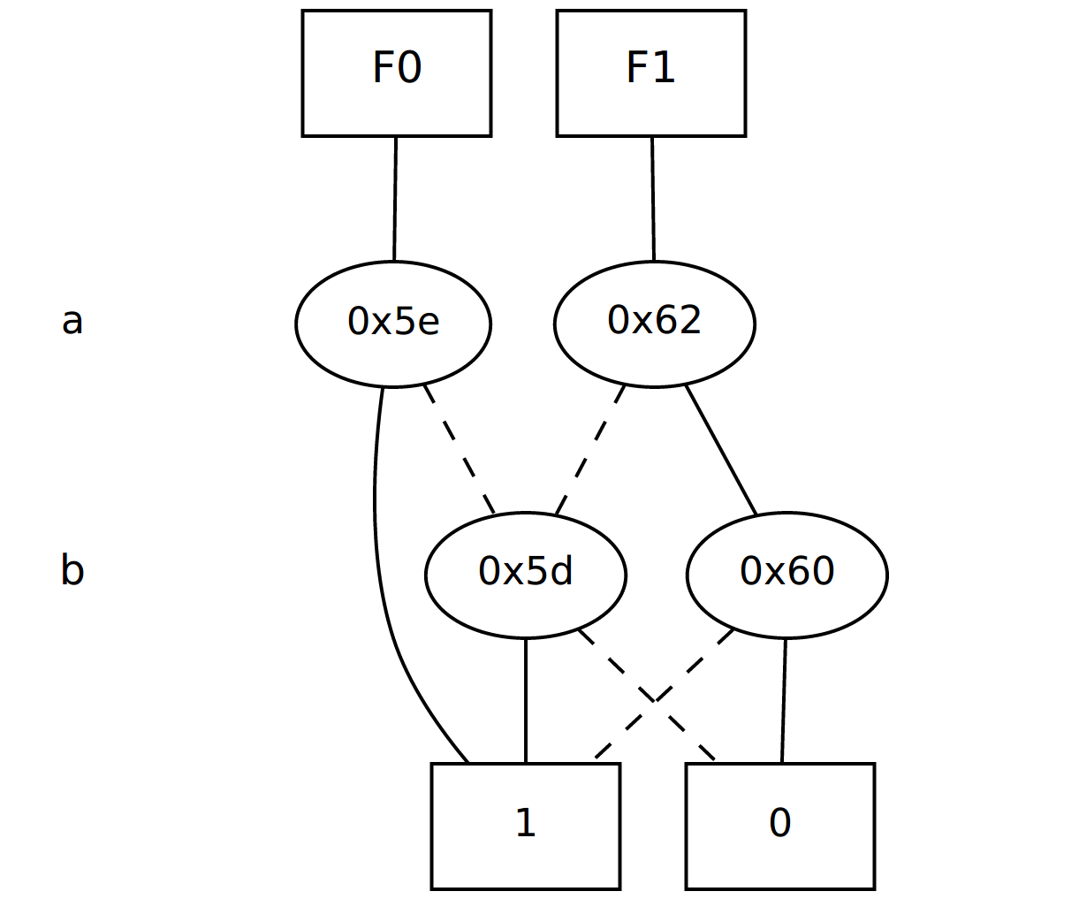
F0=a+b F1=a^b

Slide 10
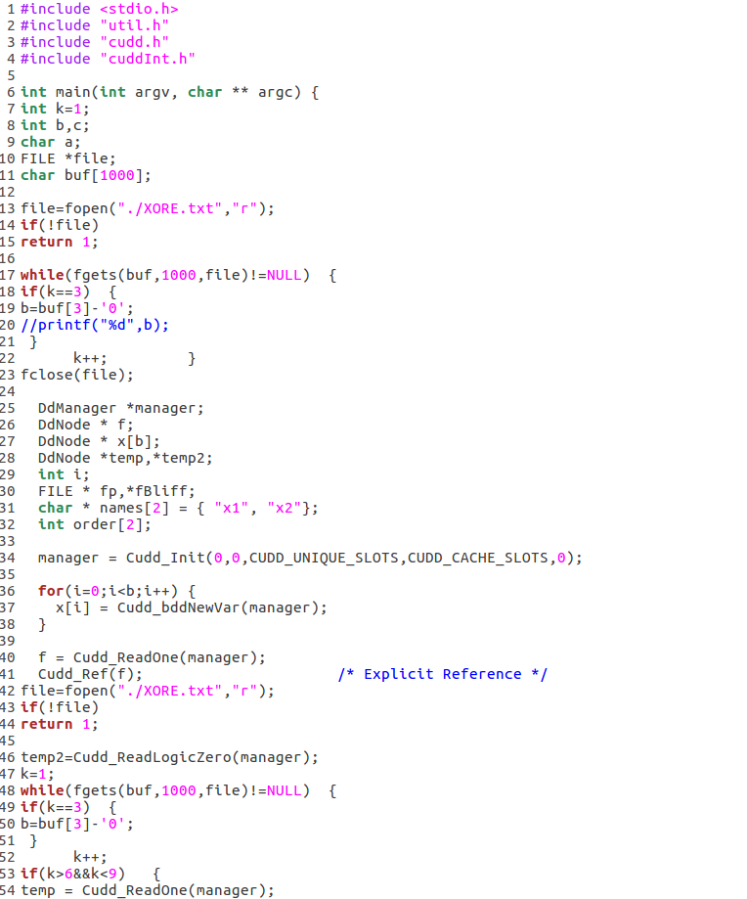
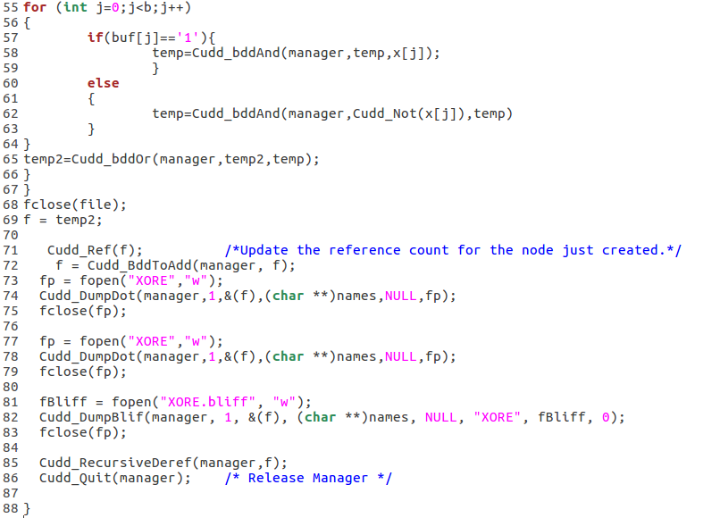
BDD from PLA file

Slide 11
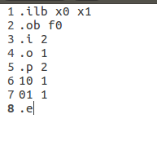
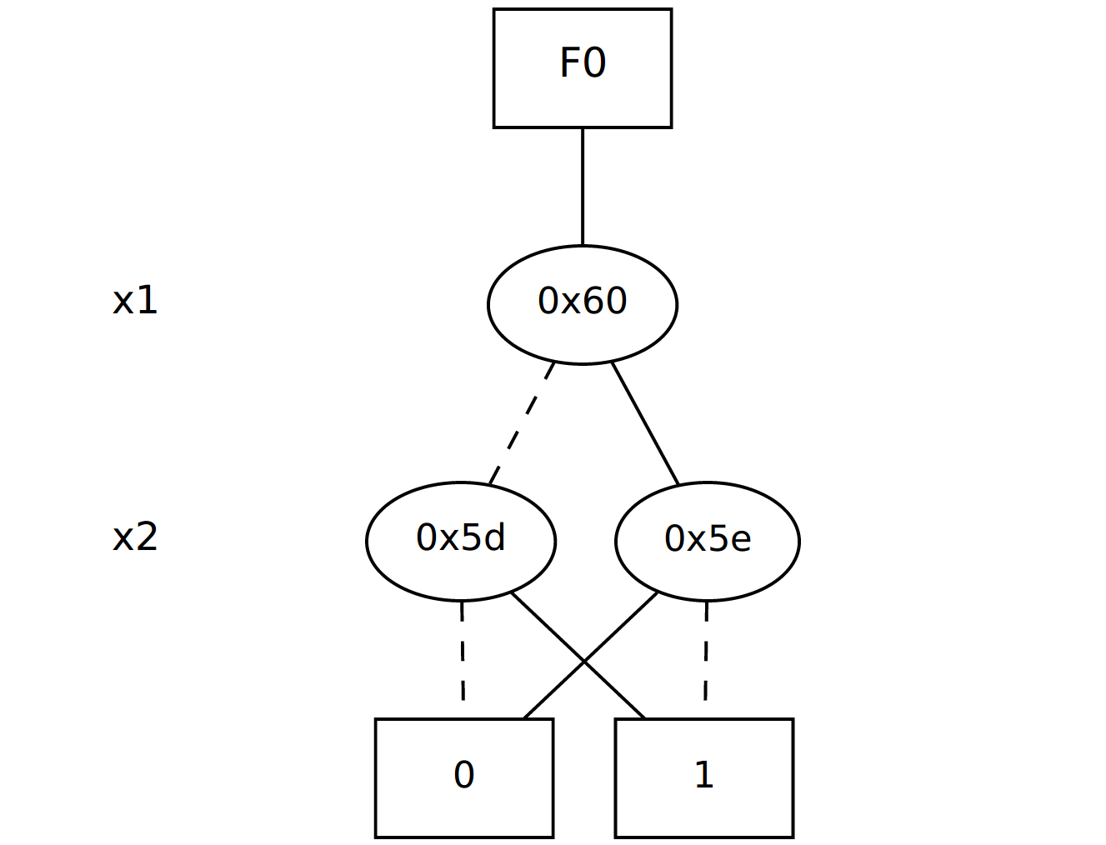
PLA file BDD

Slide 12
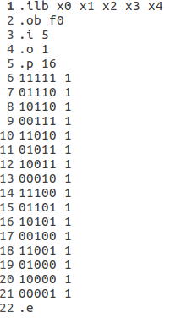
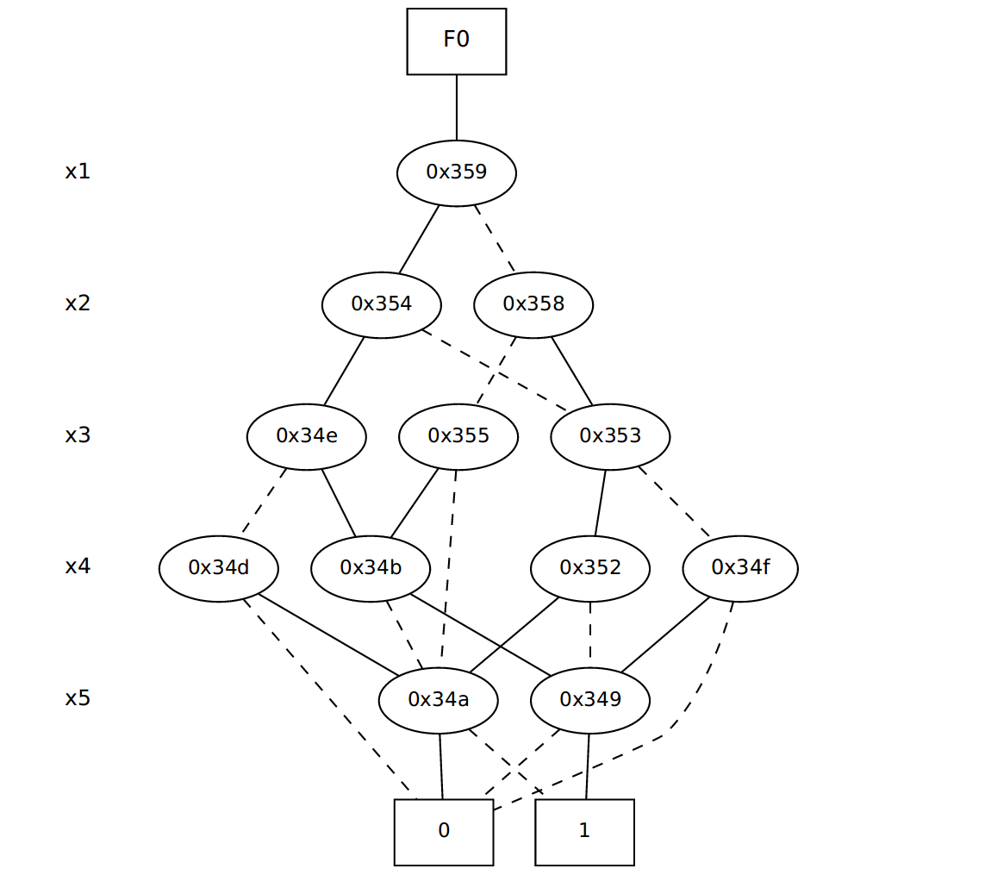
PLA FILE BDD

Slide 13
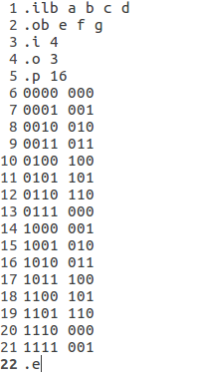
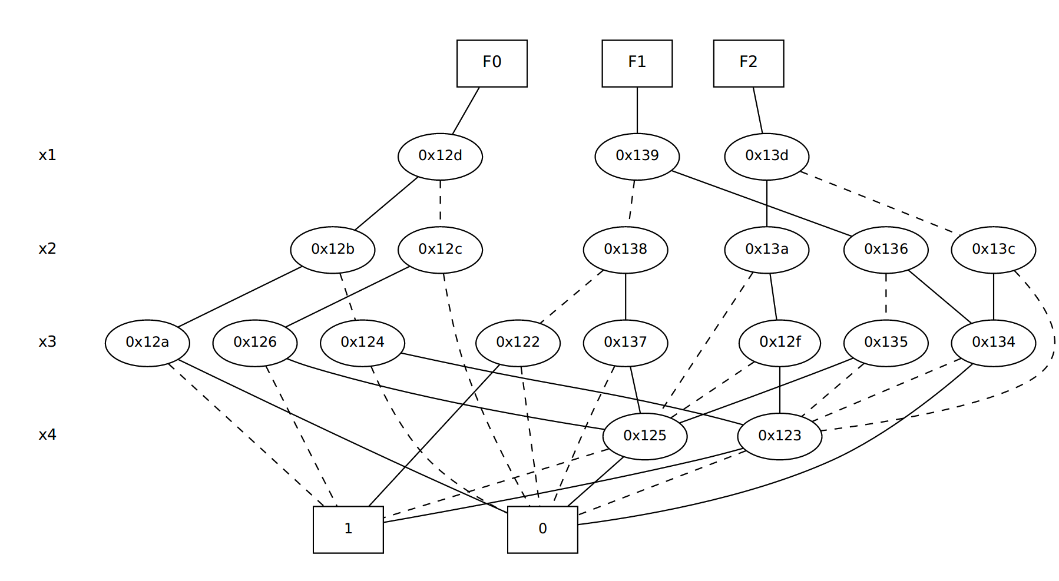
Multiple Outputs from PLA File

Slide 14
Converting dot format into any other format
dot -Tpdf input.dot -o output.pdf
dot -Tpng input.dot -o output.png

