Slide 1

Department of Computer Science and Engineering
Graphic Era (Deemed to be University)
Dehradun, Uttarakhand
January 2023
Mini Project Report on
Cybercrime Detection
Via Machine Learning and Artificial Intelligence
Under the Mentorship of
Dr. Priya Matta
Associate Professor
Department of Computer Science and Engineering
Submitted by:
Name - Deepanshu Gupta
University Roll No. – 2019472

Slide 2
INTRODUCTION
Cybercrimes
Cybercrime, also known as computer crime, refers to any criminal activity that involves the use of computers or the internet.
To combat cybercrime, law enforcement agencies and private companies have developed a variety of tools and techniques to detect and prevent these types of activities.
Cybercrime is carried out by individuals or organizations. [1]
Computer security is important because it allows users to protect their information on the network and in the system (right to privacy).[2] It also helps in defending the computer system against different types of destructive technologies and protects the PC from damage (viruses, worms, bugs, and bacteria).[2] It also helps monitor the network and protects it from different threats.
So, we should use computer security solutions on some level to protect our data from different types of sniffing stolen problems.[2] In general, Computer Security is vital for protecting the confidentiality, integrity, and availability of computer systems, resources, and data.[2] Without confidentiality, trade secrets or personally identifying information can be lost.

Slide 3
INTRODUCTION
Problem Statement: Make a model to detect cybercrime of phishing scams using machine learning and artificial intelligence
Phishing Scam
Phishing can be defined as impersonating a valid site to trick users by stealing their data comprising usernames, passwords, account numbers, national insurance numbers, etc. [3]
There are countless domains where phishing attacks can occur, online payment sector, webmail, financial institution, file hosting or cloud storage, and many others.[3] The most vital objective of the proposed project is to verify the website's validity by capturing blacklisted URLs.
The user can be notified if the blacklisted website is being accessed.
The system involves features like capturing blacklisted websites, viewing the blacklisted website, displaying pop-up notifications, and also displaying email notifications.

Slide 4
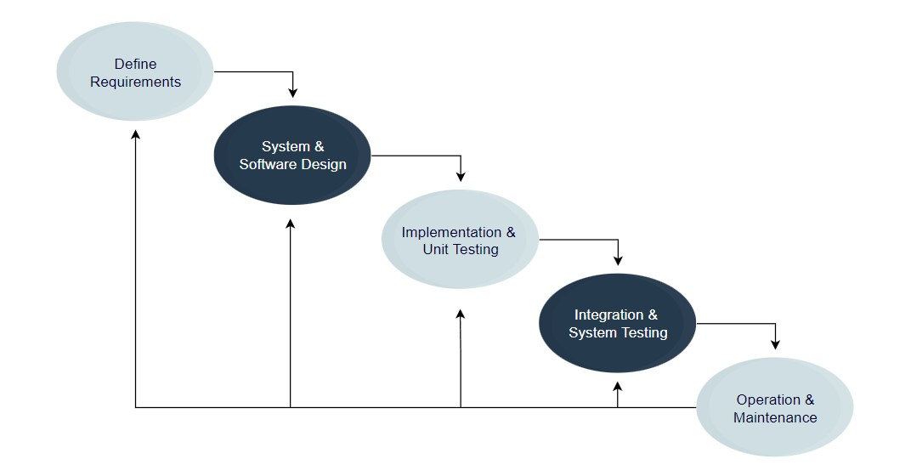
METHODOLOGY
A small-scale survey was done to see which cybercrime has been experienced the most in the region.
The processing model was decided.
Figure 2.1[4] Processing Model

Slide 5
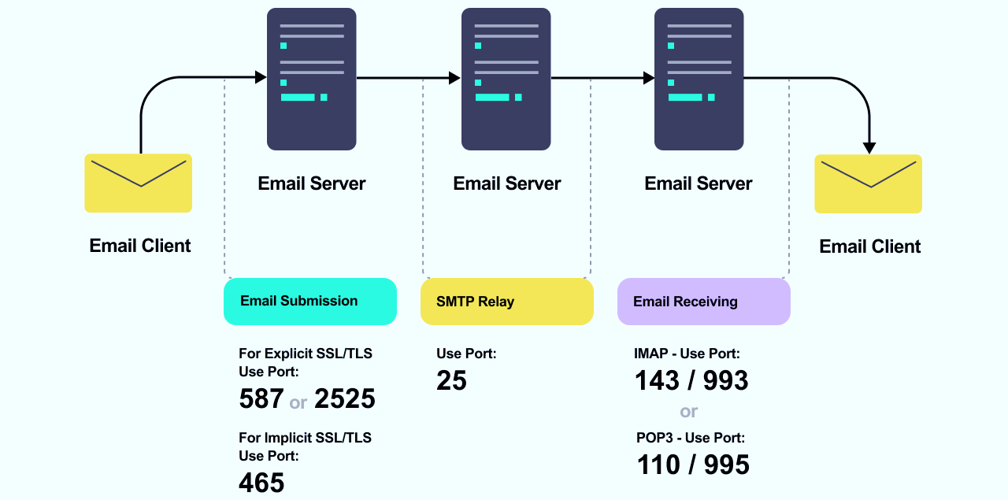
METHODOLOGY
SMTP is the industry standard protocol for sending email. If you’re looking to send email, then you’ll use SMTP instead of IMAP. An SMTP relay service can help you send email without having to build your own SMTP server.
IMAP is one of the most common protocols for receiving email. IMAP syncs messages across all devices.
POP3 is another protocol for receiving email on a single device. Using POP3 means that your email will be accessible offline and deleted from the server.
Figure 2.2 Relation between SMTP, IMAP and POP3

Slide 6
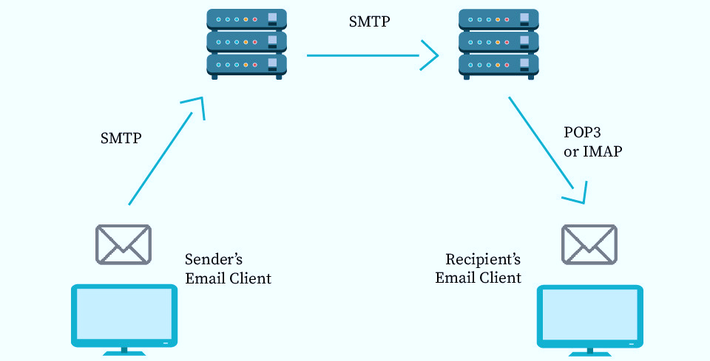
METHODOLOGY
The SMTP client will connect to the SMTP server. The email is transferred using that connection. The client and the server terminate the connection. When a user checks for a new email, the client makes a connection to the POP3 or IMAP server. The email client then provides the server with its username and password for authentication.
Figure 2.3 Working Processor of SMTP, IMAP, and POP3

Slide 7
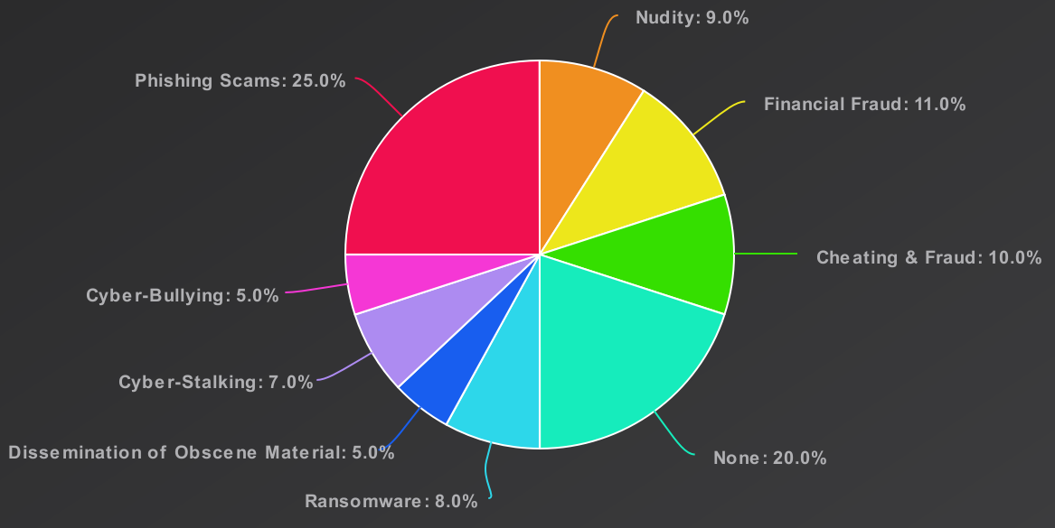
RESULT AND DISCUSSION
Maximum Occupancy
Figure 3.1 Cyber-crime Experienced Chart

Slide 8
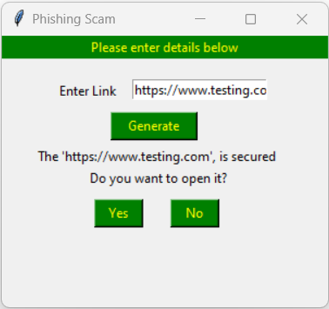
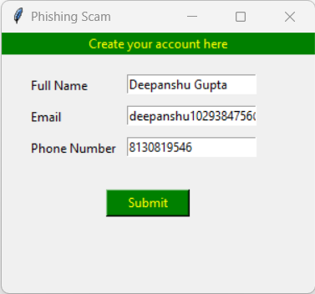
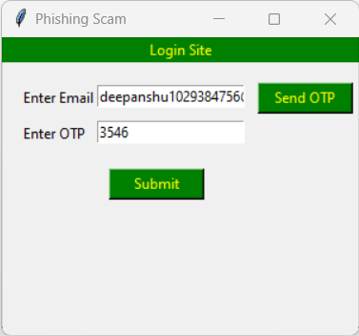
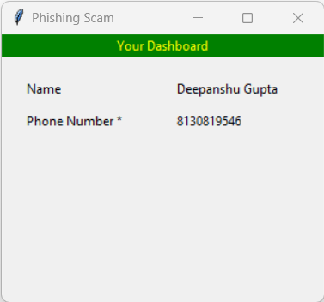
RESULT AND DISCUSSION
Figure 3.2 Sample User Interface to check URL (Step 1)
Figure 3.3 Sample User Interface to create account (Step 2)
Figure 3.4 Sample User Interface for 2-steps Verification (Step 3)
Figure 3.5 Sample User Interface to login account (Step 4)

Slide 9
CONCLUSION AND FUTURE WORK
Conclusion
With all the data and research, it won’t be an issue to say that phishing is one crime that has a wide area and methods to be implemented and cover most parts of cybercrime in the country.
Our work gives you the method to fight against phishing websites spread all over the internet and also the two-way authentication method to prevent using important words and numbers that can be used against us in any way possible.
Future work
The Model is limited to only one cybercrime and also it is based on the web application, in the future, wants to cover most of the cybercrimes with one solution and wants to make it an inbuilt function that can be used as pop-ups whenever it senses any malicious activity.

Slide 10
REFERENCES
[1] Mariam M.H.Alansari, Zainab Aljazzaf, Muhammad Sarfraz: “On Cybercrime and cyber security”.
[2] Ms. M Lakshmi Prasanthi, Tata A S K Ishwarya: “Cyber Crime: Prevention & Detection”, International Journal of Advanced Research in Computer and Communication Engineering Vol. 4, Issue 3, March 2015.
[3] Mohammed Hazim Alkawaz, Stephanie Joanne Steven, Asif Iqbal Hajamydeen: “Detecting Phishing Website Using Machine Learning”, 2020 16th IEEE International Colloquium on Signal Processing & its Applications (CSPA 2020), 28-29 Feb. 2020, Langkawi, Malaysia.
[4] https://www.educative.io/blog/software-process-model-types

Slide 11
Thank You

