Slide 1
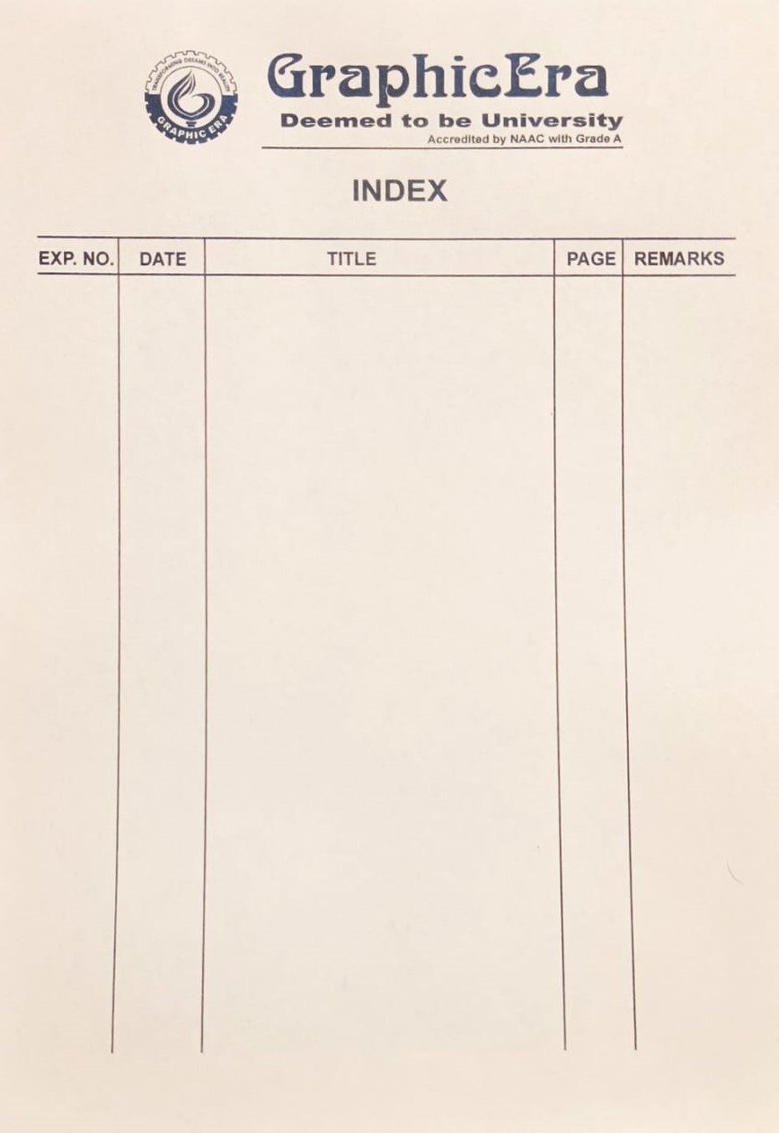
1.
2.
3.
4.
5.
Given an array of non-negative integers, design a linear algorithm and implement it using a program to find whether a given key element is present in the array or not. Also, find the total number of comparisons for each input case.
Given an already sorted array of positive integers, design An algorithm and implement it using a program to find whether a given key element is present in the array. Also, find a total number of comparisons for each input case.
Given an already sorted array of positive integers, design an algorithm and implement it using a program to find whether a given key element is present in the sorted array or not. For an array arr[n], search at the indexes arr[0], arr[2], arr[4], ....., arr[2k] and so on. Once the interval (arr[2k] < key < arr[ 2k+1] ) is found, perform a linear search operation from the index 2k to find the element key.
Given a sorted array of positive integers containing few duplicate elements, design an algorithm and implement it using a program to find whether the given key element is present in the array or not. If present, then also find the number of copies of given key.
Given a sorted array of positive integers, design an algorithm and implement it using a program to find three indices i, j, k such that arr[i] + arr[j] = arr[k].
1-4
5-8
9-12
13-16
17-20

Slide 2
6
7.
8.
9.
10.
Given an array of nonnegative integers, design an algorithm and a program to count the number of pairs of integers such that their difference is equal to a given key, K.
Given an unsorted array of integers, design an algorithm and a program to sort the array using insertion sort. Your program should be able to find number of comparisons and shifts ( shifts -
total number of times the array elements are shifted from their place) required for sorting the array.
Given an unsorted array of integers, design an algorithm and implement a program to sort this array using selection sort. Your program should also find number of comparisons and number of swaps required.
Given an unsorted array of positive integers, design an algorithm and implement it using a program to find whether there are any duplicate elements in the array or not.
Given an unsorted array of integers, design an algorithm and implement it using a program to sort an array of elements by dividing the array into two subarrays and combining these subarrays after sorting each one of them. Your program should also find number of comparisons and inversions during sorting the array.
21-23
24-27
28-31
32-34
35-38

Slide 3
11.
12.
13.
14.
15.
Given an unsorted array of integers, design an algorithm and implement it using a program to sort an array of elements by partitioning the array into two subarrays based on a pivot element such that one of the sub array holds values smaller than the pivot element while another sub array holds values greater than the pivot element. Pivot element should be selected randomly from the array. Your program should also find number of comparisons and swaps required for sorting the array.
Given an unsorted array of integers, design an algorithm and Implement it using a program to find Kth smallest or largest element in the array.
Given an unsorted array of alphabets containing duplicate elements. Design an algorithm and implement it using a program to find which alphabet has maximum number of occurrences and print it.
Given an unsorted array of integers, design an algorithm and implement it using a program to find whether two elements exist such that their sum is equal to the given key element.
You have been given two sorted integer arrays of size m and n. Design an algorithm and implement it using a program to find list of elements which are common to both.
39-42
43-46
47-49
50-52
53-55

Slide 4
16.
17.
18.
19.
Given a (directed/undirected) graph, design an algorithm and implement it using a program to find if a path exists between two given vertices or not.
Given a graph, design an algorithm and implement it using a program to find if a graph is bipartite or not.
Given a directed graph, design an algorithm and implement it using a program to find whether cycle exists in the graph or not.
After end term examination, Akshay wants to party with his friends. All his friends are living as paying guest and it has been decided to first gather at Akshay’s house and then move towards party location. The problem is that no one knows the exact address of his house in the city. Akshay as a computer science wizard knows how to apply his theory subjects in his real life and came up with an amazing idea to help his friends. He draws a graph by looking in to location of his house and his friends’ location (as a node in the graph) on a map. He wishes to find out shortest distance and path covering that distance from each of his friend’s location to his house and then whatsapp them this path so that they can reach his house in minimum time. Akshay has developed the program that implements Dijkstra’s algorithm but not sure about correctness of results. Can you also implement the same algorithm and verify the correctness of Akshay’s results?
56-57
58-59
60-62
63-65

Slide 5
20.
21.
22.
23.
24.
Design an algorithm and implement it using a program to solve previous question's problem using Bellman- Ford's shortest path algorithm.
Given a directed graph with two vertices. Design an algorithm and implement it using a program to find the weight of the shortest path from source to destination with exactly k edges on the path.
Assume that a project of road construction to connect some cities is given to your friend. Map of these cities and roads which will connect them is provided to him in the form of a graph. Certain amount of rupees is associated with construction of each road. Your friend has to calculate the minimum budget required for this project. The budget should be designed in such a way that cost of connecting the cities should be minimum and no. of roads required to connect all the cities should be minimum. He asks you for help. Now, you have to help your friend by designing an algorithm which will find minimum cost required to connect these cities. (use Prim's algorithm)
Implement the previous problem using Kruskal's algorithm.
Assume that same road construction project is given to another person. The amount he will earn from this project is directly proportional to the budget of the project. This person is greedy, so he decided to maximize the budget by constructing those roads who have highest construction cost. Design an algorithm and implement it using a program to find the maximum budget required for the project.
66-68
69-70
71-73
74-76
77-79

Slide 6
25.
26.
27.
28.
Given a graph, Design an algorithm and implement it using a program to implement Floyd Warshall all pair shortest path algorithm. Given an unsorted array of integers, design an algorithm and Implement it using a program to find Kth smallest or largest element in the array.
Given a knapsack of maximum capacity w. N items are provided, each having its own value and weight. You have to Design an algorithm and implement it using a program to find the list of the selected items such that the final selected content has weight w and has maximum value. You can take fractions of items, i.e. the items can be broken into smaller pieces so that you have to carry only a fraction xi of item i, where 0 ≤xi≤ 1.
Given an array of elements. Assume arr[i] represents the size of file i. Write an algorithm and a program to merge all these files into single file with minimum computation. For given two files A and B with sizes m and n, computation cost of merging them is O(m+n).
Given a list of activities with their starting time and finishing time. Your goal is to select maximum number of activities that can be performed by a single person such that selected activities must be non-conflicting. Any activity is said to be non-conflicting if starting time of an activity is greater than or equal to the finishing time of the other activity. Assume that a person can only work on a single activity at a time.
80-81
82-83
84
85-86

Slide 7
29.
30.
31.
32.
33.
Given a long list of tasks. Each task takes specific time to accomplish it and each task has a deadline associated with it. You have to design an algorithm and implement it using a program to find maximum number of tasks that can be completed without crossing their deadlines and also find list of selected tasks.
Given an unsorted array of elements, design an algorithm and implement it using a program to find whether majority element exists or not. Also find median of the array. A majority element is an element that appears more than n/2 times, where n is the size of array.
Given a sequence of matrices, write an algorithm to find most efficient way to multiply these matrices together. To find the optimal solution, you need to find the order in which these matrices should be multiplied.
Given a set of available types of coins. Let suppose you have infinite supply of each type of coin. For a given value N, you have to Design an algorithm and implement it using a program to find number of ways in which these coins can be added to make sum value equals to N.
Given a set of elements, you have to partition the set into two subsets such that the sum of elements in both subsets is same. Design an algorithm and implement it using a program to solve this problem.
87-89
90-91
92-93
94-95
96-97

Slide 8
34.
35.
36.
37.
38.
39.
Given two sequences, Design an algorithm and implement it using a program to find the length of longest subsequence present in both of them. A subsequence is a sequence that appears in the same relative order, but not necessarily contiguous.
Given a knapsack of maximum capacity w. N items are provided, each having its own value and weight. Design an algorithm and implement it using a program to find the list of the selected items such that the final selected content has weight <= w and has maximum value. Here, you cannot break an item i.e. either pick the complete item or don't pick it. (0-1 property)
Given a string of characters, design an algorithm and implement it using a program to print all possible permutations of the string in lexicographic order.
Given an array of characters, you have to find distinct characters from this array. Design an algorithm and implement it using a program to solve this problem using hashing.
Given an array of integers of size n, design an algorithm and write a program to check whether this array contains duplicate within a small window of size k < n.
Given an array of nonnegative integers, Design an algorithm and implement it using a program to find two pairs (a,b) and (c,d) such that a*b = c*d, where a, b, c and d are distinct elements of array
98-99
100-101
102-103
104-105
106-107
108-109

Slide 9
40.
41.
Given a number n, write an algorithm and a program to find nth ugly number. Ugly numbers are those numbers whose only prime factors are 2, 3 or 5. The sequence 1, 2, 3, 4, 5, 6, 8, 9, 10, 12, 15, 16, 18, 20, 24,..... is sequence of ugly numbers.
Given a directed graph, write an algorithm and a program to find mother vertex in a graph. A mother vertex is a vertex v such that there exists a path from v to all other vertices of the graph.
110-111
112-114

