Slide 1

Road Accident Analysis and Safety Insights
Deepanshu Kawale
© All rights reserved by Fireblaze Technologies Pvt. Ltd.

Slide 2
Problem Statement
Road accidents are a major public safety issue causing loss of life and property.
It is difficult to identify accident-prone locations and peak accident times.
Key factors like weather, road type, and traffic conditions affect accidents.
There is a need to analyze accident data to find patterns and trends.
The insights can help improve road safety and support better decision-making.
© All rights reserved by Fireblaze Technologies Pvt. Ltd.

Slide 3
About the Data
The dataset was downloaded from Kaggle and initially contained approximately 2 lakh records and 47 columns.
After data cleaning, the dataset was reduced to 199,320 rows and 21 columns by removing unwanted columns.
The cleaned dataset was used for further analysis.
© All rights reserved by Fireblaze Technologies Pvt. Ltd.

Slide 4
Tools & Techniques
Excel: Data cleaning, duplicate removal, missing value handling
SQL: Data querying and aggregation using SELECT, GROUP BY, JOIN
Python (Pandas, Matplotlib, Seaborn): Data analysis, visualization, and pattern detection
Power BI: Dashboard creation and data visualization using DAX measures
© All rights reserved by Fireblaze Technologies Pvt. Ltd.

Slide 5
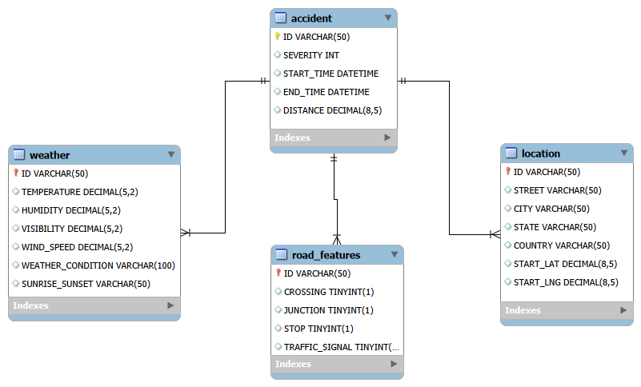
ER Diagram
© All rights reserved by Fireblaze Technologies Pvt. Ltd.

Slide 6
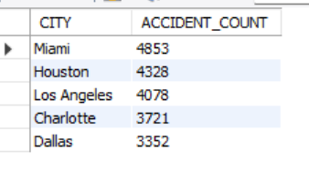
SQL-Based Data Insights
Which cities have highest accident counts?
Explanation:
SELECT L.CITY, COUNT(A.ID) AS ACCIDENT_COUNT FROM ACCIDENT A INNER JOIN LOCATION L ON A.ID= L.ID GROUP BY L.CITY ORDER BY COUNT(A.ID) DESC LIMIT 5;
This analysis finds cities with the highest number of accidents by counting accidents per city using joined accident and location data.
Solution:
These cities have the highest accident counts, so they should be prioritized for further investigation and safety planning based on data insights
© All rights reserved by Fireblaze Technologies Pvt. Ltd.

Slide 7
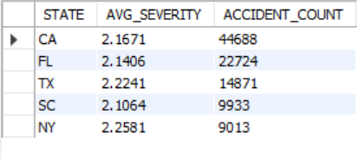
SQL-Based Data Insights
Which states have the highest number of accidents, and what is the average severity in those states?
Explanation:
SELECT L.STATE, AVG(A.SEVERITY) AS AVG_SEVERITY, COUNT(A.ID) AS ACCIDENT_COUNT FROM ACCIDENT A INNER JOIN LOCATION L ON A.ID= L.ID GROUP BY L.STATE ORDER BY ACCIDENT_COUNT DESC LIMIT 5;
Check average accident severity in each state
Identify high-risk states for comparison
Focus on top 5 states for easy analysis
Solution:
These states have the highest accident counts, so they should be analyzed further to understand accident patterns and support data-driven safety decisions.
© All rights reserved by Fireblaze Technologies Pvt. Ltd.

Slide 8
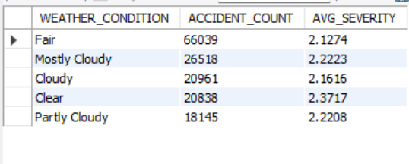
SQL-Based Data Insights
Accidents Based on Weather Conditions
SELECT W.WEATHER_CONDITION, COUNT(A.ID) AS ACCIDENT_COUNT, AVG(SEVERITY) AS AVG_SEVERITY FROM WEATHER W INNER JOIN ACCIDENT A ON W.ID=A.ID GROUP BY WEATHER_CONDITION ORDER BY ACCIDENT_COUNT DESC LIMIT 5;
Explanation:
We are analyzing how different weather conditions affect road accidents. The goal is to understand whether weather increases accident risk and severity
Solution:
Use weather alert systems for drivers
Improve visibility during fog and rain
Give safe driving warnings in bad weather
Add warning signs in risky weather conditions
© All rights reserved by Fireblaze Technologies Pvt. Ltd.

Slide 9
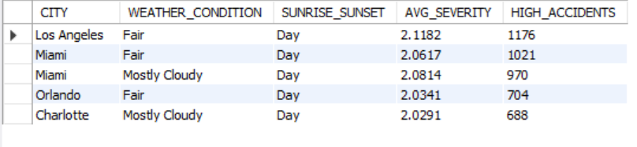
SQL-Based Data Insights
City-wise Accident Frequency & Severity by Weather and Time
SELECT L.CITY, W.WEATHER_CONDITION, W.SUNRISE_SUNSET, AVG(A.SEVERITY) AS AVG_SEVERITY , COUNT(A.ID) AS HIGH_ACCIDENTS FROM ACCIDENT A INNER JOIN LOCATION L ON A.ID=L.ID INNER JOIN WEATHER W ON A.ID=W.ID GROUP BY L.CITY,W.WEATHER_CONDITION ,W.SUNRISE_SUNSETORDER BY HIGH_ACCIDENTS DESC LIMIT 5;
Explanation:
Cities with the highest accidents
Weather conditions during accidents
Whether accidents happen more in day or night
Accident severity in different situations
Solution:
Provide weather and time-based driving alerts
Improve safety measures in high-accident cities
Increase driver awareness during risky conditions
Focus accident prevention in accident-prone areas
© All rights reserved by Fireblaze Technologies Pvt. Ltd.

Slide 10
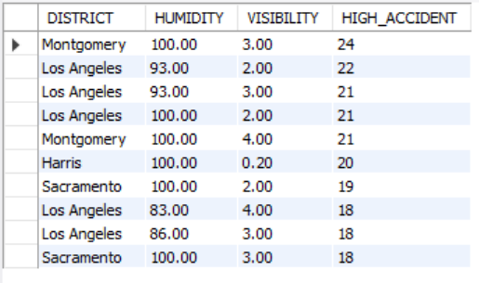
SQL-Based Data Insights
District-wise Accident Analysis in Low Visibility & High Humidity Conditions
SELECT L.DISTRICT, W.HUMIDITY, W.VISIBILITY, COUNT(A.ID) AS HIGH_ACCIDENTFROM ACCIDENT AJOIN LOCATION L ON A.ID=L.IDJOIN WEATHER W ON A.ID=W.IDWHERE W.HUMIDITY > 70 AND W.VISIBILITY < 5 GROUP BY L.DISTRICT, W.HUMIDITY, W.VISIBILITY ORDER BY HIGH_ACCIDENT DESC LIMIT 10;
Explanation:
This query helps identify districts with more accidents during:
High humidity and Low visibility conditions
It helps analyze accident risk in bad weather environments.
Solution:
Improve visibility support in risky areas
Use weather warning alerts for drivers
Add caution signs in low-visibility zones
Encourage careful driving during adverse weather conditions
© All rights reserved by Fireblaze Technologies Pvt. Ltd.

Slide 11
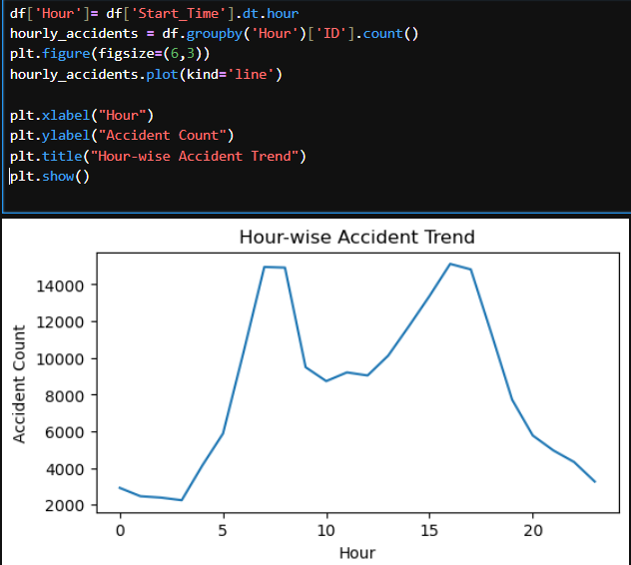
Python-Based Data Visualization Insights
Hour-wise Accident Analysis
Explanation:
This code extracts the hour from accident start time and groups data to count accidents for each hour. It helps to understand at what time accidents happen most.
Solution:
Increase traffic control and safety measures during peak traffic hours to reduce accidents. Focus should be on better signal management, awareness, and monitoring.
© All rights reserved by Fireblaze Technologies Pvt. Ltd.

Slide 12
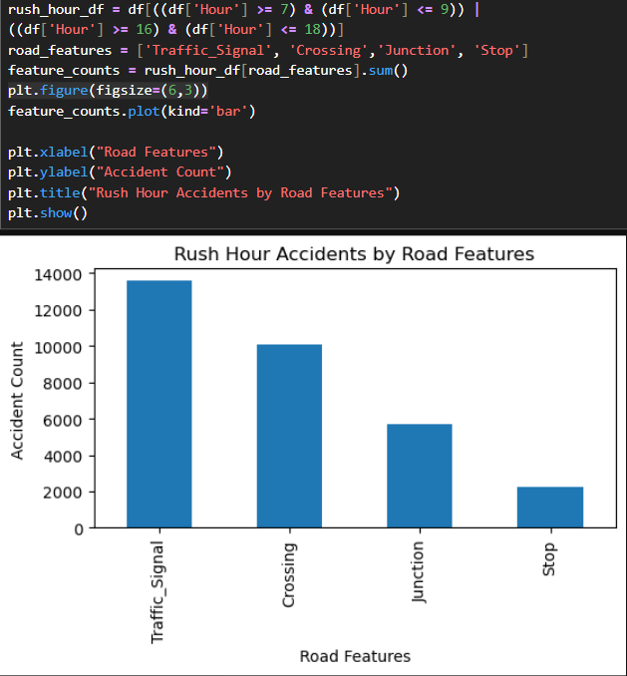
Python-Based Data Visualization Insights
Accident Trends by Road Features During Rush Hours
Explanation:
This code filters rush hour data and counts accidents based on road features like traffic signals, crossings, junctions, and stops. It helps to find which road elements contribute more to accidents.
Solution:
Improve road infrastructure and safety measures at traffic signals, crossings, junctions, and stop areas. Better monitoring and traffic management can reduce accidents in these locations.
© All rights reserved by Fireblaze Technologies Pvt. Ltd.

Slide 13
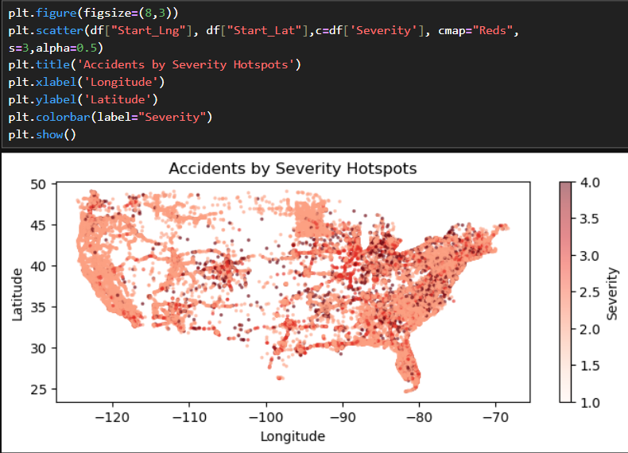
Python-Based Data Visualization Insights
Accident Severity Hotspots on Map
Explanation:
This code uses latitude and longitude to plot accident locations and color-codes them based on severity. It helps to identify high-risk geographic areas..
Solution:
Improve safety measures in high-risk accident locations identified from the map
© All rights reserved by Fireblaze Technologies Pvt. Ltd.

Slide 14
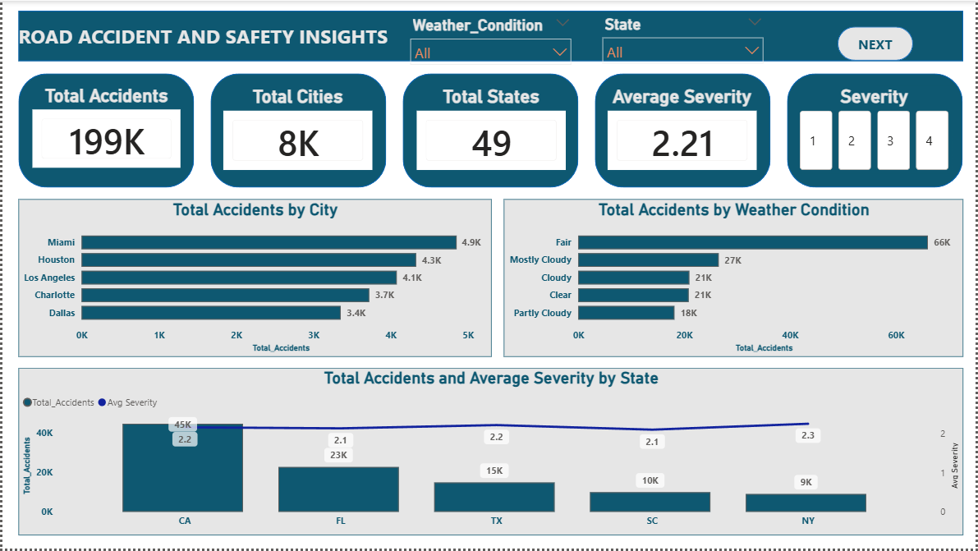
Power BI Dashboard
© All rights reserved by Fireblaze Technologies Pvt. Ltd.

Slide 15
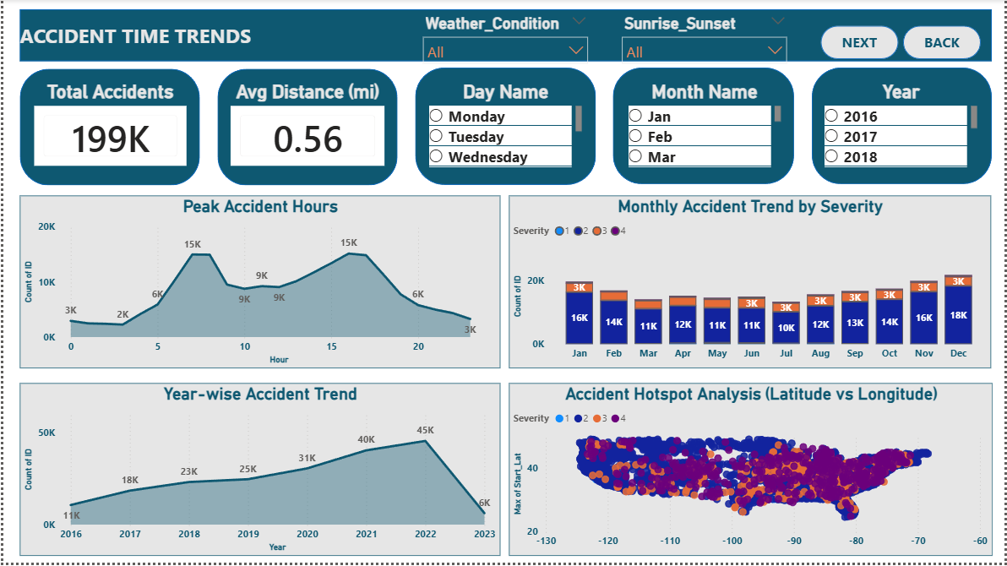
Power BI Dashboard
© All rights reserved by Fireblaze Technologies Pvt. Ltd.

Slide 16
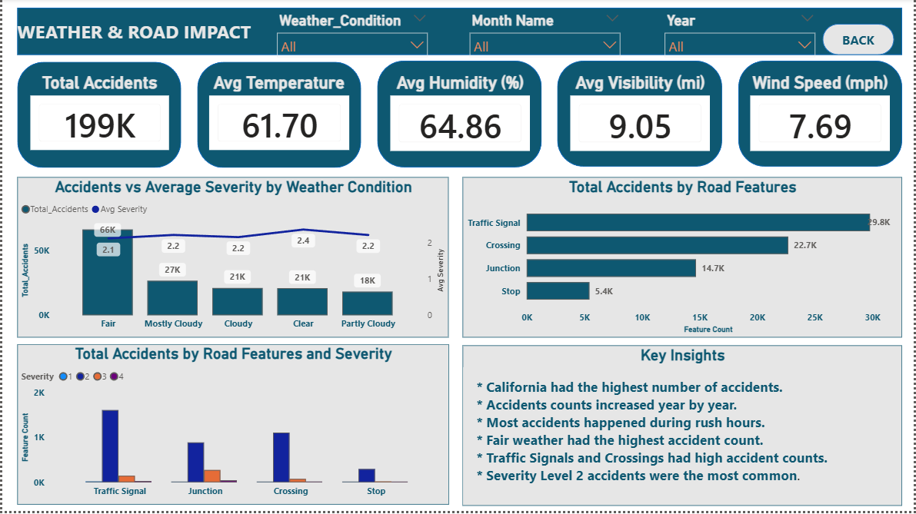
Power BI Dashboard
© All rights reserved by Fireblaze Technologies Pvt. Ltd.

Slide 17
Proposed Solution
Increase traffic control and monitoring in high accident cities.
Provide weather-based alerts to reduce accidents in risky conditions.
Upgrade safety systems at signals, crossings, and junctions.
Focus on improving safety at junctions and crossings where severity is high.
Increase police presence and control traffic during peak accident hours.
Implement stronger road safety rules to control yearly accident growth.
Install warning boards and speed control systems in accident hotspot areas.
Issue driving alerts and reduce speed limits during bad weather conditions.
Improve road safety systems during low visibility and extreme weather conditions.
Improve road design and signage at high-risk traffic points.
© All rights reserved by Fireblaze Technologies Pvt. Ltd.

Slide 18
Conclusion
The analysis shows that road accidents are strongly influenced by time, weather, and road conditions. Peak traffic hours and poor visibility conditions increase accident risk. Certain road locations such as junctions and crossings are more accident-prone. Also, a few cities and states consistently report higher accident numbers, indicating the need for targeted safety improvements. Overall, accidents are driven by a combination of traffic density, environmental conditions, and infrastructure quality
© All rights reserved by Fireblaze Technologies Pvt. Ltd.

Slide 19
Future Scope
Develop real-time accident prediction system using AI and machine learning.
Integrate live weather and traffic data for early warning alerts.
Build smart traffic management systems for high-risk cities.
Use GPS-based monitoring to identify and control accident hotspots.
Improve emergency response systems with faster alert mechanisms.
© All rights reserved by Fireblaze Technologies Pvt. Ltd.

Slide 20
Thank You
© All rights reserved by Fireblaze Technologies Pvt. Ltd.

