Slide 1
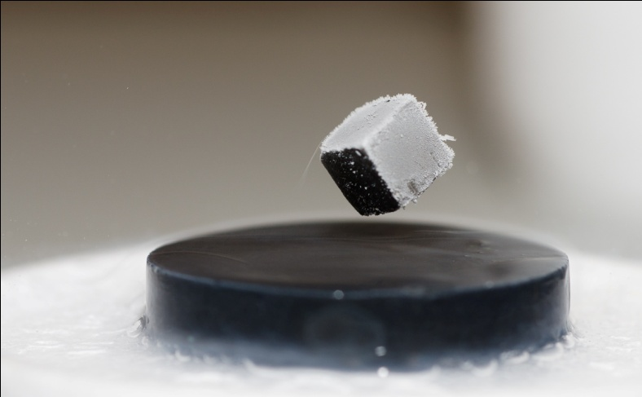
SUPERCONDUCTIVITY
Lecture 5
Energy band gap in superconductors
Flux quantization and Josephson Diode

Slide 2
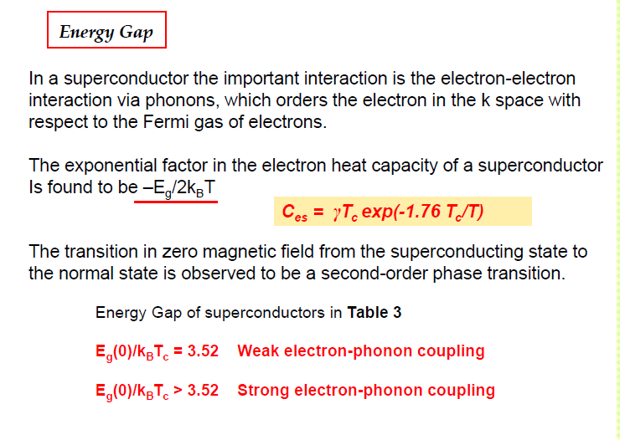

Slide 3
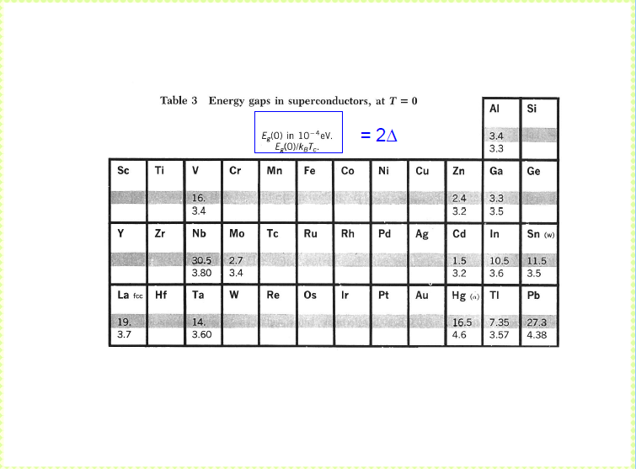

Slide 4
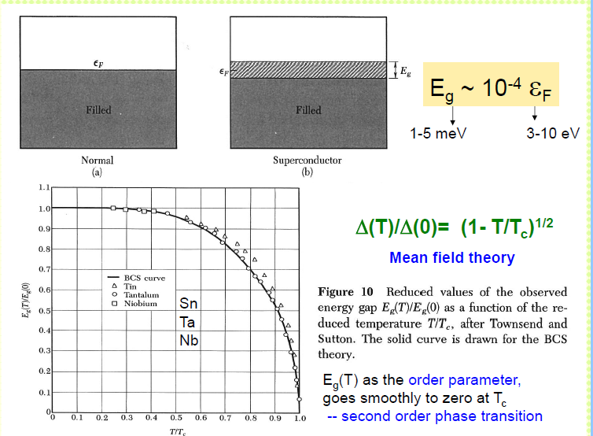

Slide 5
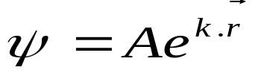
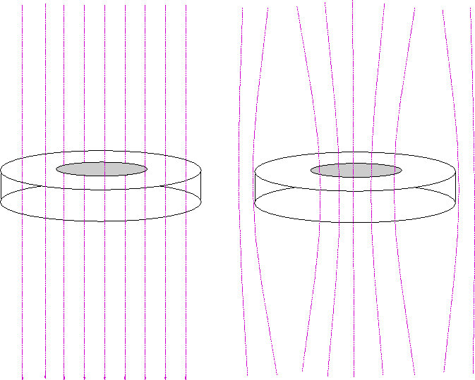
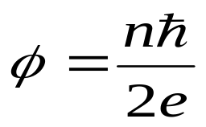
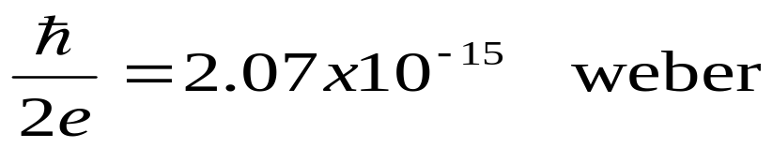
11. Flux Quantization
The persistent current in a superconductor can be accounted for through the application of quantum law, according to which the persistent current in a superconducting ring is a consequence of the quantization of the electronic states. As a consequence of which the flux in a closed superconducting loop is also quantized.
Free electron wave function is given as
Magnetic flux within the superconducting loop is quantized and is given as

Slide 6
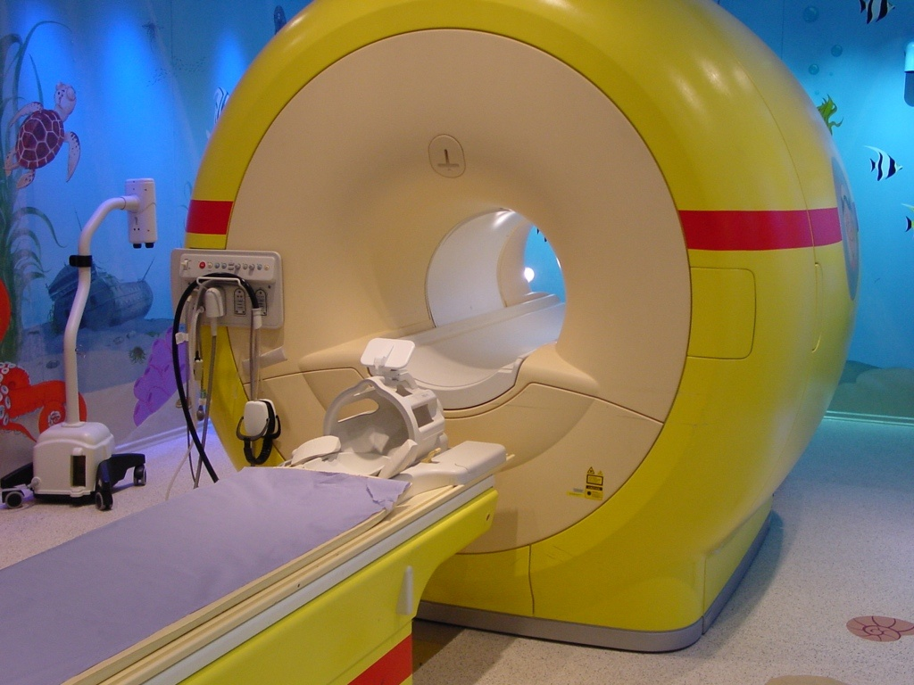
Example: medical MRI scanner
Notes:
picture of modern scanner with 1.5 T
(yellow submarine scanner, Alder Hey Children’s hospital, Liverpool, UK
>1 T cannot be done with normal conductors
cannot be done with elemental superc. either because of critical field
but with some alloys (Nb alloys with critical field up to 50 T and critical current density up to 10¹¹ Am⁻² at 4 K).

Slide 7





12. Josephson effect in superconductors:
Consider two normal metals (N) separated by an insulator junction.
If thickness of the junction >> 100 Å, no conduction electron will pass through this junction from metal 1 to metal 2. But,
If thickness of the junction ≤ 10 Å, then electron from metal 1 will start tunneling through the insulator to the metal 2. This is called quantum tunneling.

Slide 8




If one metal is changed by a superconductor then V-I characteristic changes.
This is known as Giever Tunneling.

Slide 9
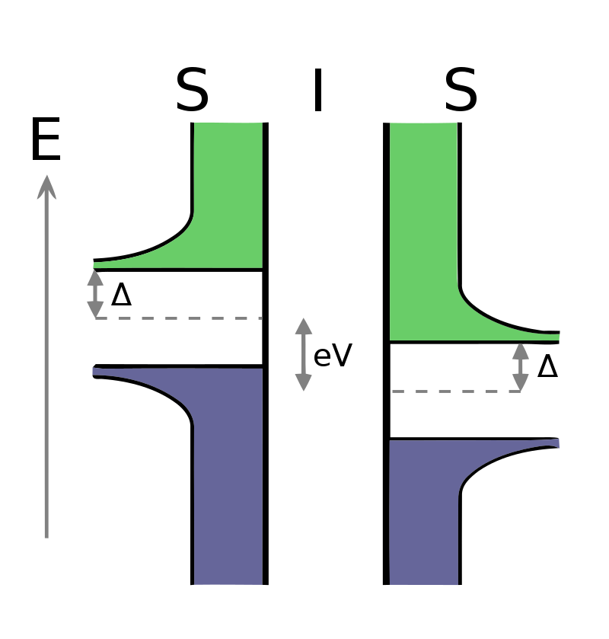
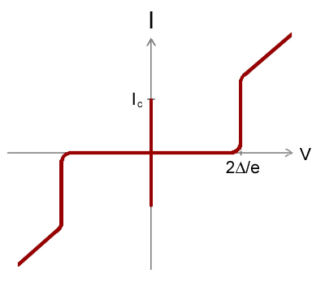
Energy diagram of a superconducting tunnel junction. The vertical axis is energy, and the horizontal axis shows the density of states. Cooper pairs exist at the Fermi energy, indicated by the dashed lines. A bias voltage V is applied across the junction, shifting the Fermi energies of the two superconductors relative to each other by an energy eV, where e is the electron charge. Quasiparticle states exist for energies greater than Δ from the Fermi energy, where Δ is the superconducting energy gap. Green and blue indicate empty and filled quasiparticle states, respectively, at zero temperature.

Slide 10






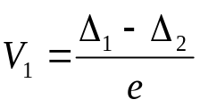
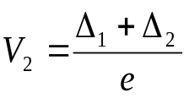
If both metals are replaced by superconductors, the
Fig.: Characteristic curve of S-I-S
Even without application of any potential Cooper pairs from one superconducting materials may tunnel through the insulating junction to the other superconducting materials.
Δ₁ and Δ₂ are the energy gap for first and second superconductors respectively.

Slide 11

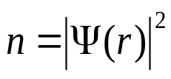


Let us define a system consisting of an ensemble of Cooper pairs by a wave function
Where φ(r) represents phase of the Cooper pairs, and
is density of Cooper pairs.
There is tendency of Cooper pairs in material 1 to equalize phase of Cooper pairs in material B and therefore they move from material 1 to 2 and give rise to current even without application of any external voltage.
DC Josephson effect
Phase difference

Slide 12
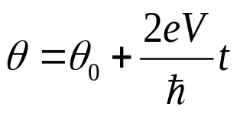

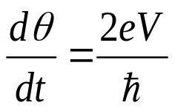
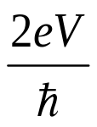
Suppose we apply an external potential V, Cooper pairs may absorb or emit energy in quantum units of 2 eV.
Due to this phase change
The current oscillates with a frequency
This is AC Josephson effect

Slide 13
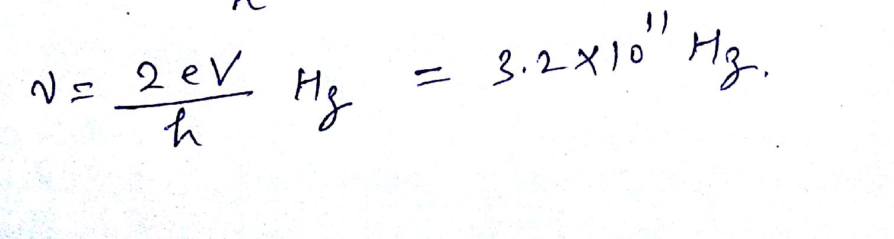
Questions
Calculate the frequency of e.m. waves radiated by a Josephson junction having voltage of 663 μV across its terminals?

