Slide 1

Capstone Project
Hotel Booking Analysis

Slide 2
Team Members Name: Deepanshu Kishore Abhishek Gaurav Shaifali

Slide 3
Agenda
To discuss the analysis of given hotel bookings data set from 2015-2017.
We’ll be doing analysis of given data set in following ways :
Basic analysis
Hotel wise analysis
Distribution Channel wise analysis
Checking for correlation
Waiting affect
By doing this we’ll try to find out key factors driving the hotel bookings trends.

Slide 4
Data Summary
Given data set has different columns of variables crucial for hotel bookings. Some of them are:
hotel: The category of hotels, which are two resort hotel and city hotel.
is_cancelled : The value of column show the cancellation type. If the booking was
cancelled or not. Values[0,1], where 0 indicates not cancelled.
lead_time : The time between reservation and actual arrival.
stayed_in_weekend_nights: The number of weekend nights stay per reservation
stayed_in_weekday_nights: The number of weekday nights stay per reservation

Slide 5
meal: Meal preferences per reservation.[BB,FB,HB,SC,Undefined]
Country: The origin country of guest.
market_segment: This column show how reservation was made and what is the purpose of reservation. Eg, corporate means corporate trip, TA for travel agency.
distribution_channel: The medium through booking was made.[Direct,Corporate,TA/TO,undefined,GDS.]

Slide 6
days_in_waiting_list: Number of days between actual booking and transact. customer_type: Type of customers( Transient, group, etc.)
Is_repeated_guest: Shows if the guest is who has arrived earlier or not.Values[0,1]-->0 indicates no and 1 indicated yes person is repeated guest.

Slide 7

Basic analysis

Slide 8
Basic Information
There are 119390 rows × 33 columns
Data type of columns are float int64 and object
Duplicates rows were present
Null values present
Null values handling
There are Company-82137, agent-12193, country-452, children-4 null values present respectively

Slide 9
Hotel wise analysis

Slide 10
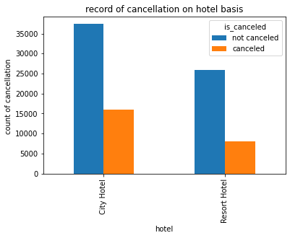
Cancellation rate hotel wise
City hotel cancelled booking is 16049
Resort Hotel cancelled booking is 7976
cancellation percentage of city hotel is 30.03%
cancellation percentage of Resort hotel is 23.48%

Slide 11
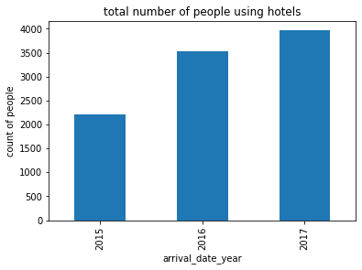
Average number of people staying per year

Slide 12
Observations
city hotel have greater percentage of cancellation
city hotel also have comparetively larger number of booking than resort hotel
their were more people staying in hotel in 2017

Slide 13
Distribution channel report
Their were 5 Distribution channel:
Direct
Corporate
TA/TO
Undefined
GDS
Now lets see how much each channel have contributed

Slide 14
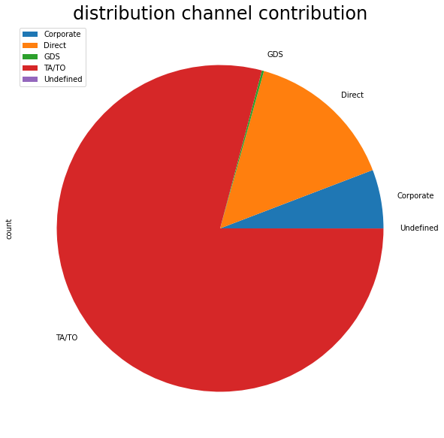

Slide 15
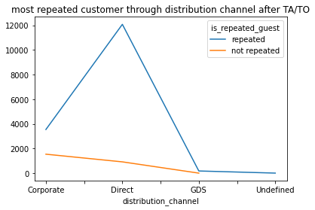
channel having more repeated customer after TA/TO

Slide 16
Observation
TA/TO have the most contribution
TA/TO even have the most number of
repeated guests
3.direct channel have most repeated guest
after TA/TO

Slide 17
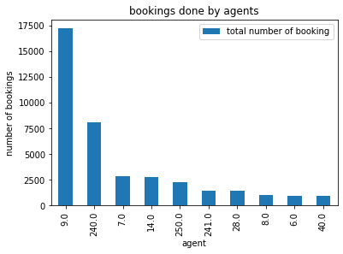
Agent Performance Report
Agent | Total number of booking
9.0 | 17235
240.0 | 8084
7.0 | 2864
14.0 | 2766
250.0 | 2285
241.0 | 1426
28.0 | 1415
Agent with I.D No.. 9 have done most number of booking

Slide 18
Checking For Correlation

Slide 19
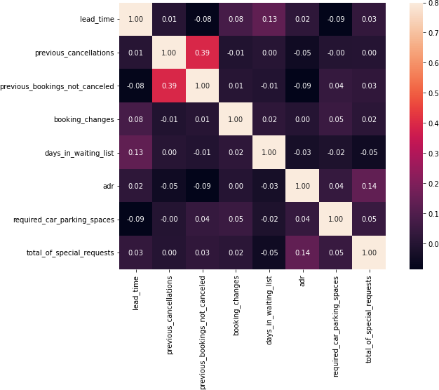
Observation
Total stay length and lead time have slight correlation. This may means that for longer hotel stays people generally plan lit tle before the the actual arrival.
Adr is slightly correlated with total_people, which makes sense as more no. of people means more revenue, therefore more adr

Slide 20
Room Insights

Slide 21
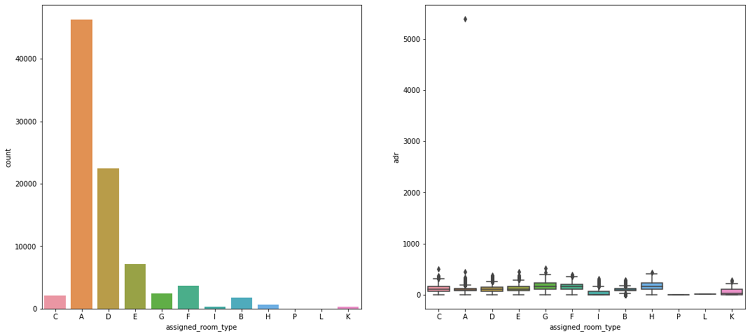
Room In Demand

Slide 22
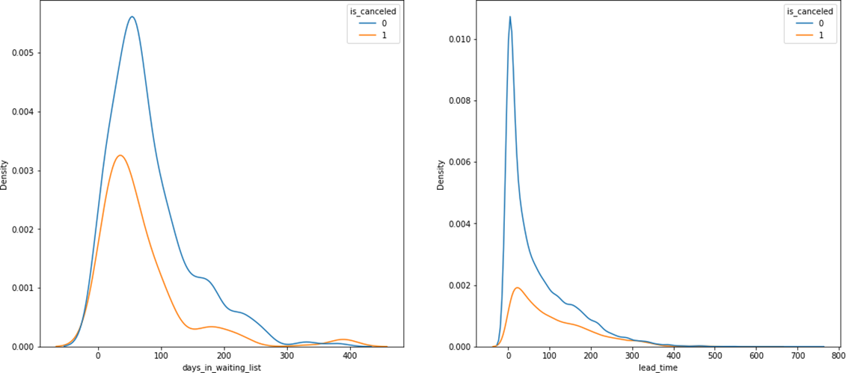
Checking whether waiting time have any affect on cancellation

Slide 23
Observation
Type A Room is in most demand
Waiting time is showing almost no affect on cancellation
Room types C, G and H are some of the highest adr(average daily rate) generating rooms

Slide 24
Thank You

