Slide 1
Monte Carlo Markov Chain

Slide 2
Monte Carlo Simulation
A model used to predict the probability of different outcomes when the intervention of random variables is present
Assigns multiple values to random variable to achieve multiple values of outcome and then averaging the results to obtain an estimate
Monte Carlo simulations help to explain the impact of risk and uncertainty in prediction and forecasting models
A variety of fields utilize Monte Carlo simulations, including finance, engineering, supply chain, and science

Slide 3

Monte Carlo Simulation: Approximate Integrals
Expected value of a function:
$$\text{E}\left[f\left(x\right)\right]= \int{p\left(x\right)f\left(x\right)dx}$$
Or for discrete x,
$$\text{E}\left[f\left(x\right)\right]= \sum_{i=1}^{N}{p\left(x_{i}\right)f\left(x_{i}\right)}$$
In both cases, we can approximate the expected value with a sample of n values $x_{1},…,x_{n}$ from the distribution p(), giving:
$$\hat{s}= \frac{1}{n}\sum_{j=1}^{n}{f\left(x_{j}\right)}$$

Slide 4
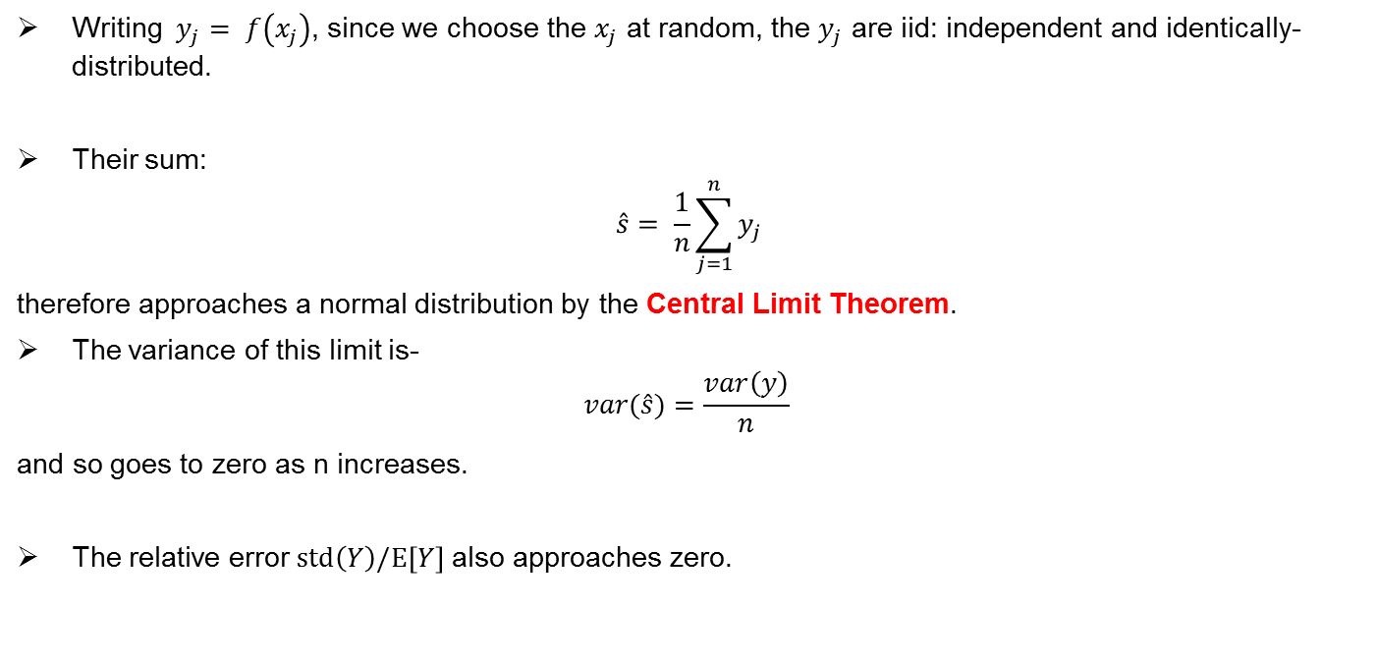
Monte Carlo Simulation: Approximate Integrals
Writing $y_{j}= f\left(x_{j}\right)$, since we choose the $x_{j}$ at random, the $y_{j}$ are iid: independent and identically-distributed.
Their sum:
$$\hat{s}= \frac{1}{n}\sum_{j=1}^{n}{y_{j}}$$
therefore approaches a normal distribution by the Central Limit Theorem.
The variance of this limit is-
$$var(\hat{s})=\frac{var\left(y\right)}{n}$$
and so goes to zero as n increases.
The relative error $std\left(Y\right)/\text{E}\left[Y\right]$ also approaches zero.

Slide 5
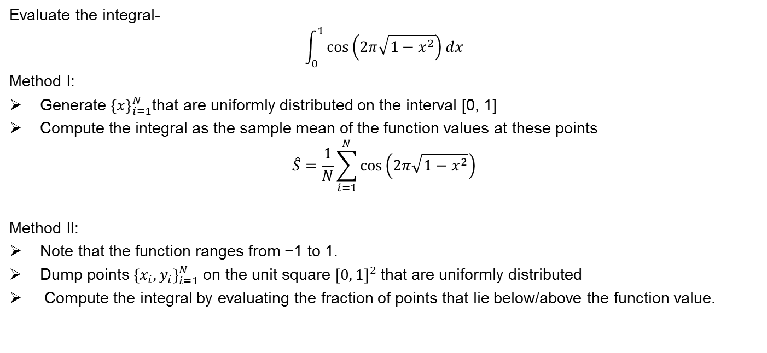
Example: I
Evaluate the integral-
$$\int_{0}^{1}{\cos\left(2π\sqrt{1−x^{2}}\right)}dx$$
Method I:
Generate ${\left\{x\right\}}_{i=1}^{N}$that are uniformly distributed on the interval [0, 1]
Compute the integral as the sample mean of the function values at these points
$$\hat{S}=\frac{1}{N}\sum_{i=1}^{N}{\cos\left(2π\sqrt{1−x^{2}}\right)}$$
Method II:
Note that the function ranges from −1 to 1.
Dump points ${\left\{x_{i}, y_{i}\right\}}_{i=1}^{N}$on the unit square ${\left[0, 1\right]}^{2}$that are uniformly distributed
Compute the integral by evaluating the fraction of points that lie below/above the function value.

Slide 6
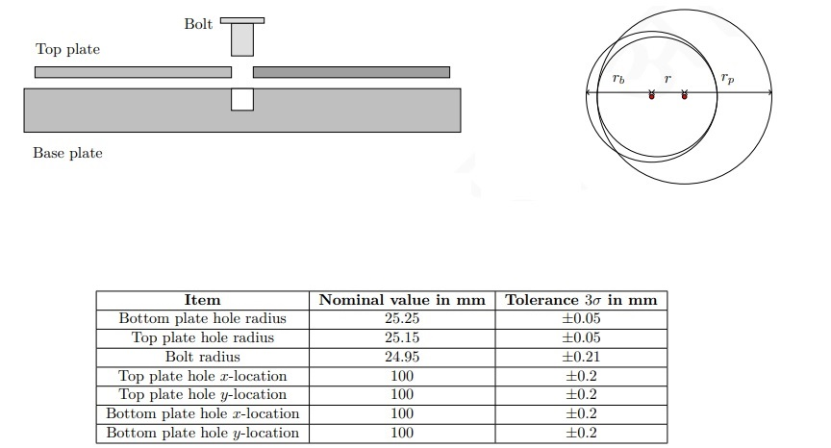
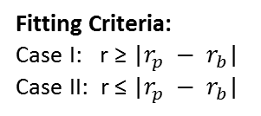
Example: II
Fitting Criteria:
Case I: r ≥ |$r_{p} − r_{b}$|
Case II: r ≤ |$r_{p} − r_{b}$|

Slide 7






Two cases
$$r_{p}$$
$$r< r_{p}−r_{b}$$
$$r= r_{p}−r_{b}$$
$$r> r_{p}−r_{b}$$
$$r_{b}$$
$$r_{p}−r_{b}$$

Slide 8

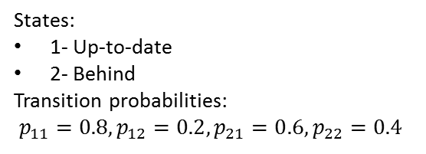

Markov Process (Discrete case)
Future state depends on the past through present state
Example: Alice is taking a probability class and in each week she can be either up-to-date or she may have fallen behind. If she is up-to-date in a given week, the probability that she will be up-to-date (or behind) in the next week is 0.8 (or 0.2, respectively). If she is behind in the given week, the probability that she will be up-to-date (or behind) in the next week is 0.6 (or 0.4, respectively). We assume that these probabilities do not depend on whether she was up-to-date or behind in previous weeks, so the problem has the typical Markov chain character (the future depends on the past only through the present).
States:
1- Up-to-date
2- Behind
Transition probabilities:
$p_{11}=0.8,p_{12}=0.2, p_{21}=0.6, p_{22}=0.4$
Transition Probability matrix:
$$\left[\begin{matrix}0.8 & 0.2 \\ 0.6 & 0.4\end{matrix}\right]$$
States are Random:
$$X_{1}=U\left(0,1\right),X_{2}=U\left(0,1\right),$$

Slide 9
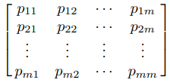
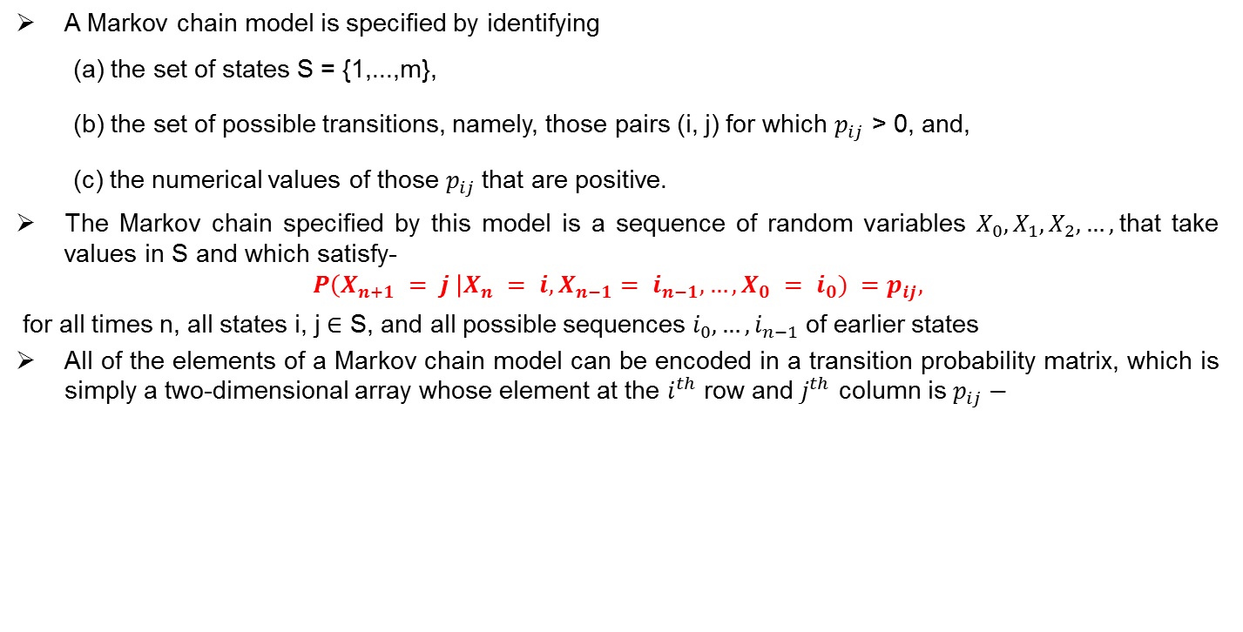
Specification of Markov Models
A Markov chain model is specified by identifying
(a) the set of states S = {1,...,m},
(b) the set of possible transitions, namely, those pairs (i, j) for which $p_{ij}$ > 0, and,
(c) the numerical values of those $p_{ij}$that are positive.
The Markov chain specified by this model is a sequence of random variables $X_{0}, X_{1}, X_{2},…,$that take values in S and which satisfy-
$$P\left(X_{n+1} = j \right|X_{n} = i, X_{n−1}= i_{n−1},…,X_{0} = i_{0}) =p_{ij},$$
for all times n, all states i, j ∈ S, and all possible sequences $i_{0},…,i_{n−1}$of earlier states
All of the elements of a Markov chain model can be encoded in a transition probability matrix, which is simply a two-dimensional array whose element at the $i^{th}$ row and $j^{th}$ column is $p_{ij}−$

Slide 10
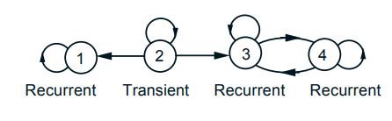
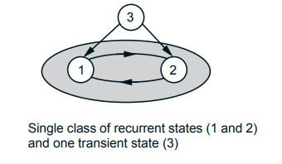
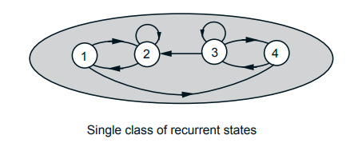
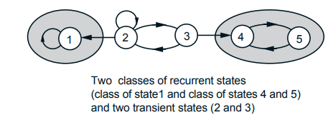
Classification of states

Slide 11

Steady state convergence Theorem
Consider a Markov chain with a single recurrent class, which is aperiodic. Then, the states j are associated with steady-state probabilities $π_{j}$ that have the following properties
$\lim_{n→∞}{r_{ij} (n)}= π_{j} , for all i, j$
The $π_{j}$are the unique solution of the system of equations below:
$$π_{j}=\sum_{k=1}^{m}{π_{k}p_{kj}}, j=1,…,m$$
$$1=\sum_{k=1}^{m}{π_{k}}$$
We have-
$$π_{j}=0;for all transient states j$$
$$π_{j}>0;for all recurrent states j$$

