Slide 1
Azure Logic Apps

Slide 2
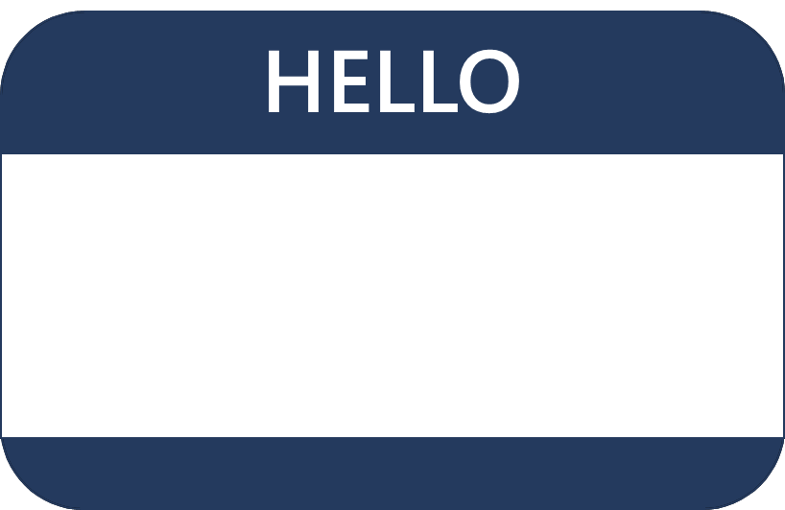

Hello! Instructor Introduction
Instructors: Deepanshu
Microsoft Certified Trainers, HPE Instructors – AI and Data Engineering
Trained 10k+ audience
RPS Consulting

Slide 3
Classroom experience (optional – adjust as needed)
Class hours
Messages
Virtual access
Smoking
Parking
Internet access
Restrooms
Recycling
Meals
Emergency procedures
Phones
Notes:
In the virtual classroom remove the items that aren’t appropriate. Demo the virtual experience including asking a question, chat, video ..

Slide 4
Microsoft Certifications
Certifications give you a professional edge by providing globally recognized industry endorsed evidence of skills mastery, demonstrating your abilities and willingness to embrace new technologies
Exam AZ-900: Microsoft Azure Fundamentals
Microsoft Certified: Azure Developer Associate
Microsoft Certified: Azure Solutions Architect Expert
Designed for candidates looking to demonstrate foundational level knowledge of cloud services and how those services are provided
Designed for Azure Developers who implement, monitor, and maintain compute, storage, network, and security
Designed for Azure Solutions Architects who create solutions for compute, network, storage, and security
Notes:
Use this slide to introduce the different exam levels – Fundamentals, Associate, and Expert. Also, the difference between exams and certifications. Some certifications require you to pass more than one exam.
Certification journey poster - https://query.prod.cms.rt.microsoft.com/cms/api/am/binary/RE2PjDI

Slide 5
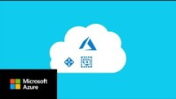
Introduction to Microsoft Azure
Notes:
https://www.youtube.com/watch?v=KXkBZCe699A

Slide 6
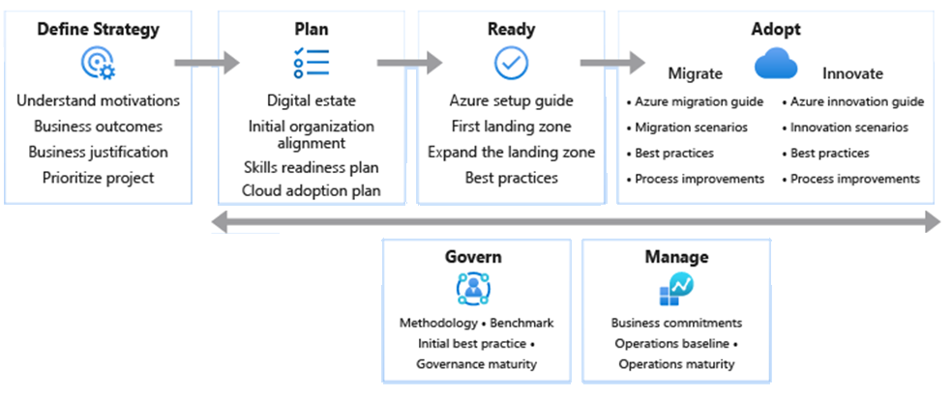
Microsoft’s Cloud Adoption Framework
Notes:
Consider talking about landing zones specifically. Use this link to review before class https://docs.microsoft.com/azure/cloud-adoption-framework/ready/landing-zone/
The cloud adoption journey - https://azure.microsoft.com/cloud-adoption-framework/#cloud-adoption-journey
Azure migration guide overview - https://docs.microsoft.com/azure/cloud-adoption-framework/migrate/azure-migration-guide
Azure cloud migration best practices checklist - https://docs.microsoft.com/azure/cloud-adoption-framework/migrate/azure-best-practices
Microsoft Cloud Adoption Framework for Azure - https://docs.microsoft.com/learn/modules/microsoft-cloud-adoption-framework-for-azure/
Strategy – Define business justification and expected outcomes of adoption
Plan – Align actionable adoption plans to business outcomes
Ready – Prepare the cloud environment for the planned changes
Adopt (Migrate/Innovate) – Migrate and modernize existing workloads / Develop new cloud-native or hybrid solutions
Govern – Govern the environment and workloads
Manage – Operations management for cloud and hybrid solutions
Organize – Align the teams and roles supporting your organization’s cloud adoption efforts

Slide 7
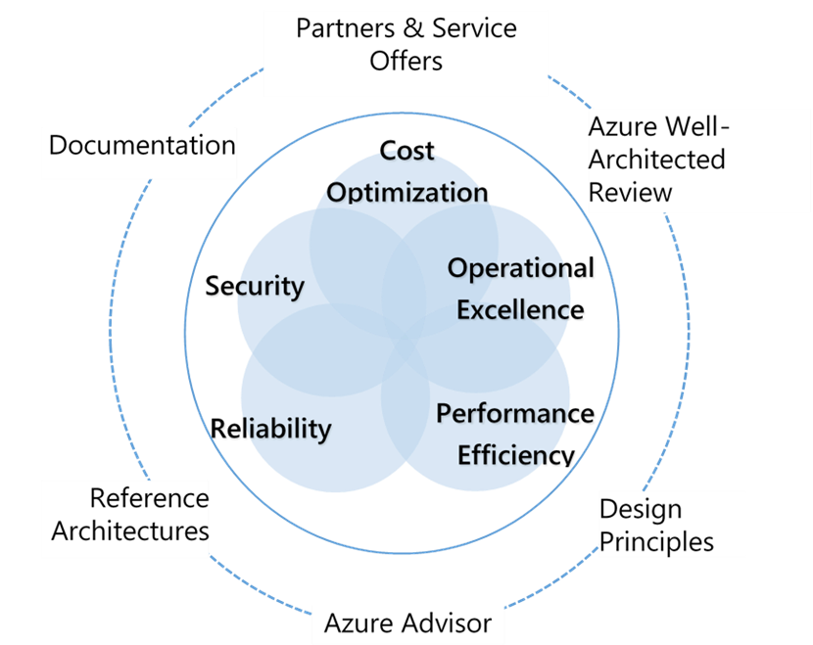
Microsoft Azure Well-Architected Framework
Cost Optimization – Managing costs to maximize the value delivered
Operational Excellence – Operations processes that keep a system running in production
Performance Efficiency – Ability of a system to adapt to changes in load
Reliability – Ability of a system to recover from failures and continue to function
Security – Protecting applications and data from threats
Notes:
Microsoft Azure Well-Architected Framework - https://docs.microsoft.com/azure/cloud-adoption-framework/
Build great solutions with the Microsoft Azure Well-Architected Framework - https://docs.microsoft.com/azure/architecture/framework/
Azure’s Well-Architected Framework targets a specific workload, and the Cloud Adoption Framework picks them up from the point of migration to the cloud.

Slide 8







Govern resources in Azure
Governance provides mechanisms and processes to maintain control over your applications and resources in Azure.
Tenant root group
Determine your requirements, plan your initiatives, and set strategic priorities
Plan for governance at every level
Management groups
Subscriptions
Resource groups
Resources
Management
groups
Subscriptions
Resource
groups
Resources
Notes:
Azure governance documentation - https://docs.microsoft.com/azure/governance/
Overview of Azure subscriptions, management groups, and resources - https://docs.microsoft.com/learn/modules/azure-architecture-fundamentals/overview
Organize your Azure resources effectively - https://docs.microsoft.com/azure/cloud-adoption-framework/ready/azure-setup-guide/organize-resources?tabs=AzureManagementGroupsAndHierarchy
Stay at high level there are slides for item in the hierarchy. Review why governance is important.
Management groups help you manage access, policy, and compliance for multiple subscriptions.
Subscriptions are logical containers that serve as units of management and scale. Subscriptions are also billing boundaries.
Resource groups are logical containers into which Azure resources are deployed and managed.
Resources are instances of services that you create. For example, virtual machines, storage, and SQL databases.

Slide 9

Plan your resource groups
A resource group is a container that holds related resources for an Azure solution.
Single resource group
Multiple resource groups
RG1
RG1
RG2
RG3
Subscription A
Subscription A
Group resources that share the same life cycle
Group by type, app, department, location, or billing
Apply RBAC and policies to a group of resources
Use resource locks to protect individual resources from deletion or change
Notes:
What is Azure Resource Manager - https://docs.microsoft.com/azure/azure-resource-manager/management/overview
Name resource groups - https://docs.microsoft.com/azure/cloud-adoption-framework/migrate/azure-best-practices/migrate-best-practices-security-management#best-practice-name-resource-groups
Implement delete locks for resource groups - https://docs.microsoft.com/azure/cloud-adoption-framework/migrate/azure-best-practices/migrate-best-practices-security-management#best-practice-implement-delete-locks-for-resource-groups

Slide 10
What is Logic Apps?
Azure Logic Apps is a cloud-based platform for creating and running automated workflows that integrate your apps, data, services, and systems.
With this platform, you can quickly develop highly scalable integration solutions for your enterprise and business-to-business (B2B) scenarios.
Azure Logic Apps simplifies the way that you connect legacy, modern, and cutting-edge systems across cloud, on premises, and hybrid environments.
Notes:
https://www.microsoft.com/en-us/videoplayer/embed/RE4qhug?postJsllMsg=true

Slide 11
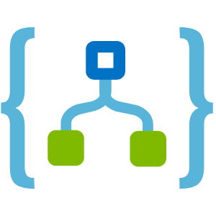
Key Terms
Workflow
Trigger
Action
Built-in Operations
Managed Connectors

Slide 12
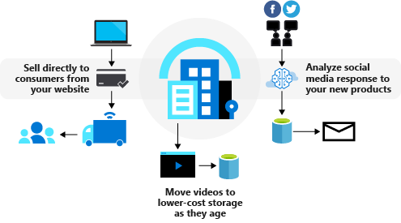
Suppose you work at an athletic shoe company that is launching a new product. You sell the shoes on your website, manage your cloud-hosted advertising videos, and monitor social media to gauge reactions to the launch. The following illustration shows these processes.

Slide 13
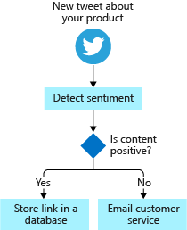
Business Process
A business process or workflow is a sequence of tasks that produce a specific outcome. The result might be a decision, some data, or a notification.
Notes:
One of the shoe-company scenarios is monitoring social media for reaction to a new product. The sequence of tasks would be: detect tweets about the product, analyze the sentiment, store a link to positive tweets, and email customer service for negative tweets.
Since the steps occur in a specific order, you'll often describe them with a flowchart. The following illustration shows a sample flowchart for the social-media monitor process. Notice how there are three types of operations: an event that starts the flow, processing steps that do most of the work, and a conditional operator that makes a decision.

Slide 14
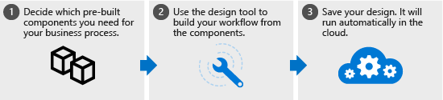
WHAT IS LOGIC APP?
Notes:
Azure Logic Apps is a cloud service that automates the execution of your business processes. You use the workflow designer to arrange pre-made components into the sequence you need. The designer sends a definition of your workflow to the Azure Logic Apps execution engine. The execution engine launches your app when conditions are right and manages the compute resources needed to run it. The following illustration shows a high-level view of the steps.

Slide 15
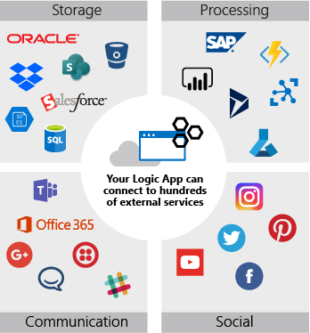
Notes:
The power of Azure Logic Apps comes from the diversity of the pre-built components and their ability to work together. The components let you connect to hundreds of external services. The following illustration shows a few of the services you can use in your logic app workflow.

Slide 16
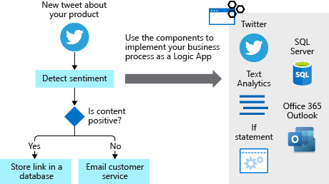
Notes:
You build your app from the services you use in your business processes. The components can be connected in any pattern you need. You can add conditional statements and loops to add decision making to your app. The following illustration shows how you would combine external services to implement the social-media monitor workflow.
The Azure Logic Apps model is extensible. If there isn't a pre-built component for the service you need, you can create your own. You can also run custom code in an Azure function that you invoke from your app.
If we had to describe the goal of Azure Logic Apps in one word, we'd choose integration. Azure Logic Apps helps you join disparate services to implement a workflow. Your job is to use the workflow designer to arrange the components into the sequence you need. For most apps, you won't need to write any code and you can be up and running in minutes.

Slide 17
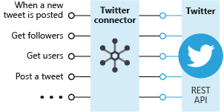
What is a connector?
A connector is a component that provides an interface to an external service. For example, the Twitter connector allows you to send and retrieve tweets, while the Office 365 Outlook connector lets you manage your email, calendar, and contacts. Azure Logic Apps provides hundreds of pre-built connectors that you can use to create your apps.
Notes:
A connector uses the external service's REST or SOAP API to do its work. When you use a connector in your logic app workflow, the connector calls the service's underlying API for you. The following illustration shows the Twitter connector and its use of the Twitter REST API.

Slide 18
What are triggers and actions?
Workflows are built from different types of tasks. For example, in our social media monitoring scenario, the workflow starts when a new tweet is posted. The workflow then analyzes the sentiment and makes a decision, based on the sentiment score. Azure Logic Apps uses the terms trigger, action, and control action for these concepts. These operations are the building blocks of Azure Logic Apps. The following diagram shows how to use each type of step in the social media monitoring app.

Slide 19
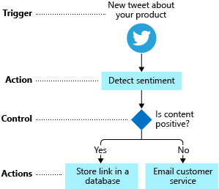
Notes:
Let's be more specific about the definitions for trigger and action:
A trigger is an event that occurs when a specific set of conditions is satisfied. Triggers activate automatically when conditions are met. For example, when a timer expires or data becomes available.
An action is an operation that executes a task in your business process. Actions run when a trigger activates or another action completes.

Slide 20
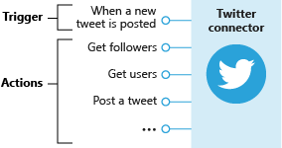
Notes:
The Twitter connector lets your logic app workflow interact with Twitter. The social media monitoring app can use a trigger from the Twitter connector to determine when new relevant tweets are available. The following diagram shows the Twitter connector with its trigger and actions:

Slide 21
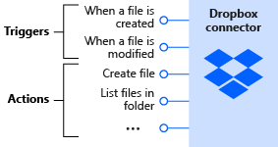
Notes:
Next, we have the Dropbox connector. Suppose you're working with a small team on a project that stored shared data in Dropbox. You can build a workflow that detects when someone changes any files and sends a notification to the other team members. The following diagram shows the Dropbox connector with its triggers and actions:

Slide 22
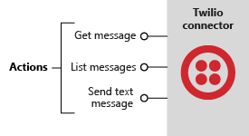
Notes:
Finally, let's look at the Twilio connector. Most connectors offer both triggers and actions, but this connector only has actions. The Twilio connector is useful when you want to send text messages for notifications. For example, you could use the Twiliio connector in the Dropbox scenario to message team members when a shared file changed. The following diagram shows the Twilio connector and its actions:

Slide 23
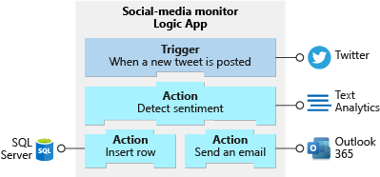
Building workflows from triggers and actions
Notes:
You build a workflow by choosing operations, specifically, a trigger and actions. A workflow must start with a trigger. You can then follow the trigger with as many actions as you need to implement your workflow. The following diagram shows the trigger and actions used in the social media monitoring app:

Slide 24
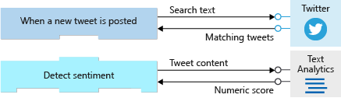
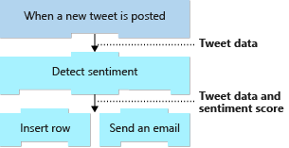
Triggers and Actions Working together
Notes:
Triggers and actions are essentially function calls to an underlying API operation. Each operation has inputs and outputs. For example, the Twitter trigger named When a new tweet is posted takes in a search string and returns the tweets that contain that string. The Text Analytics action named Detect sentiment action takes a string as input and returns the sentiment score as a floating-point number. The following diagram shows these two operations:
Image
Azure Logic Apps automatically makes the return values available throughout the rest of the operations. This feature lets you pass the results from one operation as input to the next operation. The following diagram shows the data flow for the first two operations in the social media monitoring app.
The results or outputs from an operation are available to all subsequent steps:
Image

Slide 25
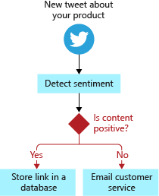
Control Actions
Control actions are special actions built-in to Azure Logic Apps that provides these control constructs:
Condition statements controlled by a Boolean expression.
Switch statements.
For each and until loops.
Unconditional branch instructions.
Notes:
Most workflows need to run different actions, based on the data that's processed. For example, a workflow might route an expense report to a different manager, based on the expense amount. In the social media monitoring app, the workflow needs to branch, based on a tweet's sentiment score. The following diagram shows the flowchart for the social media monitoring app and highlights the control logic:

Slide 26
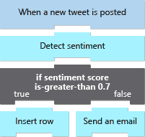
The following diagram shows the use for the condition statement in the social media monitoring app:

Slide 27
Workflow Designer
The workflow designer is a graphical tool for creating your workflows. The designer provides canvas surface where you add a trigger and actions to your workflow. For example, the social media monitoring app uses the trigger named When a new tweet is posted, a control action known as a condition, and actions named Detect sentiment, Insert row, and Send an email. The following screenshot shows the social media monitoring workflow in the designer:

Slide 28
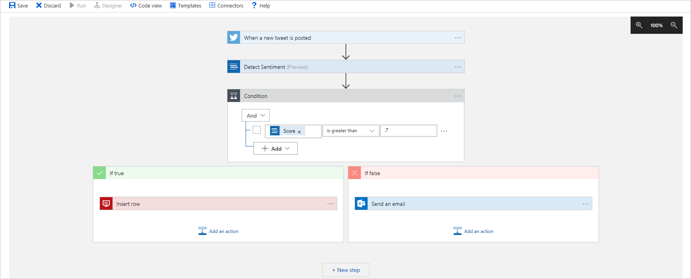
Workflow Designer

Slide 29
How logic apps work
You have an order system, and your workflow processes incoming orders. You want to review orders above a certain cost manually. Your workflow already has previous steps that determine how much an incoming order costs. So, you create an initial condition based on that cost value. For example:
If the order is below a certain amount, the condition is false. So, the workflow processes the order.
If the condition is true, the workflow sends an email for manual review. A switch determines the next step.
If the reviewer approves, the workflow continues to process the order.
If the reviewer escalates, the workflow sends an escalation email to get more information about the order.
If the escalation requirements are met, the response condition is true. So, the order is processed.
If the response condition is false, an email is sent regarding the problem.

Slide 30
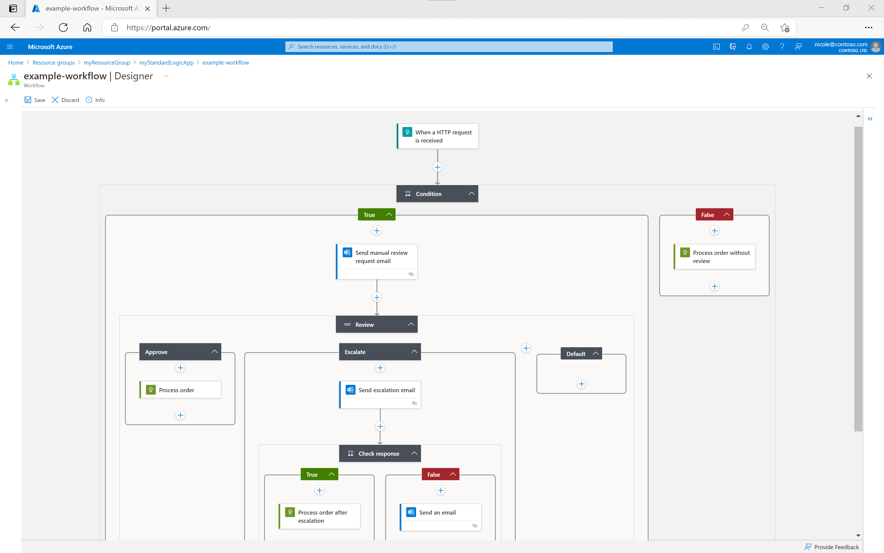
Notes:
You can visually create workflows using the Azure Logic Apps workflow designer in the Azure portal, Visual Studio Code, or Visual Studio. Each workflow also has an underlying definition that's described using JavaScript Object Notation (JSON). If you prefer, you can edit workflows by changing this JSON definition. For some creation and management tasks, Azure Logic Apps provides Azure PowerShell and Azure CLI command support.

Slide 31
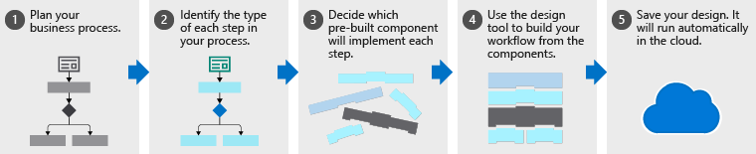
Design workflows with Azure Logic Apps

Slide 32
Plan your business process
Notes:
The first step to creating a logic app workflow is planning the steps of your business process. In the social media monitoring scenario, the steps are as follows:
Detect tweets about the product
Analyze the sentiment
Store a link to positive tweets
Email customer service for negative tweets
Typically, you can use a flowchart to capture the steps of the process. The following diagram shows the flowchart for the social media monitoring app.

Slide 33
Identify the type for each step in your process
Notes:
The steps in a business process perform different types of operations. Some respond to external events, some process or store data, and others make decisions based on the data. Azure Logic Apps uses the terms trigger, action, and control action for these three categories.
For example, in our social media monitoring scenario, a trigger starts the process when a new tweet is posted, an action performs a task such as analyzing the sentiment, and a control action makes a decision based on the sentiment score. The following diagram shows the type for each step in the social media monitoring app.

Slide 34
Map your steps to components
Notes:
To decide which pre-built component to implement, we need to be clear about component types. Let's be more formal about the definitions of the component types:
A trigger is an event that occurs when a specific conditions are met. Triggers activate automatically when the conditions are right, for example, when a timer expires or data becomes available. Every workflow must start with a trigger. In our example, we want to trigger the workflow when a new tweet mentions our product.
An action is an operation that runs one of the tasks in your business process. Actions run when a trigger activates or another action completes. Our social media monitoring app has three actions: analyze sentiment, insert database row, and send email.
Control actions are special built-in actions that let you add decisions and loops to your workflow. Our example uses a control action to branch based on the sentiment score.
A connector is a group of related triggers and actions. Conceptually, you can think of a connector as a component that lets you access a service or system. For example, the Twitter connector lets you send and receive tweets, while the Microsoft 365 Outlook connector allows you to manage your email, calendar, and contacts. The following diagram shows the Twitter connector and its operations divided into the two categories.

Slide 35
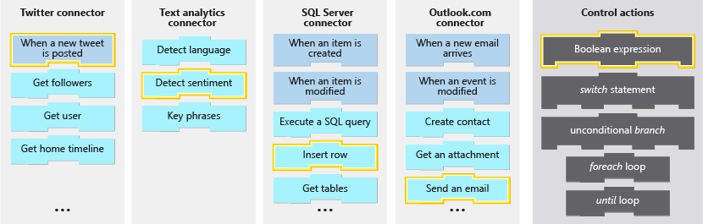
Notes:
Now, you need to map each task in your flowchart to the triggers and actions available in Azure Logic Apps. The following diagram shows the connectors we'd use in the social media app with the relevant triggers and actions highlighted.

Slide 36
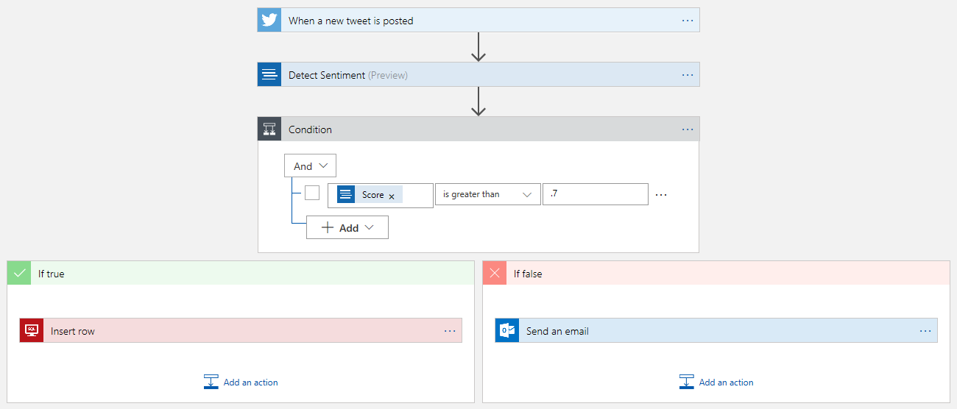
Define your workflow with the designer
Notes:
The designer in Azure Logic Apps is a graphical tool for creating your workflows. You can pick from a gallery of connectors that contain the triggers and actions that you can use in your workflow. You'll use designer to arrange the trigger, actions, and control actions. The following screenshot shows the designer with the completed workflow.

Slide 37
Detect an external event using a trigger
Trigger types
When new tweet is posted, a new row is inserted into a database, a new email arrives, or a new file is uploaded to your cloud storage. Triggers that detect data or events can use either of the following techniques:
Triggers that periodically poll or check a service or system for specific data or events that meet conditions
Triggers that wait and receive push notifications from a service or system when specific data or events meet conditions
Notes:
In Azure Logic Apps, a trigger always starts a workflow as the first step. To correctly run your workflow, you need to find the best trigger, and set up the trigger's properties for your scenario. For our example, we'll use a Twitter trigger that runs our workflow when a tweet with our product name is posted.
In this unit, we'll examine trigger types plus the strengths and weaknesses around the most common options. We'll then show how to create a logic app workflow using the Azure portal, and how to add a trigger in the workflow designer.

Slide 38
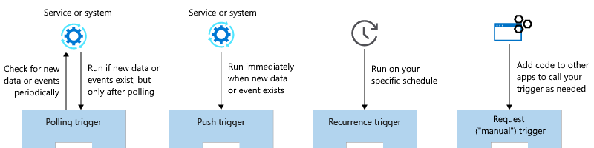
Notes:
However, what if you need a trigger that's not bound to data or events in service or system? Suppose you want to run your workflow every Saturday at midnight or some other schedule. You can use the Recurrence trigger to schedule and run any actions in a workflow. For example, you can schedule workflows that perform administrative tasks, such as running backups or archiving old data. Suppose you want to run your workflow only when called from code or another source? You can use the Request or "manual" trigger to wait for requests, for example, sent from code in your web app or mobile app.
The following diagram summarizes the previously described trigger types:

Slide 39
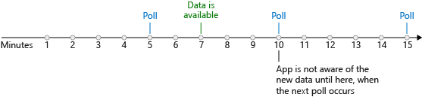
Polling trigger
A polling trigger periodically checks a service or system for data or an event that meets specific conditions. After this check, if the trigger finds data or an event that meets the conditions, the trigger starts a new workflow execution. For example, the RSS connector has a polling trigger that can regularly check for new posts in an RSS feed.
Notes:
After you add a polling trigger to your workflow, you set the Frequency and an Interval to control how often the trigger runs. The frequency is a time unit, such as Second, Minute, Hour, Day, Week, or Month. The interval is the number of time units that lapse before the trigger checks again for data or an event. For example, a polling trigger with a frequency of Minute and an interval of 5 checks every five minutes.
Polling triggers require you to choose between how often the triggers run and how much they cost. Often, there's a delay between when new data or an event happens and when the trigger detects that data or event. For example, suppose a polling trigger checks for data every five minutes. New data is available after seven minutes. The trigger doesn't detect the new data until the next poll, which happens at 10 minutes. The following diagram shows how this polling works:

Slide 40
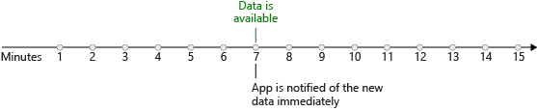
Push trigger
A push trigger waits for notifications from a service or system when data or an event meets specific conditions. The trigger subscribes to an endpoint on an external service or system. When new data or an event meets the conditions, the service or system notifies the trigger, which immediately starts a new workflow execution. For example, the Azure Service Bus connector has a push trigger that detects when a message is added to an Azure Service Bus queue.
Notes:
On the positive side, push triggers don't run when no data or events are available. So, they don't incur costs for polling. These triggers also immediately respond when new data or events exist. The following diagram shows how this push process works:
IMAGE
Why not use push triggers all the time when they respond faster and cost less than polling triggers? Unfortunately, not every connector offers a push trigger. The external service might not support push triggers, or maybe the connector author didn't choose to implement a push trigger. Generall, a connector offers either push triggers or polling triggers, but not both. In rare cases where a connector offers both options, consider using the push trigger due to better efficiency.

Slide 41
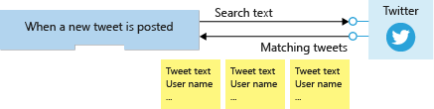
Trigger parameters and return values
Consider trigger operations as function calls that have parameters and return values. Trigger parameters let you configure the operation. The Twitter trigger named When a new tweet is posted has a parameter called Search text. The trigger uses this parameter to select matching tweets for us. Some operations use both required and optional parameters. The SQL Server trigger named When an item is created has one required parameter called Table name and several optional parameters, such as Order By and Select Query.
Notes:
Trigger return values are the results from the operation. For example, the Bitbucket connector has a trigger named When a pull request is merged. The trigger returns an object that contains data, such as the Repository identity and the Actor who approved the merge. Most triggers actually return an object collection, rather than a single object. For example, the Twitter trigger named When a new tweet is posted returns an array of TweetModel objects. Each object contains values, such as Tweet text, User name, and Followers count. The following diagram shows a collection that's returned from a trigger:
IMAGE

Slide 42
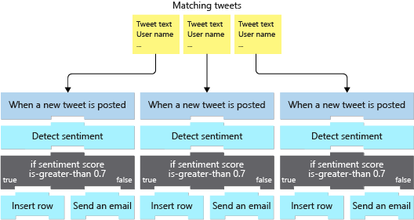
Notes:
You can use a loop to process each item, or you can set up the trigger to split up the array for processing. For most triggers, including the Twitter trigger, the default behavior automatically splits up the array. The Azure Logic Apps engine creates one workflow instance for each item, and all the instances run in parallel. The following diagram shows how each item in the returned array goes to a different workflow instance for processing:

Slide 43

A Sample Workflow (example reference)

Slide 45
Design for Azure Logic App solutions

Slide 46
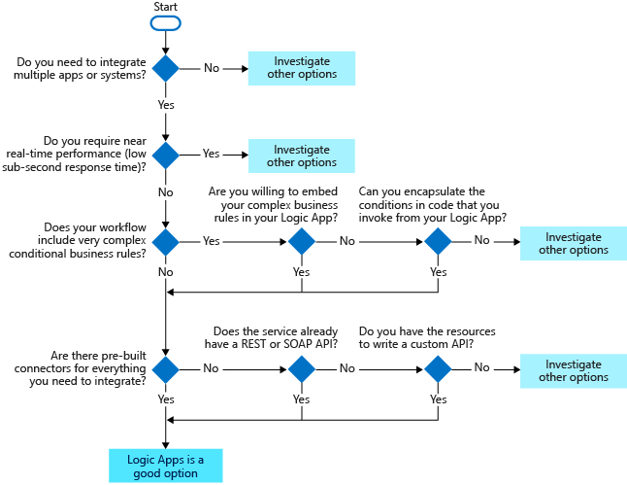
When to use Azure Logic Apps
Azure Logic Apps is a cloud-based platform creating and running workflows.
Send email notifications using Office 365 when a specific event happens
Route and process customer orders across on-premises systems and cloud services.
Move uploaded files from an FTP server to Azure Storage.
Monitor tweets, analyze the sentiment, and create alerts or tasks for items that need review.
Notes:
Azure Logic App - https://azure.microsoft.com/services/logic-apps
Azure Integration Services - https://azure.microsoft.com/product-categories/integration/
Built-in binding types - https://docs.microsoft.com/azure/azure-functions/functions-triggers-bindings
Cramo is using Logic Apps - https://customers.microsoft.com/story/cramo-professional-services-azure
You need multiple applications and systems to work together. You need to scale your apps automatically. You need to build complex and nested conditionals with business rules. You need a built-in connector for your integration.

Slide 47
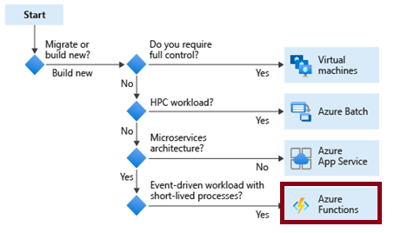
When to use Azure Functions
Azure Functions is a serverless application platform for compute-on-demand
Implement your system's logic into readily available blocks of code
Supports a microservice design
Promotes code reuse
Scales easily
Event-driven
Notes:
Azure Functions - https://docs.microsoft.com/azure/azure-functions/functions-overview
Azure Functions code samples - https://docs.microsoft.com/samples/browse/?expanded=azure&languages=csharp&products=azure-functions
Durable functions - https://docs.microsoft.com/azure/azure-functions/durable/durable-functions-overview?tabs=csharp

Slide 48
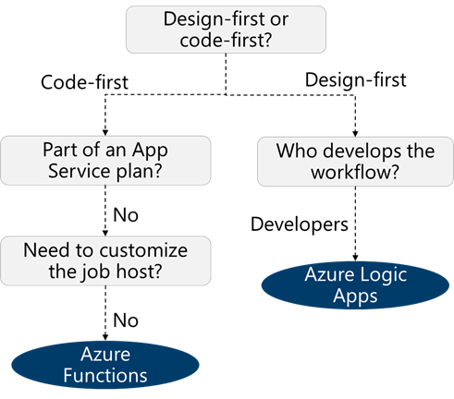
How are Logic Apps different from Functions?
Code-first vs designer-first
Comparison | Logic Apps | Durable Functions
Development | Designer-first | Code-first
Method | Create orchestrations by using a GUI or editing configuration files | Write code and use the durable functions extension
Connectivity | Large collection of connectors , B2B pack, custom connectors | Large selection of built-in binding types, write code for custom bindings
Monitoring | Azure portal, Azure Monitor logs | Azure Application Insights
Notes:
Choose the right integration and automation services in Azure - https://docs.microsoft.com/azure/azure-functions/functions-compare-logic-apps-ms-flow-webjobs
TIP: You can mix and match services when you build an orchestration. You can call functions from logic apps and call logic apps from functions. Build each orchestration based on the services' capabilities or your personal preference.

Slide 49
Review
Compare Azure Functions and Azure Logic Apps
 | Durable Functions | Logic Apps
Development | Code-first (imperative) | Designer-first (declarative)
Connectivity | About a dozen built-in binding types, write code for custom bindings | Large collection of connectors, Enterprise Integration Pack for B2B scenarios, build custom connectors
Actions | Each activity is an Azure function; write code for activity functions | Large collection of ready-made actions
Monitoring | Azure Application Insights | Azure portal, Azure Monitor logs
Management | REST API, Visual Studio | Azure portal, REST API, PowerShell, Visual Studio
Execution context | Can run locally or in the cloud | Supports run-anywhere scenarios
Notes:
Both Functions and Logic Apps enable serverless workloads. Azure Functions is a serverless compute service, whereas Azure Logic Apps provides serverless workflows. Both can create complex orchestrations. An orchestration is a collection of functions or steps, called actions in Logic Apps, that are executed to accomplish a complex task.
For Azure Functions, you develop orchestrations by writing code and using the Durable Functions extension. For Logic Apps, you create orchestrations by using a GUI or editing configuration files.
You can mix and match services when you build an orchestration, calling functions from logic apps and calling logic apps from functions.

