Slide 1
Understanding the Adapter Pattern

Slide 2
What is the Adapter Pattern?
Definition: The Adapter Pattern allows incompatible interfaces to work together by acting as a bridge.
Purpose: To enable collaboration between classes that otherwise could not work together due to incompatible interfaces.
Example: Plug adapters in real life, allowing a two-prong plug to fit into a three-prong outlet.

Slide 3
How Does the Adapter Pattern Work?
Components:
Target Interface: The interface expected by the client.
Adaptee: The existing interface that needs adapting.
Adapter: The intermediary that implements the Target Interface and translates the requests to the Adaptee.

Slide 4
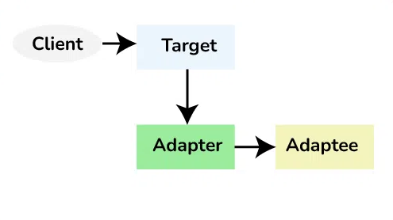

Slide 5
Pros and Cons
PROS
Promotes reusability of existing code.
Facilitates integration of new components into existing systems.
Provides flexibility in code maintenance.
CONS
Can introduce complexity in the system.
May lead to less transparent code if overused.
Performance overhead due to additional layer of abstraction.

