Slide 1

A Robotic Process Automation
Solution

Slide 2
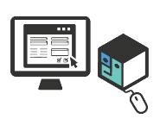
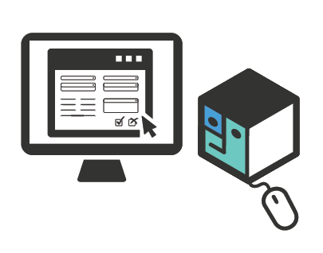
Code-Free Desktop Automation
Robotic automation aims to use a computer (a.k.a. robot) to manipulate existing application software (CRMs, ERPs, help desk, claim applications) in the same way a person works with those systems and the presentation layer to perform a specific task.
Notes:
UiPath Automation Cloud is our cloud-based Enterprise SaaS solution, ready to provision and use immediately, which helps you manage all your automation work and resources in one place. It enables you to deploy, operate, and scale your robotic factory in just a few seconds. Manage your licenses, add multiple tenants with different services, manage user access for all these services, access Orchestrator services to create Robots, environments, machines, processes, run jobs, create schedules - practically do anything you need, all from one centralized, secure location on the cloud.

Slide 3
UI PATH RPA SOLUTION
UiPath RPA is an enterprise computing platform dedicated to automating business processes.
It provides process modelling, change management, deployment management, access control, remote execution and scheduling, execution monitoring, auditing, and analytics in full compliance with the enterprise security and governance best practices.

Slide 4
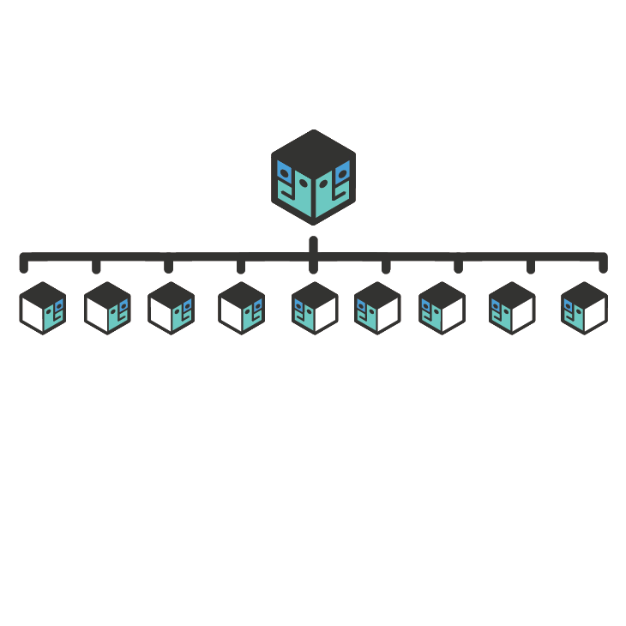
The Two Components….
UI Path Studio
UI Path Orchestrator

Slide 5
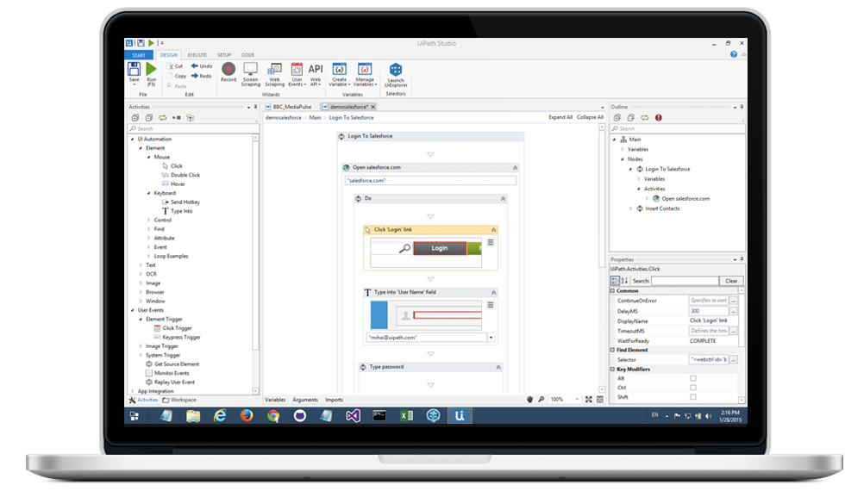
UI PATH STUDIO

Slide 6
UI PATH STUDIO
UiPath Studio is an advanced visual process modeling tool that the business user can learn to use effortlessly and without any programming knowledge.
Straightforward drag-and-drop functionality and a built-in library of predefined activities greatly enhance the user’s experience and speed up the learning curve. Alternatively, a simple “record” button click chronicles the user’s actions on the screen and translates them into logical steps to create application or web-based workflows.

Slide 7
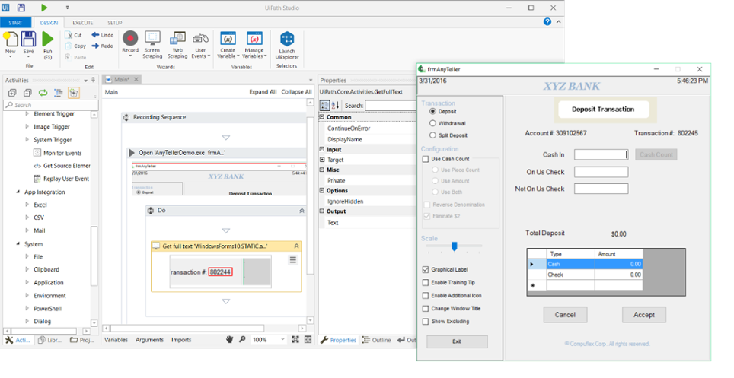
Caveats of the UI Path Studio
UI PATH STUDIO

Slide 8
Code-Free Desktop Automation
UiPath has been designed from ground up to excel at automating application presentation layer.
It "senses" the UI controls like a human, instead of blindly using fixed screen coordinates.

Slide 9
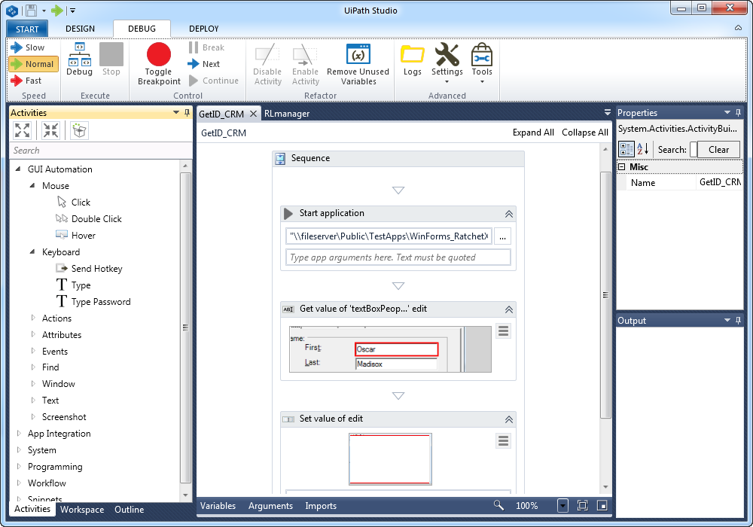
The spectacular robot designer
Does it matter to you if you create a robot in an hour or in a day? Or how long does it take to train someone to design robots?

Slide 10
The spectacular robot designer
UiPath comes with an intuitive graphical designer empowering you to assemble the automated process steps into a 100% accurate robot that works 24/7.
Designer is so simple to use that no programing knowledge is needed and can be effectively used by business analysts.

Slide 11
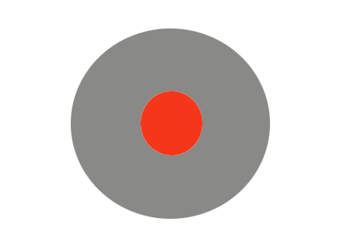
Great productivity with integrated recorder
The regular way to create an automation is to configure one action at a time. It can be time consuming and a novice might not figure out all the time what UiPath action models the real action on the screen.

Slide 12

Great productivity with integrated recorder
UiPath lets you record most actions possible on presentation layers: clicks on buttons and links, typing into editable controls, selecting a dropdown menu but also advanced actions like waiting until an image appear on the screen or even extracting structured data from a web page.

Slide 13
Great productivity with integrated recorder
The recorder is the best illustration of how productive you can be with UiPath. During recording your actions on the screen are observed and translated into logical steps in a workflow. For example you can record a whole sequence like logging in to salesforce.com, doing a search and generating a report in two minutes in one recording session.

Slide 14
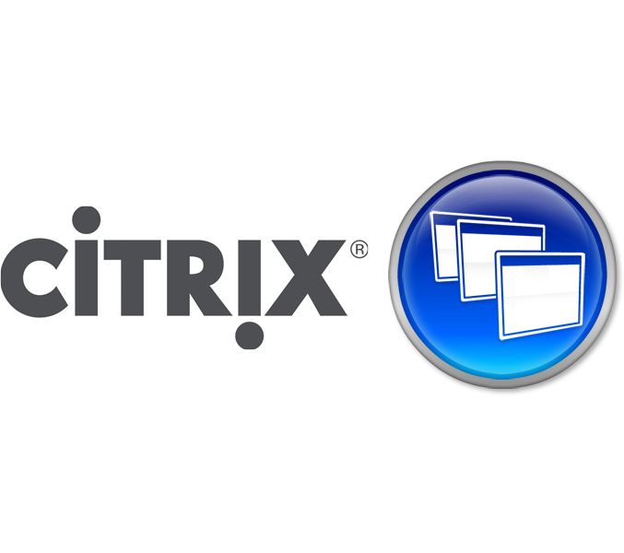
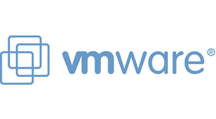
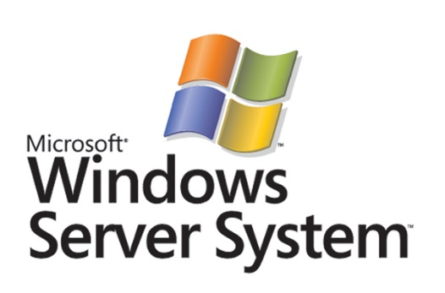
Citrix Ready
Citrix Ready
Citrix – A feature that enables the user to visually browse for and navigate to other slides without leaving Slide Show view. Your audience only sees the slide you’re presenting.

Slide 15
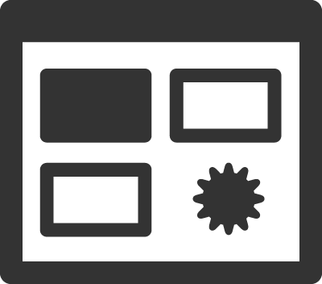
Citrix Ready
Non-intrusive automation
Help focus your audience on your ideas.
Just click to zoom in and out on a specific diagram, chart or graphic.

Slide 16
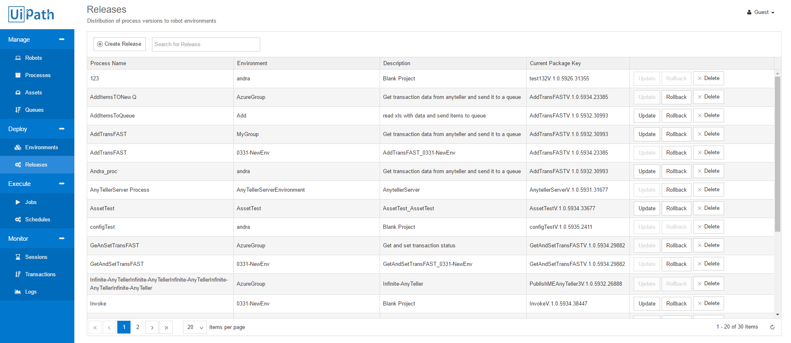
UI PATH ORCHESTRATOR

Slide 17
UI PATH ORCHESTRATOR
UiPath Orchestrator is a browser-based server application that enables you to manage robots and processes. By using the server web console you can deploy, start, stop, and schedule processes and monitor their execution by the robots. UiPath Orchestrator facilitates both human-robot collaboration and business exception handling by using centralized work queues.

Slide 18


THE TWO TYPES OF ROBOTS
FRONT OFFICE ROBOTS
BACK OFFICE ROBOTS

Slide 19
Front vs. Back Office Robots
Front Office Robots
Back Office Robots
Definition: The Front Office Robot (FOR) is a robot that works side by side with human agents and assists them to automatically complete the processes.
General use: in manual, repetitive, highly rule-based activities containing decision points that require human intervention (either due to pure judgement calls required or due to high complexity and volatility of process inputs).
Best fit for: Service desks, helpdesks, and call centres
Definition: The Back Office Robot (BOR) is a robot that works in an unattended manner, independent of any human interaction.
General use: in manual, repetitive, highly rule based back office activities not requiring any human intervention.
Best fit for: any type of back office activity prone for automation.

Slide 20
Front vs. Back Office Robots
Front Office Robots
Back Office Robots
Communication with Server is bi-directional:
Robot to Server: execution logs, automated process upload.
Server to Robot: automated process version deployment only.
Features:
Release management (automatic update/rollback)
Agent assisted mode
Centralized logging, reporting, and auditing tools
Communication with Server is bi-directional:
Robot to Server: execution logs, automated process upload, robot status.
Server to Robot: automated process version deployment, start or reset robots.
Features:
Release management (automatic update/rollback)
Centralized logging, reporting, auditing, and monitoring tools
Remote control
Centralized scheduling
Queue/robot workload management
Credential management

Slide 21
Front Office Robot in a nutshell…
In front office automation scenarios, the Orchestrator acts as a central repository for processes. It manages version control and aggregates robot logs. It also provides monitoring, reporting, and security capabilities. From its browser-based dashboard, dozens – or hundreds – of software robots can be deployed and monitored.

Slide 22
Back Office Robot in a nutshell…
In back office automation scenarios, the Orchestrator is an industry standard platform capable of queuing large volumes of transactions. It orchestrates and deploys dozens - or hundreds - of software robots in a synchronized, scheduled fashion to complete the work with remarkable speed.

Slide 23
UI PATH ORCHESTRATOR
Robots are very good at processing rule based tasks but not at classifying unstructured data or making decisions. This is human territory. Most business processes require collaboration between human users and robots. UiPath Orchestrator facilitates human- robot collaboration by providing work queues.
In a typical business process, humans transform unstructured data into structured data and send it to the queue from where the robots read it and then process the rule based transactions. When the robot encounters a business exception, it flags it for a human to review. This is a turn-based interaction that happens at the server level.

Slide 24
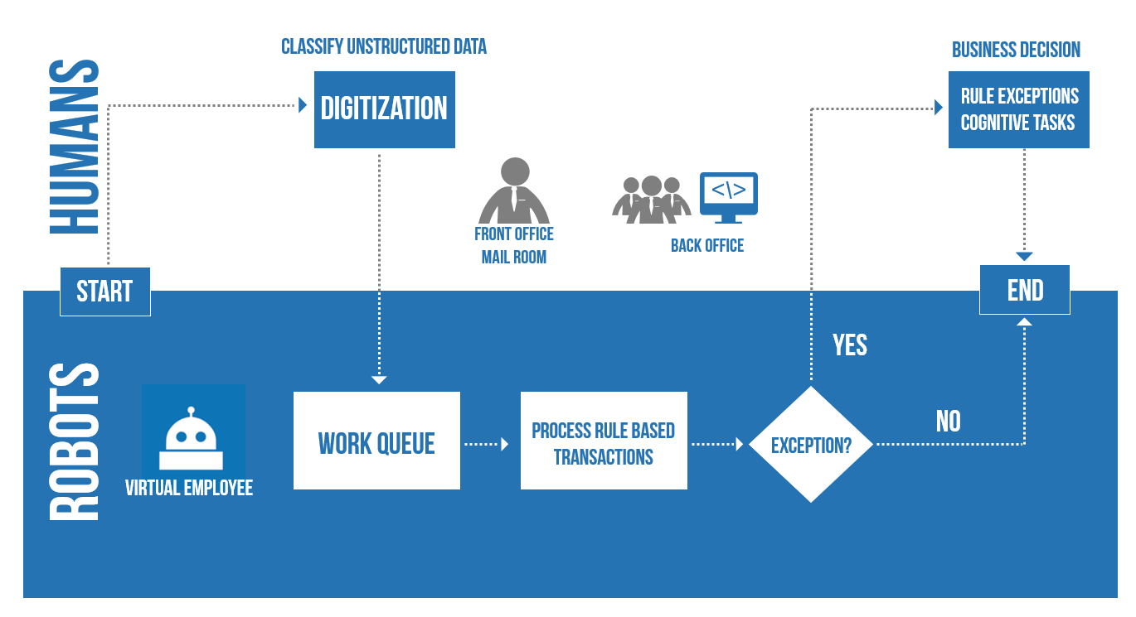
UI PATH ORCHESTRATOR

Slide 25
End to End Management Solution
Person/robot analogy stands when it comes to management too. The perfect robot do more harm than good without proper management.

Slide 26

End to End Management Solution
UiPath provides a full end to end management solution that take care of your robots from deployment and scheduling to live monitoring, reporting and analytics.
That’s true, UiPath doesn’t use custom backed security channel, does not store passwords obfuscated in a database; it uses System Center Orchestrator credential store, active directory integration and the super secure channel provided by PowerShell remoting and SSL.

Slide 27
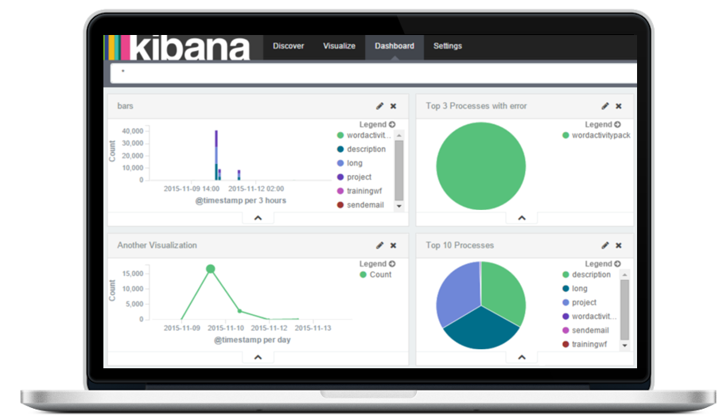
Dashboard and Analytics
Tell at a glance how many transactions are processed and the average handling time per transacation. Robots report on their work performances in the form of actionable insights and key analytics.

Slide 28
References and Citation
Video Tutorials: https://www.uipath.com/tutorials
User guides: https://www.uipath.com/guides
Automation Examples: https://www.uipath.com/examples
Knowledge based: https://www.uipath.com/kb-articles

Slide 29
References and Citation
Power Point:
http://www.slideshare.net/Deskperienced/uipath-robotic-automation

Slide 30
Robotic Process Automation Software
Intuitively design beautiful presentations, easily share and work together with others and give a professional performance with advanced presenting tools.
Notes:
In Slide Show mode, click the arrow to enter the PowerPoint Getting Started Center.

