Slide 1
Assignment – 01
Prepared By,
Deepanshu Soni, 4th Sem, ‘BCA’, ‘B’ sec.
Topic : GCP

Slide 2
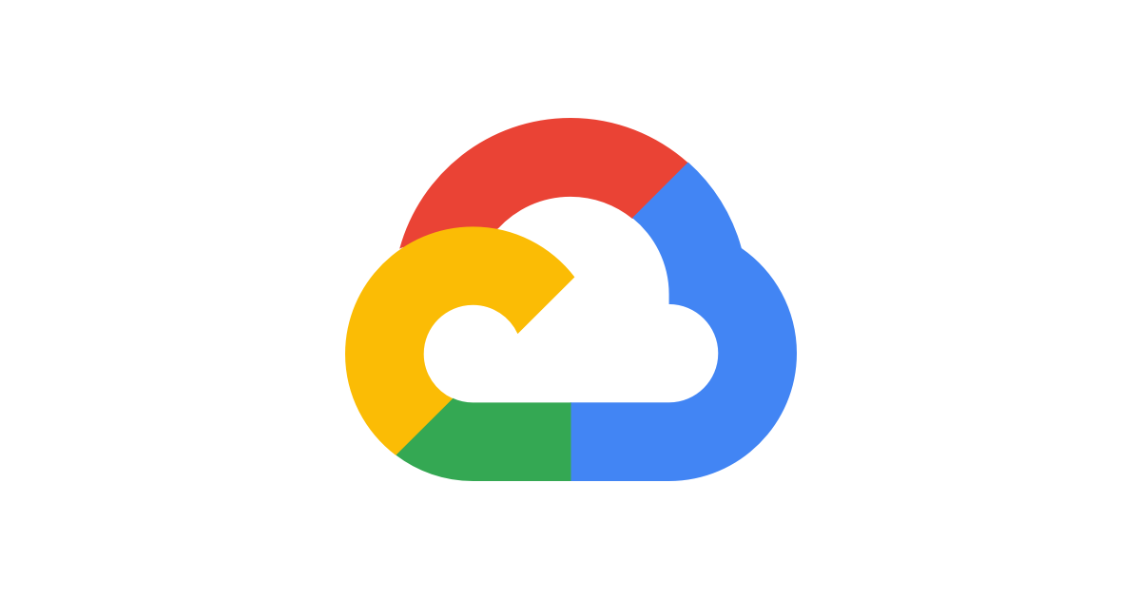
Google Cloud Platform (GCP)

Slide 3
What is Google Cloud Platform (GCP)?
Google Cloud Platform (GCP) is a comprehensive suite of cloud computing services provided by Google. It offers a wide range of modular services that cater to various needs, including computing, data storage, data analytics, machine learning, and more. GCP provides a set of management tools to help users build, deploy, and manage applications efficiently.

Slide 4
Why Use Google Cloud Platform?
Scalability: GCP allows you to scale your resources up or down based on demand. Whether you’re a startup or an enterprise, GCP can handle your growth seamlessly.
Global Infrastructure: Google’s vast network of data centers spans the globe, ensuring low-latency access to resources from anywhere.
Security and Compliance: GCP adheres to strict security standards and offers robust encryption, identity management, and compliance certifications.
Cost Efficiency: Pay only for what you use, and take advantage of flexible pricing models. GCP’s pricing is transparent and predictable.
Innovation: GCP continuously introduces new services and features, enabling developers to build cutting-edge applications.

Slide 5
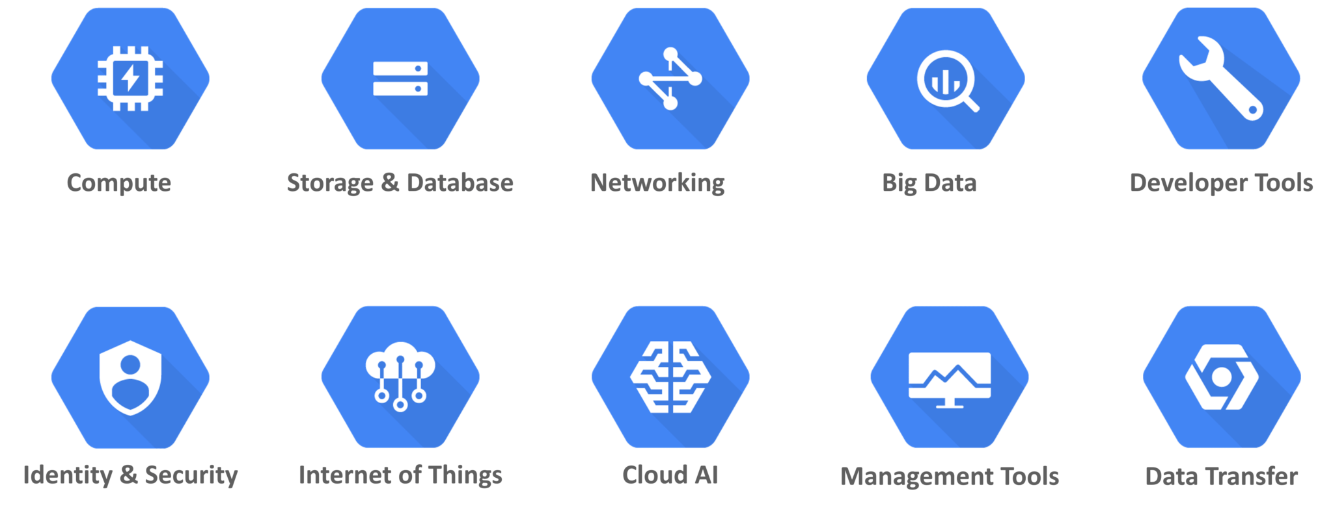
Services Provided By Google Cloud Platform

Slide 6
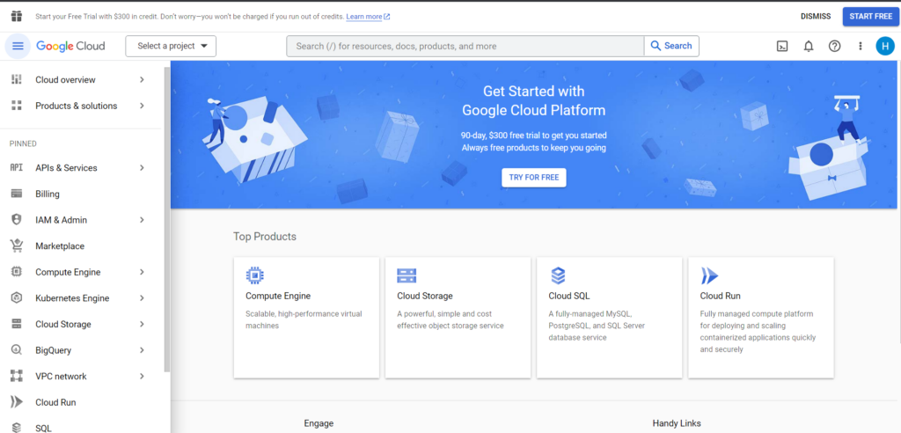

Slide 7
illustration on how GCP works?
https://blog.visual-paradigm.com/navigating-the-cloud-unveiling-the-google-cloud-platform-diagram/

Slide 8
Conclusion
Google Cloud Platform provides a powerful and flexible infrastructure for building and deploying applications...
Whether you're a developer, data scientist, or business owner, GCP offers a rich ecosystem to meet your needs...

