Slide 1
Spam Message Detection
AI PROJECT
Group Members :
Deepanshu, Roll no - 66

Slide 2
Problem Statement
Detecting message and Classify them into Spam or not Spam using NLP techniques.

Slide 3
Introduction
Spam refers to messages which are unsolicited and unwanted. Usually, spam texts are not coming from another phone. They mainly originate from a computer and are sent to your phone via an email address or instant messaging account. Because they are sent online, they are cheap and easy for scammers to send. Most of these messages are like you won a prize pool, some coupons etc. which attracts people easily towards further scam.
So our aim is to design a system which can retrieve message then pre processed with the help of NLP so our system can easily classify those messages in spam or not spam(ham) category.

Slide 4
Different Types of Spam Messages
The most popular subjects of spam messages :
Pharmaceuticals
Financial services
Online degrees
Work from home jobs
Online gambling
cryptocurrencies

Slide 5
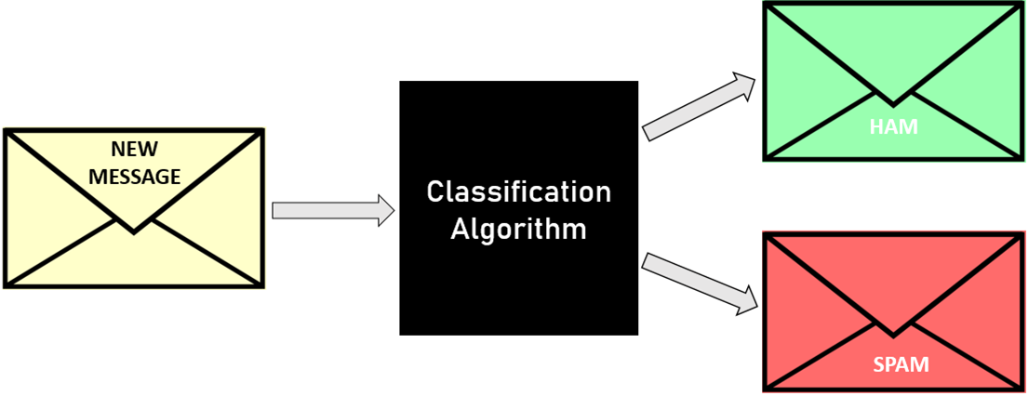
Approach

Slide 6
Approach
Training :
Message
Pre-Processing
Using NLP
Feature Extraction
Classification Model
Apply Algorithm

Slide 7
Approach
Testing:
New Message
Pre-Processing
Using NLP
Feature Extraction
Result Spam or Ham
Classification Model

Slide 8
Natural Language Processing

Slide 9
What is NLP ?
Natural language processing (NLP) is a subfield of Artificial Intelligence (AI) concerned with the interactions between computers and human (natural) languages.This technology works on the speech/text provided by the user, breaks it down for proper understanding and processes accordingly.

Slide 10
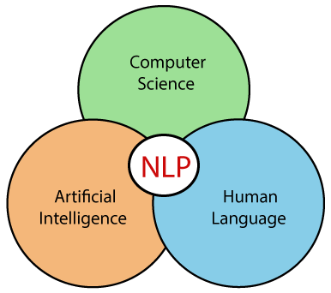
NLP

Slide 11
Various Fields of NLP
The field is divided into two different parts:
Natural Language Understanding (NLU) — The computer’s ability to understand what we say.
Natural Language Generation (NLG) — The generation of natural language by a computer.

Slide 12
About NLU
First, the computer must comprehend the meaning of each word. It tries to figure out whether the word is a noun or a verb, whether it’s in the past or present tense, and so on. This is called Part-of-Speech tagging (POS).
But,There are several challenges in accomplishing this when considering problems such as words having several meanings (polysemy) or different words having similar meanings (synonymy).
NLU involves the following tasks
It is used to map the given input into useful representation.
It is used to analyze different aspects of the language.

Slide 13
NLG
NLG is much simpler to accomplish. NLG converts a computer's artificial language into text and can also convert that text into audible speech using text-to-speech technology.
First, the NLP system identifies what data should be converted to text. If you asked the computer a question about the weather, it most likely did an online search to find your answer, and from there it decides that the temperature, wind, and humidity are the factors that should be read aloud to you.

Slide 14
Advantages of NLP
NLP helps users to ask questions about any subject and get a direct response within seconds.
NLP offers exact answers to the question means it does not offer unnecessary and unwanted information.
Most of the companies use NLP to improve the efficiency of documentation
processes, accuracy of documentation, and identify the information from large
databases.

Slide 15
Dataset : UCI Dataset
Dataset
So for classifying messages into Spam or ham we are using dataset provided by UCI which includes over 5,000 messages including spam or ham.

Slide 16
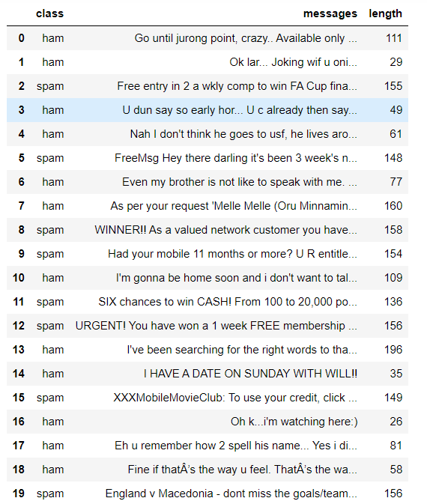
Data

Slide 17
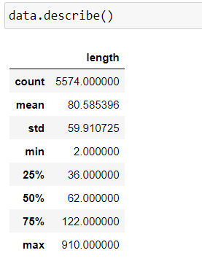
Data Information
So, here we have around 5574 messages including ham and spam

Slide 18
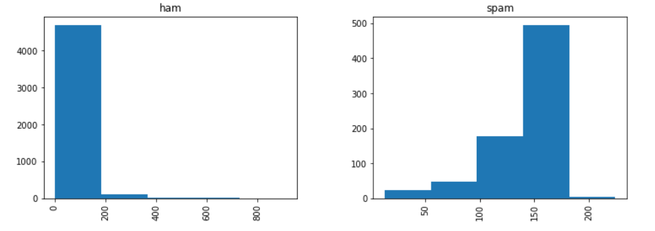
Data Information
Hence from above histogram it is clearly visible that spam messages tends to have more words.

Slide 19
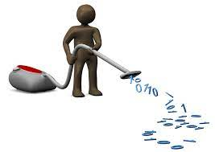
Cleaning Data
Removing Web links from the data.
Removing Punctuations from the text.
Removing stop words from the message.
For ex - I, are, am, the

Slide 20
Tokenization
Tokenization basically refers to splitting up a larger body of text into smaller lines, words or even creating words for a non-English language. So every word here known as tokens
Input = “Hi everyone how are you”
Output = “Hi” , “everyone” , “how are” “you”

Slide 21
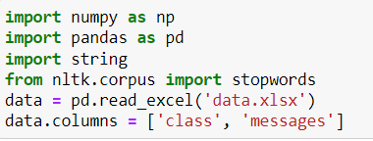
Some libraries we are using !

Slide 22
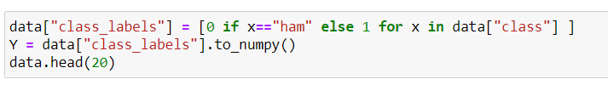
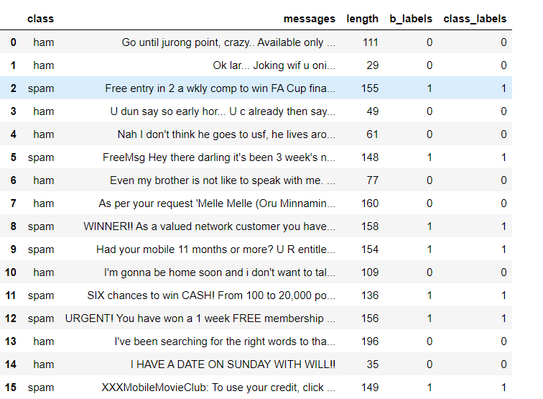
Pre-Processing
Replacing Ham with ‘0’ and Spam with ‘1’

Slide 23
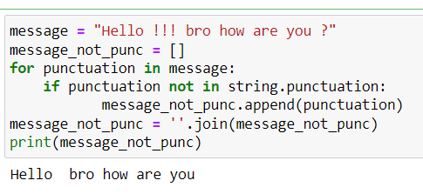
Pre-Processing
Removing Punctuations from messages :

Slide 24
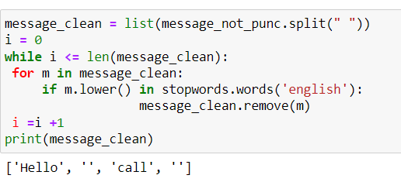
Pre-Processing
Removing Stop words from messages :

Slide 25
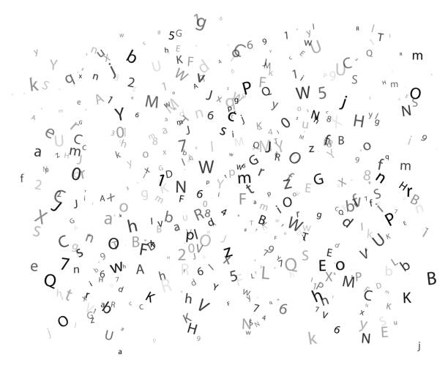

Stemming
Stemming is the process of producing morphological variants of a root/base word. Stemming programs are commonly referred to as stemming algorithms or stemmers.

Slide 26

CountVectorizer
CountVectorizer is used to convert a collection of text documents to a vector of term/token counts. It also enables the ​pre-processing of text data prior to generating the vector representation. This functionality makes it a highly flexible feature representation module for text.

Slide 27
Building Classification Model
We are building 2 classification model:
Naive bayes Classification
SVM

Slide 28
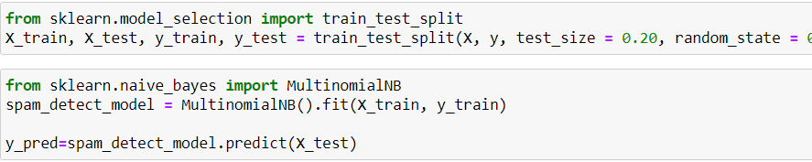
Naive Bayes Classifier
So here we are splitting our data in Training and Testing of 80:20 ratio.
Predicting on the basis of model with our Testing values.

Slide 29
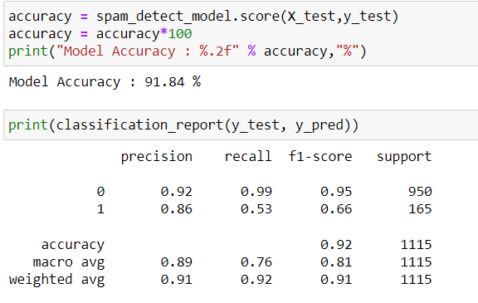
Other measures for NB

Slide 30
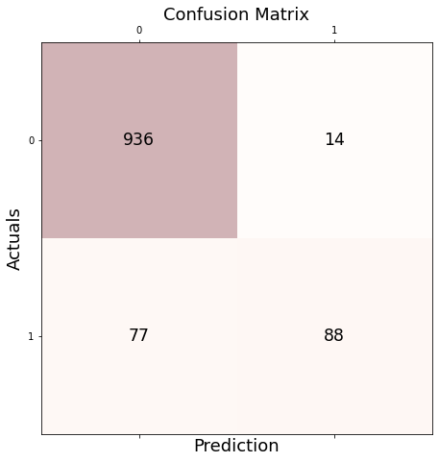
Confusion Matrix for NB

Slide 31
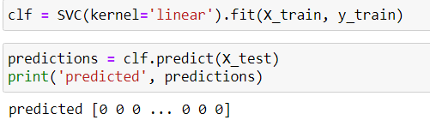
Support Vector Machine
Next we trained our Data on SVM on linear kernel which results good for us and leads us to a better accuracy then previous one.

Slide 32
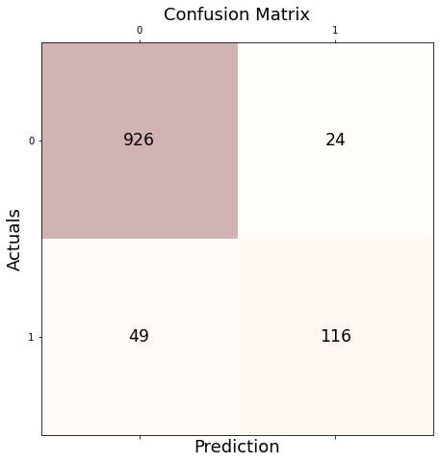
Confusion Matrix for SVM

Slide 33
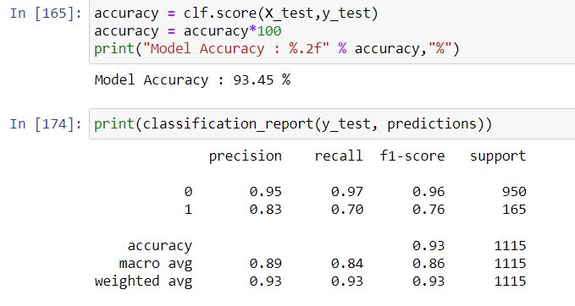
Other measures for SVM

Slide 34
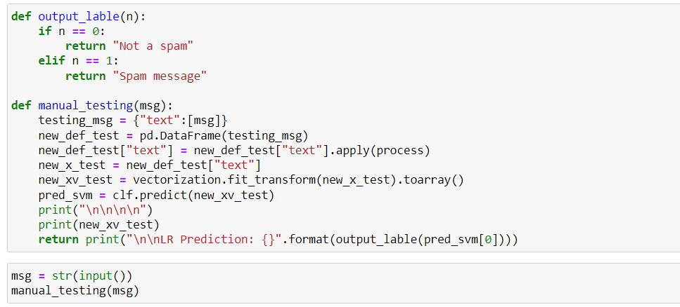

Manual Testing

Slide 35
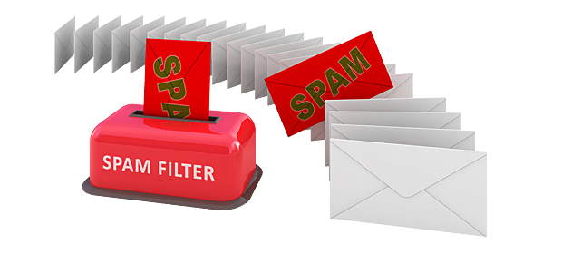
Thank You

