Slide 1
SPECTROPHOTOMETER,
A LOW-COST ALTERNATIVE
DEEPANSHU BAIDWHAN

Slide 2
What is It?
A spectrophotometer is an instrument that measures the amount of light transmitted by the sample. This information is used to measure concentration of solutes in the solution which is placed in the cuvette.

Slide 3
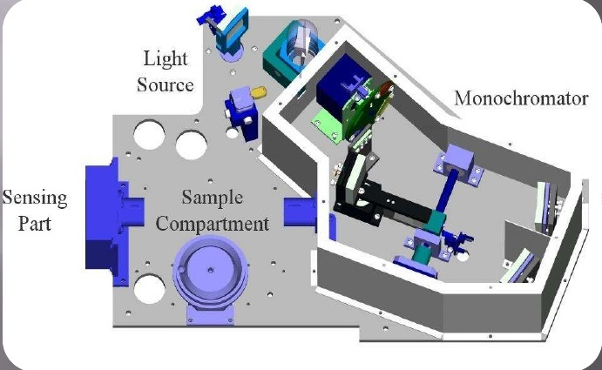
Internal Components

Slide 4

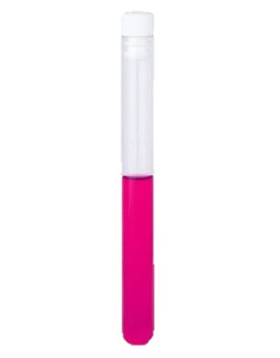
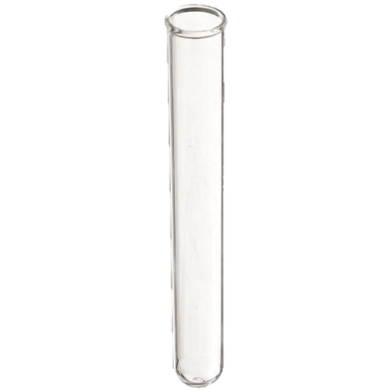
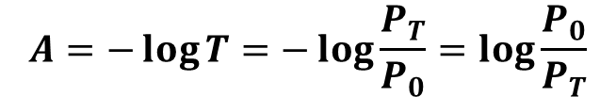
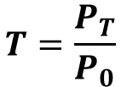
Laws of Photometry
SAMPLE
$$T=\frac{P_{T}}{P_{0}}$$
Po
PT
$$A=−\log{T}=−\log{\frac{P_{T}}{P_{0}}}=\log{\frac{P_{0}}{P_{T}}}$$
BLANK
T : is the transmittance of the solution,
PT : is the incident light intensity,
Po : is the transmitted intensity after absorption
Po

Slide 5
Uses of Spectrophotometer
Measure concentration of a solution.
Identify Organic Compounds in a solution.
Color determination within spectral range.

Slide 6
Need of A Low Cost Spectrophotometer
Applications in several fields.
High Cost of Laboratory Spectrophotometer, which varies in the range of Rs. 2,00,000 to Rs. 10,00,000.

Slide 7
PROTOTYPE
Raspberry Pi
Intensity Sensor - tsl2561
RGB - led
Cuvette

Slide 8
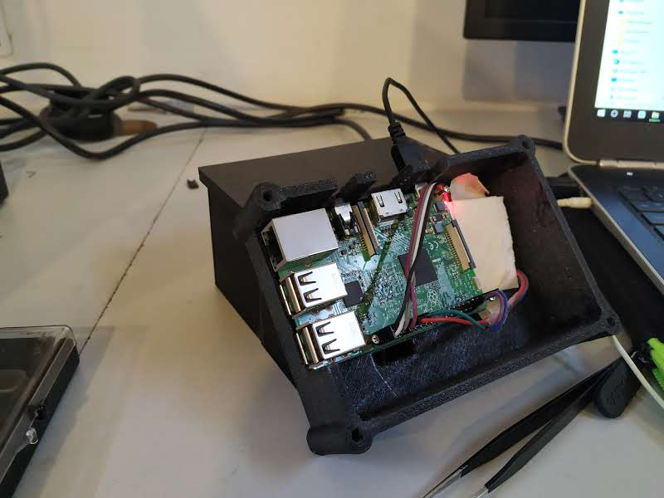
Designed Prototype

Slide 9
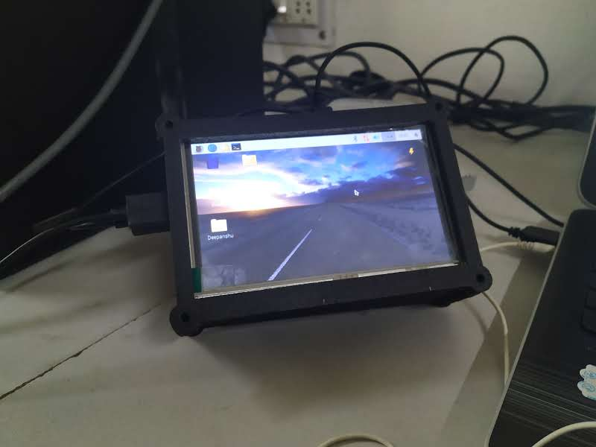
Designed Prototype

Slide 10
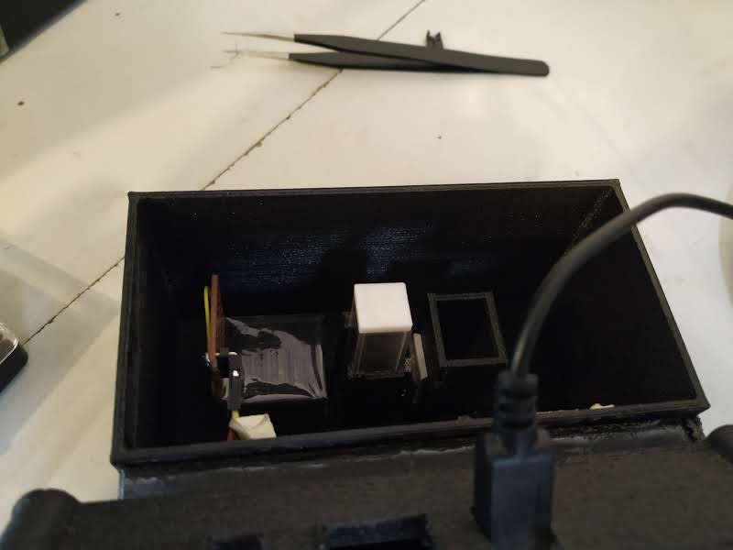
Designed Prototype

Slide 11
Experiment # 1

Slide 12
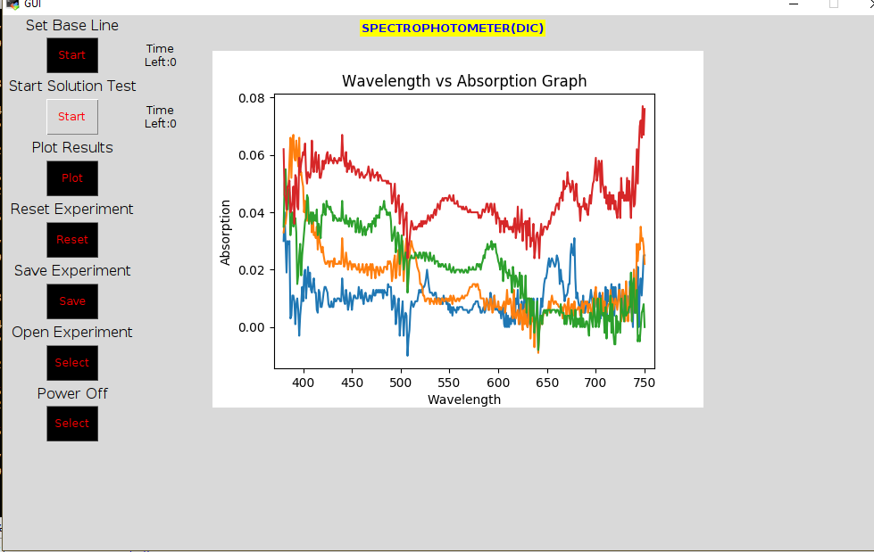
Observations
The salt solution test at different concentration

Slide 13
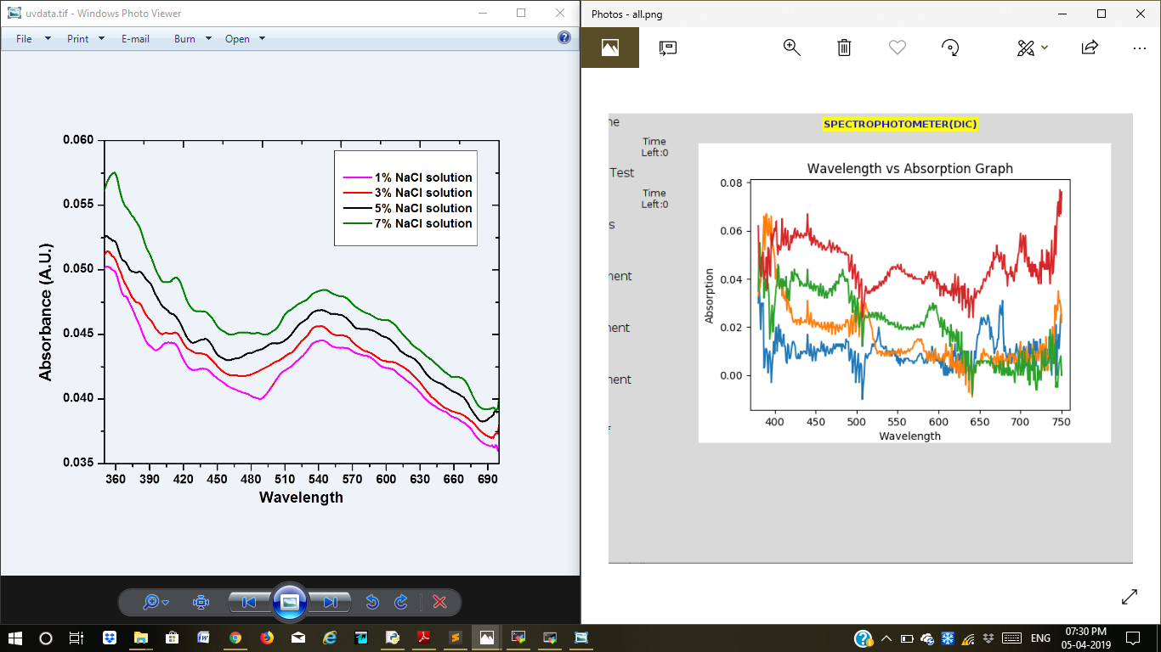
Observations
When compared with original

Slide 14
Problems with Experiment
The readings vary a lot with minor disturbance in the apparatus setup.
The transmittance vary with change in test tube.
The cylindrical nature of test tube led to distortion of light being transmitted.

Slide 15
Experiment # 2

Slide 16
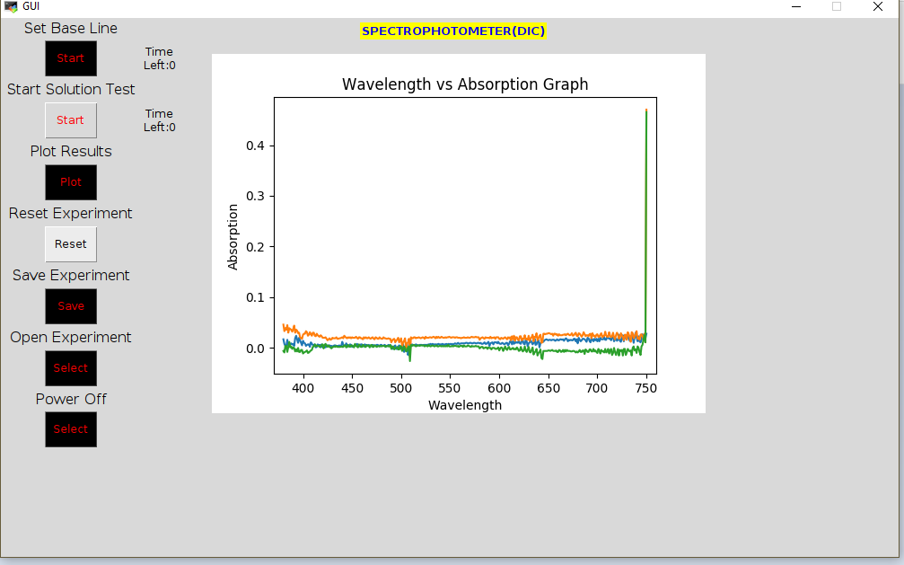
Observations
Sugar solution test at different concentration

Slide 17
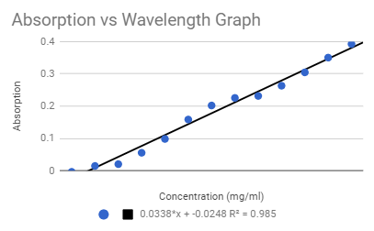
Observations
The relationship between absorption of light by the solution is linear with its concentration.

Slide 18
Experiment # 3

Slide 19
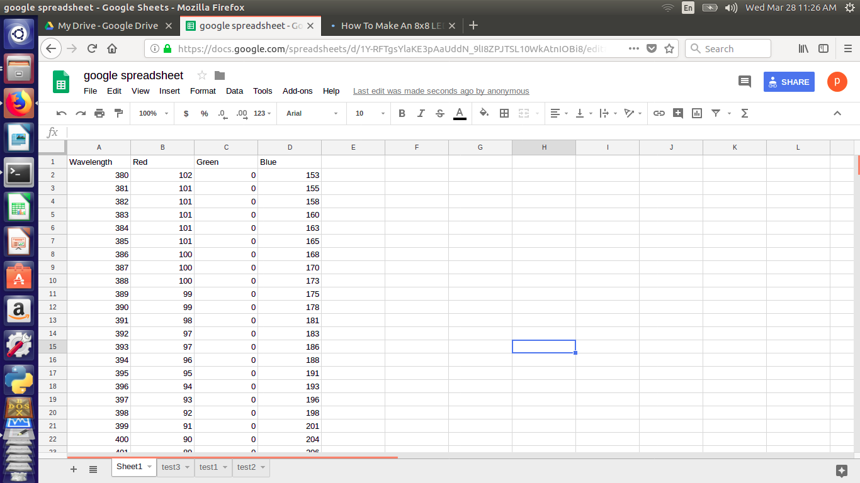
FINDING THE RGB VALUES FOR THE GIVEN WAVELENGTH:
Mapping Wavelength to RGB

Slide 20
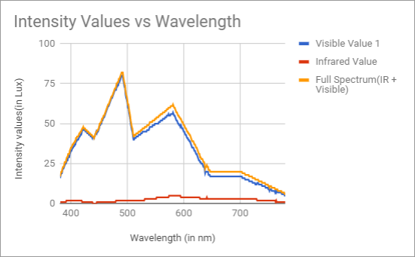
Observations
Intensity v/s Wavelength for Water Sample

Slide 21
Experiment # 4

Slide 22
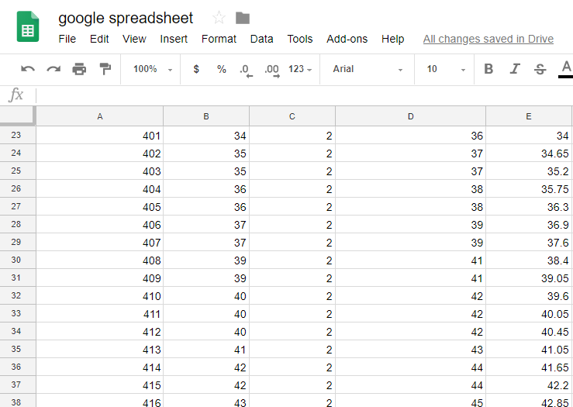
STORING THE RESULTS IN GOOGLE SHEETS USING API
Storing Data directly on Google Sheets

Slide 23
Experiment # 5

Slide 24
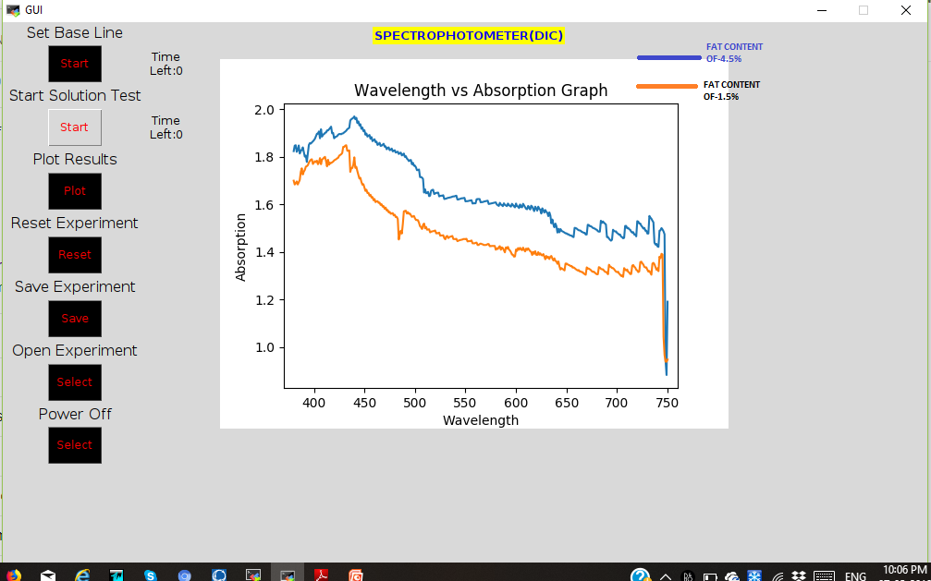
FAT CONTENT IN MILK:
Absorption Spectra for milk with 1.5% and 4.5% fat.

Slide 25
Experiment # 6

Slide 26
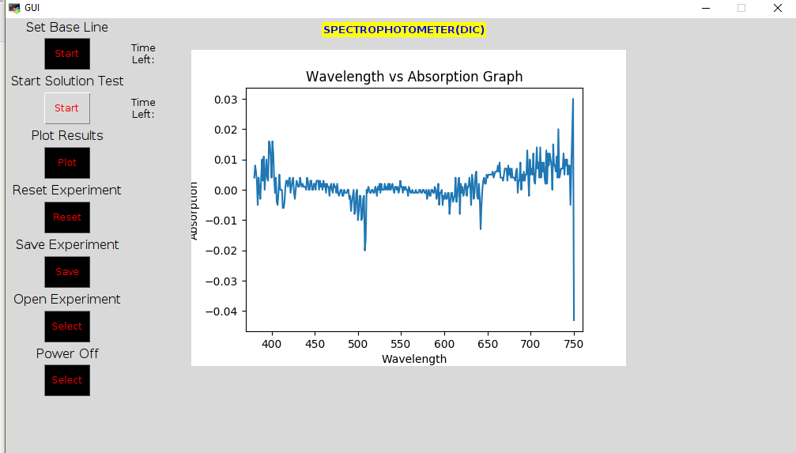
PLAIN WATER TEST
Absorption Spectrum for water

Slide 27


